Slide 1
SFP Made Simple
10. Academic Station Workshop
Dr Daria Andreeva (FY1 Imperial)

Slide 2
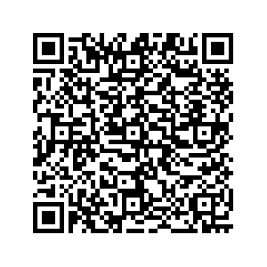
Fundraising

Slide 3
The Academic Station
*Not in all deaneries. Please check in advance!
Structure:
Varies depending on the deanery
Research paper abstract to appraise (could be any type of research article)
Present your own paper
Questions on: results + statistics, ethics, research trial set-up, etc.
London:
15 minutes prep for both academic and clinical stations
10 minutes for each academic and clinical station

Slide 4
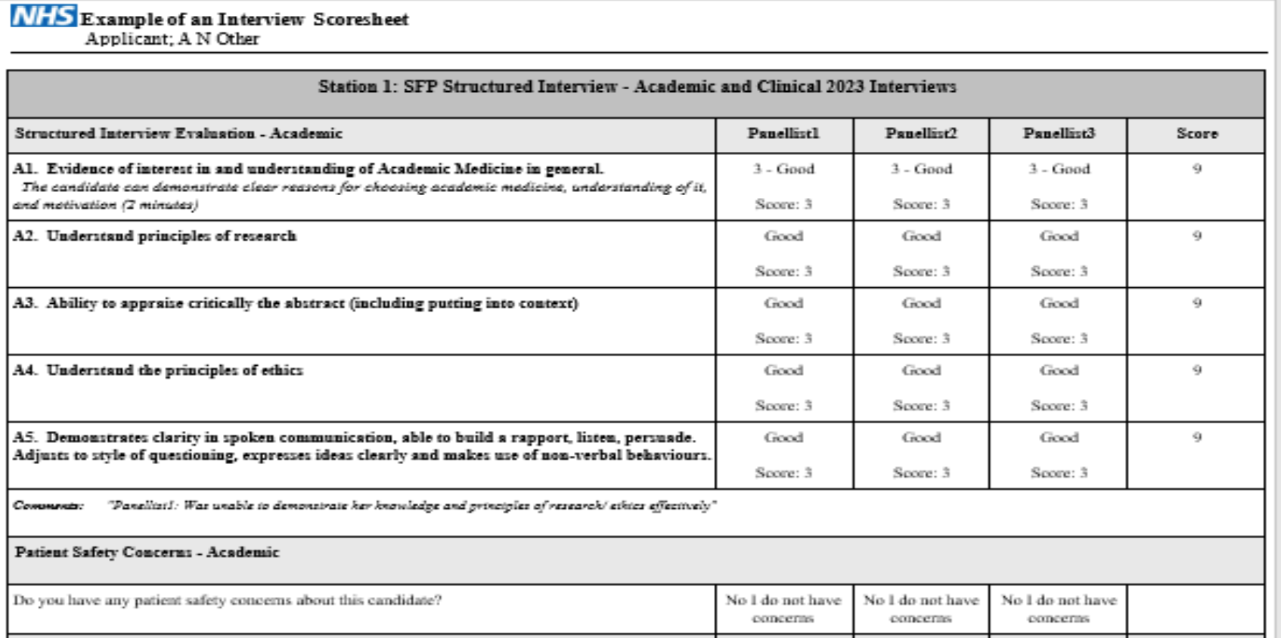
The Academic Station - How to Practice
*Not in all deaneries. Please check in advance!
Structure:
Varies depending on the deanery
Research paper abstract to appraise (could be any type of research article)
Present your own paper
Questions on: results + statistics, ethics, research trial set-up, etc.
London:
15 minutes prep for both academic and clinical stations
10 minutes for each academic and clinical station

Slide 5
The Academic Station - How to Practice
Read through the following:
How to read a paper
The doctor’s guide to critical appraisal
Scribbr: good for stats
The bottom line: critical appraisal summaries of research articles
Sign up to medical journals mailing list: The Lancet, the New England Journal of Medicine, the BMJ
Read editorials and review articles to learn how to critically appraise + stay informed about hot topics
PRACTICE, PRACTICE, PRACTICE with friends!
Start by analyzing and evaluating the abstract together
Move on to untimed practice 1 by 1
Timed practice with “exam-like” questions
MOCK INTERVIEWS: as many as you can!

Slide 6
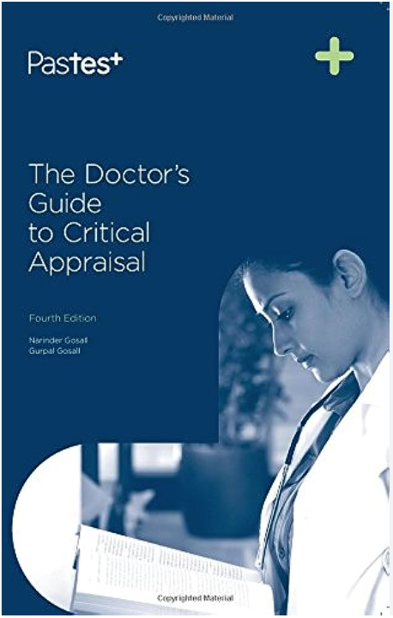
Resources

Slide 8
Structure
Overview, aims, PICO summary
Pros
Cons
Population
Intervention
Control
Outcomes
Internal validity
External validity
Ethics & others

Slide 9
Recap
Population
(CSFABB)
Intervention
(NEC)
Control
(TEC)
Outcomes
(MSKIEY)
Criteria
Sample size
Follow-up
Allocation
Blinding
Baseline characteristics
Novelty
Ethical considerations
Clinical considerations
Type
Ethical considerations
Clinical considerations
Measures
Statistical tests
Key findings
Internal validity
External validity
Y
Ethics
(CESF)
Consent
Equipoise
Safety/side effects
Funding

Slide 10
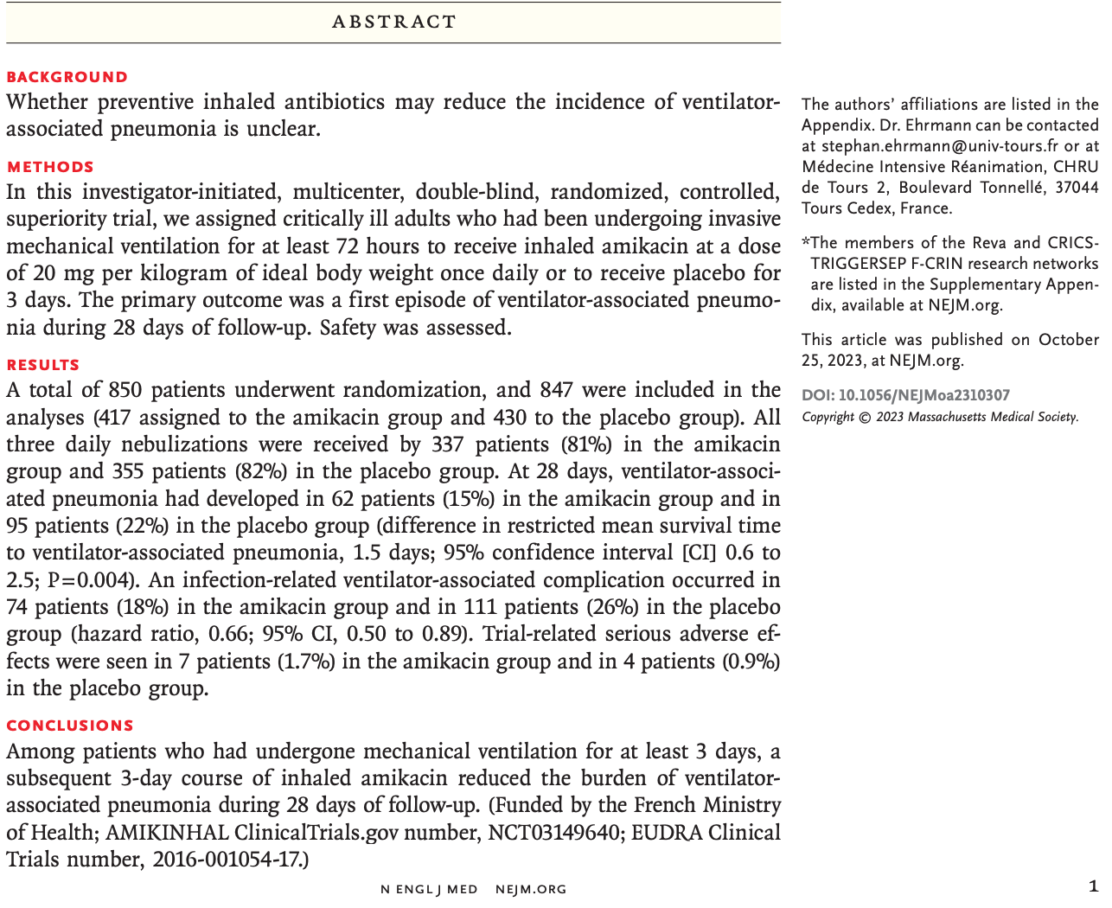

Slide 11
Please summarise the abstract

Slide 12
Example answer:
Summary: This is a multicenter, randomised, double-blind superiority trial conducted in France and published in the New England Journal of Medicine in 2023.
PIC: A total of 850 critically ill adults who had been undergoing invasive mechanical ventilation were randomised to either a 3-day course of inhaled amikacin (the intervention group) or 3-day course of placebo (the negative control group).

Slide 13
Example answer:
O: Outcomes included first episode of ventilator-associated pneumonia during 28 days of follow-up (primary outcome) and safety outcomes.
The intervention group showed a 7% reduction in total ventilator-associated pneumonia between the intervention and a statistically significant 1.5 days increase in mean survival time to pneumonia when compared to control group.
Total ventilator-associated complications were 8% less in the intervention group compared to control. However, trial-related serious adverse effects were 0.8% higher in the intervention group.

Slide 14
What do you think about the research methods design?

Slide 15
Population
Strengths:
Multicenter design allows for large sample size → decreased risk of T2E
Likely appropriate follow-up period
Randomised and double blinded → decreases possible allocation, detection and performance bias
Weaknesses:
?baseline characteristics → are confounders accounted for/equally spread between groups (comorbidities, reasons for intubation, immunocompromised, smoking)
Multicentricity leads to greater variability, less standardisation between groups

Slide 16
Intervention & control
Strengths:
Intervention has the potential to prevent serious complications → beneficence
Novel - ?previous use of inhaled amikacin
Weaknesses:
?effectiveness of dose regimen
?other antibiotic use
?issue with non-maleficence due to prophylactic use of antibiotics and subsequent complications

Slide 17
Outcomes
Strengths:
Appropriate and clinically relevant primary clinical outcome
Safety assessment performed
Weaknesses:
How was pneumonia defined?
How many pneumonias were not responsive to amikacin?

Slide 18
What do you think about the results?

Slide 19
Strengths:
Large sample → decreased risk of T2E + increased internal validity
Results show statistical significant reduction in pneumonia and complications in intervention group
Weaknesses:
?high attrition rate → was intention-to-treat analysis used?
What percentage of recorded pneumonia are resistant to amikacin?
Broad confidence intervals + are results clinically significant?
ARR is 7%, NNT (1/ARR) = 14
Higher adverse effects in intervention group → ?safety issues which are not reported in conclusion

Slide 20
What do you think about the internal validity of the study?

Slide 21
Strengths:
Large sample size → increased power
Randomised and double-blind → decreased allocation, performance and detection bias
Weaknesses:
?adjustment for confounders (i.e. stratification based on comorbidities, reason for intubation, other antibiotic treatment, immunocompromised, etc.) → could have led to T1E
?high attrition rate leading to attrition bias → was ITT analysis used?

Slide 22
What do you think about the external validity of the study?

Slide 23
Strengths:
Multicenter study → more representative of clinical practice
Weaknesses:
Selection of patients who underwent invasive mechanical ventilation for at least 72hrs, what about the others?
Study conducted in France, ?use of inhaled amikacin in UK
?differences in nursing practices (oral hygiene care, subglottic suctioning)
?cost-effectiveness and issues with safety → NNT = 14

Slide 24
What do you think about the ethical considerations of the study?

Slide 25
Ethics: The Four Quadrants
Beneficence
Autonomy
Strong clinical equipoise, as it is important to develop strategies to prevent VAP and complications
Placebo was justified in my opinion, as there is no other best alternative at the moment
How did consent occur?
Did patients consent before intubation?
?capacity to consent in altered mental state
Non-maleficence
Justice
Safety outcomes were measured, but conclusion did not report increased safety issues in the intervention group
What were the safety issues and complications?
Are we contributing to antibiotic resistance?
NNT is 14
How justifiable is it to give prophylactic antibiotics for a small difference in clinical outcome?

Slide 26
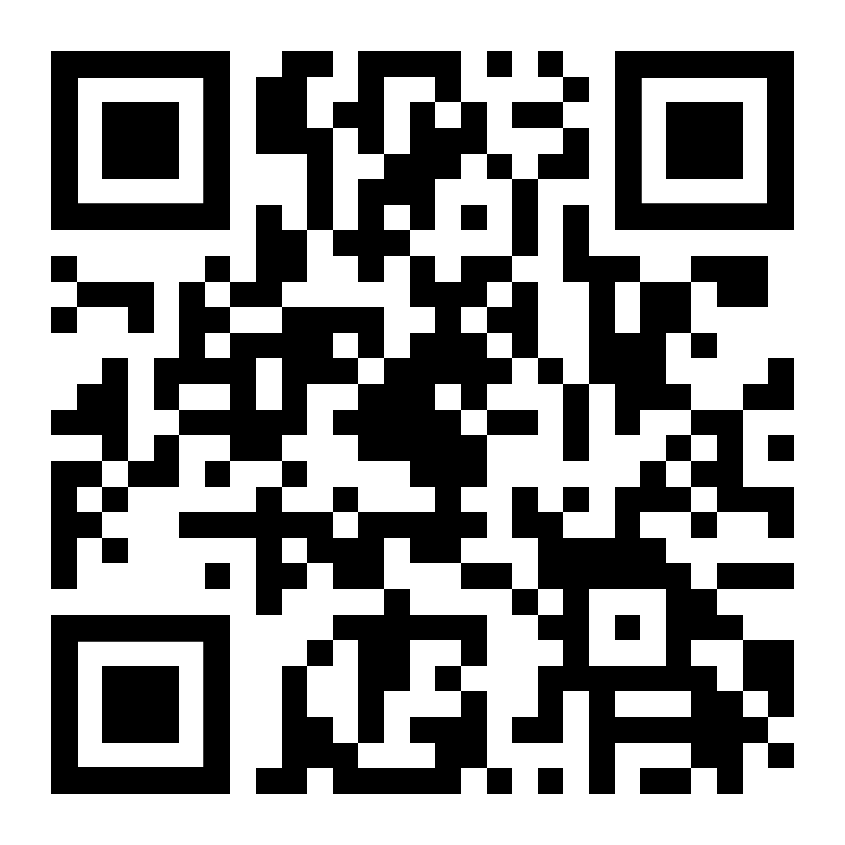
Thank you for listening!

Slide 27
Bias
Selection bias: systematic difference in the sample population and the target population.
Allocation bias: systematic differences in the groups after randomisation. Overcome by: randomisation through computer-generated sequence, allocation should be concealed by third-party allocation
Performance bias: treating groups differently. Overcome by blinding clinician, blinding patient and making trial environment same for both groups. Open-label = no blinding
Information (detection) bias: detection of outcome is biased. Altering outcome data due to preconceived ideas and beliefs. Overcome by using objective outcome measures, multi-blinding.
Recall bias: participants don’t remember events or experiences accurately/omit details.
Exclusion/attrition bias: systematic difference between withdrawals and patients continuing in the trial. Per protocol analysis overestimates effect of the intervention. Overcome by intention to treat analysis.
Selective reporting/outcome bias: only significant/meaningful results are reported. Studies usually have a primary and secondary outcome. The protocols can be registered in a database. Overcome by stating primary outcome in protocol, registering trials in ISRCTN.

Slide 28
Confounding factors
Confounder
Association
Risk factor
Exposure
Outcome
Conclusion you make/don’t make
Confounder: associated independently with both the exposure and the outcome, making it appear that there is an association between the exposure and the outcome when there is none, or masking a true association.

Slide 29
Example
Stress
Association
Risk factor
City address
Heart disease

Slide 30
Confounding factors
How to deal with them?
Study design
Analysis
Restriction: eliminate through exclusion criteria
Matching: confounders are allocated equally in different study arms
Randomisation: evenly distribute confounders
Standardisation: adjust risk of exposed group to that of unexposed group with same confounder
Statistical adjustment: use multivariate analysis to check for effect of confounder

Slide 31
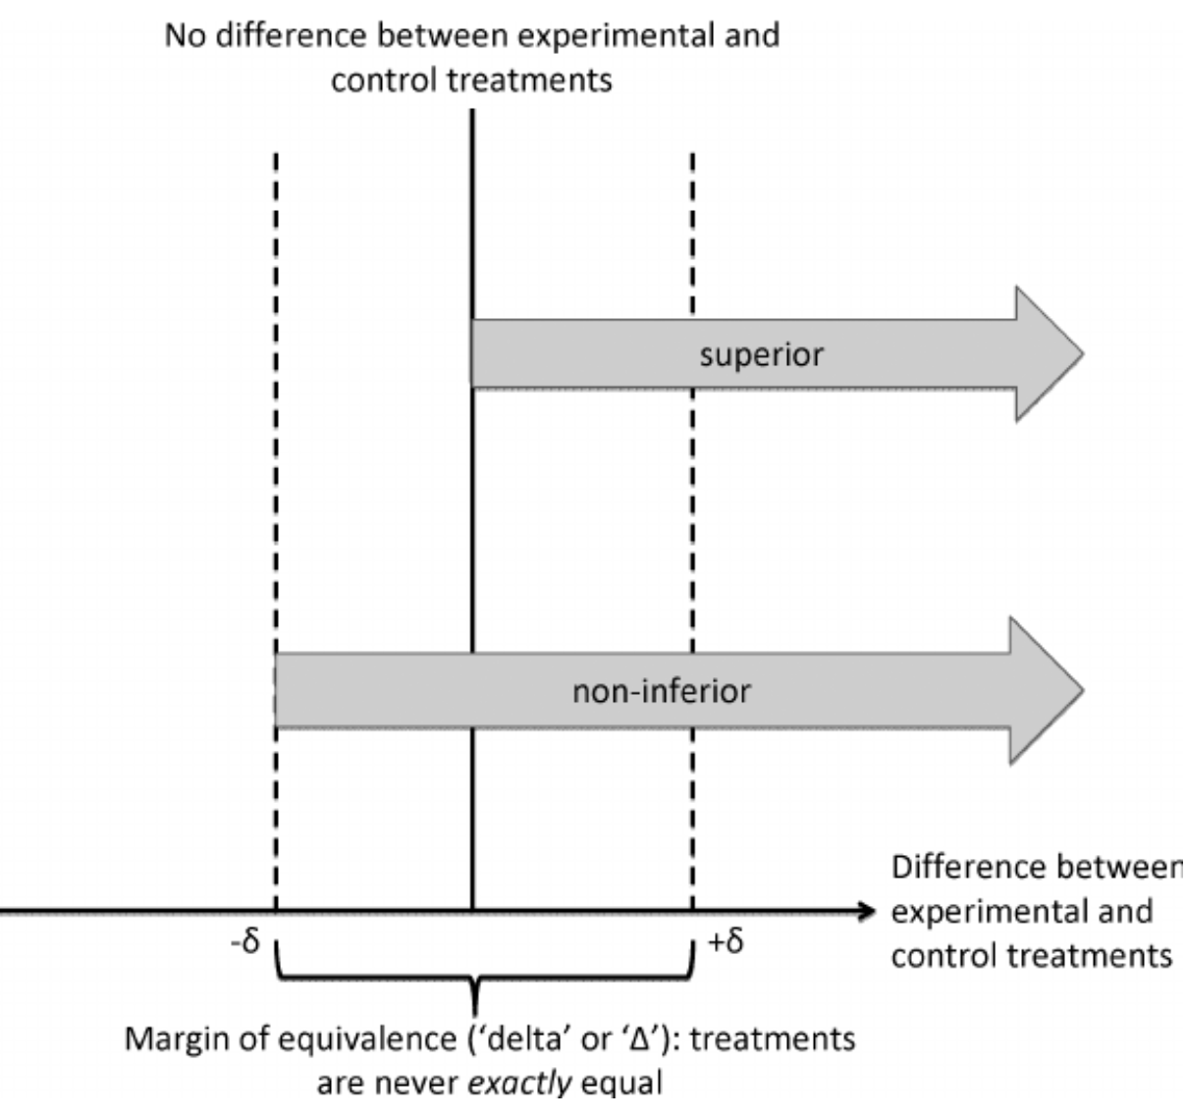

Slide 33
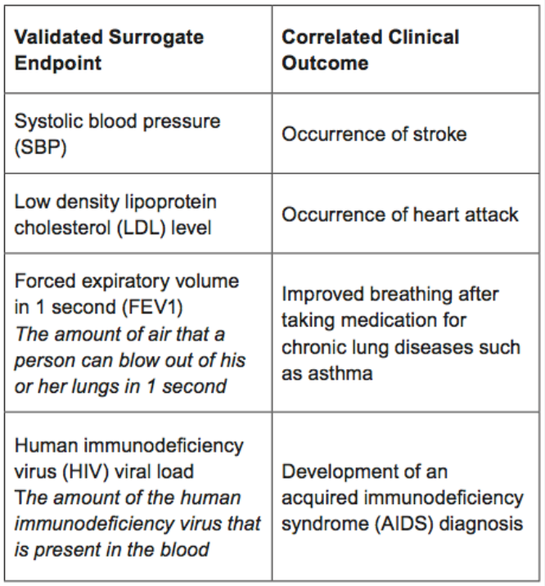

Slide 34
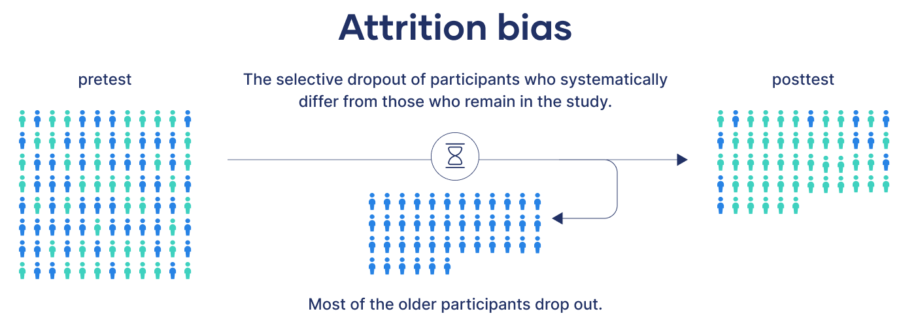

Slide 35
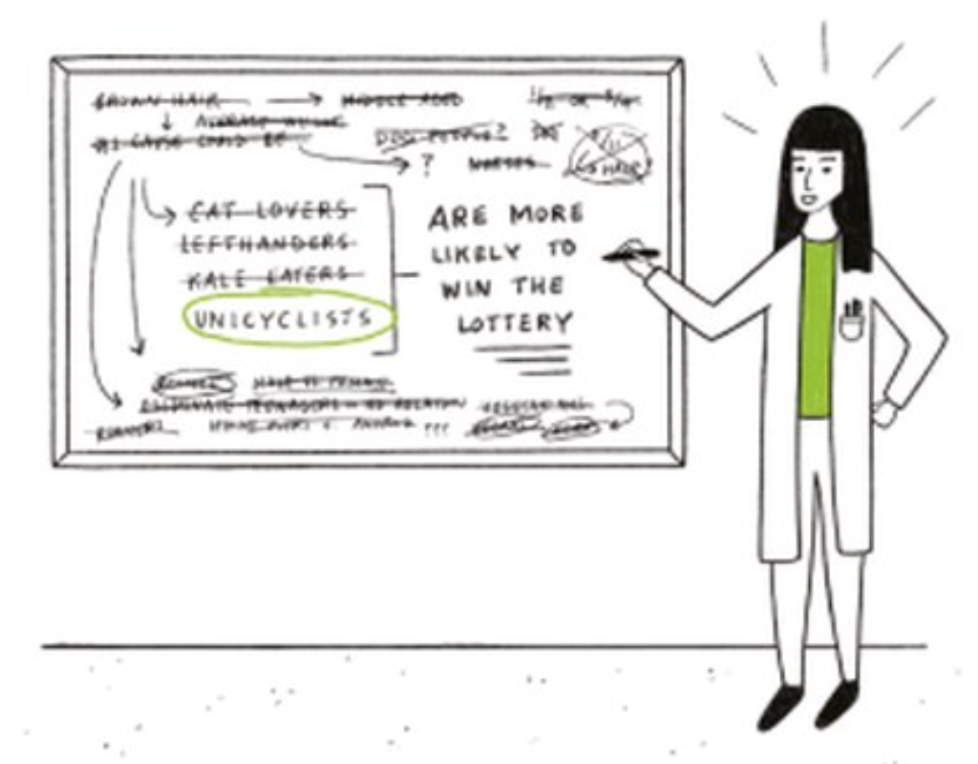
Data Dredging
The more tests you do, the higher the likelihood that one of the tests will be statistically significant by chance (type 1 error). To prevent this:
Avoid multiple hypothesis testing
Use the Bonferroni correction: this decreases the alpha level, making it harder to reach significance

Slide 36
Type 1 error (false positive)
Type 2 error (false negative)
Research conclusion: there IS a difference
Reality: there is NO difference
Causes
Confounders
Biases:
Performance bias
Detection bias
Attrition bias
Multiple hypothesis testing
When to think about this?
When results ARE statistically significant
Research conclusion: there is NO difference
Reality: there IS a difference
Causes
Sample is too small
Excessive use of exclusion criteria → diagnostic purity bias
Variance is too large
When to think about this?
When results ARE NOT statistically significant

Slide 37
Outcomes (Mnemonic: M-SKIEY)
Internal validity
External validity
Can we trust the study results? How reliable are they?
The extent of confidence in the outcome of research you are conducting
Look at:
Sources of bias
Possible confounders
Blinding
Statistical tests
Power
Can we apply these results to the wider population?
Degree to which the results can be generalised to the larger population
Look at:
Sample in the study vs population
Study setting vs real life clinical environment
Compliance
Cost-effectiveness

Slide 38
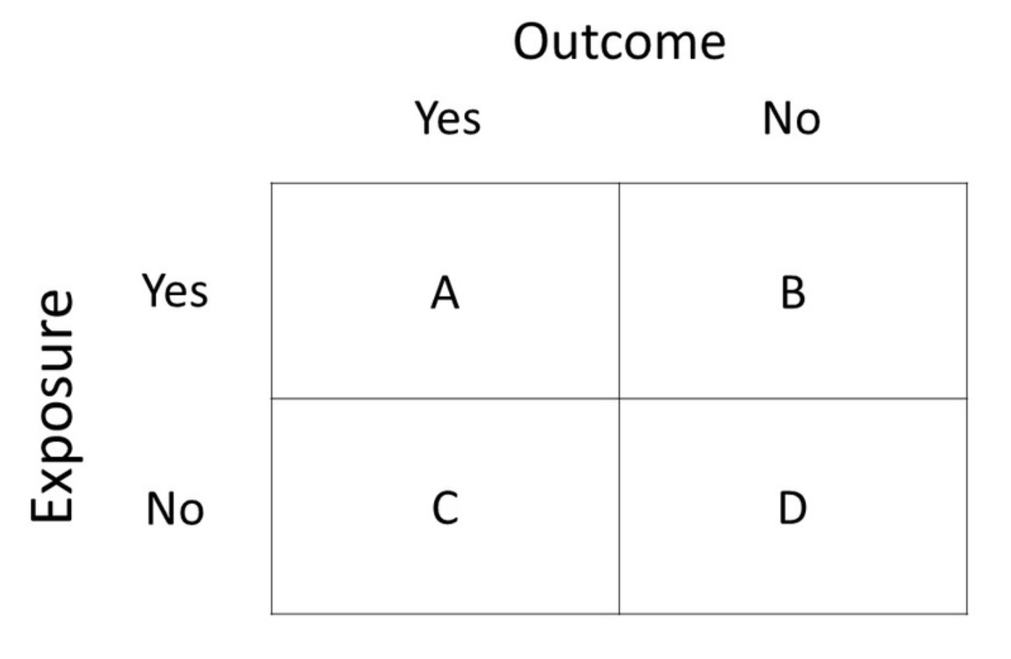
2x2 (Contingency) Tables

Slide 39
2x2 (Contingency) Tables
Example:
In our cohort study, 100 patients smoke cigarettes and 100 patients do not smoke. At the end of the study, 30 patients in the smoking group develop cancer. Only 10 patients in the non-smoking group develop cancer
Cancer
30 (A)
70 (B)
100
Smoking
10 (C)
90 (D)
100
40
160

Slide 40
Relative vs absolute risk
Absolute risk
AR in exposed cohort (y): smokers have a 30% (30/100) chance of developing cancer
AR in control (x): non-smokers have a 10% (10/100) chance of developing cancer
Absolute risk reduction (ARR): y-x = 20% → absolute amount by which smoking increases the risk of cancer
Relative risk
Relative risk of cancer in smokers compared to non-smokers: y/x = 0.3/0.1 = 3 (smokers are 3x more likely)
Relative risk reduction (RRR): difference in the risk between the two groups as a proportion of the risk in the control, (y-x)/x = 0.2/0.1 = 0.5 (50%)
Cancer
Cancer
30 (A)
30 (A)
70 (B)
70 (B)
100
100
Smoking
Smoking
10 (C)
10 (C)
90 (D)
90 (D)
100
100
40
40
160
160

Slide 41
Absolute risk
Smokers
AR: 30%
Non-smokers
AR: 10%
Absolute risk reduction
ARR: 20%

Slide 42
Relative risk
Smokers
AR: 30%
Non-smokers
AR: 10%
Relative risk
3 (300%)

Slide 43
Number needed to treat
How many people do we need to treat for 1 more person to benefit from treatment?
Calculation: 1/ARR
ARR = 0.3-0.1 = 0.2 (20%)
NNT = 1/0.2 = 5 people
The smaller the NNT the higher the benefit
Cancer
Survival
30 (A)
30 (A)
70 (B)
70 (B)
100
100
Smoking
Surgery
10 (C)
10 (C)
90 (D)
90 (D)
100
100
40
40
160
160

Slide 44
Odds ratio
Odds: ratio of number of times an event is likely to occur divided by number of times it is not likely to occur.
Odds of having cancer in smokers: 30/70 = 43%
Odds of having cancer in non-smokers: 10/90 = 11%
Odds ratio: AD/BC = 30*90/70*10 = 3.85
Cancer
Cancer
30 (A)
30 (A)
70 (B)
70 (B)
100
100
Smoking
Smoking
10 (C)
10 (C)
90 (D)
90 (D)
100
100
40
40
160
160

Slide 45
Diagnostic tests

Slide 46
Clinical trial phases
Phase 0
Phase 1
Phase 2
Phase 3
Phase 4
Human microdosing studies
Small number of people are given sub-therapeutic doses
Purpose:
Pharmacodynamics and pharmacokinetics
Human pharmacology and safety
Subjects: 20-100 healthy volunteers
Purpose: establish a dosage range, assess safety and identify any side effects
Therapeutic exploratory
Subjects: 100-150 patients
Purpose: study drug/treatment is given to patients to establish safety and effectiveness
Therapeutic confirmatory
Subjects: large number of patients in clinical settings
Purpose: further assessments of effectiveness, dose range, treatment duration & side-effects
Post marketing surveillance
Subjects: patients being treated by doctors
Purpose: study long-term side-effects and effects on special groups (children, pregnant women, elderly, etc.)
Marketing authorisation

Slide 47
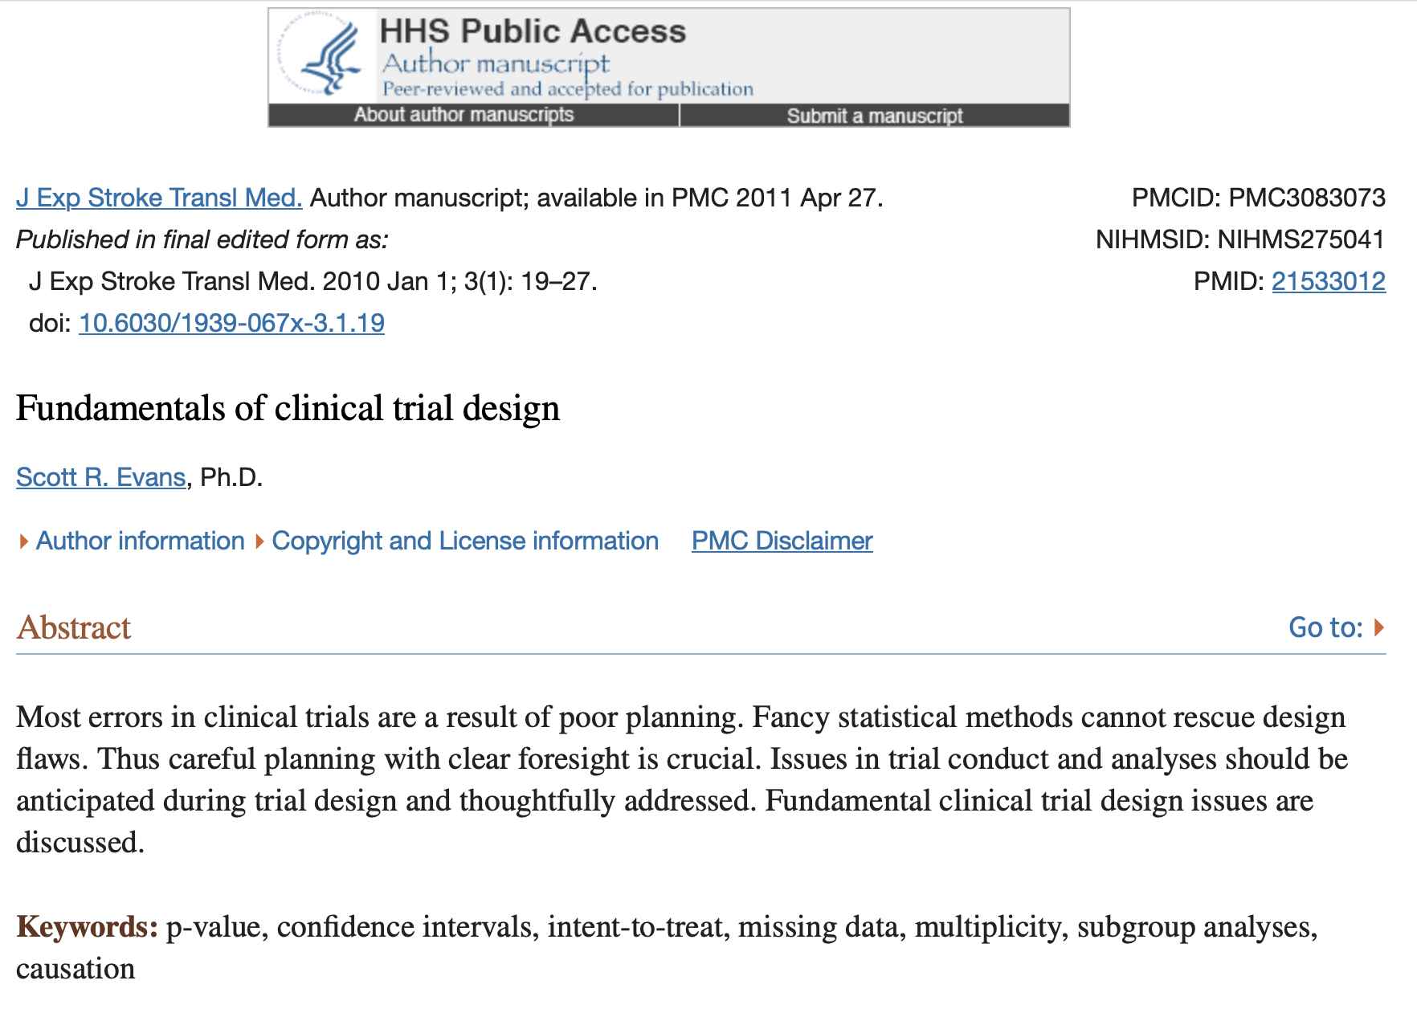
Clinical trials design: fundamentals

Slide 48
Clinical trials design: fundamentals
Research question
Planning and CTU
Funding
Trial lead up
Trial
Post-trial
Approach clinical trials unit (CTUs), get help with:
Literature search
Refine study design
Statistical input
Public involvement
Build team
Contact clinical research networks (CRNs), develop protocol and estimate resources required to help you write grant application
Sources of funding:
Industry
Research funding body (NIHR, MRC, charity)
Finalise protocol
IRAS application:
Clinical trial approval (CTA) by MHRA
Ethics approval by REC
R&D approval by HRA
Register trial: either public (WHO/ICMJE list), ISRCTN, clinicaltrials.gov
Ongoing management and monitoring
Safety reporting
Progress reporting
Financial management
Archive
Produce reports for:
Funders
Journal article
REC
MHRA

