Slide 1
GKTeach
Skeletal, Cardiac, and Smooth Muscle
STAGE 1
Ashton Neo
YEAR 2 MBBS
31/10/2024
THE CAT SOCIETY

Slide 2
LEARNING OBJECTIVES
Structure of Skeletal, Cardiac, and Smooth Muscle
Initiation of Contraction
Contraction cycle
Relaxation of muscle
Control of Smooth muscle contraction – latch bridge cycle
Factors affecting contraction
Type I and Type II Muscle fibers
We will be looking at all 3 muscle types altogether to find the similarities and differences between them
UNDERSTANDING is more important than MEMORISING

Slide 3
Structure

Slide 4
Overview - Muscle Types
Skeletal Muscle | Cardiac Muscle | Smooth Muscle
Voluntary Contraction | Involuntary Contraction | Involuntary Contraction
Striated | Striated | NOT Striated
Found all across the body | Found in the Heart | Found in the viscera
Function is Movement | Function is Pumping blood | Various functions depending on the Organ

Slide 5
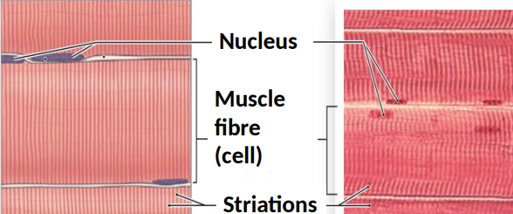
Skeletal Muscle
Limbs
Face
Walls of the body
Very Large Cells
Multinucleated
Has clear Striations – actin and myosin

Slide 6
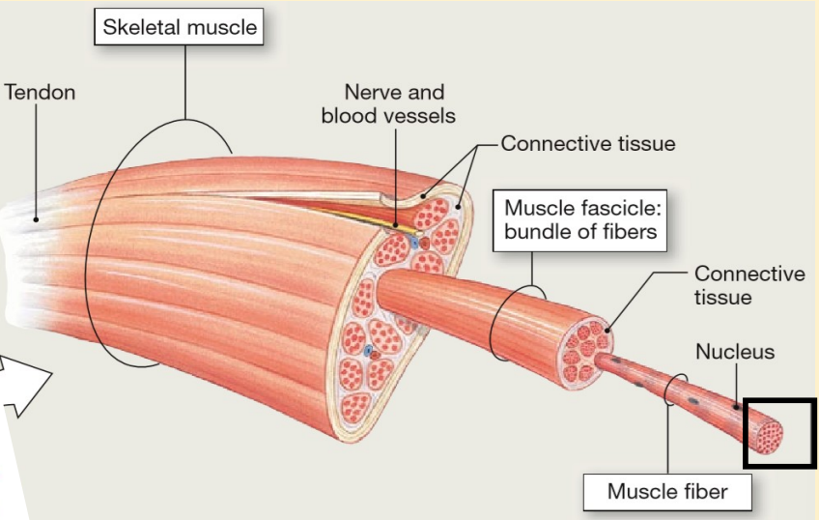
Organization of Skeletal Muscle

Slide 7
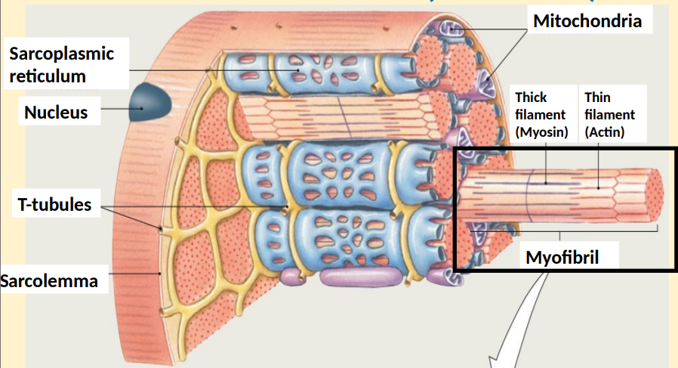
Structure of a Muscle Fiber
Epimysium
Perimysium
Endomysium

Slide 8
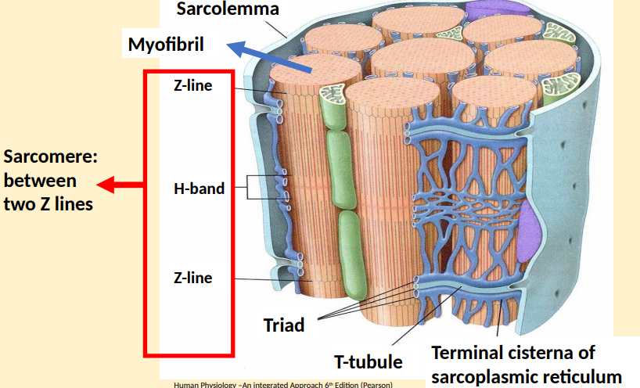
Structure of a muscle fiber

Slide 9
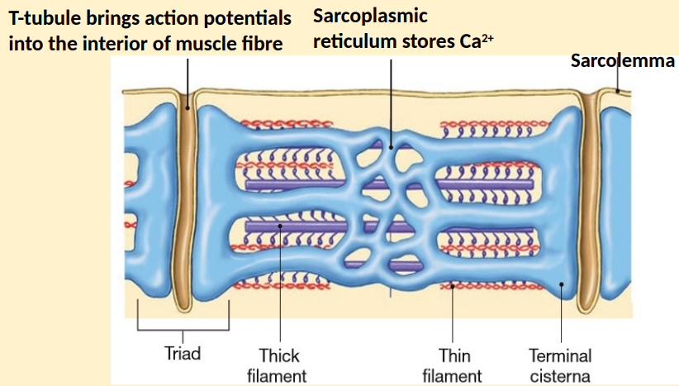
T-Tubules and Sarcoplasmic Reticulum

Slide 10
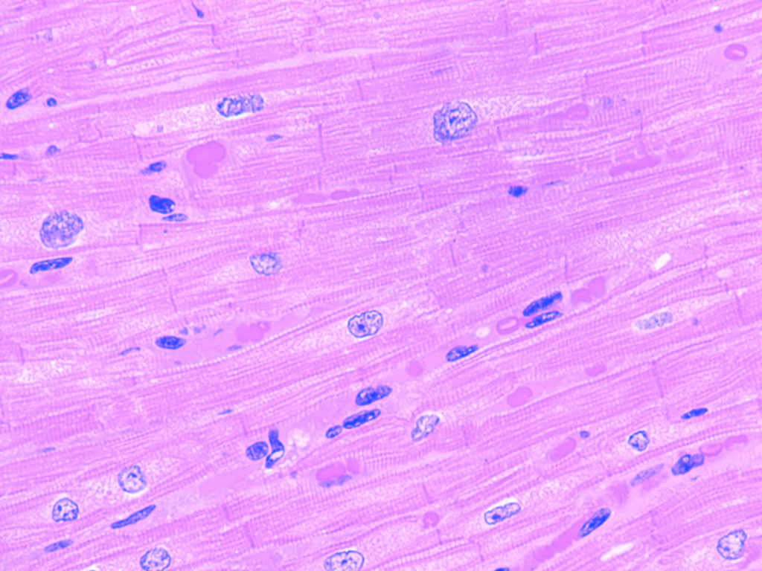
Cardiac Muscle
Branched fibers
Makes up the Myocardium layer of the heart wall
Mononucleated
Striated
Intercalated Disks separate fibers – contains gap junctions for flow of ions – Ca2+, Na+, K+
Anisotropic Conduction – Electrical Impulses travel easier along fibers than across them, due to the presence of more gap junctions at the ends of cells

Slide 11
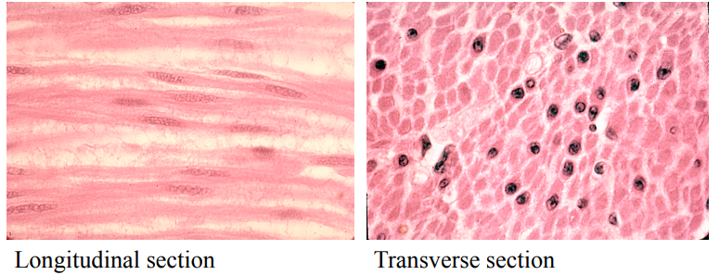
Smooth Muscle
Non-Striated
Spindle shaped
Mononucleated
Also has gap junctions
Blood vessels, airways, GI system, Myometrium, Bladder

Slide 12
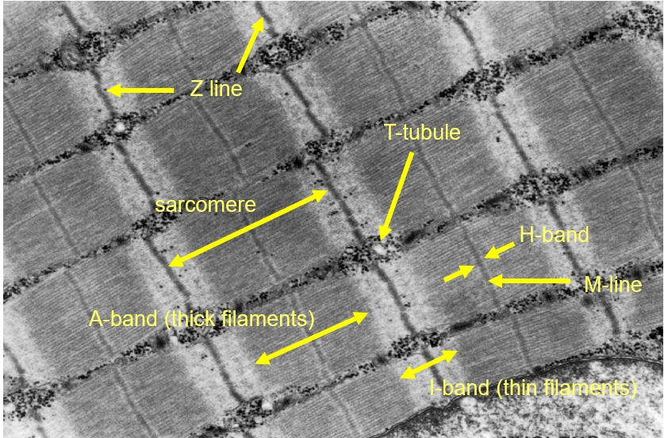
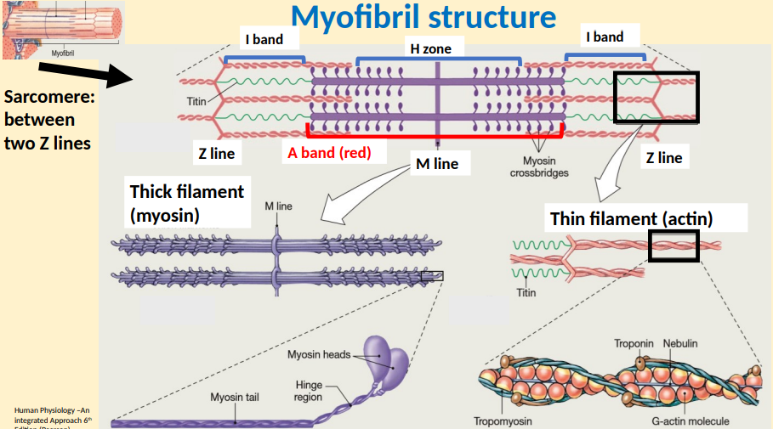
Microanatomy of Skeletal and Cardiac Muscle

Slide 13
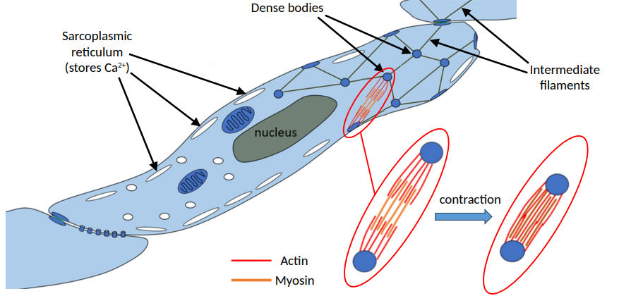
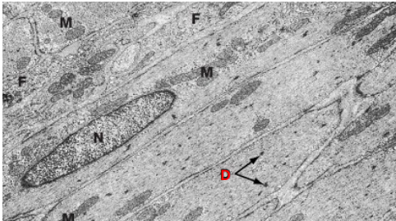
Microanatomy of Smooth Muscle
Myosin and actin anchored by dense bodies, which are connected by intermediate filaments
Organisation of Actin and Myosin are similar, but not the same

Slide 14
Initiation of Contraction

Slide 15
In order for contraction to happen, there MUST be release of Calcium

Slide 16
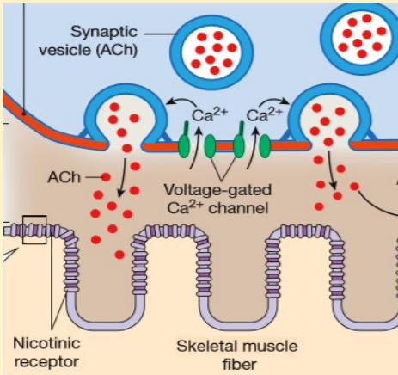
Skeletal Muscle 1
Just like a synapse
Action potential triggers VGCC to open
causing Ach-filled vesicles to release into the NMJ

Slide 17
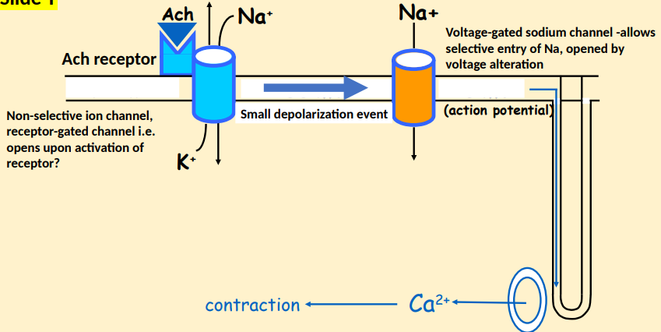
Binds to Nicotinic Ach receptor
Potassium moves out = small depolarization
Opens VGSC
Action potential travels down T-tubule
Skeletal Muscle 2

Slide 18
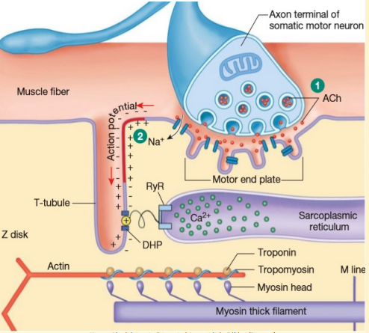
DHP = dihydropyridine receptor
RyR = Ryanodine receptor
Skeletal Muscle 3
Depolarisation activates DHP receptors
DHP activates RyR receptors on the sarcoplasmic reticulum
Release of Ca2+ from Sarcoplasmic reticulum

Slide 19
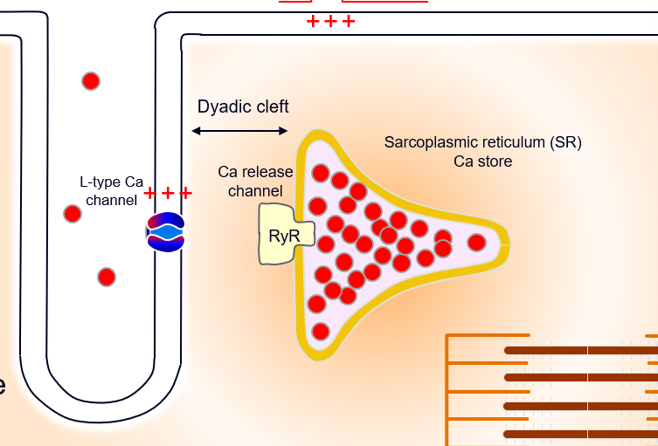
Cardiac Muscle
Exactly the same as Skeletal muscle – Except…
Calcium drives the release of Calcium from the SR
Through L-Type Channel and binds directly onto RyR to release Ca2+

Slide 20
Skeletal Muscle = VOLTAGE-induced Calcium release
Cardiac Muscle = CALCIUM-induced Calcium release

Slide 21
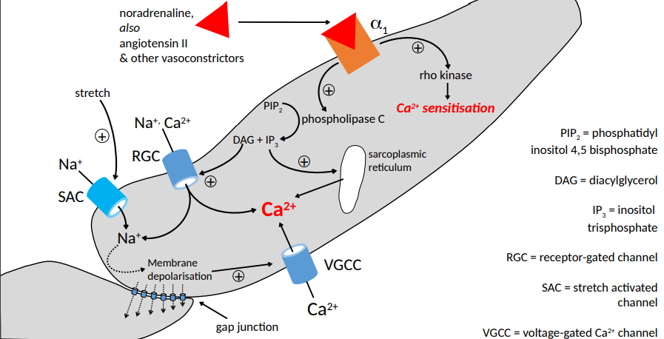
Smooth Muscle

Slide 22
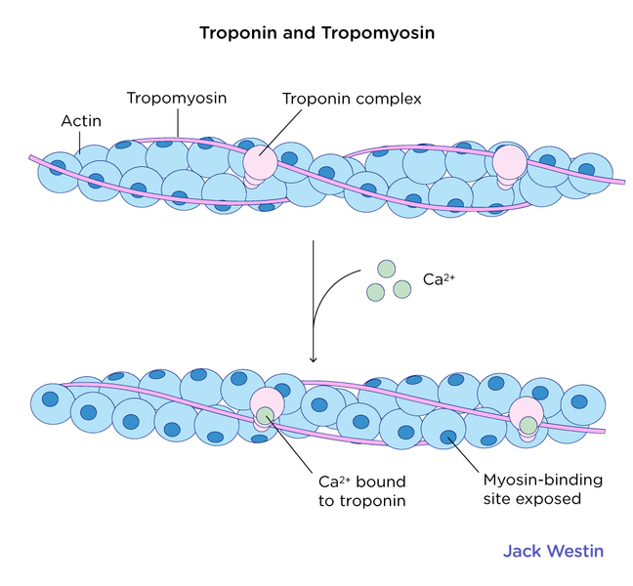
“Unlocking” Actin
Ca2+ binds onto troponin
Troponin moves tropomyosin out of the way
Binding sites on actin are now open

Slide 23
Muscle Contractile Cycle – the SAME in all muscle types

Slide 24
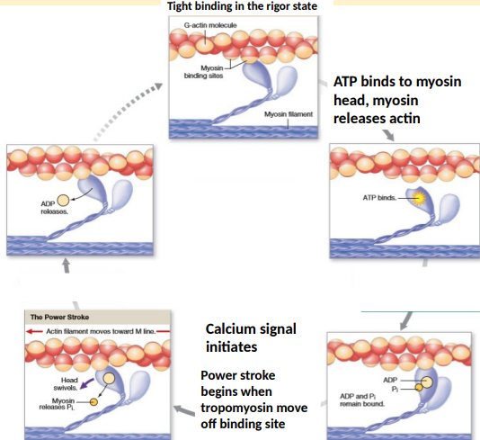
Contractile Cycle
ADP and Pi attached to the myosin head, with actin also bound to myosin
When tropomyosin moves away, the power stroke occurs, where ADP and Pi are released
ATP binds. The head detaches from Actin
ATP is hydrolysed to ADP and Pi. The head cocks back to the original position
The process repeats

Slide 25
Creatine and Creatinine
Creatine kinase Phosphorylates Creatine into phosphocreatine
This can be used as “backup fuel” to phosphorylate actin during the contraction cycle if we cannot metabolise ATP quick enough (e.g. in exercise)
The waste product is Creatinine, which is fully cleared by the kidneys
Creatinine clearance is an important indicator of kidney health in clinic

Slide 26
Relaxation of Muscle

Slide 27
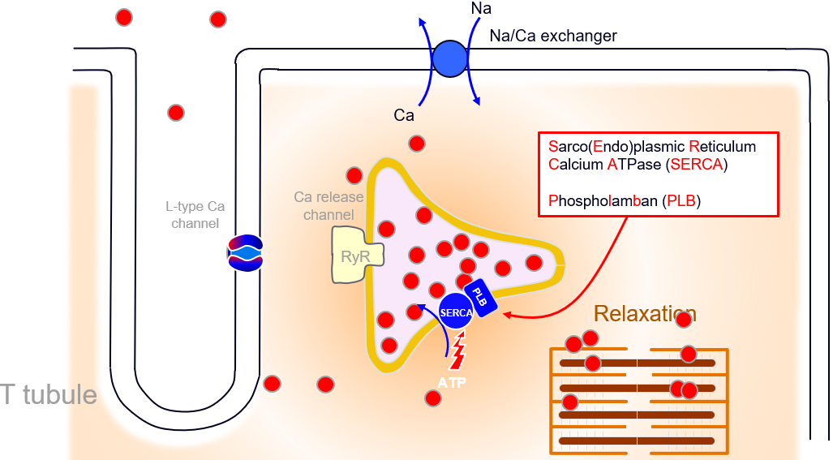
Skeletal and Cardiac Muscle
Reuptake of Calcium by SERCA
Requires ATP
All processes happen in reverse

Slide 28
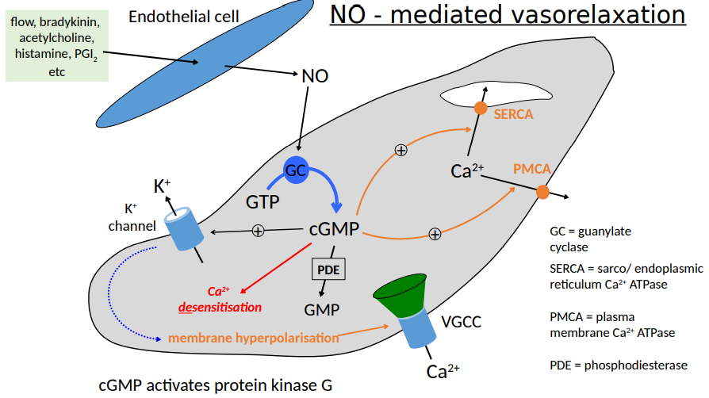
Smooth Muscle – NO-mediated relaxation

Slide 29
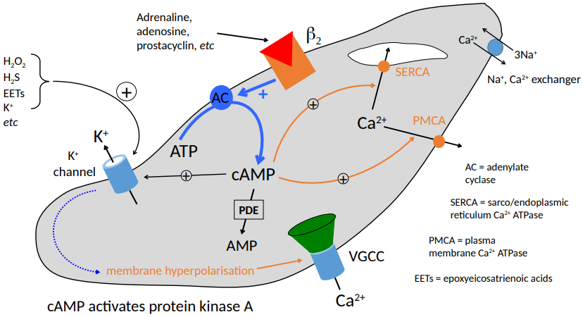
Smooth Muscle – cAMP-Mediated Vasorelaxation

Slide 30
Smooth Muscle – Latch-bridge cycle

Slide 31
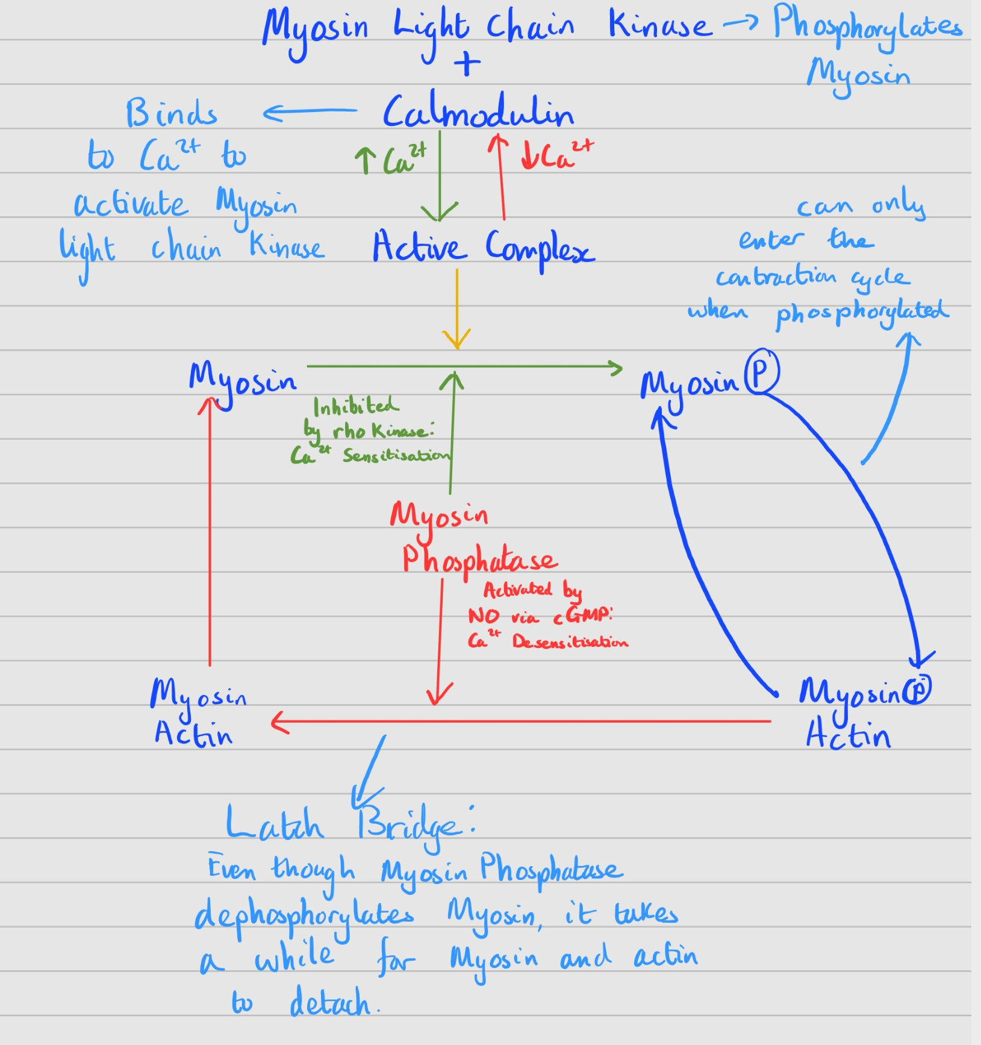

Slide 32
Stimuli for Contraction

Slide 33
Skeletal Muscle | Cardiac Muscle | Smooth Muscle
Voluntary | Rhythmic release of Calcium in the SAN | Vascular: ANS (Noradrenaline, adrenaline), serotonin, bradykinin, angiotensin, prostaglandins, etc.
Acetylcholine from motor neurones | Rate slowed by the vagus nerve | Airways: PNS, adrenaline
 | Rate increased by the accelerator nerve | Intestines: Interstitial cells of cajal, ANS, endocrine hormones, autacoids
 |  | Myometrium and bladder affected as well

Slide 34
Factors Affecting Contraction

Slide 35
Skeletal Muscle
Cardiac Muscle
Smooth Muscle
Too stretched = no overlapping myosin and actin
Stretch/Cross-bridge overlap
Ca2+ Sensitivity (temp, pH, Pi, Drugs, etc.)
Increased Venous return = increased contractility/stretch = increased Cardiac output (Frank-Starling Law)
Balancing of the different stimuli
No stretch = too much overlapping, no more overlap can happen

Slide 36
Fast and Slow Twitch Muscle Fibers

Slide 37
Slow Type 1
Fast Type 2A
Fast Type 2B
Speed of Contraction
Increased time of contraction
Sustained, small movements
Quick, Powerful movements
Speed for time to fatigue
Amount of Mitochondria and Myoglobin
Aerobic
Anaerobic

Slide 38
Clinical Application – Why is this relevant?

Slide 39
Myasthenia Gravis
Autoimmune Disease
Production of Autoantibodies targeting the post-synaptic nicotinic acetylcholine receptors at the neuromuscular junction
There are fewer receptors for acetylcholine to work on
Smaller release of calcium
Smaller/absent muscle contraction

Slide 40
Myasthenia Gravis - Symptoms
Fatigable limb muscle weakness
Ptosis (drooping of the upper eyelid)
Diplopia (double vision)
Facial Palsy (weakness of the facial muscles)
Bulbar weakness – Dysphagia (difficulty swallowing), Dysphonia (Difficulty speaking)
Proximal muscle weakness
Typically worsen with prolonged movement and by the end of the day

Slide 41
Practice SBA questions

Slide 42
SBA
Which Enzyme is Deactivated by Rho Kinase?
A) Myosin Light Chain Kinase
B) Lactate Dehydrogenase
C) Creatine Phosphate
D) Myosin Phosphatase
E) Aspartate Transaminase

Slide 43
SBA answer
Which Enzyme is Deactivated by Rho Kinase?
D: Myosin Phosphatase
Rho kinase is released by Alpha receptors as a secondary messenger when alpha-1 receptors are stimulated by noradrenaline.
This inhibits Myosin phosphatase, meaning myosin is not being dephosphorylated, allowing for continuous smooth muscle contraction

Slide 44
SBA
Which type of skeletal muscle fibre is most likely going to be the predominant type in the back muscles important for posture?
A) Type I Slow
B) Type IIa Fast
C) Type IIb Fast
D) Cardiac Muscle
E) Smooth Muscle

Slide 45
SBA answer
Which type of skeletal muscle fibre is most likely going to be the predominant type in the back muscles important for posture?
A: Type I Slow
Because the back muscles are important for posture and to keep us upright. Therefore, they need to be activated and contracted consistently. This is most likely going to be made of mostly Type I slow fibres

Slide 46
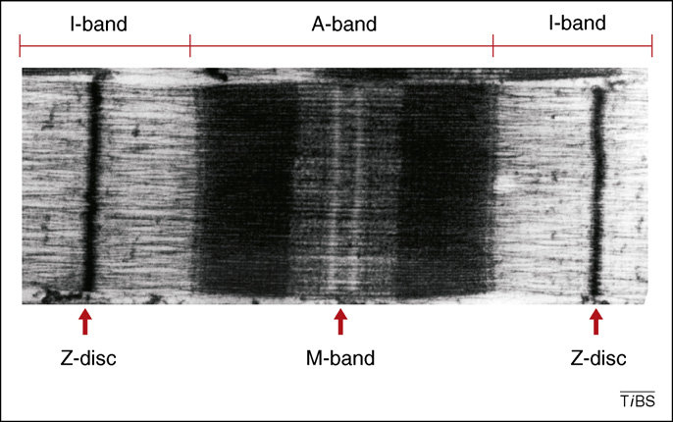
SBA
X
Y
X
Label X, Y and Z
A) X: A band, Y: M line, Z: I band
B) X: I band, Y: A band, Z: M line
C) X: A band, Y: I band, Z: M line
D) X: I band, Y: M line, Z: A band
E) X: M line, Y: A band, Z: I band
Z

Slide 47
SBA answer
Label X, Y and Z
B) X: I band Y: A band
Z: M line

Slide 48
SBA
With regard to the control of contraction, which feature is shared by cardiac and smooth muscle?
A) In both types of muscle, relaxation is brought about by the reuptake of Ca2+ into the sarcoplasmic reticulum via IP3 dependent channels
B) They both contain T-tubules which couple sarcolemmal depolarization to Ca2+ release
C) They both rely on Ca2+ influx to initiate contraction
D) They both rely on the phosphorylation of tropomyosin to initiate crossbridge cycling
E) They both rely on the release of noradrenaline from sympathetic nerves to initiate contraction

Slide 49
SBA answer
With regard to the control of contraction, which feature is shared by cardiac and smooth muscle?
C) They both rely on Ca2+ influx to initiate contraction
All muscle types rely on Calcium influx to initiate contraction.

Slide 50
Thank you for listening!
FEEDBACK
*INSERT QR CODE*

Slide 51
Extra Material

Slide 52
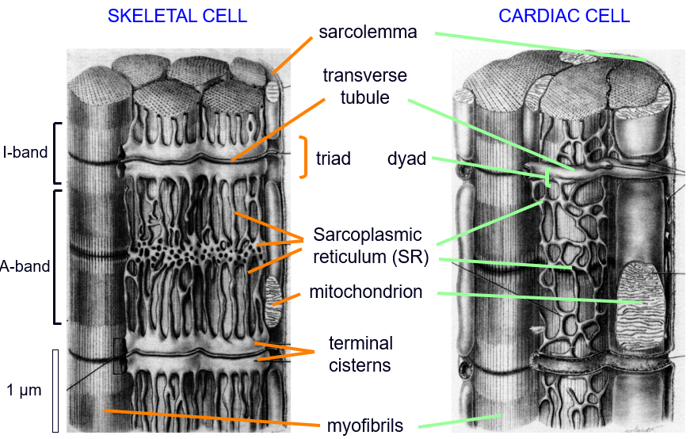

Slide 53
Skeletal Muscle Initiation of Contraction
Calcium Channels from the motor neuron open to release Ach from vesicles into the neuromuscular junction.
Ach binds to receptors on the sarcolemma membrane, opening up Na⁺ channels.
small depolarisation happens
This small depolarisation causes voltage-gated Na+ channels to open, creating an action potential.
The action potential travels down t-tubules to DHP receptor.
DHP receptor undergoes conformational shape change causing RyR to open in the sarcoplasmic reticulum.
This causes Ca²⁺ ions to release,
After contraction, Ca²⁺ is pumped back into the sarcoplasmic reticulum.

Slide 54
Smooth Muscle Initiation of Contraction
Noradrenaline is an agonist to alpha-1 adreno-receptors
angiotensin II is an agonist to their own receptors
They both activate a G-protein called rho kinase
rho kinase activates Ca²⁺ sensitisation
Gq activates phospholipase C, which splits inositol phospholipids into Di-AcylGlycerol (DAG) and Inositol Triphosphate (IP₃)
IP₃ allows release of Ca²⁺ from the Sarcoplasmic Reticulum.
DAG Activates receptor-gated channels that are non-selective, so Na+ and Ca2+ are let into the cell.
This heavily increases the Ca2+ content of the cell.
The influx of Na+ causes the membrane to become depolarised.
If there is stretching, Stretch-activated Na+ ion channels can also open.
This causes further increase of intracellular Na+.
The membrane depolarisation caused by the increased Na+ results in opening of voltage-gated calcium ion channels, in further increasing the levels of Ca2+ inside the cell.
The membrane depolarisation may spread to adjacent cells via gap junctions.
This means not every smooth muscle cell must be innervated.

Slide 55
Smooth Muscle NO mediated relaxation
Flow, bradykinin, acetylcholine, histamines, etc. stimulates endothelial cells in the vasculature to release Nitrous Oxide (NO).
NO stimulates an enzyme called Guanylate cyclase
Guanylate Cyclase converts GTP to cGMP (a secondary messenger)
cGMP activates Protein Kinase G
Protein Kinase G causes activation of Sarco/endoplasmic reticulum Ca²⁺ ATPase (SERCA), which pumps Ca²⁺ back into the sarcoplasmic reticulum.
Protein Kinase G also activates plasma membrane Ca²⁺ ATPase (PMCA) which pumps Ca²⁺ out of the cell via the plasma membrane.
Protein Kinase G also activates potassium channels, making K+ ions leave and causing hyperpolarisation.
This hyperpolarisation will close voltage-gated caldium ion channels so Ca²⁺ can no longer enter the cell.
Protein Kinase G also activates a protein that triggers Ca²⁺ DEsensitisation
Cyclic GMP is eventually destroyed by phosphodiesterase enzymes back into GMP

Slide 56
Smooth Muscle cAMP mediated relaxation
Adrenoline, Adenosine, prostacyclin, etc. binds to beta-2 adreno-receptors.
This activates a G-protein which activates adenylyl cyclase, which converts ATP to cAMP.
cAMP activates Protein Kinase A
Protein Kinase A activates the sarco/endoplasmic reticulum Ca²⁺ ATPase (SERCA) which uptakes Ca²⁺ back into the sarcoplasmic reticulum
Protein Kinase A also activates the plsma membrane Ca²⁺ ATPase (PMCA) which pumps Ca²⁺ back out of the cell.
Protein Kinase A opens Potassium Ion Channels, letting K+ ions out of the cell
This causes hyperpolarisation of the membrane.
This causes voltage-gated Ca²⁺ channels to close.
Hydrogen Peroxide, Hydrogen sulfide, Epoxyeicosatrienoic acids (EETs) and potassium ions can all cause further hyperpolarisation through the opening of K⁺ ion channels
Phosphodiesterase enzymes break down cAMP back to AMP
Na⁺/Ca²⁺ exchanger constantly removes Ca²⁺ as well.

Slide 57
Smooth Muscle Cross-bridge cycle and regulation
Calmodulin is a Calcium-binding protein.
Calmodulin activates myosin light chain kinase.
myosin light chain kinase phosphorylates the light chain on myosin, which activates it.
The phosphorylated myosin can then bind to actin using the hydrolysis of ATP to ADP.
Myosin phosphatase dephosphorylates the myosin, then inactivating it.
if contraction needs to continue, myosin phosphatase can be inhibited by rho kinase (G-protein produced when alpha-adreno receptors are activated). This is called Calcium Sensitisation. This prevents dephosphorylation of myosin allowing cross-bridge cycles with actin to continue
cGMP produced by No-mediated vasorelaxation stops rho kinase from inhibiting myosin phosphatase. This allows dephosphorylation of myosin to stop the cross-bridge cycle. This is called calcium DEsensitisation

