Slide 1
What I Wish I Knew in First Year
By: Ally, Sharon, Denise & Jean
Monday 23rd September 2024

Slide 2
Plan for Slides
Introduction + what is MSA? (Ally)
Revision methods & resources: (Lead by Ally, everyone can give their methods)
Fresher’s fortnight (Ally)
Breakdown of each module:
FMS + GBE: (Sharon)
PAS: (Ally)
IVBCP: (Denise)
Extracurriculars: (Denise)
General Tips ( Jean + Ally)
MSA Parents Scheme (Ally)
Assessments tips: (Sharon)
Conclusion + Questions: (lead by Ally)
EMDP modules and tips (Denise)
Organisation: (Jean)
Note-taking: (Jean)
Notes:
to be removed

Slide 3
Contents
What is MSA? (reminder)
Note-taking
Fresher’s fortnight
Revision methods & resources
Breakdown of each module
Extracurriculars
Assessments tips
General Tips
EMDP modules and tips
MSA Parents Scheme
Organisation
Questions
Notes:
Ally - to be dited

Slide 4
Education
Welfare
Communication & Technology
Communities
Events
Notes:
Ally

Slide 5
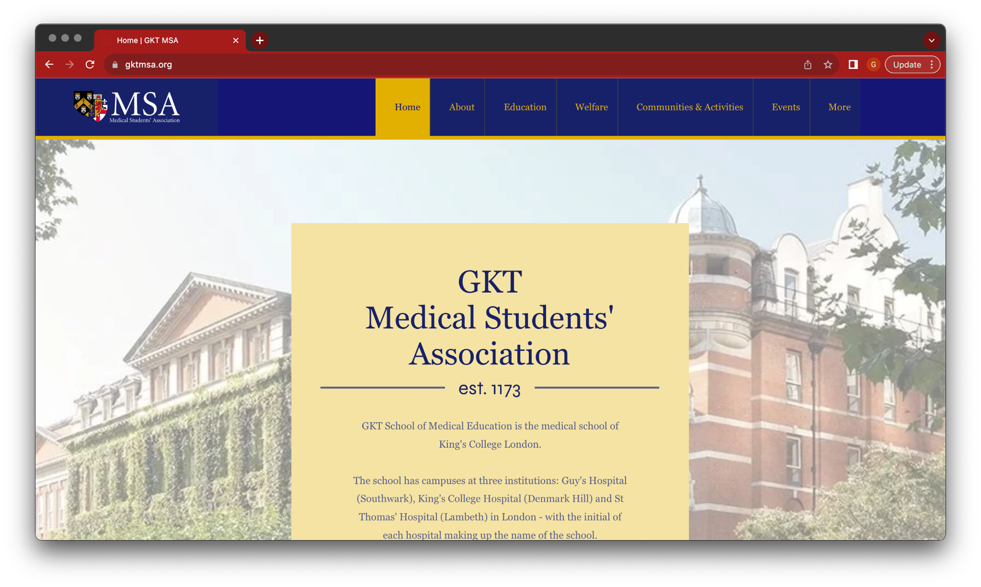
Stay Connected
Our newsletter:
newsletter
Our website:
Email:
msa@kcl.ac.uk
Instagram:
@gktmsa
Facebook:
https://www.facebook.com/GKTMedicalStudentsAssociation
Notes:
add newsletter QR code

Slide 6
Wednesday, 27th September 2023
Virtual Games Night 7:00 PM – 9:00 PM
Monday, 25th September 2023
MSA x BSA Games Night 5:00 PM – 8:00 PM
MSA Sports Night 8:00 PM onwards
Fresher’s Fortnight Week 2
Thursday, 28th September 2023
Tuesday, 26th September 2023
Scavenger Hunt 5:00 PM – 6:00 PM
Plant Pots, Paint and Pizza 4:00 PM – 7:00 PM
Big Fat GKT Quiz 7:00 PM – 10:00 PM
Friday, 29th September 2023
GKT Dice 8:00 PM – 2:00 AM
Notes:
to be edited

Slide 7
What to expect
Four modules:
Foundations of Medical Sciences (FMS) - Exams
Physiology and Anatomy of Systems (PAS) - Exams
Genes, Behaviour and Environment (GBE) - Exam
Introduction to Values Based Clinical Practice (IVBCP)
Portfolio
Film review
Patient scenario reflective essay
Philosophy essay

Slide 8
DON’T PANIC!
The following slides may induce fear; however, I promise you will survive the year

Slide 9
FMS
Blocks and content:-
Our tips:-
Cell biology and signalling (CBS) blocks
Molecular and cell genetics (MCG) blocks
Nutrition and metabolism (NAM) blocks
Actually watch the lectures the day they happen and sort out revision resources straight away
In FMS (especially NAM), lectures lead on from each other so make sure you understand each one from the get-go
It is an extension of A-level biology - if you managed to get into medicine, you definitely have the brain power to do well in this module!
The first exam is on FMS, so make revision sources (eg Anki) for it early on
Learn the amino acids! (https://www.youtube.com/watch?v=PmbcA1Sav7s )
Prepare for tutorials and use them to ask any questions you have

Slide 10
PAS
Blocks and content:-
Our tips:-
Fundamentals of anatomy and histology (FAH)
Fundamentals of physiology and pharmacology (FPP)
Anatomy of cardiovascular and respiratory system (ACRS)
Physiology of cardiovascular and respiratory system (PCRS)
Anatomy of gastrointestinal and renal system (AGRS)
Physiology of gastrointestinal and renal system (PGRS)
Anatomy of musculoskeletal system (AMS)
Most clinically relevant module of year 1
Make sure to get a good a grasp of the fundamentals - FAH and FPP
Lectures will take longer to finish and understand than FMS
Study to retain knowledge rather than pass the exams
Dissections are a massive help, and you can even go to open learning
Prepare before dissections (so you know what you are seeing)
Anatomy is best retained through constant repetition, especially AMS
Try and get a good understanding of physiology rather than memorising it
DO NOT LEAVE ANATOMY REVISION FOR LAST MINUTE
Notes:
Ally

Slide 11
GBE
Blocks and content:-
Our tips:-
Utilise tutorials (especially for biostatistics), ask questions and make note of the answers you get - ChatGPT is a good way to understand how mathematical formulae are used
Look at the bigger picture to help you keep track of details, especially for immunology and neuroscience (pathways) - they are looking for more of an understanding than ability to memorise specific facts or examples
More health informatics than expected in exams
Learn the case studies for NBSS
Immunity and infection (IAI)
Neuroscience, behaviour and social science (NBSS)
Health informatics and evidence based practice (HIEBP)
Epidemiology and biostatistics
Genomics (GBE)

Slide 12
IVBCP
Blocks and content:-
Our tips:-
Clinical Skills
Human Values
Philosophy
Do not wait until deadlines to complete tasks
Do not be afraid to volunteer and jump straight into practicing patient scenarios and clinical skills (Everyone knows that it is your first time and is intimidating, so no one is expecting you to be perfect! Volunteering early on gives you more chances to practice and takes away the fear for mandatory scenarios down the line!)
Don’t be afraid of making mistakes in patient scenarios
Take notes during your patient scenario – you will need them for your reflective essay
Use Gibbs Reflective Cycle for Human Values essays
Enjoy your clinical skills sessions! (you will get taught the key clinical skills again in year 2)
How it’s examined:
Portfolio
Film review
Patient scenario reflective essay
Philosophy essay
Notes:
sail centre- booking room for practice; good chance to practice speaking to patients in a chill environment, make the most of it; safe space to learn

Slide 13
EMDP
3 Assessed Modules: PAS, FMS, GBE
- EMDP1A- FMS & GBE
- EMDP1B- PAS & IVBCP
Art Project 1A
EMDP Socials
Welcome Dinner
Revision & Pizza socials
PBL cases
Numeracy Workshops

Slide 14
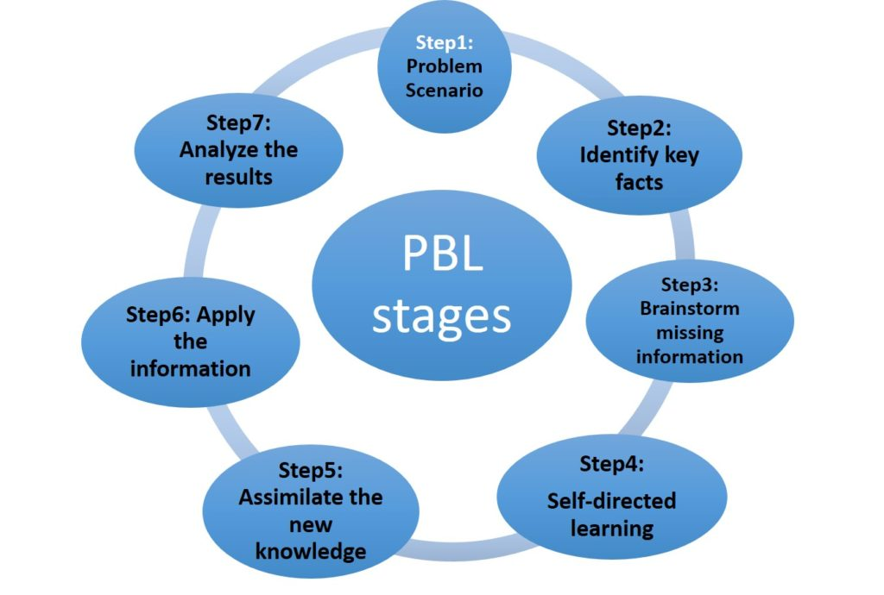
Problem Based Learning (PBL)
Common teaching method throughout Medical Schools
You’ll be given PBL cases
- Stick to your roles & work as a team
- Don’t be shy presenting
- Research thoroughly & put effort in your slides
- You’ll be given an essay at the end

Slide 15
EMDP Tips
1A = The modules are deceptive
- Don’t leave FMS to the last minute
- GBE requires a lot more attention
1B = Learn anatomy alongside physiology
- Understand how things link
- Use Passmedicine
- Use KCL quiz banks - PastTest
Attend timetabled activities
Extra time = Use to consolidate learning, join new societies, be actively engaged in the university scene
Don’t be afraid to work together and pool resources
Damilola Taylor room

Slide 16
Organisation
It is KEY to stay organised in medical school!!
- Deadlines, lectures, tutorials, independent revision, clinical skills, extracurriculars, etc.
Apps that some students found helpful for organisation in 1st year:
- Google Calendar, TimeTree, Notion Calendar (import keats timetable (ics), check weekly, you get notified before your sessions)
- Notion Notion Notion! (to-do lists/daily agenda, anki tracker, revision tracker, notes, learning outcomes, extracurriculars, etc.)
Notes:
stay on top of EVERYTHING!
Lectures: you will be behind lectures and that’s okay, what matters is that you don’t let it pile on TOO MUCH and you actually do them consistently.
Dissections - attend them! they will help you in understanding anatomy so much more
Calendar - personally TimeTree - different commitments can be gathered into one app (different commitments -> different calendars)
Calendar - Timetree (good overview of what you have for the week and tells you what you need to prepare for)
Notion - GOATED watch YT videos on how to use it, you WILL stay organised if you use it correctly
Notion! - TDLs, staying on top of lectures, anki making tracker

Slide 17
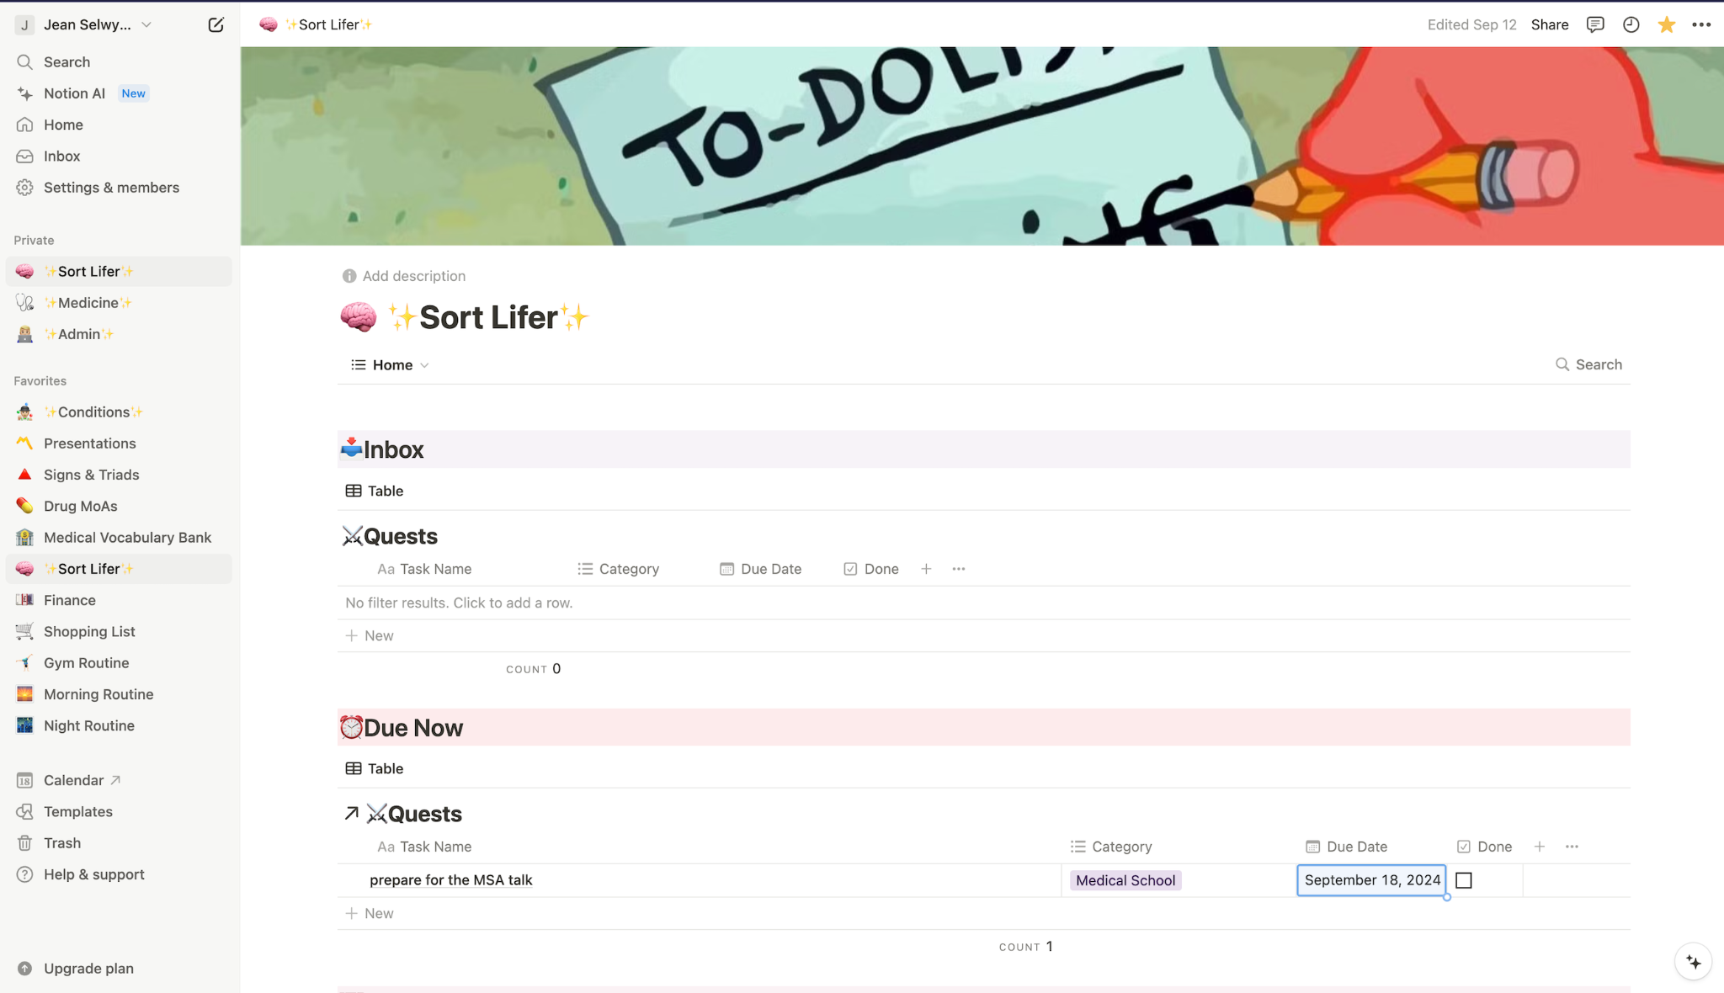
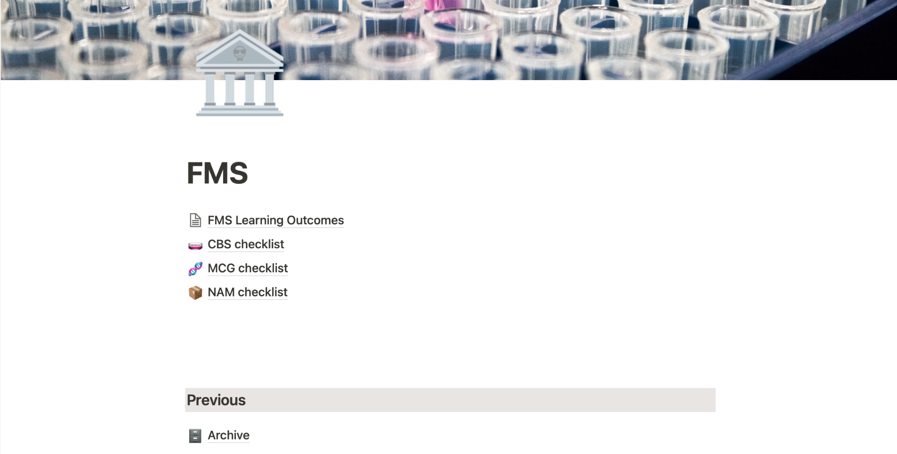
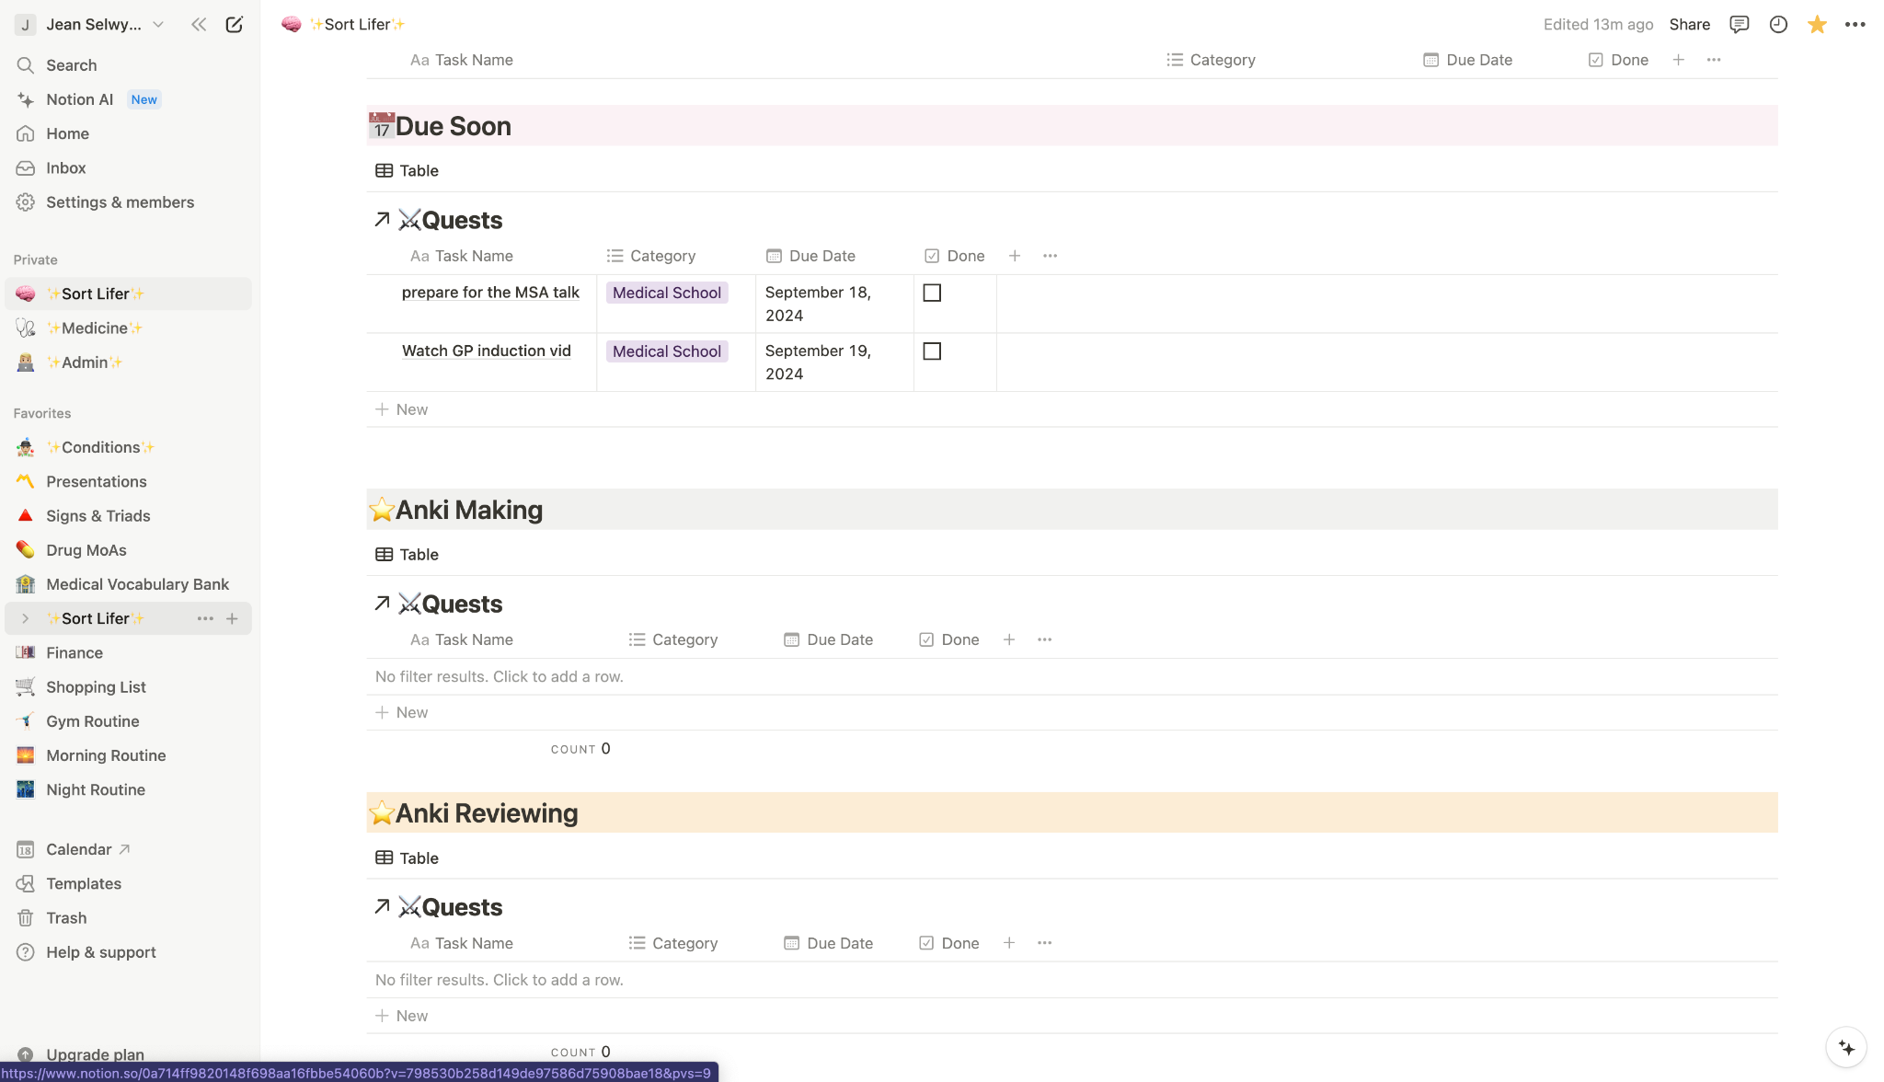
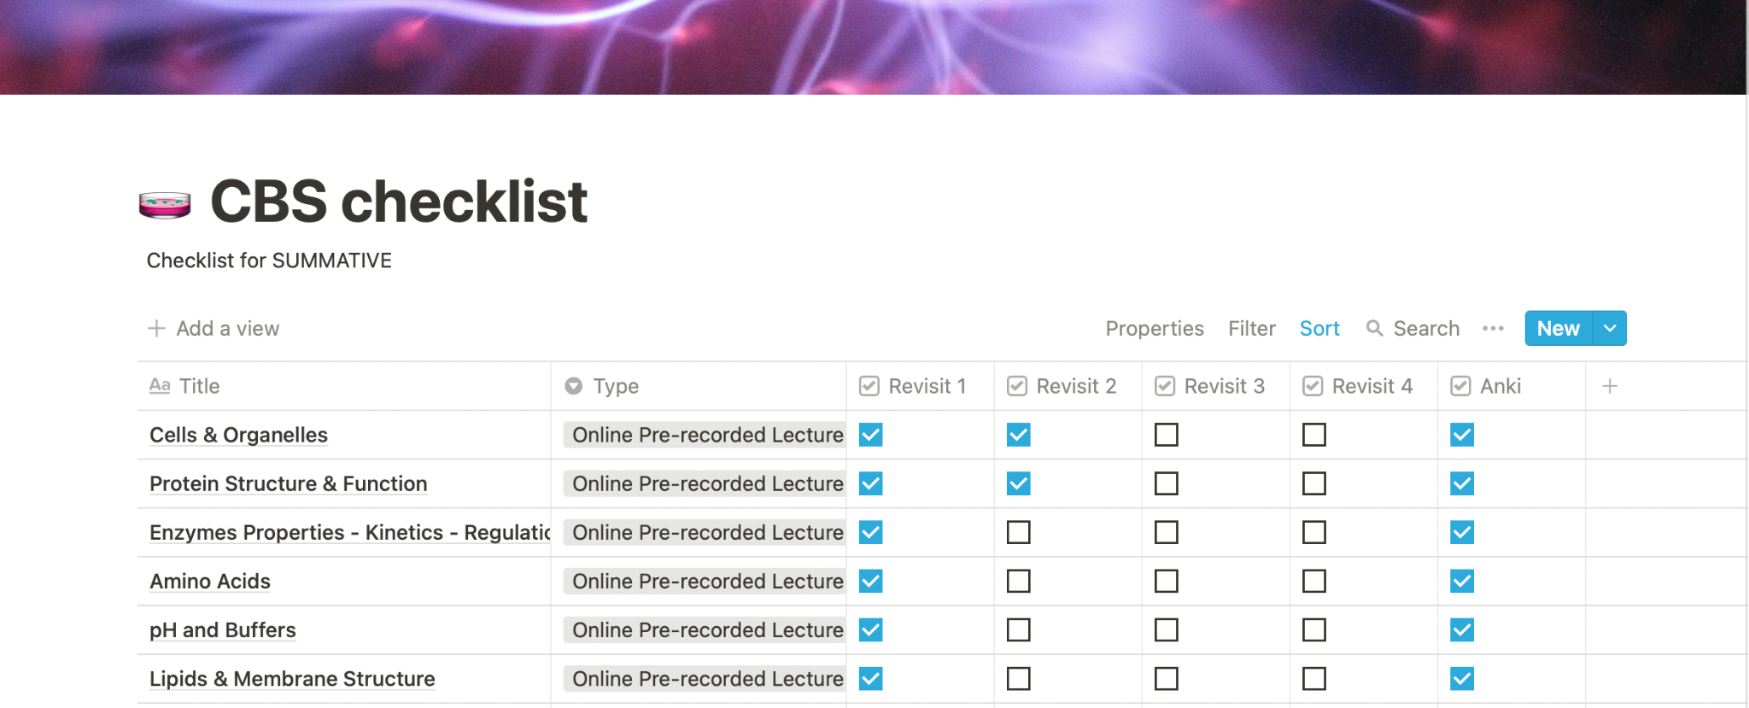
Notes:
Explain the Sort Lifer TDL - and how you do it! (Inbox = second brain) (Due Now -> if you set the due date TODAY) (Due Soon -> if you set the due date any day a week from now) (different categories e.g. Anki Making, Life / Admin)
Use Kharma Medic’s YT video on TDLs
Lecture Checklist -> LOs, lectures etc

Slide 18
Note-taking
Annotate lecture slides!
Notion! - toggle feature
iPad/tablet
- Goodnotes/notability/samsung notes
- Pre-read each lecture at least the day before before attending / watching it
- Add anything extra onto the notes, e.g. extra info from tutorials, peer teaching, etc.
- Good for syncing across devices
Anatomy - Anki!!! (Especially Image Occlusion)
Notes:
Jean - use Daanish’s Method of revision
Learning - Lectures, YT, ZeroToFinals
Note Taking - Anki, Notability, Notion (mention Toggle Feature -> show next slide)
Active Recall, Spaced Repetition - Anki (mention Image Occlusion -> show next slide)
Application - PassMed - more for second year onwards!!

Slide 19
Notes:
mention Notion 2 Anki - search online - use toggle feature to make ankis so you have both your notes and flashcards for active recall revision

Slide 20
Notes:
mention use of Anki IO and changing background - so much cooler and makes you want to revise

Slide 21
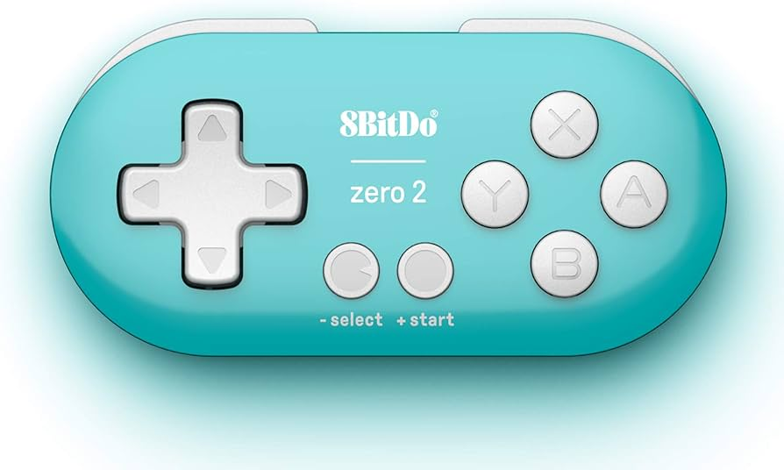
Notes:
mention Anki Controller and how it gamifies your learning experience making you want to do your anki flashcards
also mention that these are just extra stuff that made learning so much more fun in my experience, take the advise as you will

Slide 22
Add Assessments schedule

Slide 23
Assessment Tips
Have a revision plan (and stick to it!)
Be realistic – do not waste time, focus on important bits
Write all mistake close to exams on one sheet and continually review right before the exams
Practice Questions:
- Teachmed Quiz Banks
- Practice paper questions & end of block quizzes (Keats) - THESE ARE REALLY GOOD!
(The rest are good for testing knowledge but are not as representative of the exam)
-Can also use Passmed especially for AMS (anatomy of musculoskeletal system)
MCQ = process of elimination if stuck

Slide 24
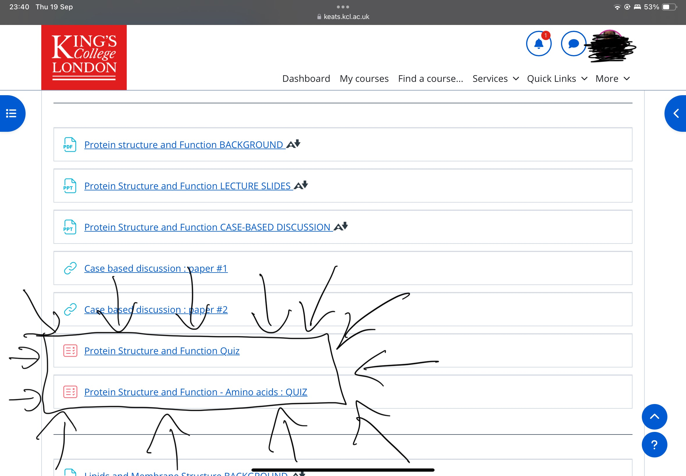
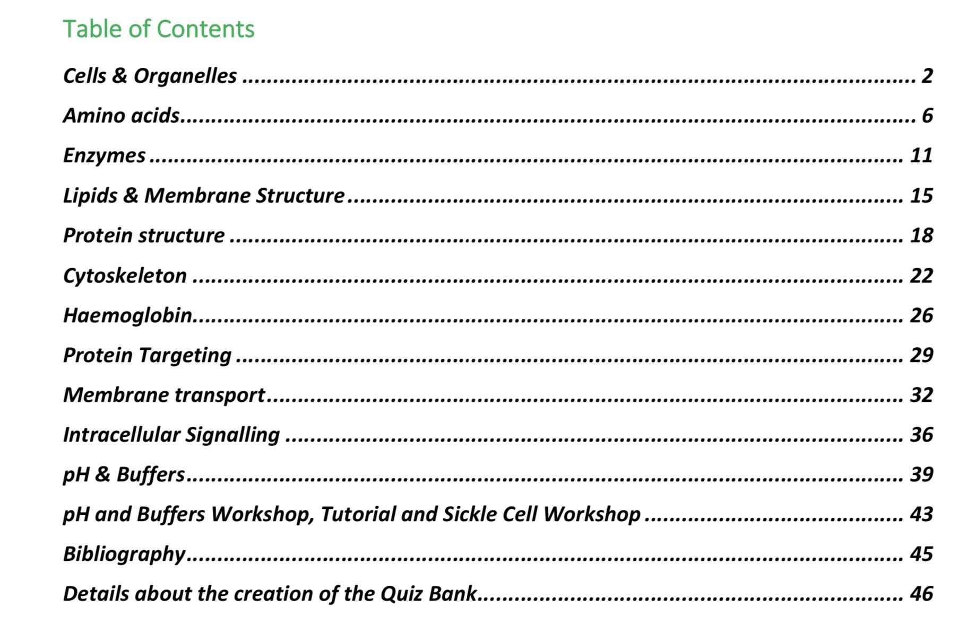
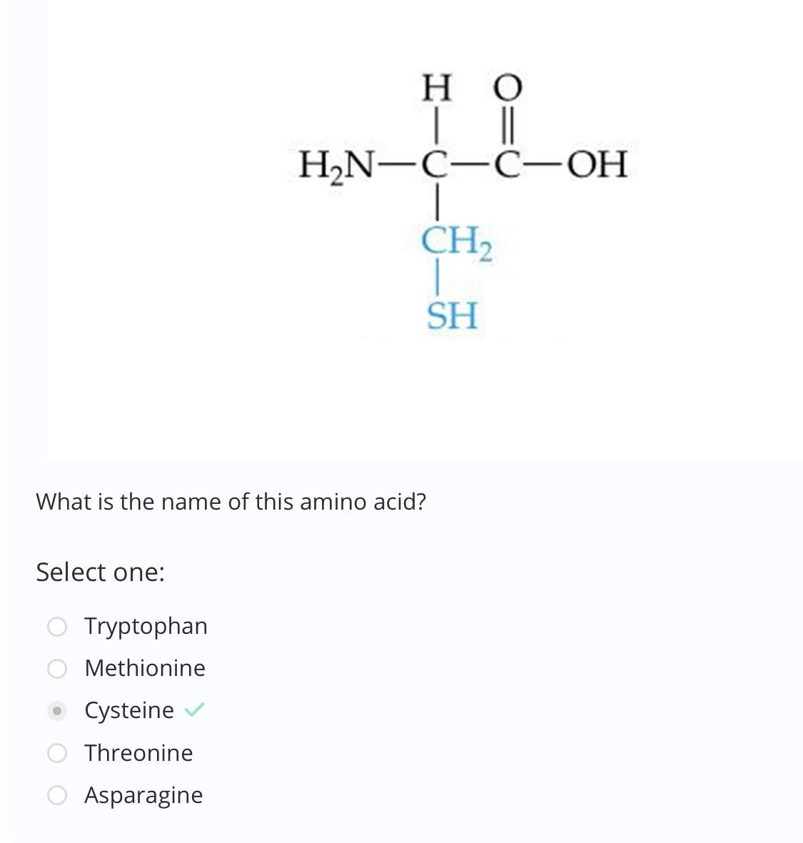
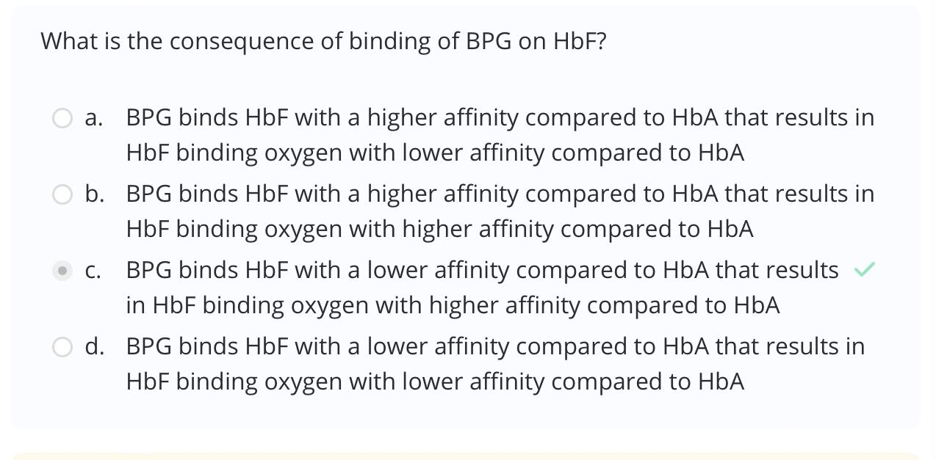

Slide 25
Revision methods & resources
Anki or Quizlet - A great way to make and organise flashcards - Active recall and spaced repetition
Websites - Teach me anatomy (great diagrams, detailed explanations of muscles/important clinical things - Teach me physiology
- Kenhub (especially for AMS)
- Osmosis
- Anatomy guy
Youtubers
- Armando hasudungan (amazing diagrams and explanations for anatomy) - Ninja nerd
- Noted Anatomist - Sam Webster - AK lectures
- Medicosis Perfectionalis
Other platforms/societies
- Teachmed (A Kings specific weekly teaching organisation to help understand content; they also organise quiz banks for your exams)
- MERJ (Organise very helpful lives/exam practice)
- Other societies (e.g. Anatomy soc, MSA (keep an eye out on insta!), EMDP soc etc There are many medical societies (don't have to be at kings only); you can also just follow them on Instagram - many release MCQs which you can use

Slide 26
Our methods
Main takeaway Everyone has different methods for things and that is completely okay! Use the method that works best for you!

Slide 27
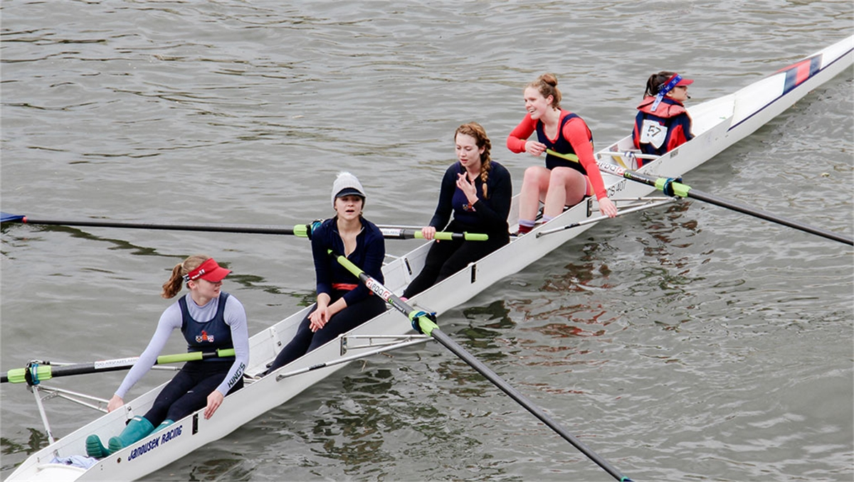
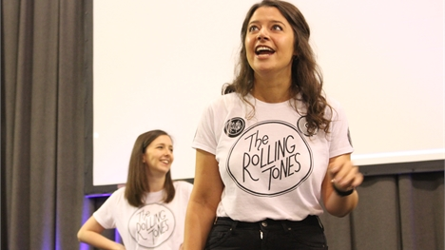
Extracurriculars
Sports clubs (KCL & GKT)
Medicine-related societies
Non-academic societies
Get involved with the MSA PALS
Conferences
King’s move app, King’s gym
Volunteering
There are X number of societies at King’s (make your own society)
Notes:
Participating in extracurriculars can help you find balance, develop new skills, and even broaden your professional network. Here are some ways you can get involved:
Sports Clubs: Both KCL and GKT offer a wide range of sports clubs. Whether you're into rowing, cheerleading, or something else, you'll find plenty of opportunities to stay active and meet like-minded people.
Medicine-Related Societies: There are societies specific to medical fields, which can help you expand your knowledge and even meet professionals in those areas.
Non-Academic Societies: It’s not all about medicine! There are plenty of non-academic societies like dance, music, or drama where you can explore other passions.
MSA Involvement: The Medical Students' Association (MSA) offers leadership opportunities, like becoming a tutor group representative. It’s a great way to develop communication skills and represent your peers.
Conferences: Attending or organizing conferences can expose you to the latest in medical research and innovations, while building your professional profile.
King’s Move App and King’s Gym: Use King’s Move app or the King’s gym to stay on top of your fitness. These resources are there to help you stay healthy during the intense demands of medical school.
Volunteering: Finally, volunteering is a great way to give back to the community while gaining valuable experience that ties into values-based clinical practice.
Whatever you choose, extracurriculars will enrich your experience, build friendships, and help you maintain a healthy work-life balance
KCL Brigade- go abroad, Ghana

Slide 28
Top Tips
Check your KCL email and Weekly Programme Update (no seriously, check these!)
Be open to trying out new ways of learning and stick to the one that works for you (Do not be discouraged if multiple methods are not working or your method is different from what others are doing)
Do lectures on time and make resources (if you are going to) as you go
- Don’t leave revision until the last minute
Don’t forget to take breaks; lectures/exam period can become intense
Don’t get intimidated by others, everyone works differently, do what is working for you!
Don’t forget to enjoy the academic portion of the year - dissection and clinical skills!
Enjoy the year overall (the academic AND non-academic part of it!) and make lots of memories!
Notes:
They have information that are useful in the Weekly Programme Update especially deadlines and timetables etc
Experiment with different learning styles - use the first few weeks of medical school to figure this out, don’t be afraid to try different methods!
Do lectures on time - refer back to my Notion slide on how to stay on top of everything
Take breaks!! You don’t wanna burn out, it’s a marathon not a sprint
As you can see, everyone has different methods of revision
ENJOY and make lots of memories! You wanna go back to Y1 with good memories

Slide 29
Thanks For Listening!
Please scan to fill in feedback! Any questions?

