Slide 1
SFP Made Simple
11. Clinical Station Workshop
Dr Angela Lochmüller (FY1 UCL)

Slide 2
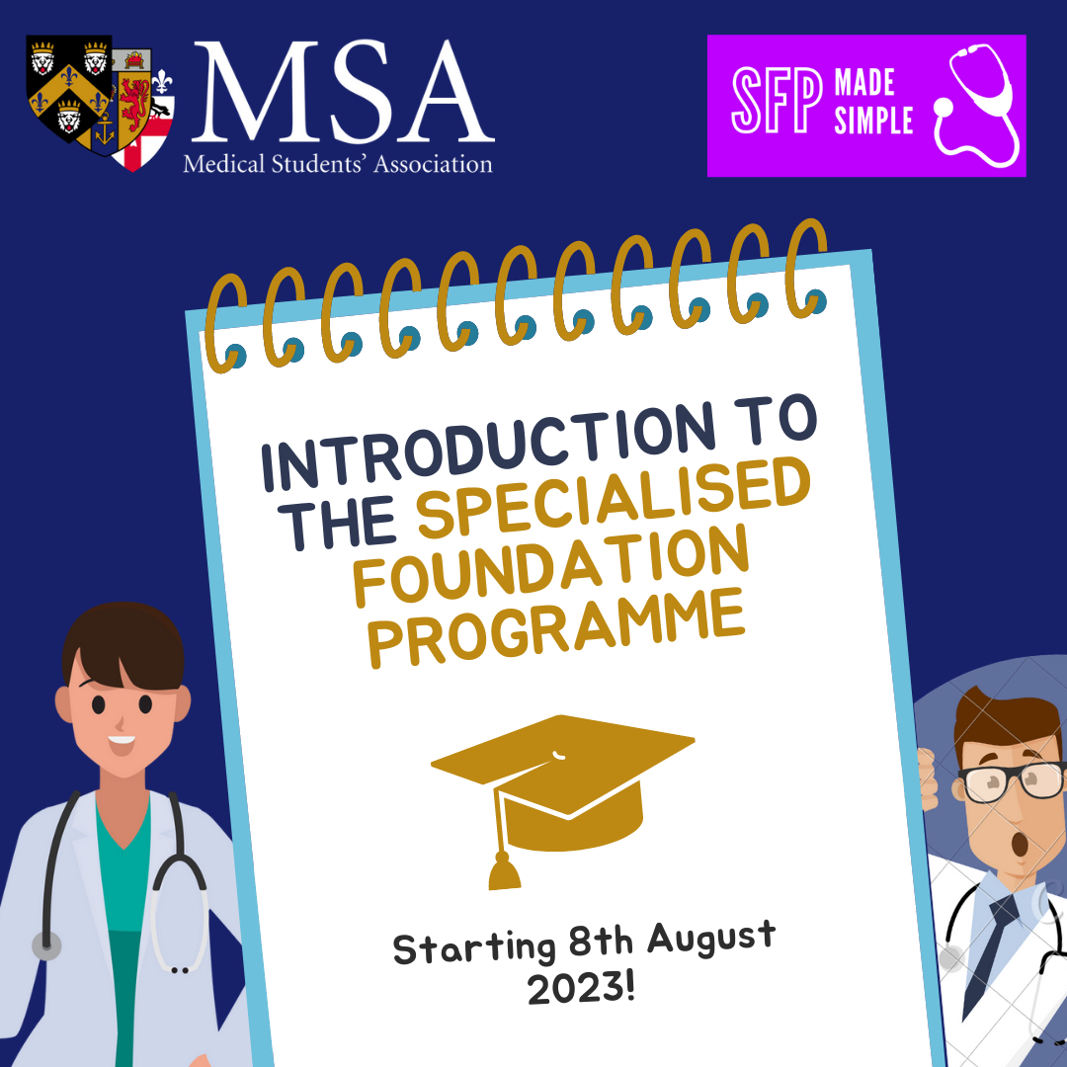
MSA Sponsor

Slide 3
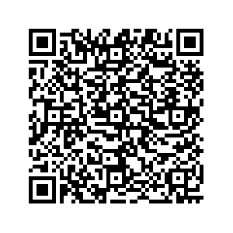
Fundraising

Slide 4
Webinar schedule
1.
Introduction to the SFP with Q&A
2.
Maximising Portfolio Marks and Self-Scoring
3.
Writing White Space Questions
4.
Introduction to Interview and Clinical Scenarios
5.
Biomedical Statistics for the SFP
6.
Academic Station and Critical Appraisal
7.
Answer the Personal Questions with Confidence
8.
Interview Practice Workshops

Slide 5
Objectives
Overview of the Clinical Interview & How to prepare
Clinical Station Examples
Q&A
1
2
3

Slide 6
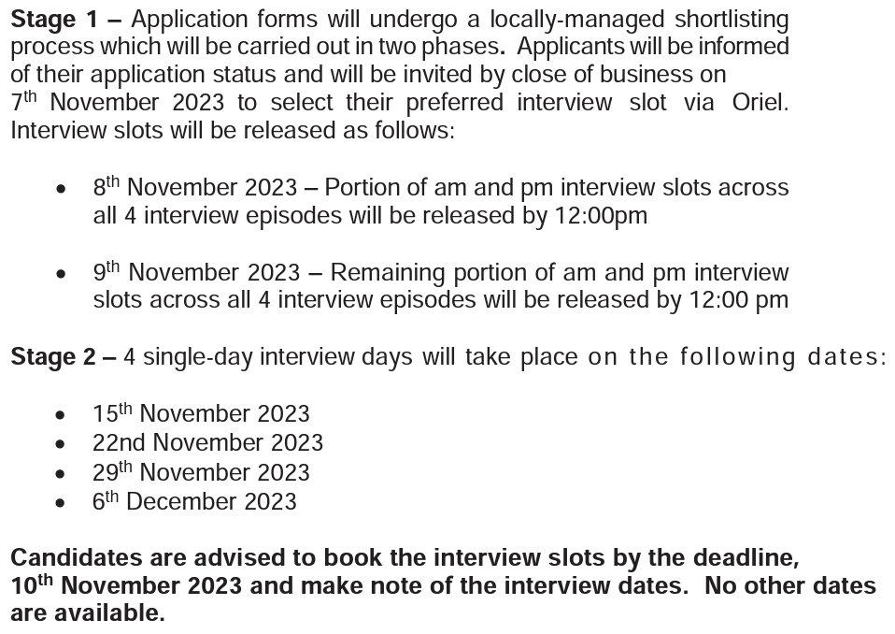
London SFP Interview Timeline

Slide 7
Sections of the Interview
Clinical
Academic
Personal
Different deaneries will include different sections and vary the content of the section - find out from previous interviewees

Slide 8
My interview experience
LONDON
~10min prep; 1 personal Q, 10min academic, 10min clinical
Clinical: 2 patients, focused on prioritisation, ethical/SJT-style twist
4 Qs, no interaction from interviewer
Prioritise
A-E + Differentials
“Difficult Pt” comms
Ethical Q
CAMBRIDGE
~10min prep; 10min clinical, 10min personal/academic
Clinical: 1 patient, focus on detailed A-E, diagnosis and management (know doses), ethical twist
4 Qs, additional info e.g. obs given
A-E
New obs/investigation findings + differentials
Technical/dosing question
Ethical Q

Slide 9
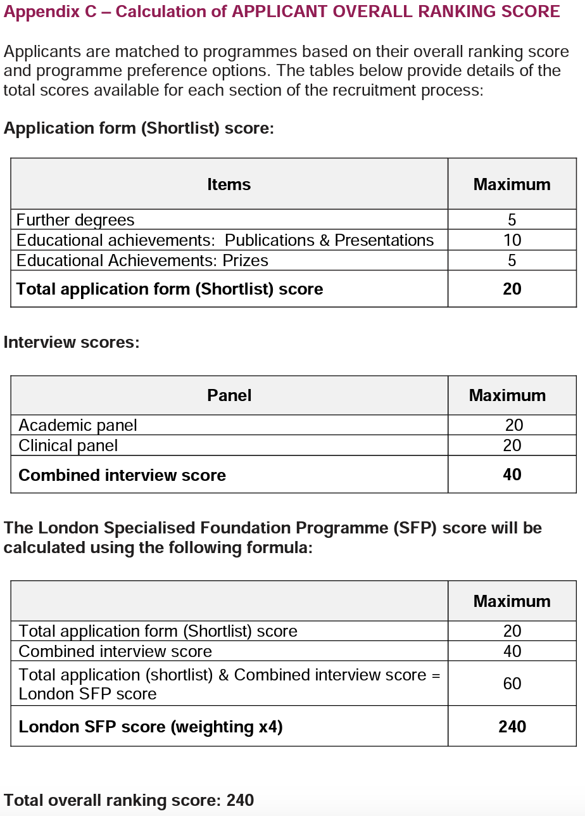
London Interview Weighting
Interview - heaviest weighted component of application
Academic - 5Qs, each max 4 points
Clinical - 4Qs, each max 5 points
Total Interview score - max 40 points
Total London SFP score - max 60 points

Slide 11
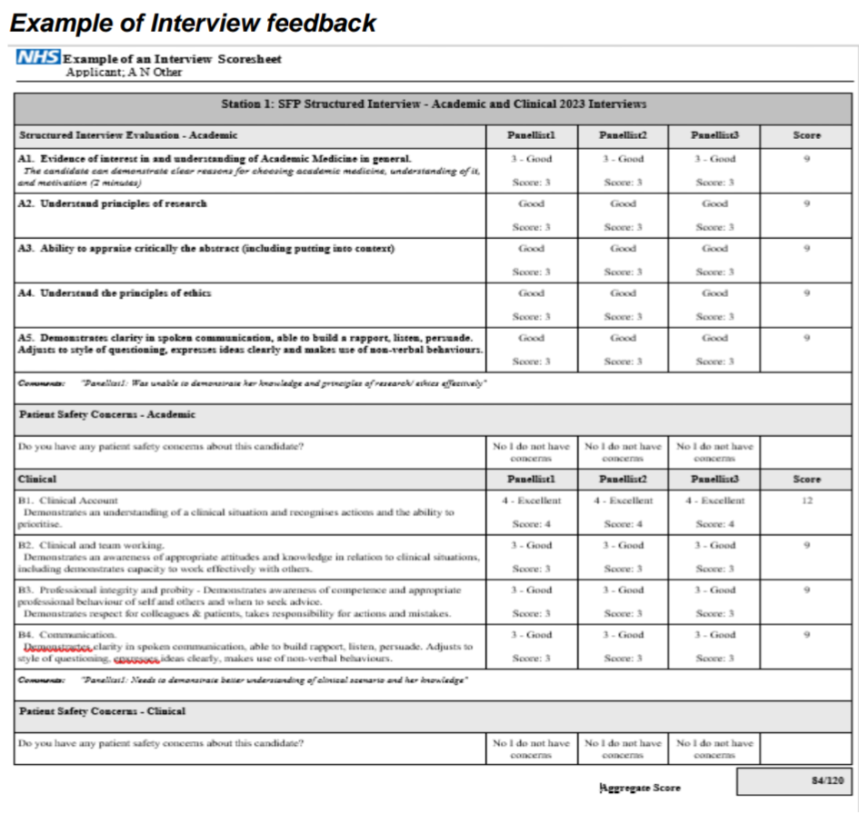
What are they looking for?
Clinical safety
Prioritisation
Problem solving
Knowledge of limits of competency
Teamwork & logistics
Knowledge of ethical principles

Slide 12
How to prepare
Practise, practise, practise!
Get familiar with content & timings
Focus on escalation routes, role/limitations of an F1 & ethical/”difficult pt” principles
Technical checks the day before e.g. good internet connection, clean background, quiet

Slide 13
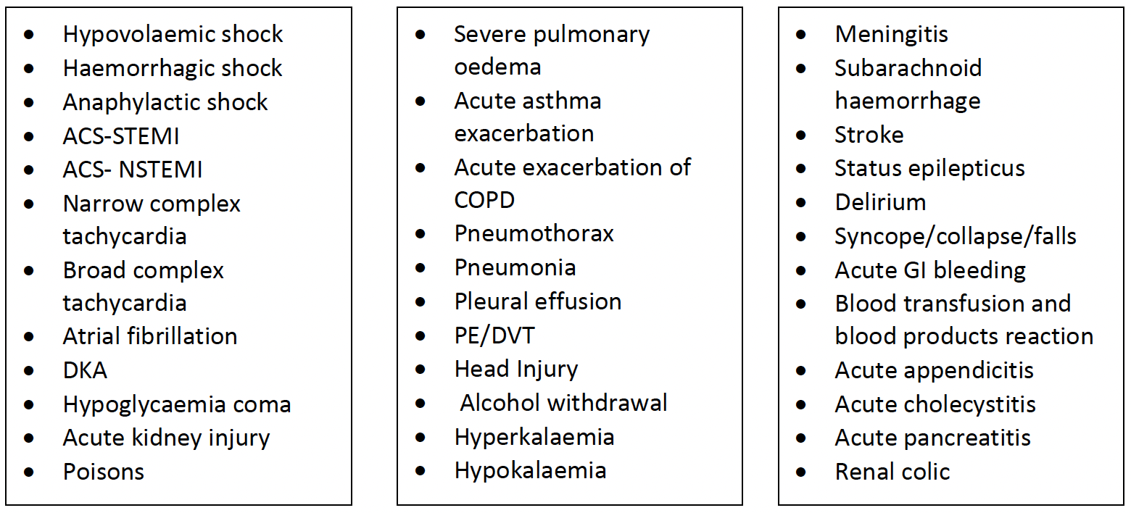
Common Conditions in Interview

Slide 14
On the day
Be confident - think about what the best F1, on day one, will actually be expected to manage!
Keep it simple - note down 3 key things to remember for each Pt e.g. ACS- trop, ECG, DAPT
Keep it real - talk through it as if it’s real life e.g. “I would ask the healthcare assistant to do an ECG”
Use your team - ask nurse to take obs for Pts before you arrive (all Pts), bleep back if Pt deteriorates, come with you to assess Pt
Escalate early - e.g. med reg, specialty reg e.g. gastro reg, CCOT, crash call/cardiac arrest/MET call/major haemorrhage protocol, consider ceilings of care (Treatment Escalation Plan, DNACPR, palliative)
Be reactive - treat & reassess as you go, react to changing situations
Don’t be put off - clarify if unsure about Qs asked, may be interrupted/asked to move on

Slide 15
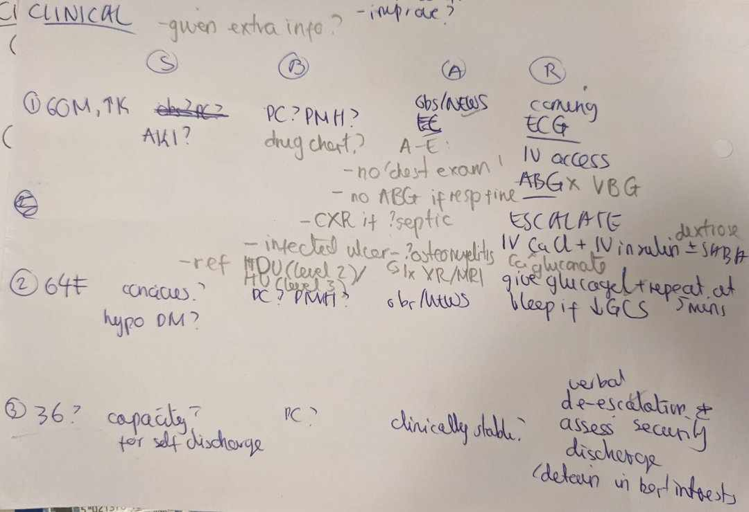
Contents of the Clinical Station
You are the medical/surgical FY1 on call, handed over 1-3 unwell patients…
Need to prioritise and discuss immediate management
Often has an added ethical element

Slide 16
Examples of ethical twists
Assess and stabilise patient
Capacity
Gillick’s competence
Self-discharge
Disruptive patient
Mental health & sectioning
Blood transfusion
Vulnerable patients e.g. safeguarding, children
DNACPR/TEP
Prescribing controlled drugs
ES/CS, Guardians of Safe Working
Medical errors/Duty of Candour (see figure on right)
Explain error and apologise
Document clearly in notes
Complete DATIX
Reflect on mistake and discuss with supervisors

Slide 17
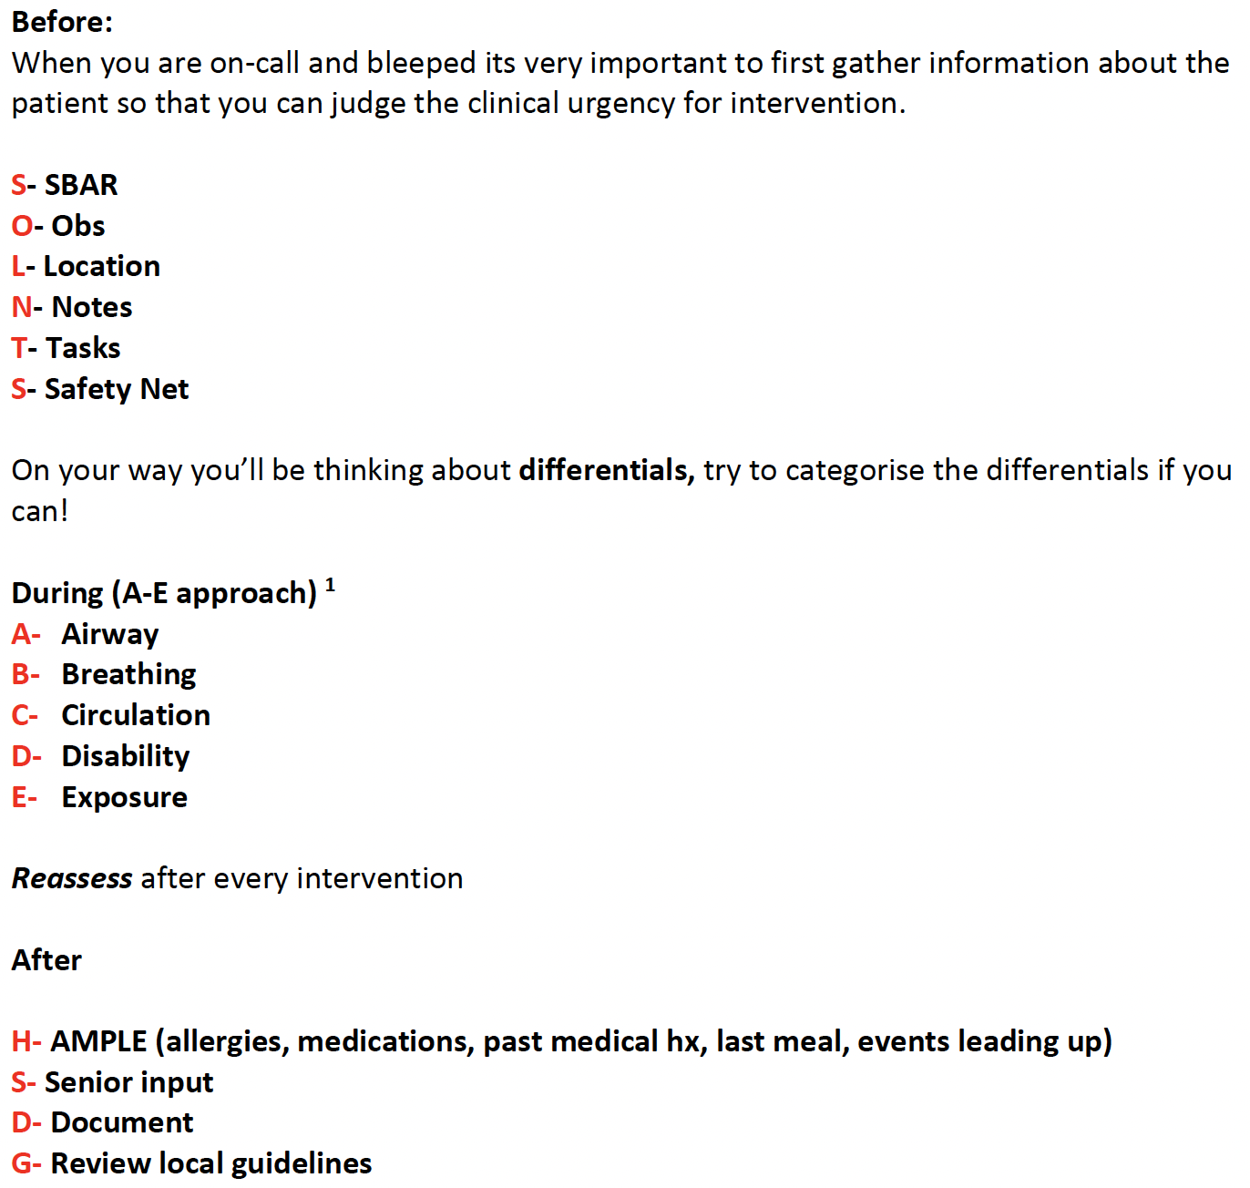
Useful Mnemonics

Slide 18
Example 1
With the information from the scenario - what are your initial thoughts on how to prioritise these tasks?
You decide to go to see patient Mrs A - describe to be how you would assess him?
How would you approach the second patient?
How would you approach Mr B?
Notes:
Acknowledge more than 1 unwell patient and prioritise- 1=B; 2=C; 3=D
Differentials - 1= PE, CAP; 2= ACS, AAA; 3= delirium
Management-
1 = increase O2 to 15L/min on NBM, consider PE, D-dimer, CTPA otherwise treatment LMWH, US Doppler, joint swelling or tenderness (?septic arthritis), signs of CAP or aspiration pneumonia
2 = ECG, Troponin, CXR, ACS protocol, continuous cardiac monitor
3 = medications missed, verbal de-escalation, make environment more comfortable, consider DoLS, least restrictive option, security to ensure staff safety, look for medical reason (retention, constipation, electrolyte, pain)

Slide 19
Example 2
You have been asked to see Taylor Swift, a 14 year old girl in the ED who has had lower abdominal pain and temperature for 12 hours since waking that morning. She has been sick twice and not eaten through the day, and does not want to move on or off the bed. She is with a teacher from her school. The mother has been contacted and is on her way in. She has requested you not to inform Marcia’s father from whom she is separated. The nurses inform you he is already on his way in as the school contacted him. They also tell you Marcia wants to leave and is refusing treatment. Her urine dipstick is clear but she has a positive pregnancy test.
1. With the information from the scenario - what are your initial thoughts on how to proceed?
2. How would you assess Taylor?
3. Any other considerations in the scenario?

Slide 20
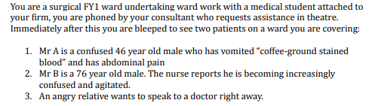
Example 3
With the information from the scenario - what are your initial thoughts on how to prioritise these tasks?
You decide to go to see patient Mr A - describe to be how you would assess him?
How would you approach Mr B?
How would you approach the angry relative?

Slide 21
Example 4
With the information from the scenario - what are your initial thoughts on how to prioritise these tasks?
You decide to go to see the first patient - describe to be how you would assess him?
How would you approach self-discharge for the first patient?
How would you approach a disruptive patient?

Slide 22
Example 5
During a surgical on call shift, you are bleeped twice in succession about the following patients.
A 65 year old male unconscious after developing sudden-onset severe abdominal pain radiating to the back. His past medical history includes hypertension, previous myocardial infarction and non-alcoholic fatty liver disease. His blood pressure is 100/70.
The relative of a 76 year old male inpatient who developed opioid withdrawal after not receiving his methadone prescription on time. The patient is clinically stable, but the relative is demanding to speak to a doctor.
How do you proceed?
With the information from the scenario - what are your initial thoughts on how to prioritise these tasks?
You decide to go to see the first patient- describe to be how you would assess him?
What are your differentials for the first patient?
How would you approach the second patient?

Slide 23
Example 6
You are the FY1 on-call in AMU. You receive 3 bleeps in rapid succession from the ward nurses.
The lab has called through a result for a 60-year-old gentleman who was admitted several hours ago. His K+ is 7.2.
64-year-old female has a CBG of 2.3mmol/L.
A 36-year-old COVID +ve patient is angry, and is demanding to be discharged.

Slide 24
Example 7
Notes:
KCL GKT?

Slide 25
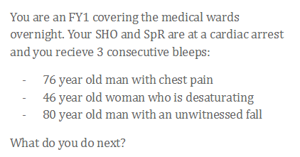
Example 8
Notes:
Gemma White’s ppt

Slide 26
Example 9
Notes:
Katie Leung’s ppt

Slide 27
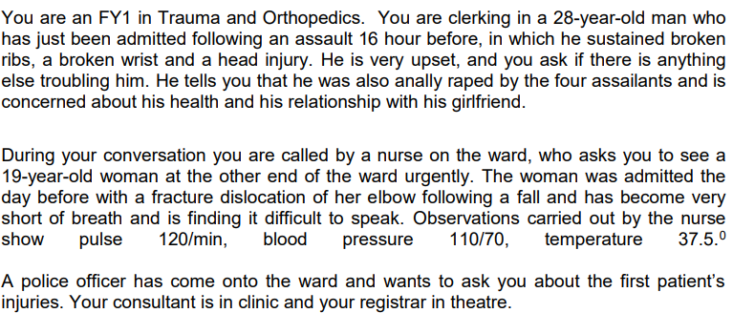
Example 10
Notes:
London SFP handbook 2022

Slide 28
Example 11
Notes:
ICSM

Slide 29
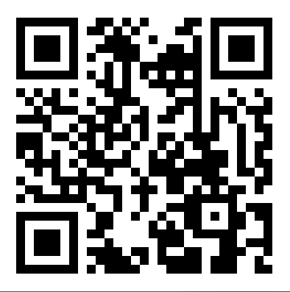
Feedback
https://forms.gle/JFE87MzAsT56h1Hw5

