Slide 1
SFP Made Simple
6. Biostatistics for the SFP
Dr Daria Andreeva (FY1 Imperial)

Slide 2
Overview
1.
Resources
2.
Data types and measurements
3.
Descriptive statistics
4.
Inferential statistics
5.
Choosing a statistical test
6.
Practice questions

Slide 3
Fundraising

Slide 4
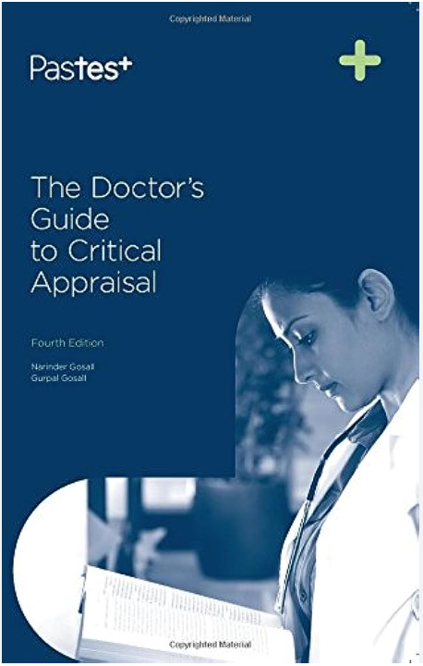
Resources

Slide 5
Let’s start our research journey…
***After you’ve formulated your hypothesis:
Data collection

Slide 6
Data types and measurements
Quantitative
Categorical (qualitative)
Types
Measurements
Discrete | Finite number of values, usually integers | Number of patients with complications
Continuous | Infinite number of values, can include decimal places | Height, weight, blood glucose
Binary | Only two possible outcomes | Biological sex (male or female), vital status (alive or deceased)
Nominal scale | No order between categories | Colours (blue, yellow, red, green), ethnicity
Ordinal scale | Data categories have an order or rank | Cancer stages, severity of disease, deprivation index
Measurements
Interval scale | Equal differences between values, no true 0 | IQ, temperature in celsius
Ratio scale | Equal differences between values, true 0 (signifies the absence of the measured variable) | Length, population

Slide 7
Our research journey
***After you’ve formulated your hypothesis:
Data collection
Descriptive statistics

Slide 8
Descriptive statistics
Summarises and organises the data you’ve collected. Three main types:
Frequency distribution
Central tendency
Variability
Frequency of every possible value of a variable in numbers or percentages.
I.e. 30% blue, 20% yellow, 50% red
Estimate the center or average of a data set.
Mean: most common method and generally the best
Median: used when data is in ordinal scale or extreme outliers
Mode: used for nominal scale data
How spread out is the data?
Range
Standard deviation: tells you on average how far each score lies from the mean. Square root of variance
Variance: average of square deviations from the mean

Slide 9
Our research journey
***After you’ve formulated your hypothesis:
Data collection
Descriptive statistics
Inferential statistics

Slide 10
Intro to inferential statistics
Hypothesis testing: you want to know is the difference/relationship significant?
Null hypothesis (H0): no true effect in the population, any difference or relationship observed in the results from your sample is due to chance
Alternative hypothesis (H1): there is a true effect in the population
Alpha level: the threshold that defines the level at which the researcher still accepts that the results can be explained by chance (usually 0.05 or 5%)
Use a statistical test to obtain:
Test statistic with confidence intervals (estimated range of values within which you are confident to X% that the population parameter lies)
P value: the probability that the results we have observed are due to chance (i.e. the likelihood that the null hypothesis is true)
If P < alpha → reject the null hypothesis
If P > alpha → accept the null hypothesis

Slide 11
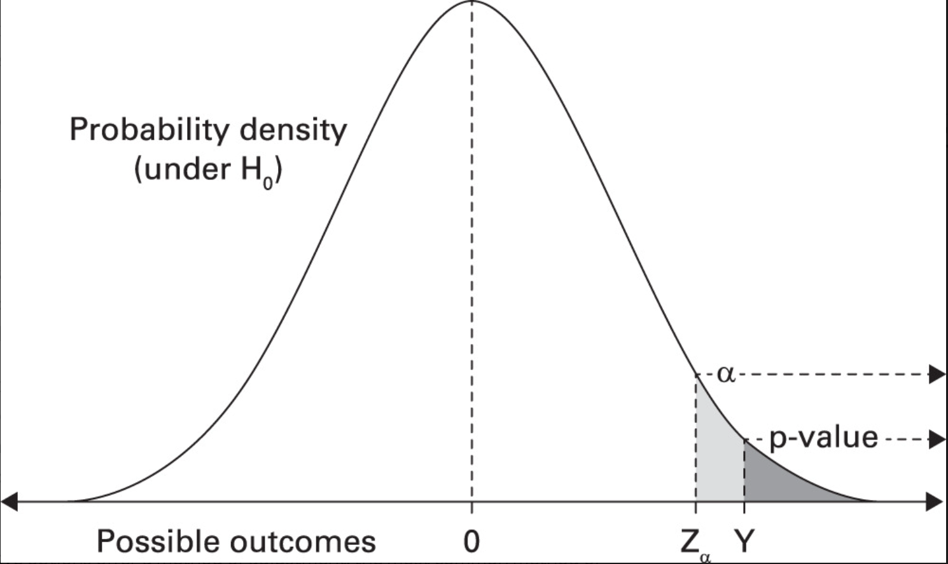

Slide 12
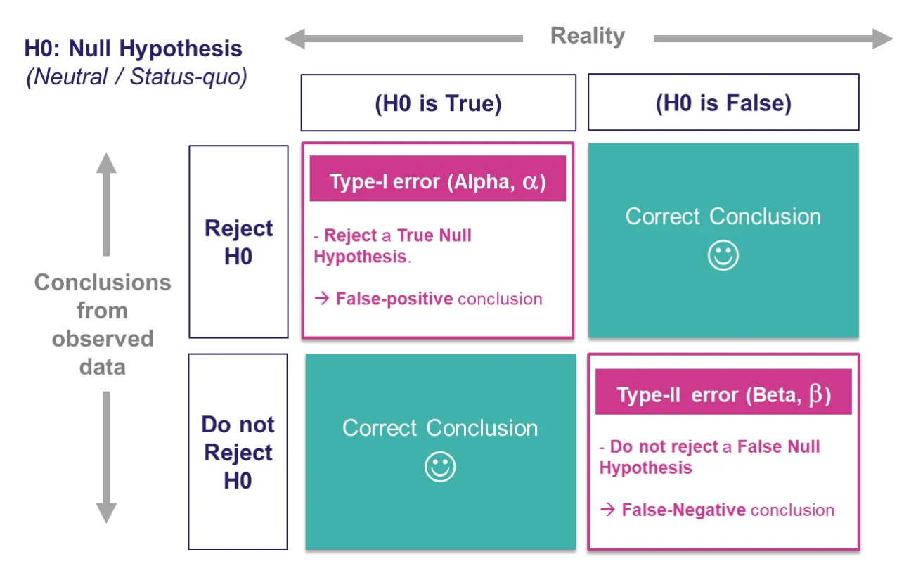
Type 1 and type 2 errors

Slide 13
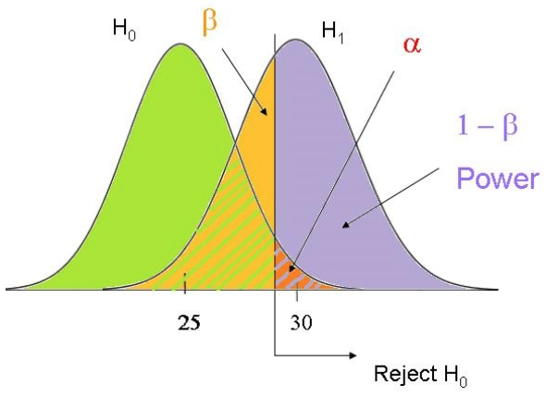
Type 1, 2 errors and power
Power: the probability that a type 2 error will not be made (the likelihood that the statistical test will detect a true effect)
Usually set at 80%

Slide 14
Let’s take a look at an example
“The mean percentage change in body weight was −13.3% with semaglutide and −2.6% with placebo (estimated difference, −10.7 percentage points; 95% CI, −11.9 to −9.4; P<0.001)”
Null hypothesis: no true effect of semaglutide on weight
Test statistic with CI: estimated difference, CI are narrow and do not cross 0 → significant
P value: <0.05 → null hypothesis is rejected
A primary efficacy outcome event occurred in 83 patients (3.2% per patient-year) in the edoxaban group and in 101 patients (4.0% per patient-year) in the placebo group (hazard ratio, 0.81; 95% confidence interval [CI], 0.60 to 1.08; P=0.15)
Null hypothesis: no true effect of edoxaban on primary efficacy outcome
Test statistic with CI: hazard ratio, CI are broad and do not cross 1 → non-significant
P value: >0.05 → null hypothesis is accepted

Slide 15
How to choose a statistical test?
Parametric vs non-parametric tests
Parametric tests are more powerful. However, to use them, your data needs to satisfy the following:
Needs to be normally distributed (fit the Bell curve)
The variance of each group being compared is similar
Data needs to be independent (through random sampling)

Slide 16
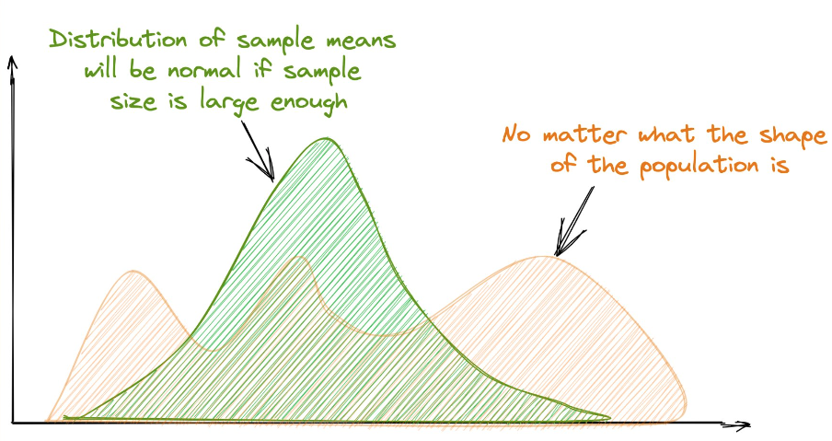
Central limit theorem
It applies to:
Sample sizes of n>30
Samples are independent
Population distribution has a finite variance

Slide 17
How to choose a statistical test?
Parametric or non-parametric tests?
Parametric tests are more powerful. However, to use them, your data needs to satisfy the following:
Needs to be normally distributed (fit the Bell curve)
The variance of each group being compared is similar
Data needs to be independent (through random sampling)
*** The rule is not to use parametric tests if the dependent variable is categorical, EVEN IF it fits CLT rules.
In summary:
Parametric: if dependent variable is continuous and data fits CLT
Non-parametric: if dependent variable is categorical or data does not fit CLT

Slide 18
How to choose a statistical test?
What type of data do you have and what’s your aim?
Comparison tests:
Test for differences between group means
IV: categorical, DV: continuous
Regression tests:
Look for cause-and-effect relationships
IV: continuous, DV: continuous/binary
Correlation tests:
Test whether variables are related
IV: continuous, DV: continuous
Chi-square tests:
Both IV and DV are categorical

Slide 19
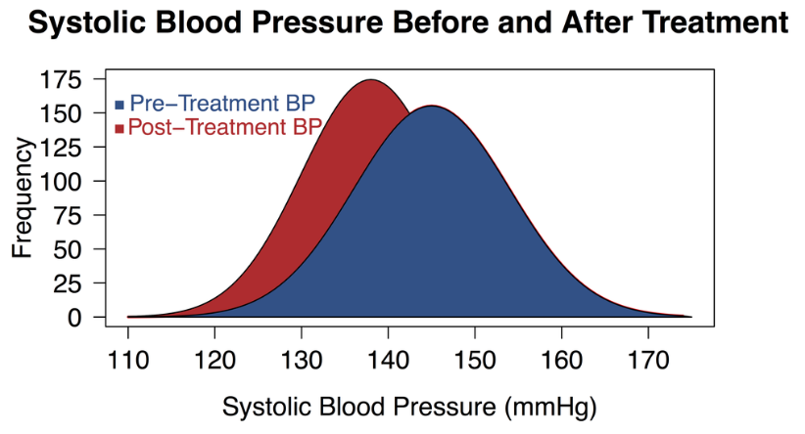
Comparison tests
Test type | Indepen var | Depen var | Description | Example | Non-parametric op
Paired t-test | 1 categorical with 2 groups | 1 continuous | Compares means between 2 groups with paired observations | Comparing blood pressure in a group of hypertensive patients before and after treatment with amlodipine | Wilcoxon signed-rank test
Unpaired t-test |  |  | Compares means between 2 groups with independent observations | Comparing pain levels in chronic back pain patients between 2 different treatment groups | Mann-Whitney U test/Wilcoxon Rank-Sum test

Slide 20
Comparison tests
Test type | Indepen var | Depen var | Description | Example | Non-parametric op
Paired t-test | 1 categorical with 2 groups | 1 continuous | Compares means between 2 groups with paired observations | Comparing blood pressure in a group of hypertensive patients before and after treatment with amlodipine | Wilcoxon signed-rank test
Unpaired t-test |  |  | Compares means between 2 groups with independent observations | Comparing pain levels in chronic back pain patients between 2 different treatment groups | Mann-Whitney U test/Wilcoxon Rank-Sum test
ANOVAs | 1+ categorical with 2+ groups | 1 continuous | Compares means between 2+ groups in one or more independent variables | Two-way: Comparing blood glucose level reduction between 3 medication groups and ethnicity | Kruskal-Wallis H

Slide 21
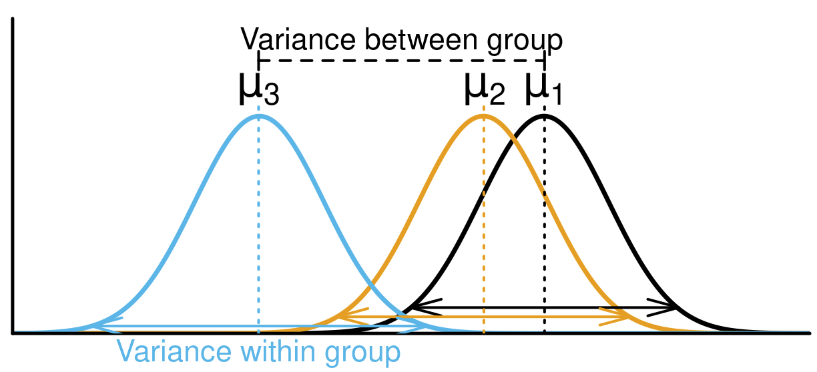

Slide 22
Comparison tests
Test type | Indepen var | Depen var | Description | Example | Non-parametric op
Paired t-test | 1 categorical with 2 groups | 1 continuous | Compares means between 2 groups with paired observations | Comparing blood pressure in a group of hypertensive patients before and after treatment with amlodipine | Wilcoxon signed-rank test
Unpaired t-test |  |  | Compares means between 2 groups with independent observations | Comparing pain levels in chronic back pain patients between 2 different treatment groups | Mann-Whitney U test/Wilcoxon Rank-Sum test
ANOVAs | 1+ categorical with 2+ groups | 1 continuous | Compares means between 2+ groups in one or more independent variables | Two-way: Comparing blood glucose level reduction between 3 medication groups and ethnicity | Kruskal-Wallis H
MANOVAs | 1+ categorical with 2+ groups | 2+ continuous | Compares means between 2+ depen var between 2+ groups in 1+ indepen variables | Comparing blood glucose level and blood pressure reduction between 3 medication groups | ANOSIM

Slide 24
Regression tests
Test type | Indepen var | Depen var | Description | Example | Non-parametric op
Simple linear regression | 1 continuous | 1 continuous | Models the relationship between 2 continuous variables | Is there a linear relationship between lung function and the number of smoking years? | -

Slide 25
Regression tests
Test type | Indepen var | Depen var | Description | Example | Non-parametric op
Simple linear regression | 1 continuous | 1 continuous | Models the relationship between 2 continuous variables | Is there a linear relationship between lung function and the number of smoking years? | -
Multiple linear regression | 2+ continuous | 1 continuous | Models the relationship between 1 depen var and 2+ indepen vars | What is the combined effect age, BMI and physical activity level on the systolic blood pressure of patients with HTN? | -

Slide 26
Regression tests
Test type | Indepen var | Depen var | Description | Example | Non-parametric op
Simple linear regression | 1 continuous | 1 continuous | Models the relationship between 2 continuous variables | Is there a linear relationship between lung function and the number of smoking years? | -
Multiple linear regression | 2+ continuous | 1 continuous | Models the relationship between 1 depen var and 2+ indepen vars | What is the combined effect age, BMI and physical activity level on the systolic blood pressure of patients with HTN? | -
Logistic regression | 1+ continuous | Binary | Models the association between the probability of an event occurring (binary outcome) and the independent variable(s) | Does treatment with trastuzumab increase the likelihood of breast cancer patients achieving remission? | -

Slide 27
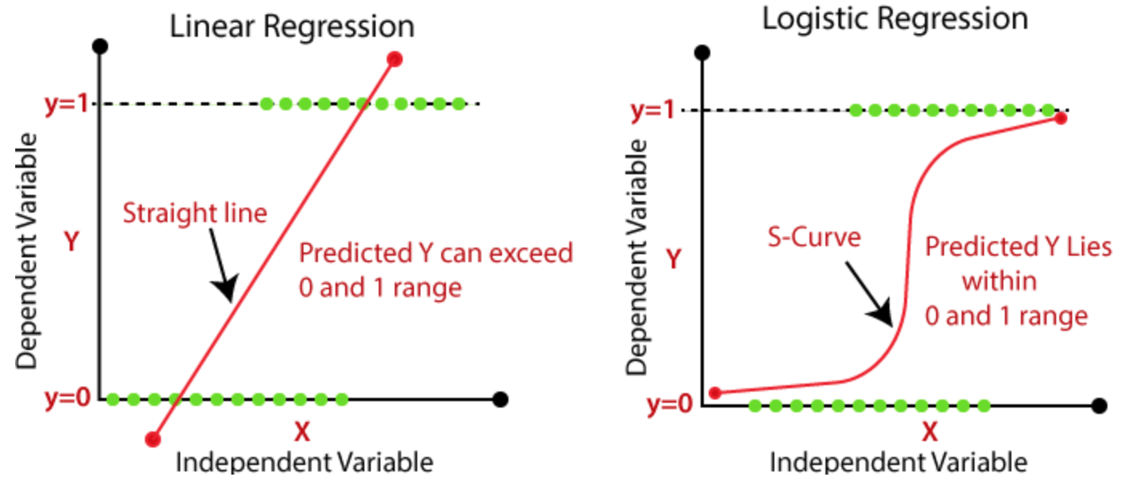
Regression tests

Slide 28
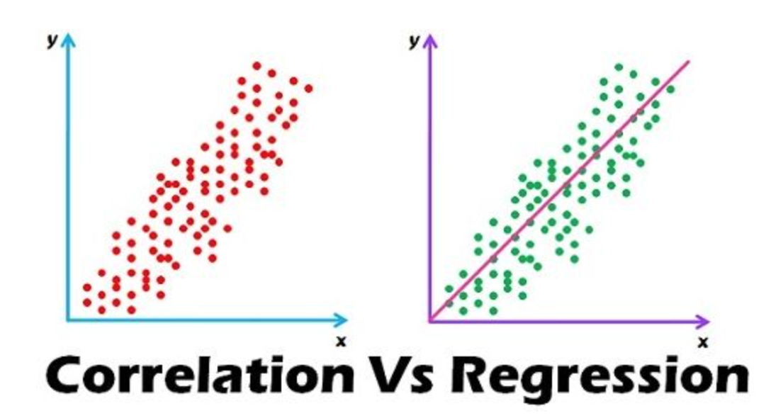
Correlation tests
Test type | Indepen var | Depen var | Description | Example | Non-parametric op
Pearson’s r | 1 continuous | 1 continuous | Assesses the strength and the direction of the linear relationship between two continuous variables (does not have predictive abilities) | Is there a significant linear correlation between the duration of regular physical exercise and the levels of HDL cholesterol in adults? | Spearman’s rho

Slide 29
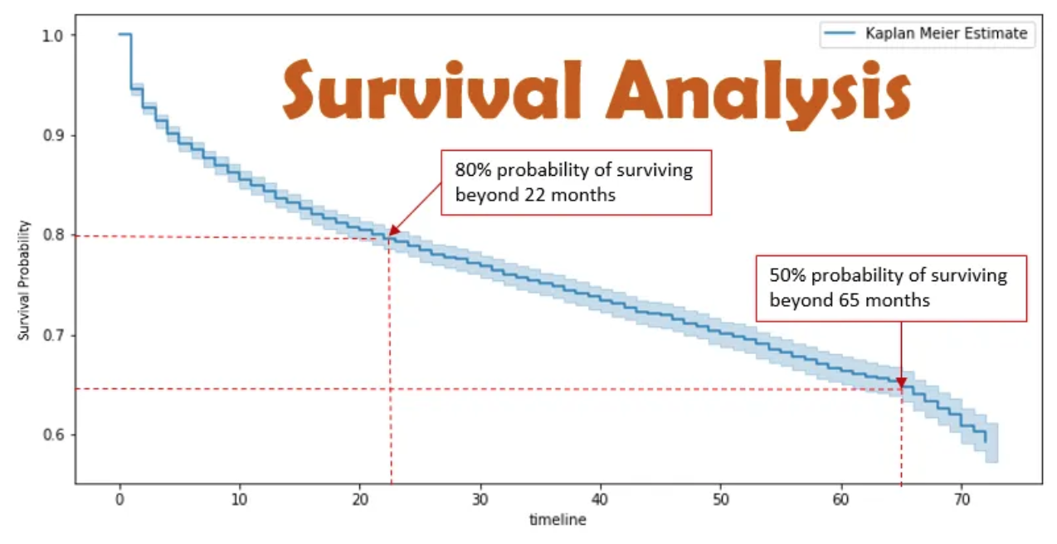
Survival analysis (time-to-event)
Kaplan Meier (one predictor) vs Cox proportional hazard regression (multiple predictors)
Hazard ratio: ratio of hazard rates. I.e. in a drug trial, control group might die at twice the rate per unit of time compared to the treatment group.

Slide 30
Next week:
Introduction to the academic interview
Introduction to critical appraisal
Chi Square tests
Diagnostic tests
Notes:
https://forms.gle/grBkRR5QS28nxDj66

Slide 31
Question time
Paper exploring outcomes in patients with cleft palate surgery at 6 months vs 12 months
Insufficient velopharyngeal function at 5 years of age was observed in 21 of 235 infants (8.9%) in the 6-month group as compared with 34 of 226 (15.0%) in the 12-month group (risk ratio, 0.59; 95% confidence interval, 0.36 to 0.99).
Do you think the P value is:
Less than 0.05
More than 0.05
Could this be a Type I or Type II error? Why?

Slide 32
Question time
Paper exploring outcomes in patients with cleft palate surgery at 6 months vs 12 months
Insufficient velopharyngeal function at 5 years of age was observed in 21 of 235 infants (8.9%) in the 6-month group as compared with 34 of 226 (15.0%) in the 12-month group (risk ratio, 0.59; 95% confidence interval, 0.36 to 0.99).
Do you think the P value is:
Less than 0.05
More than 0.05
Could this be a Type I or Type II error? Why?
Type I error (could be due to bias, confounding, multiple hypothesis testing)

Slide 33
Question time
I want to investigate what factors influence a patient's length of hospital stay following a surgical procedure, and to what extent these factors contribute to the variation in length of stay.
What are my dependent and possible independent variables and how will I measure them?
What statistical test should I perform?

Slide 34
Answer
I want to investigate what factors influence a patient's length of hospital stay following a surgical procedure, and to what extent these factors contribute to the variation in length of stay.
What are my dependent and possible independent variables and how will I measure them?
The dependent variable is the length of hospital stay, which is a continuous variable measured in days. Potential predictor variables could include age, type of surgery, comorbidities (e.g., diabetes, heart disease), preoperative health status, and postoperative complications.
What statistical test should I perform?
Multiple linear regression

Slide 35
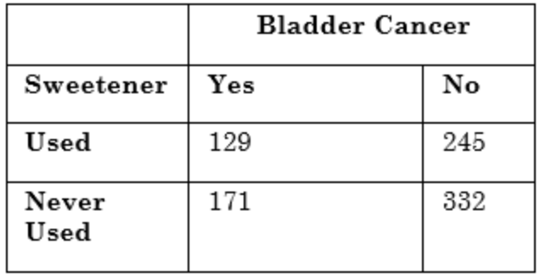
Question time
What statistical test will you use to analyse the data?

Slide 36
Question time
What statistical test will you use to analyse the data?
Chi-square tests (data is categorical)

Slide 37
Thank you for listening!

