Slide 1

What I Wish I Knew in Intercalation
Zalanda Shinwarie, MSc Cardiovascular Research
Monday 22nd September 2025

Slide 2

What We Will Discuss
A year out of medicine?
Typical week/ semester
Exam styles
Scientific reading
Research, Dissertation / Publication Opportunities
How to Prepare for Exams
Awards
Useful resources I wish I knew of before starting

Slide 3
A year out of medicine…
Well done for escaping medicine! I mean… passing your previous year
Not really clinical (depends on your course)
Great opportunity to learn how to research & network
Reading scientific papers
Very independent - you are not ‘spoon-fed’
A lot of choice in what modules to pick (not every course) + lots of independent time
The ‘final year’ project and dissertation (scary)
BARELY ANY MCQs???????
Early conclusion: it is NOT a year off :(
Notes:
Might not be as scary if you have already done a BSc / written a dissertation etc. Different if you’re coming straight from medical school.

Slide 4
Typical Semester in Each Course
In the year you will complete 120/180 credits in total
MAKE SURE YOU HAVE A GOOD SPLIT OF CREDITS BETWEEN SEMESTERS
Non-dissertation modules will have many lectures, seminars and tutorials
Lectures are ACTUALLY relevant for your exams
  Most final exams require to use content from lectures (+wider reading) in your answers!
Seminars and tutorials contribute to consolidating your learning
Many lab projects require you to come up to 3 days a week
Luckily you get reading week (depends on the course)!!!
Notes:
Mine:
First 6 month = 4 days lectures / workshops. 1 day lab.
Last 6 months - clinical project

Slide 5
Exam Styles
Essays / Lab reports
  A scientific essay is not like the essays we wrote in A Level Biology
  Coursework - may or may not be timed - get ready for many deadlines!
  Timed final exams at Excel => 2-3 essays under timed conditions (minimum ~1.5k words each)
    LECTURERS FROM THAT MODULE WILL MARK THEM!
You may get some MCQs
  But the usual variation will be SBAs
  Could be an extended 3-6 mark answer
Dissertation
  Lab Project - very practical : sometimes you’ll need to write a lab report in some modules!
  Library Project/ literature review etc- a lot of reading
  Project Design - planning

Slide 6
Scientific Reading/Critical Appraisal
There are many different ways to read a scientific paper
You WILL get better at understanding them
How to read a paper:
  Recognise what type of paper you are reading!
    Is it an original article? (primary research)
    Case Report?
    Systematic Review?
    Literature Review?
    Clinical Trial Report?
  Really understand the abstract! You will get an idea of what the general methods are investigating and a brief idea on the main conclusion.
  Use AI in a responsible, non-plagiarism and sensible manner for understanding.

Slide 7
…
The first half of the abstract is highly relevant to the introduction of the paper
  The introduction helps you understand the greater scope of the topic
    Read through each subheading as if that is the ‘key point’ of the subsection
  At the end of the introduction, what is the main question the paper wants to answer?
As you’re reading the methods, read the headings before the large body of text.
  You may get a heading informing where they got samples/instruments/equipment from
  How they extracted cells/specimens/data
  What they did with this^ - this could be experiments like ELISA, PCR, flow cytometry for a lab report etc…

Slide 8
…
Results section is where you really have to understand the figures
  THIS IS WHERE THE MAIN UNDERSTANDING OF CONCLUSIONS COME FROM
  You may get a few stats in the actual writing of the results section which are highly relevant but alas more jargon
Discussion is where you can critique the paper. Is that truly what the results show? Correspond that with the introduction!
Notes:
2 things for a good paper
A good abstract
And good figures

Slide 9
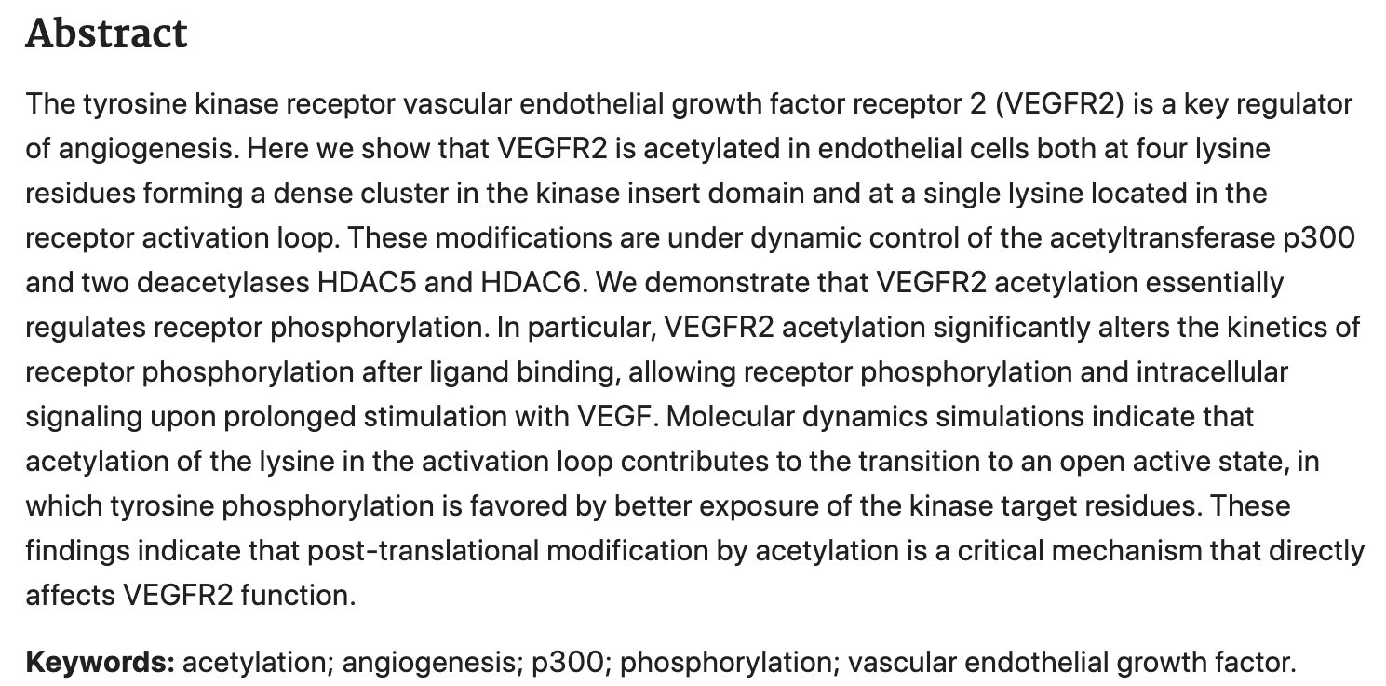
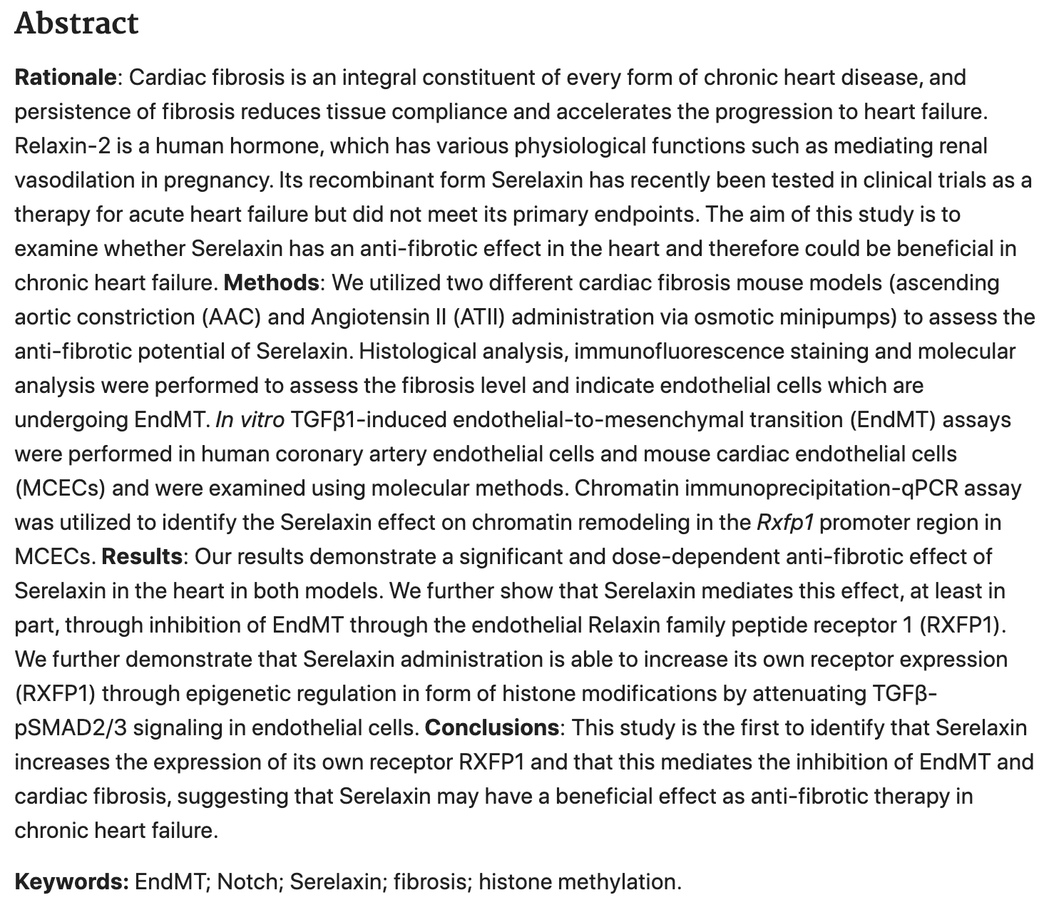
Notes:
2 things for a good paper
A good abstract
And good figures

Slide 10
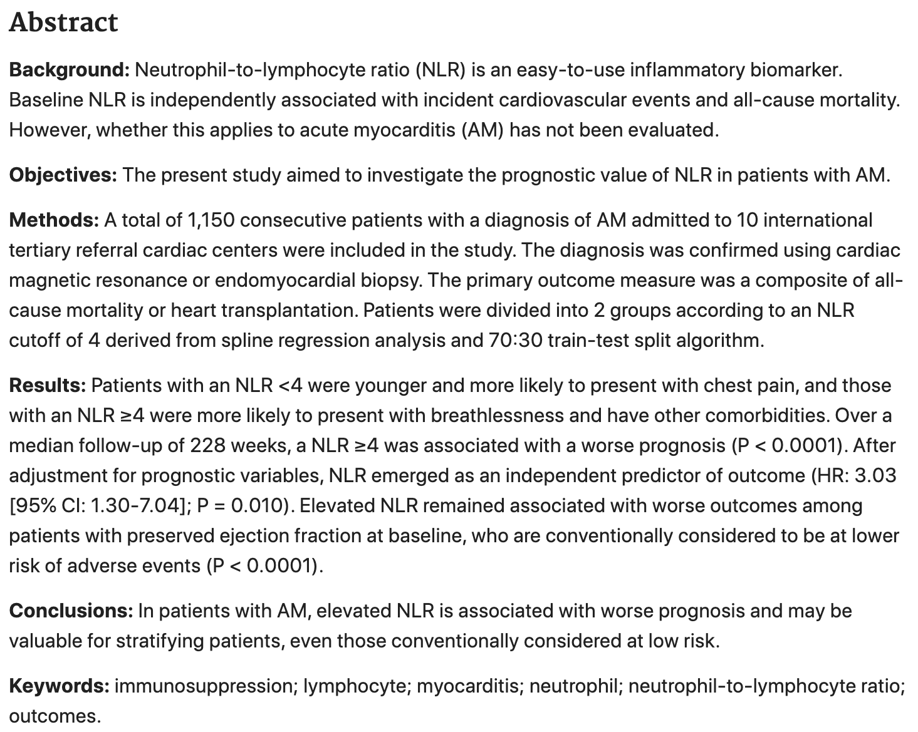
Notes:
2 things for a good paper
A good abstract
And good figures

Slide 11
Research
Your ‘final year project’/dissertation is a great opportunity to access how research works in the scientific community
When you embark on research with a particular supervisor - try to maintain a good working relationship (very important)!!!
GET FAMILIAR WITH HOW STATISTICS WORK EARLY!
  PRISM, SPSS, R
Ask from the START if there is scope for publishing!
  DO NOT WORRY IF NOT! You can ask your course lead what your interests are and if they know any ongoing research you would like to join in.
The UKFPO point allocations constantly changes - only embark on research if you genuinely have an interest in that area - value your time always!

Slide 12
Dissertations/Projects
Lab Project (usually 45 credits) => my MSc project was 60 credits :- ⅓ of my degree!
  Up to 3 days a week in the lab
  Experiments
  Lab meetings
  Journal Clubs
  Wider departmental meetings
Project Design (usually 30 credits)
  Essentially planning a primary research project
  You will hypothesising a way to ‘answer’ a scientific question by planning a project
Library Project (usually 15 credits)
  Could be similar to a literature review
  A lot of papers to read

Slide 13
Awards
You can get awards eg. highest project mark etc
Definitely speak to your course lead about the criteria for some of these awards
It will be announced whilst you walk for graduation!!!
Classified degree => pass, merit, distinction
Opportunity to submit your project outcome to conferences for posters, oral presentations etc.

Slide 14
REMINDER:
YOU DO NOT NEED TO GET THAT FIRST CLASS TO ACHIEVE A DEGREE!
Notes:
If all fails and you end up hating the course, by the end of the year, you'll have figured out whether research is something you'd like/wouldn't like to explore as a potential career.!!!

Slide 15

Useful Resources
01
MSA
KASL on KEATs
King’s Academic Skills for Learning
iBSc buddy scheme
02
03
Websites I wish someone told me about early during my MSc (you’ll thank me later) :
Chatpdf
PopAi
Paperpal
Scite
Our newsletter:

Slide 16
Thanks for listening!
Any questions?
zalanda.shinwarie@kcl.ac.uk
msa@kcl.ac.uk

