Slide 1

What I Wish I Knew for Year 4
Rossel Ahmad, Malik Takreem Ahmad

Slide 2

CONTENT LIST
Overview of Year 4
Overview of the 4 different blocks
QIP
Portfolio Prep
Assessments
General tips

Slide 3

Year 4 Overview
Introductory Week
4 eight-week clinical blocks:
  Emergency Medicine and Critical Care
  Women’s Health
  Child’s Health
  Mental Health
Each block:
  Week 1 – Induction week to the block/site
  Weeks 2-7 – Clinical Placement
  Week 8 – Themed Learning Week
Quality Improvement Project (August until Feb/March)
Exams:
PT1 in October/November
PT2 in January
PT3 in May/June (Summative)
OSCE in June (Formative)
PT4 (resit) in August
Notes:
Rossel

Slide 4
A typical week in Year 4
 | AM | PM
Monday | Placement | Placement
Tuesday | Placement | Placement
Wednesday | QIP | QIP/Self-Directed Study/Sports
Thursday | Placement | Placement
Friday | Placement | Placement
Notes:
Takreem

Slide 5
A typical day in Year 4
 | Monday | Wednesday
Morning | Placement (ward/theatre/clinic) | QIP work/team meetings
Afternoon | Placement (teaching) | Sports
5-6:30pm | Gym/Sports | Research Work
6:30-8pm | Revision session 1 (pathophys) | Research Work
8-9pm | Dinner + Relax | Dinner + Relax
9-10:30pm | Revision session 2 (anki + passmed) | Revision session (anki + passmed)
Notes:
Takreem

Slide 6
Returning from 3rd Year
You will have come straight from OSCE practice (you probably havent touched passmed since January, which is FINE!)
You will notice the language changing when you’re spoken to by seniors- the aim is no longer to just pass, but be a good resident doctor on the wards
The placement time will be more demanding, with around 4 days a week in the hospital
Use the first couple of weeks to familiarise yourself with the new block, the new site and accom, and build a support network that will get you through the upcoming block
The responsibility will be higher but your knowledge and confidence will also grow!!
Don’t rush into getting sign offs done from the first week- take your time to ease yourself in
Notes:
Rossel

Slide 7
Returning from Intercalation
It’s going to feel daunting – that’s normal
But you WILL have to pick up the pace - and be doing more than your peers
Time Management is the key here
Recall memory will be affected - so have strategies in place (e.g. Anki)
Bonus - think about how you can utilise your knowledge from intercalation and integrate into medicine (publications, teaching etc.)
YOU WILL MOST DEFINITELY IMPROVE!
You do pick it up quicker than you expect
Notes:
Takreem

Slide 8
E-Portfolio
Engagement logs – luckily no more 150 words...
Reflections – usually 6 per block
Mini-CEX – usually 1 per block
CBD – usually 1 per block
Supervisor sign offs (Clinical, Educational)
  ES – Start and end of year sign off, end of block sign off
  CS – start, mid, end of block sign off
8 Mandatory sign offs
Clinical skills – actually achievable?!! get the male cath done ASAP in EMCC, fill in the kaizen form in front of the doctor so they can sign you off with the correct level
Make a list at the start of each block!
Try get them done early on in the block
Notes:
Rossel

Slide 9
Emergency Medicine and Critical Care
Emergency medicine (A&E)
  - Great for clerking (histories, examinations)
  - Clinical skills (Try to complete most here)
Anaesthetics
  - Great for clinical skills
  - Cannulas
  - Drawing up drugs
  - Infusions
Critical Care
  - A-E assessments (bread and butter)
  - Management of complex patients
  Revise Physiology prior to attending placement (use textbooks + Osmosis)
Notes:
Takreem

Slide 10
Child Health
Paeds A&E is great to practice Hx and Ex of child with parents.
NICU/SCBU/Neonatal or Baby Units – great for teaching
Get familiar with the paeds Hx taking model (it's a bit different & likely to come up in OSCEs)
Spotting the sick child E-learning on KEATS
“Don't forget the bubbles” website
Online patient scenarios on KEATS (in general the KEATS page is good for paeds)
@brownskinmatters Instagram page
Get familiar with describing rashes and how to prescribe fluids for children!
Always ask about the birth, immunisations and social workers!
KEEP YOUR SAFEGUARDING HATS ON! – HEADSSS assessment
Aim for this block is to leave being confident in your PAEDS history taking skills
Notes:
Rossel

Slide 11
Women’s Health
Typically split into
  Sexual Health – a lot of clinical skills here
  Gynae wardclinics
  Antenatal clinics
  Labour Ward (nights)
  Breast week
  Main theatres and Day Surgery
Quite a hands-on placement : surgical and medical wise
Lots of teaching
Opportunities to scrub in and assist during C-section and assist in deliveries.
Introduce yourself to the patient beforehand, don’t just come in at the end!!
Spaces are shared with student midwives often
Notes:
Takreem

Slide 12
Women’s Health
Probably will get the best examination teaching during simulation sessions with midwives, antenatal clinics
Maternity Assessment Unit
Breast Clinic
Sign offs:
speculum/bimanual vaginal examination/female catheter/swabs
best to do this during day surgery as patient will be under anaesthesia (remember your consent form!)
Consent is not guaranteed - be aware
For the bimanual/speculum examination find the surgical team prior to attending surgery so they can help tell you which patient's they should you can ask for consent.
First day of placement, ask what days they actually have gynae surgeries
Notes:
Takreem

Slide 13
Mental Health
2 mental health placement locations in the block
Teaching days
  Forensic Psychiatry
  Child and Adolescent Mental Health
  Old Age Psychiatry
Placements vary in how much there is to do
Ask for teaching sessions from clinical supervisor
Optional placements - e.g. Place of safety & Liaison psych (can sign up on KEATS)
Get used to asking about risk and how to perform assessment (as always will need to do this in OSCEs)
Further understanding into Mental Health Act and Mental Capacity Act
This is the block you’ll have the most free time in so make the most out of it!
Check out RCPsych opportunities
Notes:
Rossel

Slide 14
General tips
Go to formal teaching + get the slides
Get a subscription to PassMedicine and/or Quesmed depending on which you prefer
Make friends with the F1/F2s (esp. on peripherals)
Try and push for prescribing teaching!
  This can be quite sporadic throughout the year – KCH, you're lucky to have Shivani...
Share resources amongst your friendship groups!!!
Study like you’re a final year med student – pretty much everything you see could be examinable
Teaching junior students (highly recommended)!
  Join the MSA PAL scheme as a facilitator if you haven’t in previous years.
Try to stay on top of everything e.g. portfolio
Notes:
Rossel + Takreem

Slide 15
Making the most of Teaching (in Hospital)
Go to formal teaching- year 4 teaching is actually super useful!
  Pester whoever’s doing it for the slides after!
Be curious and ask questions- try to think like a resident doctor and ask for practical advice
Make friends with the doctors (especially in peripherals) and establish aims from the beginning
Always try to have a back up plan if teaching is cancelled or rescheduled
Make anki flashcards there and then to save time
If you’re not confident on a clinical skill, keep practicing in clinical skills teaching
If you want more teaching in a specific topic, ask the lead and they will most likely arrange it for you
Try to not miss/skip your sessions as you will likely have to come in another day to catch up which can be difficult
If you have the time (and the energy), coming to the teaching prepared with some notes will make you get the most out of it
Notes:
Rossel

Slide 16
Quality Improvement Project
Beginning of September: groups are allocated- cannot be changed
January: critical appraisal presentation
Late February: project write-up and reflective diaries are due
Every Wednesday:
- meetings- highly recommend to join them live and write your reflections straight after
- self-directed learning such as online e-learning on KEATS, attending a patient shadow,
- working on project, preparing for the presentation, writing it all up)
Notes:
Rossel

Slide 17
Quality Improvement Project advice
Start early
  - Organise your patient shadowing as soon as you can
  - Establish expectation from early- are you looking to publish?
  - Search for conferences and note down deadlines
Work consistently throughout the year
  Write your reflective log as you go along, as it will mean:
  1) you can be thorough (you won't need to rely on retrospective memory)
  2) create a shared document for the group to collaborate on
  Organise a timeline in the first couple of weeks to establish feasible deadlines
Engage with your project and supervisor
  - find out what they are expecting of you
if unsure, ASK
The Keats QIP resources/templates are very useful!
Notes:
Rossel and Takreem

Slide 18
Portfolio prep
Start early
  - Projects can take time - 2 years can fly by….
  - Search for conferences and note down deadlines
Personalisation is key
- Don’t compare yourself to your peers - flesh out your own path
  - Find out what your future career may require you to do - e.g. some specialties emphasise teaching, vs research, vs surgical logbook
- Always check the latest guidance from whichever college/specialty you’re interested in
COLLABORATE - don’t gatekeep
- Shared work = easier work
Go to conferences - to learn + network as well as present
- Find UK/London conferences that have low cost of entry
  - Student Conferences are good for practical tips from peers
Notes:
Takreem

Slide 19
Year 4 Assessments
PT1 and PT2 (Formative); PT3 (Summative) and OSCE (Formative)
Textbooks are gold standard
Question banks are 2nd line (& do a mix)
  - Passmed
  - Quesmed
- Pastest - similar question style to PTs
- Quesmed
Mock exams, question banks and any past papers you can find (e.g. Medical School Council ones on KEATS)
Revise everything – UKMLA and beyond
Little but consistent
Notes:
Takreem

Slide 20
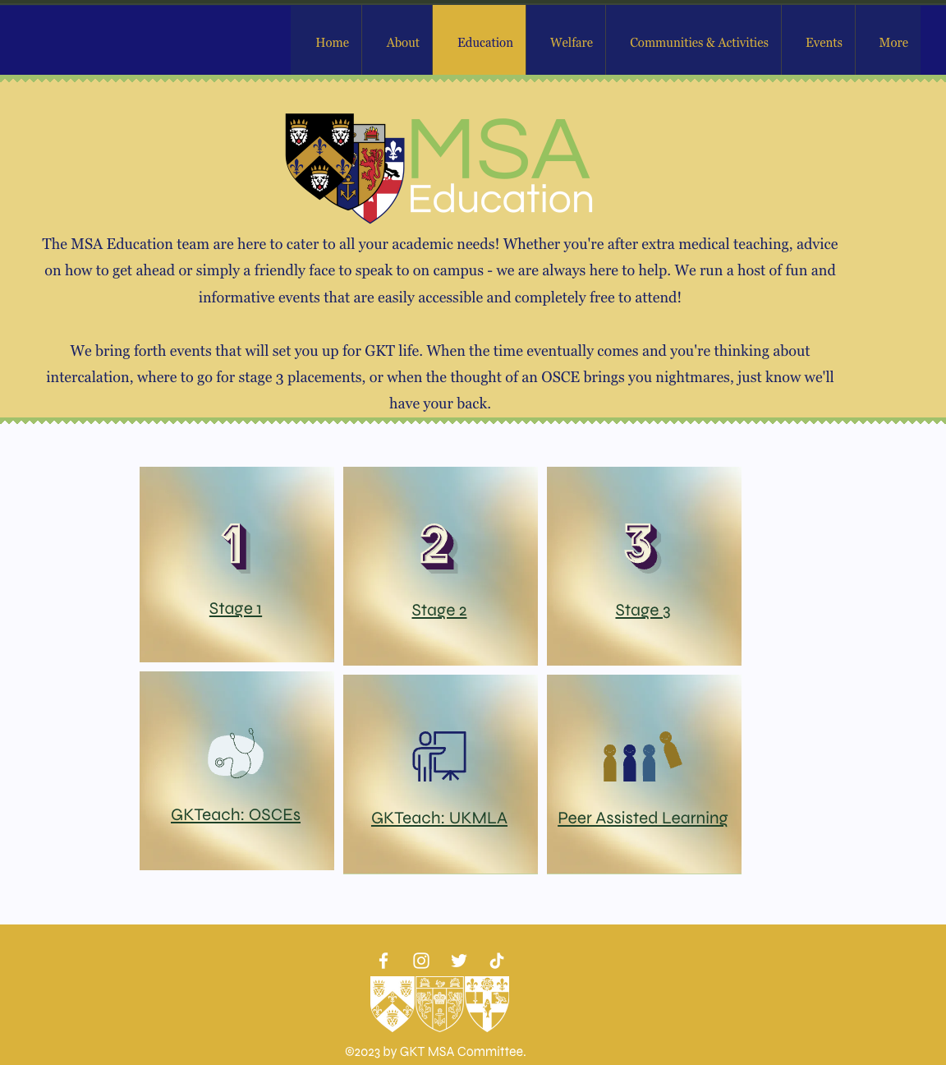
General exam and revision tips- PT
Progress Tests
  - go through topics with friends; teach each other
  - Start early enough- year 4 is not the one to cram
  - Build a strong routine from the beginning and stick to it
Textbook recommendations:
- Basic pathology by robbins cotran and kumar
- Kumar and Clark textbook for UK medicine
Quantity AND Quality
- E.g. Pathophys + 100 question bank questions + Anki review
https://www.gktmsa.org/education
Notes:
Takreem + Rossel

Slide 21
General exam and revision tips- OSCE
OSCE
  - One week between PT and OSCE- pack all of your revision then
  - Purple guide no longer a thing- go back to the basics
  - find a group of friends who you can do OSCE circuits with before exams
  - Learn your ABCDE’s, cardio resp abdo exams very well
  - be honest when providing feedback during practice
  - use the OSCE stations and the feedback on KEATS
  - attend society mock OSCE sessions
  - Remember it’s only formative but we strongly recommend taking it as seriously as possible as it will be the last chance before the real thing
https://www.gktmsa.org/education
Notes:
Rossel

Slide 22
Mental Health & Wellbeing
It's not going to be as full on as you think it will be at the start!
Taking days off for your mental health (just as you would do for physical health) is fine! Just communicate this to your site administrator
Try to pace yourself in terms of revision to avoid burnout
Notes:
Rossel

Slide 23
Useful Resources
Psychiatry PRN
Oxford Handbook of Clinical Medicine (10 Edition)
Oxford Handbook of Clinical Specialties (11 Edition)
Clinical methods textbook - hutchisons/chamberlain/macleod
Basic pathology by Robbins cotran and kumar
Passmedicine questions and textbook
OSCE Stop Textbook
OSCE Stop Website (free)
OSCE Stations Blogspot: http://osce-stations.blogspot.com (free)
Osmosis videos - for pathophys
Geeky Medics
Essential Examination Textbook
Child Health Mock Progress Test on Keats CH Page
Child Health Patient Scenarios on Keats CH Page
Quesmed YouTube Videos (free)

Slide 24
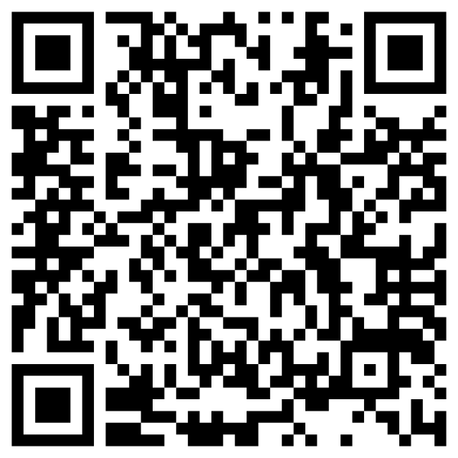
Any questions? Feedback form
Wishing you all the best in Year 4!
Useful contacts:
mbbsstage3@kcl.ac.uk
msa@kcl.ac.uk
ibrahim.toufiq@kcl.ac.uk (MSA VP Education 25/26)
Follow GKT MSA on Instagram, Facebook & Twitter!
Feedback:
https://forms.gle/2bRFnFq7dBz1kzEL7

Slide 25
Keep an eye out for PALS sign-ups, opening next week!

