Slide 1

What I Wish I Knew for Year 3
Ally Fattal, Maheen Siddiqui, Maria Mir, Yathavi Charavanamuttu
Notes:
Ally

Slide 2
What We Will Be Covering
A week in third year
Progress Test Tips
Third year timeline
OSCEs
Stage 2 Year 3 Blocks
Intercalation
Mental Health
Wellbeing
Scholarly Project
Resources and Opportunities
Doctor as Teacher
Notes:
Ally

Slide 3
MON
Hospital Placement
Mental health (alternates w Balint) or Scholarly project
TUES
A Week in Third Year
WED
Doctor as Teacher (DaT)
THUR
Hospital Placement
Mental health (alternates w Balint) or Scholarly project
FRI
Notes:
Yathavi

Slide 4
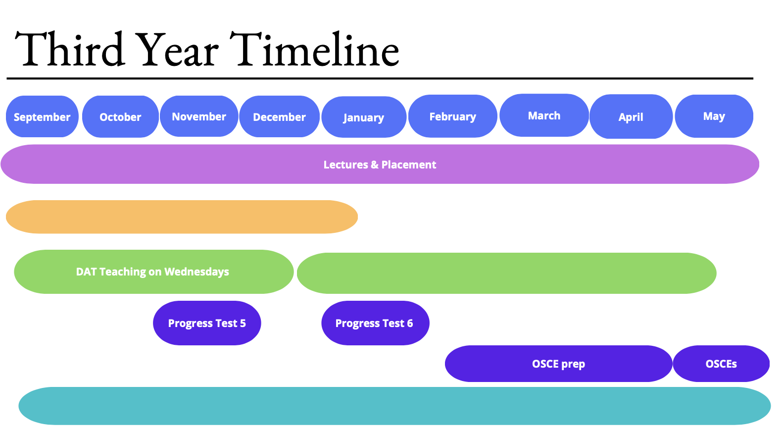
SP Submission: early January
Scholarly Project
DaT Portfolio Submission:
Early May
DAT Teaching on Wednesdays
DaT essay submission:
Wednesday 06 March
20-22 May OSCE
Extracurricular activities
Notes:
Yathavi

Slide 5

STAGE 2 YEAR 3 BLOCKS
Notes:
Ally

Slide 6
Trauma and Accidents
GENERAL ADVICE
A lot of overlap with CMS.
Learn A-E assessment, how to calculate GCS.
ATLS and BLS teaching
Review how to interpret CXRs, AXRs, Pelvic XR, CTs, ABGs and ECGs - try presenting
Revise examinations before going into placement
Log in to Kaizen Portfolio beforehand
Get to see surgeries!
CONTENT:
ORTHOPAEDICS
ACUTE AND EMERGENCY
Notes:
Maria
Lots more bedside teaching for most blocks in 3rd year
4th years can teach you stuff, help out with clinical skills
-T&A placement is good opportunity to practise reading CXRs, ABGs, ECGs and examinations (abdo, cardio, resp)
-Logging into kaizen on your phone beforehand saves time as doctors and nurses are often busy
-EPR login - good to look up more about patient’s history, review imaging
get to see a surgery! KCH Have two guaranteed surgical hours. great opportunity to get your scrubbing in sign up (major purpose for this session) so get it done then!
some surgeries especially trauma will have a lot of components, e.g.orthopaedic srugeons and vascular surgeons etc… so it might be hard to see.

Slide 7

Some T&A Topics
Spinal injuries
Head injuries
Toxicology and substance misuse (alcohol, paracetamol, TCAs, cocaine, aspirin, benzodiazepines)
Eye emergencies (linked to CMS)
ENT emergencies (linked to CMS) + sinusitis, pharyngitis, tonsillitis, peritonsillar abscess, epiglottitis, angioedema and airway obstruction
Upper and lower limb fractures
Urological emergencies - acute urinary retention, renal/ureteric colic, testicular torsion, haematuria
MSK injuries - shoulder dislocation, hip fracture, septic arthritis
X-ray interpretation
Notes:
Maria

Slide 8
Cognition, Movement and Senses
GENERAL ADVICE
Brush up on your understanding of where and what the effects of a lesion are (e.g. upper vs lower motor neuron), as well as your neurological exams
Ask to take history from and/or examine patients, try to identify the pathology and find a doctor to present back to
Bedside teaching is really useful (depending on your placement site, you might get this; if not, you can always reach out to the hospital block lead and request for it)
Practice using the ophthalmoscope and otoscope when patients attend their eye and ear appointments
CONTENT:
NEUROLOGY
ENT
OPHTHALMOLOGY
Notes:
Maheen
basically all your neuro + ENT + opthalmology
based on lesion site, you get different signs = very logical, detective work
exams are really fun to do, esp when you can elicit signs
KCH bedside teaching, again really useful (2-3 ppl with a consultant)
KCH ophthalmology teaching day = rotate around 6 station learning key skills
pt’s have their pupils dilated for eye appts most of the time
may not have time to do full U or L limbe examinations so it’s always helpful to practice eliciting reflexes as this can be tricky to get right. You don’t want to get to OSCEs not having got many reflexes
that’s how i think of it, like look feel move
: There’s quite a few things you need to check in a neuro exam so it’s helpful to always have a very clear structure that you can stick to. When presenting back, used the same structure as for the exam. Consultants love it if you’re systematic and you’re less likely to miss mentioning important info. Also good practice for OSCEs

Slide 9
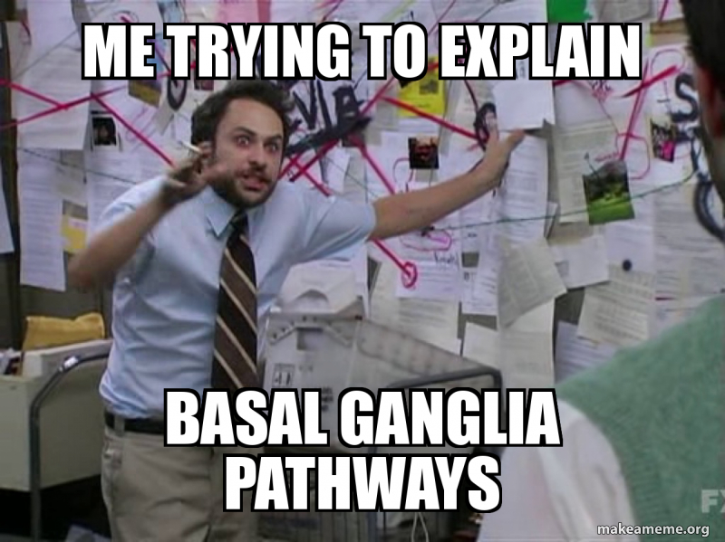
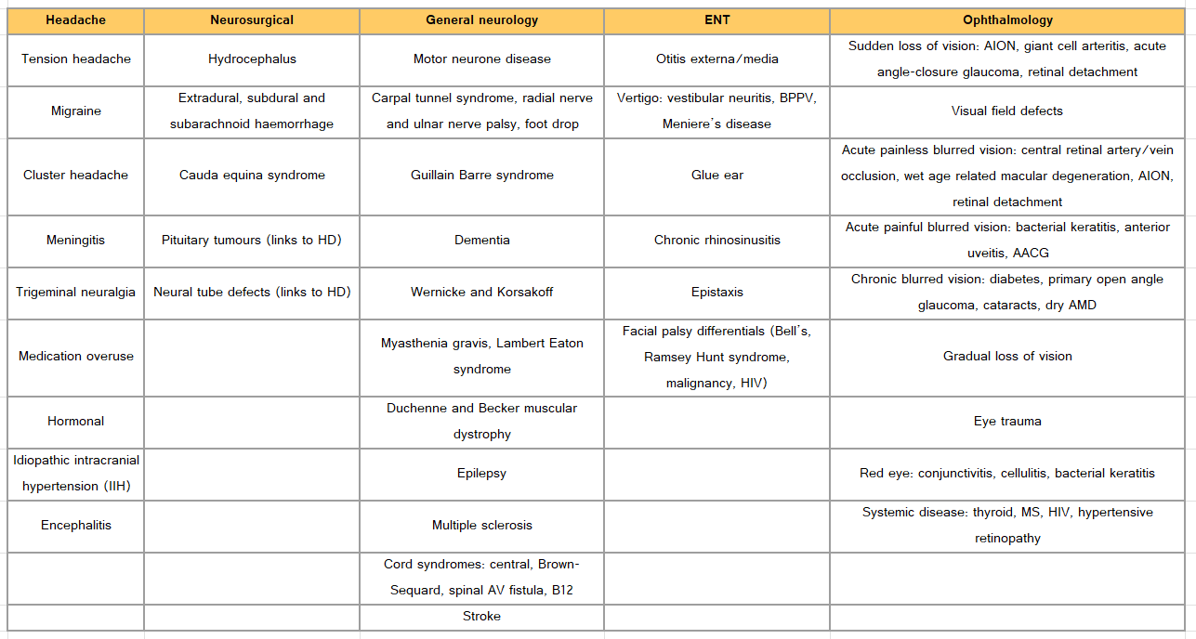
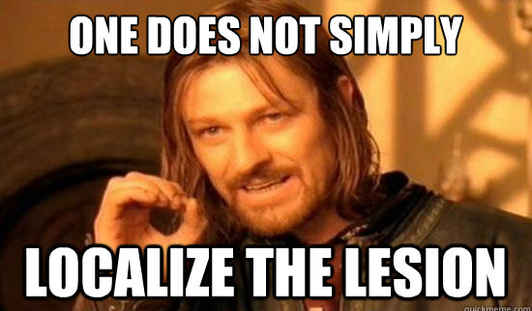
Some CMS Topics
Notes:
Maheen

Slide 10
Vascular
GENERAL ADVICE
ECG interpretation can be challenging at first, but with a structured approach and some practice, it will be a walk through the park :) - Familiarise yourself with common
Online case scenarios on KEATs
Guidelines are your best friend, know first line treatments (PT’s)
This is your time to master (cardiac and resp) examinations
Great opportunity to listen to heart murmurs, measure observations and practise other clinical skills
Take this time to practice clinical skills as much as possible
Really immerse yourself in Cardiology!
CONTENT:
CARDIOLOGY
VASCULAR
Notes:
Ally
best time to revisit all of your cardio conditions from supporting life (lots of overlap) plus more surgical vascular conditions
get slick with ECG, one of those things you always forget how to and have to go back + revise
guidelines - yes or no maps that tell you which condition and what management e.g. tachycardia, bradycardia
which murmurs = which conditions
KCH - Sam Oram ward is great for seeing cardio patients
KCH teaching is actually really good, but its 8am lectures :( (because doctors have clinics at 9)
KCH: scrubs from the cath lab
Finding pulses especially on legs and feet can be difficult - be honest about whether you can feel them or not -doctors will help you out - may be faint anyway because of PAD
Ona:
there tends to be a few patients on a few wards with interesting heart sounds, these patients would get a LOT of traffic because of teaching groups/ so be kind and considerate! I’m not sure about covid restrictions but look at alternative wards! at KCH everyone goes to Annie Zunz and the coronary care unit but Cotton (that may be a covid ward) and victoria and albert, aso have patients with intersting sounds. Moreover, youre less likely to see peripheral arterial disease
i saw several heart attacks, I saw a aortic dissection, please remember that these patients are ill! It can be a very shockign thing to experience so be prepared understand whats going to happe
i want t emphasise that guidelines are your best friend!! what ar the 5 drugs that reduce the morbidiyt of a paitent etc.. you should be able to rattle this off. imaging isnt as important

Slide 11
Some Vascular Topics
Antiplatelets and anticoagulants pharmacology
Atherosclerosis and risk factors
Hypertension
Lipids and drugs
Angina (stable and unstable), MI (NSTEMI and STEMI)
Heart failure
Valvular (aortic stenosis, mitral regurgitation, aortic regurgitation, mitral stenosis are main ones)
Heart drugs pharmacology (diuretics, beta blockers, ACE inhibitors, ARBs)
Bradyarrhythmias and how to manage (heart blocks)
Tachyarrythmias (atrial fibrillation, atrial flutter)
Abdominal aortic aneurysm VS aortic dissection
Infective endocarditis, pericarditis
Notes:
Ally

Slide 12
Cancer and Clinical Genetics
GENERAL ADVICE
One of the most ‘academic’ blocks
Be prepared for a range of specialties: from respiratory to urology!
You will not know everything (especially in haem)
Watch the lectures - are useful for a baseline understanding
Spend 10-15 mins preparing the day before/on the way to placement (read up on the key cancers)
Breast Clinic! - get there early, know how to do the examination - it is a hard sign off to get elsewhere!
CONTENT:
ONCOLOGY
HAEMATOLOGY
Notes:
Yathavi
bite medicine and society tutorials are great for learning about cancers
tumour markers can be an easy PT point
except for oesophageal, GORD and alcohol intake
there are things you should know,

Slide 13
Some CCG Topics
Cancer screening (breast, cervical, bowel)
Breast cancer
Lung cancer
GI cancer (oesophageal, pancreatic, gastric, colorectal)
Different types of treatment
Haematological malignancies
Urological cancers
Head and neck cancers
Palliative care; WHO pain ladder for analgaesia
Tumour markers
Acute oncology - hypercalcaemia, hyponatraemia, AKI, large bowel obstruction, biliary obstruction, ascites, pleural effusion, SVCO, SOL
Notes:
Yathavi

Slide 14
Mental Health
Once every fortnight, you have placement and the other week you have teaching
Placements - One term will be in community mental health and one in hospital mental health
    Community Mental Health is more relaxed - you see patients, who are relatively stable and managed in the community - it is more calls, medication review consultations etc
    Hospital mental health is in a more acute setting, so you will see patients who are more unwell
Teaching - you have small group teaching and Balint
  Small group teaching - teaching on psychiatry topics
    good resource for exam revision/OSCE prep, can ask any questions and cover topics you are struggling with, let your firm head know if you are having issues at your placement
  Balint (compulsory, reflection sessions to talk about cases that you found interesting
Notes:
Ally and Maheen
me and my partner had a shared document were we wrote up mental state exams for each patient we saw and it helped a lot to understand how some patients present
Remember what to ask/observe for psychiatric history and MSE, both are different
don’t write off balint group as a waste of time - it can be very useful in improving the way you understand patients and communicate with them as hear different perspectives from your peers and supervisor

Slide 15
Mental Health - Advice
The big question - is it unsafe or scary?
Everyone has different experiences - some students have experienced something scary and others haven’t. For the most part, most students did not experience anything scary
Just make sure you are aware and taking precautions to be safe, and the rest should not be too scary
  Going in, just remember to advocate for yourself and speak to the team early on to ensure you are clear on everything (e.g. where alarms are, what to do when feeling unsafe etc)
  Stick together with your placement partner and remain vigilant
  Follow your gut instinct
  Know that you can set boundaries and ask for help - e.g. if your partner has not come to placement and you do not feel comfortable going in, tell the team - one of the doctors can come in with you or you can be allocated another task
Notes:
Ally and Maheen
PsychED Up- course where they ran weekly 2 hour sessions for 7 weeks. Small groups, a psychiatrists, actors. Opportunity to practice how you interact with more complex/difficult patients, see other students doing as well and learning how to improve your techniques. Very helpful for placement & OSCEs. Was online last year

Slide 16
Mental Health - Advice
Placement
  Brush up on common presentations and common exam questions - you will also get to reinforce a lot of this learning on placement
  Risk assess always!!!
  Learn how to take and present MSEs
  If you do not have much going on during community placement, use the time to revise and do psychiatry (or other) questions (if term 1) or OSCE prep (if term 2) with your placement partner
Teaching
  Make the most of small group teaching - it is very useful! You can ask your firm head to teach a certain topic that you are not as confident with. If they do any practice scenarios, make sure you volunteer and get involved - this is the place to learn!
  Balint does not have to be awkward or very formal - if you engage and talk like you would have a conversation with friends, time passes by so much quicker. And (of course keeping in mind the conversation, your group and your balint leads), sometimes you can make jokes and keep it lighthearted. (Apparently some people would also bring snacks as a group)
Notes:
Ally and Maheen
PsychED Up- course where they ran weekly 2 hour sessions for 7 weeks. Small groups, a psychiatrists, actors. Opportunity to practice how you interact with more complex/difficult patients, see other students doing as well and learning how to improve your techniques. Very helpful for placement & OSCEs. Was online last year

Slide 17
Mental Health - Advice
Exams
  Psychiatry is a high yield topic in exams, and is relatively easy to grasp - so is a win-win situation to study and understand
  Medically unexplained symptoms (Hypochondriasis, Malingering, Conversion) come up very frequently in exams
  Keep in mind the key adverse effects of medications and the symptoms to look out for!
  Do not forget practicing psychiatry related scenarios (including for comms stations!) for your OSCE
Resources:
  Handbook on KEATS - Bringing Psychiatry Alive: An interactive guide for medical students
  Oxford Handbook of Clinical Specialties and the accompanying MCQ book were great for Psychiatry and loads of other blocks inc. Trauma and Accidents and Human Development
Notes:
Ally and Maheen
PsychED Up- course where they ran weekly 2 hour sessions for 7 weeks. Small groups, a psychiatrists, actors. Opportunity to practice how you interact with more complex/difficult patients, see other students doing as well and learning how to improve your techniques. Very helpful for placement & OSCEs. Was online last year

Slide 18
Some Mental Health Topics
Affective Disorders | Anxiety disorders | Psychosis | Personality disorders | Medically unexplained Symptoms | Eating disorders | Medications | Miscellaneous
Low mood | PTSD | Schizophrenia | Cluster A - odd or eccentric | Munchausen | Bulimia | Antidepressants | Mental Health Act and sections 2, 3, 4, 5(2), 6, 12, 17
Depression | OCD | Delusional disorder | Cluster B - Dramatic or emotional | Malingering | Anorexia | Antipsychotics | Risk Assessment
Bipolar | Generalised Anxiety Disorder |  | Cluster C - anxious or avoidant | Conversion | Binge - eating | Extra-pyramidal side effects | Psychiatric emergencies
 | Social Anxiety Disorder |  |  | Somatisation |  | Serotonin syndrome | Risk assessment
 | Panic disorder |  |  | Hypochondrial |  |  | Capacity
Notes:
Ally and Maheen
the diagnostic criteria for personality disorders has changed! but this is how i learnt it.

Slide 19

Scholarly Project
Every Tuesday/Friday during term 1
Communicate regularly with your supervisor and collaborate with your partners
If struggling to get a response from supervisor, find their nhs email / contact the scholarly project team: mbbsspm@kcl.ac.uk early!
Understand how you’ll be assessed
Try and get your first full draft done before Christmas
Scholarly project deadline and PT6 revision is a pressure point. Give yourself plenty of time!
Don’t put pressure on yourself for a publication!
Give yourself mini deadlines and stick to them
Notes:
Maria and Ally

Slide 20
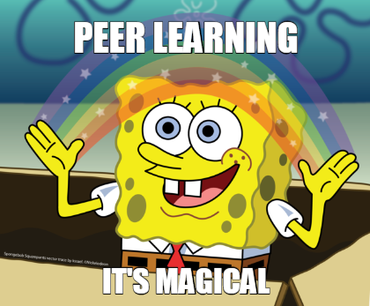
Doctor as Teacher
Weekly online teaching in term 2 - start with small group activity/discussion in the morning and then lecture to discuss the theory underpinning it in the afternoon
For coursework/assessment, you do a 10 minute microteach (teach any medical-related topic to a small group of 5-6 students online, applying the theory you have learnt throughout the module)
You then write an essay reflecting on this teaching and what you have learnt (you have to choose 3 of the 6 topics you will cover in the module to reflect on)
Advice
  It is a very relaxed module, so enjoy it!
  Try to keep up with the lectures weekly; they are not too intense
  Make sure you ask your peers from your microteach to write down the feedback and to send it to you via email (you will need this for the essay)
Notes:
Maheen
micro teach is all about experimenting with teaching style, topic isn’t as important, it’s only 10 minutes long - reflect on micro teach soon after, so you can reference it properly in your essay (word count was 2500 for us)

Slide 21
Progress Test Strategies
Everyone studies differently (and starts at different times)!
Keep it simple and sustainable
Make sure you have completed all topics by January
Our strategy:
  PassMedicine, all topics - press go and hope for the best
  Use NICE guidelines as your textbook
  BMJ Best Practice for more detail
  AI to explain [but always double check against NICE!]
Other strategies:
  Split into blocks, rotate (spaced repetition etc.,)
  Study by the UKMLA list (make notes, then test with questions)
  YouTube videos, textbooks (Davidson’s/Oxford Clinical Cases)
Notes:
Yathavi and Maheen
80/20 rule, time-management, high yield, common in exams = common in clinical practice
Pastest bought by KCL
but really all of us
Everything in the question stem is relevant to determining what the answer is - hoping to run a session on exam technique around December. PT is a combination of knowledge and exam technique.
Try to start practice questions early on and have a routine eg. 30 minutes of SBAs on a weekend. Doesn’t matter if you get things wrong and your centile is 10 on passmed, make a note of the topic and create a brief summary around it.
Know relevant nice guidelines e.g. criteria for 2 week waits, ct head scans.
Society revision sessions, TL tutorials and PALS can be v helpful!

Slide 22
OSCEs
2 days - 2 different sites
8 stations each day (16)
practice with your friends
get Geeky Medics OSCe subscription (can split with people)
learn the examinations as per KEATS
be prepared for the ‘assessment stations’
honestly - not a now problem. survive term 1 first - worry about this in March (Feb if you’re eager)
The MSA Education Team will run OSCE teaching sessions and a mOSCE nearer to the time! Keep an eye out for these !!
Notes:
Yathavi and Maria
-Hx: At 6 min you will be asked to briefly summarise + talk about next steps (investigations, referral). Sometimes it’s difficult to take a complete hx. Hx structure is good, but don’t be too rigid with it (eg. asking earlier in the hx about smoking if you suspect lung cancer shows you are thinking about ddxs rather than just asking questions without an end goal in mind)
-Examinations: at 6 min- present findings, most likely diagnosis. Very important to keep your answer structured
-Comms: full 8 min of talking with the patient. Let the patient guide the discussion focusing on what they want to get out of the consult
Comms stations, people do struggle to understand them and the best way to approach. read the examples and the mark schemes they have on keats!

Slide 23
INTERCALATION
Notes:
Maria and Ally

Slide 24
Pros vs Cons
Pros
Cons
You will learn A LOT
Time to really commit to developing skills you previously didn’t have time for
You will be taught (depends where)
Time to really focus and build your portfolio
Explore a world outside of medicine / a change in rhythm
Grow as a person and as an academic
Greater understanding of what you want to do in the future
Network (even more if you intercalate elsewhere) & make new friends
Develop new learning skills
An extra year of tuition fee and maintenance costs
Your course might be different to what you thought (especially if you don’t do your research well)
Might have to learn things by yourself
Lots of change
Can be very intense
Group work - painful or amazing
Can be mentally challenging
When you’re coming back, joining a new year group
Overlap between masters and fourth year
Notes:
Maria and Ally

Slide 25
How to pick the right course? (and decide to intercalate?)
really think about what is important to you & what your deal breakers are (there will be things you don’t enjoy but what would really break it for you)
For example:
  What do I want to learn? (- Has there been something I’ve wanted to learn more about but just haven’t had the time or opportunity?)
  Does teaching matter to me?
  Does socialising and meeting new people matter to me?
  Do I want to stay at king’s or go somewhere else?
  If i did not specialise in this field in the future, would i still develop skills i can use elsewhere?
  is it important for you to graduate with a merit or distinction? (what if you don’t - would you still do it all over again?)
Notes:
Maria and Ally

Slide 26
How to pick the right course? (and decide to intercalate?)
Do your RESEARCH WELL!!!!
Find people who have done the course and talk to at least two people (find the bad and the good)
Consider how long the course has been running for
Look at the modules offered and what they entail (the module description might be completely different to the module title)
Ask your mentors (ideally at diff stages of their career) what they think (don’t just ask one person)
Notes:
Maria and Ally
how to find the right mentors (someone when you look at them, you want to be like them. (e.g. they have a trait you aspire to have, they work in a field you’re interested in) and their values somewhat align with you)
a mentor is not just a formal role (your friends/colleagues in the years above you, etc)
hold on to them.

Slide 27
The Other (Equally as Important) Stuff
Notes:
Maheen

Slide 28
Wellbeing
Please take care of yourself and make it a non-negotiable priority - lack of sleep + lack of proper eating + workload + stress = everything catches up very quickly and it is not nice
Remember that, at the end of the day, nothing exists if your health doesn’t (e.g. doesn’t matter the amount of hours if you are unwell on the day of your exam)
Reach out for help - so many people will be in the same boat; reach out to a friend, a senior, your personal tutor, faculty member, family, GP, MSA; whoever you are comfortable with; sometimes just talking to someone helps, other times they can offer valuable insight and advice and sometimes they can put things into perspective
Do NOT lose perspective, you are doing good - it is easy to fall into the trap of thinking you are not doing enough because it seems that everyone else somehow has a lot more hours in the day; take a moment to reflect how far YOU have come, not relative to anyone else
Notes:
Maheen
Please take care of yourself and make it a non-negotiable priority - lack of sleep + lack of proper eating + workload + stress = everything catches up very quickly and it is not nice
Remember that, at the end of the day, nothing exists if your health doesn’t (e.g. doesn’t matter the amount of hours if you are unwell on the day of your exam)
Reach out for help - so many people will be in the same boat; reach out to a friend, a senior, your personal tutor, faculty member, family, GP, MSA; whoever you are comfortable with; sometimes just talking to someone helps, other times they can offer valuable insight and advice and sometimes they can put things into perspective
Do NOT lose perspective - it is easy to fall into the trap of thinking you are not doing enough because it seems that everyone else somehow has a lot more hours in the day; take a moment to reflect how far YOU have come, not relative to anyone else
Remember that circumstances mean that comparison is never fair and balanced (e.g. it is a given that someone who works 3 jobs and has a full time caring role might not have the time, energy and/or capacity to be able to engage in as many societies as someone who does not have to do either) (This is a more extreme example to get the point across, but always remember that!)
Celebrate small wins - sometimes it is the little things that you have to actively found the joy in to keep sane. Decided on your SPM research question? Well done. Cooked for yourself after a long while? Proud of you. Caught up with friends even when you felt like isolating? Pat yourself on the back

Slide 29
Wellbeing
Remember that circumstances mean that comparison is never fair and balanced (e.g. it is a given that someone who works 3 jobs and has a full time caring role might not have the time, energy and/or capacity to be able to engage in as many societies as someone who does not have to do either) (This is a more extreme example to get the point across, but always remember that!)
Celebrate small wins - sometimes it is the little things that you have to actively found the joy in to keep sane. Decided on your SPM research question? Well done! Cooked for yourself after a long while? Proud of you! Caught up with friends even when you felt like isolating? Pat yourself on the back!
Remember that at the end of the day you are becoming a doctor - I have never seen a patient ask a doctor how many publications they had; what patients do remember is how you made them feel, if you listened to them, if you took them seriously, if you helped <3 Absolutely put in all the effort to do the best you can (whatever that means for you), but throughout all of that, do not lose sight of the bigger picture
Notes:
Maheen
Please take care of yourself and make it a non-negotiable priority - lack of sleep + lack of proper eating + workload + stress = everything catches up very quickly and it is not nice
Remember that, at the end of the day, nothing exists if your health doesn’t (e.g. doesn’t matter the amount of hours if you are unwell on the day of your exam)
Reach out for help - so many people will be in the same boat; reach out to a friend, a senior, your personal tutor, faculty member, family, GP, MSA; whoever you are comfortable with; sometimes just talking to someone helps, other times they can offer valuable insight and advice and sometimes they can put things into perspective
Do NOT lose perspective - it is easy to fall into the trap of thinking you are not doing enough because it seems that everyone else somehow has a lot more hours in the day; take a moment to reflect how far YOU have come, not relative to anyone else
Remember that circumstances mean that comparison is never fair and balanced (e.g. it is a given that someone who works 3 jobs and has a full time caring role might not have the time, energy and/or capacity to be able to engage in as many societies as someone who does not have to do either) (This is a more extreme example to get the point across, but always remember that!)
Celebrate small wins - sometimes it is the little things that you have to actively found the joy in to keep sane. Decided on your SPM research question? Well done. Cooked for yourself after a long while? Proud of you. Caught up with friends even when you felt like isolating? Pat yourself on the back
Remember that at the end of the day you are becoming a doctor - I have never seen a patient ask a doctor how many publications they had; what patients do remember is how you made them feel, if you listened to them, if you took them seriously, if you helped <3

Slide 30
And if you remember nothing else, just hold on until post-January
Notes:
Maheen

Slide 31
MSA Stuff
1st term
MSA To Intercalate or Not talk
GKTeach Sessions
2nd term:
Halfway Ball!!!!!!!
To Stay or To Go talk for stage 3 placements and allocations
Overall
PALS NOW OPEN
A lot more! (Keep an eye out on our Instagram @gktmsa)

Slide 32
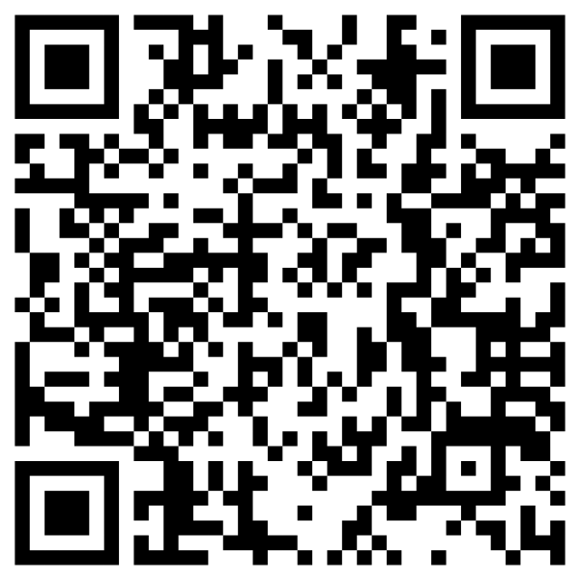
PALS NOW OPEN!
Sign ups to be a facilitator to teach year 2 students open next week
Sign up to be taught by year 4/interacalating students

Slide 33

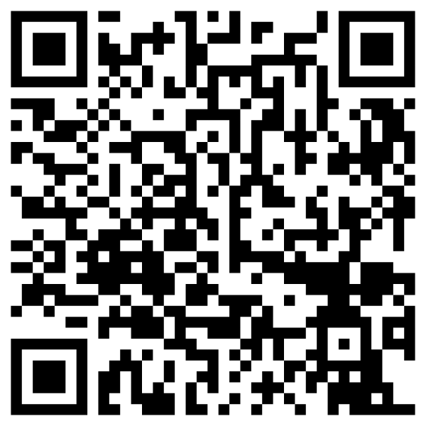
Any questions? Feedback form
Wishing you all the best in Year 3!
Useful contacts:
mbbsstage3@kcl.ac.uk
msa@kcl.ac.uk
ibrahim.toufiq@kcl.ac.uk (MSA VP Education 25/26)
Follow GKT MSA on Instagram, Facebook & Twitter!
Feedback:
https://forms.gle/D9X9tQDHa86TBN2e9

Slide 34
STRUCTURE
week in life of third year - ally
third year timeline - yathavi
each of the blocks
  t+a - maria
  cms - maheen
  vascular - ally
  ccg - yathavi
  mh - ally + maheen
scholarly project - maria + ally
doctor as teacher - maheen
progress test tips + actually doing your degree - yathavi + maheen
osce tips - yathavi + maria
intercalation - maria + ally
please look after yourself/extra MSA bits - maheen
the end

