Slide 1
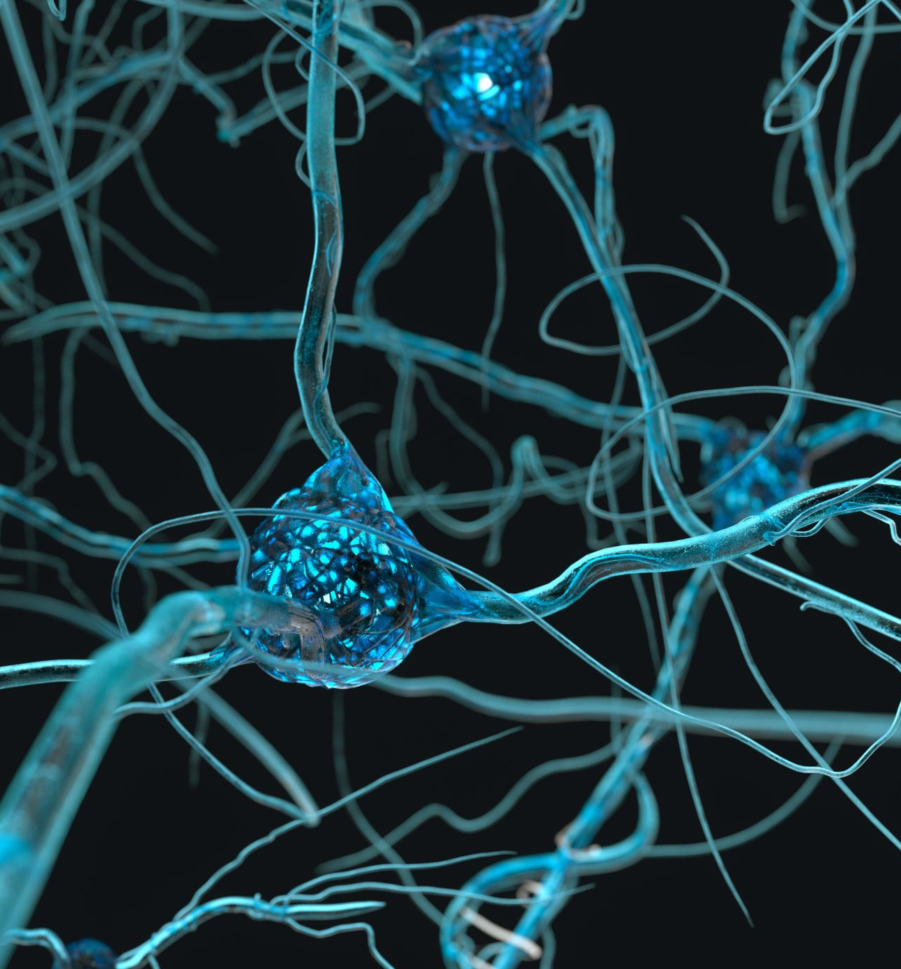


Nervous system , ANS pharmacology and Intracellular signalling
(Self-proclaimed) Professor Sarjak Gautam

Slide 2

What to expect from this session
There are lots of topics within the scope of what I will be covering today, ofc I cannot cover them all so I will be focusing on the very key concepts
I'll make this very interactive. I will ask questions throughout.
We will do a couple of MCQs from the student-made question bank as well.

Slide 3

Some advice for learning these topics (with some general advice)
Medicine is very logical so always keep the bigger picture in mind.
In general, images are a lot easier to remember than a string of words
With cell signalling, think of it like a story of events. Keeping the diagrams in your mind is really helpful for this, you can sorta make it like a little animation. Try draw the pathway from memory a few times and then you will not forget it.
If you really boil it down, the very key concept of the first two intro to pharmacology lectures is the way in which a drug interacts with a receptor and the ways in which we can analyse this and modulate this. Ofc, there are lots of graphs associated with this but if you apply the concepts you learnt in Chemistry (and a little bit of maths) then you will be fine
With pharmacokinetics, always keep ADME in mind as well as the definitions. Again, think of it like a story of events in terms of what happens to the drug from the moment you swallow to the moment it gets excreted in the urine or faeces via bile. Everything makes sense if you keep thinking about that.
With nerve anatomy, there's a lot of words on Rocky's powerpoints about the path of nerve fibres, try draw it on top of an anatomy image and it'll feel a lot easier to remember.

Slide 4
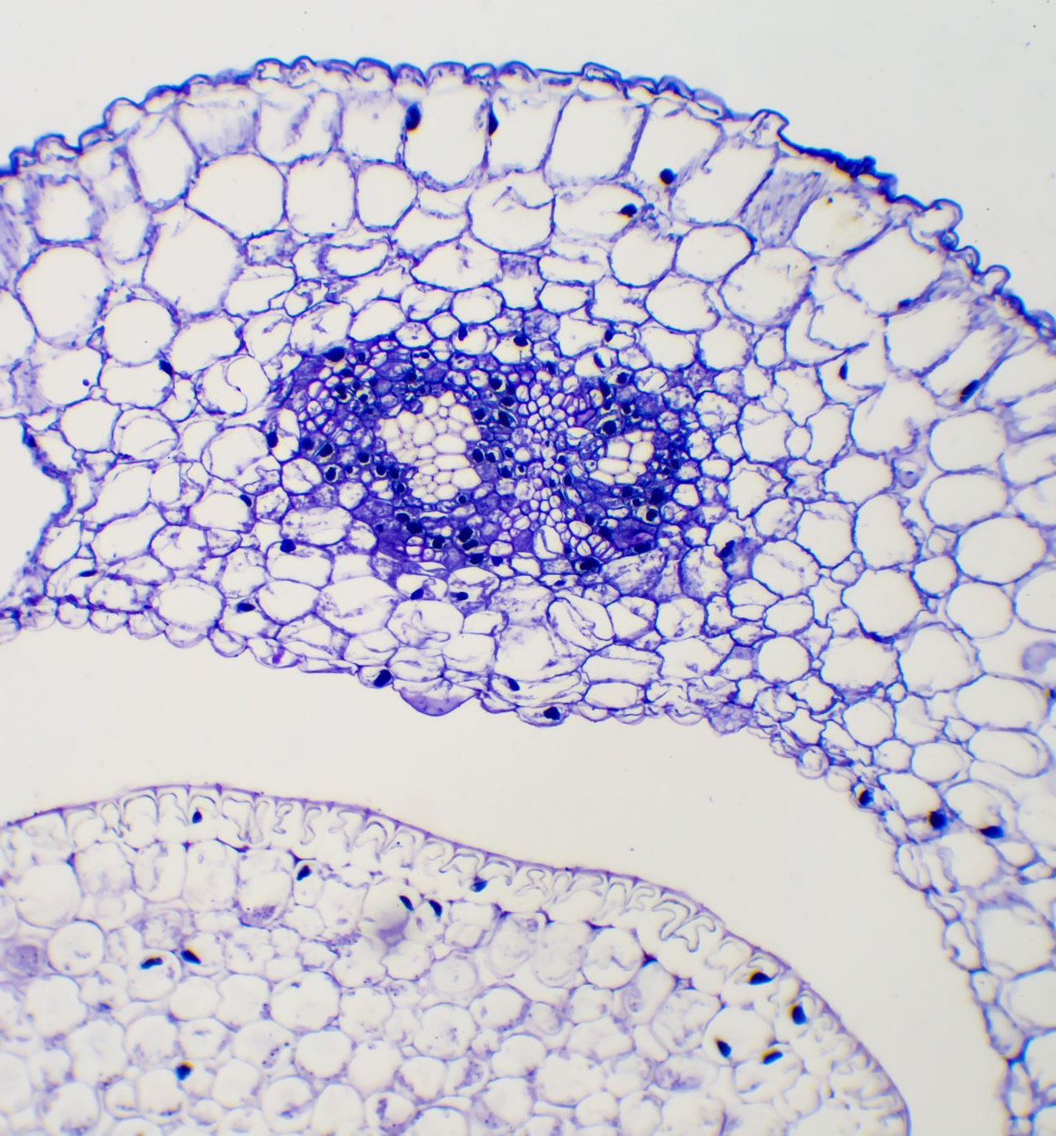
Intracellular signalling – really important!!
This underpins so much of what you learn in physiology – it comes up EVERYWHERE

Slide 5
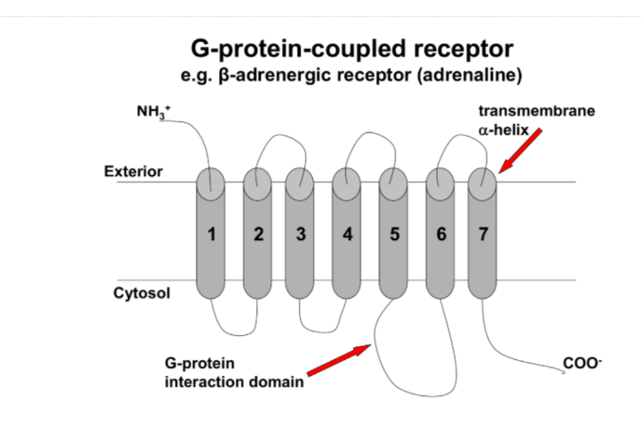
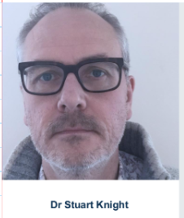
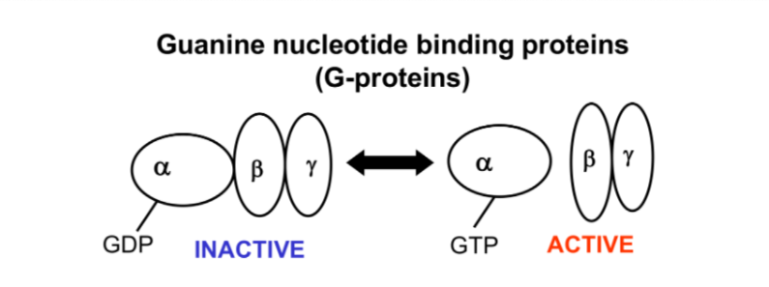
What happens when a molecule binds to a GPCR?
Before we start, somebody give me a generic overview of what happens when a molecule such as adrenaline binds to a GPCR...
    Conformational change (Stuart loves that phrase doesn't he)
    Now the GPCR interacts with the G protein in such a way that Gα's affinity for GDP for GDP decreases
    So now the GDP molecule detaches from the Gα subunit and a GTP molecule replaces it
    When GTP is bound to Gα, the heterotrimeric protein becomes unstable and Gα dissociates. Gα is now active.
"If in doubt, just say conformational change"
-Stuart Knight, 2024

Slide 6
Gs pathway
In this case, the Gα subunit activates adenylate cyclase, which catalyses the conversion of ATP to cAMP
Two molecules of cAMP bind to the regulatory subunits of cAMP dependant PKA (one to each regulatory subunit), freeing the catalytic subunits
Now PKA goes and phosphorylates things
PKA phosphorylates a wide variety of proteins, there was an example in your lecture involving glycogen breakdown but you'll cover this in NAM so I won't go into it now
OK fine, but how do we stop this from being permanently activated?
The Gα itself has GTPase activity – so GTP gets hydrolysed to GDP and the complex reassociates

Slide 7
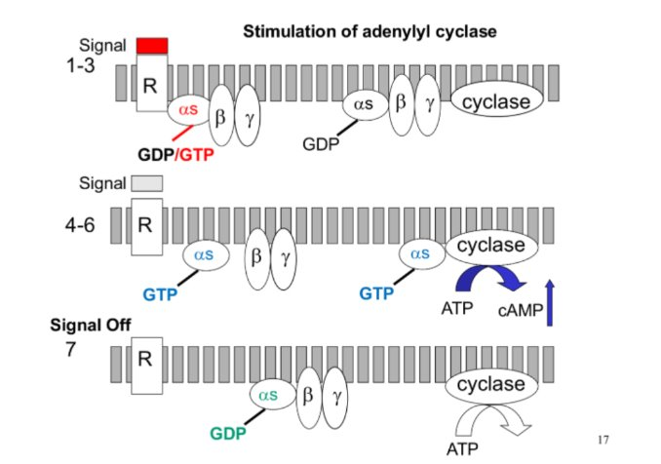
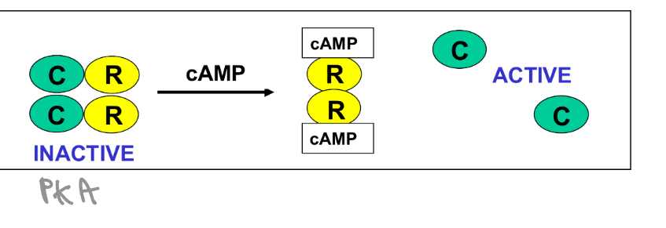
Some diagrams

Slide 8

Gi
This one is kinda simple
The Gαi subunit inhibits adenylate cyclase
So basically less cAMP and therefore less active PKA

Slide 9
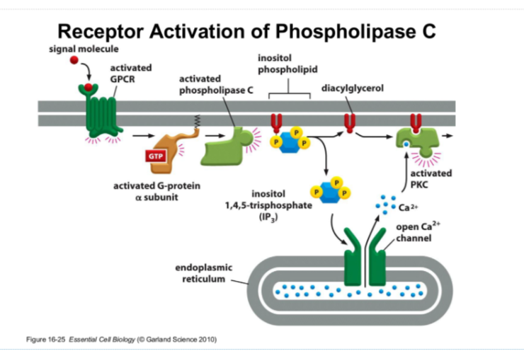
Gq pathway
The Gαq subunit activates phospholipase C
Phospholipase C catalyses the conversion of PIP2 to IP3 and DAG
IP3 opens calcium channels in the ER, increasing intracellular calcium
DAG (along with calcium) activates PKC

Slide 10
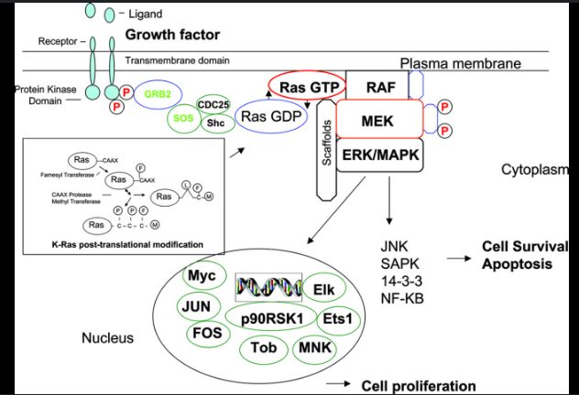
Ras MAPK pathway – beware of different names!!
You will cover this pathway again when doing NAM (mechanism of action of insulin), but different names will be used.
Basically, MAPKKK, MAPKK etc are generic names. Raf, MEK etc are specific types.
  When hormone binds, there is autophosphorylation of tyrosine residues on the receptor. That explains the name receptor tyrosine kinase.
  SH2 domain of Grb2 binds to the phosphotyrosine
  SoS (son of sevenless) is bound to Grb2
  This complex removes GDP from Ras, and allows GTP to bind to Ras
  This phosphorylates Raf (MAPKKK)
  This phosphorylates MEK (MAPKK)
  This phosphorylates MAPK
  This activates transcription factors

Slide 11

MCQs!!

Slide 12
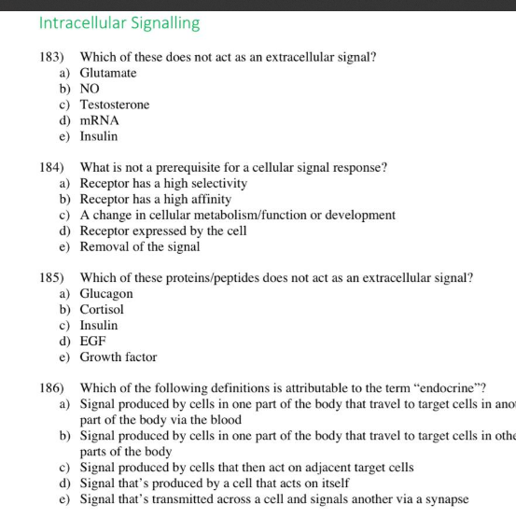

Slide 13
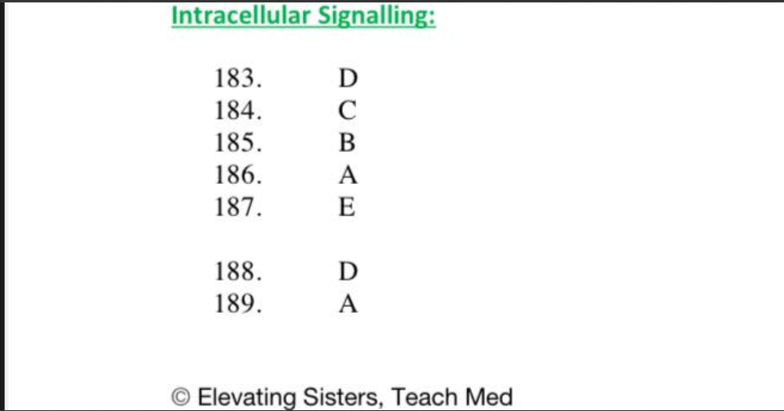

Slide 14
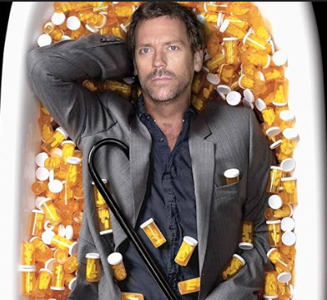
Now onto pharmacology...

Slide 15

A little question for you
How can a drug be specific but not selective?

Slide 16
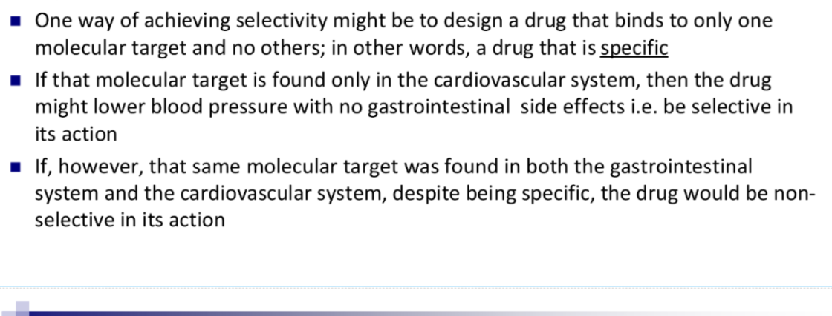
That’s how

Slide 17

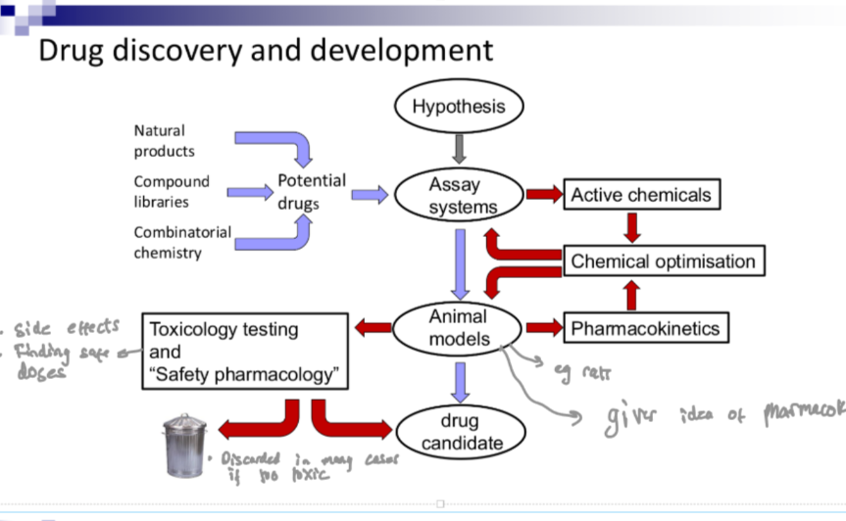
Alr now I'm gonna pick on people. Let's start from the hypothesis to drug candidate...

Slide 18
Someone tell me the difference between toxicology testing and safety pharmacology
Toxicology testing – using higher and higher doses over chronic periods (weeks, months) – to identify tissues/organs at highest risk
Safety pharmacology – using therapeutic dose range to identify any acute effects on ‘core battery’- CV, CNS, respiratory

Slide 19
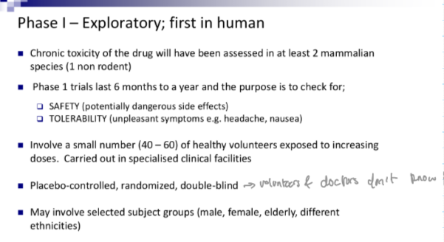
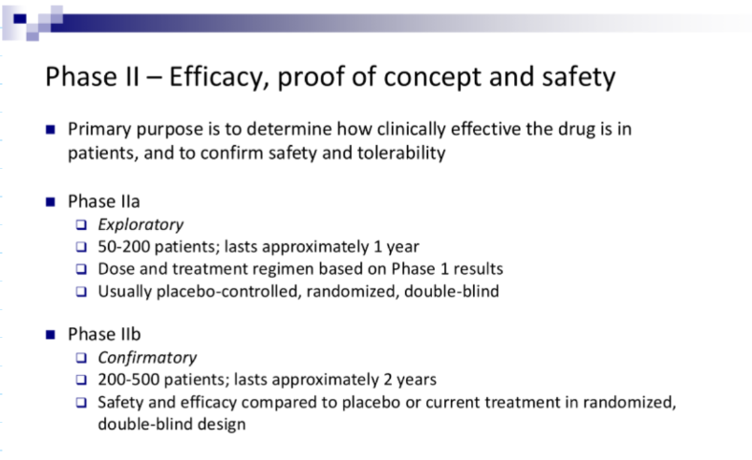
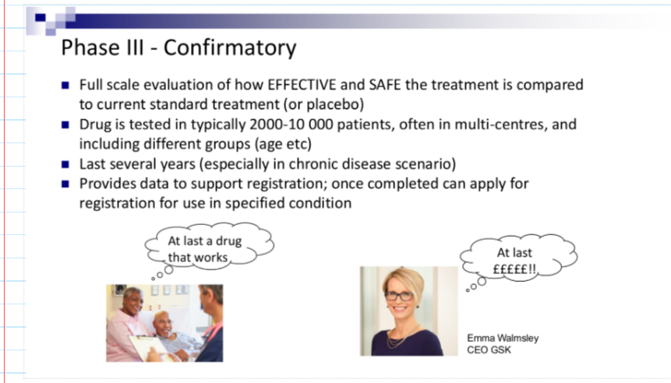
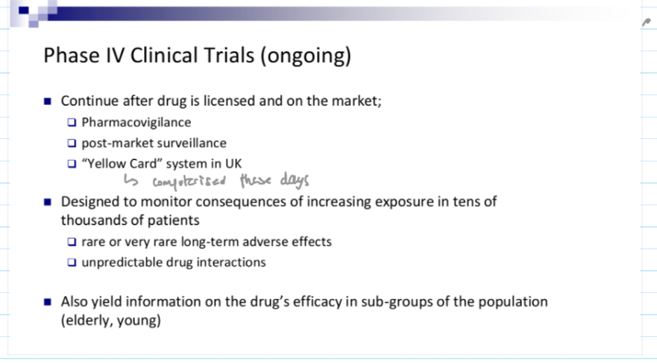
Now onto clinical trials (let's speedrun this please)

Slide 20
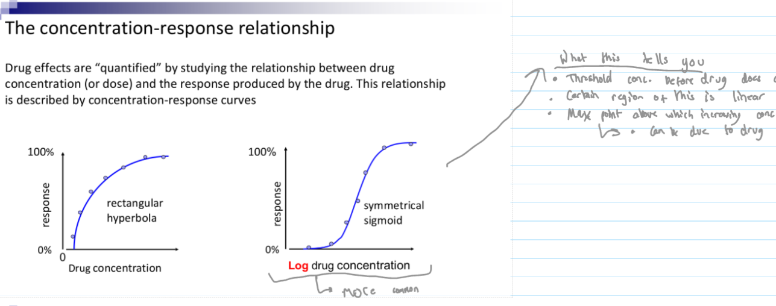
Question: what is the shape of a conc. response curve and why do we usually apply logarithm
Applying logarithm is useful because of the sigmoid shape – can tell the concentration at which increasing the dose doesn't really do much

Slide 21
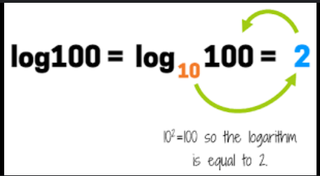
For anyone who didn't do A-level maths or equivalent, a logarithm basically just tells you the missing power, it's like the inverse function of an exponent
Usually we use "base 10" which means we are finding missing powers of ten
Ln means log base e which means we are finding missing powers of a special number e

Slide 22
Formula for Kd and why it is that way round (someone tell me the formula)
Kd stands for DISSOCIATION CONSTANT so we are looking at how quickly it dissociates.
Because we would otherwise expect it to be [DR] / [D][R] (at least I did)
Apparently (according to my good friend ChatGPT) there is another constant called association constant which is that way round
So, ofc, a high Kd means the drugs dissociates from the receptor quickly and so has LOW affinity
A low Kd means the drug dissociates from the receptor slowly (it sticks on for longer) and so has HIGH affinity

Slide 23
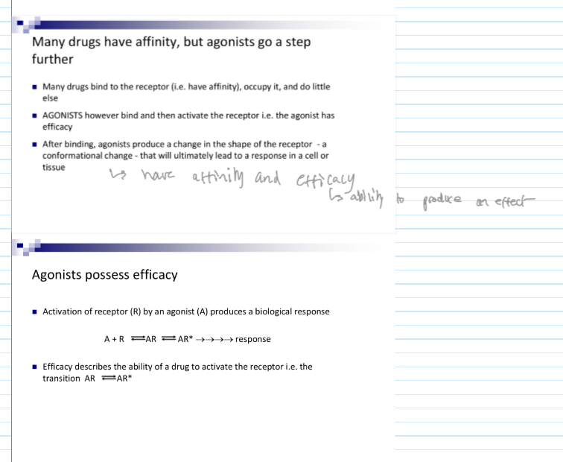
Affinity and efficacy – could just skip this

Slide 24
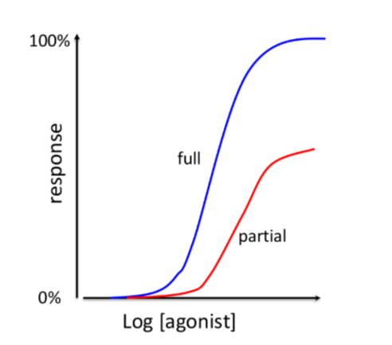
Partial vs full agonists
It's in the name really, a full agonist will produce maximum effect, even if only a fraction of the receptors are occupied
A partial agonist cannot produce maximum effect even if every receptor is activated
If we keep this in mind, the graphs are quite intuitive

Slide 25
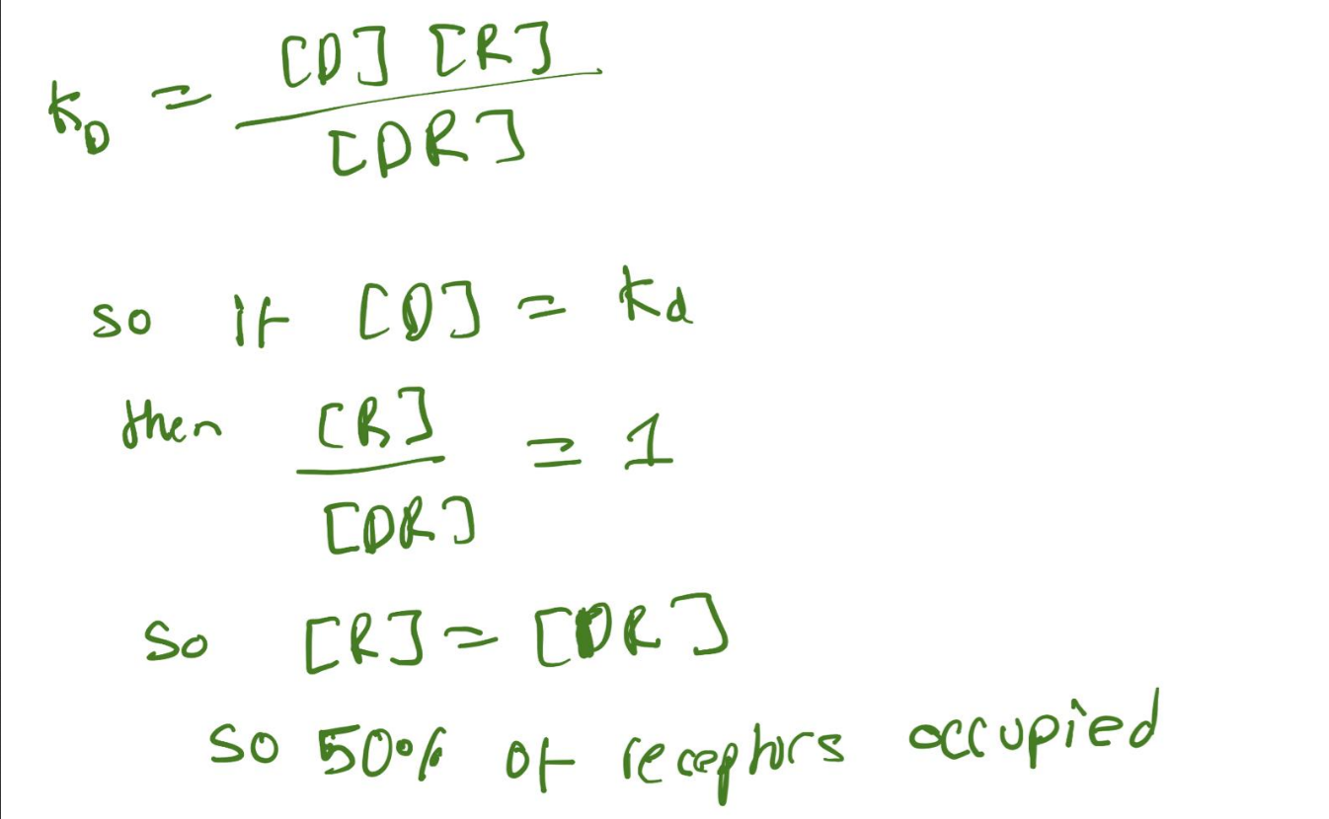
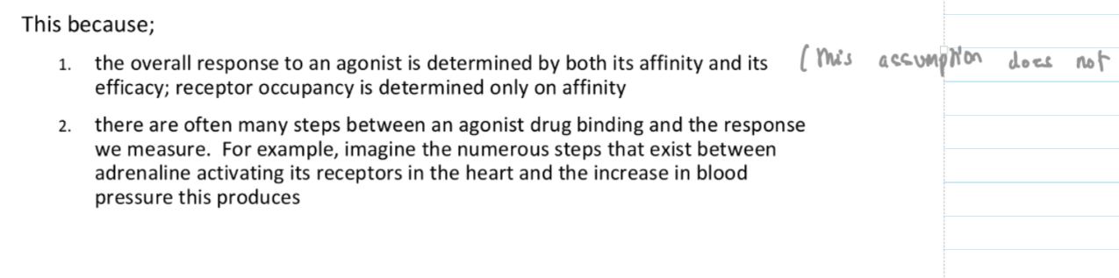
Key question for you guys
Ok so you probably remember from chemistry principles that if the concentration of drug = Kd then the 50% of the receptors are occupied
Why is Kd not the same as EC50?

Slide 26
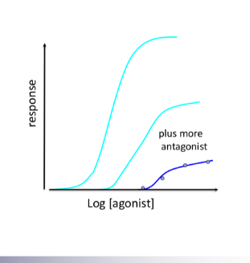
Graphs of antagonists – quite intuitive
Reversible competitive antagonists produce parallel shift to the right – you need more of the drug to produce the same effect because there's competition (but at least the receptors are completely out of the game), you can still reach max effect if you just saturate
Irreversible competitive antagonists produce non-parallel shift and the graph doesn't reach the same height – makes sense because there are fewer functional receptors

Slide 27
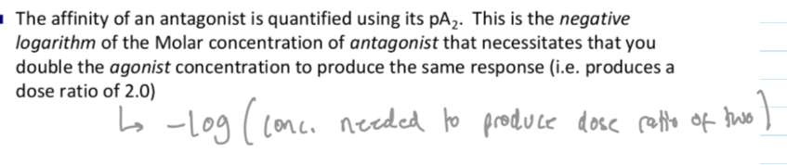
pA2 and it's relationship to affinity – someone define it and tell me
The higher the pA2, the lower the affinity of the antagonist
This is quite intuitive – logarithms find the missing power. If you are doing negative logarithm then the higher the pA2 the lower the A2.
-log(0.1) = 1
-log(0.01) = 2

Slide 28
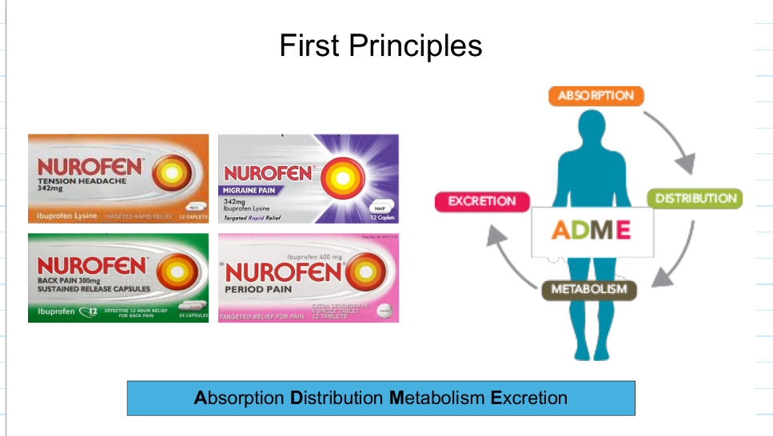
The most important concept in PK - what does ADME stand for?

Slide 29
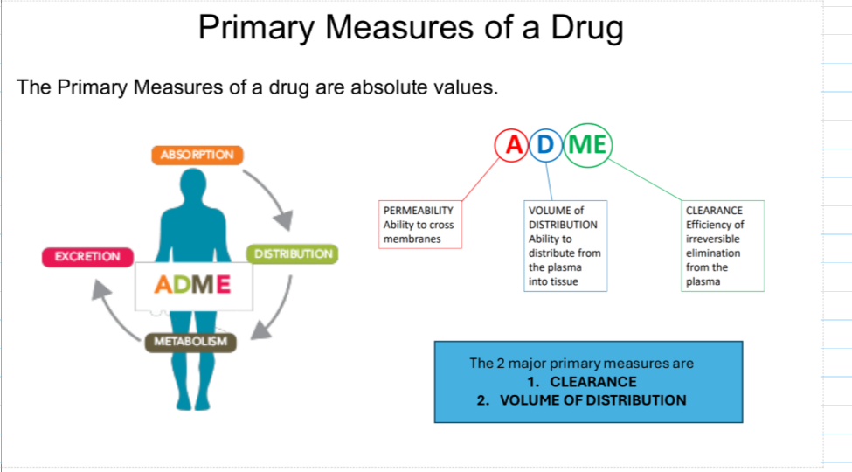
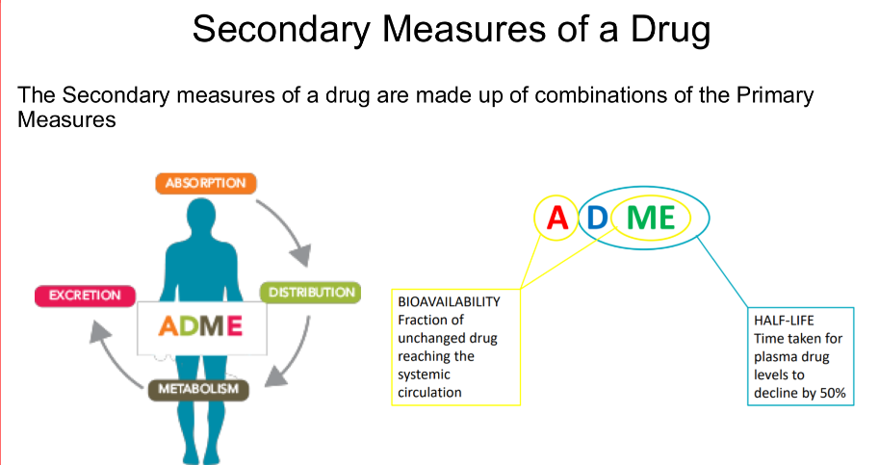
Now let's use this principle
Which part of ADME do permeability, volume of distribution and clearance correspond to?
What about half life?
Volume of distribution is a bit of an interesting but very useful measurement. Here is the definition in case you are not completely familiar:
Volume of distribution is defined as the apparent volume of fluid into which a drug would need to be distributed to achieve a concentration equal to the concentration in the plasma.
So a higher value means the drug is more likely to be found in the tissues of the body

Slide 30
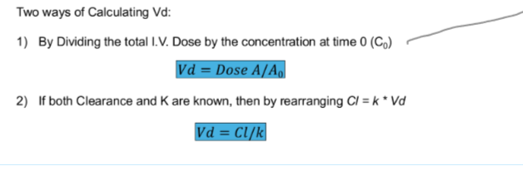
Two ways of calculating volume of distribution (sort of) explained
This pretty much just stems from its definition. The IV dose tell you how much of the drug is in the system. The concentration at time 0 tells you the concentration in the blood at that moment in time
Since clearance is volume of the blood is being cleared per unit time, dividing this by the elimination rate constant (which has units time^-1) gives you a value with units of volume.

Slide 31
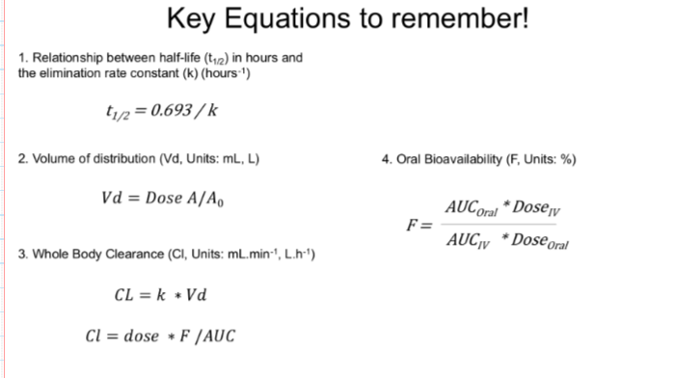
Here are all the key equations
If you did A-level maths, the half life equation is derived from a differential equation, 0.693 is an approximation of ln(2)

Slide 32
MCQs!!

Slide 33
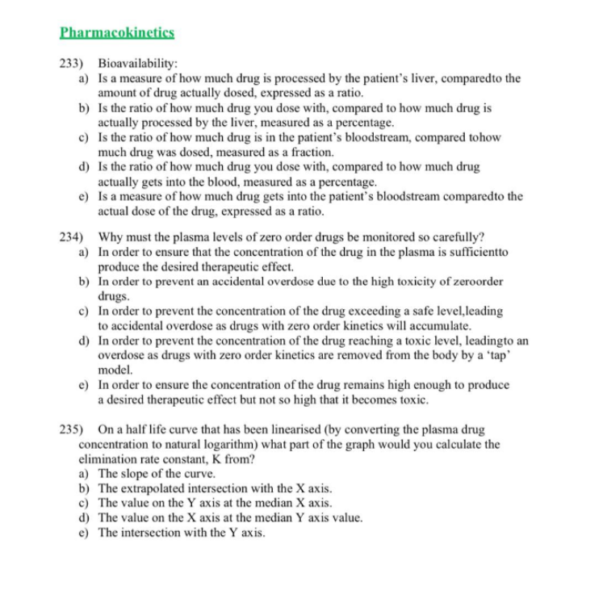

Slide 34
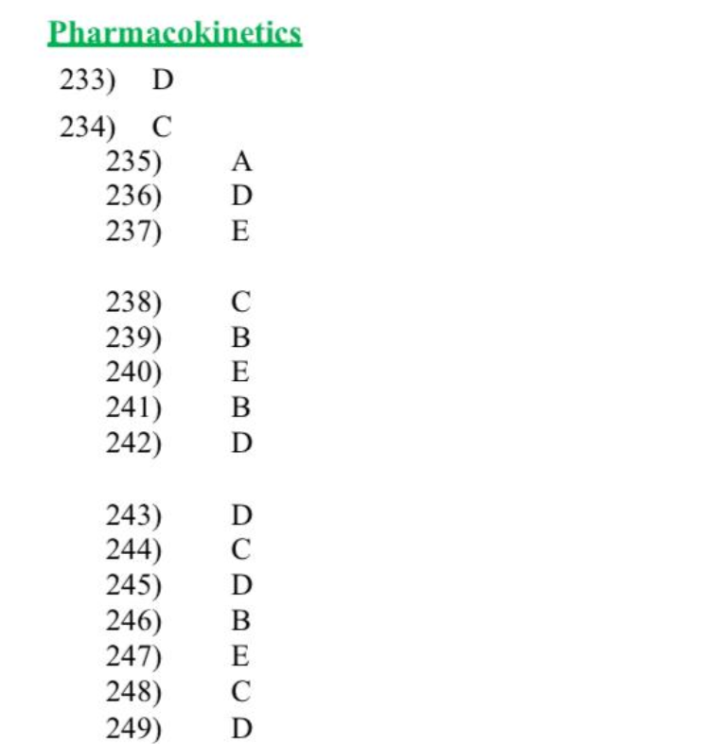

Slide 35

Now onto nerves...

Slide 36
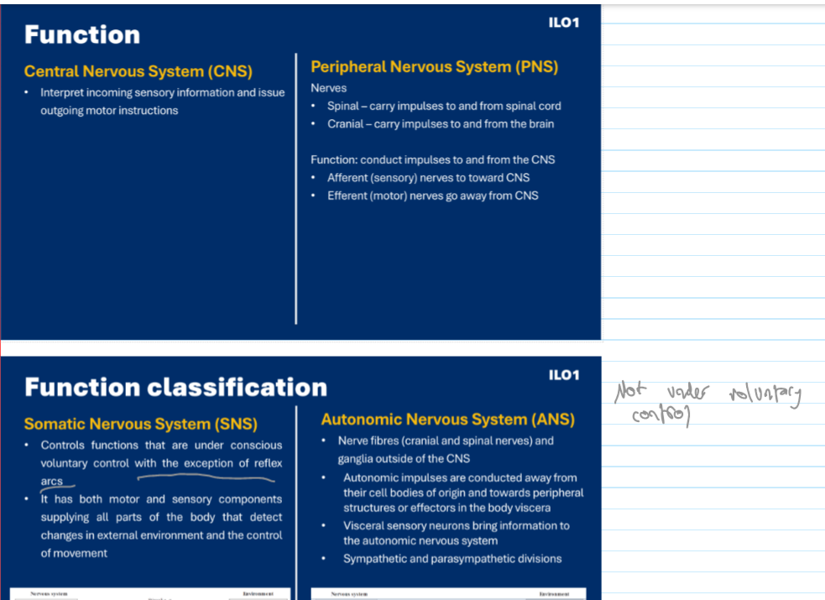
I have a feeling you know this already but this is really key so I've put it here

Slide 37
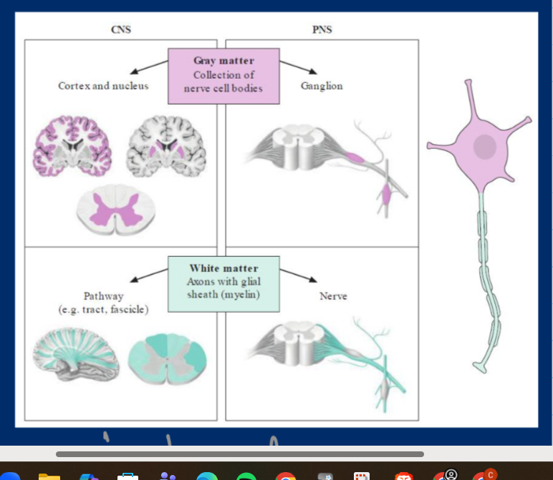
Someone tell me what is grey and white matter as well as the terminology for both in the brain and spinal cord
Grey matter is mostly cell bodies, white matter is mostly axons

Slide 38
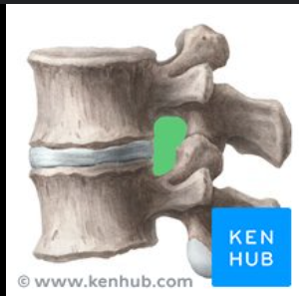
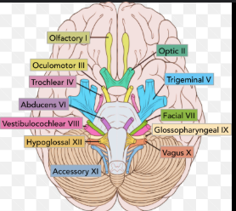
Some info about nerves themselves
There's two types:
Cranial nerves – there's some very interesting mnemonics for these. There's twelve. These originate from the brain
Spinal nerves – these come out of the intervertebral foramina (foramen = hole). These originate from the spinal cord.

Slide 39
Ventral and dorsal horn - which is sensory, which is motor?
Ventral is motor – Vroom
Dorsal is sensory – other one so it's sensory

Slide 40
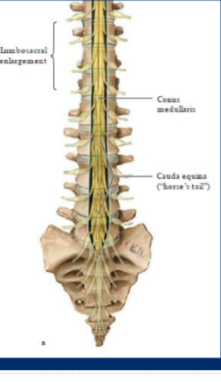
Enlargements, conus medullaris, cauda equina
The enlargements correspond to the limbs – ofc lots of nerves going to the limbs
Conus medullaris is where the spinal cord ends
Cauda equina (horse tail) is basically just a bundle of nerves. It looks like a horse's tail because the nerves are all going down to pelvis / legs

Slide 41
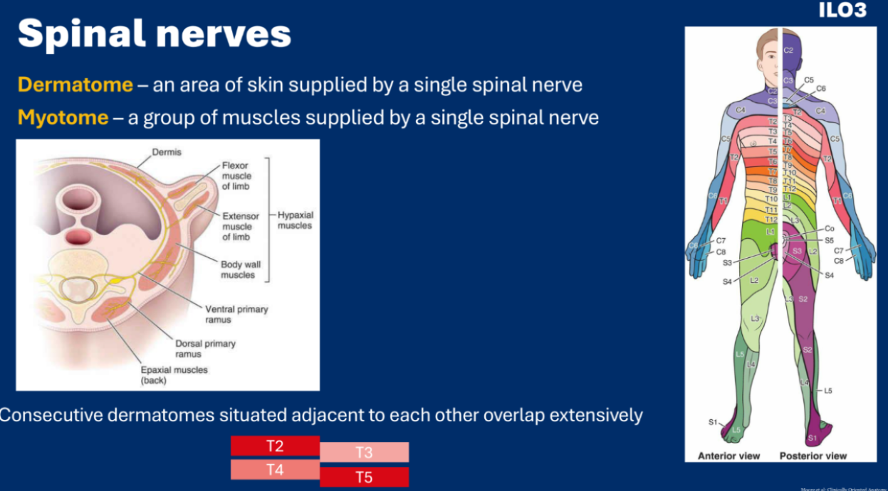
Dermatomes and myotomes
As you can imagine, this is really important for assessing nerve function e.g. after a major accident

Slide 42
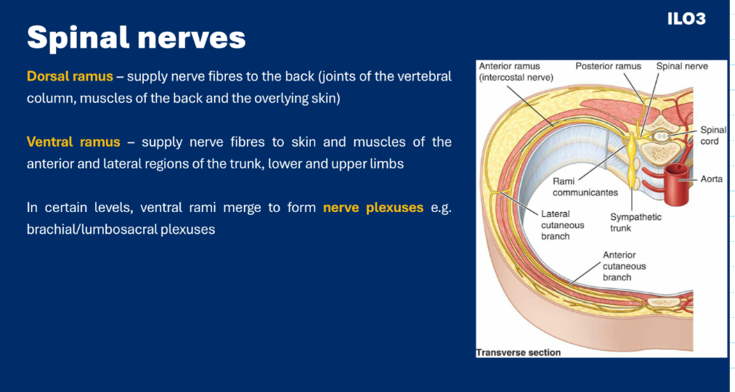
Each spinal nerve splits into a dorsal and ventral ramus

Slide 43
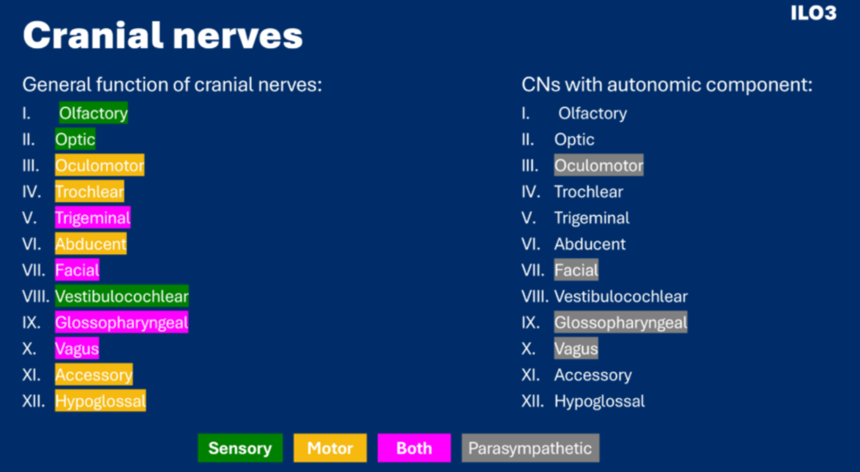
Cranial nerves – there's a very terrible but very memorable mnemonic out there (you didn't hear it from me)

Slide 44
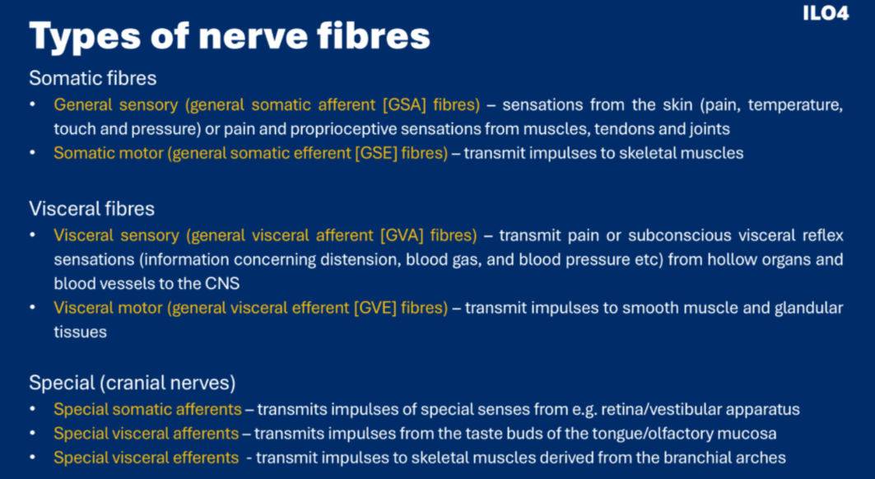
Types of nerve fibres – this kinda makes sense if you just keep voluntary vs involuntary in mind

Slide 45
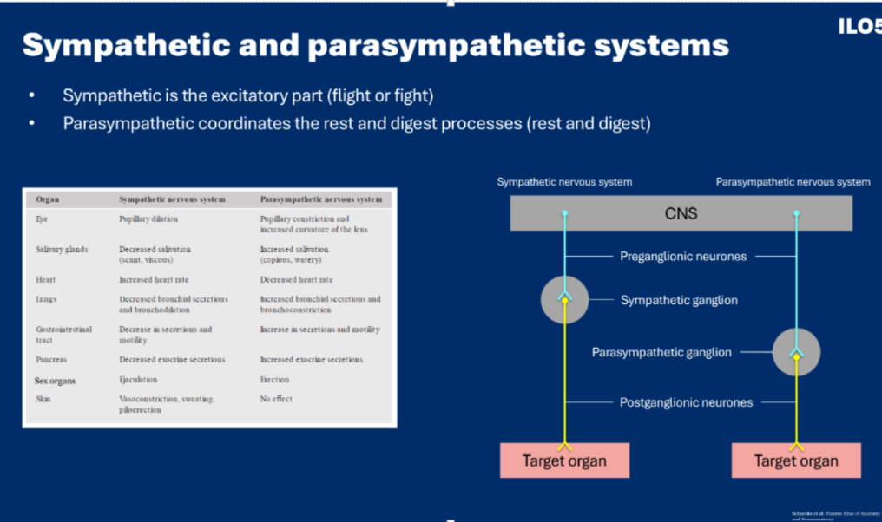
Preganglionic and postganglionic nerves

Slide 46
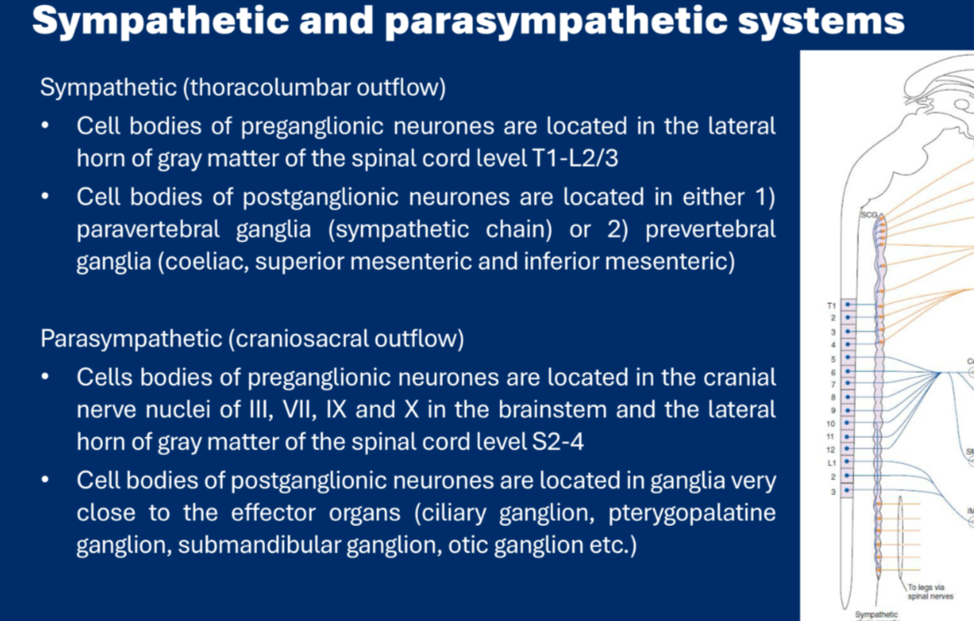
For the ganglia for sympathetic, remember how it says on the PPT that sometimes fibres go straight through sympathetic chain without synapsing

Slide 47
MCQs!!

Slide 48
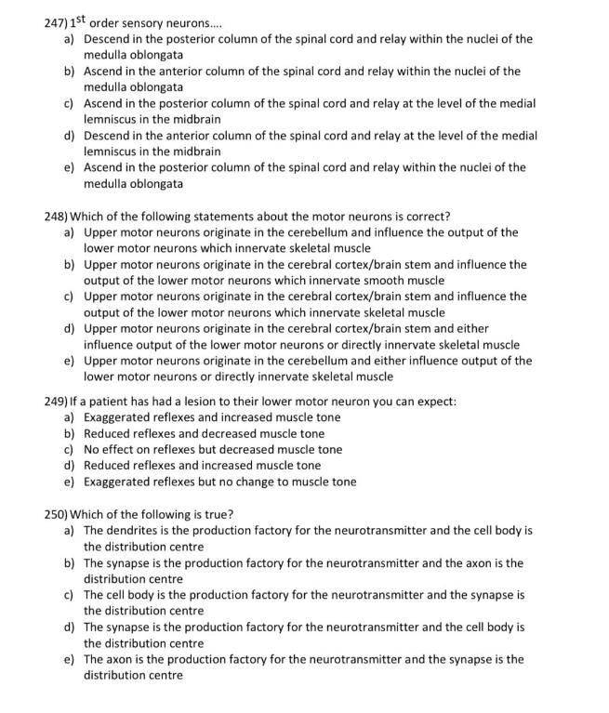

Slide 49
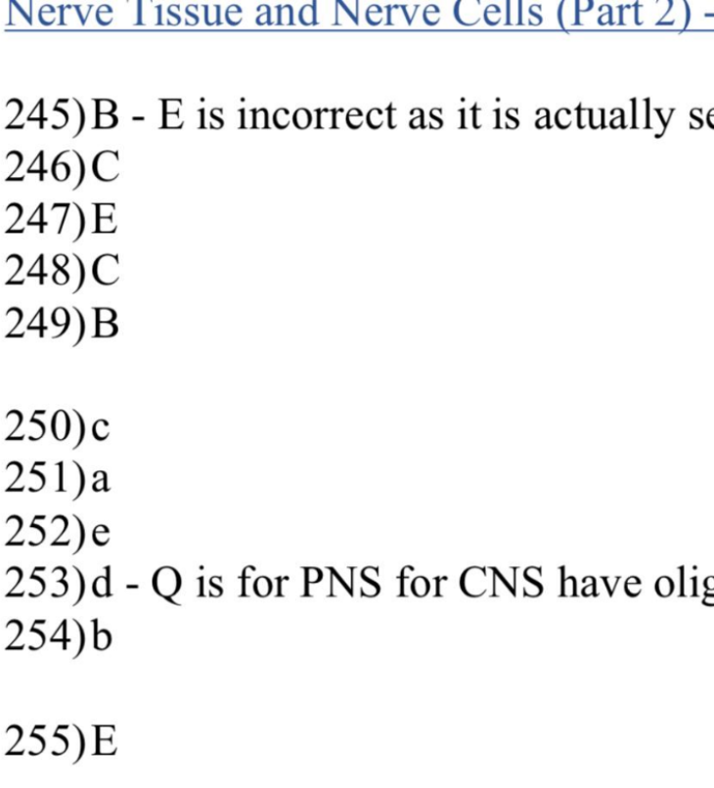

Slide 50
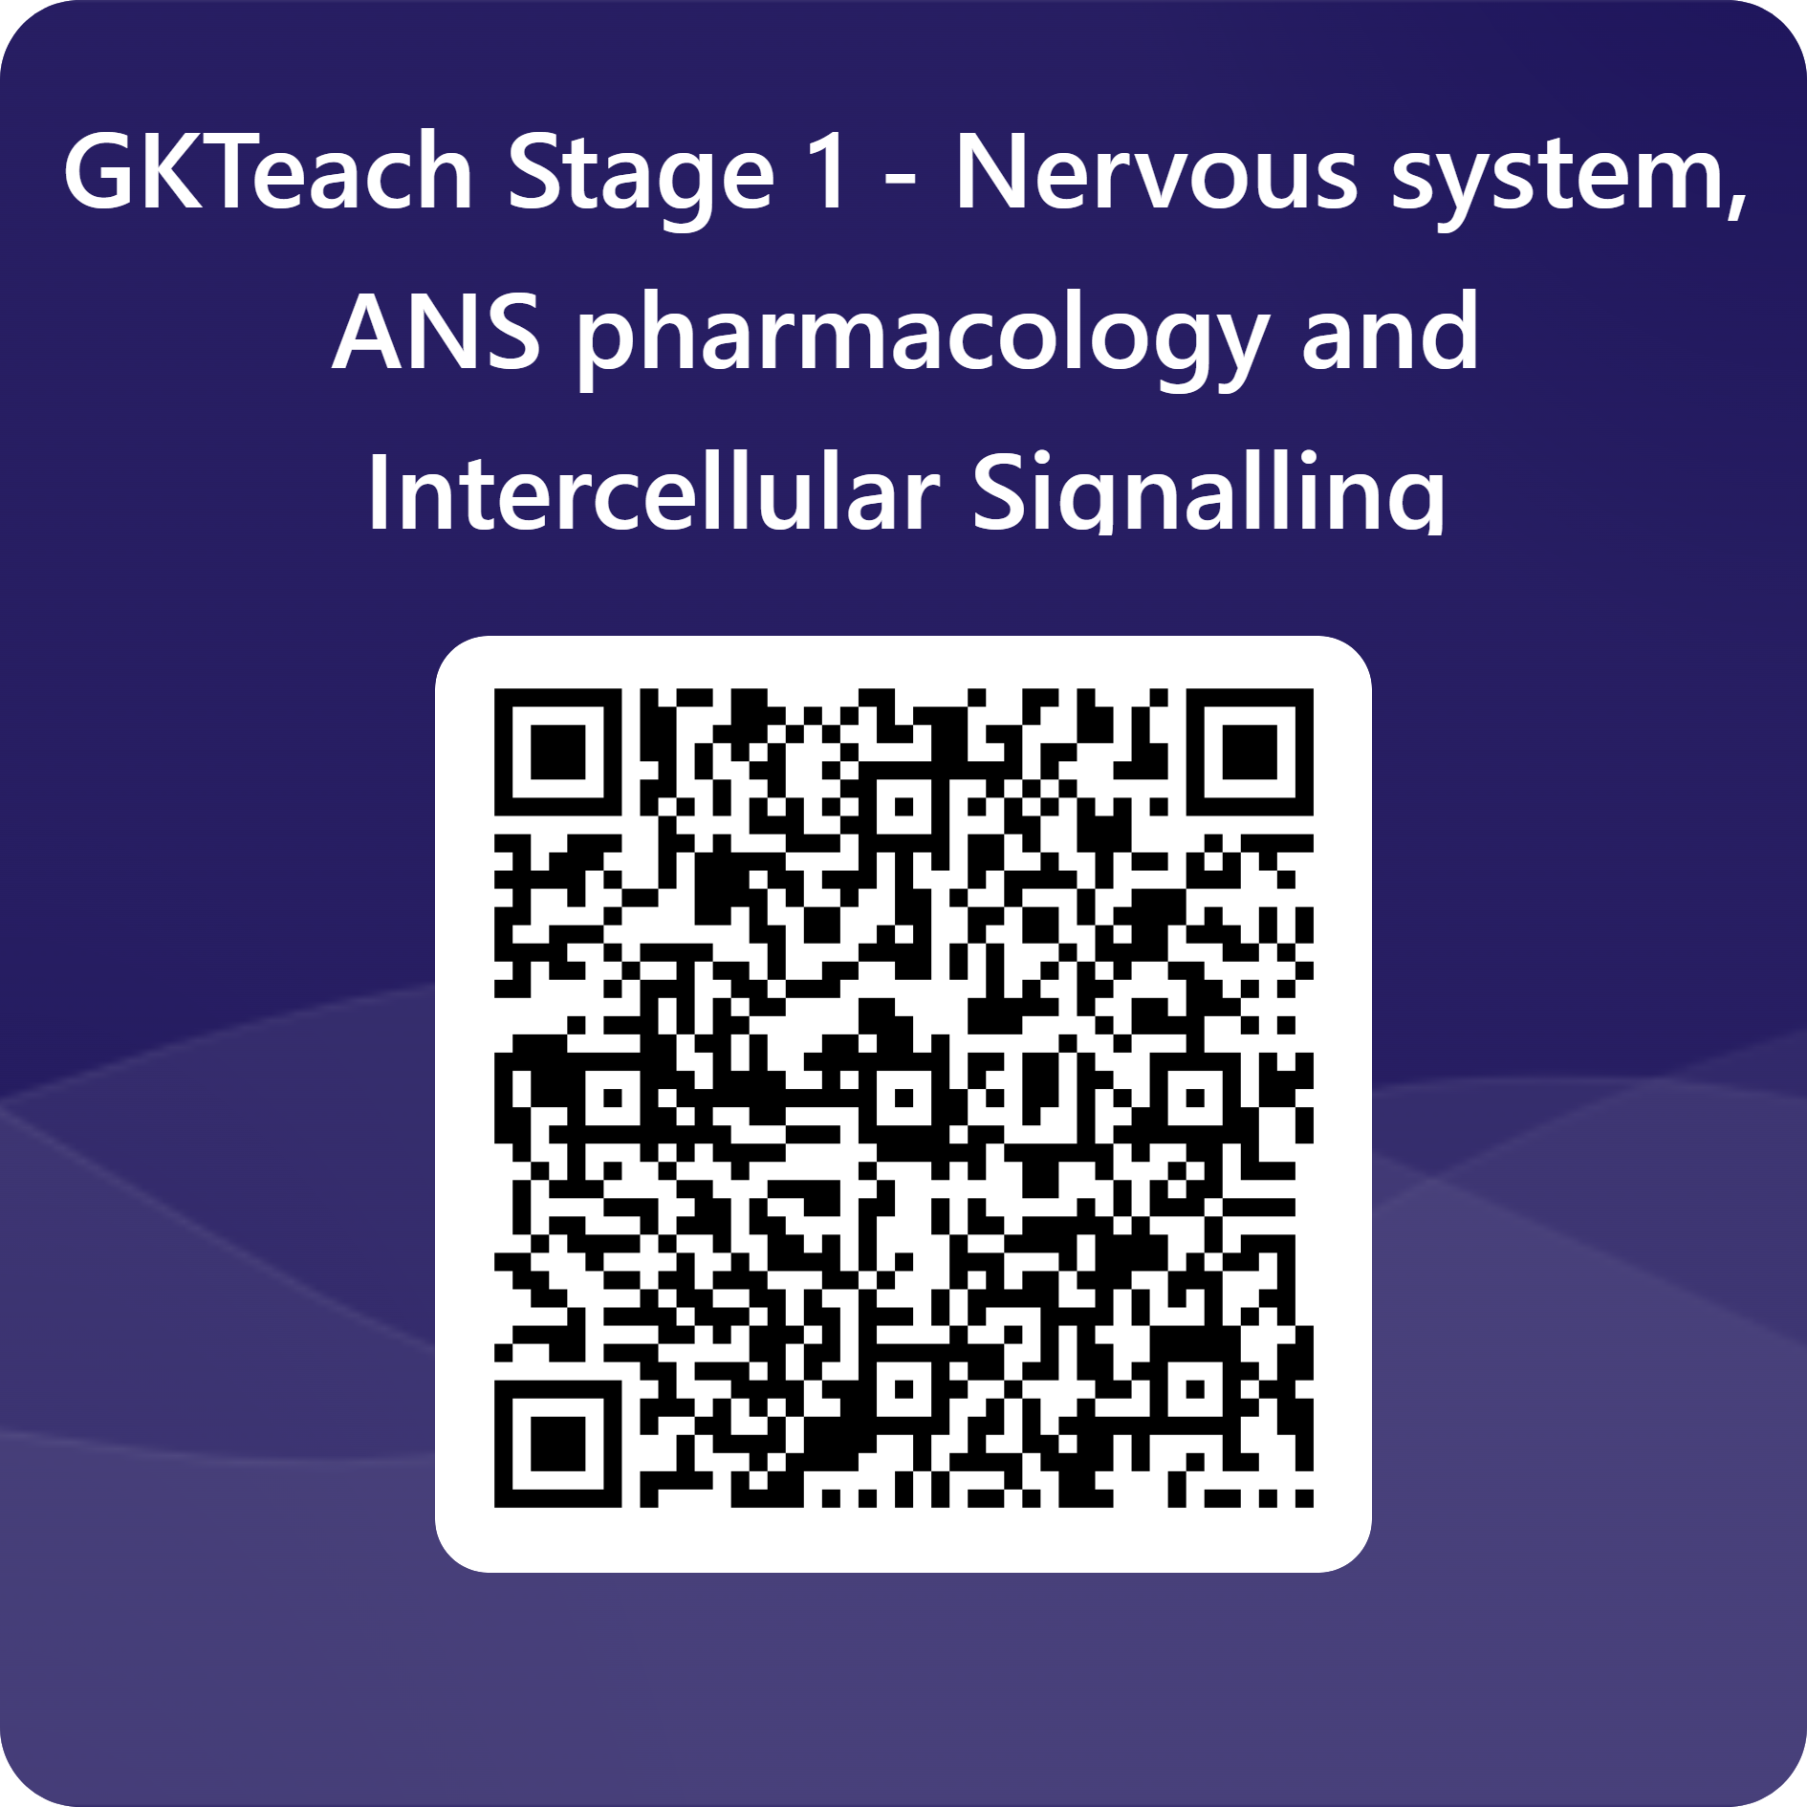
Thank you!
Any questions?
sarjak.gautam@kcl.ac.uk
Please take a moment to fill out the feedback form - the slides will be shared afterwards!

