Slide 1
What I Wish I Knew in Fourth Year Wednesday 21st August 2024 Tanzim Shahid and Natasha Ssozi

Slide 2
Year 4 Overview
Introductory Week
4 eight-week clinical blocks:
Emergency Medicine and Critical Care
Women’s Health
Child’s Health
Mental Health
Each block:
Week 1 – Induction week to the block/site
Weeks 2-7 – Clinical Placement
Week 8 – Themed Learning Week
Quality Improvement Project (August until Feb/March)
Exams:
PT1 in October/November
PT2 in January
PT3 in May/June (Summative)
OSCE in June (Formative)
Notes:
Tanzim

Slide 3
A typical week in Year 4
 | AM | PM
Monday | Placement | Placement
Tuesday | Placement | Placement
Wednesday | QIP | QIP/Self-Directed Study/Sports
Thursday | Placement | Placement
Friday | Placement | Placement
Notes:
Tanzim

Slide 4
Returning to clinical placements the transition from intercalation to 4th year
It’s going to feel daunting – that’s normal
It’s been a year where a lot of you would have little to no clinical practice
Expect not to be great – less stress on yourself and allows you to better see where you need improvement without the emotional backlash of ‘I’m so bad!'
YOU WILL MOST DEFINITELY IMPROVE!
You do pick it up quicker than you expect
Notes:
Tanzim

Slide 5
E-Portfolio
Engagement logs – luckily no more 150 words...
Reflections – usually 6 per block
Mini-CEX – usually 1 per block
CBD – usually 1 per block
Supervisor sign offs (Clinical, Educational)
ES – Start and end of year sign off, end of block sign off
CS – start, mid, end of block sign off
8 Mandatory sign offs
Clinical skills – actually very achievable?!!
Make a list at the start of each block!
Try get them done early on in the block
Notes:
Natasha

Slide 6
General tips
Go to formal teaching
Pester whoever’s doing it for the slides after!
Get a subscription to PassMedicine and/or Quesmed depending on which you prefer
Make friends with the F1/F2s (esp. on peripherals)
Try and push for prescribing teaching!
This can be quite sporadic throughout the year – KCH, you're lucky to have Shivani...
Share resources amongst your friendship groups!!!
Especially if they've intercalated – use their brain
Study like you’re a final year med student – pretty much everything you see could be examinable
Teaching junior students (highly recommended)!
Join the MSA PAL scheme as a facilitator if you haven’t in previous years.
Try to stay on top of everything e.g. portfolio
Notes:
Natasha

Slide 7
Emergency Medicine and Critical Care
Most enjoyable block for the both of us!
Emergency medicine (A&E)
- Great for clerking (histories, examinations)
- Clinical skills (Try to complete most here)
Anaesthetics
- Great for clinical skills
- Cannulas
- BVM
- Drawing up drugs
- Infusions
Critical Care
- A-E assessments
- Management of complex patients
Revise Physiology prior to attending placement
Notes:
Natasha lead
Tanzim to pitch further comments after natasha

Slide 8
Women’s Health
Typically split into
Sexual Health – a lot of clinical skills here
Gynae wardclinics
Antenatal clinics
Labour Ward (nights),
Breast week,
Main theatres and Day Surgery
Quite a hands-on placement : surgical and medical wise
Opportunities to scrub in and assist during C-section and assist in deliveries.
Introduce yourself to the patient beforehand, don’t just come in at the end!!
Probably will get the best examination teaching during simulation sessions with midwives, antenatal clinics, on Maternity Assessment Unit and Breast Clinic
Sign offs: speculum/bimanual vaginal examination/female catheter/swabs – best to do this during day surgery as patient will be under anaesthesia (remember your consent form!)
For the bimanual/speculum examination find the surgical team prior to attending surgery so they can help tell you which patient's they should you can ask for consent.
First day of placement, ask what days they actually have gynae surgeries
Notes:
Natasha lead
Tanzim to pitch further comments after natasha

Slide 9
Child Health
Paeds A&E is great to practice Hx and Ex of child with parents.
NICU/SCBU/Neonatal or Baby Units – great for teaching
Get familiar with the paeds Hx taking model (it's a bit different & likely to come up in OSCEs)
Spotting the sick child E-learning on KEATS
“Don't forget the bubbles” website
Online patient scenarios on KEATS (in general the KEATS page is good for paeds)
@brownskinmatters Instagram page
Get familiar with describing rashes and how to prescribe fluids for children!
Always ask about the birth, immunisations and social workers!
KEEP YOUR SAFEGUARDING HATS ON! – HEADSSS assessment
Notes:
Tanzim lead
Natasha to pitch further comments after Tanzim

Slide 10
Mental Health
2 mental health placement locations in the block
Teaching days
Forensic Psychiatry
Child and Adolescent Mental Health
Old Age Psychiatry
Placements vary in how much there is to do
Ask for teaching sessions from clinical supervisor
Optional placements - e.g. Place of safety & Liaison psych (can sign up on KEATS)
Get used to asking about risk and how to perform assessment (as always will need to do this in OSCEs)
Further understanding into Mental Health Act and Mental Capacity Act
Notes:
Tanzim lead
Natasha to pitch further comments after Tanzim

Slide 11
Quality Improvement Project
Beginning of September: groups are allocated
January: critical appraisal presentation
Late February: project write-up, patient shadowing reports and reflective diaries are due
Every Wednesday:
- meetings
- self-directed learning such as online e-learning on KEATS, attending a patient shadow,
- working on project, preparing for the presentation, writing it all up)
Opportunity to present findings at conferences
Notes:
Natasha

Slide 12
Quality Improvement Project advice
Start early
- Organise your patient shadowing as soon as you can
Work consistently throughout the year
Write your reflective log as you go along as it will mean:
1) you can be thorough (you won't need to rely on retrospective memory)
2) create a shared document for the group to collaborate on
Organise a timeline in the first couple of weeks to establish feasible deadlines
Engage with your project and supervisor
- find out what they are expecting of you
if unsure, ASK
The Keats QIP resources/templates are very useful!
Notes:
Tanzim

Slide 13
Year 4 Assessments
PT1 and PT2 (Formative)
PT3 (Summative) and OSCE (Formative)
Question banks are your best friends! (& do a mix)
- Passmed
- Quesmed
- Anki
Mock exams, question banks and any past papers you can find (e.g. Medical School Council ones on KEATS)
Revise everything – UKMLA…
Notes:
Natasha

Slide 14
General exam and revision tips
Progress Tests
- go through topics with friends; teach each other
OSCE
- use the Purple OSCE Guide on KEATS
- find a group of friends who you can do OSCE circuits with before exams
- go through cases and stations
- be honest when providing feedback
- use the OSCE stations and the feedback on KEATS
- attend society mock OSCE sessions
https://www.gktmsa.org/education
Notes:
Tanzim

Slide 15
Mental Health & Wellbeing
It's not going to be as full on as you think it will be at the start!
Taking days off for your mental health (just as you would do for physical health) is fine! Just communicate this to your site administrator
Try to pace yourself in terms of revision to avoid burn out
Notes:
Tanzim

Slide 16
Useful Resources
Psychiatry PRN
Oxford Handbook of Clinical Medicine (10 Edition)
Oxford Handbook of Clinical Specialties (11 Edition)
Passmedicine questions and textbook
OSCE Stop Textbook
OSCE Stop Website (free)
OSCE Stations Blogspot: http://osce-stations.blogspot.com (free)
Osmosis videos
Geeky Medics
Essential Examination Textbook
Child Health Mock Progress Test on Keats CH Page
Child Health Patient Scenarios on Keats CH Page
Quesmed YouTube Videos (free)
Notes:
Natasha

Slide 17
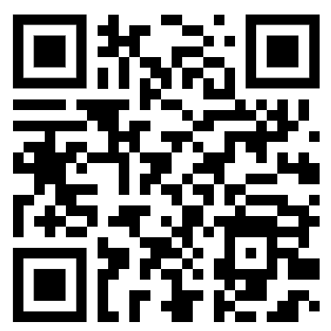
Any questions? Feedback form
Wishing you all the best in Year 4!
Useful contacts:
mbbsstage3@kcl.ac.uk
msa@kcl.ac.uk
yathavi.charavanamuttu@kcl.ac.uk
Follow GKT MSA on Instagram, Facebook & Twitter!
Feedback:
https://forms.gle/FrCfd62ywuPgxjN99

Slide 18
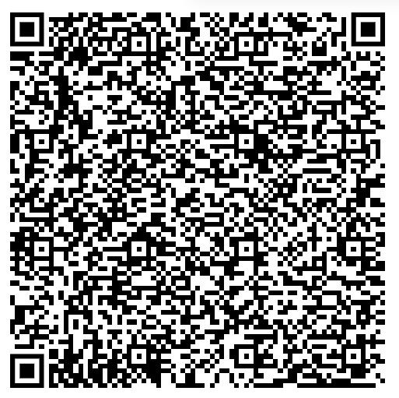
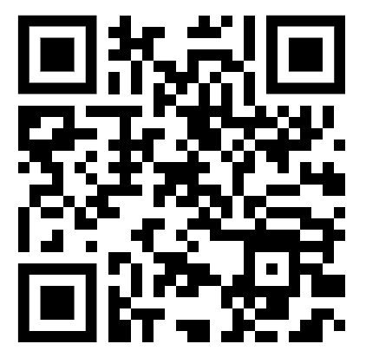
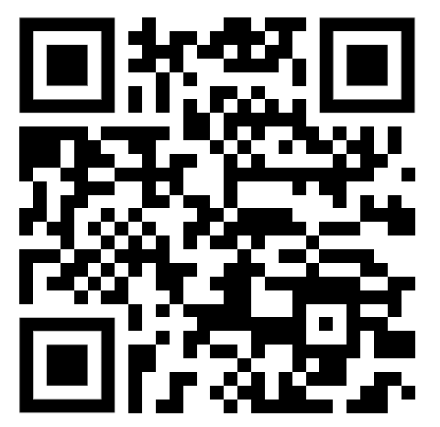
Peer Assisted Learning (PALs) Sign Up:
Want to be a STUDENT for PALs?
Sign up to be taught by year 5s!
Want to be a FACILITATOR for PALs?
Sign up to teach year 3s!
iBSc Buddy Scheme Sign Up:
Lastly,
Please collect your blues and shields awards from the MSA office NOW!
Have you just graduated from your iBSc?
Sign up to be an intercalators buddy for your course!

