Slide 1







GKTeach
PCRS – Cardiac
Physiology
STAGE 1
Akshaya Krishna Perumal
YEAR 3 MBBS
08/12/2025

Slide 2


Control of Heart Rate

Slide 3
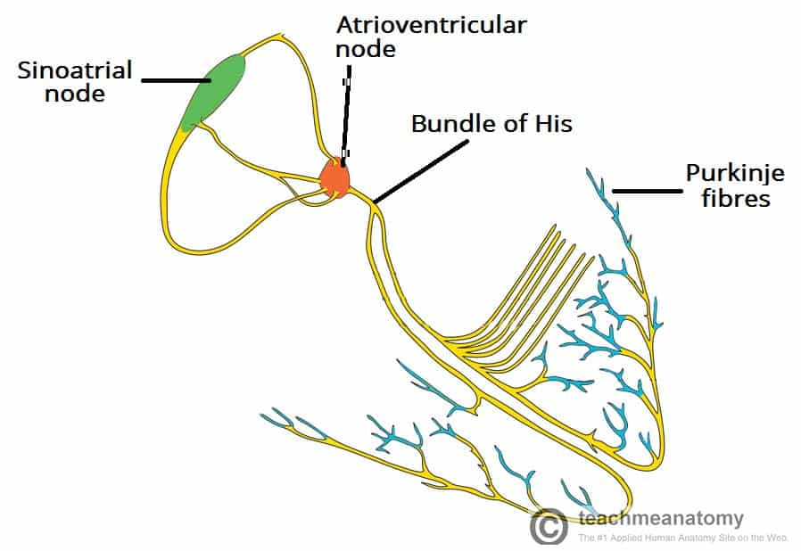

Conduction through the Heart
  Primary pacemaker of the heart = SAN
  Travels to AVN → bundle of His → Left and Right bundle branches → Purkinje Fibres
  There is a pause in conduction at the AVN – to allow ventricles to fill up completely before impulse to contract is passed on

Slide 4
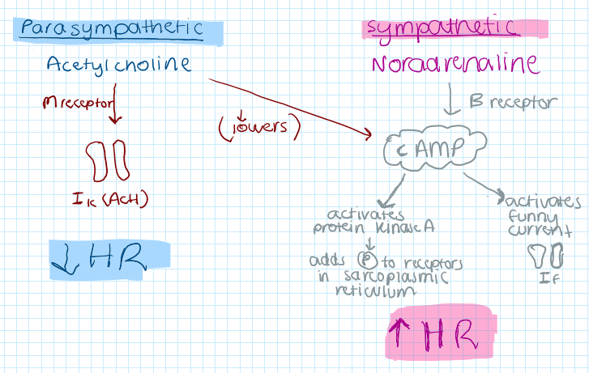
Neurohormonal control of Heart Rate
  Para-sympathetic control - vagus nerve - Acetylcholine
  Sympathetic control - sympathetic nerves - Noradrenaline
Initial heart rate increase up to 90bpm is done through decreasing vagal action
Heart rate increase further than 90bpm is done through activating sympathetic nerves

Slide 5
Steps of Cardiac Cycle
  1. Diastole
  LA pressure > LV : mitral valve will open due to pressure and blood enters LV
  Final emptying of blood from LA → LV occurs due to atrial contraction
  2. Systole
  Isovolumic contraction – LV contracts but aortic valve is closed so LV pressure rises
  Ventricular ejection - LV pressure keeps rising higher than aortic pressure : aortic valve opens and LV empties
  3. Diastole
  As contraction ends, LV pressure falls until aortic valve shuts
  Isovolumic relaxation – pressure keeps falling until LA pressure > LV and cycle repeats

Slide 6
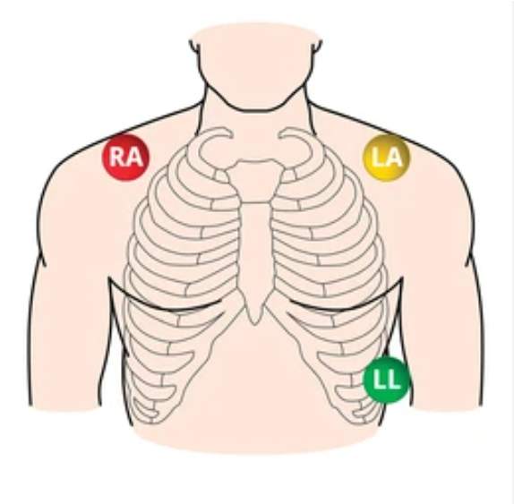
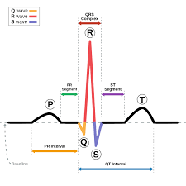
ECGs
  Electrocardiogram
  3 Lead ECG: Lead 1 (Right Arm) ; Lead 2 (Left Arm) ; Lead 3 (Left Leg)
  Waves of ECG
  P = Atrial depolarization
  Q = Septal depolarization
  R = Ventricular depolarization (towards apex)
  S = Ventricular depolarization (towards atria)
  T = Ventricular repolarization
  Atrial repolarization can’t be seen on the ECG, as it is masked by the QRS complex

Slide 7
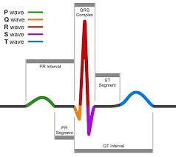
ECGs
  ECG Intervals
  PR Interval – Atrial conduction and AVN delay
  QRS duration – ventricular conduction velocity
  QT Interval – ventricular action potential duration
  ST segment – recovery to ventricular repolarization

Slide 8
Control of Cardiac Output

Slide 9
Cardiac Output
  Cardiac Output = Heart Rate x Stroke Volume
  Factors of Cardiac Output: Heart Rate, Stroke Volume, Preload, Afterload
  Preload – filling pressure of ventricle
  LV preload = Pulmonary Venous Pressure
    RV preload = Central Venous Pressure
  Afterload – resistance to ejection pressure
  LV afterload = mainly aortic BP
  RV afterload = mainly pulmonary artery BP
  Both systemic and pulmonary circulation are in series, so LV output must equal RV output, so venous return must equal cardiac output

Slide 10
Preload
Factors increasing preload | Factors decreasing preload
Increasing blood volume Venoconstriction Respiratory pump Skeletal muscle pump | Hemorrhage Dehydration (exercise, sweating) Venous pooling (standing)

Slide 11
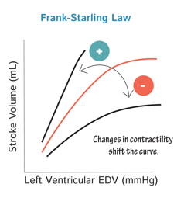
Frank-Starling Law
As EDV increases so does SV
more blood in, more blood out
Why?
As ventricles fill more, myocardial fibres stretch
Stretch improves contraction by 2 methods
1. More stretch = optimises actin-myosin filament alignment
More cross bridges leads to stronger contraction
2. More stretch = makes Troponin C more sensitive to Ca2+
Importance?
Ensures LV and RV stroke volume are perfectly matches

Slide 12
Contractility Changes
Contractility is the strength of cardiac contraction independent of preload and afterload
Represented by shifts of the entire curve up or down, whereas preload changes move along the frank-starling curve

Slide 13
Control of Blood Pressure

Slide 14
Blood Pressure and Flow during Cardiac Cycle
During Systole | During Diastole
75% of Stroke Volume is stored transiently in aorta and large arteries This means potential energy is stored in the elastic walls of these vessels 25% of the stroke volume is pushed into the smaller arteries | During Diastole - need to rely on the stored potential energy (of arterial recoil) to propagate blood flow as the heart is no longer contracting Stored pressure falls and flow continues through smaller arteries and reaches tissues

Slide 15
Blood Pressure
Systolic BP – peak arterial pressure during ventricular systole when LV ejects blood into the aorta
Diastolic BP – lowest arterial pressure during ventricular diastole, when heart is no longer contracting
Blood Pressure = Cardiac Output X Total Peripheral Resistance
Propagation of pulse - pressure wave of the hearts pulse travels faster than the blood itself
As it moves through the circulation system, vessels becoming stiffer
There is higher resistance in smaller vessels

Slide 16
Short term BP control - Baroreceptor Reflex
Baroreceptors: found in aortic arch (→ Vagus X nerve) and carotid sinus (→ Glossopharyngial IX nerev)
They contain nerve endings that are sensitive to stretch
Lower pressure (less stretch) leads to less nerve impulse firing
This reflex maintains relatively constant pressure
Sensitivity of reflex: greatest when Mean BP between 80-150mmHG, also more sensitive when there are rapid changes in pressure
Adaptation of reflex – partially resets when a new pressure is sustained

Slide 17
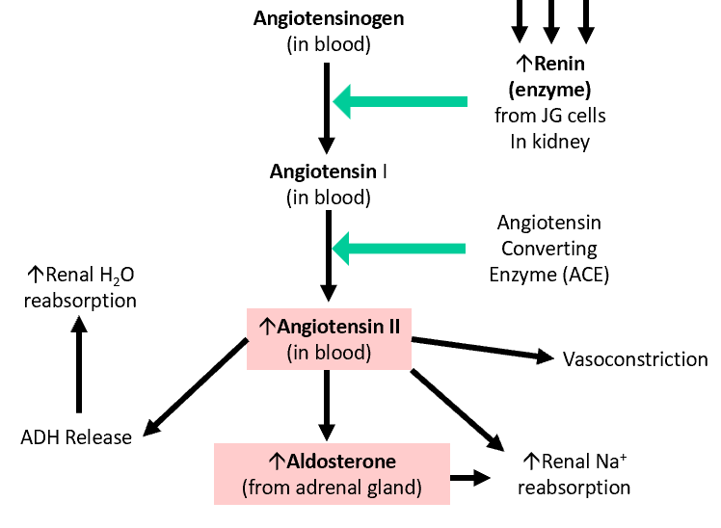
Long Term BP control - by Kidney action
By RAAS cascade | By Pressure Natriuresis / Diuresis
Activated when kidneys detect low perfusion (happens when blood pressure is low) | Higher BP = higher renal perfusion = Higher sodium excretion and water excretion Decreases blood volume and therefore decreases blood pressure

Slide 18
SBA
The increase in stroke volume that occurs when end-diastolic volume increases is primarily due to:
A. Increased sympathetic nerve activity
B. Increased myosin ATPase activity
C. Increased sarcomere length
D. Increased circulating adrenaline
E. Increased heart rate

Slide 19
SBA answer
Answer: C
Stretch → better actin–myosin overlap + ↑ Ca²⁺ sensitivity.

Slide 20
SBA
In Chronic Heart Failure, fluid retention often leads to symptoms such as ankle oedema. Through which mechanism this this likely to occur
Reduced afterload
B. Increased baroreceptor firing
C. Increased parasympathetic tone
D. Activation of RAAS
E. Decreased venous pressure

Slide 21
SBA answer
Answer: D
If cardiac output is lower – there will be renal hypoperfusion
This activates the RAAS cascade – learding to sodium and water retention
This causes oedema

Slide 22
SBA
A healthy adult begins light exercise. His heart rate increases from 55 bpm to 85 bpm.
Which mechanism is primarily responsible for this initial rise?
A. Increased sympathetic firing
B. Increased circulating adrenaline
C. Withdrawal of vagal tone
D. Increased noradrenaline reuptake
E. Increased AV node conduction speed

Slide 23
SBA answer
Answer: C
Heart rate increases up to 90bpm is achieved through withdrawing action of the vagus nerve

Slide 24
GKTeach
PCRS – 4,5,6
Control of blood flow
Fluid balance
Co-ordinated cardiovascular responses
STAGE 1
Shruti Turaga
08/12/2025
YEAR 8 MBBS

Slide 25
Control of blood flow

Slide 26
  Vascular tone regulatory mechanism
  The vascular endothelium in controlling blood flow
  Active hyperaemia
  Flow autoregulation in the brain
LEARNING OBJECTIVES

Slide 27
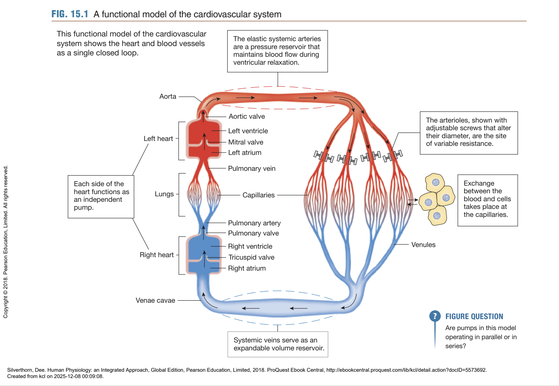

Slide 28
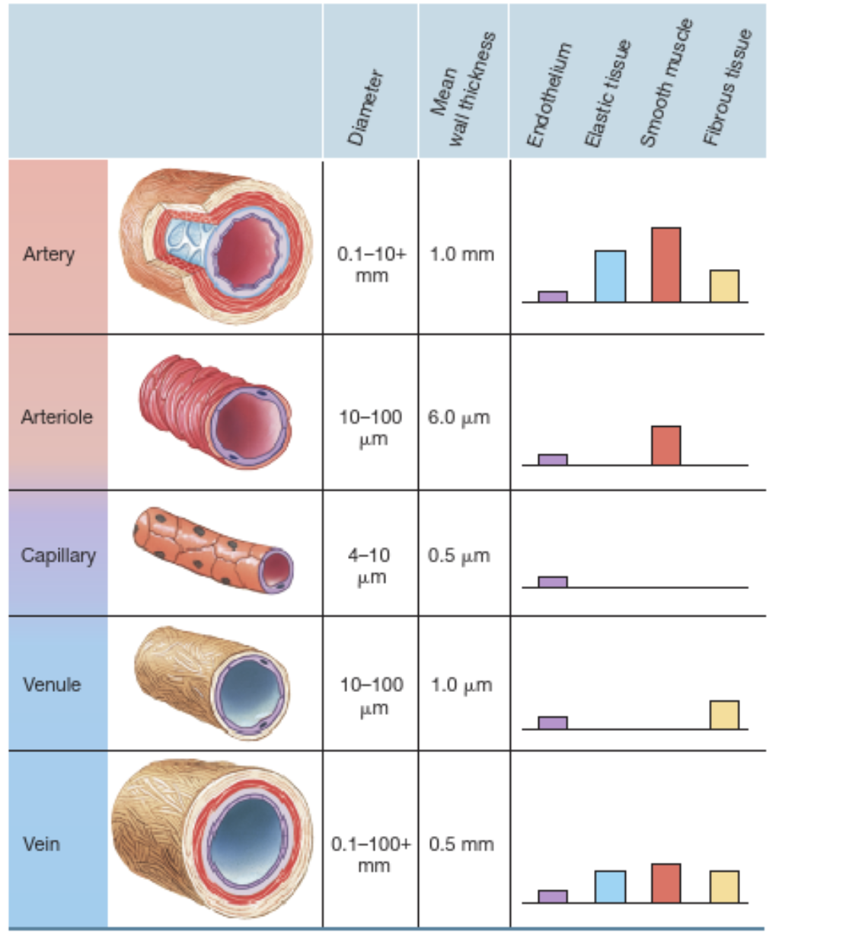
Notes:
Focus on high SM @ arteriole (regulation of resistance), high elastic tissue @ artery (maintains BF during ventricular relaxation ie by 'bouncing back'), veins (high capacitance – ie can expand), capillaries

Slide 29
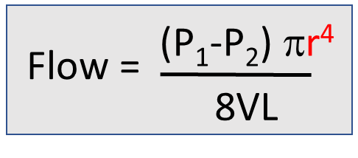


Blood flow regulation to organs/tissues
  So, arteriole as the MAIN RESISTANCE VESSELS -> control of regional blood flow
  VASOCONSTRICTION = increased resistance
  Resting tone
  VASODILATION = decreased resistance
  Poiseuille's law – effect of radius on flow?
  +

Slide 30
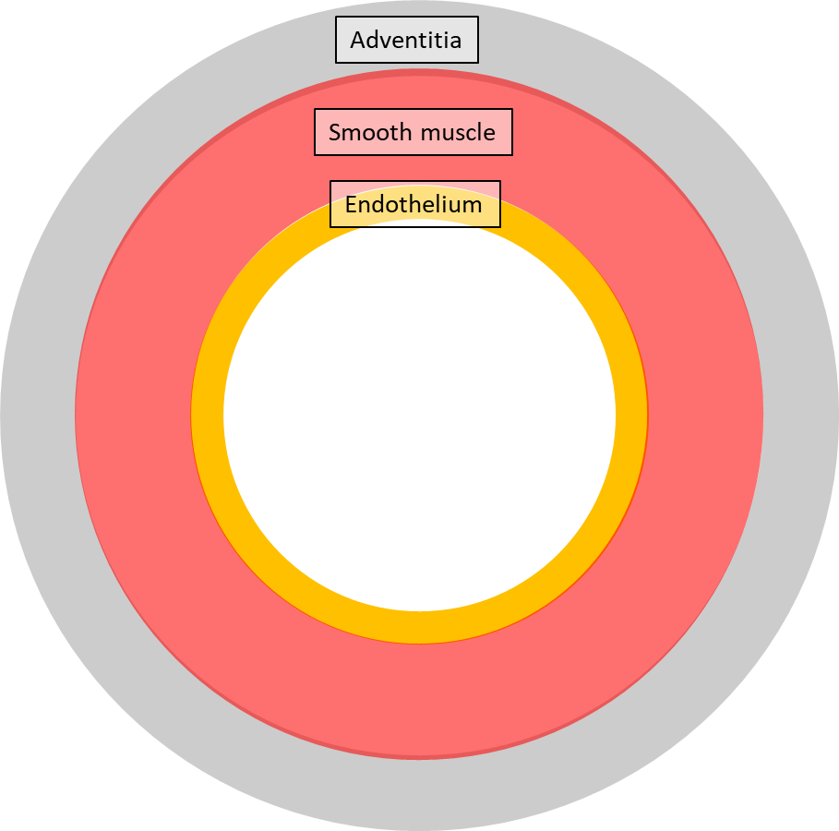






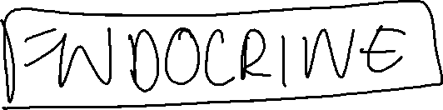



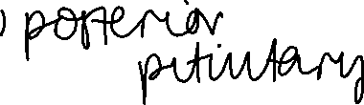









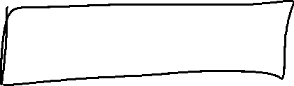



























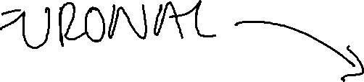






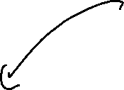


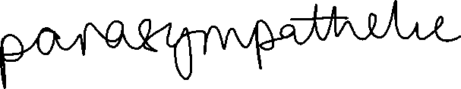








Slide 31
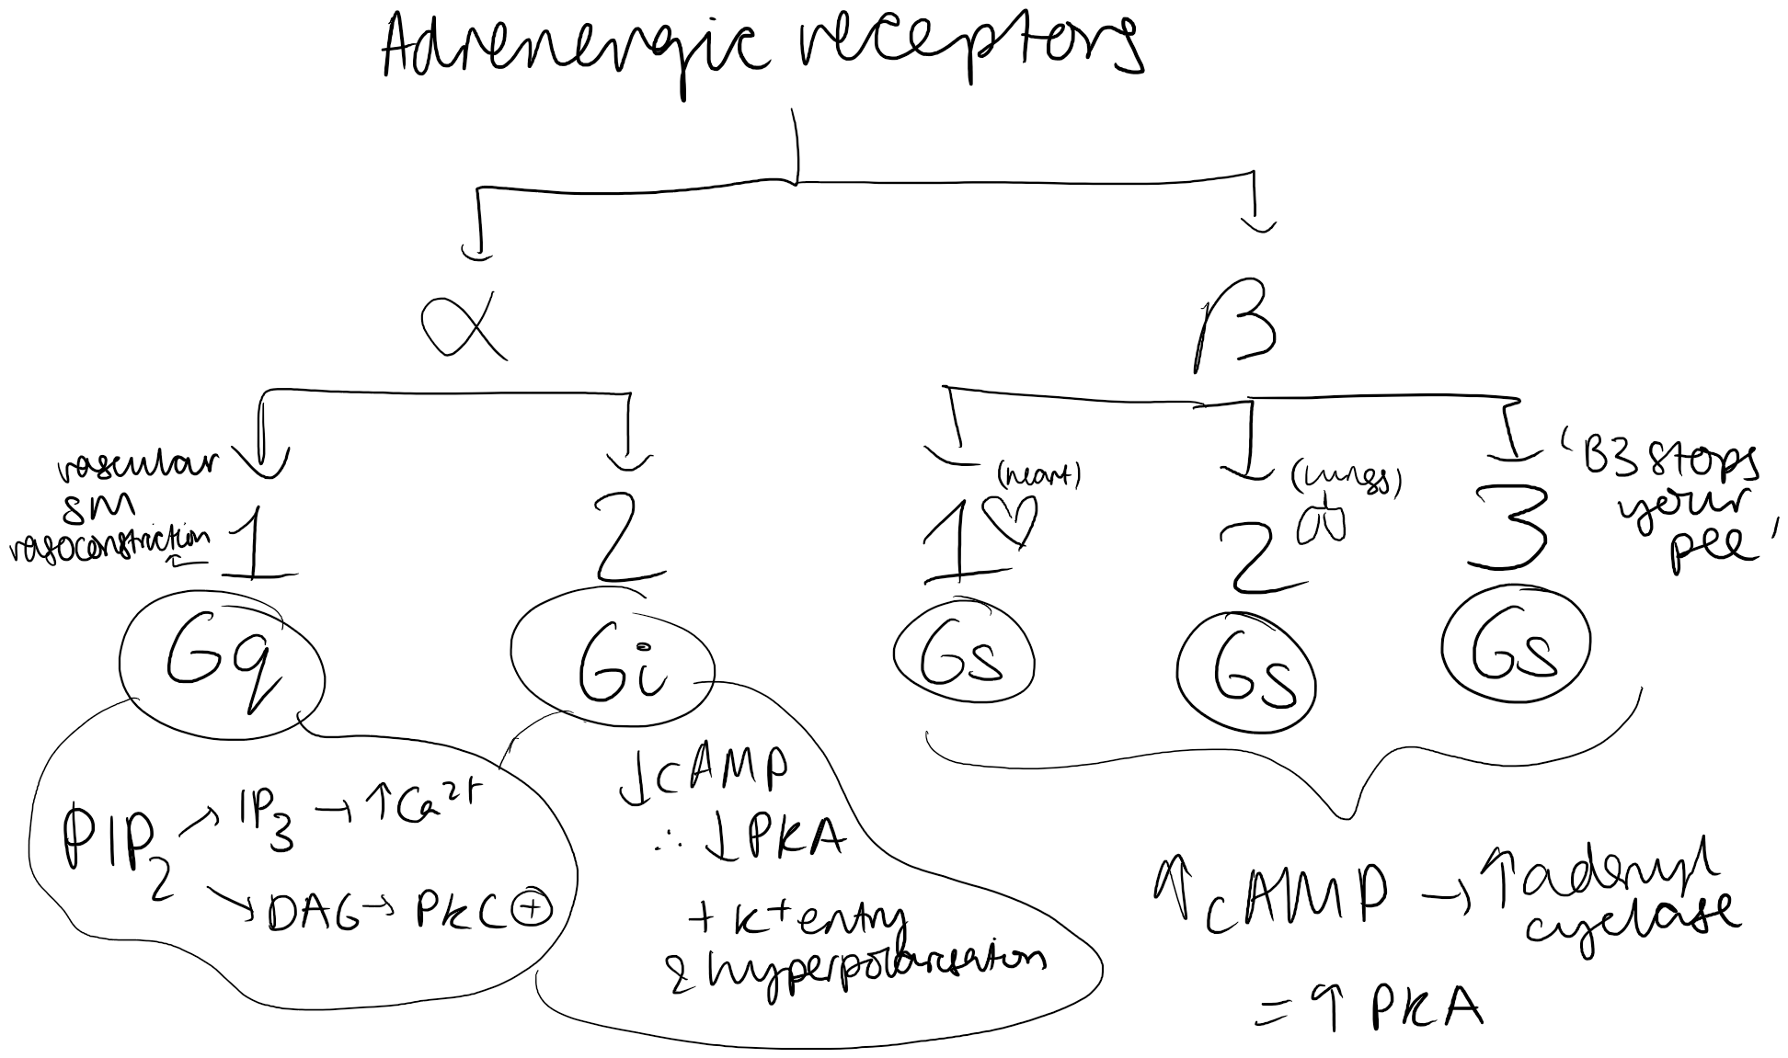
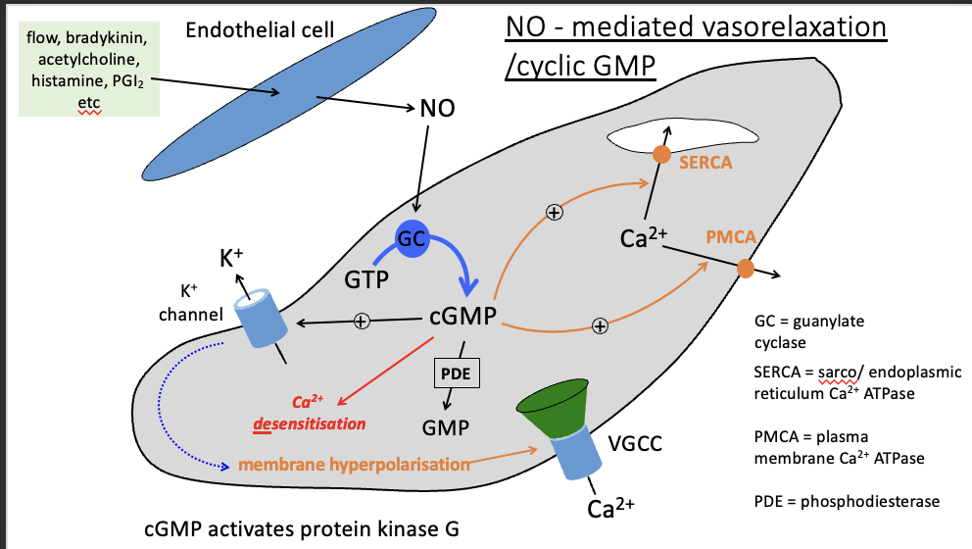
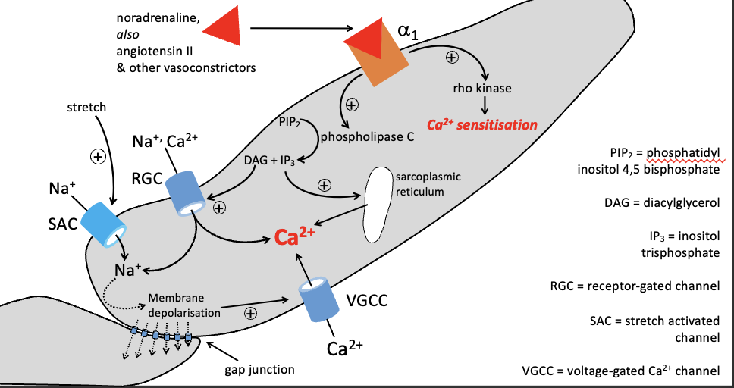
jumpscare (apologies)
  So adrenaline is a vasoconstrictor in most of the body (alpha 1 – both NA and adrenaline) apart from :
    In the coronary circulation + skeletal muscle, where it's a vasodilator (B2 – adrenaline only; fight/flight)
Notes:
•Vasoconstrictors bind to a1 receptors
•Activates PLC
•PLC splits PIP2 into DAG and IP3
•IP3 causes Ca release from SR
•DAG activates non-selective cation channels – allows influx of Na and Ca
•SAC allow more Na influx
•Membrane depolarizes, so VGCC open à Ca influx
•NO activates GC
•GC activates cGMP
•cGMP promotes efflux of Ca and uptake of Ca into the SR via SERCA
•cGMP also opens K+, which causes hyperpolarization and closes VGCC
•cGMP also opposes action of rho-kinase à Ca desensitisation

Slide 32
jumpscare (apologies)
Notes:
QISS mnemonic

Slide 33




















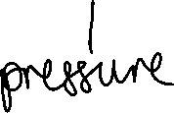
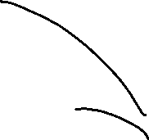











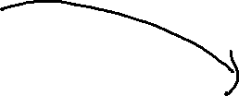






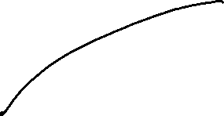









  MYOGENIC
  Stretch opens VG sodium channels
  Resulting Membrane depolarisation opens VG Ca2+ channels
  Ca2+ influx; contraction
  METABOLIC
  Endothelium-derived
  ACh (PNS), bradykinin and histamine
  + shear forces (flow) -> mechanoreceptors

Slide 34
Flow autoregulation
  Incorporates both myogenic and metabolic control – used when relatively constant blood flow needs to be maintained, ie in the brain, kidneys and heart at rest
  Myogenic more important for smaller vessels, metabolic more when diameter larger
  coronary flow reserve = arterioles partially constricted @ rest, can dilate to increase flow up to four-fold to meet increase demands (ie exercise, atherosclerosis)

Slide 35
Fluid balance in the microcirculation

Slide 36
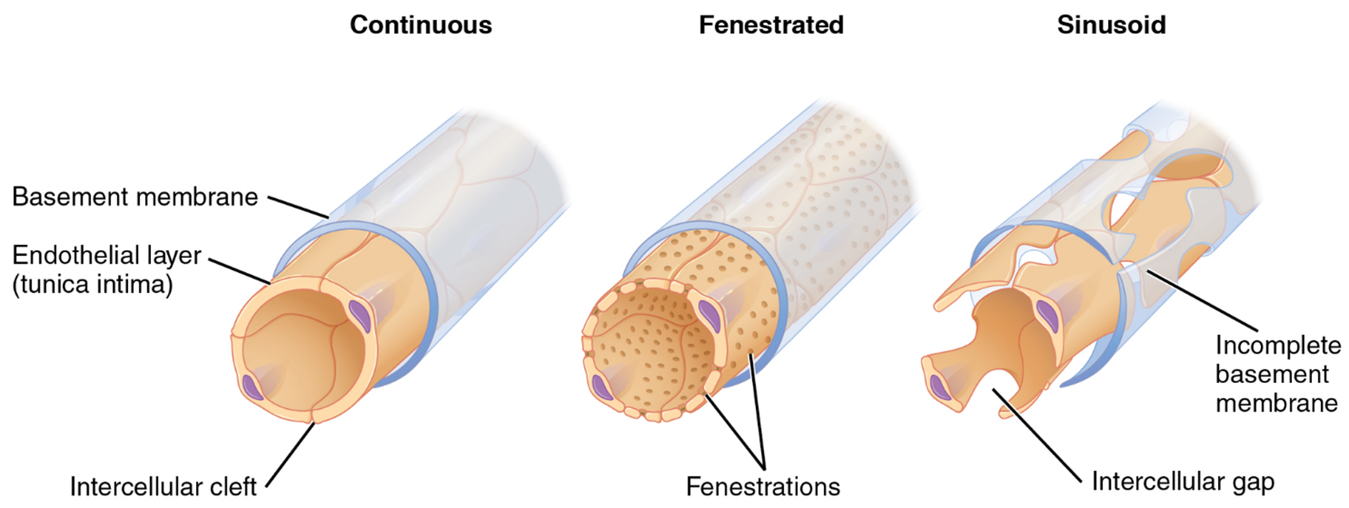
Types of capillary

Slide 37
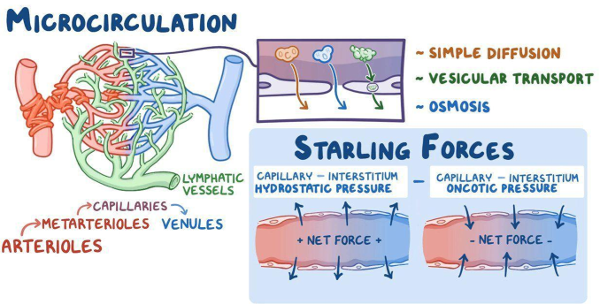
Movement across capillary wall
  Fluid moves out of the capillaries (filtration) and back in (absorption); net filtration of 2-4L over day, with excess returned to blood via lymphatic system -> an increase in this = oedema
    Dependent on Starling equation :
      J_{v} ∝ (P_{cap}-P_{int}) – σ (Π_{cap}-Π_{int})
      Aka net movement = hydrostatic pressure difference– osmotic pressure difference
      Hydrostatic pressure -> pressure of liquid in a tube, affected by gravity)
      Osmotic pressure -> pressure of substances within the blood trying to pull fluid in via osmosis
        Colloidal/ oncotic pressure for proteins
        Crystalloid pressure for ions/small molecules that are easily diffusible
      Reflection coefficent to show effect of permeability of the membrane

Slide 38
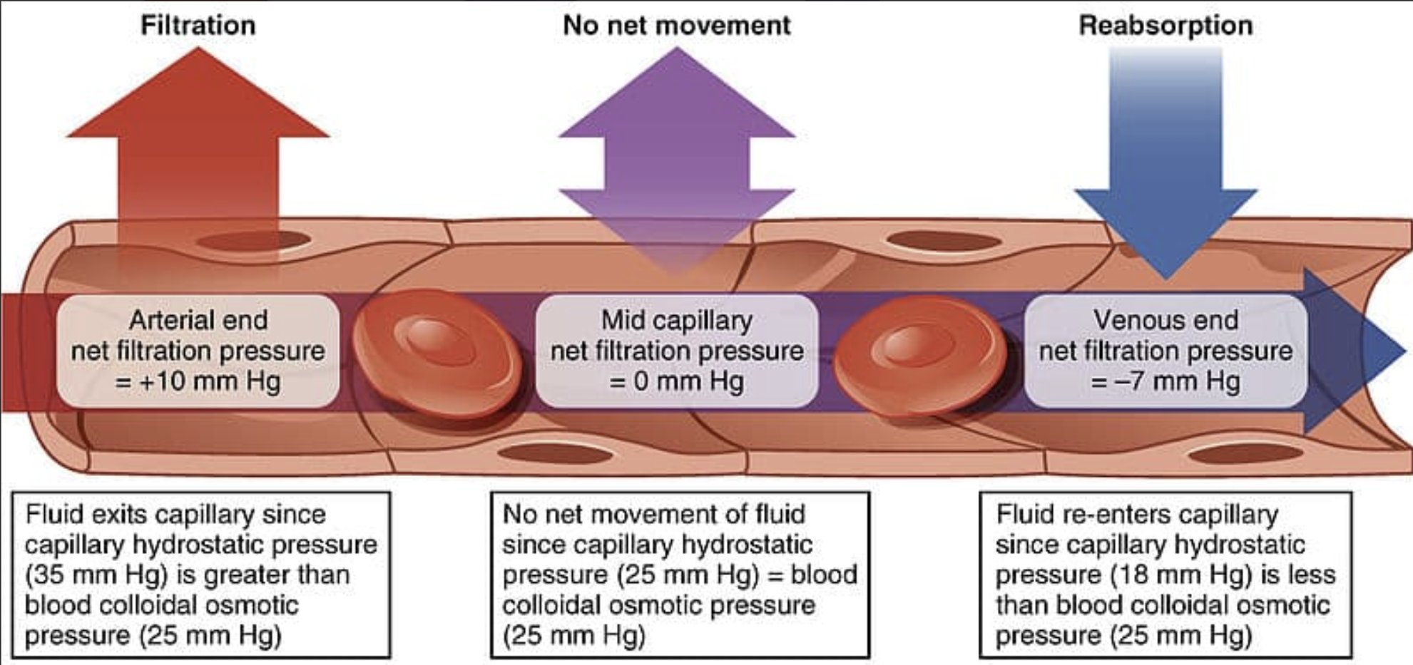
4 factors affecting oedema
  Using the Starling equation, anything increasing net filtration increases oedema :
    Hydrostatic pressure difference – osmotic pressure difference
  INCREASING hydrostatic pressure – ie HF, venous blockages (VTE)
  DECREASING plasma oncotic pressure – ie reduced [protein] from burns, malnutrition (think wet beri-beri), liver dysfunction
  Increased permeability of vessels - ie in inflammation
  Lymphatic obstruction

Slide 39
Coordinated cardiovascular responses : orthostasis and haemorrhage

Slide 41
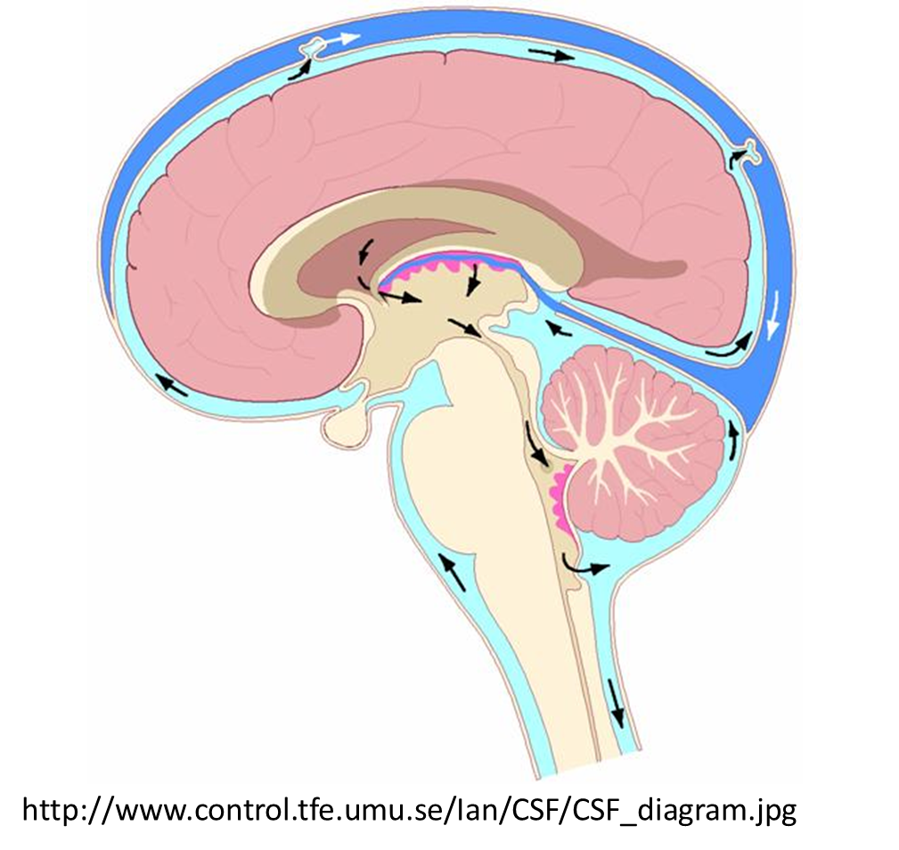
Orthostasis
  Pressure in a column of liquid -> higher at base of column due to gravity
  If the blood vessels were rigid tubes, in theory this would cause no change due to the 'siphon effect', because there's a closed system with a pump (the heart)
    However the blood vessels are NOT rigid and are in fact very distensible (compliant)!
  Hence you get blood 'pooling' in your legs when you stand due to distension of veins in foot, especially as you get transient shutting of venous valves in the limbs (because of the weight of the blood)
  Redistribution of blood -> less blood returning to heart -> less blood in vena cava = ↓CVP → ↓SV → ↓CO (and morst importantly, reduced blood flow to the brain!!)
  Veins a couple cm above the heart will collapse, but cerebral veins don't!
    Effect of gravity on CSF within meninges essentially holds brain expanded, keeping it from collapsing
Notes:
(like how negative pressure in interpleural space keeps it open)

Slide 42
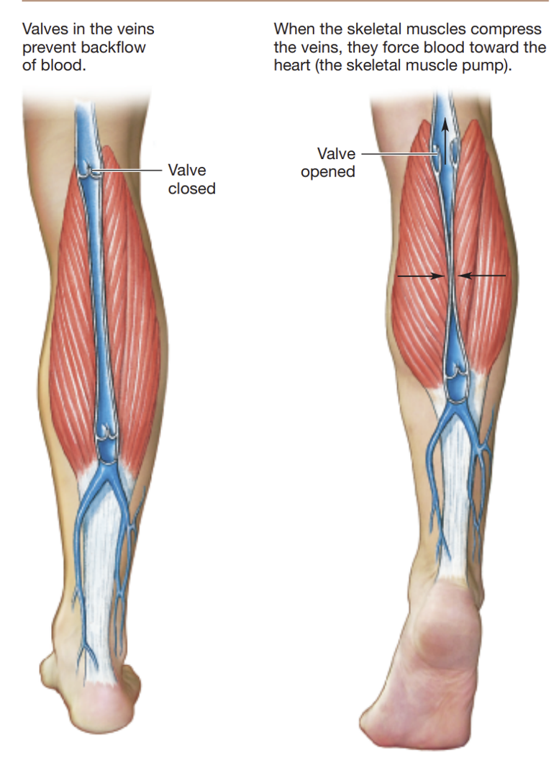
Compensatory mechanisms (x3):
  Baroreceptor reflex : to increase HR and contractility
  Veno-arteriolar axon reflex
    Increased SNS firing in response to stretch in walls of veins due to increased BP and volume, causing nearby arteriolar vasoconstriction
  Skeletal muscle pump
    Muscles 'milk' veins – compression between two valves forces blood up to heart
    Failure of these mechanisms : vaso-vagal syncope :
    Prolonged quiet standing – sudden loss of compensation, rapid reflex BP fall and brain under-perfusion; faint returns the person to horizontal position to restore BP
    Chronic autonomic failure (ie in older patients) -> weaker/slower response that leads to light-headedness on standing
Notes:
Vaso = vasodilation
Vagal = vagally mediated bradycardia

Slide 43
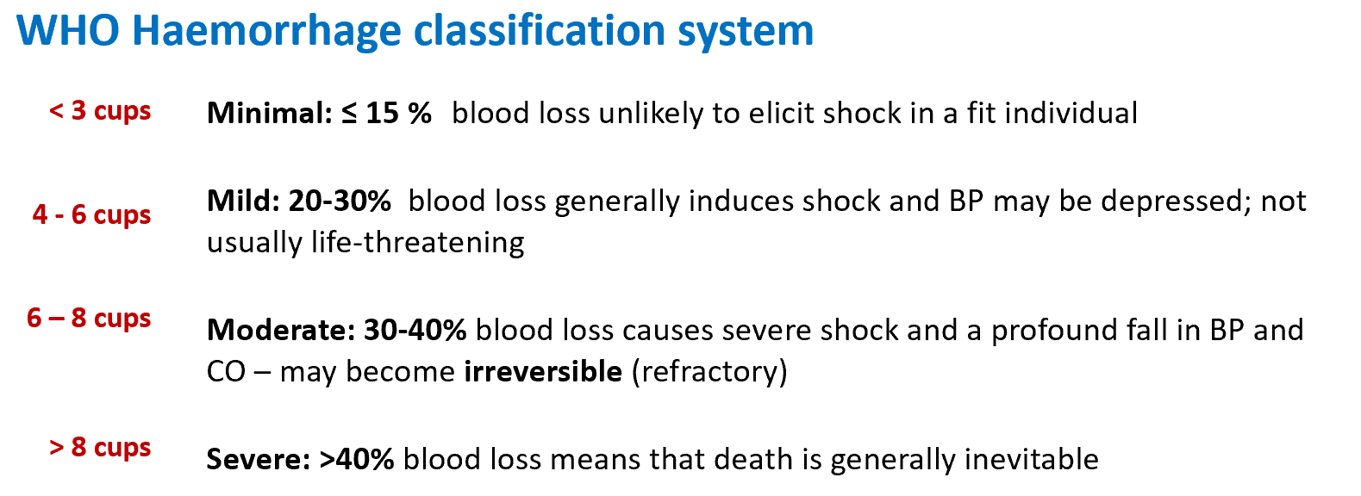

Haemorrhage
  Circulatory shock = if blood flow around body insufficient to meet demands (not just low BP)
  Haemorrhage causes hypovoaemic shock (ie loss of blood volume)
  Signs/ symptoms :
    Cold/clammy extremities (peripheral vasocconstriction)
    Confusion/agitation (cerebral hypoperfusion)
    Low pulse pressure (always) and often low BP
Notes:
Vaso = vasodilation
Vagal = vagally mediated bradycardia

Slide 44
Compensatory mechanisms (x4)
    High pressure baroreceptors (in carotid sinus and aortic arch)
      Ie the initial baroreceptor reflex (fastest response)
    Low-pressure baroreceptors :
      ↓Cardio-pulmonary stretch receptors – in heart + large pulmonary vessels -> via hypothalamus/medulla stimulate :
        Adrenaline release
        ADH (vasopressin) release
          + LESS ANP release -> increased RAAS (also due to reduced renal perfusion)
      The vasoconstriction therefore helps ↑CVP and ↑TPR, therefore increasing CO and BP
    Peripheral chemoreceptors – in carotid and aortic bodies (↓pO2, ↑pCO2 and ↓pH. )
      Sympathetic vasoconstriction triggered + increased ventilation (more on this in resp PCRS)
    Central chemoreceptors – in the brainstem (↓pH in medulla)
      Aka the CNS ischaemic response – very severe; dangerous levels of reduced gut and renal perfusion (think multi-organ failure)
      Therefore 'last-ditch' - only when BP falls below 50mmHg
Notes:
Vaso = vasodilation
Vagal = vagally mediated bradycardia

Slide 45
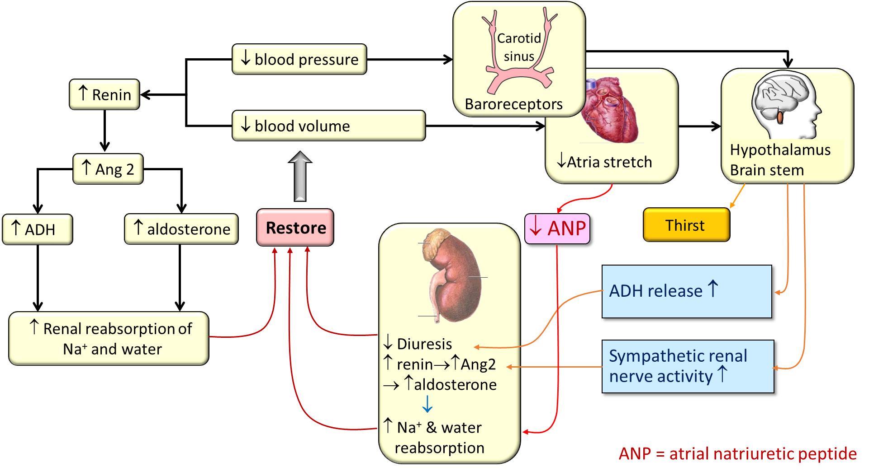
Compensatory mechanisms (x4)
Notes:
Vaso = vasodilation
Vagal = vagally mediated bradycardia

Slide 46
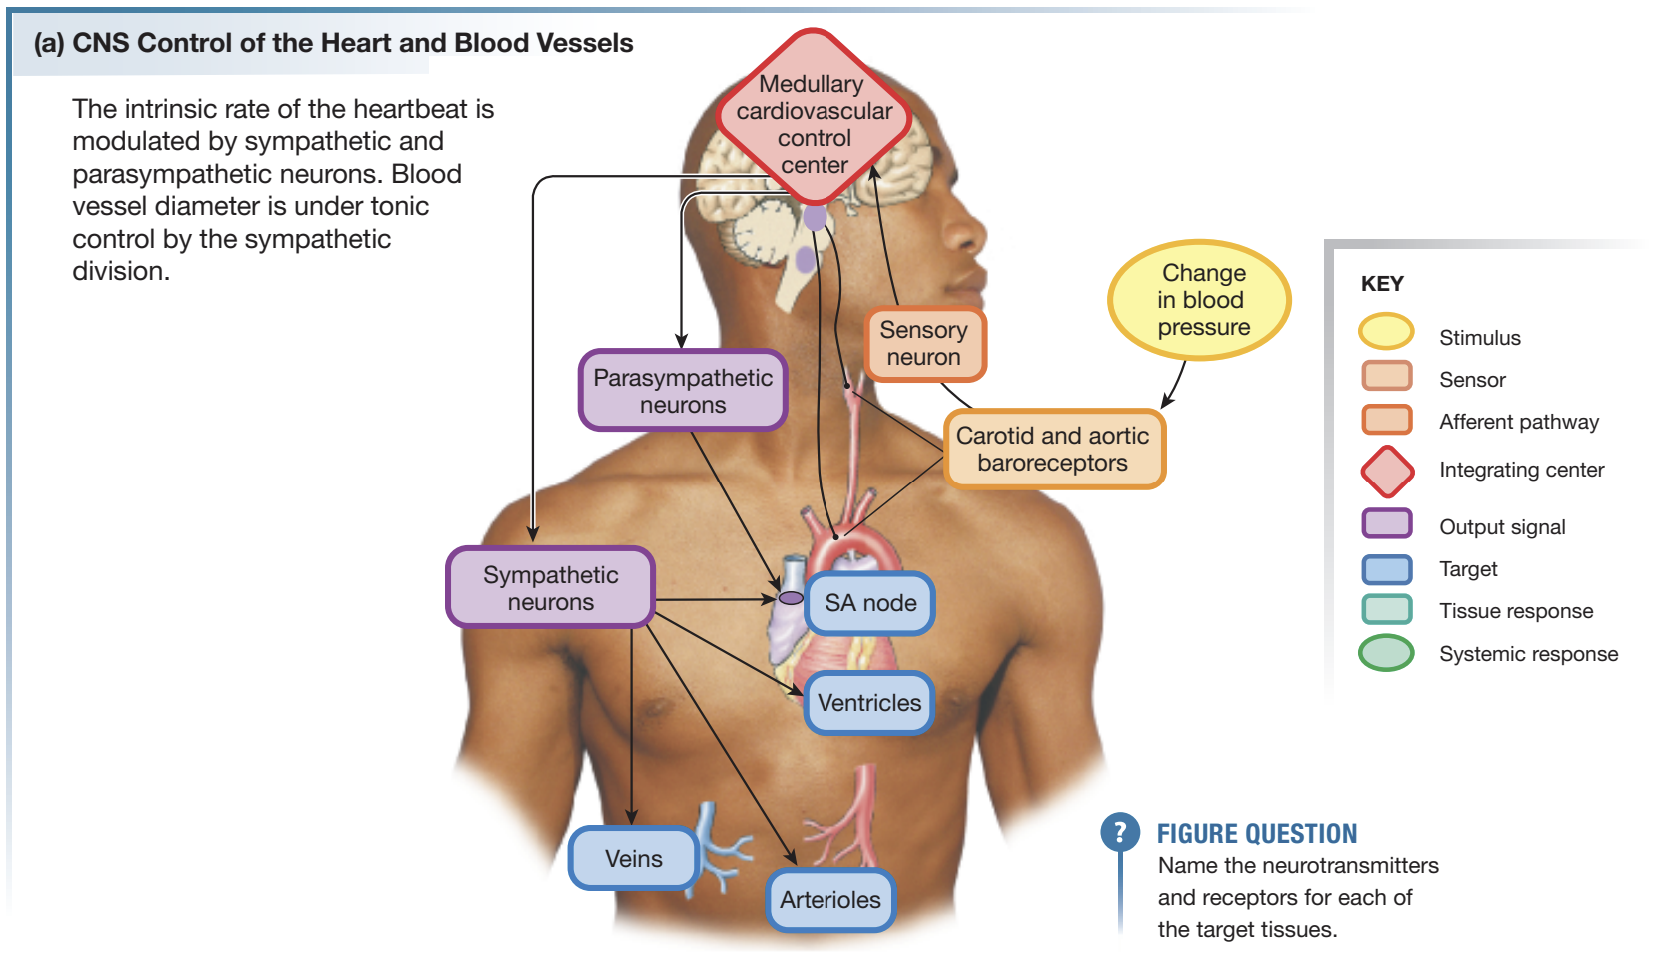
Haemorrhage
Notes:
Vaso = vasodilation
Vagal = vagally mediated bradycardia

Slide 47
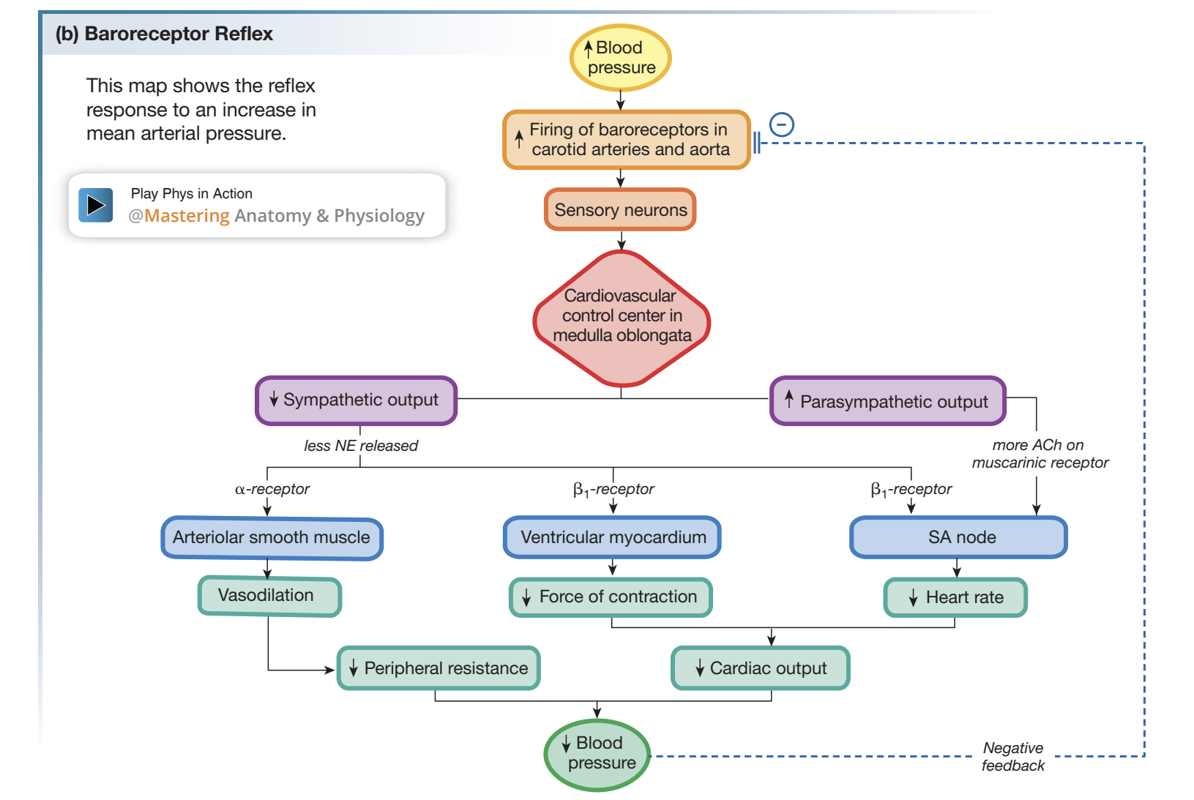
Notes:
Vaso = vasodilation
Vagal = vagally mediated bradycardia

Slide 48
SBA
During vigorous exercise, tachycardia reduces
coronary perfusion time due to shorter diastole.
However, myocardial blood flow still increases.
Which mechanism is most responsible?
a) Myogenic contraction in coronary arterioles
b) Accumulation of local metabolites; myocardial vasodilation
c) Increased parasympathetic tone to the ventricles
d) Reduced left ventricular afterload

Slide 49
SBA
During vigorous exercise, tachycardia reduces
coronary perfusion time due to shorter diastole.
However, myocardial blood flow still increases.
Which mechanism is most responsible?
a) Myogenic contraction in coronary arterioles
b) Accumulation of local metabolites; myocardial vasodilation
c) Increased parasympathetic tone to the ventricles
d) Reduced left ventricular afterload

Slide 50
SBA
An 84 year old chronic alcoholic has late-stage liver failure. Which of these mechanisms could explain the excessive fluid in her calves (oedema)
Decreased capillary permeability due to inflammation
Dilation of nearby hepatic lymph nodes
Reduced plasma oncotic pressure due to loss of protein synthesis
Reduced hydrostatic pressure due to chronic vasodilation

Slide 51
SBA
An 84 year old chronic alcoholic has late-stage liver failure. Which of these mechanisms could explain the excessive fluid in her calves (oedema)
Decreased capillary permeability due to inflammation
Dilation of nearby hepatic lymph nodes
Reduced plasma oncotic pressure due to loss of protein synthesis
Reduced hydrostatic pressure due to chronic vasodilation
Notes:
Can you do 10 or ttoo much

Slide 52
SBA
Which blood vessels are most capable of changing total peripheral resistance (TPR)?
Small muscular arteries
Arterioles
Metarterioles
Capillaries

Slide 53
SBA
Which blood vessels are most capable of changing total peripheral resistance (TPR)?
Small muscular arteries
Arterioles
Metarterioles
Capillaries

Slide 54
SBA
A patient presents to the Emergency Department in a confused and disorientated
state, with clammy skin and shortness of breath. Further assessment reveals that they are hypotensive and tachycardic. They are suspected to be in haemorrhagic shock.
Which of the following does not describe the mechanisms in their body taking place in an attempt to help regulate their blood flow?
SNS activation causes constriction in splanchnic, renal and muscle vascular beds, therefore raising total peripheral resistance.
Angiotensin II contributes to regional vasoconstriction.
PNS nerve firing causes vasoconstriction in the pancreas, salivary glands and reduces TPR.
Adrenaline acts on β1, β2 receptors and dilates coronary and skeletal muscle beds and constricts most other vascular beds via α1 receptors.
Vasopressin contributes to regional vasoconstriction.

Slide 55
SBA
A patient presents to the Emergency Department in a confused and disorientated
state, with clammy skin and shortness of breath. Further assessment reveals that they are hypotensive and tachycardic. They are suspected to be in haemorrhagic shock.
Which of the following does not describe the mechanisms in their body taking place in an attempt to help regulate their blood flow?
SNS activation causes constriction in splanchnic, renal and muscle vascular beds, therefore raising total peripheral resistance.
Angiotensin II contributes to regional vasoconstriction.
PNS nerve firing causes vasoconstriction in the pancreas, salivary glands and reduces TPR.
Adrenaline acts on β1, β2 receptors and dilates coronary and skeletal muscle beds and constricts most other vascular beds via α1 receptors.
Vasopressin contributes to regional vasoconstriction.

Slide 56
SBA
A patient with 70% LAD (left anterior descending) stenosis develops chest pain during exertion, although he is asymptomatic at rest.
Which mechanism best explains why symptoms appear specifically on exercise?
a) Parasympathetic activity limits coronary perfusion when heart rate rises
b)Coronary reserve is already used at rest, leaving little
capacity to increase flow during exercise
c) Coronary vessels constrict in response to higher blood pressure during exertion
d) Reduced venous return prevents sufficient preload from reaching the heart

Slide 57
SBA
A patient with 70% LAD stenosis develops chest pain during exertion, although he is asymptomatic at rest.
Which mechanism best explains why symptoms appear specifically on exercise?
a) Parasympathetic activity limits coronary perfusion when heart rate rises
b)Coronary reserve is already used at rest, leaving little
capacity to increase flow during exercise
c) Coronary vessels constrict in response to higher blood pressure during exertion
d) Reduced venous return prevents sufficient preload from reaching the heart

Slide 58
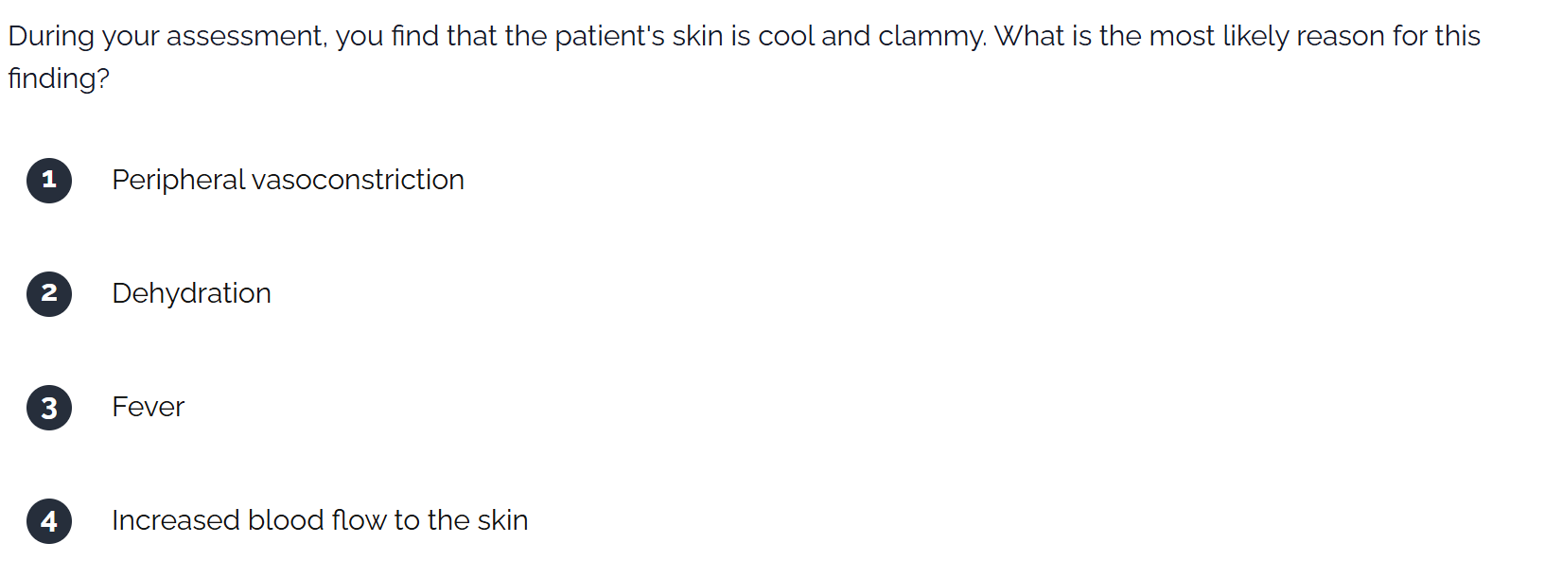
SBA

Slide 59
SBA

Slide 60
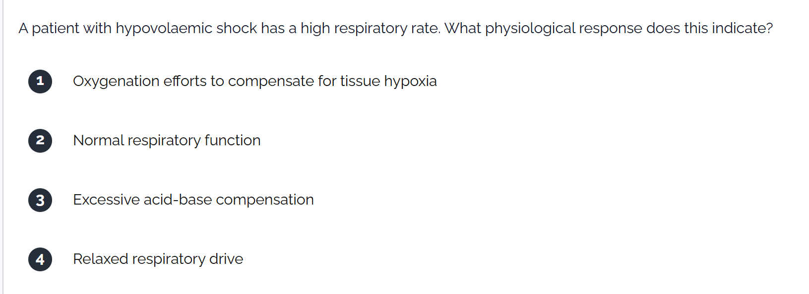
SBA

Slide 61
SBA

Slide 62
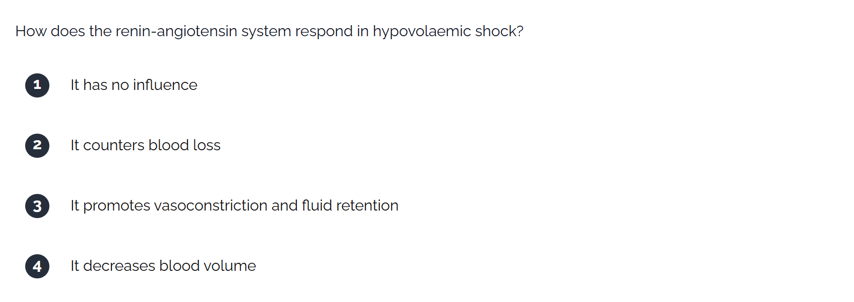
SBA

Slide 63
SBA

Slide 64
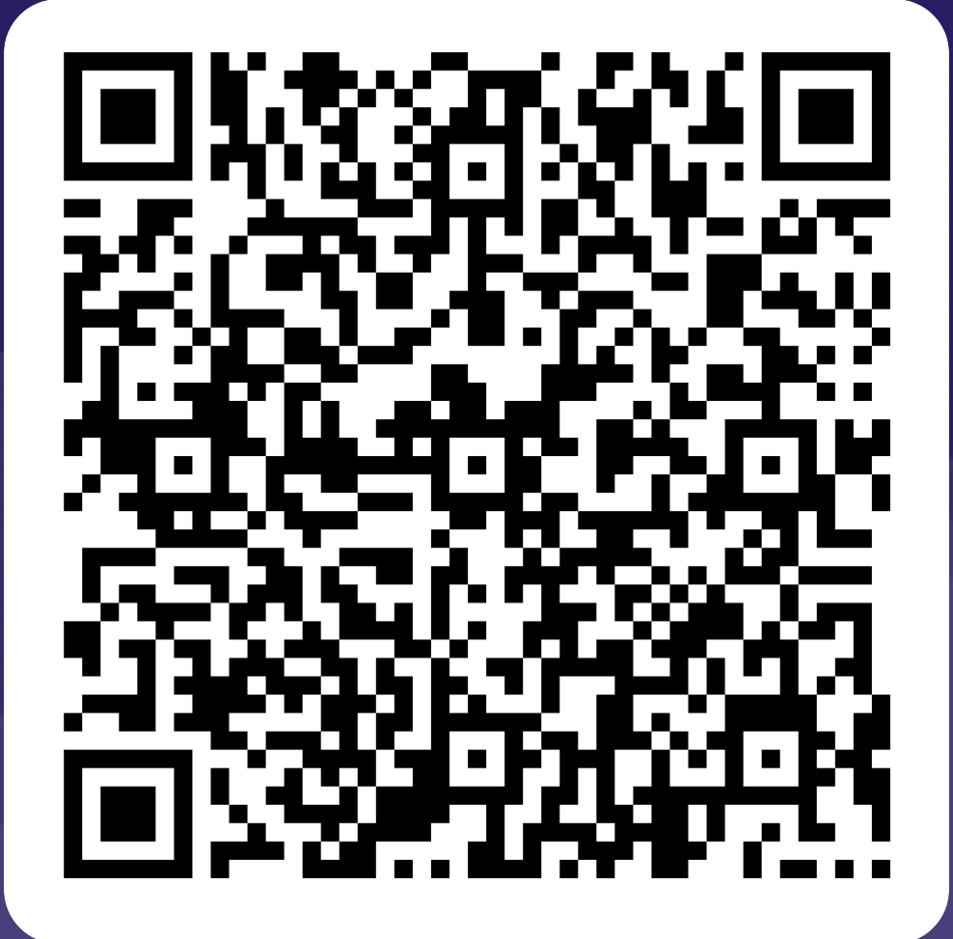
FEEDBACK
Thank you!!
Any questions?
akshaya.krishna_perumal@kcl.ac.uk,
shruti.turaga@kcl.ac.uk

