Slide 1







GKTeach
NAM
STAGE 1
FBS recap
YEAR 1 MBBS
10/04/26
Amy Zhang (Yr 3)

Slide 2

Anaerobic metabolism
Glycolysis
  Converts 6C glucose into 2 3C pyruvate
Net yield of 2 ATP
  Use 2 ATP
  Make 4 ATP
Produces NADH
Notes:
-Occurs in cytosol as glucose can’t enter mitochondria→ needs to be converted into pyruvate
-ATP synthesis and production of high energy co-factors
Breakdown of stored glycogen from liver

Slide 3
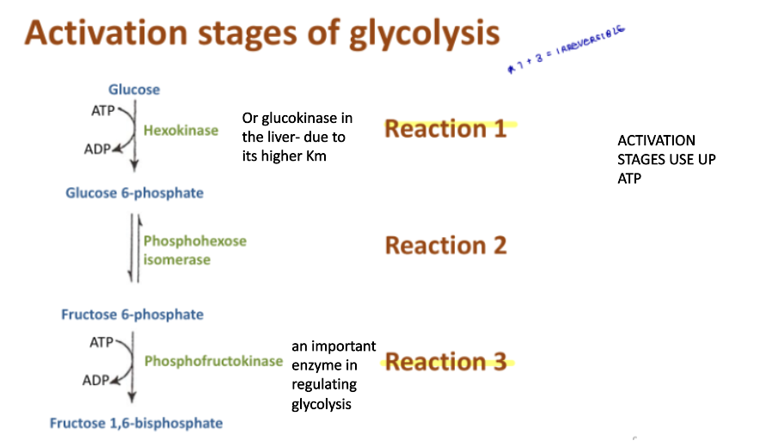


Notes:
-1 and 3 irreversible *IMPORTANT*
Hexokinase in all tissue apart from liver
Glucokinase in liver as liver produces glucose to maintain levels so doesn’t want to compete with brain for glucose stores

Slide 4
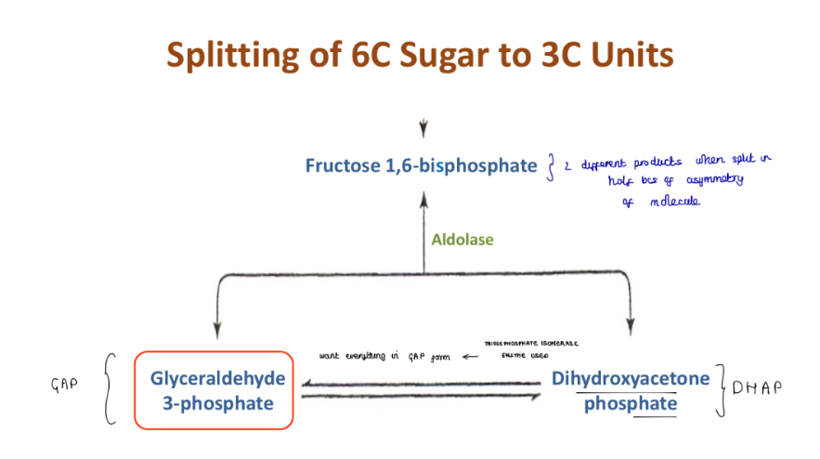

Slide 5
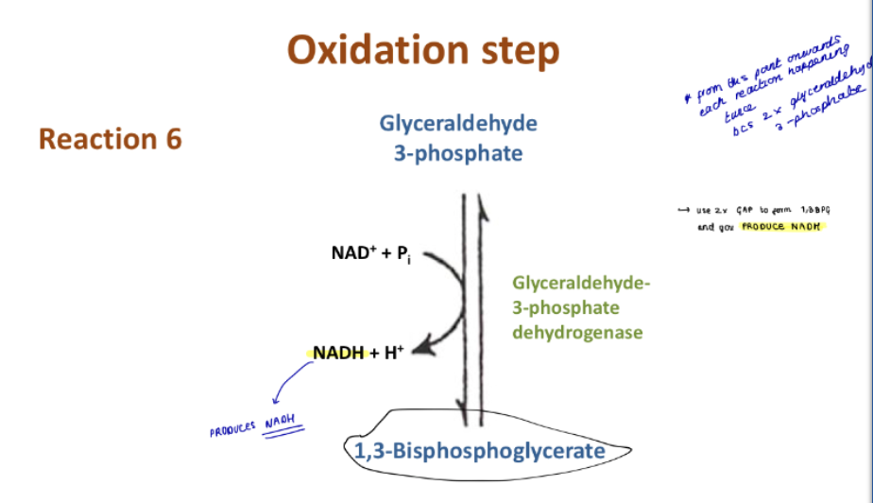

Slide 6
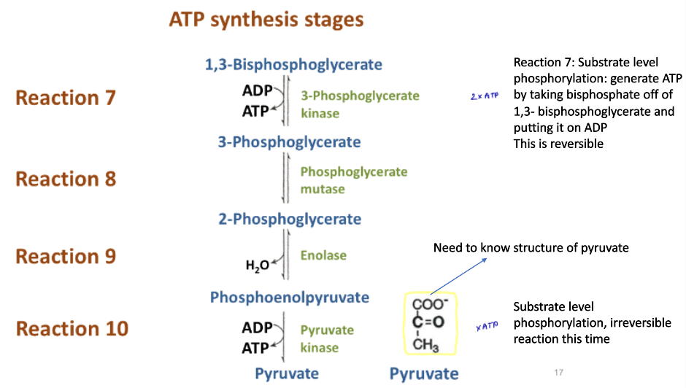
Notes:
Pyruvate→ Lactate by lactate dehydrogenase
-Regenerates NAD- from NADH

Slide 7
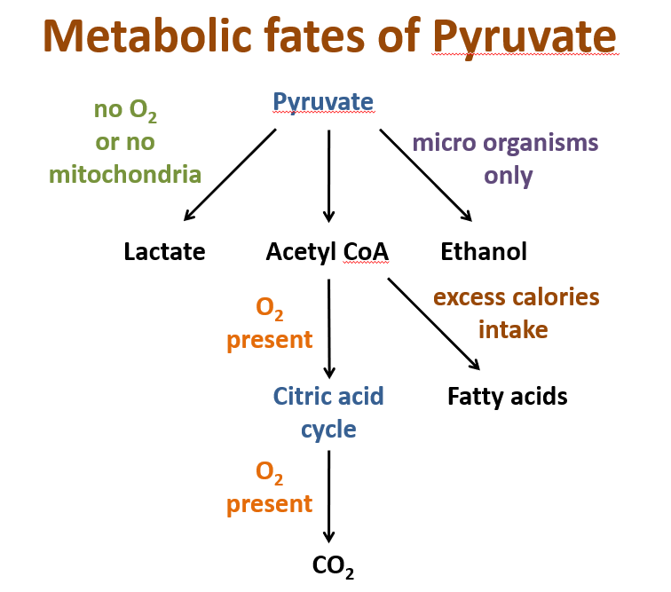

Slide 8
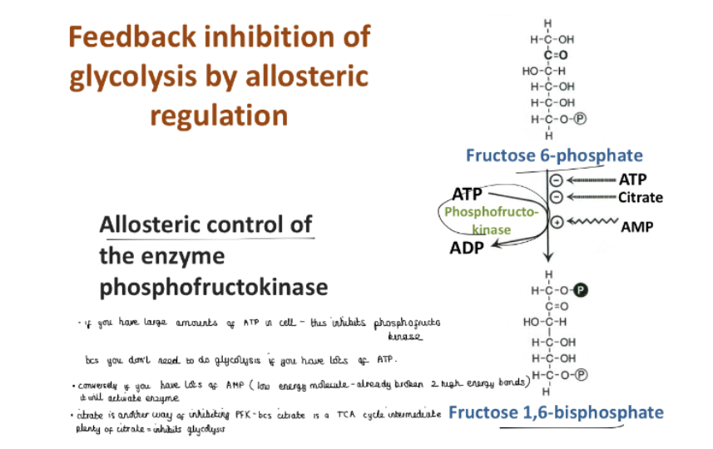
Notes:
PFK plays major role in glucose control

Slide 9
Aerobic metabolism
TCA cycle
Oxidative phosphorylation
Notes:
Occurs in mitochondrial matrix
Occurs in all tissues with mitochondria (not RBC or white muscle fibres)
Produces ATP, CO2 and H2O

Slide 10
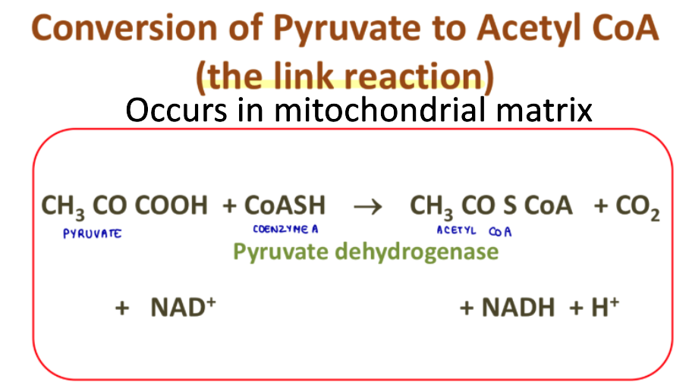

Slide 11
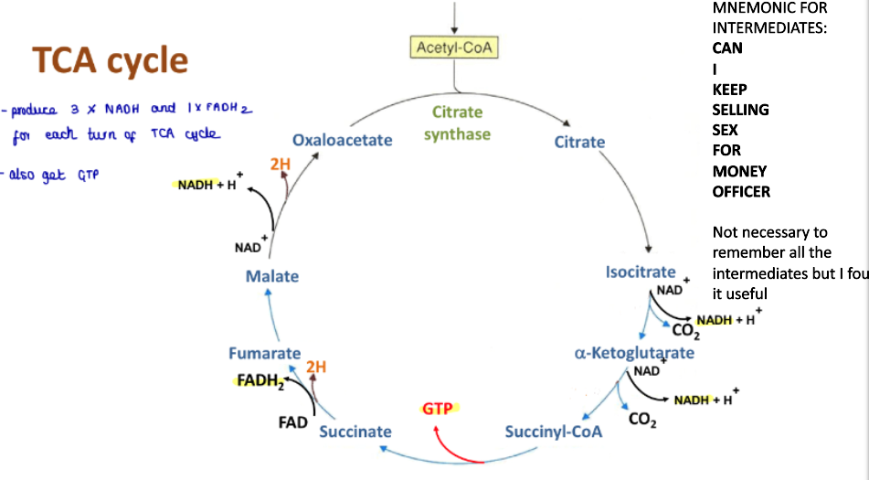

Aconitase
Malate dehydrogenase
Isocitrate dehydrogenase
Fumarase
Succinate dehydrogenase
Alpha keto-dehydrogenase
Succinyl CoA synthetase
Notes:
-Citrate synthase, isocitrate dehydrogenase and alpha keto-dehydrogenase are irreversible
Produce 3 NADH, 1 FADH2 and 1 GTP (equivalent to ATP) and lose 2 molecules of CO2 = completely oxidized acetyl CoA

Slide 12
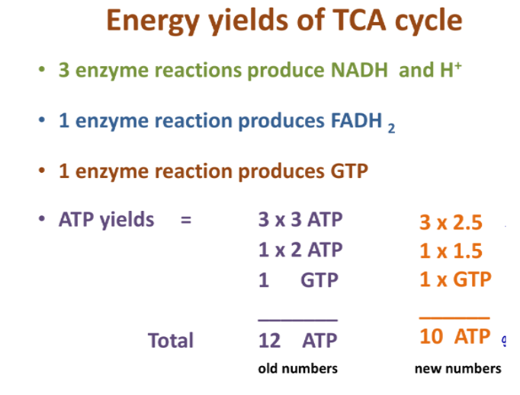

Slide 13
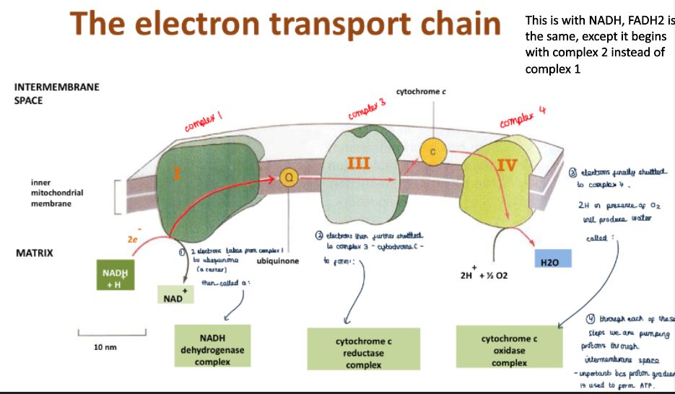

Slide 14
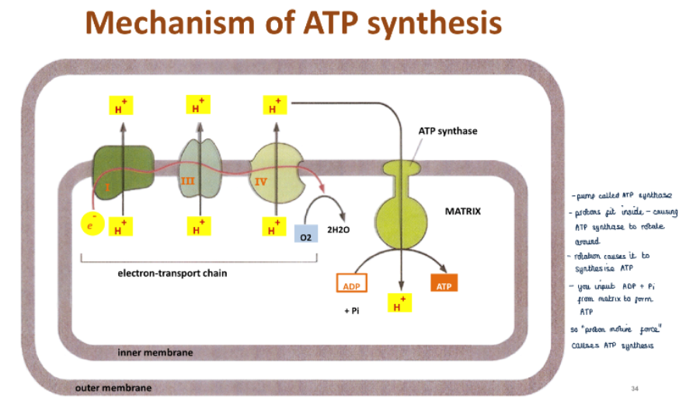

Slide 15
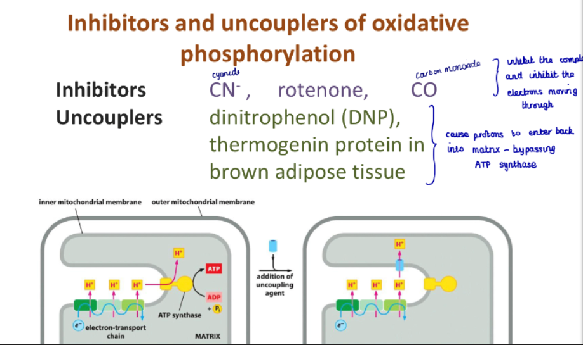
Notes:
Cyanide, rotenone and carbon monoxide inhibit complexes and electrons moving through
Uncouples enable protons to enter back into the matrix, bypassing ATP synthase

Slide 16
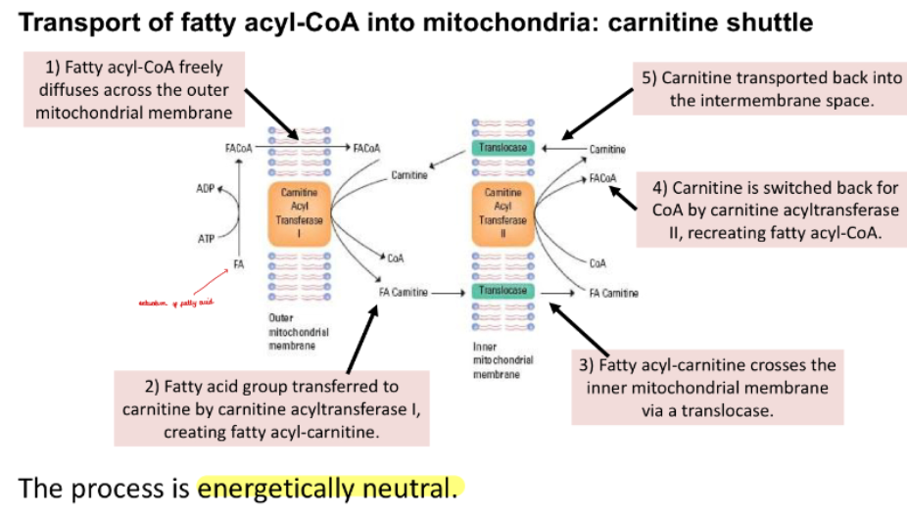
Fat metabolism
Notes:
Fat stored as triglycerides
Use lipase to break it down
Lipases activated by adrenaline and glucagon
First fatty acids linked to Coenzyme A→ fatty acyl-CoA (catalysed by acyl-CoA synthetase)
Converted into fatty acyl-carnitine (catalysed by carnitine acyltransferase I)
Fatty acyl-carnitine transported to inner mitochondrial membrane via translocase enzyme
Carnitine converted back to fatty acyl-CoA (catalysed by carnitine acyltransferase II)
Free carnitine transported back into intermembrane space

Slide 17
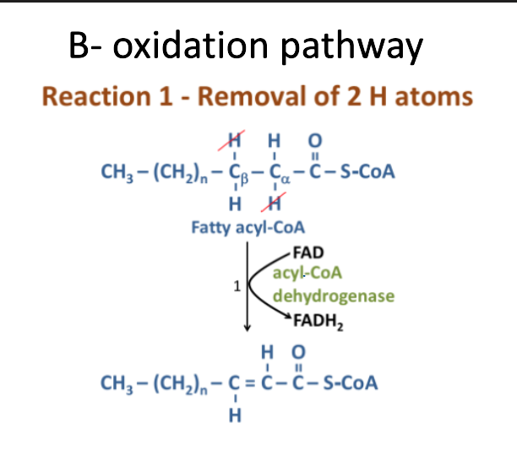
Notes:
Beta oxidation pathway produces acetyl-CoA and fatty acyl-CoA 2C shorter
DEHYDROGENATION
Remove 2H from acyl coA via acyl-CoA dehydrogenase
Enoyl CoA+ FADH

Slide 18
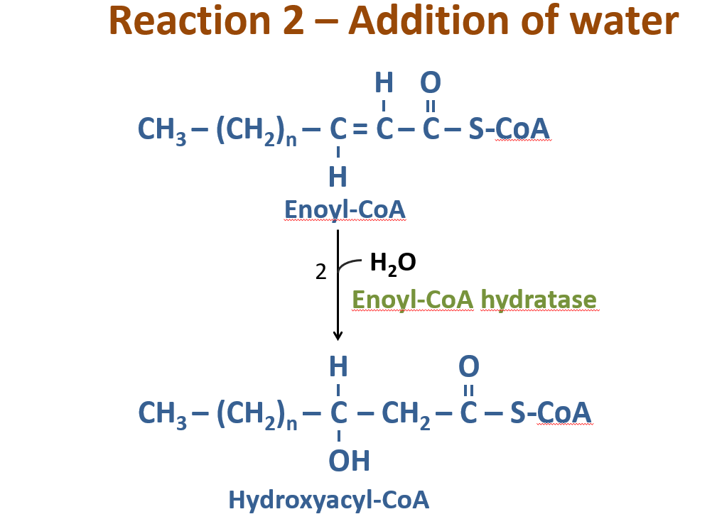
Notes:
HYDRATION

Slide 19
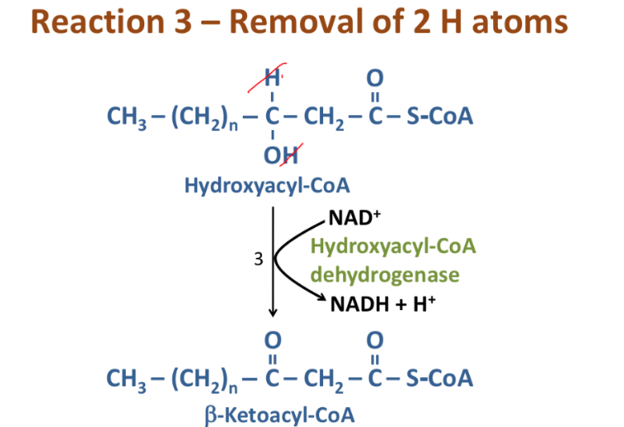
Notes:
DEHYDROGENATION
Converts hydroxy group to keto group

Slide 20
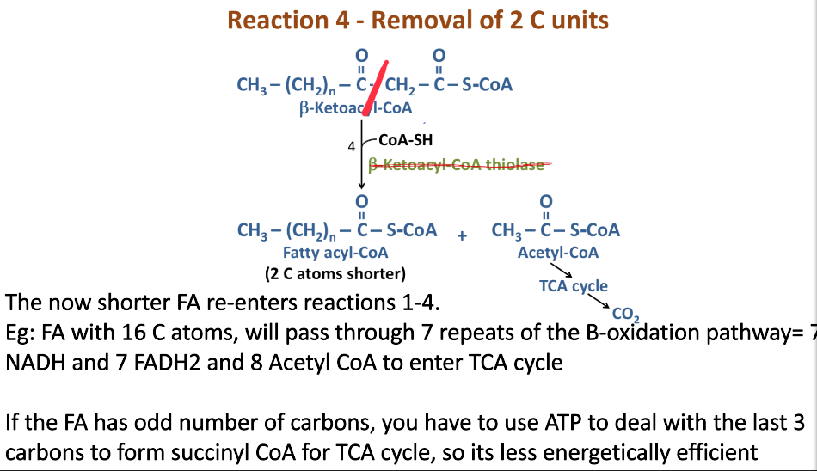
Notes:
THIOLYSIS
Cleaved→ minus 2 C
Re-enters cycle

Slide 21
Ketone body formation
Ketogenesis occurs in :
      -Starvation
  -Type 1 diabetes
Acetyl CoA→ Acetoacetate and Beta-hydroxybutyrate
Tissues that can’t use ketone bodies
  -Liver
  -Red blood cells
Important in the brain
Notes:
-Liver produces ketone bodies
-Brain can’t use fatty acids as can’t get past blood-brain barrier SO has to use ketone bodies
Fatty acid oxidation in hepatocytes→ excess levels of this exceeds level of TCA cycle→ excess acetyl CoA converted into ketone bodies in liver
-RBC don’t have mitochondria so can’t undergo beta oxidation- has to use glucose only

Slide 22
Glycogen synthesis
Blood glucose high→ liver synthesises glycogen
Blood glucose low→ liver degrades glycogen
Glycogen in muscle degraded to glucose-6-phosphate→ glycolysis for muscle contraction
Notes:
-Occurs in cytosol as glucose can’t enter mitochondria→ needs to be converted into pyruvate
-ATP synthesis and production of high energy co-factors

Slide 23
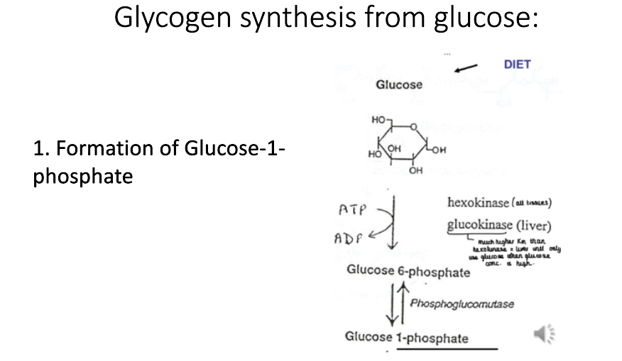
Notes:
-Glucokinase has higher km→ lower affinity for glucose SO liver will only use when the glucose concentration is high

Slide 24
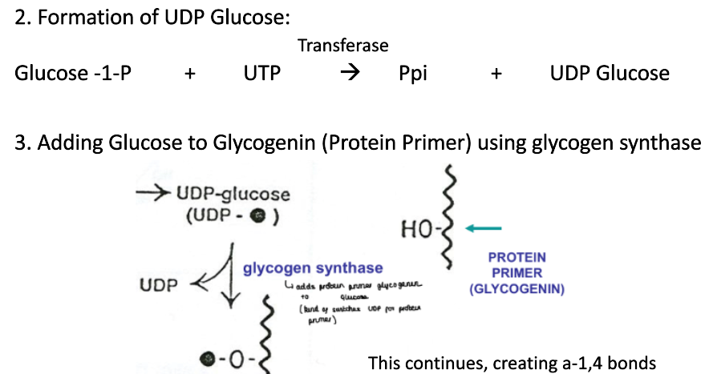
Notes:
-Glycogenin adds glucose residues from UDP-glucose to itself→ forms short glycogen primer
Forms 1-4 glycosidic straight chain bonds
Add 1-6 bonds to add branches→ more surface area so more efficient hydrolysis

Slide 25
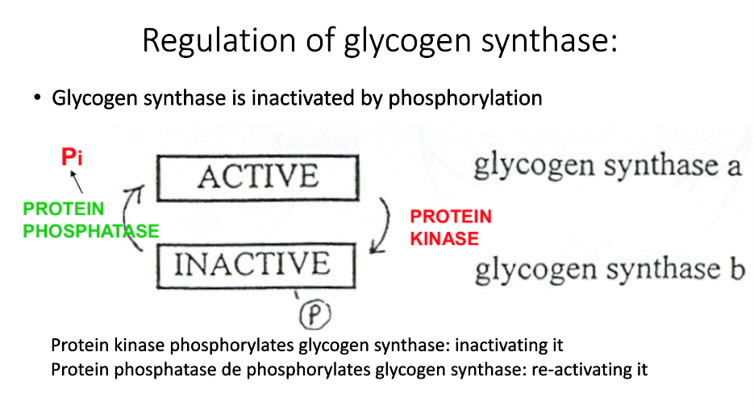
Regulation of glycogen synthase
Notes:
Glycogen synthase inactivated by phosphorylation
Protein kinase phosphorylates
Protein phosphatase dephosphorylates

Slide 26
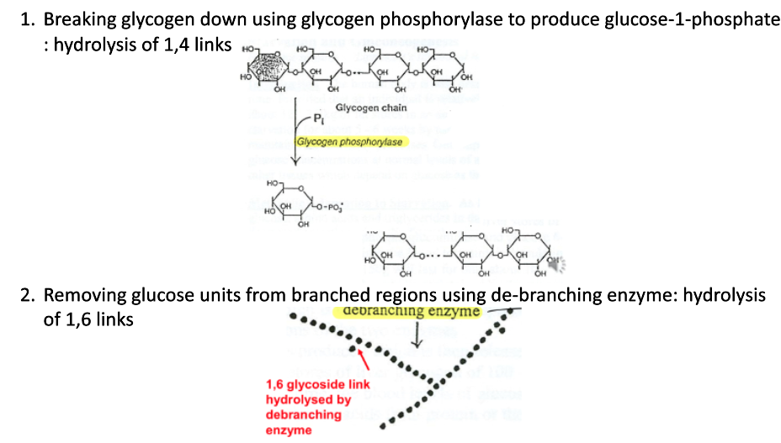
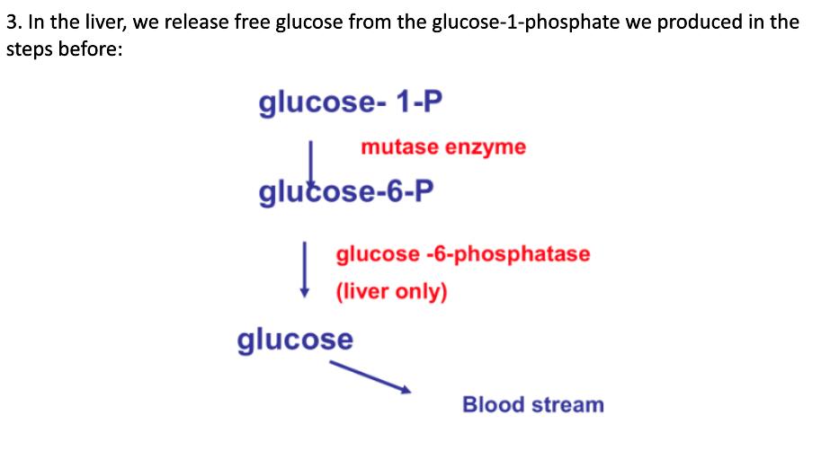
Glycogen breakdown
Notes:
Secretion of glucagon stimulated by low blood glucose, high concentration of amino acids and adrenaline
Phosphorylation
Debranching
Glucose-1-phosphate→ glucose-6-phosphate
Glucose-6-phosphate→ free glucose

Slide 27


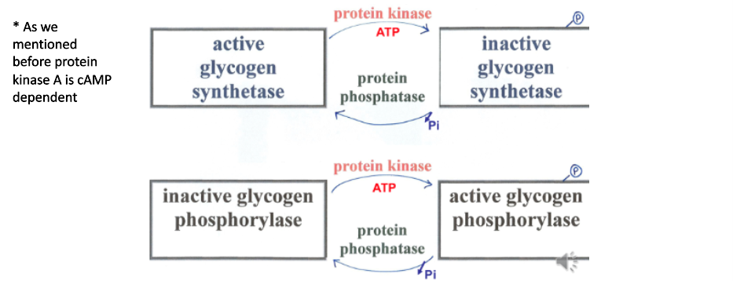

Notes:
Active form of glycogen phosphorylase is phosphorylated so synthesis and degradation don’t occur at the same time
Addition of insulin activates phosphatase→ activates glycogen synthetase
Addition of adrenaline and glucagon activates protein kinase
-Adrenaline from in muscle
- Glucagon in liver

Slide 28
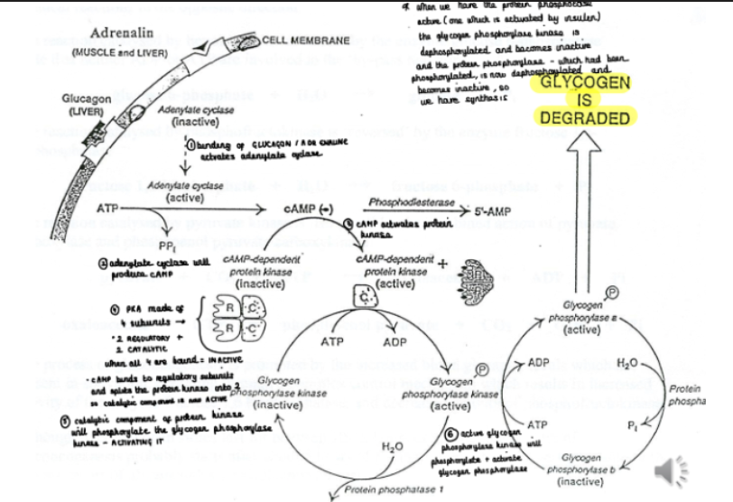
Notes:
Effect of adrenaline in muscle and liver:
Activates adenylate cyclase- converts ATP→ cAMP
cAMP acts as second messenger→ activates PKA
PKA phosphorylates + activates glycogen phosphorylase kinase
Glycogen phosphorylase kinase phosphorylates + activates glycogen phosphorylase

Slide 29
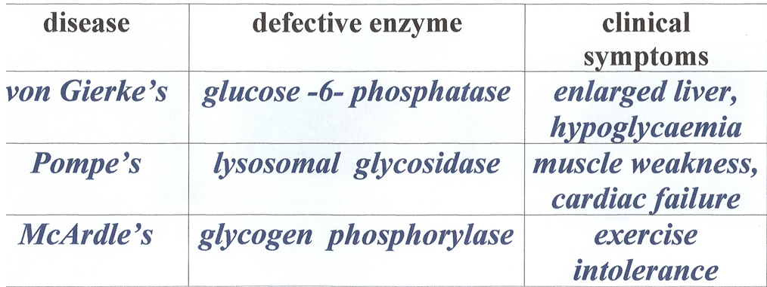
Glycogen storage diseases

Slide 30
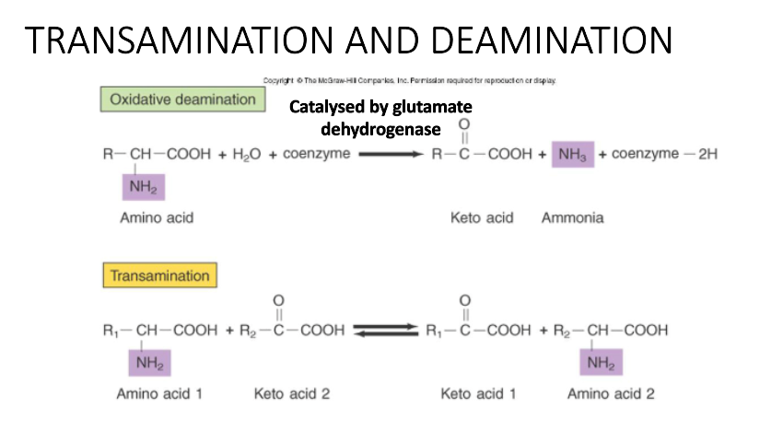
Amino acid metabolism
Notes:
AA required as building blocks for proteins, synthesis of neurotransmitters, creatine, carnitine, haem…etc
Act as source of blood glucose in fasting and starvation
Excess AA broken down and nitrogen excreted as urea in urine
Remove amino group and add to keto acid version of AA you want
Amino acid and keto acid pairing (e.g. glutamate and alpha-ketoglutaratae)
Aminotransferase enzyme catalyses transamination- specific to amino and keto acids involved
Transfer of amino group (e.g. amino group from glutamate transferred to alpha-ketoglutarate)
Formation of new amino and keto acid (e.g. alpha-ketoglutarate and alanine/aspartate)
After losing amino groups, amino acids will become oxo acids→ can enter TCA pathway to provide ATP
Only glutamate will produce ammonia in deamination
Alanine + alphaketoglutarate → pyruvate + glutamate

Slide 31
Key amino acids
Glucogenic AA can be converted to glucose by liver in starvation
Leucine and lysine only degraded to acetyl CoA (ketogenic)
Phenylalanine, tyrosine, tryptophan and isoleucine can be converted into both glucose and ketone bodies (both glucogenic and ketogenic)
Notes:
Most AA become oxo acids after losing their amino groups→ can be metabolised in TCA cycle to provide source of ATP
Ketogenic amino acids can be converted to ketone bodies via ketogenesis

Slide 32
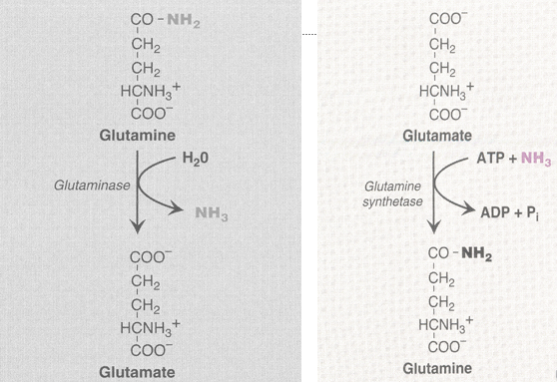
Glutamine
Notes:
Glutamine important as:
-amino groups transported as glutamine
-can transport 2 amino groups from muscle to liver safely
One alpha amino group to AA, other on side chain as amide
-carrier of ammonia in blood
Contains two amino (NH2) groups

Slide 33
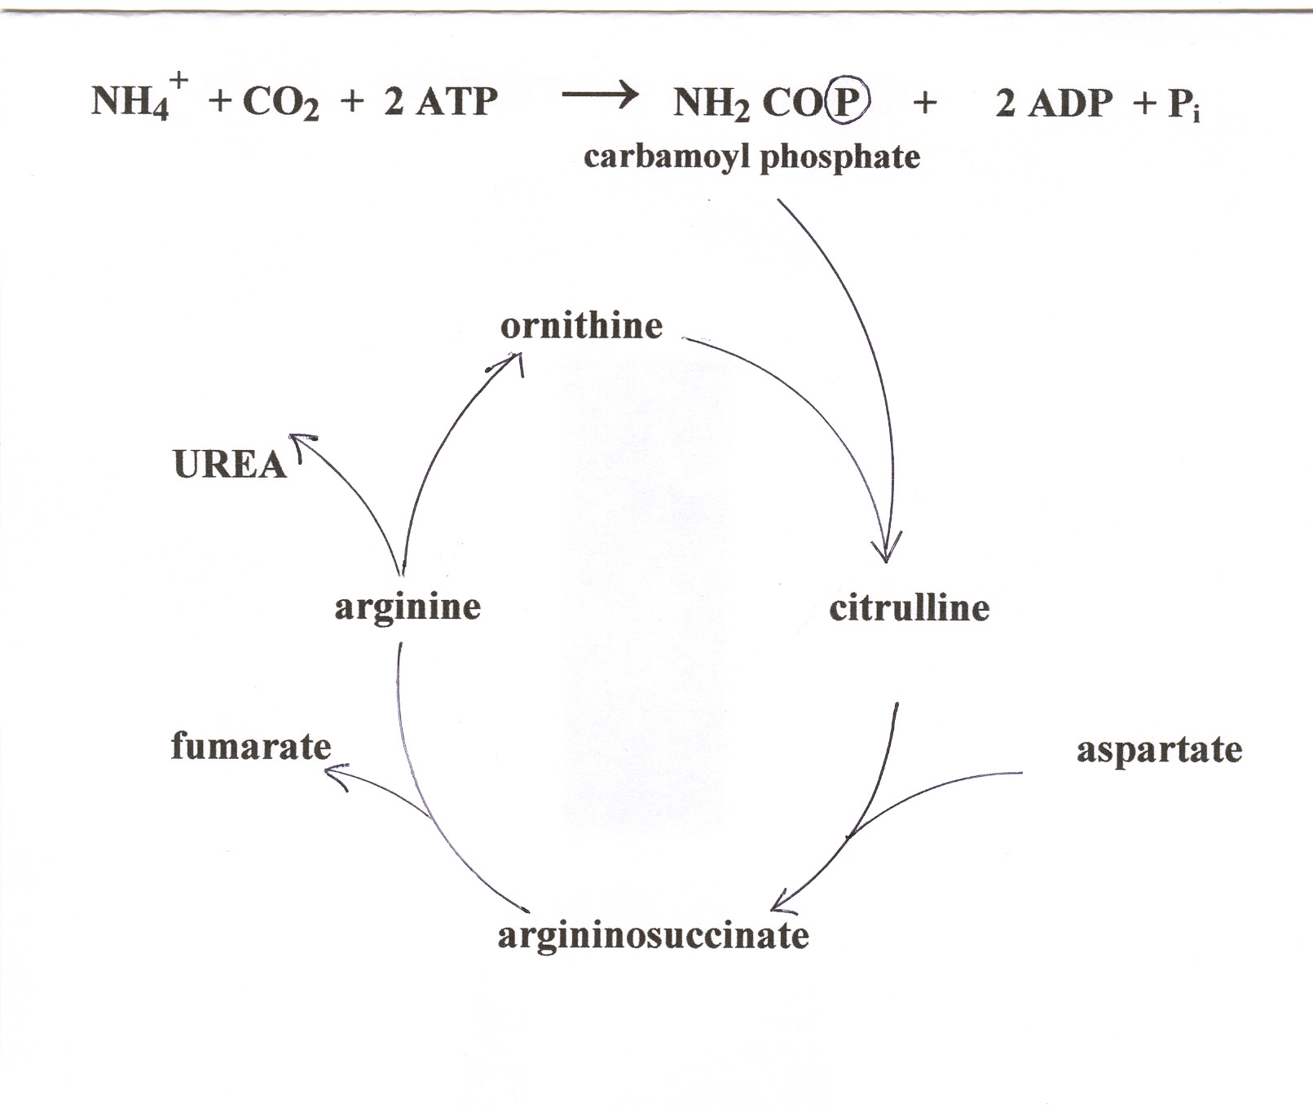


Notes:
Stars are where amino groups come from
NH4 from breakdown of alanine, glutamine, glutamate
CP converted to citrulline by combining with ornithine
Citrulline transported from mitochodnria→ cytosol
Citulline→ arginiosuccinate by combining with aspartate
Arginiosuccinate→ arginine
Arginine hydrated→ UREA and ornithine
Ornithine recycled back into cycle

Slide 34
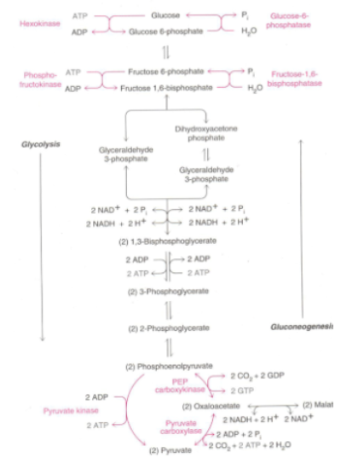
Glucose metabolism
Reverse of glycolysis
Regulated by:
  Availability of substrates
  Activation of enzymes
After 24 hours of fasting, no glycolysis, ALL gluconeogenesis
Notes:
Glucose synthesised from non-carbohydrate sources in liver
Can’t produce glucose from fatty acids as pyruvate→ acetyl coA irreversible
-Glucose-6-phosphatase, fructose-1,6-bisphosphate phosphoenolpyruvate carboxykinase when insulin : glucagon ration is low= fasting state
-Pyruvate carboxylase activated by acetyl CoA
Need to bypass irreversible reactions
-Hexokinase replaced with glucose-6-phosphatase
-Phosphofructokinase replaced with fructose-1,6-bisphosphatase
Occurs in cytosol

Slide 35
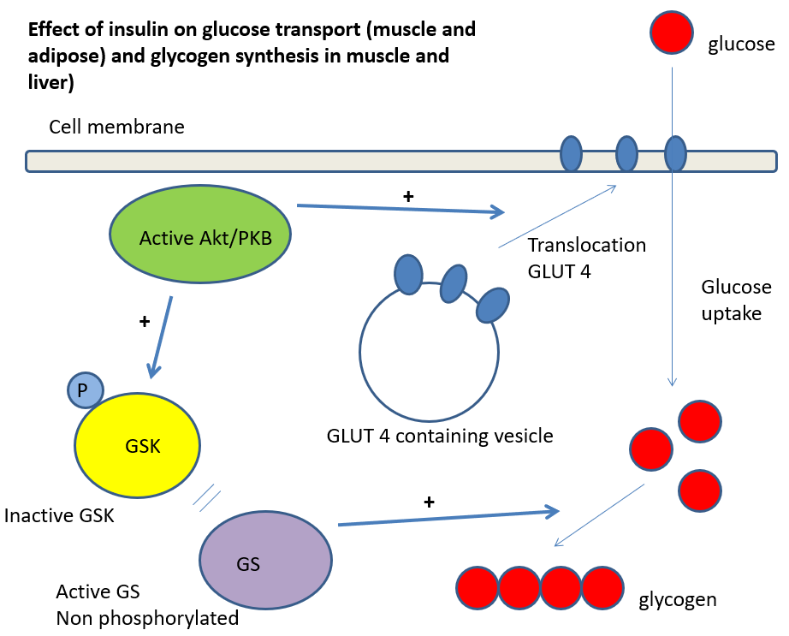
Notes:
Stimulation of glucose uptake- insulin binds to insulin receptors on surface of cells
Activates Akt/PKB→ GLUT4 translocation promoted
Increased glucose entry into cells due to more GLUT4 transporters
AT THE SAME TIME Akt phosphorylates GSK (glycogen synthase kinase)→ inactivates it
Therefore can’t phosphorylate GS (glycogen synthase)→ produces glycogen from glucose

Slide 36
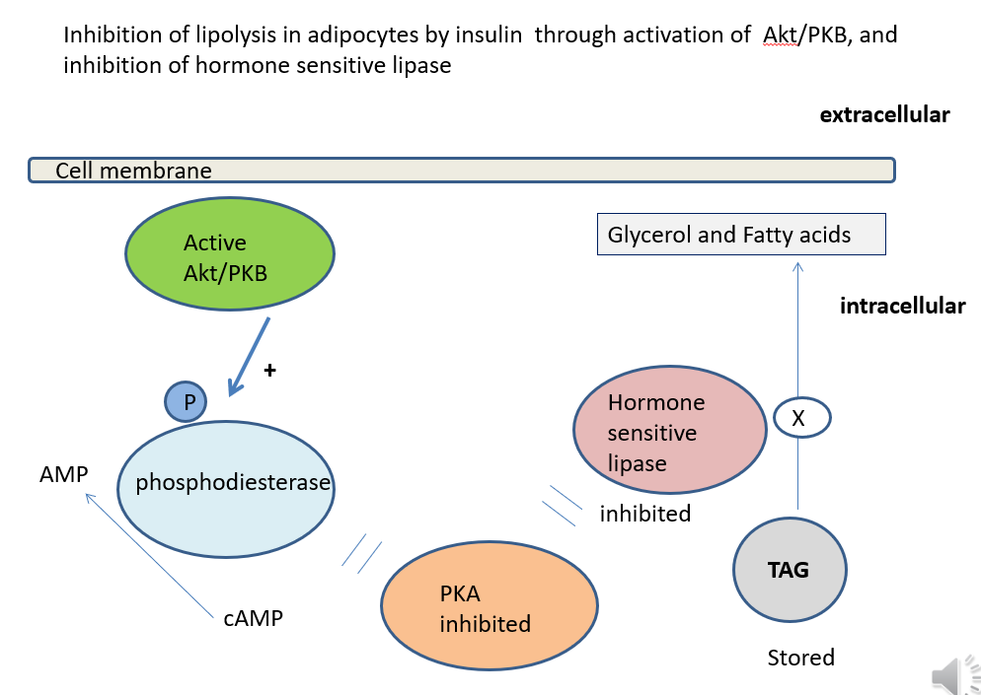
Notes:
Activates AkT/PKB→ phosphorylates phosphodiesterase→ degrades cAMP→ lower levels of cAMP→ reduces activation of PKA→ decreased phosphorylation of HSL (enzyme crucial in lipolysis)→ inactive HSL→ decreased breakdown of TAG into fatty acids and glycerol

Slide 37
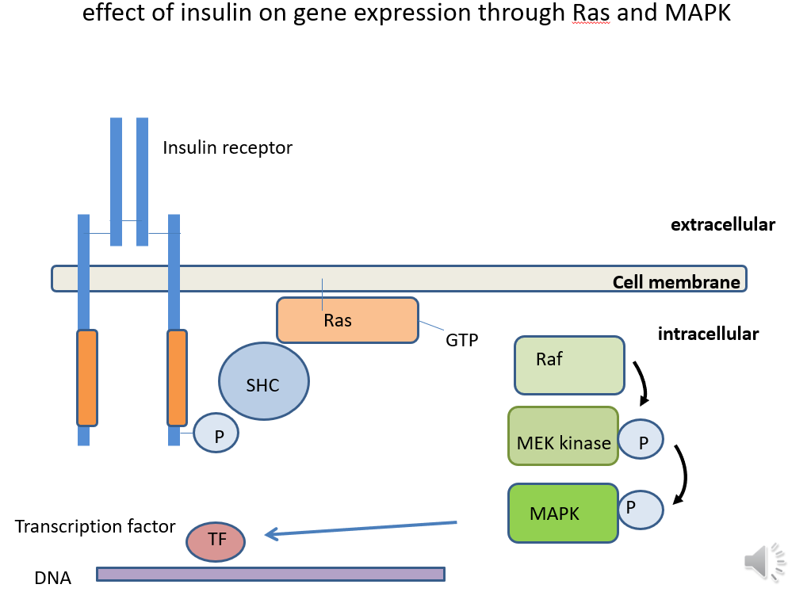
Notes:
Insulin receptor activation
Phosphorylated insulin receptor recruits and phosphorylates SHC proteins→ exchange GDP for GTP on GTPase Ras which activates it
Activated Ras initiates MAPK signalling cascade- Raf activates MEK kinase which activates MAPK
Transcription factor is phosphorylated→ promotes transcription

Slide 38
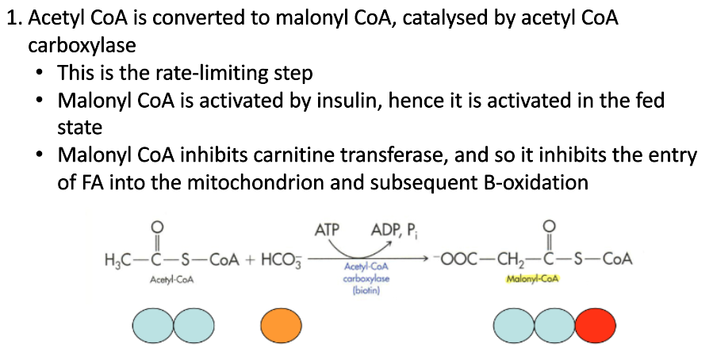
Fatty acid synthesis
Excess carbohydrates→ liver stores glycogen+ excess converted into fatty acids and fat
FED STATE- citrate exported to cytosol to be broken down into oxaloacetate and acetyl CoA
Notes:
Long term reserve is fat at triacylglycerols
1. Carboxylation of acetyl-CoA→ malonyl-CoA catalysed by acetyl CoA carboxylase

Slide 39
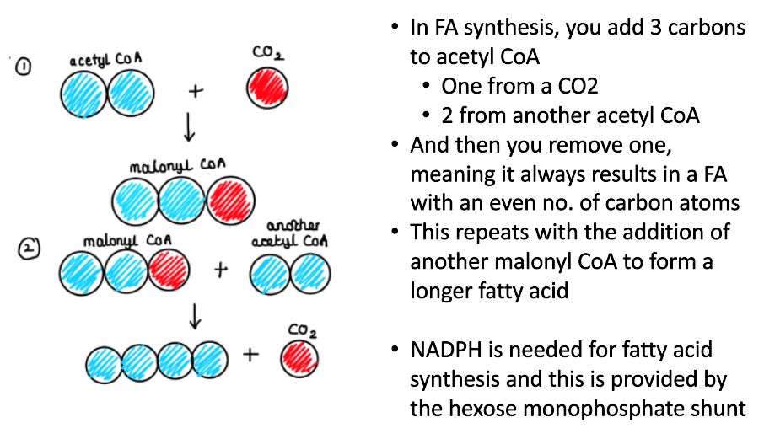
Notes:
Fatty acids esterified into TAG
Glycerol phosphate + 3 FAs combine to form TAG

Slide 40
Metals
Sodium (Hypo/hypernatraemia)
Regulates fluid and electrolyte balance and BP
Eain regulator of ECF volume
Calcium (Hypo/hypercalcaemia)
Deficiency causes rickets in children, osteoporosis in adults
Iron
Primary overload- haemochromatosis→ treat with phlebotomy
Secondary overload- alcohol-associated liver disease, excessive diet→ treat with iron chelating agents
Deficiency- anaemia→ treat with ferrous sulphate, ferrous gluconate IV
Notes:
Haemochromatosis (inherited) caused by mutations in genes that regulate hepcidin or ferroportin
Anaemia caused by decreased intake, impaired absorption, increased demand, GI bleeding
Iron ESSENTIAL for haemoglobin synthesis

Slide 41
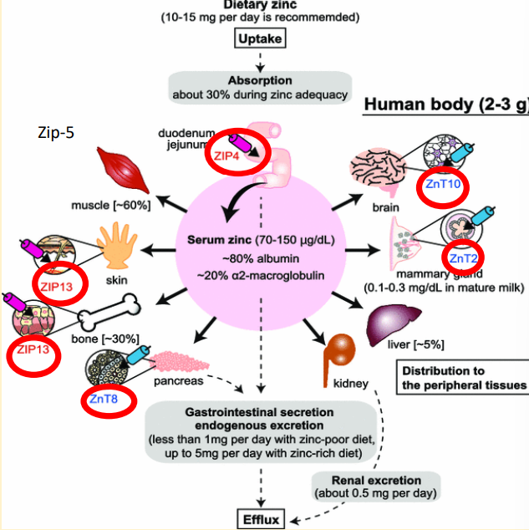
Metals
Zinc
Deficiency- Acrodermatitis enteropathica
Treated with oral zinc supplementation
Copper
Deficiency- Menkes disease→ treat with copper injections
Overload- Wilson disease→ Kayser-Fleisher rings
Treat with copper chelation therapy, high doses of zinc can prevent permanent organ damage
Notes:
Zinc transporters transport zinc ions from extracellular region/ lumen into cytoplasm
Menkes X-linked recessive pattern, mutations in ATP7A which regular copper levels
Wilson disease- mutation in ATP7B which is copper transport protein in liver

Slide 42
Vitamins
Fat soluble: A, D, E, K
Water soluble: B, C
Learn name, function and deficiency
B1- Thiamin
B2- Riboflavin
B3- Niacin
B5- Pantothenic acid
B6- Pyridoxine
B7- Biotin
B9- Folate/ folic acid
B12- Cobalamin
A- Retinol *beta-carotene version is ANTIOXIDANT*
C- Ascorbic acid *ANTIOXIDANT*
D- Calciferol
E- Tocopherol *ANTIOXIDANT*
Notes:
B1- Beri beri, Wernicke encephalopathy, Korsakoff psychosis
B12- neurological defects
Vitamin K used for clotting

Slide 43
B vitamins deficiencies
B1- Thiamin
Coenzyme for pyruvate→ acetyl CoA
Beri beri: infantile, acute cardiac, chronic dry
Wernicke’s encephalopathy
Korsakoff’s psychosis
B2- Riboflavin
Associated with protein
Used as FAD and FMN in redox reactions
B3- Niacin
Used as NAP and NADP in redox reactions
Pellagra: dermatitis, diarrhoea, dementia
B6- Pyridoxine
Used in amino acid metabolism
Inactivated by isoniazid
Notes:
Alcoholic suffer from B vitamin deficiencies
Pts with TB will be given B6 supplements
Pyridoxal phosphate in active form
Vitamin K used for clotting

Slide 44
Vitamin B deficiencies
B9- Folate/ folic acid
Carrier of methyl groups
Found in green vegetables, liver and whole grains
Prescribed in pregnant women to reduce neural tube defects
B12- Cobalamin
Carrier of 1C groups
Found ONLY in animal tissues
Binds to intrinsic factor needed for absorption + transport of B12
  -Deficiency of IF= pernicious anaemia
  Neurological symptoms
  Used for amino acid metabolism and DNA synthesis
  Can cause megalobalstosis
Notes:
Megaloblastosis= impaired DNA synthesis in bone marrow, large immature RBC precursors
B12- neurological defects
Neural tube defects→ pregnant women prescribed folate

Slide 45


MCQs

Slide 46
SBA
1. What is the name of the enzyme which converts fructose-6-phosphate to fructose-1,6-bisphosphate?
A) Aldolase
B) Phosphofruktokinase
C) Phosphoglucose isomerase
D) Triose phosphate isomerase
E) Hexokinase
Notes:
B

Slide 47
SBA
2. Inactive glycogen synthetase is activated by…?
A) Protein kinase
B) Protein phosphatase
C) Protein phosphorylase
D) Glycogen synthase
E) Protease
Notes:
B

Slide 48
SBA
3. If a fatty acid chain is made up of 24 carbons, how many rounds of beta oxidation will it undergo?
A) 10
B) 11
C) 12
D) 13
E) 14
Notes:
B

Slide 49
SBA
4. In starvation, which of the following pathways does glycerol undergo?
A) Gluconeogenesis
B) Glycolysis
C) Beta-oxidation pathway
D) TCA cycle
E) Glycogenesis
Notes:
A

Slide 50
SBA
5. What happens in both the liver and muscle in the fed state?
A) Both glycogen synthetase is inhibited and phosphorylase are activated
B) Glycogen synthetase is inhibited and phosphorylase is activated
C) Glycogen synthetase is activated and phosphorylase is inhibited
D) Glycogen synthesis is inhibited
E) Gluconeogenesis is activated
Notes:
C

Slide 51
SBA
6. Why does glucokinase produce glucose-6-phosphate in the liver, and not hexokinase?
A) Glucokinase has a higher Km than hexokinase
B) Glucokinase has a higher affinity for glucose
C) The pH of the liver would cause denaturation of hexokinase
D) Glucokinase functions at low concentrations of glucose
E) The liver contains allosteric inhibitors of hexokinase
Notes:
A

Slide 52
SBA
7. What hormone activates lipolysis?
A) Insulin
B) Adrenaline and glucagon
C) Adrenaline and noradrenaline
D) Glucagon and glucose
E) Thyroxine
Notes:
B

Slide 53
SBA
8. Oxidative deamination is the conversion of…
A) An amino acid to a carboxylic acid + ammonia
B) An amino acid to a keto acid + ammonia
C) A keto acid to an amino acid + ammonia
D) An amino acid to a keto acid
E) A carboxylic acid to a keto acid
Notes:
B

Slide 54
SBA
9. What are the fat soluble vitamins?
A) C D E K
B) B C
C) A B E K
D) A D E K
E) No vitamins are fat soluble
Notes:
D

Slide 55
SBA
10. Accumulation of which mineral causes Wilson’s disease?
A) Iron
B) Calcium
C) Copper
D) Zinc
E) Potassium
Notes:
C

Slide 56
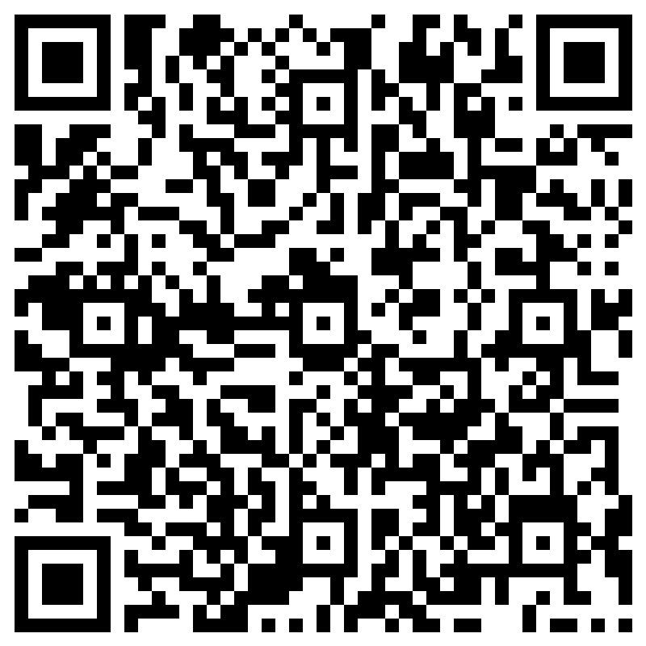
FEEDBACK
Thank you!!
Any questions?
amy.zhang@kcl.ac.uk

