Slide 1



Year 2 OSCE Crash Course
Communication Skills
By: Maheen Siddiqui (Yr4) and Amy Zhang (Yr3)

Slide 2
What is a comms station?
Communication!
Explore and explain
Full 8 minutes

Slide 3
What can come up?
The big three!
    Explaining medication
    Explaining a diagnosis
    Explaining a procedure
Explaining test results (usually linked to explaining diagnosis)
Addressing social concerns
Breaking bad news
Handling an angry or upset patient

Slide 4
Steps to approach a comms station
Brief “catch-up” of what has happened so far
      “Just so we are on the same page, do you mind giving me a brief summary of what has happened so far leading up to this point”
Explore:
      What do they already know?
      What would they like to know?
      What would you like them to know?
      What are their concerns?
Always chunk and check - after giving a bit of information, say “does that make sense so far?” “any questions so far?”
Summarise
Safety net!!! + follow ups
Leaflets/website for more information (always!)

Slide 5
Useful structure frameworks
etting
erception
nvitation
nowledge
motion
trategy and summary
ash your hands
ntroduce
ermission/ consent
xpose/ explain
eposition
S
P
I
K
E
S
W
I
P
E
R
I
C
E
deas
oncerns
xpectations

Slide 6
Specific Advice - Explaining a Diagnosis
What is normal anatomy/physiology?
What happens in the disease
Causes
Problems/complications
Management

Slide 7
Specific Advice - Explaining a Diagnosis
e.g. Hypertension
What is normal anatomy/physiology? | The circulation system within your body is made up of your heart, a muscular pump, and blood vessels. The pressure within the vessels is a combination of how hard the heart pumps and how stretchy the vessels are. This is measured both when the heart pumps – systole- the top number, and when the heart relaxes – diastole- the bottom number.
What happens in the disease | High blood pressure occurs when the vessels become less elastic and more narrow. This means that to pump blood around the body, the heart has to work harder, which increases the pressure in the vessels. It is normal for your blood pressure to go up and down during the day, especially when you are active; however, it should not be consistently greater than 140 over 90. Although your blood pressure is high today, this doesn’t necessarily mean you have hypertension. To formally diagnose, I would like for you to be fitted with a machine that takes readings over 24 hours and provides an average.
Causes | The most common cause of high blood pressure is getting older. However, many factors in your lifestyle can have a significant impact; including smoking, lack of exercise, being overweight, drinking alcohol in excess and a diet high in salt, sugar and fats.
Problems/complications | The fatty deposits in your blood vessels can build up in vessels leading to different organs, causing different impacts. e.g. if the deposits block the vessel going to the heart, it can cause a heart attack. If it affects the vessels in the brain, they can cause a stroke.
Management | Our target in managing your high blood pressure is to reduce it below a target range. You are unlikely to have any symptoms of high blood pressure, so it must be regularly monitored to ensure we are always maintaining this target. We recommend a combination of healthy lifestyle changes and long-term medications. I can explain and discuss these options with you in more detail so you understand how they will help.

Slide 8
Specific Advice - Explaining a Drug
Brief history and contraindications
What is the drug?
How does it work?
How to take the drug?
What to do if you miss a dose?
Monitoring required?
Side effects?
      Pro tip - most drugs will have nausea as a potential side effect

Slide 9
Specific Advice - Explaining a Drug
e.g. ACEi
Brief history and contraindications/why is it important to treat | High BP can be quite dangerous and can damage the vessels leading to your organs. This can cause issues like heart attacks and strokes.
What is the drug? | Ramipril is what we call an ACE inhibitor - it is just one of the medications used to reduce your blood pressure and keep it controlled
How does it work? | They work by widening the blood vessels and reducing the amount of salt and water in the body.
How to take the drug? | Take the tablet once a day
What to do if you miss a dose? | If you miss a dose, take it as soon as you remember. But if you don’t remember until the next day, skip the missed dose and just take your usual daily amount. Do not take extra to make up for a missed dose.
Monitoring required? | You are going to need yearly BP checks, although we recommend home monitoring if you can purchase a cuff. Local pharmacies usually have them in stock. We will also have to do some blood tests to check your kidney function before we start treatment and every year after too
Side effects? | Not all patients who take ACE inhibitors experience side effects, but it’s good to be aware of them before you start. Most commonly, this may be symptoms like feeling lightheaded, due to low blood pressure. Tummy upset, rashes and feeling sick is also quite common Another common side effect is a dry cough. If it becomes too troublesome, there are alternative classes of medication we can try, so do get in touch. Some rarer side effects are the swelling of face and neck - if this happens, call 999 immediately

Slide 10
Specific Advice - Explaining a Procedure
What is the procedure?
Why is it performed?
Details of procedure (before, during, after)?
What are the side effects and risks?
      Pro tip - if you are not sure, pain, bleeding and infection are almost always one for procedures

Slide 11
Specific Advice - Explaining a Procedure
e.g. Endocscopy
What is the procedure? | A test used to look into your digestive system, mainly the food pipe and the stomach, and the first part of the next section of the digestive tract which you may know as the duodenum.
Why is it performed? | Doing this to help figure out what is causing your symptoms (relate to whatever symptoms and/or blood test results they have). It gives us a very clear, direct view of the lining of your stomach. While we are in there, we can also take tiny, painless samples of tissue - called biopsies - to test in the lab, or even treat certain problems right away
Before Procedure | IFor us to get a clear view, your stomach needs to be completely empty. We'll ask you not to eat anything for 6 hours before the test, and to stop drinking clear fluids 2 hours before. We will review your daily medications with you, and before we start, we'll go over everything again so you can sign a consent form.
During Procedure | We insert a thin, flexible tube with a camera attached on the end into your mouth and down your food pipe until just a bit after the stomach We give you a spray to numb the back of the throat and we can give you something to make you feel a bit sleepy so you relax and don't feel as sick We pump a little bit of air into your stomach to inflate it so we can see better The entire procedure will take around 20-45 minutes
After Procedure | It's important if you do have the mild sedative not to drive for at least 24 hours afterwards, which means you might need someone to take you home. This also applies to operating heavy machinery, signing important documents, and doing anything else you might feel is dangerous or needs your full attention
Side Effects and Risks? | It is a very routine and safe procedure. It is completely normal to have a mildly sore throat for a day or two, or to feel a bit bloated and burpy from the air we put in. Some other side effects and risks can include pain, infection and bleeding. There is also a rare risk of making a tiny tear in your food pipe or stomach, called a perforation. We will be ensuring you are monitored throughout to keep you safe.

Slide 12
Human Development Potential Stations
Diagnosis | Procedures | Drugs
STI | Thyroidectomy | Emergency Contraception
Miscarriage | Parotidectomy | COCP
 | Induction of labour | POP
 |  | Condom
 |  | Contraceptive Implant
 |  | IUS
 |  | HRT

Slide 13
Supporting Life Potential Stations
Diagnosis | Procedures | Drugs
COPD | Bronchoscopy | Inhaler
Asthma | CABG | DOACs
Hypertension | Stenting Procedures | Statin
Angina

Slide 14
Inflammation Potential Stations
Diagnosis | Procedures | Drugs
Diabetes | Gastroscopy | Metformin
Paediatric GORD | Colonoscopy | Methotrexate
GORD | Biliary Surgery | Insulin
 | Dialysis Counselling

Slide 15
Ageing Potential Stations
Drugs
Warfarin
Levodopa
Bisphosphonates

Slide 16
Key takeaways
Structure your consultation
Explore patient perspective
Use clear, simple explanations
Chunk and check
Always check understanding and summarise

Slide 17
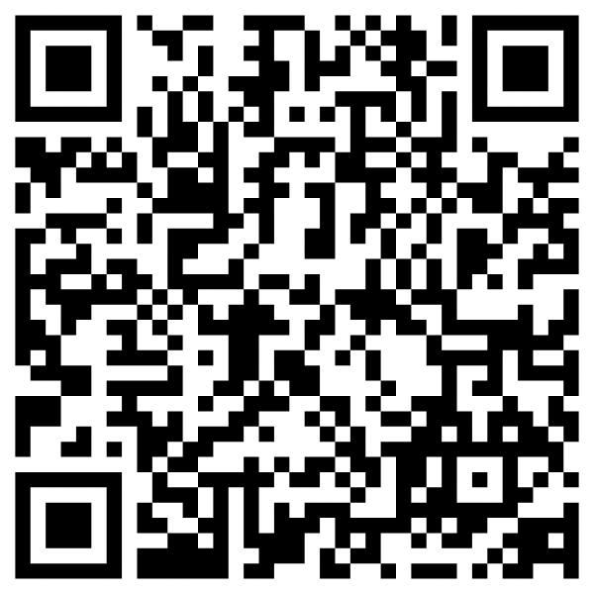

Slide 18
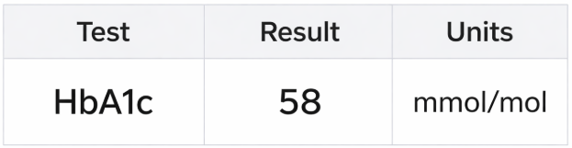
Scenario 1
A 53-year old woman has been called back to the GP to examine her HbA1c test results. Please interpret the results and advise her on her next steps.

Slide 19
Scenario 2
A 72-year old man has recently started 20mg atorvastatin for high cholesterol. He’s a bit worried as he’s already on other medication for hypertension and osteoarthritis. Please discuss his concerns and the medication.

Slide 20
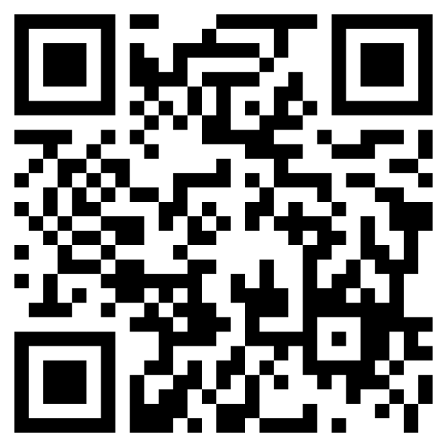
Feedback Form

