Slide 1
SFP Made Simple
9. Answer the Personal Questions with Confidence
Dr Daria Andreeva (FY1 Imperial)

Slide 2
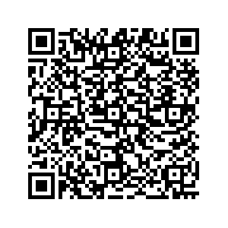
Fundraising

Slide 3
Use of Personal Questions
Ranges between deaneries
Person specification
E.g. North West state that they only ask about career aspirations

Slide 4
Top Tips
Personal presentation
Key examples
Frameworks
Practice

Slide 5
Categories in the Personal Section
Motivation
Why SFP?
Career aspirations
Competence
Leadership
Managing stress
Teamwork
Personal questions
Life outside medicine
Other degrees/jobs

Slide 6
Key Frameworks
STAR
CAMP
SPIES

Slide 7
STAR
S | Situation – a brief description of the story.
T | Task – what was the aim of the task?
A | Action – what did you do and how did you do it?
R | Result/Reflection – what was the end result and how did you reflect upon it?

Slide 8
2. CAMP
C | Clinical
A | Academic
M | Management
P | Personal

Slide 9
3. SPIES
S | Seek information
P | Patient Safety
I | Initiative
E | Escalate
S | Support

Slide 10
Example Questions - Career Aspirations
Why SFP? | Why academic medicine?
Why this specific region? | What attracts you to academia?
What are the challenges you might face on the SFP in comparison to the FP? | Why do you think you are a strong SFP applicant?
What are you long-term career goals? | What is your biggest achievement?
Why the SFP instead of a PhD? | What is the difference between clinical researchers and scientists?

Slide 11
Example Questions - Competencies
Describe a time in which you were a good team player. | Describe a time in which you were a good leader.
Describe a time in which you were a good teacher. | Describe a time in which you dealt well with change.
Describe a time in which you were a good communicator. | Describe a time in which you managed a difficult colleague.
Describe a time in which you showed great empathy. | Describe a time in which you were a good motivator.

Slide 12
Example Questions - Personal
How do you deal with stress? | What do you do in your free time?
What is a journal article that you enjoyed recently? | How do you effectively manage your workload?
How do you effectively meet deadlines? | Talk about a complex decision you made and how you went about it.
Describe a time in which you showed great empathy. | Describe a time in which you were a good motivator.

Slide 13
Great Resource

Slide 14
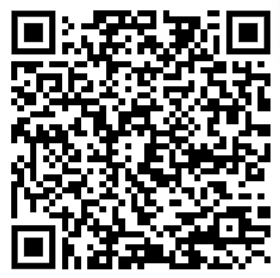
Thank you!

