Slide 1







GKTeach
Anatomy of the Musculoskeletal System
STAGE 1
By Ibraheem Ghafoor, Stage 2 Year 2
17/04/2026

Slide 2
  The Spine and Vertebral Column
  The Upper Limb
  The Lower Limb
  Questions!!
CONTENTS

Slide 3

But first… Anatomy Basics
For Bones:
  Articulations
  Foramina
  Sites of muscle attachment
Tuberosities/Tubercles/Condyles/Trochanters
Processes
Fossas

Slide 4
But first… Anatomy Basics
For Muscles:
  Origins
  Insertions
  Actions
  Innervations
  Vasculature

Slide 5


The Spine and Vertebral Column

Slide 6
Overview
Twenty four vertebrae in the adult spine:
7 Cervical
12 Thoracic
5 Lumber
Sacrum (5 fused vertebrae)
Coccyx (4 fused vertebrae)

Slide 7
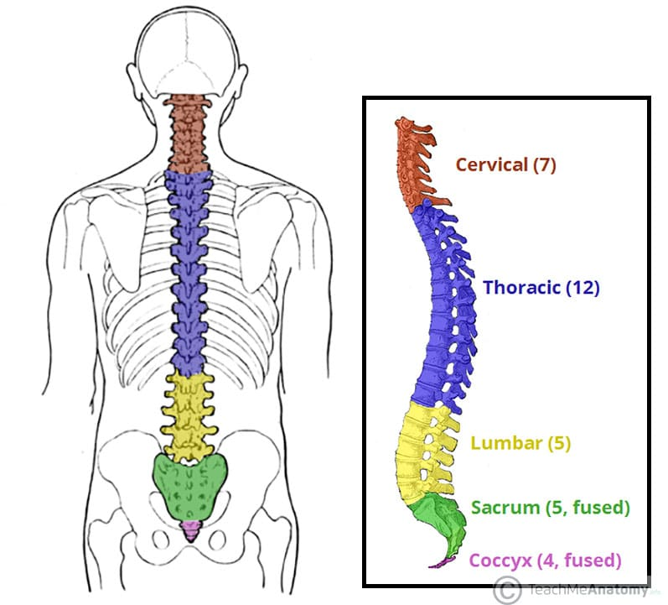

Slide 8
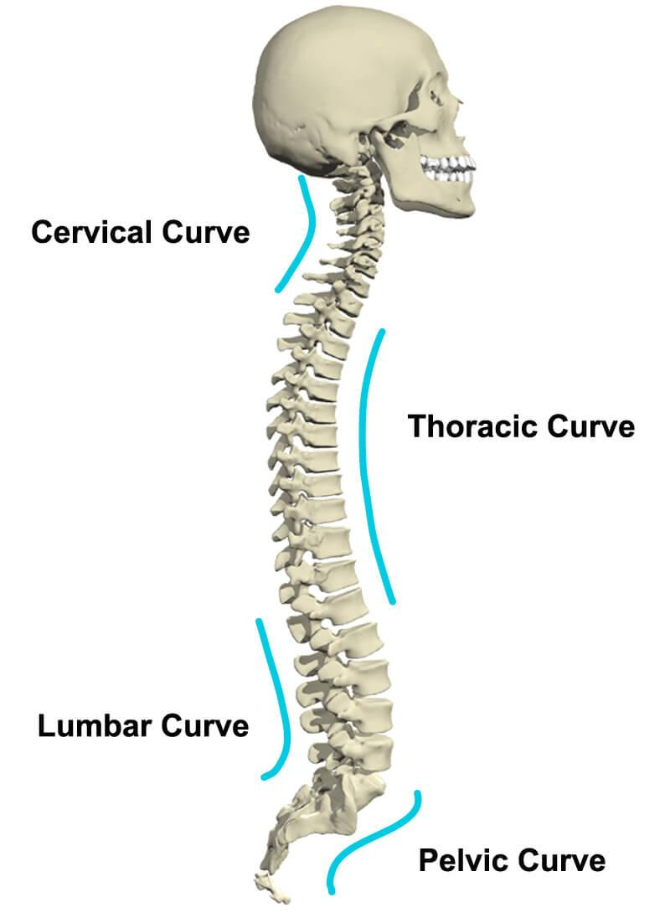
Curvatures
Primary:
Thoracic
Sacral
Secondary:
Cervical
Lumbar

Slide 9
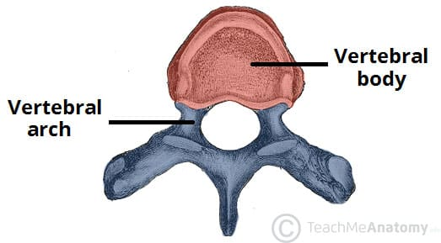
Structure of a Vertebra
ANTERIOR
POSTERIOR

Slide 10
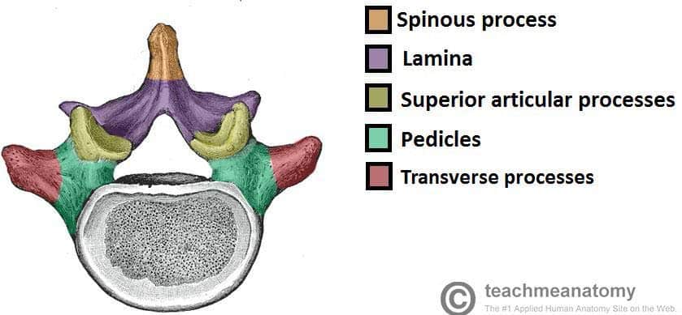
Structure of a Vertebra

Slide 11
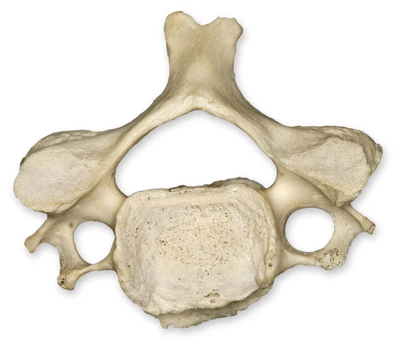
Cervical Vertebrae
Important features:
Bifid spinous process
Transverse foramina
Triangular vertebral foramen
Superior and inferior articular facets

Slide 12
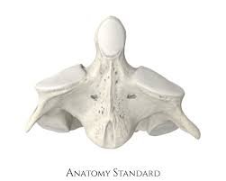
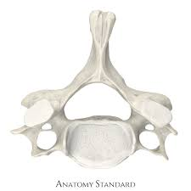
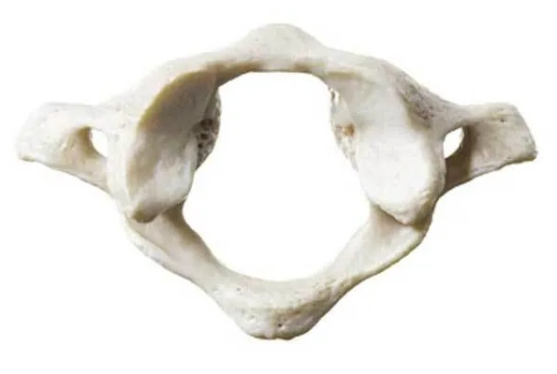
C1, C2, and C7
C1 “Atlas”
C2 “Axis”
C7
Large superior articular facets for occipital bone
No vertebral body
Facet for odontoid process
No spinous process
Large superior articular facets
Odontoid process (for articulation with C1)
Spinous process NOT bifid
Larger vertebral body

Slide 13
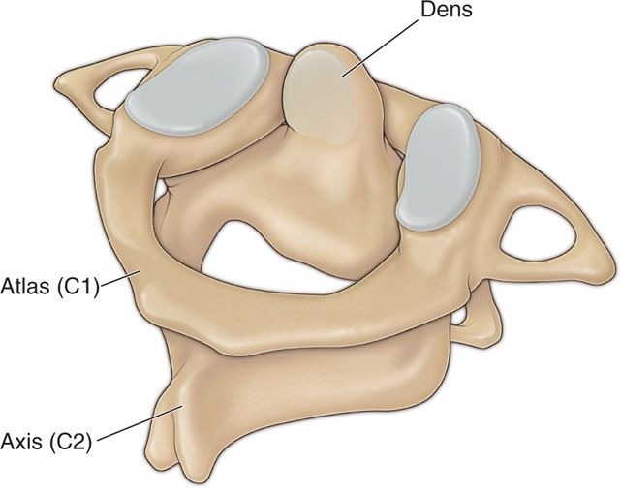

Slide 14
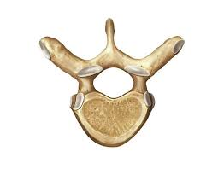
Thoracic Vertebrae
Important features:
Demi-facets for costal head articulation
Costal facets on transverse process
Spinous process slants inferiorly
Heart shaped vertebral body
Sup. and inf. Articular processes are ANGLED posteriorly and anteriorly

Slide 15
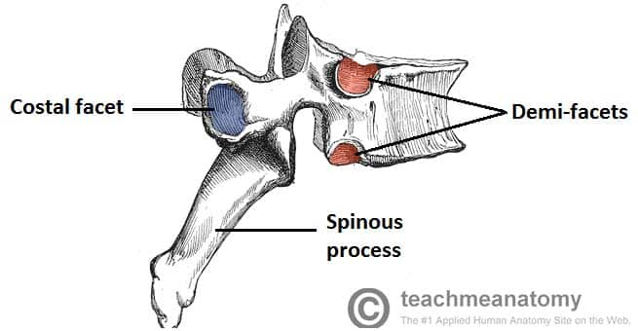

Slide 16
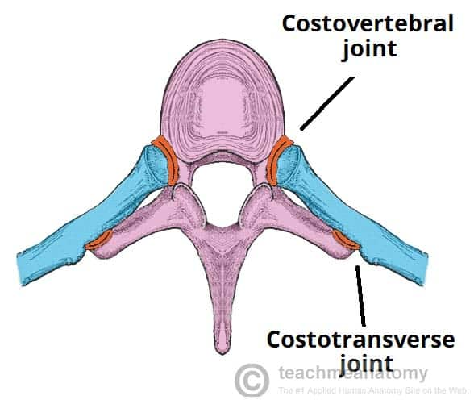

Slide 17
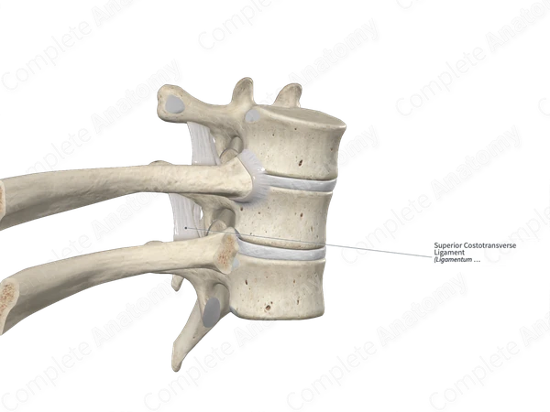

Slide 18
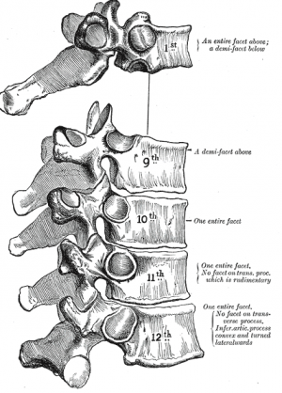
T1 and T9-12
T1: The first rib entirely articulates with T1; however it still has an inferior demifacet for the second rib
T9: Ribs 10-12 articulate with only their numerically corresponding vertebra, so T9 has no inferior demifacet
T10-12: as mentioned above, only articulate with a single rib, the numerically corresponding one.

Slide 19
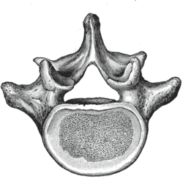
Lumbar Vertebrae
Features:
BIG vertebral body (for load bearing)
Short spinous process
Mammillary and accessory processes (for muscle attachment)

Slide 20
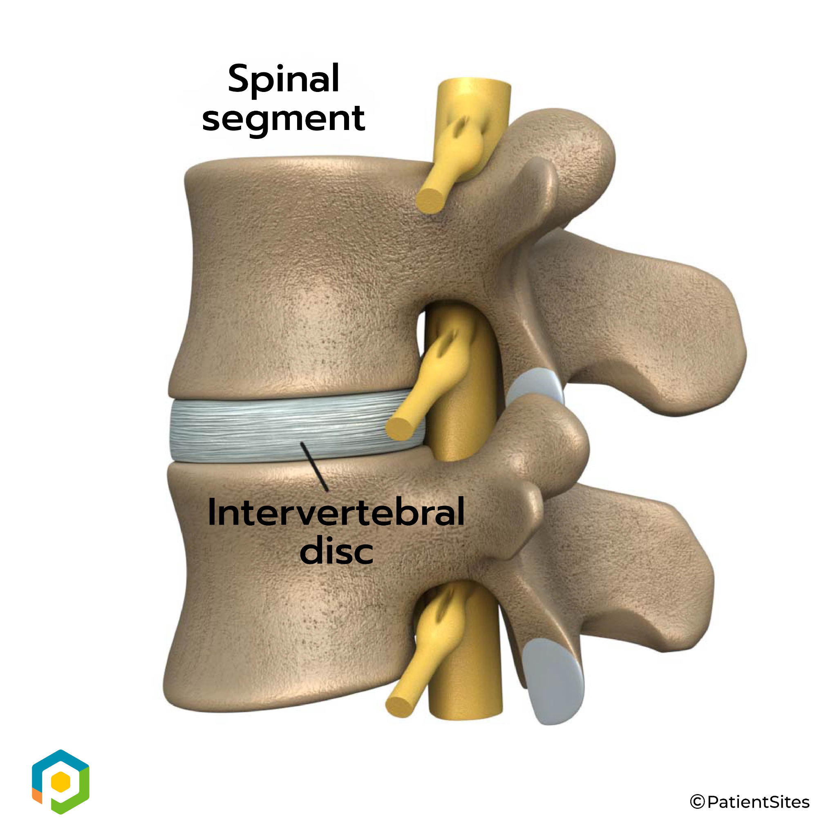
Joints of the Vertebral Column
Intervertebral discs: almost immovable.
This is a SYMPHYSIS, a type of SECONDARY CARTILAGINOUS JOINT.
Between articular processes: movable joints, SYNOVIAL.

Slide 21
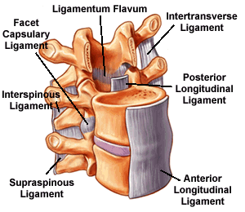
Ligaments of the Vertebral Column

Slide 22
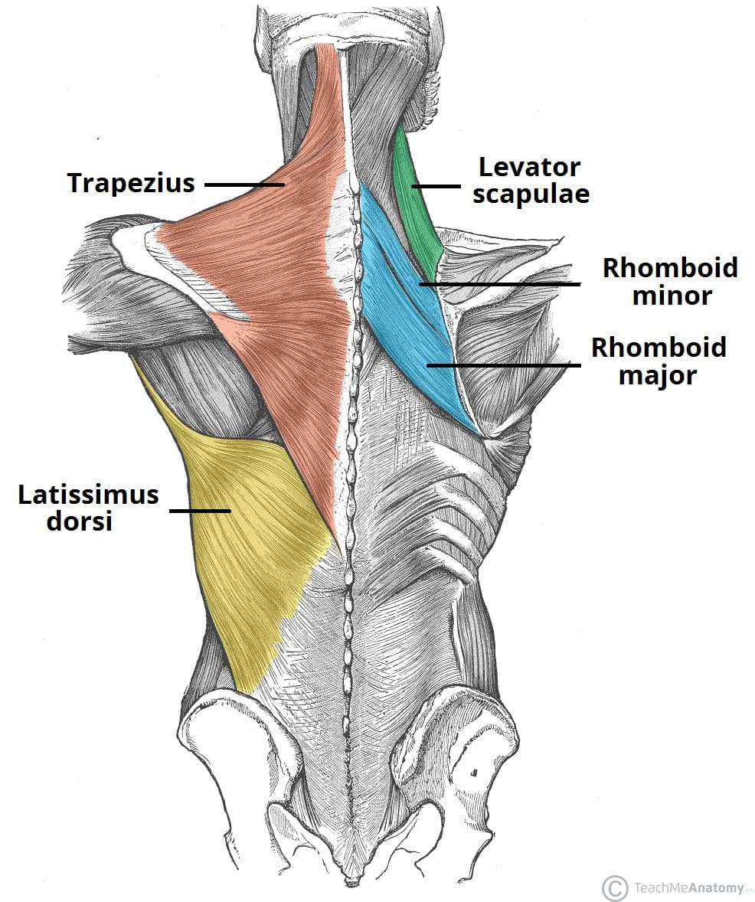
Muscles of the Spine
SUPERFICIAL LAYERS:
Trapezius:
O: occipital bone, nuchal ligament, spinous processes of C7-T12
I: lateral clavicle, acromion, spine of scapula
A: elevation, retraction, depression of scapula
I: CNXI; the accessory nerve

Slide 23
Muscles of the Spine
SUPERFICIAL LAYERS:
Latissimus Dorsi:
O: T7-T12 spinous processes, thoracolumbar fascia, iliac crest
I: intertuburcular groove of humerus
A: extends, adducts, medially rotates the arm
I: thoracodorsal nerve
V: thoracodorsal artery

Slide 24
Muscles of the Spine
Levator Scapulae:
Action: elevates scapula (also ipsilateral neck flexion)
Rhomboid Major + Minor:
Action: retraction and elevation of scapula

Slide 25
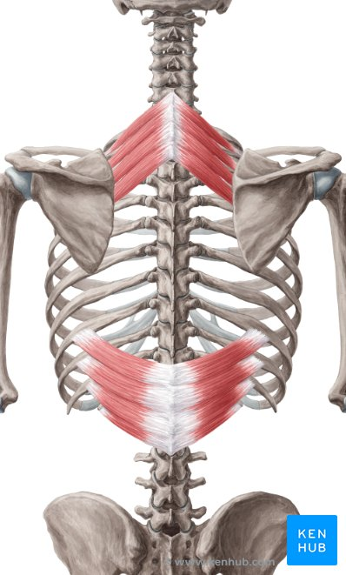
Muscles of the Spine
INTERMEDIATE LAYER:
Serratus posterior superior:
Originates from nuchal ligament + C7-T1
Inserts onto ribs 2-5
Elevates ribs during inspiration
Serratus posterior inferior:
Originates from T11-L2
Inserts onto ribs 9-12
Depresses ribs

Slide 26
Muscles of the Spine
INTERMEDIATE LAYER:
Serratus posterior superior:
Originates from nuchal ligament + C7-T1
Inserts onto ribs 2-5
Elevates ribs during inspiration
Serratus posterior inferior:
Originates from T11-L2
Inserts onto ribs 9-12
Depresses ribs

Slide 27
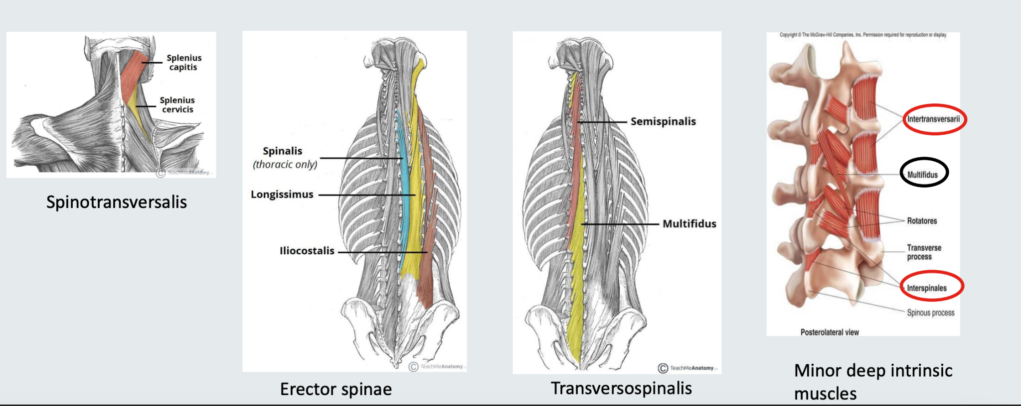
Deep Muscles of the Spine

Slide 28
The Upper Limb

Slide 29
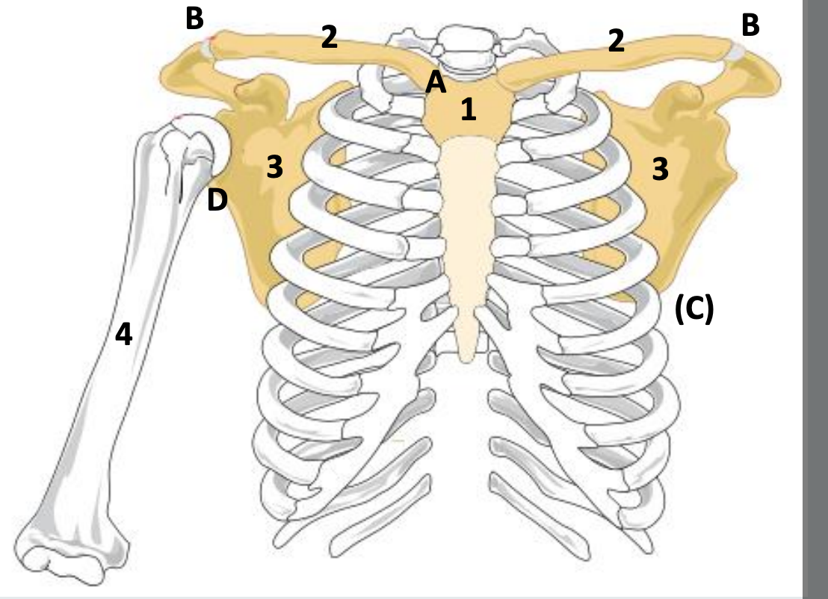
The Pectoral Girdle
The pectoral girdle consists mostly of the clavicles and scapula, but also contains the humerus and manubrium.
It contains four joints:
The sternoclavicular joint
The acromio-clavicular joint
The glenohumeral joint
The scapulo-thoracic “joint”

Slide 30
The Pectoral Girdle
The pectoral girdle consists mostly of the clavicles and scapula, but also contains the humerus and manubrium.
It contains four joints:
The sternoclavicular joint
The acromio-clavicular joint
The glenohumeral joint
The scapulo-thoracic “joint”

Slide 31
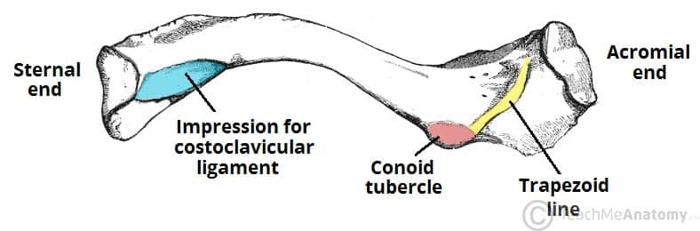
The Clavicle

Slide 32
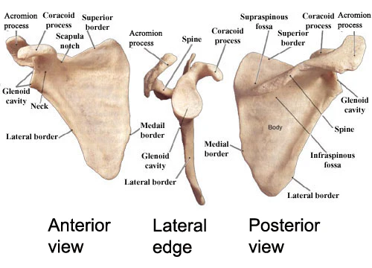
The Scapula

Slide 33
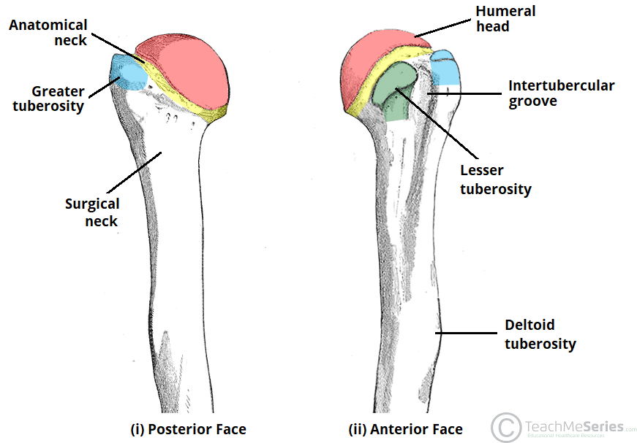
The Humerus
Note important features:
The tuberosities
The intertuburcular groove
Surgical neck: common fracture sites (this may injure the radial nerve)

Slide 34
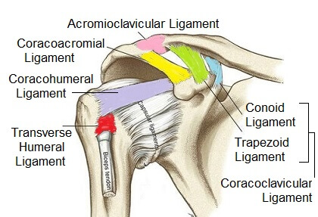
The Glenohumeral Joint
The shoulder, or “glenohumeral joint” is the articulation between the head of the humerus and the glenoid cavity of the scapula.
Two ligaments secure the joint.
Within the same region, there are also two other ligaments that secure the acromioclavicular joint: the acromioclavicular and coracoclavicular ligaments.

Slide 35
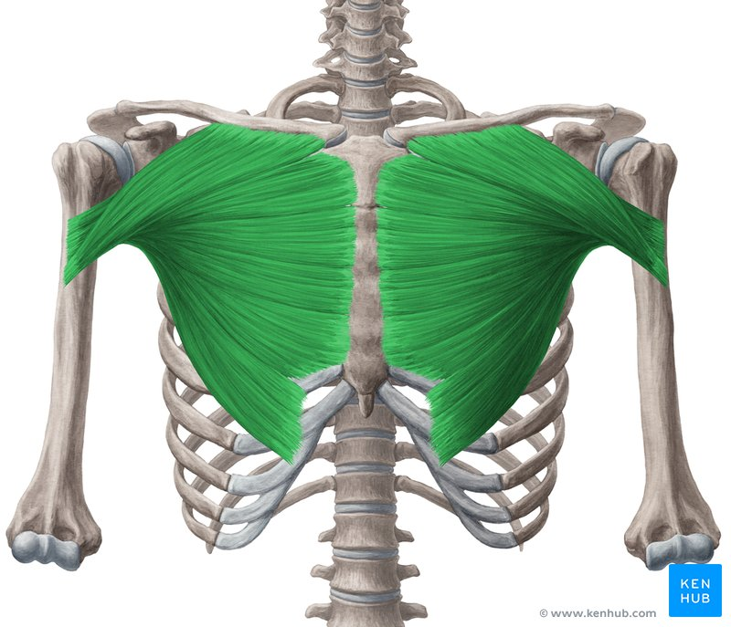
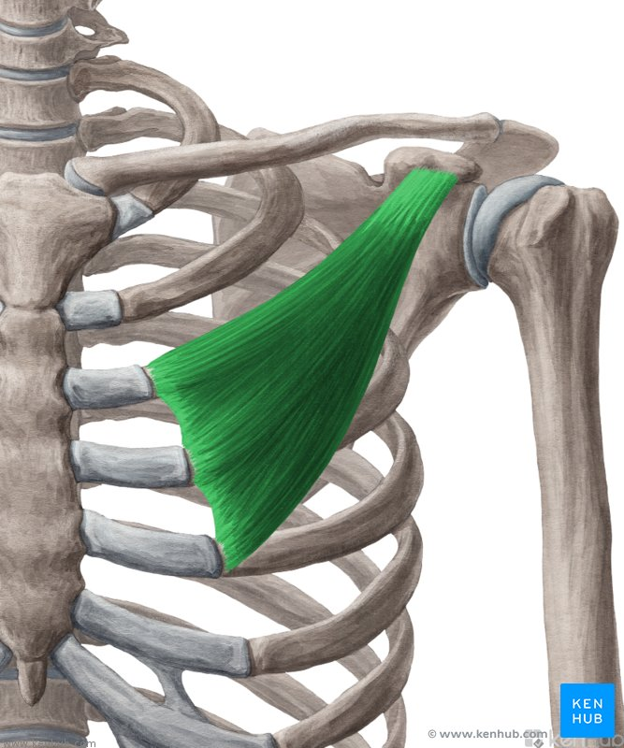
Pectoralis Muscles
Pectoralis Major
O: clavicle, sternum, abdominal (rectus sheath aponeurosis)
I: lateral lip of intertubucular groove of humerus
A: flexion, adduction, medial rotation
Pectoralis Minor (deep to Major!)
O: ribs 3-5
I: coracoid process of scapula

Slide 36
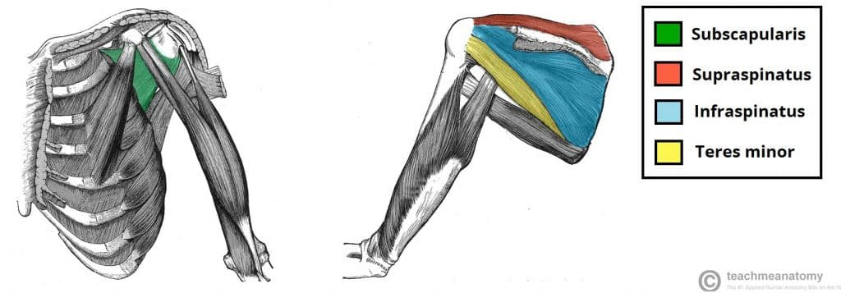
Rotator Cuff Muscles
The rotator cuff muscles are the main rotators of the arm (they rotate the arm medially and laterally).
They originate from the scapula and all insert around the head of the humerus.
Despite being a rotator cuff muscle, supraspinatus does NOT rotate the arm. Its function is to initiate abduction of the arm (first 10-15º)

Slide 37
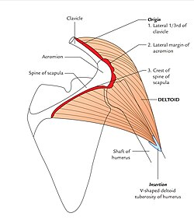
The Deltoid
The deltoid is a multipennate muscle of the shoulder.
Supraspinatus initiates abduction of the arm, but above 10-15º, the deltoid does the rest.
It also assists in flexing and extending the arm.

Slide 38
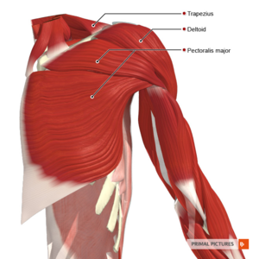

Slide 39
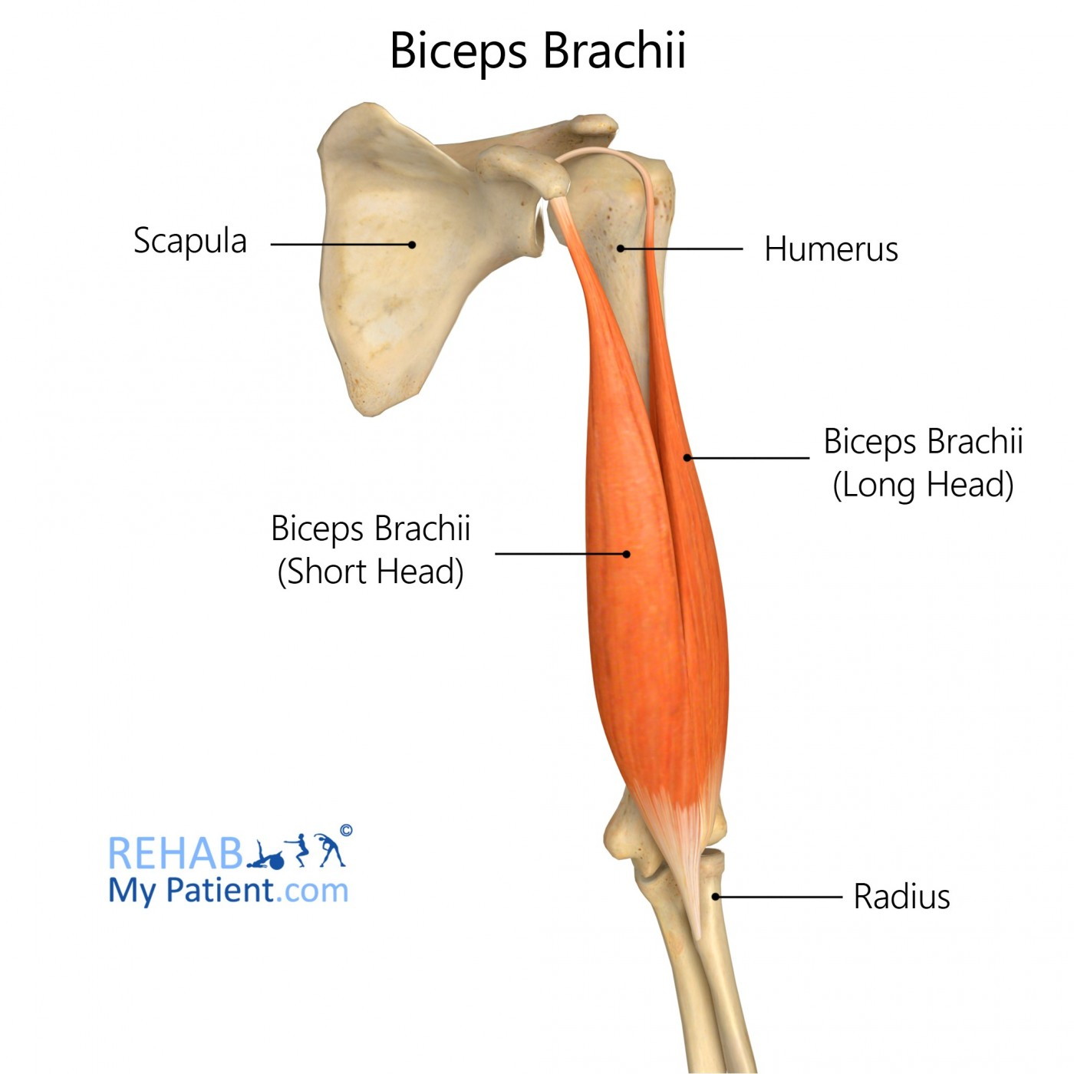
The Muscles of the Arm
The anterior compartment of the arm hosts three main muscles:
Bicep brachii:
O: Long head: supraglenoid tubercle; short head: coracoid process
I: Radial tuberosity (+ a bicipital aponeurosis)
A: supinator; THEN flexor
I: musculocutanous nerve
V: brachial artery

Slide 40
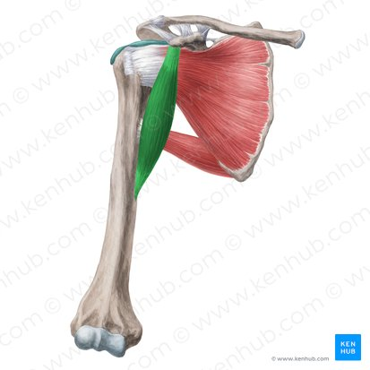
The Muscles of the Arm
The anterior compartment of the arm hosts three main muscles:
Coracobrachialis:
O: coracoid process
I: medial aspect of humerus
A: adduction and flexion
I: musculocutanous nerve
V: branches of brachial artery

Slide 41
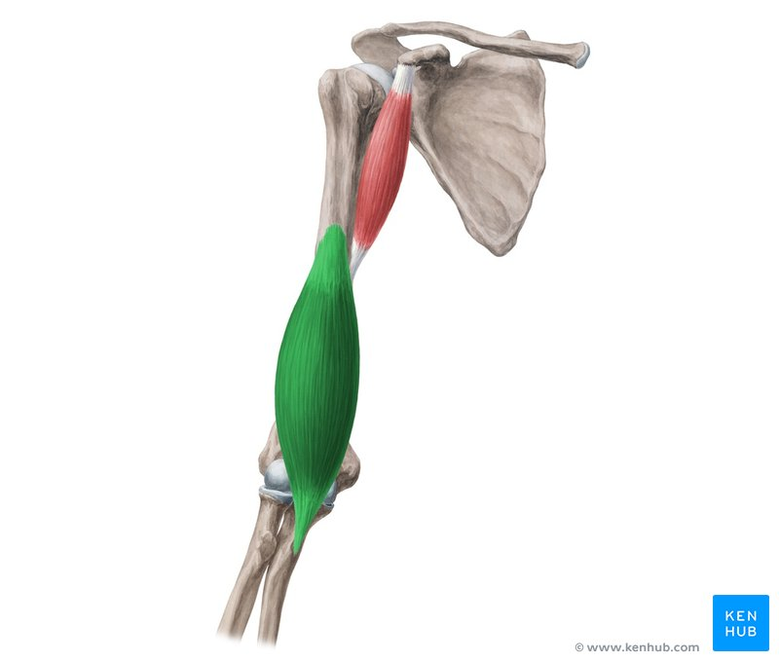
The Muscles of the Arm
The anterior compartment of the arm hosts three main muscles:
Brachialis:
O: anterior surface of humerus
I: ulnar tuberosity
A: main flexor of forearm
I: musculocutanous nerve

Slide 42
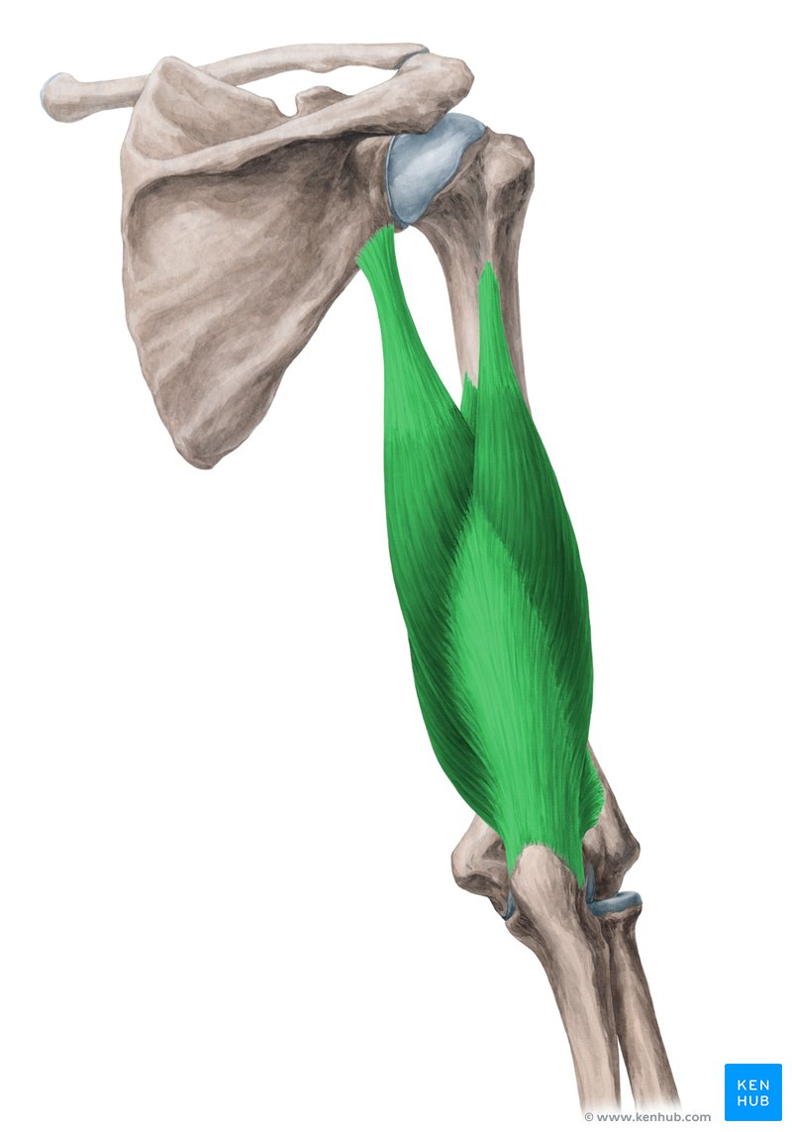
The Muscles of the Arm
The posterior compartment of the arm contains only one muscle:
Triceps brachii:
O: long head: infraglenoid tubercle; medial and lateral heads: posterior surface of humerus
I: olecranon of ulna
A: extensor of forearm (and also of arm)
I: radial nerve
V: profunda brachii artery

Slide 43
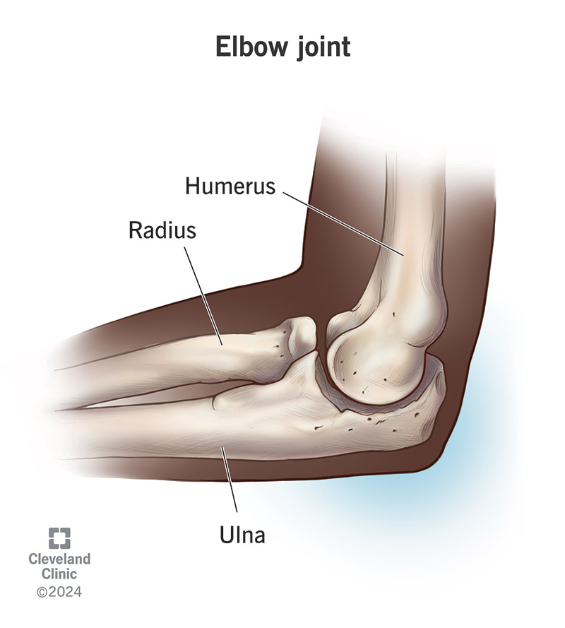
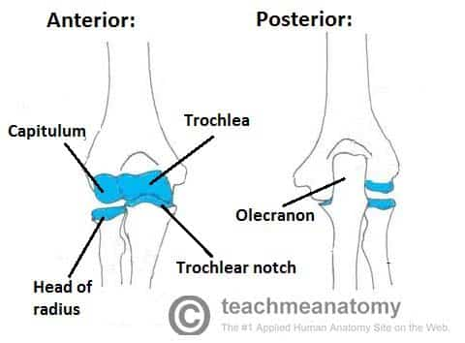
The Elbow Joint
The elbow joint is a “hinge” joint.
The trochlea of the humerus sits in the olecranon of the ulna.
The capitulum of the humerus articulates with the radius.

Slide 44
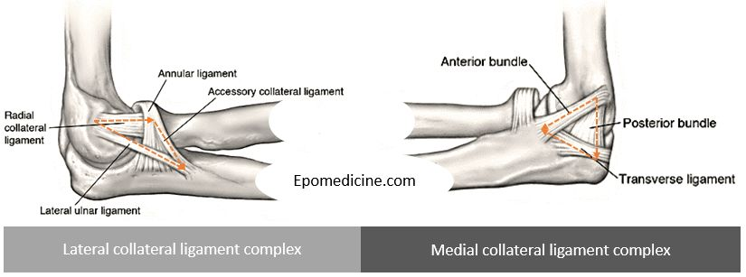
The Elbow Joint: Ligaments
Three ligaments keep the elbow joint in place.
RADIAL COLLATERAL LIGAMENT ULNAR COLLATERAL LIGAMENT
The annular ligament keeps the head of the radius in place during pronation/supination

Slide 45
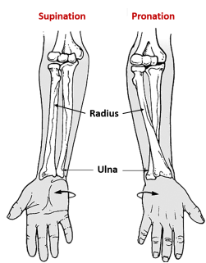

Slide 46
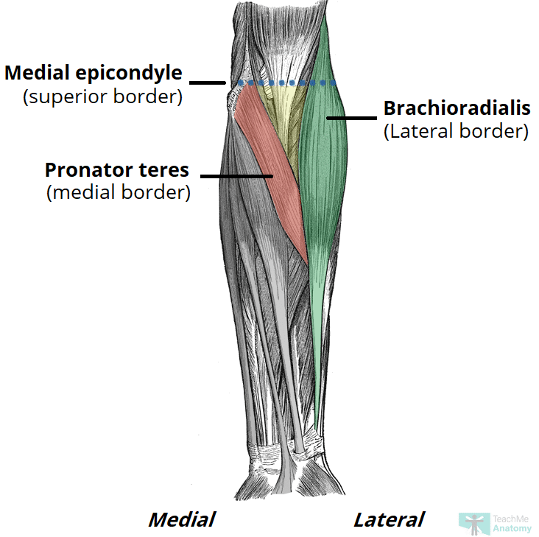
Cubital Fossa
An important region, the elbow “pit”, where important structures run between the arm and the forearm.
Borders: L: brachioradialis; M: pronator teres; S: imaginary line between humeral epicondyles
CONTENTS:
Radial nerve; biceps brachii tendon; brachial artery (bifurcates here); median nerve

Slide 47
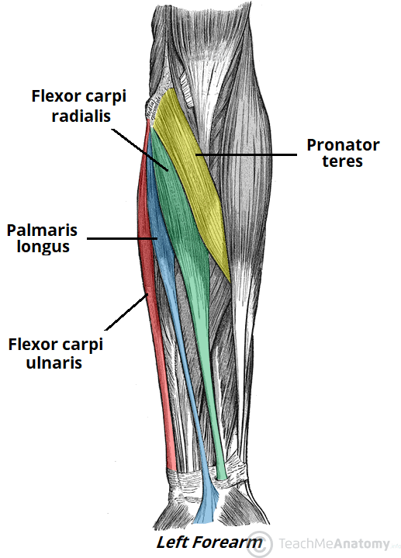
Anterior Compartment of Forearm
The anterior forearm FLEXES the hand and fingers, and pronates the hand.
SUPERFICIAL LAYER:
Pronator teres: pronation
The rest: flexion of the hand
INTERMEDIATE LAYER:
Flexor digitorum superficialis: flexes fingers

Slide 48
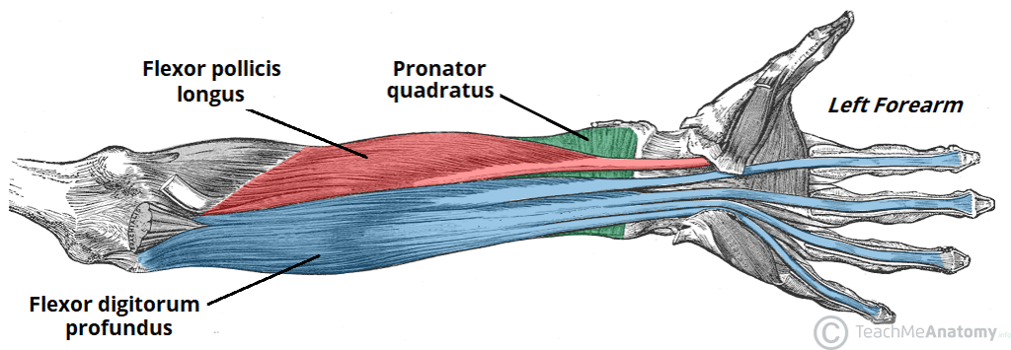
Anterior Compartment of Forearm
The anterior forearm FLEXES the hand and fingers, and pronates the hand.
DEEP LAYER:
Flexor pollicis longus: flexes thumb
Flexor digitorum profundus: flexes fingers
Pronator quadratus: pronates hand

Slide 49
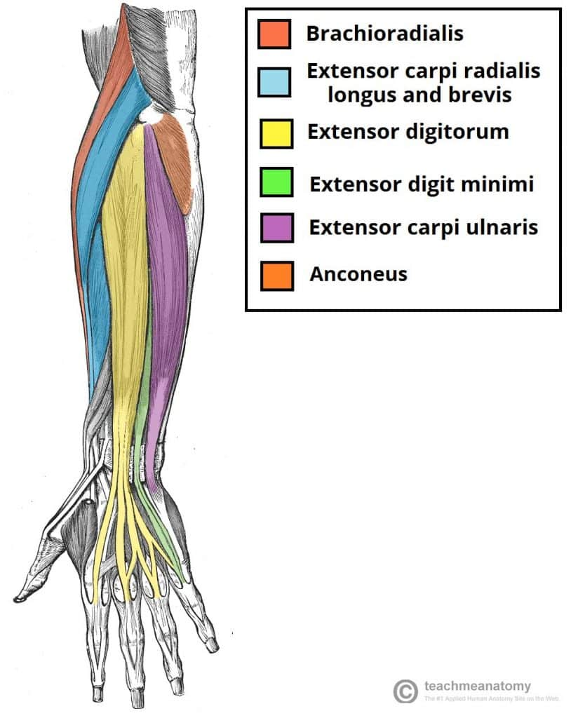
Posterior Compartment of Forearm
The anterior forearm EXTENDS the hand and fingers, and supinates the hand.
SUPERFICIAL LAYER:
Extensor digitorum
Extensor carpi ulnaris
Extensor carpi radialis (longus and brevis)
Extensor digiti minimi

Slide 50
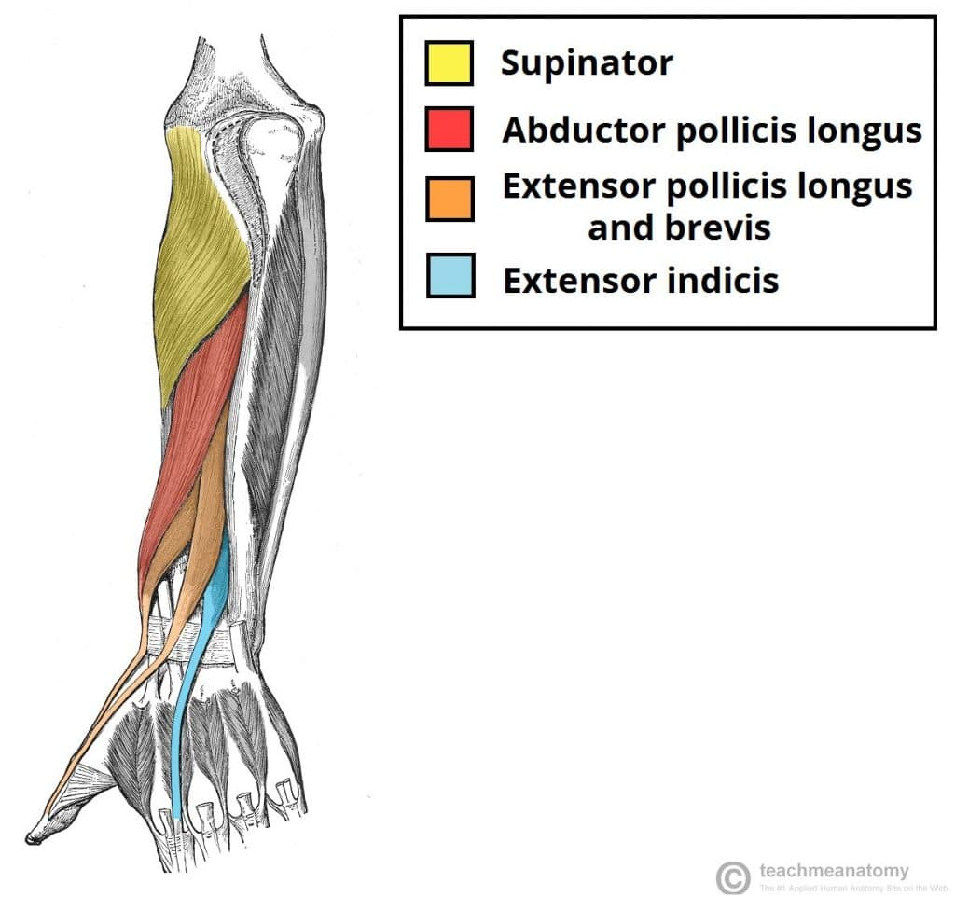
Posterior Compartment of Forearm
The anterior forearm EXTENDS the hand and fingers, and supinates the hand.
DEEP LAYER:
Supinator
Abductor pollicis longus
Extensor pollicis (longus + brevis)
Extensor indicis

Slide 51
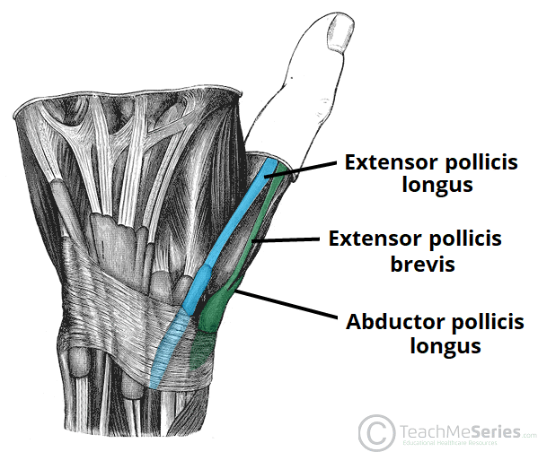
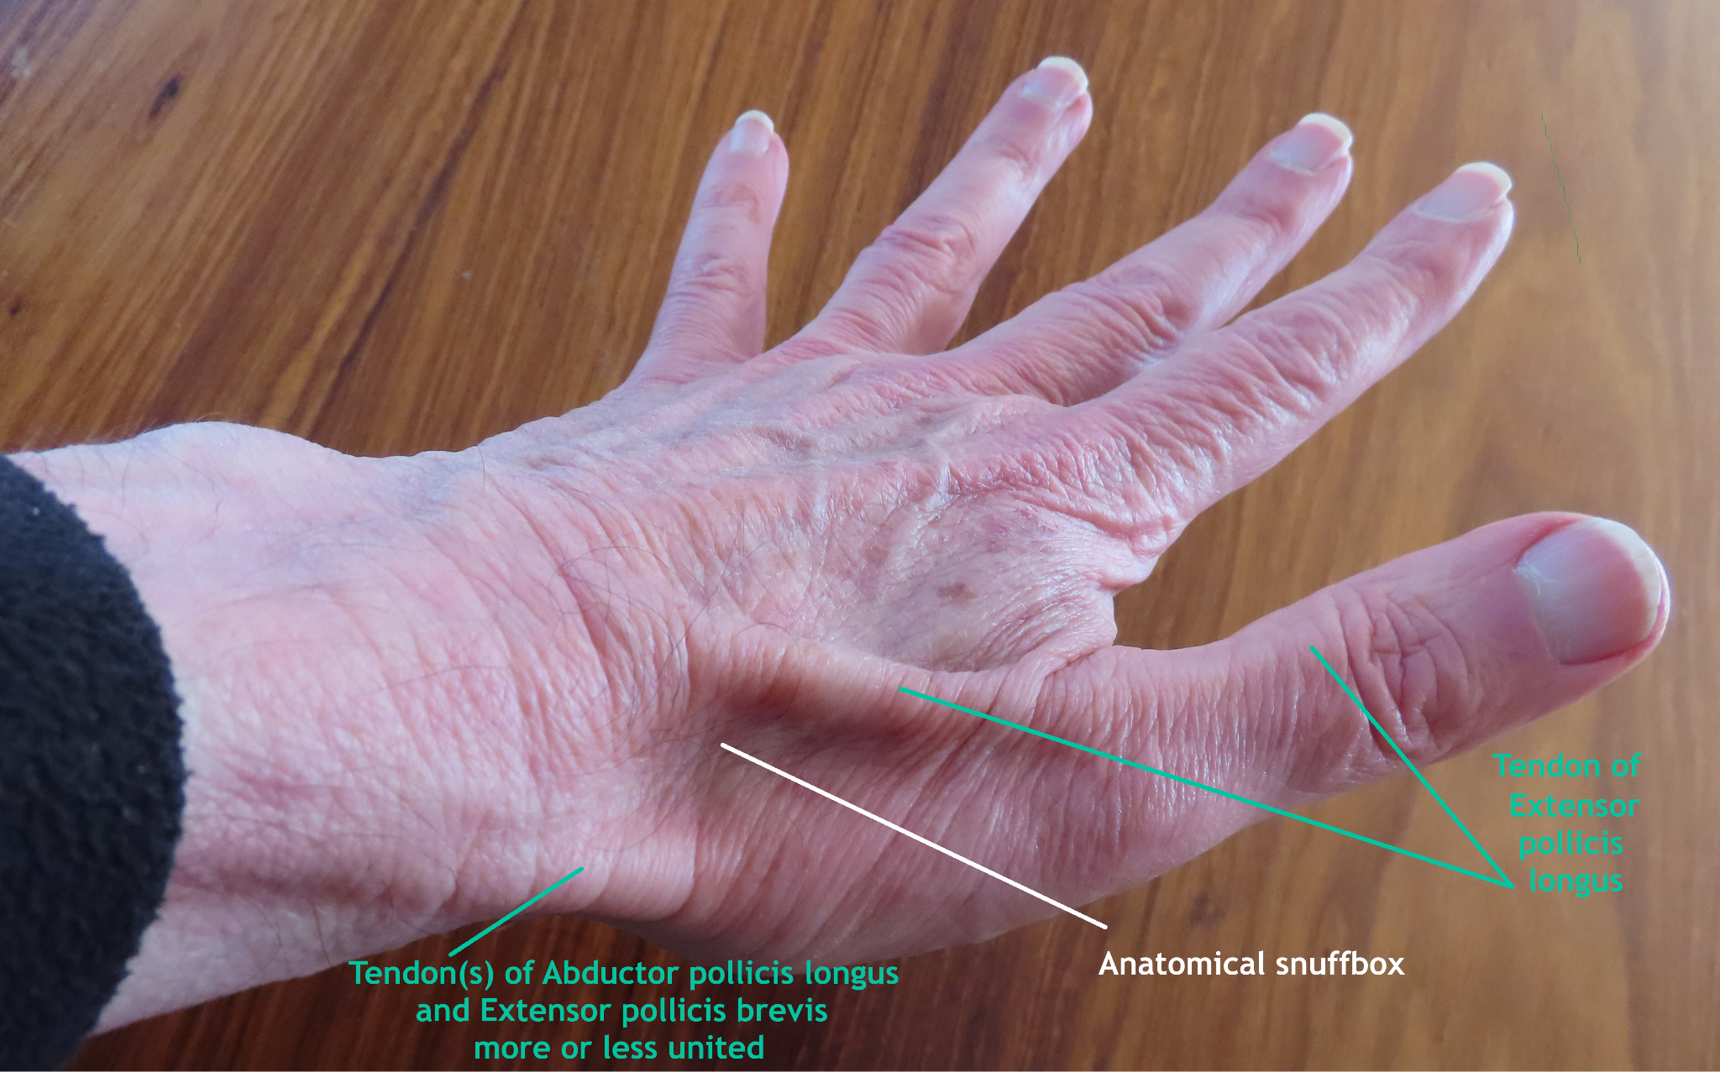
The Anatomical Snuffbox
The anatomical snuffbox is an anatomical feature of the hand as a result of numerous tendons travelling from the forarm into the hand.
Borders:
Tendon of extensor pollicis (longus + brevis)
Abductor pollicis longus
**the radial artery travels
through the snuffbox

Slide 52
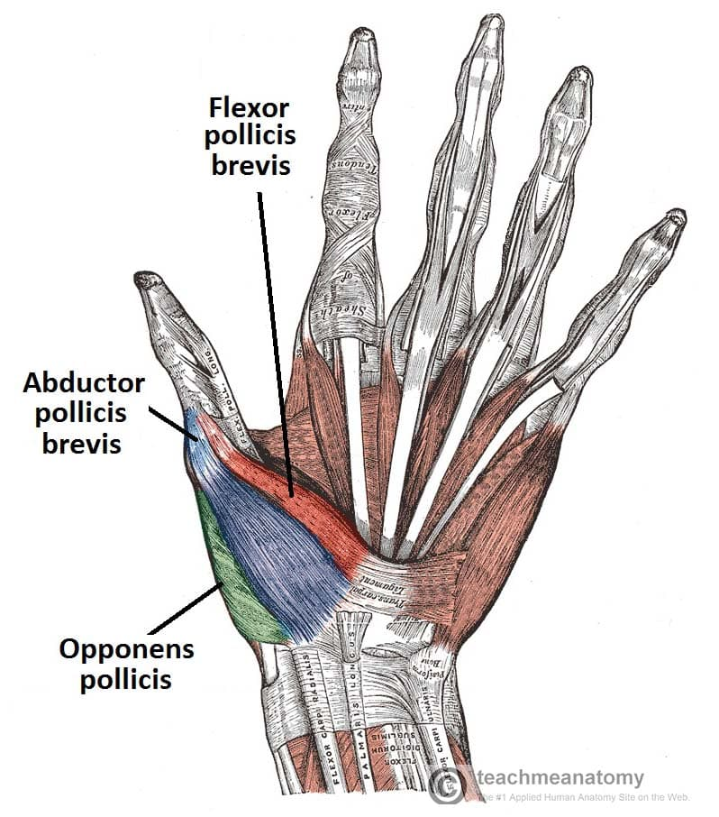
The Thenar Muscles
The thenar muscles are located by and move the thumb.
The three thenar muscles are:
Flexor pollicis brevis
Abductor pollicis brevis
Opponens pollicis (this makes your thumb move towards your pinkie)
These three muscles make up the THENAR EMINENCE, the pad by the base of your thumb.

Slide 53
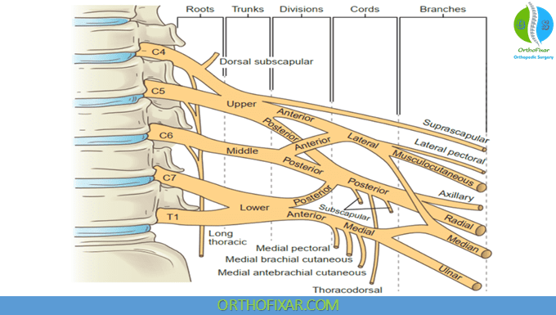
Innervation of the Upper Limb
The upper limb is innervated by a series of nerves that arise from a complex network called the brachial plexus.
Origins C5-T1
Gives off five main nerves: axillary, radial, ulnar, median, and musculocutaneous
Also gives off other nerves, most of which travel down the trunk to supply other muscles e.g. latissimus dorsi and serratus anterior

Slide 54
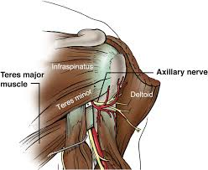
The Axillary Nerve
C5-C6
Exits axilla through the QUADRANGULAR SPACE
Innervates deltoid, teres minor, glenohumeral joint (and long head of triceps)
Can be injured in shoulder dislocation

Slide 55
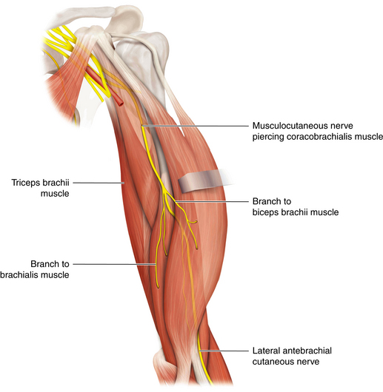
The Musculocutaneous Nerve
C5-C7
Innervates all anterior arm muscles (biceps brachii, coracobrachialis, brachialis)
Continues as lateral cutaneous nerve of forearm (hence name)
“Pierces” through coracobrachialis muscle

Slide 56
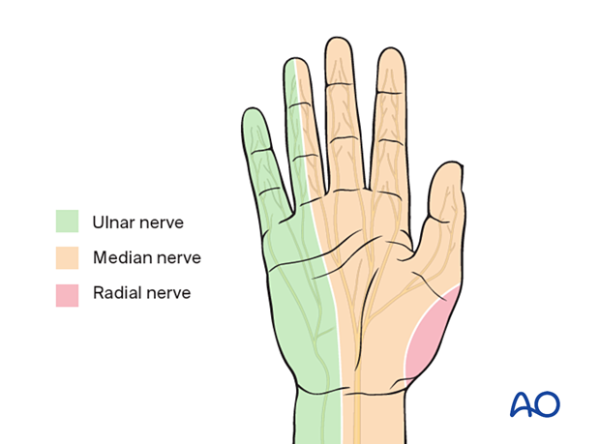
Median, Ulnar, Radial Nerves
The median, ulnar and radial nerves run all the way into the hand.
The median nerve runs along the anterior aspect of the arm, through the cubital fossa, then along the radial side of the anterior forearm. Innervates all anterior forearm muscles (except FCU and medial half of FDP) and the thenar muscles. sensory innervation of the thumb, index, middle and half of the ring finger.
The ulnar nerve runs along the medial aspect of the arm, before looping around the olecranon (the ulnar nerve is actually what you trigger when you hit your “funny bone”. It then travels down the anterior forearm (ulnar side), innervating the FCU and medial half of FDP. It innervates the pinkie and half the ring finger.

Slide 57

Median, Ulnar, Radial Nerves
The median, ulnar and radial nerves run all the way into the hand.
The radial nerve runs along the posterior aspect of the arm, innervating the triceps brachii muscle. It then passes through the cubital fossa before returning to the posterior side, supplying the entire posterior compartment of the forearm and terminating in the posterior aspect of the hand.

Slide 58

Vasculature of the Upper Limb
The vasculature of the upper limb is relatively simple. It is supplied completely by one main artery: the axillary artery. The axillary artery is the name given to the continuation of the subclavian artery past the first rib. This then becomes the brachial artery after it passes the shoulder (specifically, the inferior border of the Teres Major muscle).
This artery has many branches, but terminates at the cubital fossa where it divides into radial and ulnar branches. These then anastomose in arterial arches in the hand.

Slide 59
Vasculature of the Upper Limb
The vasculature of the upper limb is relatively simple. It is supplied completely by one main artery: the axillary artery. The axillary artery is the name given to the continuation of the subclavian artery past the first rib. This then becomes the brachial artery after it passes the shoulder (specifically, the inferior border of the Teres Major muscle).
This artery has many branches, but terminates at the cubital fossa where it divides into radial and ulnar branches. These then anastomose in arterial arches in the hand.

Slide 60

Vasculature of the Upper Limb

Slide 61
The Lower Limb

Slide 62

The Femur

Slide 63

The Hip Joint
The acetabulum is located at the junction between the three bones of the pelvis: the ilium, pubis and ischium.
Each pelvic bone also gives off its own ligament to support this joint.
Important note: hip dislocations are most common when the legs are flexed

Slide 64

Muscles of the Hip
There are three gluteal muscles:
Gluteus maximus: extends hip joint (I: inferior gluteal nerve)
Gluteus medius: abduction and medial rotation (I: superior gluteal nerve)
Gluteus minimus: abduction and medial rotation (I: superior gluteal nerve)

Slide 65

Deep Muscles of the Hip
The deep muscles of the hip joint all have the same function: lateral rotation
Piriformis
Obturator internus
Superior and inferior gemellus
Quadratus femoris
(Use the acronym PSOIQ to remember their names and the order from superior to inferior!)

Slide 66

The Sciatic Foramen
The piriformis muscle is especially significant as it divides the greater sciatic foramen, a foramen of the pelvis, into superior and inferior parts. Note: there is also a lesser sciatic foramen, and this is the area beneath the sacrospinal ligament. Do NOT confuse this with the inferior greater sciatic foramen.

Slide 67

The Thigh
The thigh has three compartments:
Anterior (extensors of the knee)
Posterior (flexors of the knee)
Medial (adductors at the hip joint)
The anterior thigh contains many muscles.
The quadriceps femoris consist of four:
Rectus femoris, vastus lateralis, vastus intermedius, vastus medialis
These four EXTEND the knee joint. Rectus femoris also works to flex the hip joint.

Slide 68
The Thigh
Psoas major and minor, and the iliacus, unite to form the iliopsoas muscle. This flexes the hip and laterally rotates.
The sartorius muscle (the longest muscle in the body!) flexes at both the hip and the knee.

Slide 69

Adductor Compartment
There are six muscles in the adductor compartment of the thigh.
Obturator externus
Adductor brevis
Adductor longus
Adductor magnus
Gracillis
Pectineus
(remember APAGOA!)

Slide 70

Posterior Thigh
The posterior thigh is home to the hamstring muscles.
Biceps femoris
Semitendinosus
Semimembranosus
These all work to EXTEND the hip joint and FLEX the knee joint.

Slide 71

Femoral Triangle
The femoral triangle is another key landmark where structures pass through to supply the leg.
Borders:
Superiorly by inguinal ligament
Medially by adductor longus
Laterally by sartorius
Contents (remember NAVaL): femoral nerve, femoral artery, femoral vein, lymphatics).

Slide 72


The Knee Joint
A hinge joint, the knee is the articulation between the femur and the head of the tibia (the fibula is not involved). It is held together by seven ligaments:
Medial and lateral collateral ligaments
Patellar ligament
Oblique and arcuate popliteal ligaments
Anterior and posterior cruciate ligaments

Slide 73

Pes Anserinus
Three leg muscles from different compartments all insert together on the medial tibial condyle, in an insertion called the “pes anserinus” due to its resemblance to a goose’s foot.
It consists of the semitendinosus, gracillis, and sartorius.

Slide 74

Popliteal Fossa
Another important region.
Borders:
Superomedially: semimembranosus
Superlaterally: biceps femoris
Inferiorly: gastroecnemius
Contents:
tibial , common fibular, posterior cutanous thigh nerves
Popliteal artery and vein, small saphenous vein
Popliteal lymph nodes

Slide 75


Muscles of the Lower Leg
Lower leg muscles control the movement of the feet.
The posterior compartment FLEXES the foot (plantarflexion)
The gastroecnemius also helps in knee flexion
The deep muscles also INVERT the foot
DEEP:
Popliteus
Flexor digitorum longus
Flexor hallucis longus
Tibialis posterior

Slide 76

Muscles of the Lower Leg
Lower leg muscles control the movement of the feet.
The anterior compartment DORSIFLEXES the foot.
Tibialis anterior
Extensor hallucis longus
Extensor digitorum longus
Fibularis tertius

Slide 77

Muscles of the Lower Leg
Lower leg muscles control the movement of the feet.
The lateral compartment EVERTS the foot:
Fibularis longus
Fibularis brevis

Slide 78

Muscles of the Lower Leg

Slide 79

Muscles of the Foot
The dorsum of the foot only contains two muscles:
Extensor digitorum brevis
Extensor hallucis brevis

Slide 80
Muscles of the Foot
The plantar surface, however, contains FOUR LAYERS of muscle.
Remember the 2nd and 4th layers are quite minor in function. But overall its quite similar to the hand.

Slide 81
Muscles of the Foot
LAYER 1: abductor hallucis, flexor digitorum brevis, abductor digiti minimi (remember Big Toe, Little Toe, and the Rest)
LAYER 2: lumbricals
LAYER 3: flexor hallucis brevis, adductor hallucis, flexor digiti minimi brevis, opponens digiti minimi (remember Big Toe, Little Toe, Big Toe, Little Toe)
LAYER 4: interossei

Slide 82
Nerves of the Lower Limb
The nerves of the lower limb are quite simple (thankfully), because there basically just one per compartment.
THIGH: anterior receives innervation from the FEMORAL NERVE. Adductors receive innervation from OBTURATOR NERVE. Posterior recieves innervation from SCIATIC NERVE.
Then, just above the knee joint, the sciatic nerve splits into the tibial and common fibular nerves.
LEG: anterior recieves innervation from TIBIAL NERVE. Posterior recives innerevation from DEEP FIBULAR NERVE. Lateral (evertors) receive innervation from SUPERFICIAL FIBULAR NERVE.

Slide 83


Slide 84
Questions!

Slide 85


Slide 86


Slide 87


Slide 88


Slide 89
FEEDBACK
*INSERT QR CODE*
Thank you!!
Any questions?
ibraheem.ghafoor@kcl.ac.uk

