Slide 1
SFP Made Simple
3. Writing White Space Questions
Dr Angela Lochmüller (FY1 UCL)

Slide 2
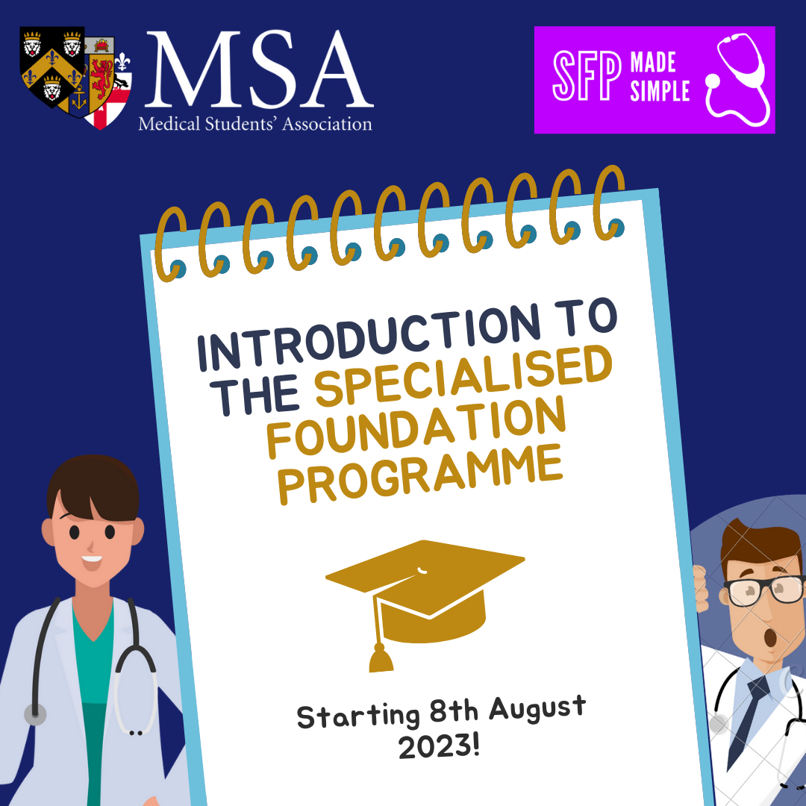
MSA Sponsor

Slide 3
Fundraising

Slide 4
Webinar schedule
1.
Introduction to the SFP with Q&A
Tuesdays at 18:30
2.
Maximising Portfolio Marks and Self-Scoring
3.
Writing White Space Questions
4.
Introduction to Interview and Clinical Scenarios
5.
Biomedical Statistics for the SFP
6.
Academic Station and Critical Appraisal
7.
Answer the Personal Questions with Confidence
8.
Interview Practice Workshops

Slide 5
Objectives
Understand what WSQs are and how to write them
Analyse examples of WSQs
Q&A
1
2
3

Slide 6
The Specialised Foundation Programme
Two-year programme
5 blocks of clinical placements + 1 block of research/leadership/education, or
6 blocks of clinical placements + time release for research/leadership/education
Application process
Shortlisting stage - 2023 was based on
White space questions (**not London)
Additional degrees
Presentations (up to 10)
Distinctions, merits and/or scientific/medical prizes (up to 10)
Publications (up to 10)
*EPM decile will NOT count for SFP 2024
Interview stage
Personal questions and/or
Clinical station and/or
Academic station

Slide 7
Preparation
Decide on SFP SUoAs & collect portfolio points
Rank SFP preferences & prepare for interview
- August
October
September
November
Write WSQs & submit Oriel application
Give interview & relax!

Slide 8
Timeline
Date | Event | Action
12th September 2023 | Registration opens on Oriel | Register on Oriel
20th September 2023 | Applications for FP, SFP, FPP open | Write up application
4th October 2023 (midday) | Applications for FP, SFP, FPP close
13th October 2023 (midday) | Deadline to change SFP ranking and preferences | Finish ranking preferences
13th October - 29th December 2023 | SFP selection process | Interviews
10th January 2024 | 1st offers released | Accept within 48hrs
17th, 24th, 31st January 2024 | Round 2, 3, 4 | Accept within 48hrs
5-9 February 2024 | Clearing round | Accept within 48hrs

Slide 9
Where and what?
SFP locations:
Broken down into Specialised Units of Application (SUoA)
Can apply to a maximum of 2
Programmes by location
All SUoA offer research programmes, others:
East of England: MedEd
East Midlands (LNR & Trent): MedEd + Leadership
KSS & Wessex: MedEd + Leadership
North West of England: MedEd + Leadership
Peninsula: MedEd + Leadership
Scotland: MedEd + Leadership
Wales: Leadership
West Midlands: MedEd + Leadership
Yorkshire & Humber: MedEd
Notes:
Medical education (as of 2023)
East of England
East Midlands (LNR & Trent)
KSS & Wessex
North West of England
Peninsula
Scotland
Yorkshire & Humber
Leadership & management (as of 2023)
East Midlands (LNR & Trent)
KSS & Wessex
North West of England
Peninsula
Scotland
Wales

Slide 10
What are White Space Questions?
WSQs are designed to test your passion for SFP, your knowledge of the programme you're applying to and what you have learnt from your experiences so far
They are an opportunity for you to show your "non-conventional" achievements, especially if you don't have many objective prizes, publications, etc
Not all SuoAs require WSQs, check on each individual webpage i.e. London do NOT
Notes:
Other pro that might change: knowing your allocation in advance

Slide 11
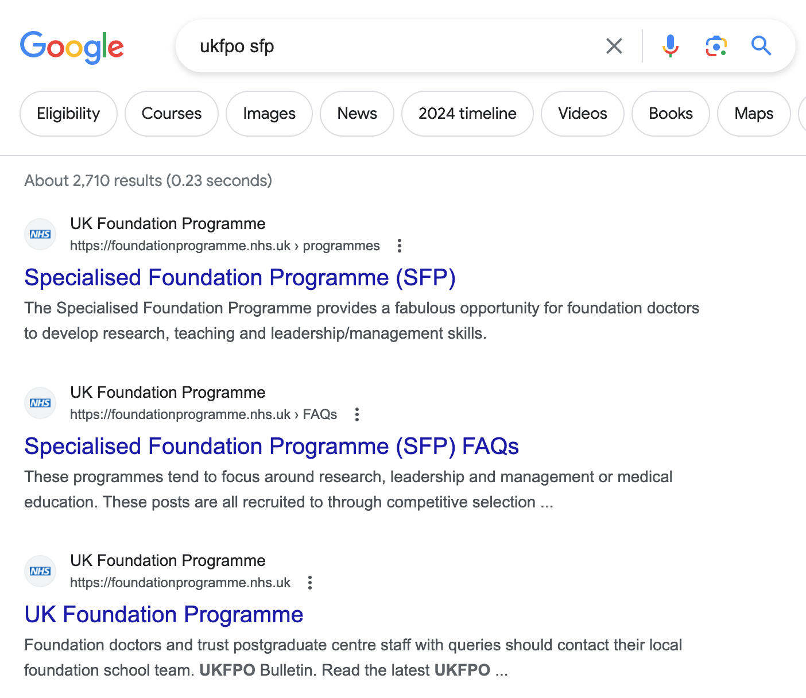

Slide 12
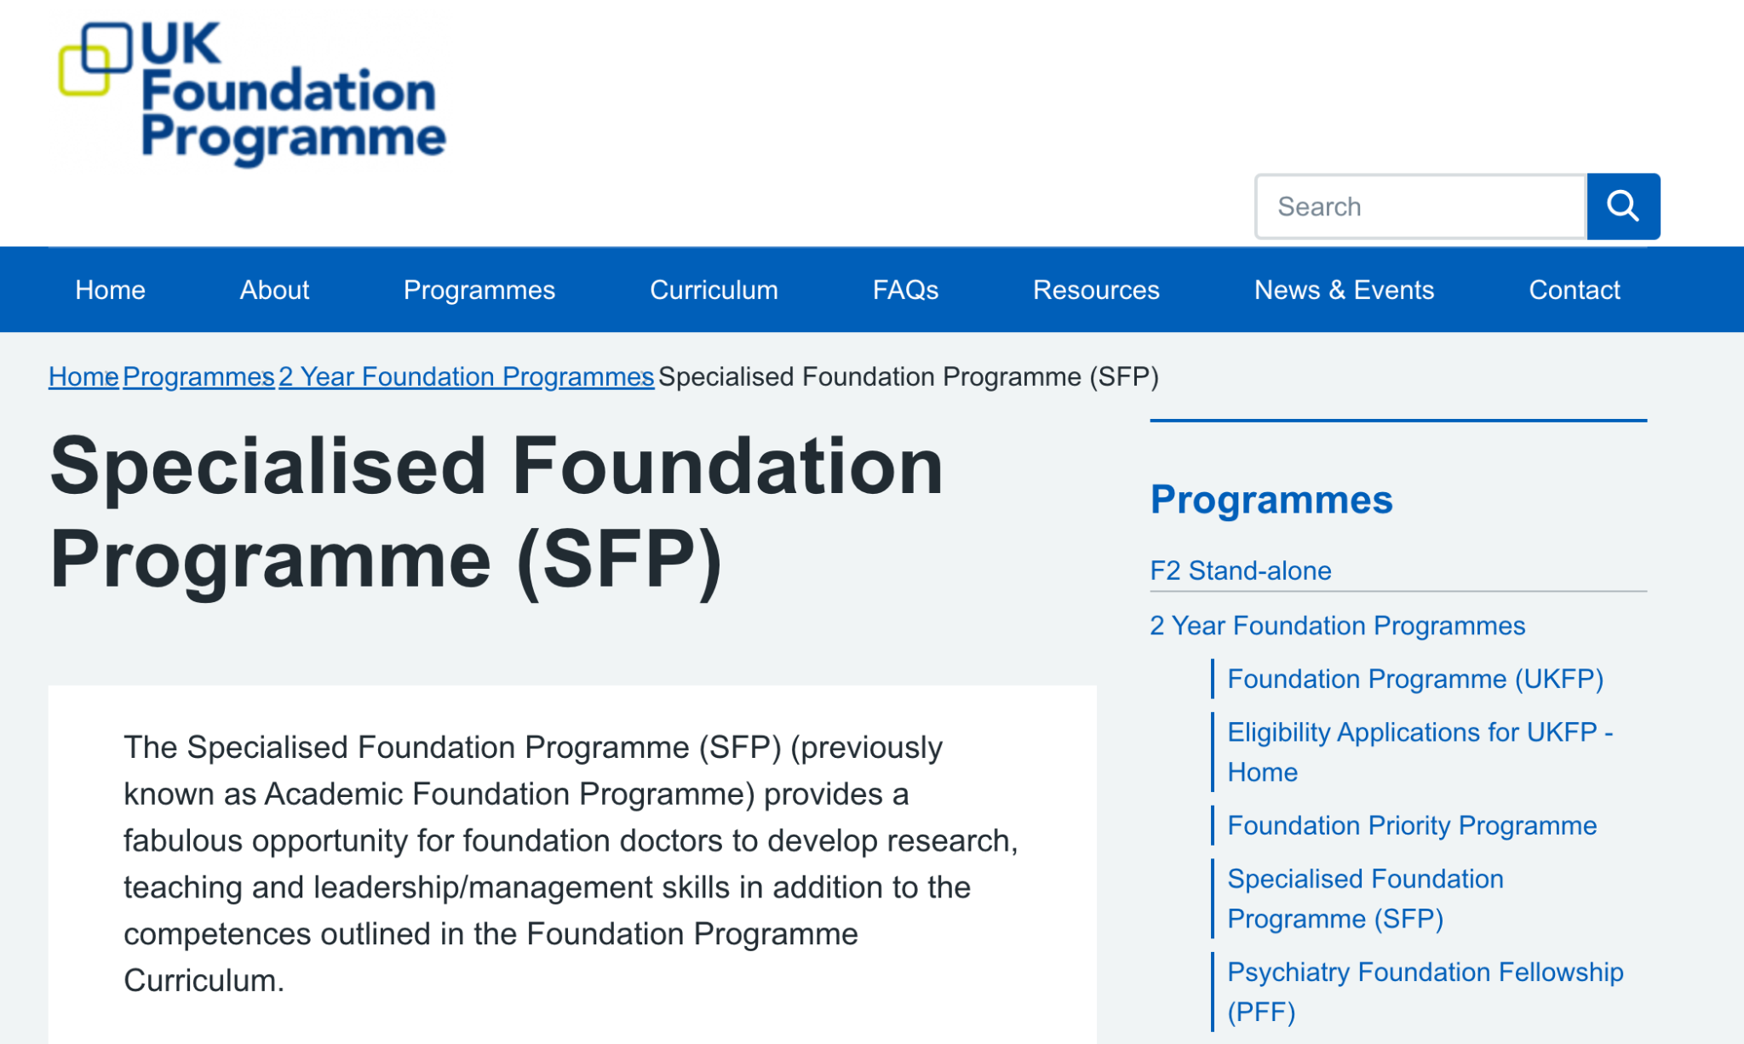
Notes:
Medical education (as of 2023)
East of England
East Midlands (LNR & Trent)
KSS & Wessex
North West of England
Peninsula
Scotland
Yorkshire & Humber
Leadership & management (as of 2023)
East Midlands (LNR & Trent)
KSS & Wessex
North West of England
Peninsula
Scotland
Wales

Slide 13
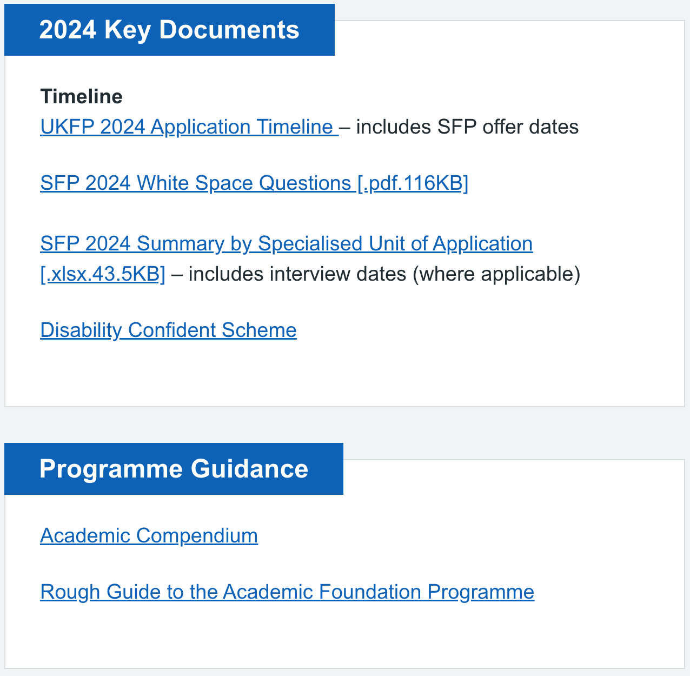
Notes:
Medical education (as of 2023)
East of England
East Midlands (LNR & Trent)
KSS & Wessex
North West of England
Peninsula
Scotland
Yorkshire & Humber
Leadership & management (as of 2023)
East Midlands (LNR & Trent)
KSS & Wessex
North West of England
Peninsula
Scotland
Wales

Slide 14
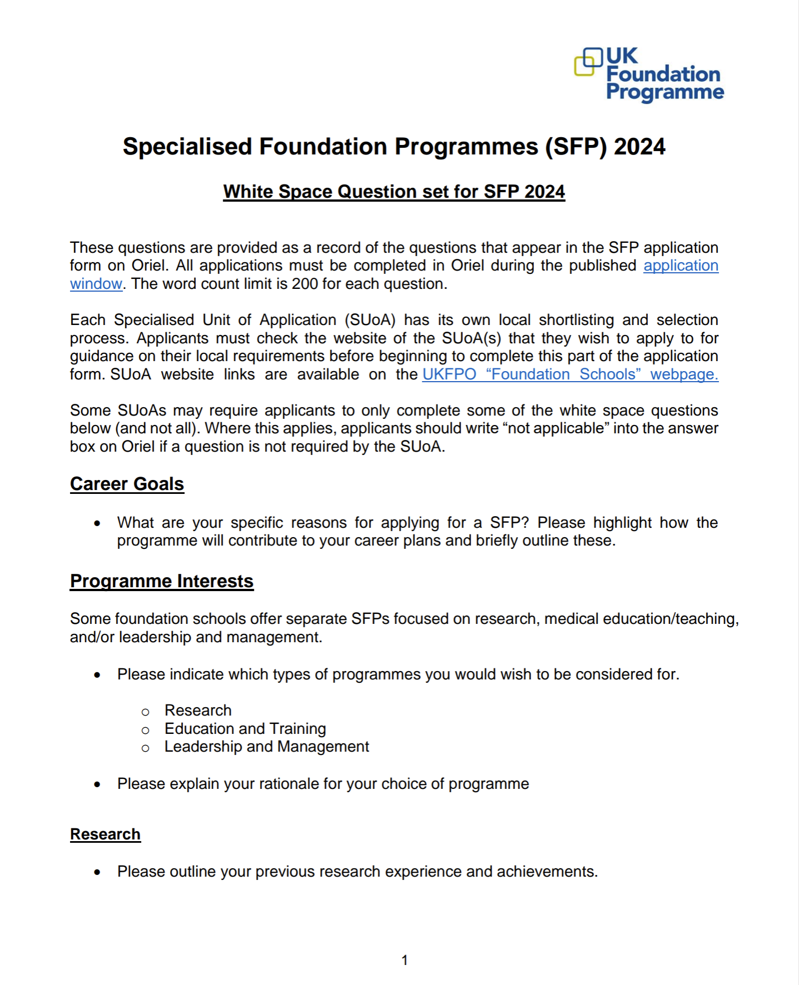
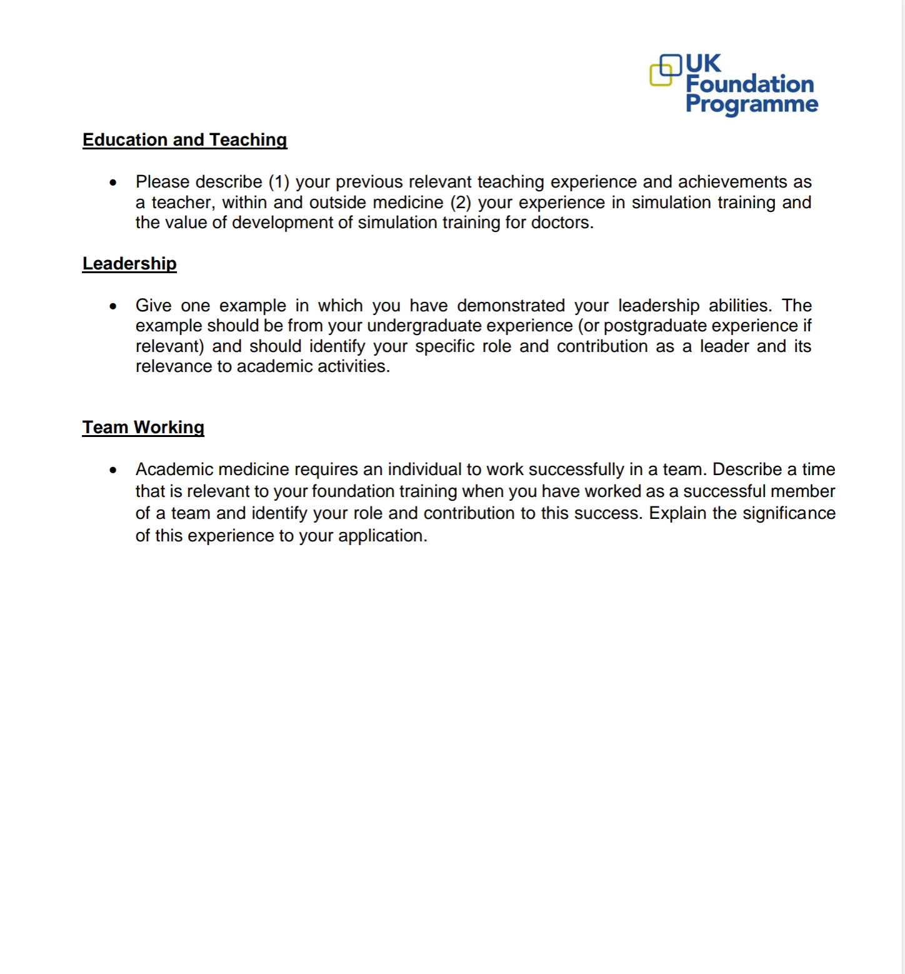

Slide 15
The Questions of 2024
Career Goals: What are your specific reasons for applying for a SFP? Please highlight how the programme will contribute to your career plans and briefly outline these.
Programme Interests: Please explain your rationale for your choice of programme
Research: Please outline your previous research experience and achievements.
Education and Teaching: Please describe (1) your previous relevant teaching experience and achievements as a teacher, within and outside medicine (2) your experience in simulation training and the value of development of simulation training for doctors.
Leadership: Give one example in which you have demonstrated your leadership abilities. The example should be from your undergraduate experience (or postgraduate experience if relevant) and should identify your specific role and contribution as a leader and its relevance to academic activities.
Team Working: Academic medicine requires an individual to work successfully in a team. Describe a time that is relevant to your foundation training when you have worked as a successful member of a team and identify your role and contribution to this success. Explain the significance of this experience to your application.

Slide 16
How to write WSQs
Start with a list of your achievements/examples
Work to a word limit of 200 each Q
Reader of each Q may be same or different, i.e. can use same examples, but make different points
Try and link points back to the theme of the SFP you're applying for e.g. research/management/teaching
Reflection, reflection, reflection!
ChatGPT?
Proofreading
1
PEE
Point
Example
Explain
2
CAMP
Clinical
Academic
Managerial/Teaching
Personal
3
STAR
Situation
Task
Action
Reflection

Slide 17
Tips: Career Goals
What are your specific reasons for applying for a SFP? Please highlight how the programme will contribute to your career plans and briefly outline these.
Explain why you want to do an SFP
Explain why you’re applying to this SuoA
Search SuoA/uni websites for potential supervisors & contact them, esp Oxbridge
Contact previous SFPs on programmes you're applying to to find out specifics of programme i.e. via LinkedIn, Twitter
Be specific about you career plans
Mention the integrated academic pathway +- your goal of being an NHS academic lecturer (you are a long term investment!)

Slide 18
Example 1: Career Goals (Cam)
Career goals
Skills/Experience
Prog specifics
Link to SFP
My master’s in Genomic Medicine at the University of Cambridge inspired me to explore a career in genomics research. I have since had the privilege to work with a research team in Cambridge University’s Department of Neurosciences, with whom I have published four original research articles in peer-reviewed journals, including one article as co-first author. I would relish the opportunity to maintain my relationship with the university, develop my academic skills and hone my passion for clinical research via an SFP.
I have been heavily involved in near-peer teaching, including leading weekly teaching sessions for undergraduate medical students during my master’s degree year. Additionally, I co-founded the Cambridge University Genomic Medicine Society and co-host the podcast ‘Genomics Unravelled’, an educational podcast about the future of genomics in healthcare with guests including Dame Professor Sally Davies. I hope to continue developing my teaching skills and benefit from the excellent education and supervision system offered by the university.
I believe an SFP will equip me with the knowledge, skills and confidence to progress along the integrated academic pathway, with the hope of completing an academic clinical fellowship, a clinical lectureship and a PhD in the rapidly changing and challenging environment of the NHS.

Slide 19
Example 2: Career Goals (Cam)
Skills
Career goals
Prog specifics
Link to SFP
Career goals
Skills/Experience
Prog specifics
Link to SFP
Networking with academics and assisting in a wide variety of fascinating research projects during self-organised electives in tertiary stroke and neurology units has inspired me to pursue academic neurology. This would include a PhD, academic clinical fellowship and lectureship, balancing clinical decision-making alongside translational research. Achieving a 1st class BSc in Neuroscience and Mental Health confirmed the rewarding and challenging nature of research and piqued my interest in neurodegeneration.
Clinical neurology rotations offered will be invaluable for my future career. I am excited for the unique opportunity to work in Addenbrookes’ hospital, a world-renowned tertiary centre specialising in movement disorders. DGH rotations will provide a wider range of experiences to further my clinical experience. I look forward to improving scientific communication and research methodology planning during the protected 4-month research block. I have already contacted the Barker/Williams-Gray group, who produce tangible outcomes for individuals with Parkinson’s, with the aim of pursuing publications and presentations under mentorship from world-leading, high-output teams. I also plan to enhance teaching and learning skills fostered through undergraduate peer tutoring.

Slide 20
Example 2: Career Goals (Oxford)
Career goals
Skills/Experience
Prog specifics
Link to SFP
My two-year research assistant job in developing a biobank of maternal and neonatal samples to investigate the impact of Covid-19 on pregnancy reaffirmed my desire to pursue academia. The stimulating team environment encouraged me to contribute to 11 grant applications raising over £1,000,000 and develop valuable skills, ranging from sample processing to coding. Overall, the opportunities for holistic growth and clinical innovation through research make the integrated academic training pathway a clear choice for me.
Professor Lakhoo’s unique achievements in improving global training and access to paediatric surgery inspire me to join the Oxford Global Surgery team. Having co-founded a paediatric surgery society, I yearn to be surrounded by world-leading specialists to develop surgical competencies and contribute, with a subsequent PhD and academic fellowship, in achieving sustainable paediatric surgical practices worldwide. Alongside clinical knowledge, the SFP will allow me to advance my research methodology skills to achieve this.
Through the teaching courses and ‘Management in Medicine’ programme provided by OUCAGS, I hope to build upon my experiences as peer-assisted-learning tutor and President of KCL Leaders in Health. Mastering effective communication will improve my ability to work in clinical multidisciplinary teams and advocate findings for translation of research into policy.

Slide 21
Example 2: Career Goals (Manchester)
Career goals
Skills/Experience
Prog specifics
Link to SFP
Pushing the boundaries of knowledge through research is paramount in medicine. Throughout both of my degrees, I proactively pursued opportunities for research. I have been part of numerous projects including an audit into acute asthma exacerbations at St Thomas’ Hospital, a cross-sectional study of Ophthalmology doctors’ consultation styles, and in vitro studies into the cellular biomechanics of heart failure. Publishing in wide-ranging types of research has highlighted the importance of all stages of research on policy making and the quality of patient care. An SFP, and subsequently the Integrated Academic Training Pathway, would allow further development as a holistic academic.
I am striving for a career in dermatology in which research is central, with the ambition to contribute to the development of the field for the betterment of patient-centred care. The dedicated 4-month research rotation in the North West would provide me with an invaluable opportunity to develop not only my knowledge, but my research skills through the mentorship of world-leading dermatologists, and contribute to a future PhD grant proposal. In addition, the flexibility of the North West programme in research topic allocation excites me, as it would offer greater autonomy to pursue research in which I have interest.

Slide 22
Tips: Programme Interests
Programme Interests: Please explain your rationale for your choice of programme
Research: Please outline your previous research experience and achievements. Education and Teaching: Please describe (1) your previous relevant teaching experience and achievements as a teacher, within and outside medicine (2) your experience in simulation training and the value of development of simulation training for doctors. Leadership: Give one example in which you have demonstrated your leadership abilities. The example should be from your undergraduate experience (or postgraduate experience if relevant) and should identify your specific role and contribution as a leader and its relevance to academic activities.
Expand on your achievements
Pick achievment that demonstrates variety of skills, i.e. smaller achievement with larger involvement may be better
State skills you have developed and how you will apply these to the SFP i.e. use academic compendium
Show your knowledge of research/teaching/management - try to mention ethical approval
Open with best objective outcome of achievement if possible
Always link back to why you want to do the SFP

Slide 23
Example 1: Programme Interests 1 (Cam)
Theme
Skills/Experience
Prog specifics
Link to SFP
Inspired by my studies on the Genomic Medicine master's at Cambridge (Distinction), I believe that the Cambridge research SFP offers a unique opportunity to pursue my dual interests in genetics and neuroscience. I became interested in neurogenetics during my self-organised clinical internship at the Friedrich-Baur-Institute Department of Neurology (Ludwig-Maximilians-University, Munich). Meeting patients with rare neurological diseases encouraged me to get involved with a research team in the Department of Neurosciences at Cambridge. Since then, I have undertaken six original research projects; four are published and two are currently ongoing.
One of these ongoing projects is an expansion of my master’s research with Professor Evan Reid under the Department of Medical Genetics, pertaining to developing a novel gene identification pipeline using UK 100,000 Genomes Project data. Excitingly, I'm currently writing a report on a novel gene that I discovered using my pipeline, with hopes of publishing as first author this year. I would love to continue my collaboration with The Reid Lab and develop my skills in research methodology and academic writing during the 4-month SFP academic rotation. Fostering these skills under the guidance of leading academics will allow me to pursue my ambition to progress through the integrated academic pathway.

Slide 24
Example 2: Programme Interests 1 (Cam)
Theme
Skills/Experience
Prog specifics
Link to SFP
Undertaking the Cambridge SFP will further my passion for research cultivated throughout medical school in a pioneering centre for clinical neurology and trailblazing neuroscience research. I have enjoyed the exciting challenges of designing research methodology and adapting experiments in line with evolving research. I am eager to enhance my statistical analysis and coding skills to manage large neuroimaging datasets after an R taster course during my BSc. I believe that the Wolfson Brain Imaging Centre’s focus on innovative functional neuroimaging would provide the perfect environment for this. Supervision from high output teams will allow me to hone scientific writing and poster preparation skills.
I have enjoyed both the molecular-level attention to detail of basic scientific research and seeing rewarding improvements in participants’ mobility when assisting with stroke clinical trials. I would be grateful for the opportunity to learn from multi-disciplinary teams conducting translational research, including large scale RCTs such as PROSPECT-M-UK.
Attending relevant sub-specialist clinics during the research block will provide interesting clinical opportunities which contextualise research. CATO seminars and mentoring schemes will provide invaluable advice on future career planning.

Slide 25
Example 1: Programme Interests 2 (Cam)
Theme
Experience/Skills
I have published an original research article as co-first author and presented posters at the American Society of Human Genetics Annual Meeting and a global graduate student symposium. My research was part of a multi-national bioinformatics project called the ‘treatabolome’, which involved reviewing evidence for the effectiveness of targeted therapies across rare disease. I gained valuable experience in study design, data analysis, academic writing and presenting.
During my Genomic Medicine master’s at Cambridge, I developed a novel gene identification pipeline using UK 100,000 Genomes Project data and delivered an oral presentation that won first prize at a national student conference. I have since expanded this project and hope to publish a case report on a novel gene I discovered using my pipeline this year. I learnt various bioinformatics skills, including programming.
Furthermore, I have published two other original research articles with the Cambridge’s Department of Neurosciences, specifically a 190-family cohort study in 'Brain' and a case report in 'Journal of Neurology'. We are also working on establishing a phenotypic database on mitochondrial disease variants called ‘MitoPhen’, with the aim of publishing next year. These projects have given me greater insight into the full research process, from project proposal to publication.

Slide 26
Example 2: Programme Interests 2 (Cam)
Theme
Experience/Skills
My BSc project looked at a-synuclein distribution within olfactory bulb dopaminergic neurones in Parkinson’s and Parkinson’s plus syndromes. I learnt to design a pertinent, feasible hypothesis for a 4-month project in collaboration with my supervisor. I gained proficiency in immunohistochemistry and immunofluorescence including 3D CLARITY, as well as confocal microscopy, and analysis using FIJI and Zen. I used initiative to successfully optimise the CLARITY technique by reviewing literature and contacting external researchers. I also audited methods of diagnosing neurodegeneration, requiring systematic analysis of 1000 datasets. Conducting another nationally presented audit assessing documentation of consent in thrombolysis trials taught me about research ethics and GCP research standards. I have also won an oral presentation prize for a QUIP implementing a Hindi-language animation about antibiotics in a Southall GP. This statistically improved understanding of antibiotic indications and demonstrated the importance of tailoring interventions to patient needs.
As joint-first author on a project exploring student satisfaction with assessments during COVID-19, I applied for the Imperial Education Ethics Review Process and learnt about risk-benefit analysis. I also learnt quantitative analysis using GraphPad Prism, qualitative coding of interviews and manuscript writing, and am currently communicating with BMC Medical Education as the manuscript is under revision.

Slide 27
Tips: Team Working
Academic medicine requires an individual to work successfully in a team. Describe a time that is relevant to your foundation training when you have worked as a successful member of a team and identify your role and contribution to this success. Explain the significance of this experience to your application.
State what makes a successful team member i.e. write a list of buzz words of team member qualities relevant to being a junior doctor
Never just list skills, always give examples of how you showed them and how they are relevant
Pick an example where a problem arose and you solved it
Examples of bering a leader and a team member
Use objective outcomes to prove your team was successful
Link back to skills you want to develop/apply in SFP

Slide 28
Example 1: Team Working (Cam)
Outcome
Skills/Experience
Reflection
Link to SFP
During university, I was part of a team of three students that undertook a quality improvement project on increasing Electronic Discharge Note completion on a District General Hospital ward.
The project began with the logistical barrier of our team being placed at a different site to our supervisor, which meant that we had to travel over one hour for each data collection session (during Covid) and were unfamiliar with the ward environment and staff. I led the team on overcoming the problem by keeping in close contact with our supervisor, the ward matron and a junior doctor, who were familiar with the ward and had well-established rapport with different staff. In this way, we were able to characterise the problem, design and implement three interventions and analyse our results over three months, producing individual reports.
This experience taught me the importance of resilience in adversity and working collaboratively as a multi-disciplinary team, which are skills transferable to my foundation training. My team valued my leadership and organisational skills, including communicating with key stakeholders and devising a realistic project timeline. However, I was also able to follow others in tasks such as data collection and analysis, respecting their skills and contributions.

Slide 29
Example 2: Team Working (Cam)
Outcome
Skills/Experience
Reflection
Link to SFP
As Imperial Society of Research and Academia president, I led an 11-member committee to organise 2 international conferences attended by 300 students worldwide, alongside educational and networking courses. I identified team members’ skill sets and accordingly motivated them to achieve specific goals within defined deadlines. I made shared decisions under pressure, such as rapidly adapting all events online during COVID.
Our major goal was to increase event attendance. I held regular committee meetings to discuss this, and along with publicity and networking leads, proactively implemented suggestions, such as increasing social media reach by creating publicity schedules, creating a community with social events, and networking with other research societies. This increased society members from 100 to over 400. Ensuring communication between event coordinators, treasurer and sponsorship officer resulted in sponsorship of over £1000. Collaboratively conducting service evaluations of our conferences improved my statistical analysis and reflective skills.
We organised online SFP mock interviews for 160 attendees, which involved dividing the extensive research into online platforms that this required. 2 days before, 50% of examiners cancelled. I resolved the arising conflict by encouraging open group discussion, rearranging cancelled interviews and supporting team members through difficult conversations with disappointed interviewees.

Slide 30
Example 2: Team Working (Manc)
Outcome
Skills/Experience
Reflection
Link to SFP
Over the course of a year, I led an audit into acute asthma exacerbations requiring admission at St Thomas’s Hospital. I was part of a multidisciplinary team consisting of consultants, registrars, nurses, and healthcare assistants. As the team leader, I was responsible for the timeline and organisation, delegation of tasks, and troubleshooting issues. The project was published as a poster in BMJ Thorax.
The challenge of taking the lead in a diverse team, and working towards a common research goal, was one of the best development opportunities of my medical career thus far. I thoroughly enjoyed driving a successful project through leveraging each individual’s strengths and fostering trusting relationships between team members. The team had a culture of resilience and adaptability, cultivated through each member having clearly defined roles.
Through working with experienced clinicians, I acquired skills including complex statistical analysis, academic writing, and the ability to optimise projects continuously. The experience improved my abilities in people management, setting targets and managing deadlines. These will prove instrumental throughout all rotations of the SFP, as I will be confident not only in my conduct of research, but in managing and effectively collaborating in high-stress, time-pressured environments in hospital settings.

Slide 31
Q&A & Feedback form
Slides and recordings to be emailed on completion of the feedback form.

