Slide 1
SFP Made Simple 2. Maximising Portfolio Marks and Self-Scoring
Dr Katherine Kuncewicz (FY1 UCL)
Dr Daria Andreeva (FY1 Imperial)
Dr Angela Lochmüller (FY1 UCL)

Slide 2
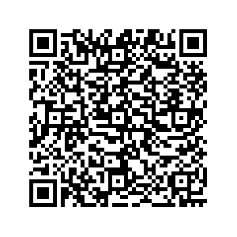
Fundraising
Tuesdays at 18:30

Slide 3
Aims
1.
Introduction to portfolio
2.
Deadline
3.
Differences to 2023 cohort
4.
Examples
5.
Key take-home points

Slide 4
Purpose of Portfolio
Get offer for interview
Illustration of interest in research/leadership/management
Show academic excellence – especially with EPM removal
Show interest in clinical research

Slide 5
Submission deadline: 4th October 2023

Slide 6
London Portfolio Scoring for 2024 Intake
Maximum 20 points
Separated into further degrees, publications and prizes
Maximum 5 for further degrees
Maximum 10 for publications
Maximum 5 for prizes

Slide 7
Difference from 2023 Cohort
Higher focus on publications
Negation of presentations/posters
No EPM
(No SJT)

Slide 8
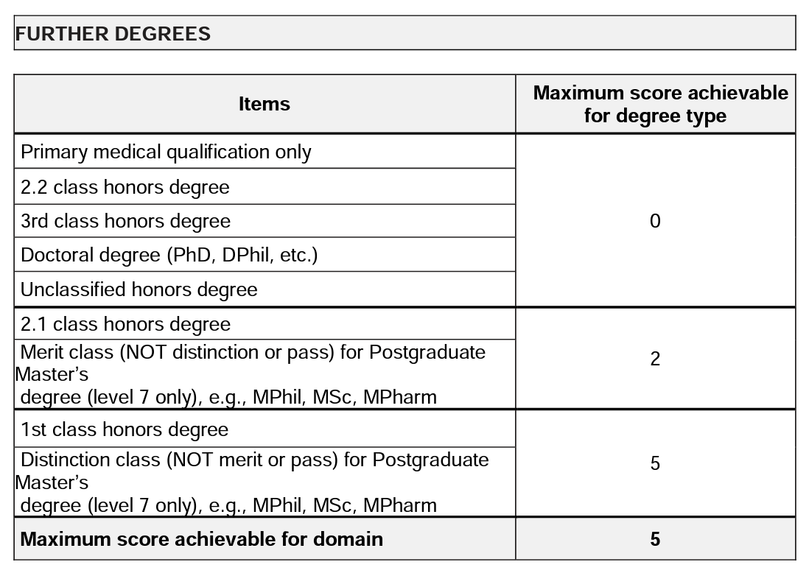

Slide 10
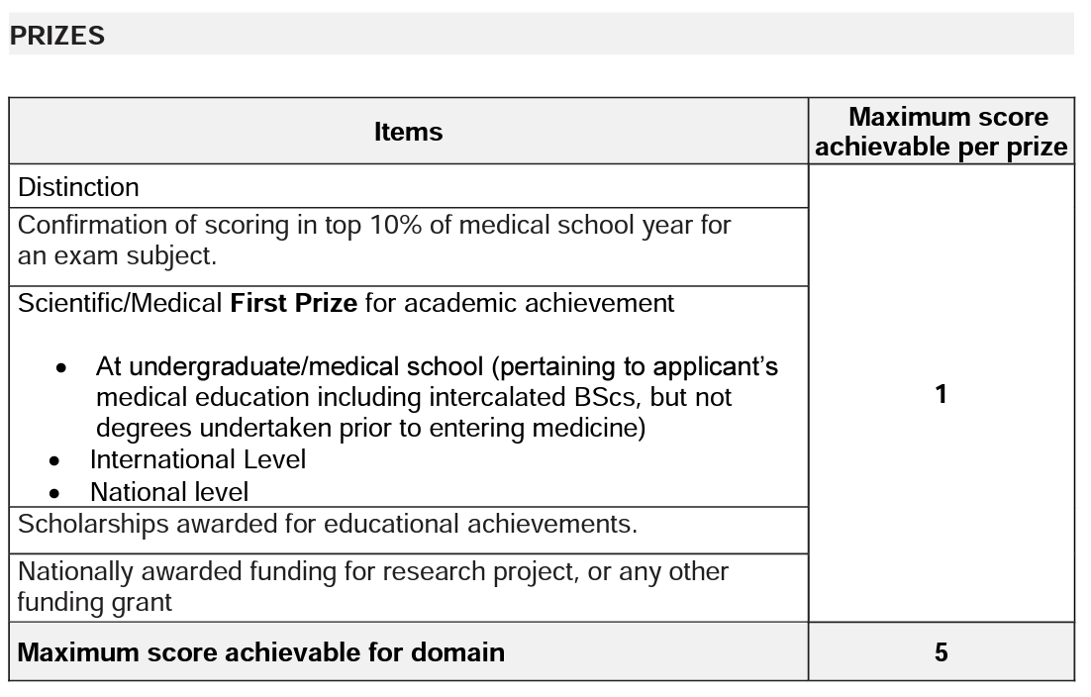

Slide 11
Case Study 1

Slide 12
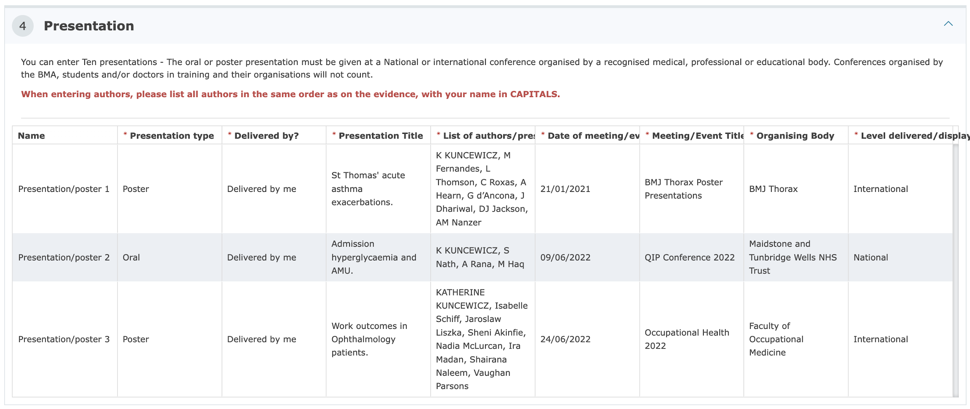
Notes:
Medical education (as of 2023)
East of England
East Midlands (LNR & Trent)
KSS & Wessex
North West of England
Peninsula
Scotland
Yorkshire & Humber
Leadership & management (as of 2023)
East Midlands (LNR & Trent)
KSS & Wessex
North West of England
Peninsula
Scotland
Wales

Slide 13
Notes:
Medical education (as of 2023)
East of England
East Midlands (LNR & Trent)
KSS & Wessex
North West of England
Peninsula
Scotland
Yorkshire & Humber
Leadership & management (as of 2023)
East Midlands (LNR & Trent)
KSS & Wessex
North West of England
Peninsula
Scotland
Wales

Slide 14
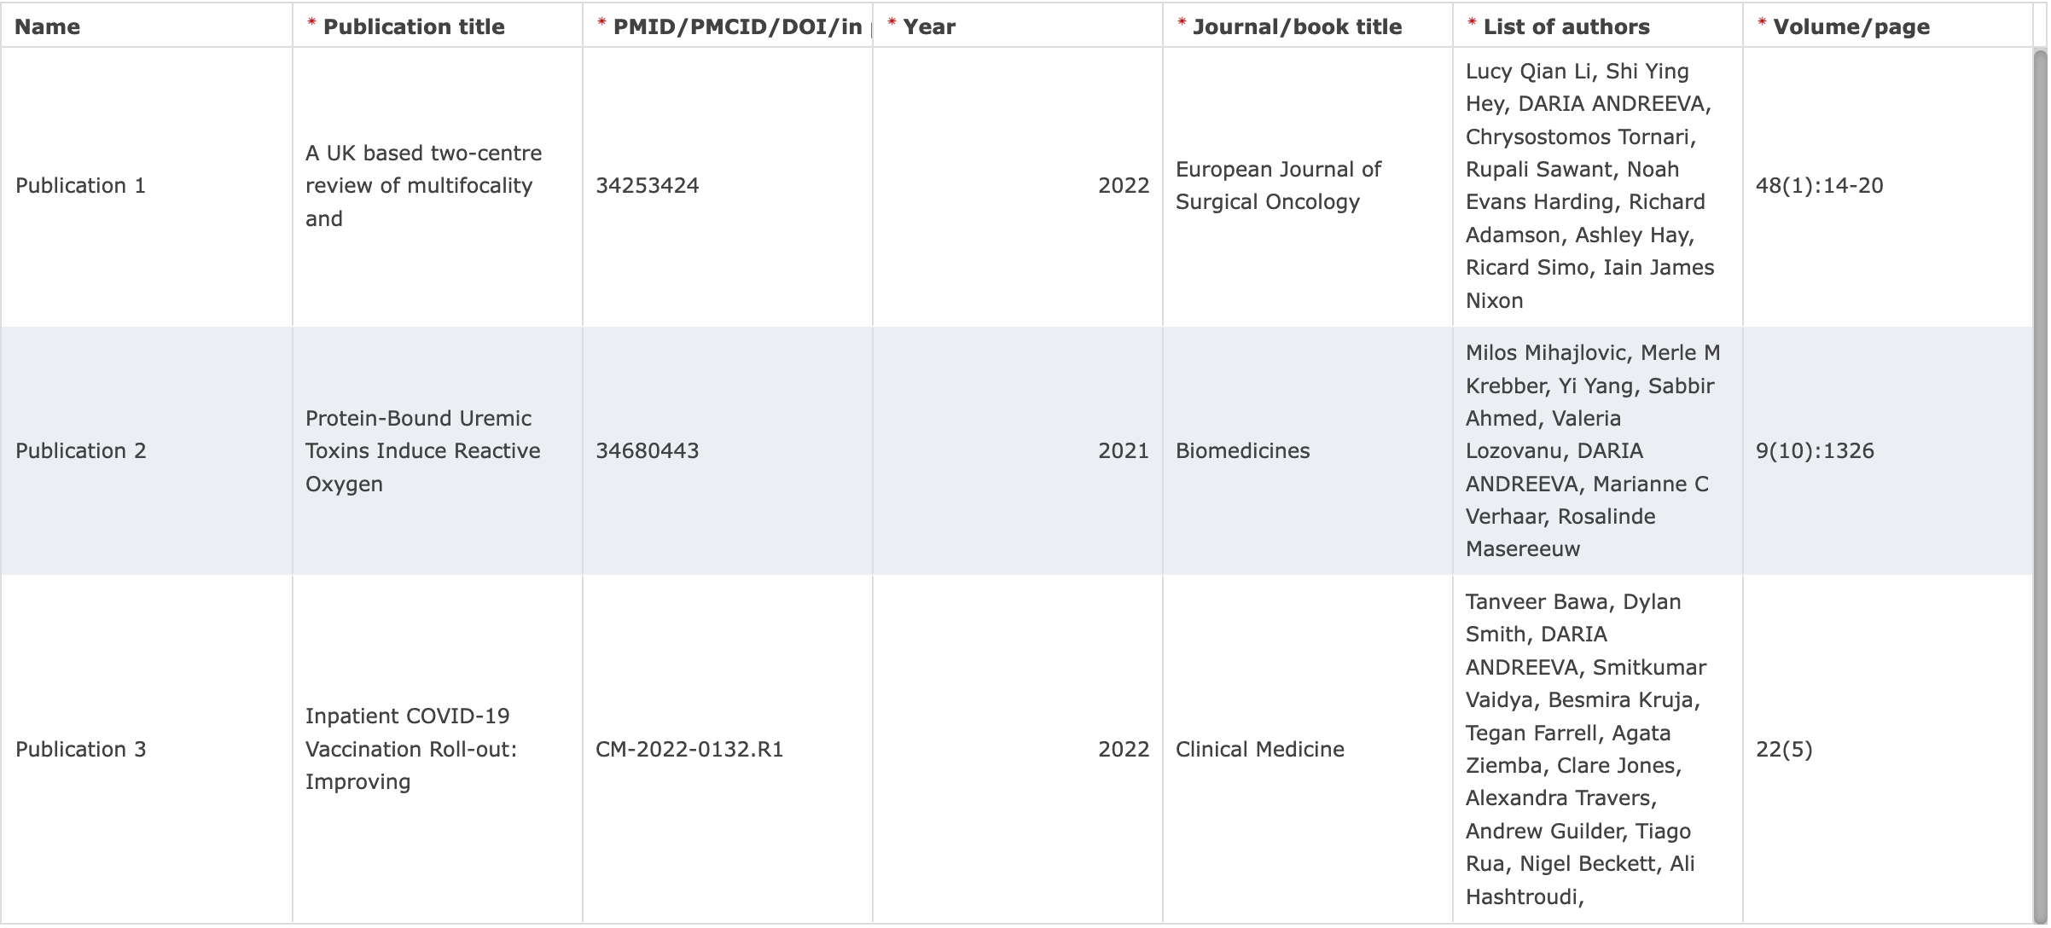
Case Study 2

Slide 15
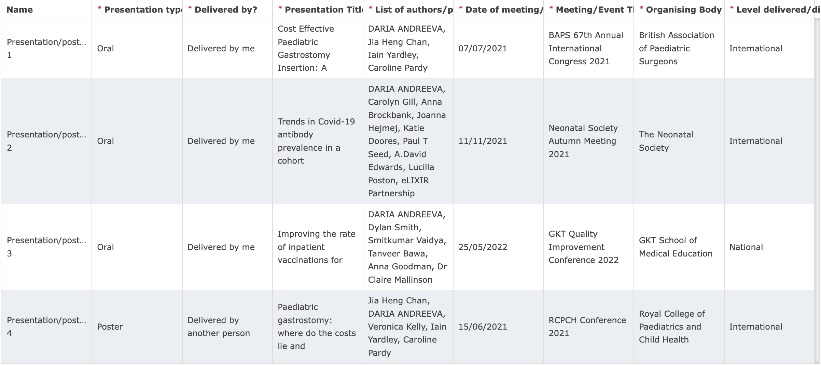

Slide 17
Next Steps + Take-Home Points
Email head of year/stage for evidence
Gather evidence of publications/prizes
Wording is important
If in year 4 and below:
Approach clinicians - publication
Apply for accessible prizes
Appeals process

Slide 18
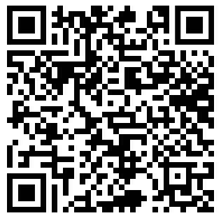
Q&A & Feedback form
Slides and recordings to be emailed on completion of the feedback form.

