Slide 1



Year 2 OSCE Crash Course
A-E Assessment
By: Maheen Siddiqui (Yr4), Jean Dimaculangan (Yr3) & Shruti Turaga (Yr3)

Slide 2
General Tips & Advice

Slide 3
Treat problems as you discover them and reassess after every intervention
Call for help when needed!
3 parts: Clinical Assessment, Investigations & Interventions
Review results as they become available (e.g. laboratory investigations)

Slide 4
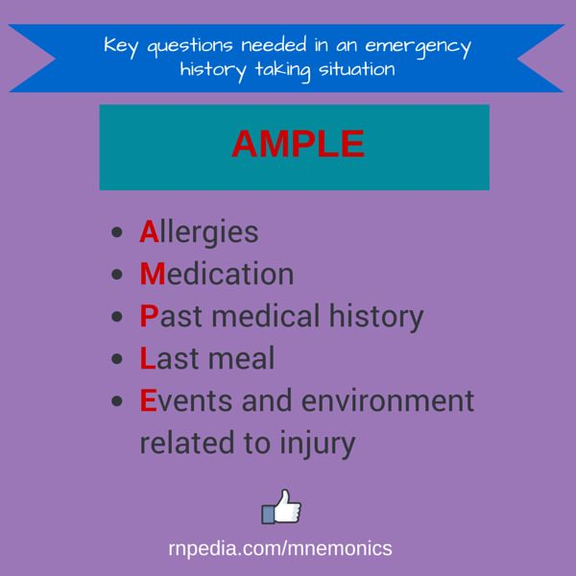
AMPLE mnemonic

Slide 5
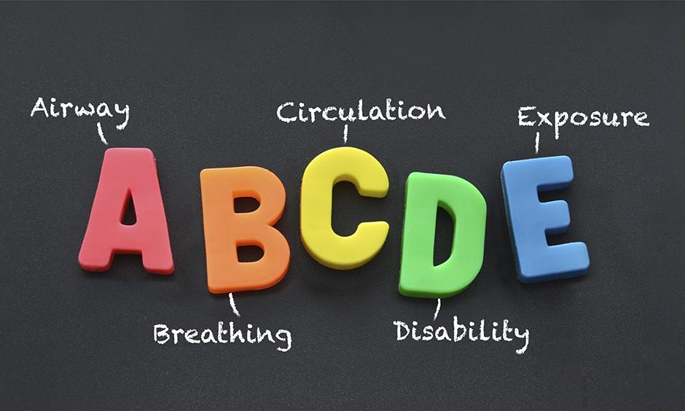
A-E: Airway

Slide 6

A-E: Airway
Talking?

Slide 7
Airway
Is the airway patent?
Clinical Assessment
Can the patient talk?
  Yes 🡪 Airway is patent and you can move on to B
  No 🡪 Look, listen and inspect
    Look : signs of airway compromise: angioedema, cyanosis, see-saw breathing, use of accessory muscles
    Listen : abnormal airway noises: stridor, snoring, gurgling
    Inspect : anything obstructing the airway, such as secretions or a foreign object
Investigations
None significant

Slide 8
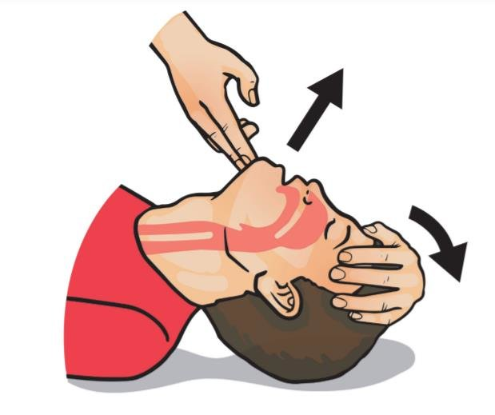
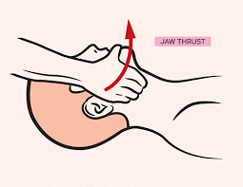
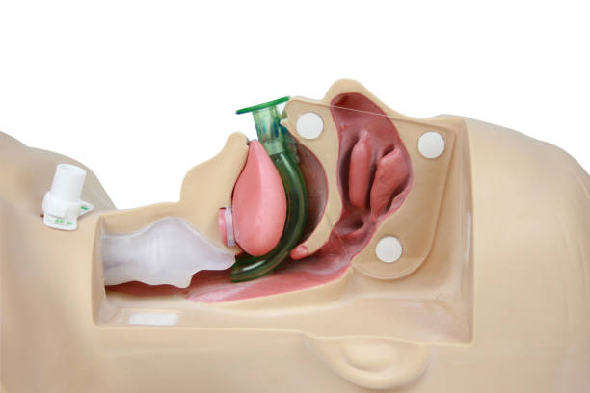
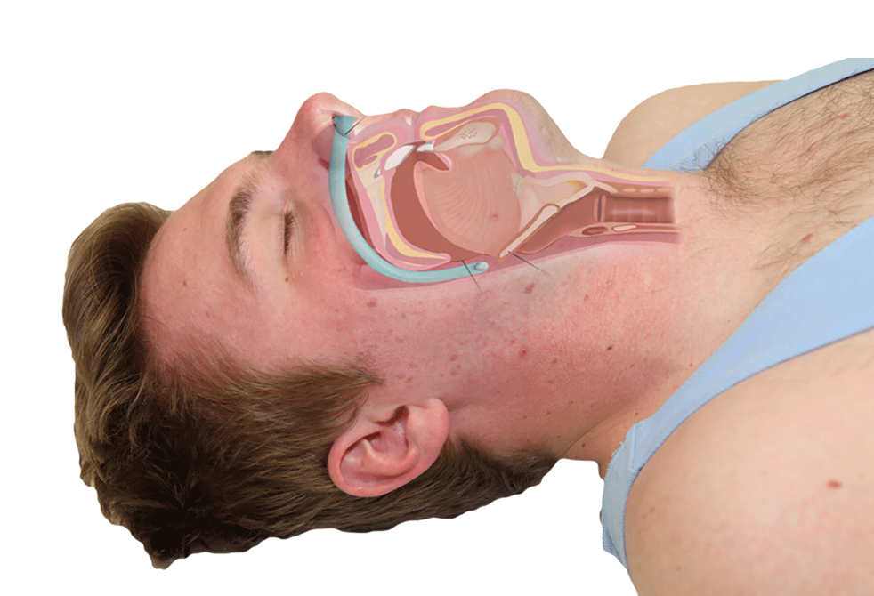
Airway
Interventions
Seek immediate expert support from crash team (anaesthetist and emergency medical team)
Perform basic airway manoeuvres to help maintain the airway whilst awaiting senior input
  Head-tilt chin-lift manoeuvre
  Jaw Thrust
  + Airway adjuncts (oropharyngeal airway or nasopharyngeal airway)
Head-tilt chin-lift
Jaw Thrust
Oropharyngeal airway
Nasopharyngeal airway
If patient has significant trauma with suspected spinal involvement
Only if patient is unconscious as it may induce gagging and aspiration
Can be used in partly or fully-conscious patients

Slide 9
Airway
Specific Airway Interventions
If a specific cause of airway compromise is identified, it should be rapidly treated:
  Anaphylaxis: intramuscular adrenaline
  Blood, vomit or secretions in the airway: suction, patient positioning (left lateral position)
  Stridor: sit the patient upright, urgent anaesthetic/ENT input
  Foreign body: basic life support choking algorithm

Slide 10
Airway Quiz Time
You go in to see a patient who is in a medical emergency. Upon performing an A-E, you find that their airway is not patent.
You have performed basic airway maneouvres, but it does not seem to be helping. The patient is slowly losing consciousness, but is still conscious.
What would your next step be?

Slide 11
Airway Quiz Time
You go in to see a patient who is in a medical emergency. Upon performing an A-E, you find that their airway is not patent.
You have performed basic airway maneouvres, but it does not seem to be helping. The patient is slowly losing conscious, but is still conscious.
What would your next step be?
Nasopharyngeal airway

Slide 12
A-E: Airway
Talking?

Slide 13
A-E: Breathing

Slide 14
A-E: Breathing
General inspection
Tracheal position
Chest expansion
Chest percussion
Chest auscultation
Respiratory rate
Oxygen saturations

Slide 15
Breathing
Is there sufficient oxygenation and ventilation?
Clinical Assessment
Oxygen saturations (Normal 94-98% in healthy adults and 88-92% in COPD patients)
  Low sats : PE, aspiration, COPD, asthma and pulmonary oedema
Respiratory rate (Normal 12-20 breaths per minute)
  Low RR : sedation, opioid toxicity, raised ICP or exhaustion in airway obstruction with CO2 retention (e.g. COPD)
  High RR : airway obstruction, asthma, pneumonia, PE, pneumothorax, pulmonary oedema, heart failure, anxiety

Slide 16
Breathing
Clinical Assessment (contd.)
General inspection
  Cyanosis, shortness of breath, cough, stridor
Tracheal position
  Deviates away from tension pneumothorax and large pleural effusions
  Deviates towards lobar collapse and pneumonectomy
Chest expansion
  Reduced but symmetrical: pulmonary fibrosis
  Reduced and asymmetrical : pneumothorax, pneumonia, and pleural effusion
Percussion of chest
  Dullness : increased tissue density (e.g. cardiac dullness, consolidation, tumour, lobar collapse)
  Stony dullness : underlying pleural effusion
  Hyperresonance : decreased tissue density (e.g. pneumothorax)
Auscultation
  Bronchial breathing, quiet/reduced breath sounds, wheeze, coarse crackles, fine end-inspiratory crackles

Slide 17
Breathing
Investigations
Arterial blood gas (if low oxygen saturations)
Chest X-ray
Interventions
Patient positioning – upright
Non-rebreather mask with high-flow oxygen of 15L
  If COPD, this can be transitioned to a 24% (4L) Venturi mask

Slide 18
Breathing
Specific Breathing Interventions
If a specific cause of breathing difficulties is identified, it should be rapidly treated:
  Acute asthma: nebulised bronchodilators (salbutamol/ipratropium), corticosteroids and other agents (e.g. magnesium sulphate, aminophylline)
  Exacerbation of COPD: bronchodilators (salbutamol/ipratropium), corticosteroids, antibiotics (if evidence of infection)
  Pneumothorax: management as per British Thoracic Society guidelines
  Pneumonia: antibiotics

Slide 19
Breathing Quiz Time
What are specific interventions in breathing for someone with acute exacerbation of asthma?

Slide 20
Breathing Quiz Time
What are specific interventions in breathing for someone with acute exacerbation of asthma?
Nebulised bronchodilators (salbutamol/ipratropium), corticosteroids and other agents (e.g. magnesium sulphate, aminophylline)

Slide 21
A-E: Breathing
General inspection
Tracheal position
Chest expansion
Chest percussion
Chest auscultation
Respiratory rate
Oxygen saturations

Slide 22
A-E: Circulation

Slide 23
A-E: Circulation
General inspection
Temperature
JVP
Blood pressure
Auscultation
Fluid balance assessment
Pulses and HR
CRT
Ankles and sacrum

Slide 24
Circulation
Is circulation stable?
Clinical Assessment
General inspection
  Pallor, oedema
Fluid balance assessment
  Reduced urine output (oliguria) (<0.5 ml/kg/hr) : dehydration, hypovolaemia, reduced cardiac output and acute kidney injury
Palpation
  Cool hands : poor peripheral perfusion (e.g. congestive cardiac failure, ACS)
  Sweaty and sweaty/clammy : poor peripheral perfusion and autonomic dysfunction (e.g. acute coronary syndrome / ACS)

Slide 25
Circulation
Clinical Assessment
Capillary refill time (CRT) (Normal <2 sec)
  >2s : Poor peripheral perfusion (e.g. hypovolaemia, congestive heart failure)
Pulses
  Irregular : arrhythmias such as atrial fibrillation
  Slow-rising pulse : aortic stenosis
  Pounding pulse : aortic regurgitation as well as CO2 retention
  Thready pulse : intravascular hypovolaemia (e.g. sepsis)
Heart rate (Normal 60-99 beats per minute)
  Low HR (<60) : acute coronary syndrome (ACS), ischaemic heart disease, electrolyte abnormalities (e.g. hypokalaemia) and drugs (e.g. beta-blockers)
  High HR (>99) : hypovolaemia, arrhythmia, infection, hypoglycaemia, thyrotoxicosis, anxiety, pain and drugs (e.g. salbutamol)

Slide 26
Circulation
Clinical Assessment (contd.)
Blood pressure (Normal between 90/60 and 140/90 mmHg, but check patient’s baseline )
  Low BP : hypovolaemia, sepsis, adrenal crisis and drugs (e.g. opioids, antihypertensives, diuretics)
  High BP : hypervolaemia, stroke, Conn’s syndrome, Cushing’s syndrome and pre-eclampsia (in pregnant females)
JVP
  Raised JVP : right-sided heart failure, tricuspid regurgitation, constrictive pericarditis
Auscultation
  Pericardial rub or muffled heart sounds : pericarditis or cardiac tamponade
  Third heart sound : congestive heart failure
  Murmur of recent onset : Recent MI (e.g. papillary muscle rupture) or endocarditis
Ankles and sacrum
  Oedema : heart failure

Slide 27
Circulation
Investigations
IV Cannulation
  Wide-bore IV cannula (14G or 16G)
Blood tests and blood cultures
  FBC, U&Es, LFTs for all
  Specific situations
    Sepsis: CRP, lactate and blood cultures
    Haemorrhage or surgical emergency: coagulation and cross-match
    Acute coronary syndrome: troponin
    Arrhythmia: calcium, magnesium, phosphate, thyroid function tests, coagulation
    Pulmonary embolism: D-dimer (if appropriate based on Well’s score)
    Overdose: toxicology screen (e.g. paracetamol levels)
    Anaphylaxis: consider serial mast cell tryptase levels
  12-lead ECG and continuous cardiac monitoring
  Bladder scan
  Urine pregnancy test
  Cultures/swabs
  Fluid balance/catheterisation

Slide 28
Circulation
Interventions
Fluid resuscitation
  500ml bolus of 0.9 sodium chloride or Hartmann’s solution over less than 15 minutes
Reassess
Repeat administration up to 4 times
Seek senior input if negative response or patient not responding adequately
Blood transfusion (if significant haemorrhage)

Slide 29
Circulation
Specific Circulation Interventions
If a specific cause of circulatory compromise is identified, it should be rapidly treated:
  External haemorrhage : direct pressure
  Acute coronary syndrome : analgesia (morphine), nitrates, aspirin, antiplatelets (e.g. clopidogrel) and oxygen if required
  Sepsis : sepsis six: ‘take three give three’ [ take: blood cultures, urine output, serum lactate | give: abx, oxygen and fluids]
  Fluid overload : diuretics, close fluid balance monitoring
  Atrial fibrillation : treatment of underlying trigger, consideration of rate vs rhythm control
  Pulmonary embolism (unstable) : alert senior clinician for consideration of systemic thrombolysis

Slide 30
Circulation Quiz Time
A patient comes in with heart failure. Upon examination, you notice they are hypotensive and require fluids. What fluids will you prescribe?

Slide 31
Circulation Quiz Time
A patient comes in with heart failure. Upon examination, you notice they are hypotensive and require fluids. What fluids will you prescribe?
250ml bolus of 0.9 sodium chloride or Hartmann’s solution over less than 15 minutes

Slide 32
A-E: Circulation
General inspection
Temperature
JVP
Blood pressure
Auscultation
Fluid balance assessment
Pulses and HR
CRT
Ankles and sacrum

Slide 33
A-E: Disability

Slide 34
A-E: Disability
Consciousness
Pupils
Blood glucose
Brief neurological assessment
Drug chart review

Slide 35
Disability
Is neurological state stable?
Clinical Assessment
Capillary blood glucose (normal fasting 4.0 – 5.8 mmol/L)
Consciousness - ACVPU
  Reduced consciousness : hypovolaemia, hypoxia, hypercapnia, metabolic disturbance (e.g. hypoglycaemia), seizure, raised ICP or other neurological insults (e.g. stroke), drug overdose, iatrogenic causes (e.g. administration of opiates)
Pupils (size, symmetry, direct and consensual pupillary responses)
  Pinpoint pupils : opioid overdose or Dilated pupils : tricyclic antidepressant overdose
  Asymmetrical pupils : intracerebral pathology (e.g. stroke, space-occupying lesion, raised ICP)
Brief neurological assessment
Drug chart review

Slide 36
Disability
Investigations
CT head (if intracranial pathology suspected)
Interventions
Correct hypoglycaemia
  Administration of oral or IV glucose
Maintain airway
  Immediately alert seniors if concerned about patient’s consciousness level
  Urgent expert help from anaesthetist if GCS 8 or below, or a P or U on ACVPU scale

Slide 37
Disability
Specific Disability Interventions
If a specific cause of reduced consciousness is identified, it should be rapidly treated:
  Opioid overdose : ventilation, naloxone
  Diabetic ketoacidosis (DKA) : intravenous fluids and insulin
  Seizures : maintain airway, benzodiazepines
  Hypercapnia : urgent senior clinician review for consideration of ventilation

Slide 38
Disability Quiz Time
A GCS below which value warrants urgent help from an anaesthetist to maintain airway?

Slide 39
Disability Quiz Time
A GCS below which value warrants urgent help from an anaesthetist to maintain airway?
GCS below 8

Slide 40
A-E: Disability
Consciousness
Pupils
Blood glucose
Brief neurological assessment
Drug chart review

Slide 41
A-E: Exposure

Slide 42
A-E: Exposure
Inspection
Palpation

Slide 43
Exposure
Are there any other symptoms?
Clinical Assessment
Inspection
  Skin : rashes, bruising, signs of infection
  IV lines : erythema, discharge
  Abdomen : distension, swelling
  Calves : erythema, swelling
  Surgical wounds : haematoma, active bleeding or infection
  Output of catheter and any surgical drains : blood loss, fluid loss, evidence of infection
Palpation of abdomen and calves
Investigations
Cultures/Swabs

Slide 44
Exposure
Interventions
Control bleeding
Warm the patient
Treat infection

Slide 45
Exposure Quiz Time
What forms the exposure part of an A-E assessment?

Slide 46
Exposure Quiz Time
What two things form part of the exposure part of an A-E assessment?
Inspection and Palpation

Slide 47
A-E: Exposure
Inspection
Palpation

Slide 48
Further: Escalation

Slide 49
Escalation
Important teams to contact
If a patient is critically unwell (e.g. peri-arrest, cardiac arrest), the cardiac arrest team should be alerted (the team typically consists of an anaesthetist, medical registrar and other clinicians).
  Airway problems
    Anaesthetics +/- ENT
  Breathing problems
    Medical registrar on call
    Critical care team
  Circulation problems
    Medical registrar on call
    Critical care team
    Other specialists depending on the suspected pathology (e.g. microbiologist, cardiologist, surgeon, gastroenterologist)

Slide 50
Escalation
Important teams to contact (contd.)
  Disability problems
    Medical registrar on call
    Anaesthetics if the airway is threatened (e.g. GCS<8)
    Other specialists depending on the suspected pathology (e.g. neurosurgeon, endocrinologist, neurologist)
  Exposure problems
    Medical registrar on call
    Other specialists depending on the suspected pathology (e.g. surgeon, dermatologist, microbiologist)

Slide 51
Final Quiz Time
Can you list out the main assessments that form each of the parts of the A-E assessment?

Slide 52
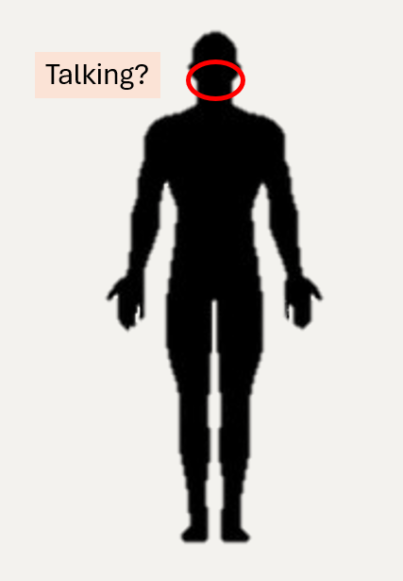
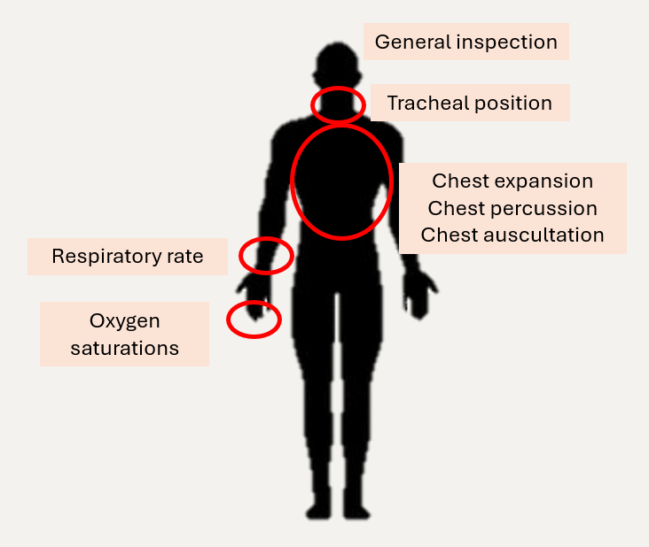
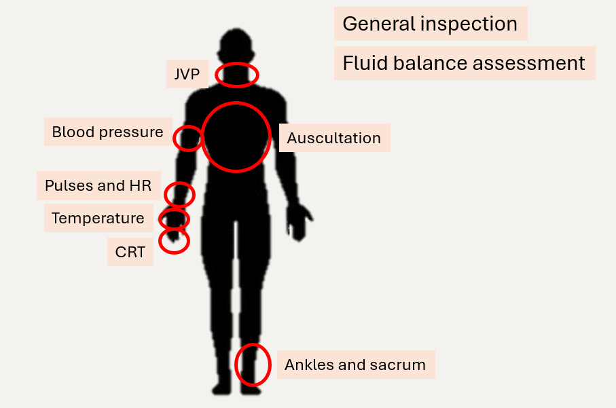
Final Quiz Time
Can you list out the main assessments that form each of the parts of the A-E assessment?

Slide 53
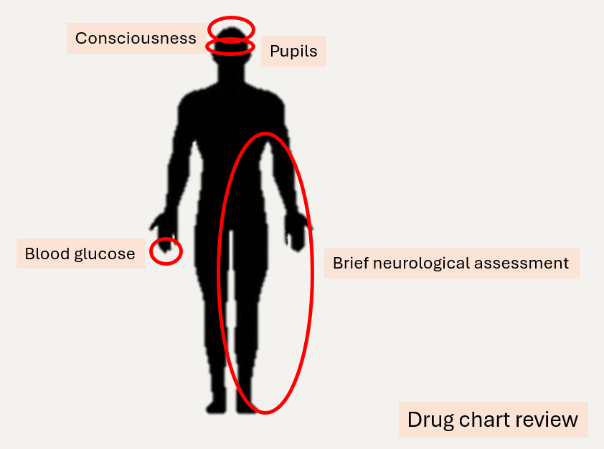
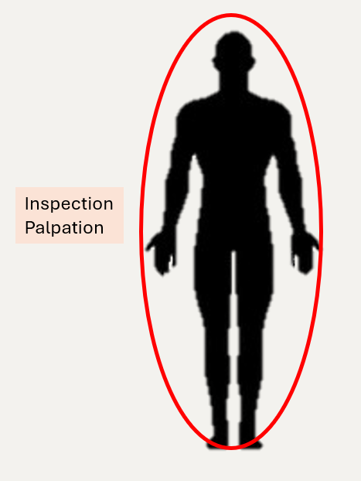
Final Quiz Time
Can you list out the main assessments that form each of the parts of the A-E assessment?

Slide 54
Summary

Slide 55
Summary
 | Assessment | Investigation | Intervention
Airway | Talking? If no, look, listen, inspect | None | Expert help Airway manoeuvres
Breathing | Oxygen saturations Respiratory rate General inspection Tracheal position Chest expansion Percussion of the chest Auscultation | ABG Chest X-ray | Patient positioning Oxygen
Circulation | General inspection Fluid balance assessment Palpation Capillary refill time Pulses Heart rate Blood pressure JVP Auscultation Ankles and sacrum | IV cannulation Blood tests and blood cultures ECG Bladder scan Urine pregnancy test Other cultures/swabs Fluid output/catheterisation | Fluid resuscitation Blood transfusion

Slide 56
Summary
 | Assessment | Investigation | Intervention
Disability | Blood glucose Consciousness Pupils Brief neurological assessment Drug chart review | CT head | Correct hypoglycaemia Maintain the airway
Exposure | Inspection Palpation | Cultures/Swabs | Control bleeding Warm the patient Treat infection

Slide 57
ISBAR Tool

Slide 58
ISBAR Tool
Introduce/ Identify
Identify yourself, your role, and your patient and location if calling.
Situation
What is going on with the patient?
Background
What is the context?
Assessment and Impression
What is the problem?
Recommendation
What is the plan?

Slide 59
ISBAR Tool
INTRODUCTION: Allows your colleague to know who you are and to be ready to receive
information
• Identify yourself, your role, (and if calling also state the location of patient)
SITUATION: The ‘headline news’
• Reason for speaking to them, state your concerns “I’d like to speak to you about.....because I
am concerned about....”
• State the patient’s diagnosis, or reason for admission and current problem
BACKGROUND: Contextual information to set the scene
• Patient history – clinical background or context
• What patient admitted for and other relevant clinical information since admission
• Previous observations / NEWS Score.

Slide 60
ISBAR Tool
ASSESSMENT & IMPRESSION: Information to inform decision making
• Current problems, observations and treatments
• Description of symptoms
• Observations in ABCDE order
• Impression / Raise concerns
• State what you are thinking. ‘thinking out loud’
• The problem that needs treating and concerns for patient
• Or state you are not sure what the problem is and ask what to do while you await
their arrival
RECOMMENDATIONS: Close the loop on agreed plan
• Request action required
• Raise concerns/ask for help
• close the loop of communication
o info understood? Agreed plan?
o Timeframe for action

Slide 61
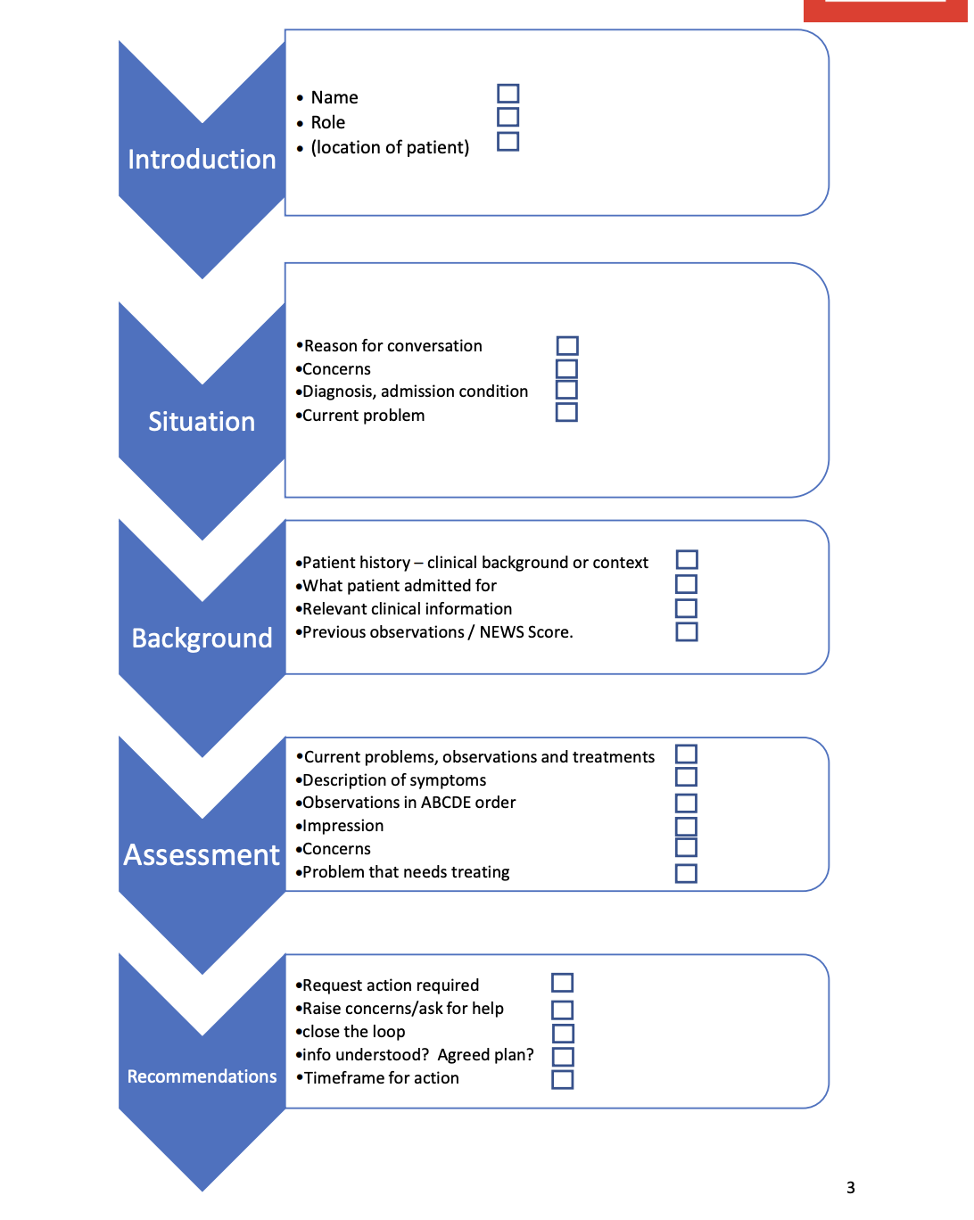

Slide 62
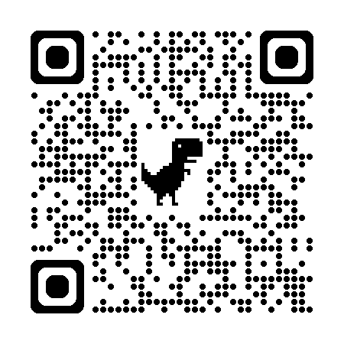
Case 1

Slide 63
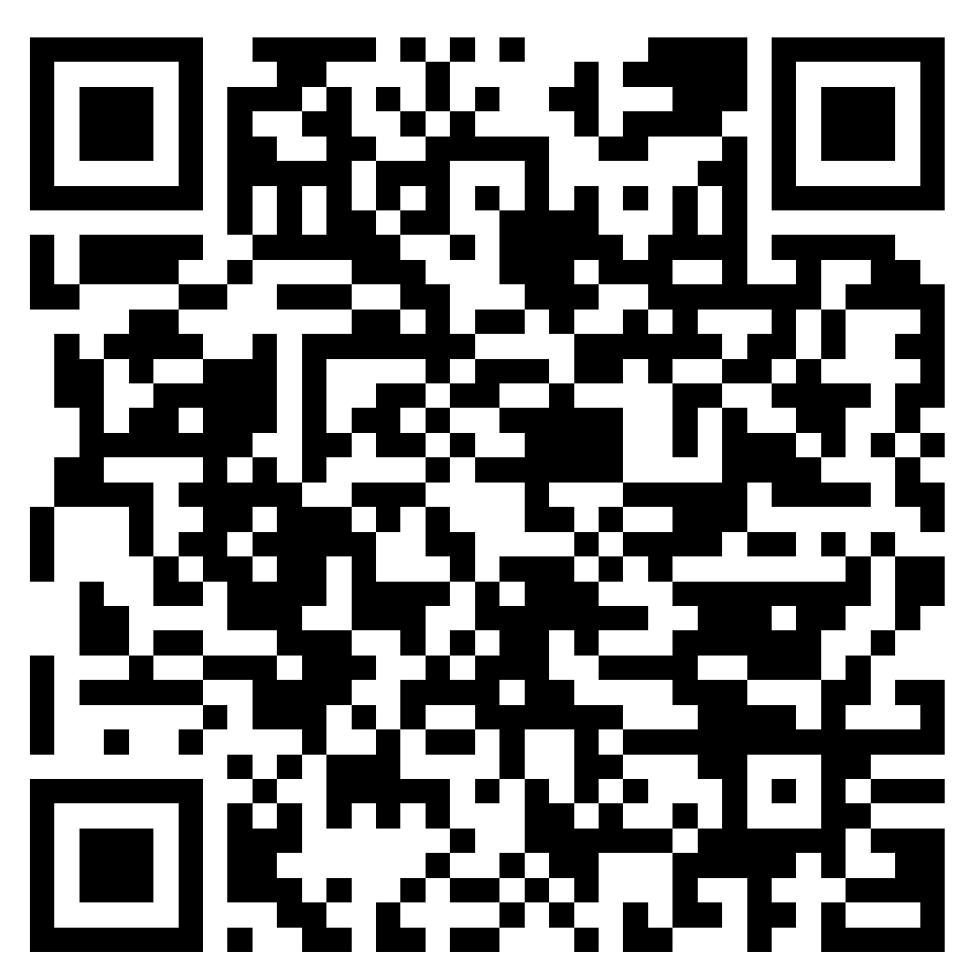
Case 2

Slide 64
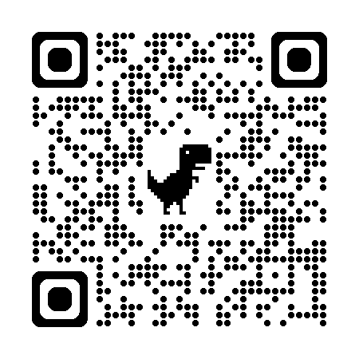
Case 3

Slide 65
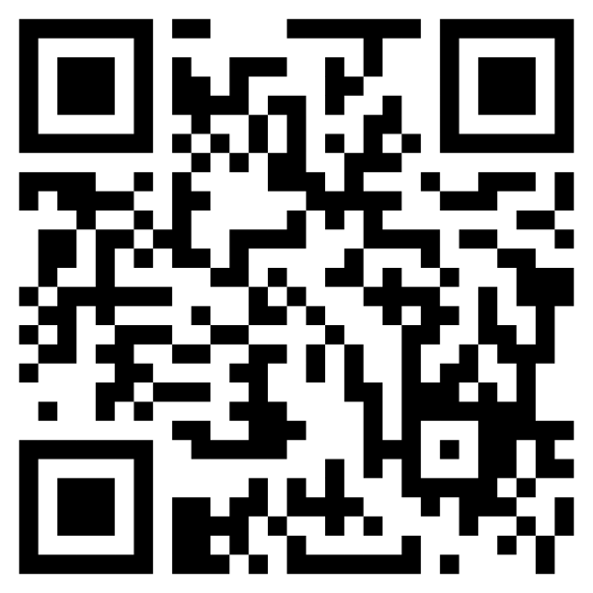
Feedback Form

