Slide 1

What I Wish I Knew in Second Year
By: Jean, Shruti, Taiyyib & Akshaya
Monday 8th September 2025
Notes:
Jean will introduce (everyone briefly introduce themselves)

Slide 2
What We Will Be Covering
General Overview & Tips
General Practice (GP)
Assessments
OSCEs
E-Portfolio
Progress Test 3 Tips
Hospital Placement
Wellbeing
SSC
Resources and Opportunities
Block Overview
Notes:
Jean

Slide 3
MON
LECTURES
General:
A Week in the Life of a Second Year Med Student
TUES
GP/HOSPITAL PLACEMENT
WED
ANATOMY / CASE BASED DISCUSSIONS
THUR
INTRO TO RESEARCH (SEM1) /
SSC (SEM2)
FRI
GP/HOSPITAL PLACEMENT
Notes:
Jean

Slide 4
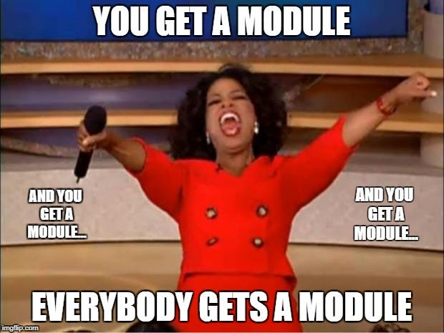
Stage 2 Year 2 Modules
From Science to Clinical Practice 1: Progress Tests 1,2,3 PT3 is summative
Human Development: OBGYN, Paeds, Endo
Supporting Life: Cardio, Resp, Neuro, Pharm
Inflammation: Rheum, Gastro, Nephro, Infectious Diseases, Diabetes
Ageing: Bone Diseases, Dementia, Delirium, Frailty, Falls, PD
Introduction to Clinical Research - 300 word summative
Student Selected Components - 2,000 word Dissertation / Creative Piece / Exam (languages only)
Longitudinal GP Placement - GP sign offs on Kaizen
NB: Your hospital placement blocks may NOT align with your teaching blocks
Notes:
Jean

Slide 5

General Advice for 2nd Year🫡
Be CONSISTENT from the very beginning! Cramming will not save you this time :(
A lot of FIRSTs this year - PTs, OSCEs, placements etc.
You will not be able to cover EVERYTHING for PTs and that’s okay
Focus on perfecting histories and examinations this year
Be on top of your sign offs
Bring a notepad to take notes with during placements
Have fun!!!
Notes:
Jean

Slide 6
Assessments Summary
Progress Test 1: November - (Formative)
150 SBA Questions on content from all years.
You will not know everything nor will be expected to.
Remember you have only done one block so won’t know much and that’s fine you will improve each time! Use it as
Progress Test 2: January (Formative)
Progress Test 3: May (Summative)
OSCE: March (Formative)
Intro to clinical research - 300 word summative essay & a quiz January
SSC essay/ creative piece / language exam - April
Kaizen e portfolio - May
Notes:
Shahnaz

Slide 7
What is a PT?
It tests you on the content you are expected to know by the time you qualify as a doctor
  Ensuring that you’re prepared for the AKT (Applied Knowledge Test) at the end of your final year (part of the MLA)
Each PT has 150 SBAs, and you will be examined on content from all years
  You won’t know (and are not expected) to know everything - all you have to do is pass; the pass mark is set according to your year
Can use the MLA content map to help with conditions list and map to blocks. You don’t learn everything on the content map, this is everything you need to cover by final year!
Remember you are not just studying to pass exams, but to become doctors and treat patients!
Notes:
Think of the reasoning as being part of a spiral learning curriculum - you’re slowly building up knowledge over the years whilst solidifying what you’ve already learnt

Slide 8
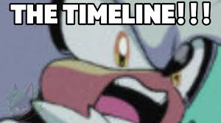

10th Nov
2nd Feb
30th Mar
1st Jun
Longitudinal GP placement
Block 1
Block 2
Block 3
Block 4
PT 1 - Nov
fOSCE - Mar
PT 3 - May
PT 2 - Jan
SSC
Key :
formative
eportfolio sign off deadline
summative
ICR essay and quiz
Notes:
4 blocks, 7 weeks each, of which one will be a campus week (+/ RCGP)
three PTs, the third is summative

Slide 9
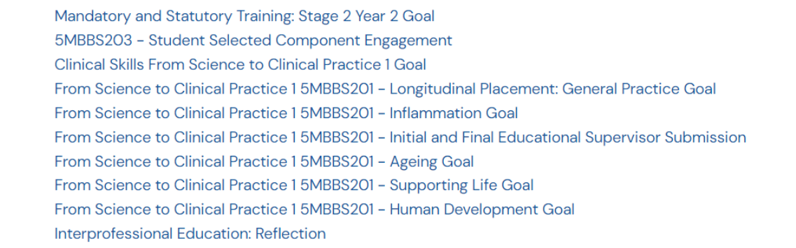
E-portfolio
Notes:
Maheen

Slide 10
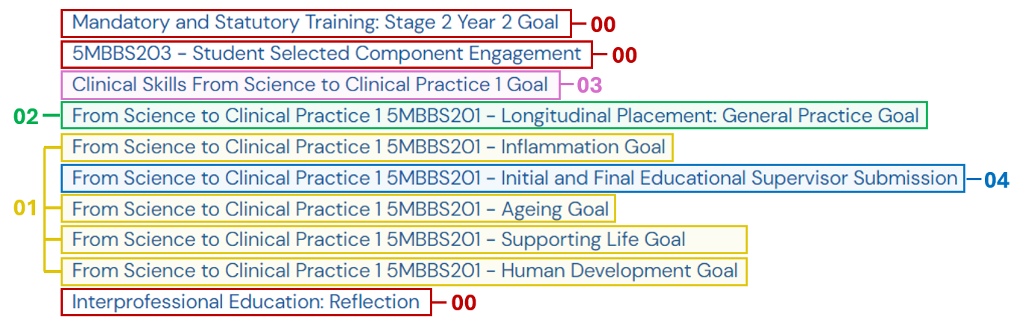
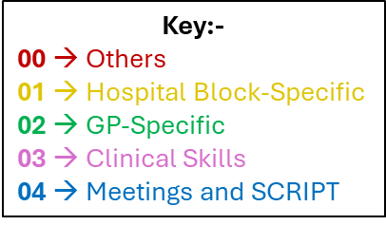
E-portfolio
Notes:
Maheen

Slide 11
E-portfolio
In the next few slides, guidance and recommended timelines to complete the e-portfolio are covered
The recommended timelines are noted in little red boxes – these are there to help direct you in completing your E-portfolio as efficiently as possible
Key for upcoming slides
Side-by-side - Complete on a daily/weekly basis
Whenever possible - Keep these sign-offs in the back of your mind, so you can initiate and/or take the opportunity to do them, and complete the sign-off
As soon as possible - You do not need anything to get these signed off - you can get these done right NOW if you wish! Try to get these done as soon as possible, so they can be ticked off and you do not have to worry about them along with other deadlines later down the year
Notes:
Maheen

Slide 12
E-portfolio: 00 → Others
Before placement starts
Needs to be completed before placement start
MAST guidance document on KEATS + courses on eLFH
After SSC finishes
Simply shows that you engaged with your SSC
Just fill in the details of your SSC and supervisor at the end of the SSC, and your supervisor will fill it out for you
After the two IPE sessions finish
There will be two online sessions throughout the year
You need to write a few words to reflect what you learnt through those sessions
Notes:
Maheen

Slide 13
E-portfolio: 01 → Hospital Block-specific goals
At the end of each block
Each hospital block has a specific goal on Kaizen
For all hospital blocks:
  Engagement log
  Reflective notes: a case I saw and reflected on
  Educational supervisor: end of block report
Side-by-side
Whenever possible
End of block
For Inflammation and Supporting Life:
  SLE: CBD
For Ageing and Human Development:
  SLE: Mini-Cex
Whenever possible
Whenever possible
Notes:
Maheen

Slide 14
E-portfolio: 01 → Hospital Block-specific goals
Lots of words…. what does any of this mean?
Engagement log - Write down what you learnt/did every day
CBD (Case based discussion) - Present a case (e.g. Hx, PMHx, FHx, SHx, Ivx, Tx etc) to someone (can be someone on the wards, or in some hospitals, there is dedicated time to present it to your teaching fellows)
Mini-Cex - Perform a practical skill on a real patient (e.g. take a history, perform an examination)
Reflective notes – A case I saw and reflected on - Reflect on a case you saw during your placements on that block (use the Gibbs’ reflective cycle)
Educational supervisor end of block report - Write a few words of reflection at the end of the block
Notes:
Maheen

Slide 15
E-portfolio: 02 → GP-specific goals
GP has its own goals on Kaizen
  SLE: Mini-Cex
  SLE: CBD
  Reflective notes: reflections on GP group assessment
  Reflective notes: reflections on going above and beyond
  Illness Scripts and Condition Write-Ups
  GP Reflection on Multi-Source Feedback
Whenever possible
Whenever possible
After working on your group project
As soon as possible
Try to get them done before Christmas break
Whenever possible
Notes:
Maheen

Slide 16
E-portfolio: 02 → GP-specific goals
More words… what do they mean?
  SLE: Mini-Cex → Perform a practical skill on a real patient (e.g. take a history, perform an examination); needs to be done in the GP usually
  SLE: CBD → Present a case (e.g. Hx, PMHx, FHx, SHx, Ivx, Tx etc) to someone (can be someone in the practice, or your educational supervisor might want you to present it to them)
  Reflective notes: reflections on GP group assessment → Reflect on what it was like working with your group, and what you learnt from it
Notes:
Maheen

Slide 17
E-portfolio: 02 → GP-specific goals
  Reflective notes: reflections on going above and beyond → Reflect on a time you went above and beyond; this could be in a professional capacity (e.g. you went above and beyond your studies, and took part in an extracurricular, attended a conference, were part of a society committee), personal capacity (e.g. you went out of your comfort zone to achieve something) or something for others (e.g. you did something to help someone else)
  Illness Scripts and Condition Write-Ups → Write about the full history of a patient in GP (i.e. Hx, PMHx, FHx, SHx etc) and then write about a condition associated with the patient (i.e. its description, epidemiology, aetiology, pathology, symptoms, investigations, management etc))
  GP Reflection on Multi-Source Feedback → collect feedback from multiple sources (usually 5 is a good number) - some examples of sources can be your clinical partner, GP group, educational supervisor, other staff in the GP you sit in with (there will be a form you can send round; all you need to do is collate and reflect on the feedback you get)
Notes:
Maheen
Could use the PALS scheme/ parents scheme here (sneaky plug)!

Slide 18
E-portfolio: 03 Clinical Skills
Preparatory 🡪 You do not need to perform these skills, you just need to have seen them (can be on wards, using videos, etc.) 🡪 Once you have seen them, you can self-certify (these do not need to be signed off by someone else)
  Prepare and administer injectable (intra-venous) drugs e.g. antibiotic
  Correct techniques for ‘moving and handling’, including patients
  Carry out venepuncture
  Carry out intravenous cannulation
  Set up an infusion
  Performing and interpreting a 12 lead electrocardiograph (ECG)
  Setting up and managing a 3-lead ECG monitor
  Prepare direct ophthalmoscopy
  Perform surgical scrubbing up
  Use of local anaesthetics
  Wound care and basic wound closure and dressing
  Carry out arterial blood gas and acid base sampling from the radial artery in adults
  Carry out safe and appropriate blood transfusion
As soon as possible/
Whenever possible
Notes:
Maheen

Slide 19
E-portfolio: 03 Clinical Skills
Level 1 🡪 These need to performed by you under supervision, and the supervising person must sign it off
  Handwashing 🡪 Any placement
  Measuring observations 🡪 Any placement
  Peak flow testing 🡪 GP
  Instructing patients in the use of devices for inhaled medication 🡪 GP
  Advising patients on how to collect a mid-stream urine specimen 🡪 GP
  Urine multidipstick test 🡪 Labour or prenatal wards (HD), GP
  Prescribe and administer oxygen 🡪 Respiratory ward (SL)
  Prepare and administer injectable (subcutaneous) drugs 🡪 Diabetes ward (INF), C-Section ward (HD), Ageing wards (warfarin etc)
  Prepare and administer injectable (intramuscular) drugs 🡪 GP (One day reserved for flu jabs)
  Nutritional assessment 🡪 GP
  Measuring capillary blood glucose 🡪 Ageing wards or Diabetes wards (IN)
  Taking nose, throat, skin and wound swabs 🡪 GP, Early Pregnancy Unit (HD)
Whenever possible
Notes:
Maheen

Slide 20

E-portfolio: 04 Meeting and Scripts
Whenever possible
&
You will have a meeting with your educational supervisor (i.e. your GP tutor) at the start of the year to discuss plans and expectations, and then one at the end of the year to review what you have accomplished
Both these meetings are logged in as part of goals on the e-portfolio
As soon as possible
Online modules on prescribing – you have access to SCRIPT from first year, and to the required modules on Kaizen, so you should be able to complete them as early as you wish
Some of the modules are also really helpful in understanding topics (e.g. a few on conditions, on medications etc), and will help you in lectures, workshops, placements, PTs, OSCE, knowledge etc.
Notes:
Maheen

Slide 21
Making the most of hospital placement
Have clear goals for the day and share them with the Drs - they want to help
Introduce yourself to all members of the team and shadow other HCPs not just the Drs
Take every opportunity to practise Hx and Examinations- good revision for OSCES
  Don’t forget to follow these up - look at the patient’s notes (with permission) to see what you missed, have a go at interpreting scans etc.
  Try presenting cases- it’s a key skill and you will get useful feedback
Ask Drs/ nurse in charge which patients have good signs or would be good to examine
Get your sign offs done early ideally first or second week so you have time for it to get signed off- do more than one if necessary
Notes:
!Jack

Slide 22
Making the most of hospital placement - cont.
Attend hospital teaching and ask your clinical fellows for teaching sessions- they are there to teach if you ask you shall receive
  similarly, on the wards, if you ever want to see anything, there’s no harm in asking - say you notice a patient going for a scan, ask if you can see it, for example
If there’s nothing happening don’t feel you have to stay on the ward - try to make the most out of placement if there’s nothing happening
Book the skills room with friends in chandler sail to practise skills/ OSCE throughout the year
Sign off for blocks are: MiniCEX/CBD and reflection on case and engagement log (fill it in as you go along to stop everything pilling up)
Don’t stress about knowing everything, as long as you’re willing to learn and know the basics, you will end up learning a lot as you go!
Notes:
!Jack

Slide 23

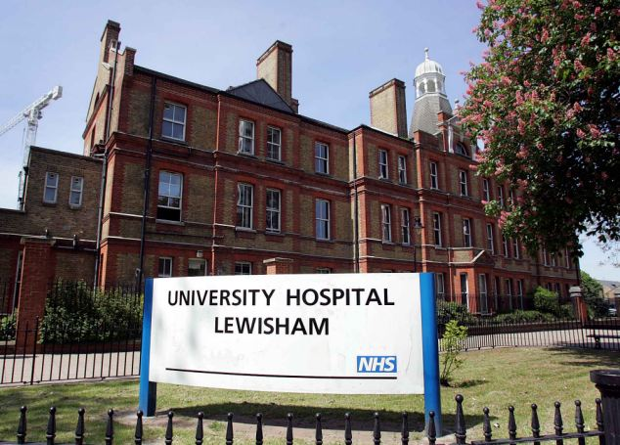


Notes:
Ally

Slide 24
Student Selected Component (SSC)
Choosing between Language Vs Research Project :
  Choose what you would enjoy!!
  When choosing a project, think about workload, time, how it’s assessed and what your overall aim is for the project (publication?)
Research projects :
  Contact your supervisor early on if you haven’t heard back from them try and find their NHS email address
  Make sure you have a clear idea of what your project entails and how you will be assessed
    Usually 1. the essay and 2. engagement (on kaizen)
  Set some deadlines for yourself and stick to them!! (don’t leave it till the end!)
Enjoy it and have fun - bit of a break from the clinical work and lectures!
Notes:
Jack (and Jean for language SSC)

Slide 25



Student Selected Component (SSC) - Language
Twice a week lessons, likely on Strand campus
Homework, Exams etc. - back to secondary school vibe!
Language Exam - 1x Oral Exam, 1x Writing Exam
Only do a language SSC if you’re passionate about the language you choose (or so you can enjoy anime the way it was meant to be watched… P.S. it’s sub, and you know it.)
Notes:
Jean

Slide 26

STAGE 2 YEAR 2 BLOCKS
Notes:
Ally

Slide 27
HUMAN DEVELOPMENT
GENERAL ADVICE
Don’t be afraid to show your eagerness and get involved!
Speak to prospective mothers, and learn to take obstetric histories!
Have a good understanding of typical pregnancy timeline, childhood infections and immunisations
Do read up on relevant conditions and guidelines the night before placement!!
Don’t feel discouraged if you don't see a birth
CONTENT:
WOMEN'S HEALTH
PREGNANCY
CHILD HEALTH
ENDOCRINOLOGY
Notes:
Ally

Slide 28
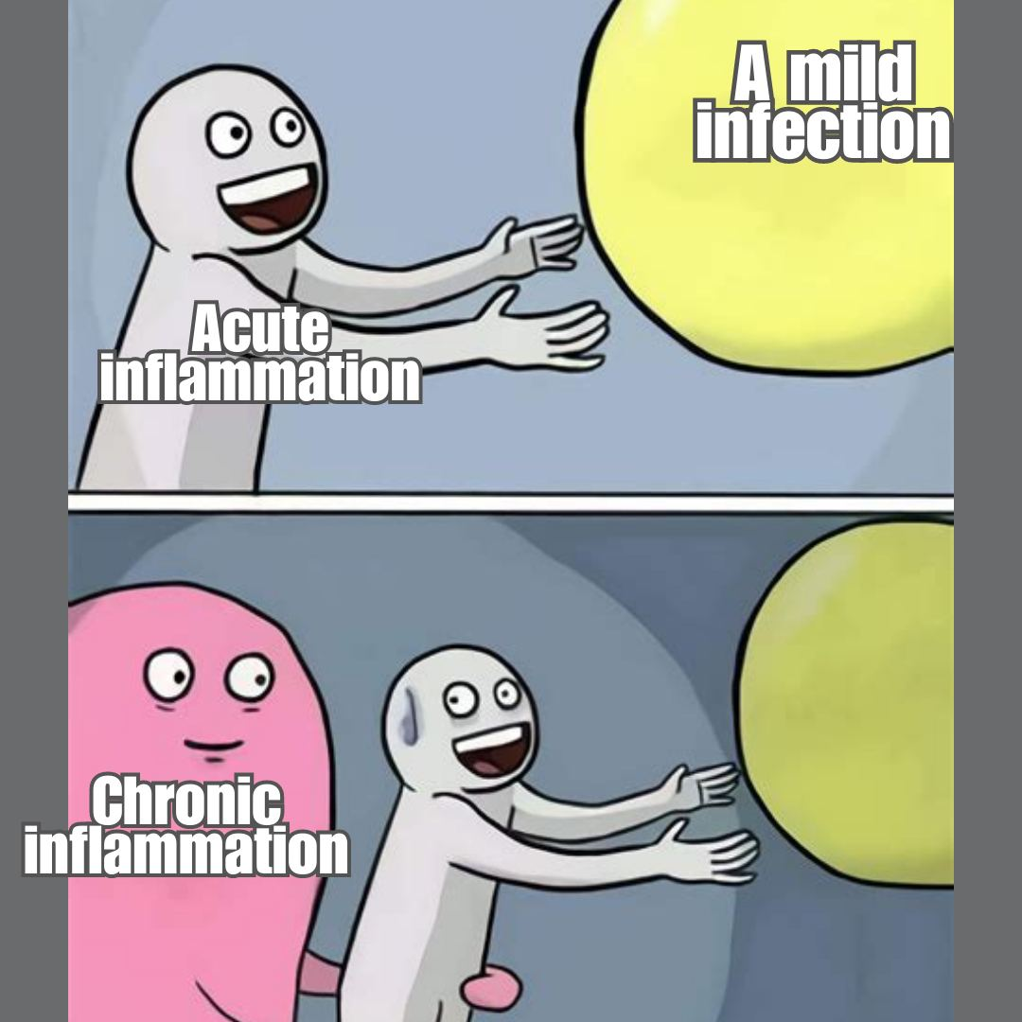
INFLAMMATION
GENERAL ADVICE
CONTENT:
RHEUMATOLOGY
GASTROENTEROLOGY
NEPHROLOGY
INFECTIOUS DISEASES
DIABETES
(wards/clinics vary by site)
Make sure that you prepare for these placements!
Good block to get through sign-offs! especially blood glucose and SC insulin
Will see a lot of common presentations and memorable clinical signs
Ask lots of questions!
Notes:
Jean

Slide 29
AGEING
GENERAL ADVICE
CONTENT:
BONE DISEASES (OSTEOPOROSIS ETC.)
DEMENTIA
DELIRIUM
FRAILTY AND FALLS
PARKINSON’S DISEASE
Ask staff on the wards for good patients to take a history from - most elderly patients love to talk and you can learn a lot from them!
Be aware of how an ill elderly patient may present (many only show signs of delirium).
Talk to and familiarise yourself with the different roles involved in their care (occupational therapy, dietician, physiotherapy etc.)
Notes:
Ally

Slide 30
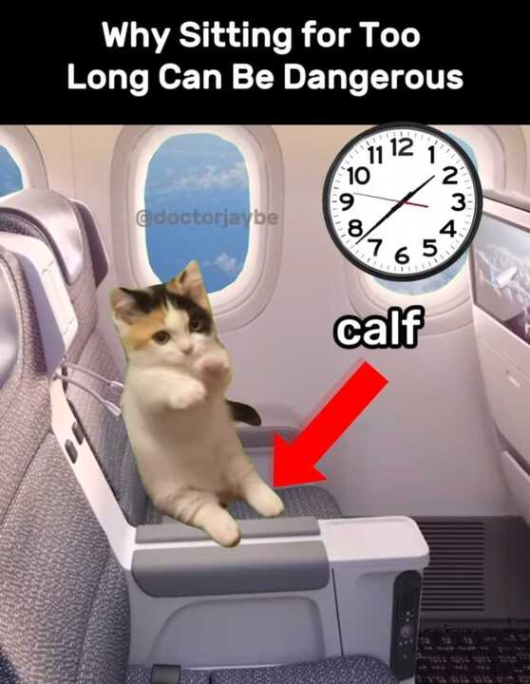
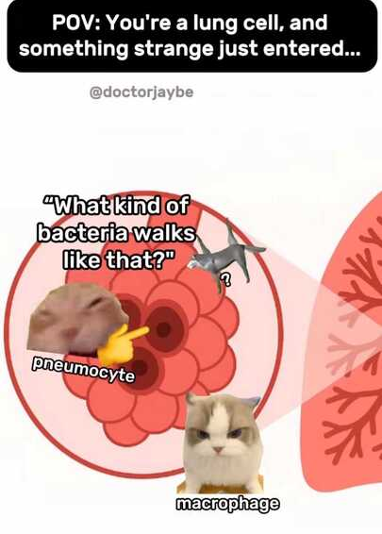
SUPPORTING LIFE
GENERAL ADVICE
by the end of the block, make sure you’ve understood :
  Key BP and cardio medications (calcium channel blockers, ACE inhibitors, thiazides etc)
  How to read basic ECGs, ABGs, and CXRs
  go over heart/mediastinum anatomy (arteries especially) beforehand if your in the cath labs/ cardiac surgery
Have BMJ best practice/passmed textbook/BNF/ the oxford clinical handbook on your phone
Look for friendly MDT members - wards/theatres can be busy so attach yourself to someone who is willing to teach
Do as many cardio/resp exams as possible - especially as patients may have clinical signs!
CONTENT:
CARDIOLOGY
RESPIRATORY
RENAL
NEUROLOGY
Notes:
don’t worry about not getting as many sign-offs done this block - focus on making sure you’re understanding what’s going on

Slide 31
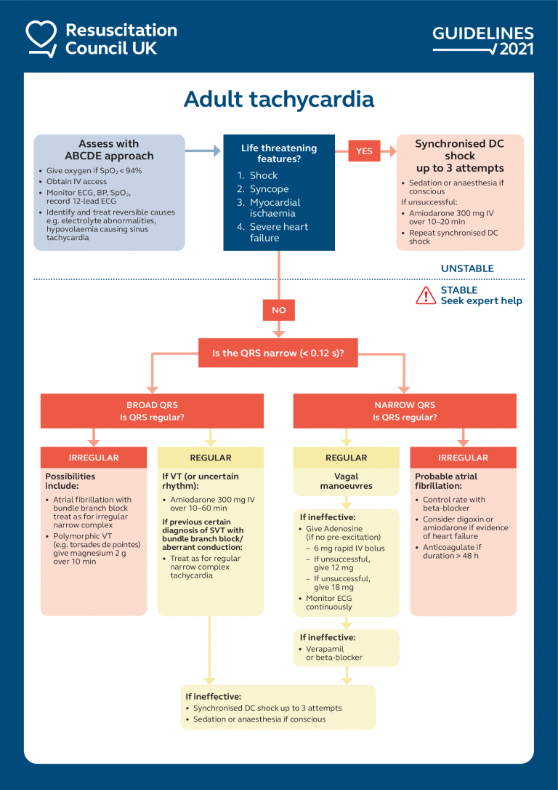
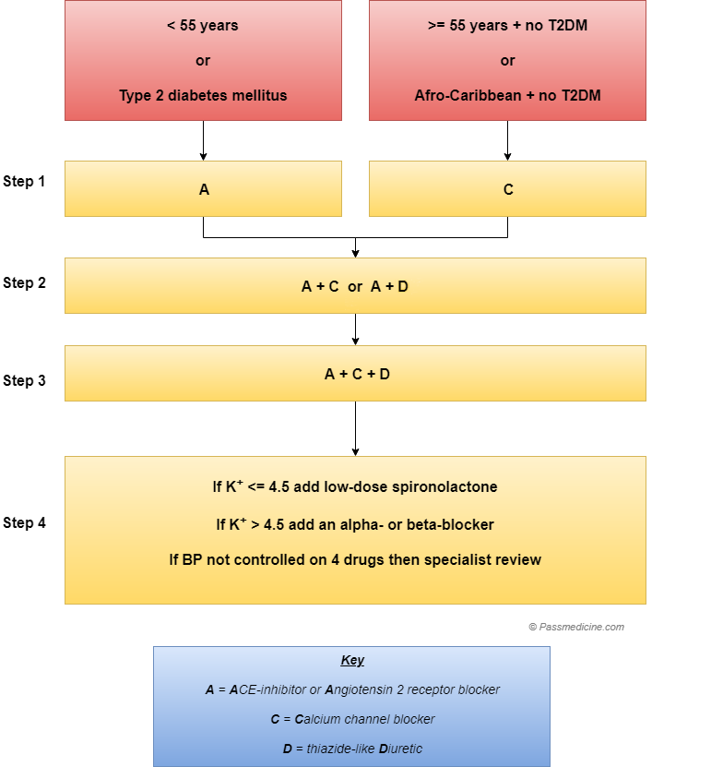
Notes:
Yathavi

Slide 32

GENERAL PRACTICE
GENERAL STRUCTURE
Tuesday/ Friday
8-10 people in each practise- usually everyone has a clinical partner
Day is divided into a group tutorial in the morning/afternoon - topic for that week will be on Keats
Other half of the day: student clinic, patient home visits, self directed learning, working on your group project
Group Projects - likely clinical humanities, you’ll work on it throughout the year
Sign-Offs (Kaizen):
Illness scripts (5x)
Mini Cex - history, skill
Case Based discussion
Multi source feedback reflection
Reflection on group project
Clinical skills (3 teaching sessions to ensure you get these done)
Notes:
Shahnaz

Slide 33
Making the most of GP
Your GP tutor will be your educational supervisor- meet regularly for sign offs remind them if needed. Remind them of key deadlines
Attend your teaching - it’s definitely useful. opportunities for personalised small group teaching - can ask for teaching on any topic
Listen actively when they’re explaining things rather than jotting it down instantly
If you have student clinic, take notes- esp useful for writing up illness scripts, case based discussions, eg
Write illness scripts as you go along - it’s useful revision
Get all sign offs done asap - GP is the best place for them
Keep on top of the group project
Simulated patients on campus week and RCGP sessions are amazing great practise for OSCES
Don’t be afraid to contact block leads early on off there are issues with GP tutors not signing things off or lack of face to face teaching - they need to know so they can fix it if you’re not learning
Notes:
!Shahnaz

Slide 34
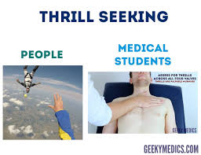
OSCEs
Objective Structured Clinical Examinations
OSCE FORMAT
ADVICE FOR NEARER OSCEs
Geeky medics is your best friend!
Practice with friends - do mock OSCE scenarios
  Run through each examination and ask for peer feedback
Read the OSCE guide on keats + clinical skills checklists!
Your clinical tutor (if you have one) is an invaluable resource - try to ask for bedside teaching!
6x 8 minute stations (inc: clinical skills, history taking, comms, examinations/assessment)
ADVICE FOR NOW
Practice shortened examinations on patients
- listen for signs (e.g. murmurs)
Take histories of patients + present back
- ask for feedback from docs and work on it
During placement teaching/ small group teaching (think clinical communication workshops) try to volunteer where you can!
NOTE
MSA will do OSCE rev later - for now, no stress!
Notes:
Yathavi
Use the 2 minutes before the station to plan what things to ask/say/come up with differentials.

Slide 35
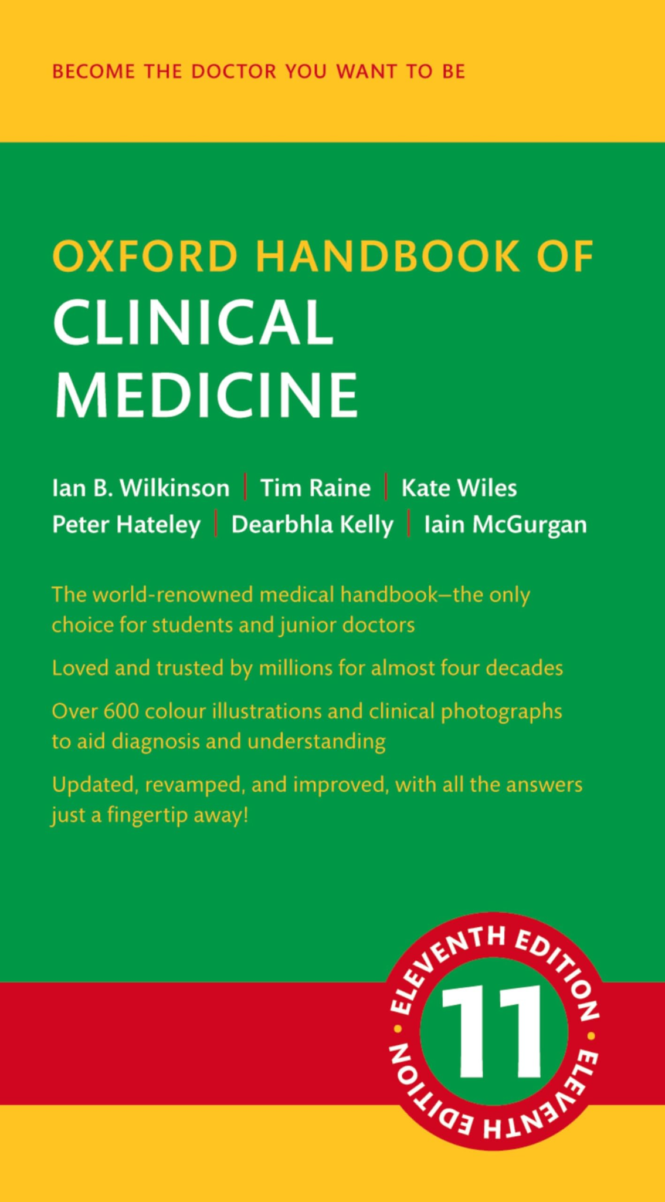








Progress Test 3 Tips
150 SBAs on content from all years similar to the AKT
PT1 - super chill (don’t stress it!)
Lots of different approaches
  could learn everything (year 1-5) in mild detail
    can pass on pattern recognition (may not retain) PassMed
  or learn year 2 content in depth (helps a lot with OSCEs too) Bleep64.com
  Question Bank: PassMedicine (Paid One), QuesMed
Resources: NICE CKS, BMJ Best Practice
  questions are very guideline based
Look out for society revision sessions:
  MSA GKTeach UKMLA
Notes:
Everyone share their own tips on how they study for the PTs!!
Find the balance between knowing the content and actually studying for your exams - focus shifts depending on the season!!

Slide 36
You don’t need to know everything, don’t compare yourself
1
Focus on becoming a good doctor, not a good medical student!
2
WELLBEING
Reach out to friends in older years for support and advice
3
Work together and help each other out
4
Find a routine and enjoy life outside the course!
5
Notes:
Ally
You don’t need to know everything- use placement to reinforce what is common and high yield

Slide 37



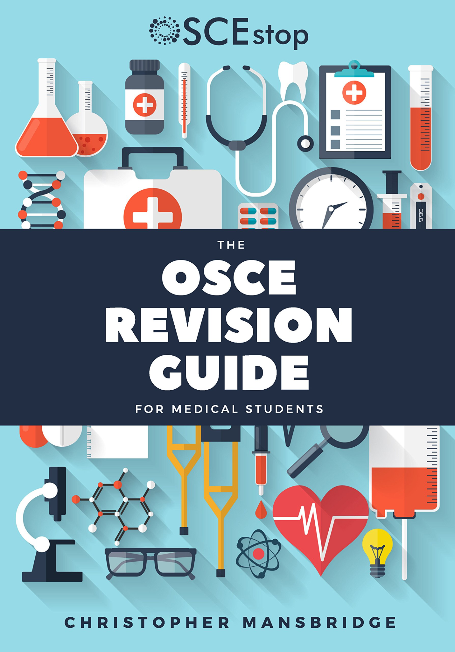


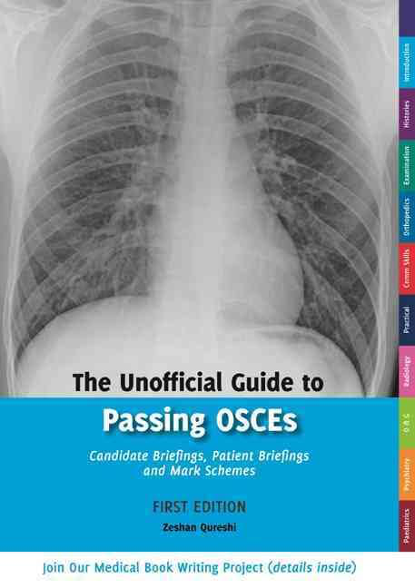


Useful Resources:
Practice SBAs
PassMedicine
Quesmed
Active Recall
Anki
Organisation
Notion
OSCES
Geekymedics
KEATS page
OSCEstop book
The Unofficial Guide to passing OSCEs
Others
KEATS page
Bleep64.com
Notes:
everyone

Slide 38
01
Stage 1 GKTeach
Useful Opportunities
02
GKTeach UKMLA
03
PALS
04
Parents Scheme
Notes:
Jean

Slide 39
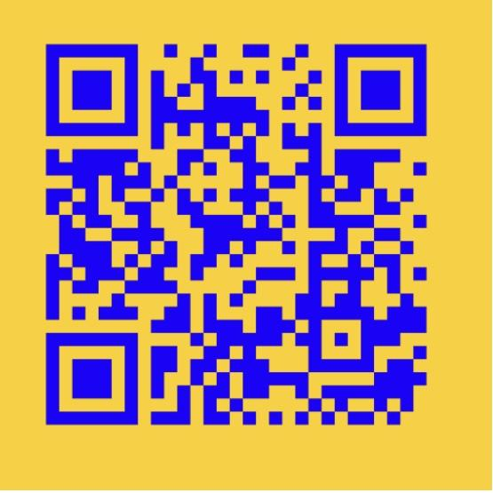
PALS sign up forms:
Students:
Notes:
Ally

Slide 40
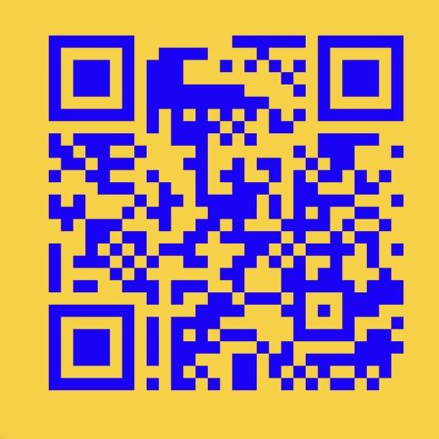
Feedback Form
Notes:
Ally

Slide 41
Thank you for listening!
Any questions?
Notes:
Ally

Slide 42
What We Will Be Covering
General Overview & Tips Jean
General Practice (GP) Akshaya
Assessments Shruti
OSCEs Shruti
E-Portfolio Taiyyib
Progress Test 3 Tips Taiyyib Akshaya Jean Shruti
Hospital Placement Shruti
Wellbeing Akshaya
SSC Jean Shruti Taiyyib
Resources and Opportunities Taiyyib
BLOCK OVERVIEW
Notes:
Ally

