Slide 1







GKTeach
PCRS – Respiratory Physiology
STAGE 1
Tammy Lam
YEAR 2 MBBS
11/12/2025

Slide 2
  Describe Darcy’s Law and Poiseuille’s Law
  Define alveolar pressure, intra-pleural pressure and transpulmonary pressure and explain their role in normal breathing
  Explain the effect of ‘dead space’ on alveolar ventilation
  Describe simple tests of lung function: spirometry, FEV1/FVC and peak expiratory flow rate
  Understand how FEV1, FVC, FEV1/FVC ratio and peak expiratory flow rate are affected by chest wall and pulmonary restriction and airflow obstruction
  Understand partial pressures, fractional concentration and water vapour pressure
  Understand the cause of peripheral and central cyanosis
  Describe the carriage of carbon dioxide and role of bicarbonate and carbamino compounds
  Define hypercapnia and hypocapnia, and describe key causes and effects
LEARNING OBJECTIVES

Slide 3


LAWS OF FLOW

Slide 4

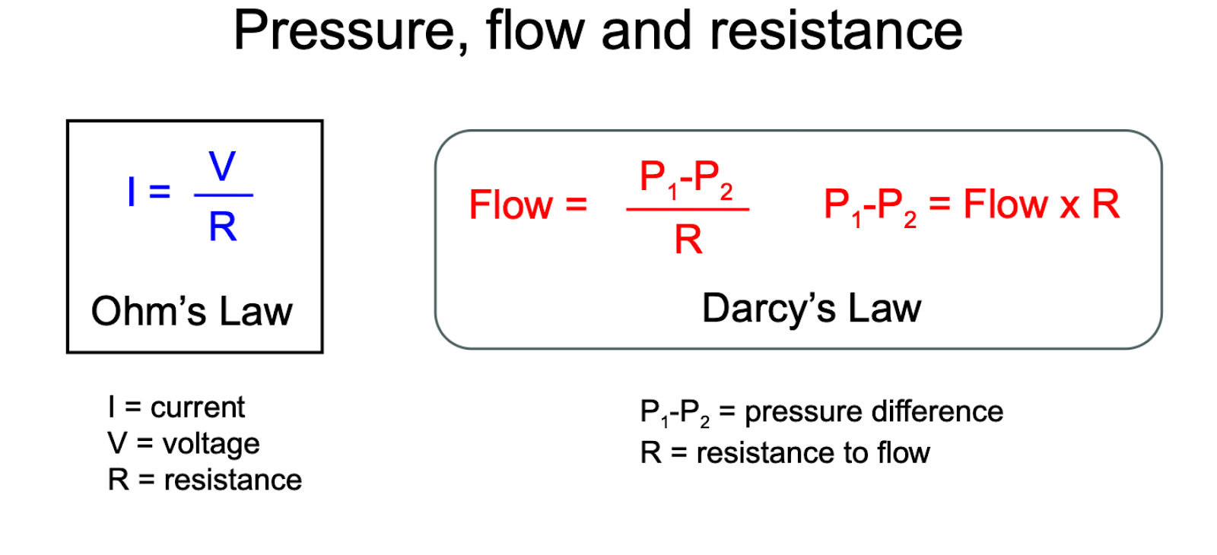
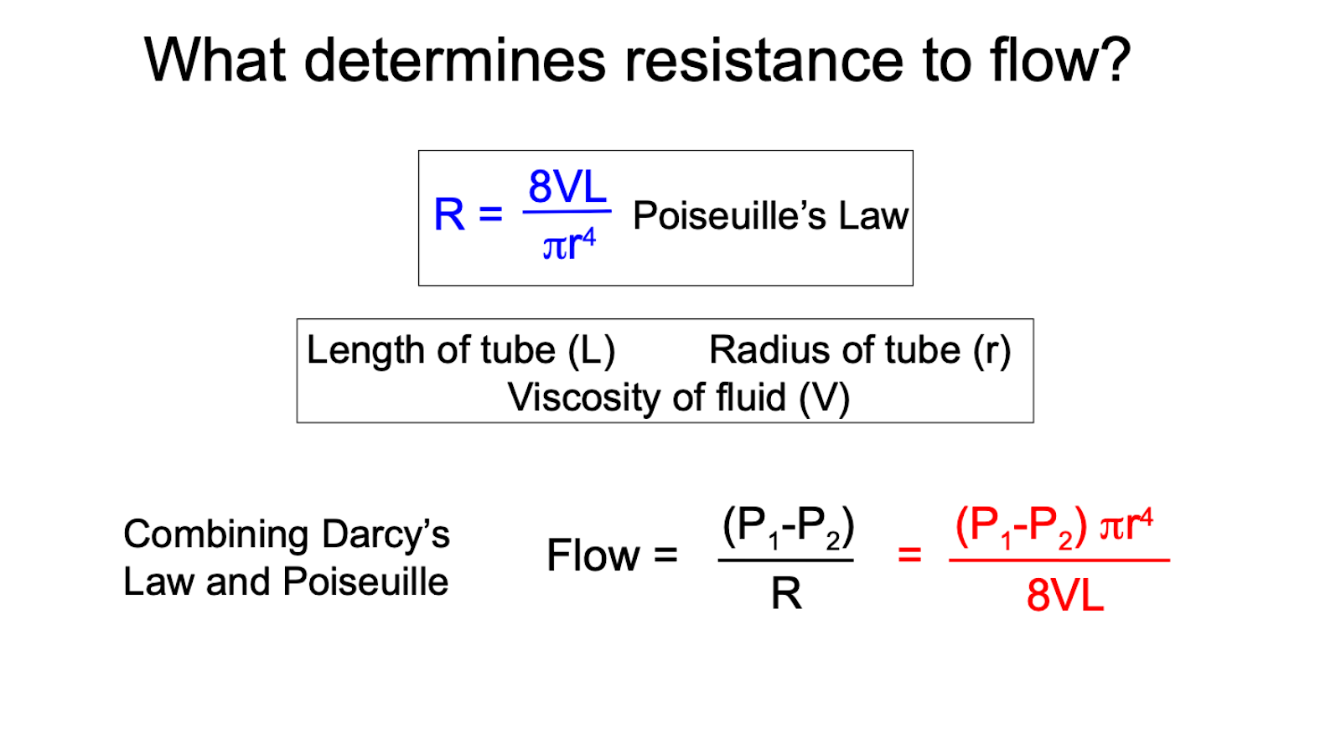
Darcy’s Law and Poiseuillie’s Law
  Flow and pressure difference are proportional to each other
  Therefore, flow is directly proportional to r4, and resistance is inversely proportional to r4.
  This means that a small change in radius causes a large change in resistance.

Slide 5
Types of Pressure
  Alveolar pressure – pressure within the alveoli
  Intrapleural pressure – pressure within the pleural cavity
  Transpulmonary pressure – P(alveolar) - P(intrapleural pressure)

Slide 6
Alveolar pressure
  Alveolar pressure – pressure within the alveoli
  During inspiration: alveolar pressure drops below atmospheric pressure so air can flow into lungs
  During expiration: alveolar pressure rises above atmospheric pressure, pushing air out of lungs
  Cycles between slightly negative (inspiration) and slightly positive (expiration) during normal breathing

Slide 7
Intrapleural pressure
  Intrapleural pressure – pressure within the pleural cavity
  Typically negative due to elastic recoil of lungs pulling inward and chest wall pulling outward, which creates a suction effect so lungs don’t collapse
  During inspiration: intra-pleural pressure becomes more negative as thoracic cage expands
  During expiration: intra-pleural pressure becomes less negative as thoracic cage returns to its resting state

Slide 8
Transpulmonary pressure
  Transpulmonary pressure – P(alveolar) - P(intrapleural)
  Acts as a distending force that keeps the lungs open
  A positive transpulmonary pressure is necessary for the lungs to remain inflated.
  During inspiration: higher transpulmonary pressure allows lung expansion
  During expiration: lower transpulmonary pressure facilitates recoil but prevents collapse

Slide 9
Dead Space (Vd)
  Dead space - airway volume with no gas exchange
  Anatomic – all except alveoli and respiratory bronchioles (typical volume = 150mL)
  Physiologic – anatomic and areas where gas exchange is dysfunctional (roughly the same in a healthy person)
  Alveolar ventilation = minute ventilation – dead space ventilation
Notes:
add pictures

Slide 10
LUNG FUNCTION TESTS

Slide 11
Types of Lung Disease
  Obstructive lung disease – narrowing of airways that reduce airflow (e.g. asthma, COPD)
  Restrictive lung disease – poor chest wall and/or lung expansion (e.g. lung fibrosis, phrenic nerve damage)
Notes:
if dead space is increased, alveolar ventilation is decreased

Slide 12
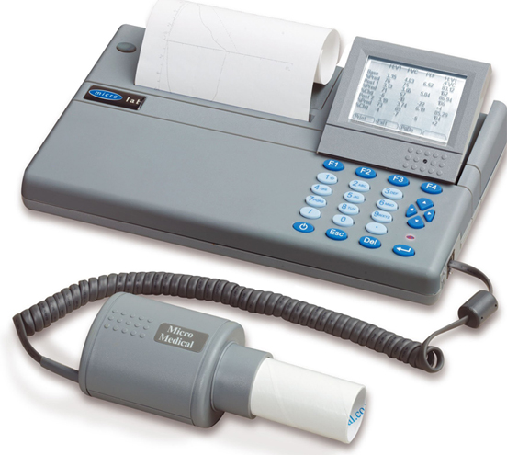
Spirometry
  Spirometry – measures volume of air inhaled and exhaled
  FEV1 (forced expiratory volume in 1 second) – volume of air expelled in the 1st second of forced exhalation
  FVC (forced vital capacity) – maximum amount of air that can be forcible exhaled after a full inhalation
Notes:
if dead space is increased, alveolar ventilation is decreased

Slide 13
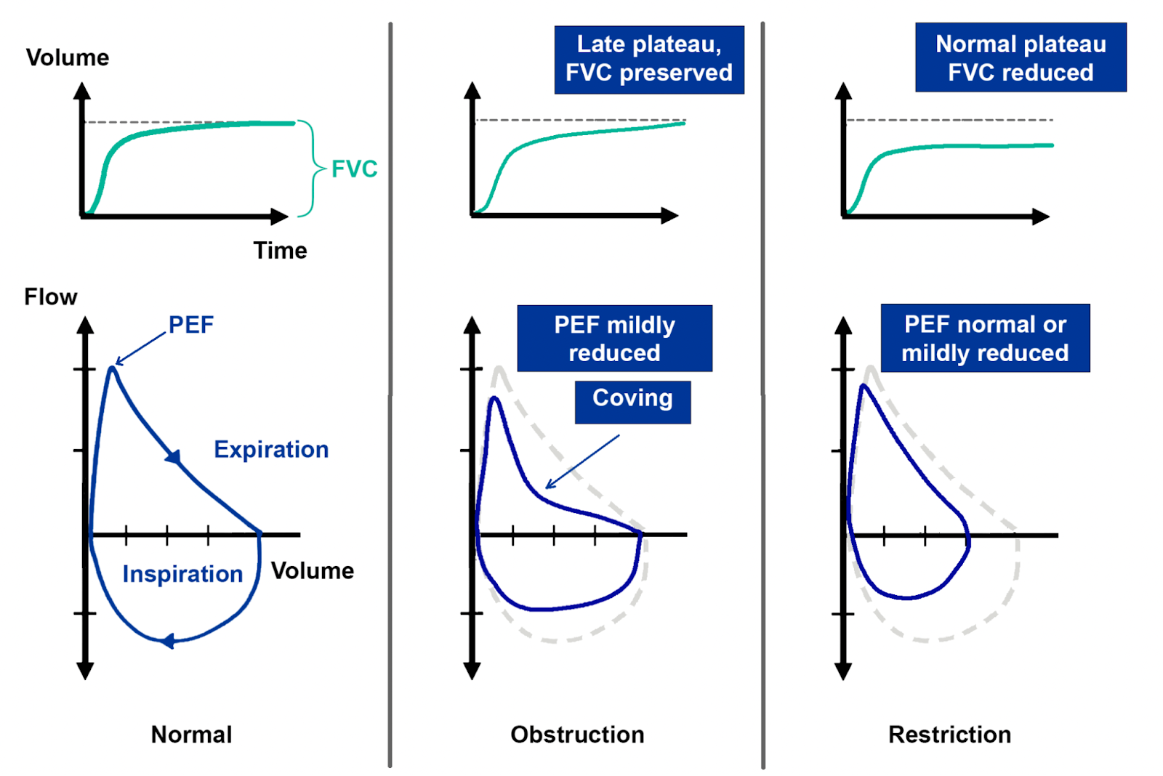
Spirometry – what does this tell you?
  Calculate FEV1/FVC ratio
  Normal FEV1/FVC > 70%
  In obstructive lung disease, FEV1 decreases, FVC stays normal, so FEV1/FVC decreases
  In restrictive lung disease, FEV1 and FVC decreases, so FEV1/FVC either stays normal, or increases.
Notes:
add graph

Slide 14
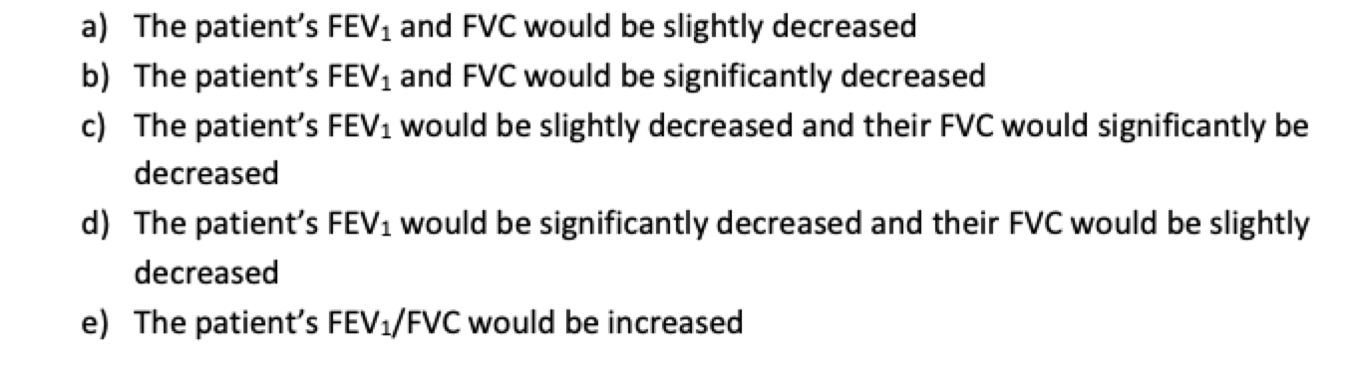
SBA
A patient diagnosed with COPD has ther lung function test tested with a forced expiratory spirogram. How would the patient’s FEV1 and FVC compare to that of a healthy person?
Notes:
D

Slide 15
A patient diagnosed with COPD has ther lung function test tested with a forced expiratory spirogram. How would the patient’s FEV1 and FVC compare to that of a healthy person?
D: The patient’s FEV₁ would be significantly decreased and their FVC would be slightly decreased.
Why: COPD is an obstructive lung diseaseso FEV₁ falls markedly. FVC may be normal or only mildly reduced - it can fall a bit because of air-trapping and inability to fully empty the lungs, but the drop in FEV₁ is proportionally much larger. That gives a reduced FEV₁/FVC ratio (the key diagnostic feature of obstruction).
Notes:
D

Slide 16
GASEOUS DIFFUSION AND TRANSPORT

Slide 17
Some nomenclature before we start…
Fractional concentration = FO₂ (or %)
Partial pressure = PO₂
Barometric pressure = P_{B}
Inspired = P_{I}O₂, F_{I}O₂
Alveolar = P_{A}O₂, F_{A}O₂
Arterial = P_{a}O₂, F_{a}O₂
Common pressure units = mmHg (0.133 kPa)
Notes:
if dead space is increased, alveolar ventilation is decreased

Slide 18
Partial Pressure
  Partial pressure (P) – pressure exerted by an individual gas in a mixture of gases
  Fractional concentration (F) – pressure exerted by an individual gas in a mixture of gases
  Pgas = Fgas x Pbarometric
  Water vapour pressure (PH2O) – pressure exerted by water vapour
  Water vapour pressure rises with temperature
  Since alveolar air temperature is constant, water vapour pressure is constant
  PiO2 = FiO2 x (Pbarometric – PH2O)
Notes:
if dead space is increased, alveolar ventilation is decreased

Slide 19
Composition of Gases
  Alveolar gas – decreased O2 due to uptake by blood, inceased CO2 due to release from blood, increased water vapour due to humidification of airways
  PAO2 = PIO2 – (PaCO2/R)
  So if P_{a}CO₂ decreases, P_{A}O₂ increases.
Cannot directly measure PAO2 because even though CO2 diffuses into the alveolus to replace O2 diffusing into the pulmonary capillary, one molecule of CO2 does not replace one molecule of O2.
^^This is why you need to divide PaCO2 by R (R=0.8)
Notes:
if dead space is increased, alveolar ventilation is decreased

Slide 20
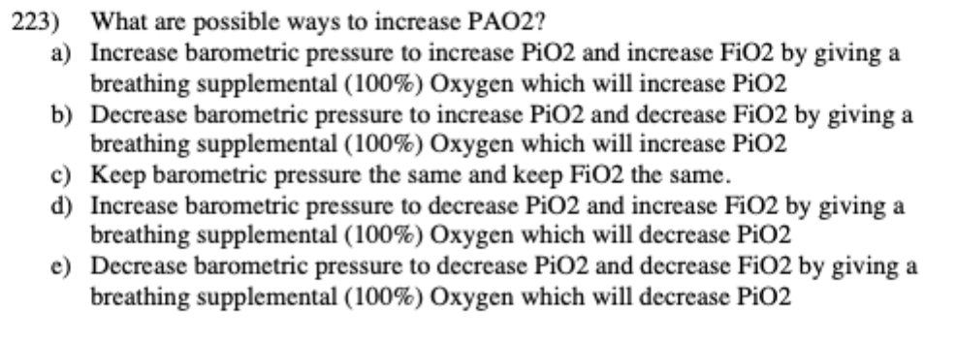
SBA
What are possible ways to increases alveolar O2?

Slide 21
What are possible ways to increases alveolar O2?
A: Increase barometric pressure to increase PiO₂ AND increase FiO₂ by giving 100% O₂ -> both changes raise alveolar O₂.
Why: PiO2 = FiO2 x (Pbarometric – PH2O)
b) Decreasing PB reduces PiO₂ – wrong.
c) Keeping PB and FiO₂ the same means no change.
d) Increasing PB but decreasing PiO₂ makes no physiological sense; giving 100% O₂ increases PiO₂, not decreases it.
e) Decreasing PB and decreasing PiO₂ both lower alveolar O₂.
Notes:
D

Slide 22
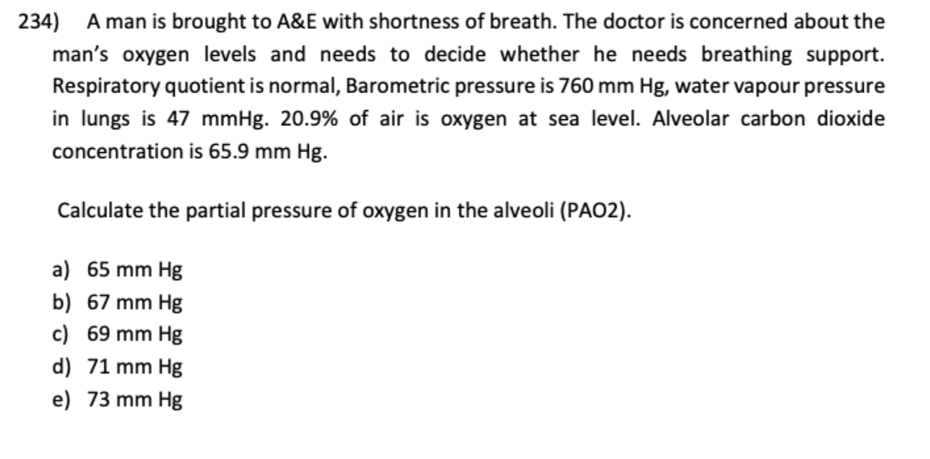
SBA
  PiO2 = FiO2 x (Pbarometric – PH2O)
  PAO2 = PIO2 – (PaCO2/R)
Notes:
B

Slide 23
B: 67mmHg
Calculate inspired O₂ partial pressure (PiO₂):
PiO2 = FiO2 x (Pbarometric – PH2O) = 0.209x(760-47) = 149 mmHg
2. Use alveolar gas equation (R=0.8):
PAO2 = PiO2 - PaCO2/R = 67 mmHg
Notes:
D

Slide 24
Diffusion of Gases
Alveolar PO₂ is higher than PO₂ entering the pulmonary capillary.
This partial pressure gradient drives diffusion of O₂ through the large area of thin alveolar-capillary membrane
At rest, pulmonary capillary PO₂ = alveolar PO₂ about 1/3 of the way along the pulmonary capillary
CO₂ diffuses rapidly across the alveolar-capillary exchange surface.
CO₂ moves down its partial pressure gradient, from the pulmonary capillary blood to the alveolar air, from where CO₂ is expelled to the atmosphere during expiration
CO₂ diffuses around 20x faster than O₂ as it is more soluble despite it having a lower partial pressure gradient
Notes:
if dead space is increased, alveolar ventilation is decreased

Slide 25
Transfer factor/diffusing capacity (DL)
Transfer factor/diffusing capacity (DL) – measures the efficiency of gas transfer across the alveolar-capillary membrane
Assessed for oxygen, often using CO (DLCO) as a proxy because CO binds strongly to Hb and is diffusion limited rather than perfusion limited
Notes:
if dead space is increased, alveolar ventilation is decreased

Slide 26
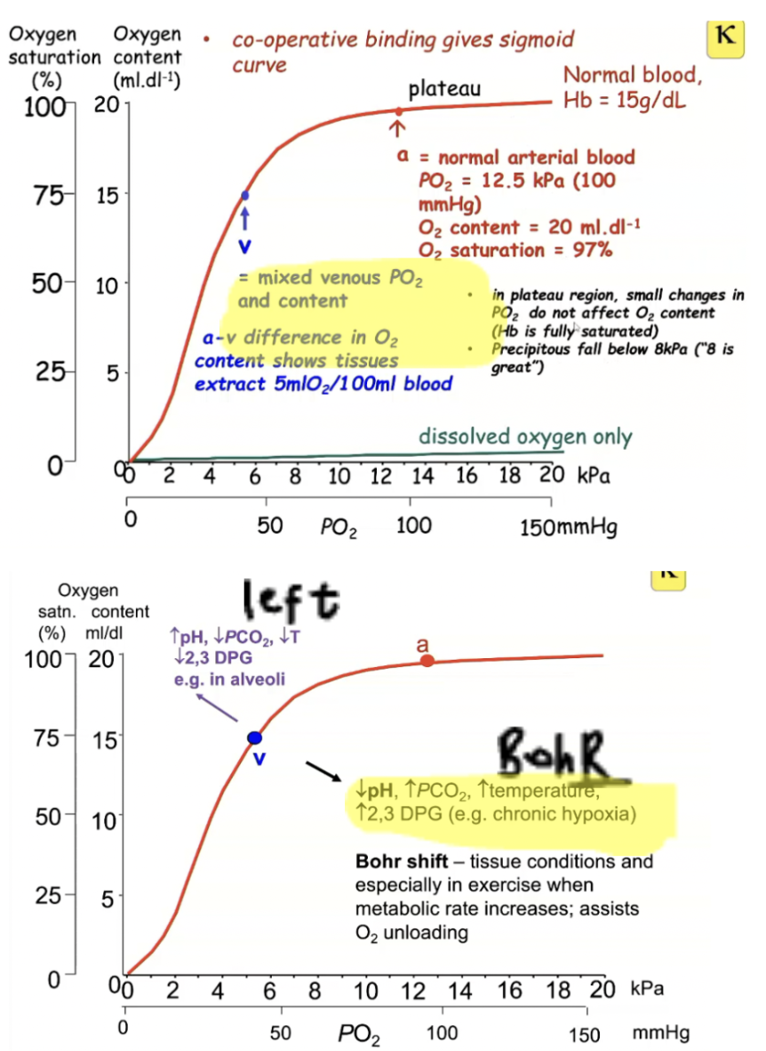
Oxygen Carriage Curves
Haemoglobin greatly increases O2 carrying capacity in the blood.
Cooperative binding mechanism gives rise to the sigmoidal shape of the oxyhaemoglobin curve
**a-v difference is 5mLO2/100mL blood
Notes:
if dead space is increased, alveolar ventilation is decreased

Slide 27
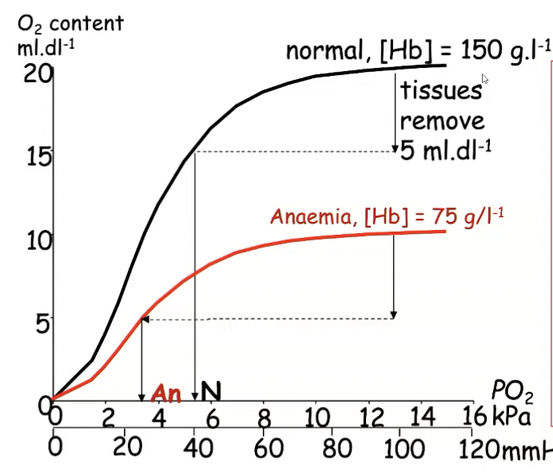
In anaemia…
Tissues still need to metabolise O2, extracting 5mL.dL-1 from blood
Venous PO2 (3.6) will be lower, hence tissue PO2 will also be low at 3.6kPa, causing hypoxia
Limits extraction of O2 during exercise, causing fatigue and poor exercise tolerance
Notes:
if dead space is increased, alveolar ventilation is decreased

Slide 28
Cyanosis
  If supply of O2 to the tissues is deficient, content of deoxyHb in tissue capillaries increases because of hypoxia.
  deoxyHb has a blue tinge, causing discolouration of tissues and thus cyanosis.
  There are 2 types – peripheral and central cyanosis.
Notes:
if dead space is increased, alveolar ventilation is decreased

Slide 29
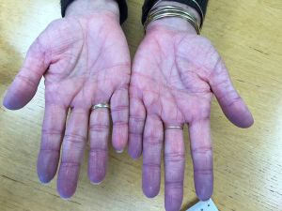
Peripheral Cyanosis
  Peripheral cyanosis – reduced blood flow to a region resulting in hypoxic tissues, causing blue grey tinge to appear in extremities (e.g. hand, feet), O2 content is normal
  Causes:
  Cardiovascular shock
  Low temperature
  Reduced CO
  Poor arterial supply
Notes:
if dead space is increased, alveolar ventilation is decreased

Slide 30
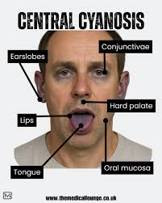
Central Cyanosis
  Central cyanosis – arterial hypoxaemia (reduction in O2 content), buccal mucosa and lips are best sites to spot this
  Causes:
  Low pO2 in arterial blood
  Reduced ability of blood to carry O2
  Reduction in tissue blood flow
  Tissue unable to utilise O2
Notes:
add picture

Slide 31
SBA
Which of the following incorrectly describes cyanosis?
Central cyanosis is due to arterial hypoxaemia
B. Peripheral cyanosis is due to a blue-ish grey tinge in extremities
COPD is a potential cause of cyanosis
Blueish lips are a sign of central cyanosis
Low temperature and reduced CO may lead to cyanosis

Slide 32
B: Peripheral cyanosis is due to a blue-ish grey tinge in extremities
A. Central cyanosis is due to arterial hypoxaemia -> Correct
Central cyanosis = low PaO₂ → increased deoxygenated Hb in arterial blood.
B. Peripheral cyanosis is due to a blue-ish grey tinge in extremities -> the wording says “is due to a blue-ish grey tinge” which describes what it looks like, not what causes it.
Peripheral cyanosis is caused by increased O₂ extraction due to slow/poor peripheral circulation, not by the colour itself.
The blue-ish tinge is a result, not the cause.
This makes B the incorrect description.
C. COPD is a potential cause of cyanosis -> Correct
Severe COPD can cause central cyanosis via hypoxaemia.
D: Blueish lips are a sign of central cyanosis -> Correct
E. Low temperature and reduced CO may lead to cyanosis -> Correct
Cold → vasoconstriction → slow flow → peripheral cyanosis
Low cardiac output also → sluggish circulation → peripheral cyanosis.
Notes:
D

Slide 33
CO2 Carriage
  CO2 is carried in 3 forms:
  60% as HCO3-
  30% as Hb-CO2
  10% dissolved CO2
Notes:
if dead space is increased, alveolar ventilation is decreased

Slide 34
Method 1: Converted into HCO3-
  Conversion of CO2 to HCO3-:
  CO2 diffuses into RBCs from tissues
  2. Inside RBCs, CO2 reacts with water to form H2CO3, catalysed by the enzyme carbonic anhydrase
  3. Carbonic acid rapidly dissociates into HCO3- and H+
  4. HCO3- is transported out of the RBC into the plasma in exchange for chloride ions (the chloride shift) to maintain electrical neutrality
Notes:
if dead space is increased, alveolar ventilation is decreased

Slide 35
Method 2: Bind to Hb
  CO2 reacts with the terminal amine groups of haemoglobin, forming carbaminohaemoglobin (HbCO2).
  This is reversible and depends on the partial pressure of CO2.
  Haldane effect – this facilitates unloading of O2 as deoxygenated Hb binds to CO2 more readily, which helps transport CO2 from tissues to the lungs
  In the lungs, the high O2 concentration promotes CO2 release from Hb, aiding exhalation
Notes:
if dead space is increased, alveolar ventilation is decreased

Slide 36
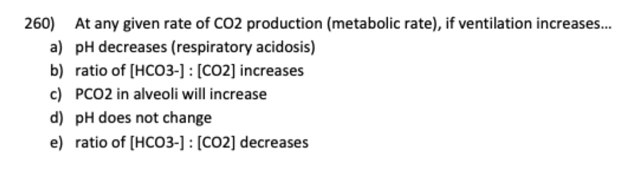
SBA
Notes:
B

Slide 37
At any given rate of CO2 production (metabolic rate), if ventilation increases…
B: HCO3-:CO2 increases
Why: If ventilation increases -> alveolar ventilation ↑ -> PaCO₂ ↓ -> ↑ pH (respiratory alkalosis)
Notes:
D

Slide 38
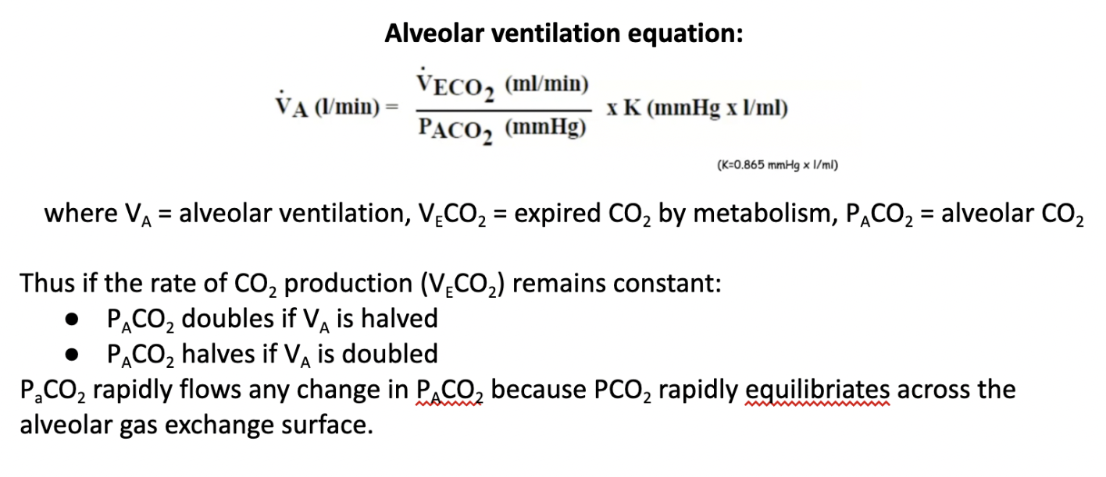
**VERY IMPORTANT EQUATION**
Notes:
if dead space is increased, alveolar ventilation is decreased

Slide 39
Hypocapnia
Hypocapnia – caused by hyperventilation, results in low PaCO2 (<5.3 kPa), low PCO2 reduces H+ causing respiratory alkalosis
Causes:
Anxiety, pain, excessive mechanical ventilation
Diseases contributing to metabolic acidosis such as renal failure or diabetes
Consequences:
Low PaCO2 causes cerebral vasoconstriction and thus cerebral hypoxia, resulting in dizziness and visual disturbances
Alkalosis decreases plasma free Ca2+, increasing the excitability of cells (VGCC opens at lower threshold potentials), resulting in disturbed sensations (such as pins and needles) and unwanted tetanic muscle contractions (spasms in fingers)
Notes:
if dead space is increased, alveolar ventilation is decreased

Slide 40
Hypercapnia
Hypercapnia – caused by hypoventilation, results in high PaCO2 (>6 kPa) and low PaO2, high PCO2 increases H+ and causes respiratory acidosis
Causes:
Head injury impairing respiration
Anaesthetics
Drugs
Chronic Lung Disease
Consequences:
Increased PaCO2 -> peripheral vasodilation, flushed skin, full pulse, extra systoles
Very high PCO2 (>10kPa) depresses CNS function, causing confusion, drowsiness, coma and death
Notes:
if dead space is increased, alveolar ventilation is decreased

Slide 41
QUICKFIRE SBAs

Slide 42
SBA
  What happens during hypoventilation?
  Hypocapnia
  Low PCO2
  Reduction in H+
  Low arterial PO2
  Respiratory alkalosis
Notes:
B

Slide 43
  What happens during hypoventilation?
D: Low arterial PO2
Why: Hypoventilation lowers alveolar O2 -> hypoxaemia
A – Hypocapnia – false as hypoventilation causes hypercapnia
B: low PCO2 -> false as PCO2 increases
C: reduction in H+ -> false as CO2 + H2O -> H+ + HCO3- so an increase in CO2 would cause increase in H+ -> acidosis
E: respiratory alkalosis -> hypoventilation causes respiratory acidosis
Notes:
D

Slide 44
SBA
  Which of the following is a consequence of hyperventilation?
  Peripheral vasodilation
  CNS function depressed
  Unwanted tetanic contractions
  Increased Ca2+ concentration
  Full pulse
Notes:
B

Slide 45
  Which of the following is a consequence of hyperventilation?
C: Unwanted tetanic contractions
Why: Hyperventilation -> Hypocapnia -> unwanted tetanic contractions due to increased excitability of VGCC
Notes:
D

Slide 46
SBA
  What is the effect of hyperventilation on the shape of the HbO2 dissociation curve?
  Curve shifts to the left
  Curve shifts to the right
  Curve remains the same
  Curve shifts up
  Curve shifts down
Notes:
B

Slide 47
  What is the effect of hyperventilation on the shape of the HbO2 dissociation curve?
A: Curve shifts to the left
Why: Hyperventilation ->decrease in PaCO2 -> increase in pH -> shift to the left as Hb has higher affinity to oxygen
Notes:
D

Slide 48
SBA
  What are the effects of anaemia on a patient with a normal respiratory system?
  No effect
  A normal alveolar PCO2, a high carrying capacity of blood, a low O2 content of blood
  A low alveolar PO2, a normal O2 carrying capacity of blood, a low O2 content of blood
  Normal alveolar PO2, low O2 carrying capacity of blood, normal O2 content of blood
  normal alveolar PO2, low O2 carrying capacity of blood, low O2 content of blood
Notes:
B

Slide 49
  What are the effects of anaemia on a patient with a normal respiratory system?
E: normal alveolar PO2, low O2 carrying capacity of blood, low O2 content of blood
Why: Normal Alveolar PO₂ → because ventilation and gas exchange in the lungs are unaffected.
Low carrying capacity of blood and low O2 content of blood due to anaemia so Hb has lower affinity for oxygen
Notes:
D

Slide 50
SBA
  What effect does restricting the chest and lung expansion have on FEV1/FVC ratio?
  FEV1/FVC ratio decreases following decrease in FVC
  FEV1/FVC ratio stays the same or increases, following reduced FEV1 and decreased FVC
  FEV1/FVC ratio stays the same or increases, following no change to FEV1 and FVC
  FEV1/FVC ratio decreases following increase in FVC
  FEV1/FVC ratio is not relevant to restriction
Notes:
B

Slide 51
  What effect does restricting the chest and lung expansion have on FEV1/FVC ratio?
B: FEV1/FVC ratio stays the same or increases, following reduced FEV1 and decreased FVC
Why: In restrictive lung disease (including anything that restricts chest/lung expansion):
Total lung volumes ↓
FVC ↓
FEV₁ ↓, but less than FVC, so:
FEV₁/FVC ratio = normal or increased
Restriction makes the lungs stiffer, so they recoil more strongly, helping air flow out faster during forced expiration.
Thus:
Both FEV₁ and FVC fall
FVC falls more proportionally, leading to a normal or high FEV₁/FVC
Notes:
D

Slide 52

FEEDBACK
Thank you!!
Any questions?
wing.4.lam@kcl.ac.uk

