Slide 1
SFP Made Simple
8. Academic Station Part 1&2
Dr Daria Andreeva (FY1 Imperial)

Slide 2
Fundraising

Slide 3
The Academic Station
*Not in all deaneries. Please check in advance!
Structure:
Varies depending on the deanery
Research paper abstract to appraise (could be any type of research article)
Present your own paper
Questions on: results + statistics, ethics, research trial set-up, etc.
London:
15 minutes prep for both academic and clinical stations
10 minutes for each academic and clinical station

Slide 4
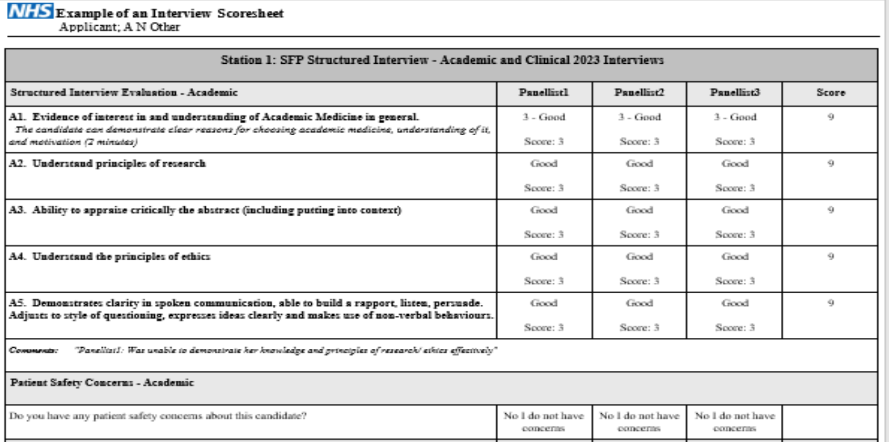
The Academic Station - How to Practice
*Not in all deaneries. Please check in advance!
Structure:
Varies depending on the deanery
Research paper abstract to appraise (could be any type of research article)
Present your own paper
Questions on: results + statistics, ethics, research trial set-up, etc.
London:
15 minutes prep for both academic and clinical stations
10 minutes for each academic and clinical station

Slide 5
The Academic Station - How to Practice
Read through the following:
How to read a paper
The doctor’s guide to critical appraisal
Scribbr: good for stats
The bottom line: critical appraisal summaries of research articles
Sign up to medical journals mailing list: The Lancet, the New England Journal of Medicine, the BMJ
Read editorials and review articles to learn how to critically appraise + stay informed about hot topics
PRACTICE, PRACTICE, PRACTICE with friends!
Start by analyzing and evaluating the abstract together
Move on to untimed practice 1 by 1
Timed practice with “exam-like” questions
MOCK INTERVIEWS: as many as you can!

Slide 6
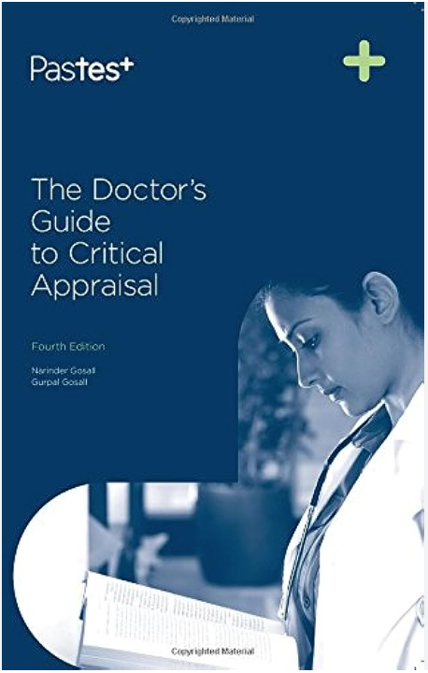
Resources

Slide 8
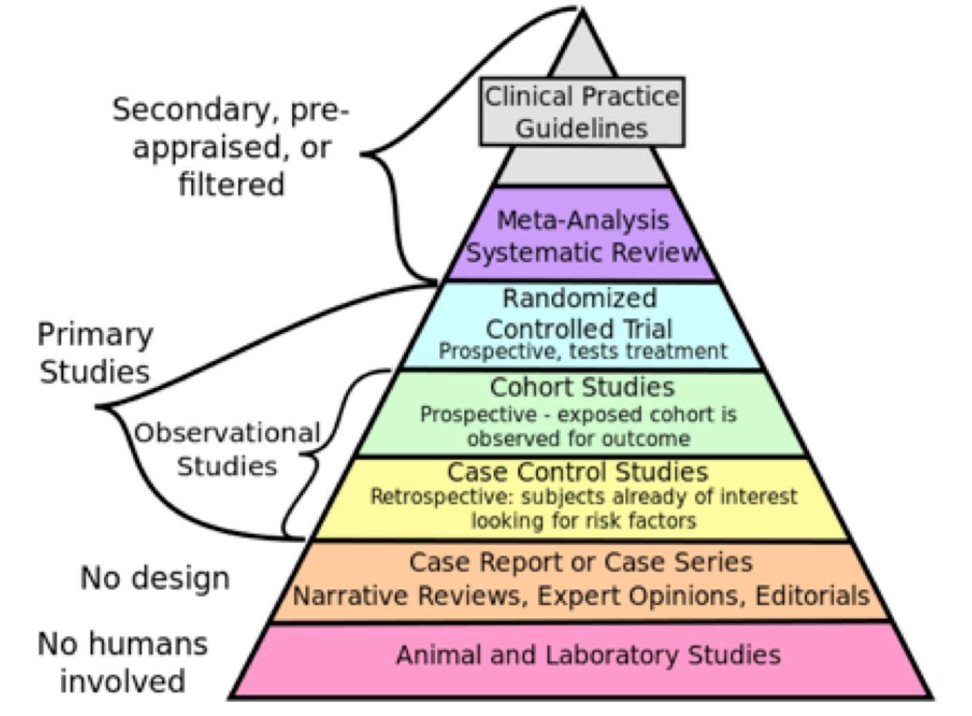
Hierarchy of evidence

Slide 9
Meta-analyses & systematic reviews
Advantages:
Comprehensive: takes into account many studies
Gold-standard in the hierarchy of evidence
Explicit and rigorous methodology: reduces bias
FREE (almost)
Disadvantages:
Does not provide new information
Relies on “keyword” searches
*Takes a lot of time and effort

Slide 10
Randomised controlled trials
Tests the effectiveness of a treatment/device/procedure vs no treatment/different treatment.
Randomised: assignment of participants to a group is random;
Single-blinded: either participants or researchers are unaware of group assignment
Double-blinded: both participants and researchers are unaware of group assignment
Advantages:
Highly controlled environments with limited variables affecting outcomes
Good for statistical analyses
Disadvantages:
Expensive
Volunteer bias
Does not reveal causation
Loss to follow-up

Slide 11
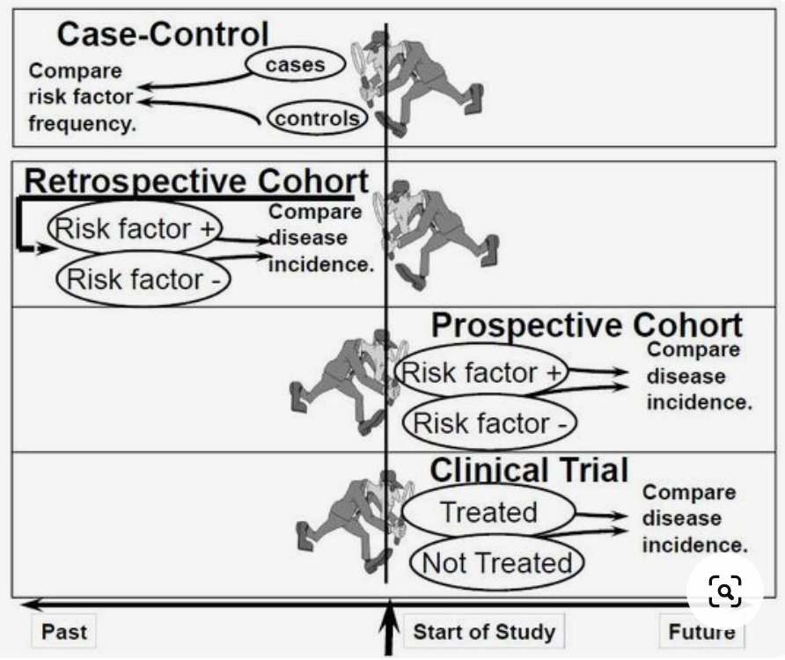

Slide 12
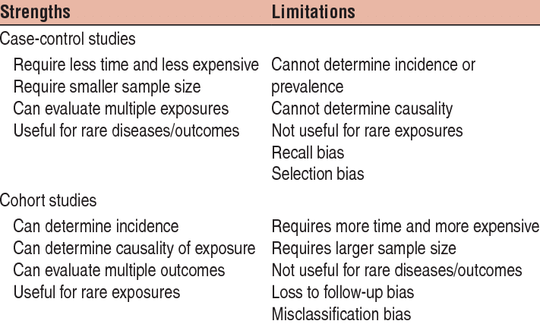
Cohort studies vs Case Control studies

Slide 13
Bias
Selection bias: systematic difference in the sample population and the target population.
Allocation bias: systematic differences in the groups after randomisation. Overcome by: randomisation through computer-generated sequence, allocation should be concealed by third-party allocation
Performance bias: treating groups differently. Overcome by blinding clinician, blinding patient and making trial environment same for both groups. Open-label = no blinding
Information (detection) bias: detection of outcome is biased. Altering outcome data due to preconceived ideas and beliefs. Overcome by using objective outcome measures, multi-blinding.
Recall bias: participants don’t remember events or experiences accurately/omit details.
Exclusion/attrition bias: systematic difference between withdrawals and patients continuing in the trial. Per protocol analysis overestimates effect of the intervention. Overcome by intention to treat analysis.
Selective reporting/outcome bias: only significant/meaningful results are reported. Studies usually have a primary and secondary outcome. The protocols can be registered in a database. Overcome by stating primary outcome in protocol, registering trials in ISRCTN.

Slide 14
Confounding factors
Confounder
Association
Risk factor
Exposure
Outcome
Conclusion you make/don’t make
Confounder: associated independently with both the exposure and the outcome, making it appear that there is an association between the exposure and the outcome when there is none, or masking a true association.

Slide 15
Example
Stress
Association
Risk factor
City address
Heart disease

Slide 16
Confounding factors
How to deal with them?
Study design
Analysis
Restriction: eliminate through exclusion criteria
Matching: confounders are allocated equally in different study arms
Randomisation: evenly distribute confounders
Standardisation: adjust risk of exposed group to that of unexposed group with same confounder
Statistical adjustment: use multivariate analysis to check for effect of confounder

Slide 17
Structure
Overview, aims, PICO summary
Pros
Cons
Population
Intervention
Control
Outcomes
Internal validity
External validity
Ethics & others

Slide 18
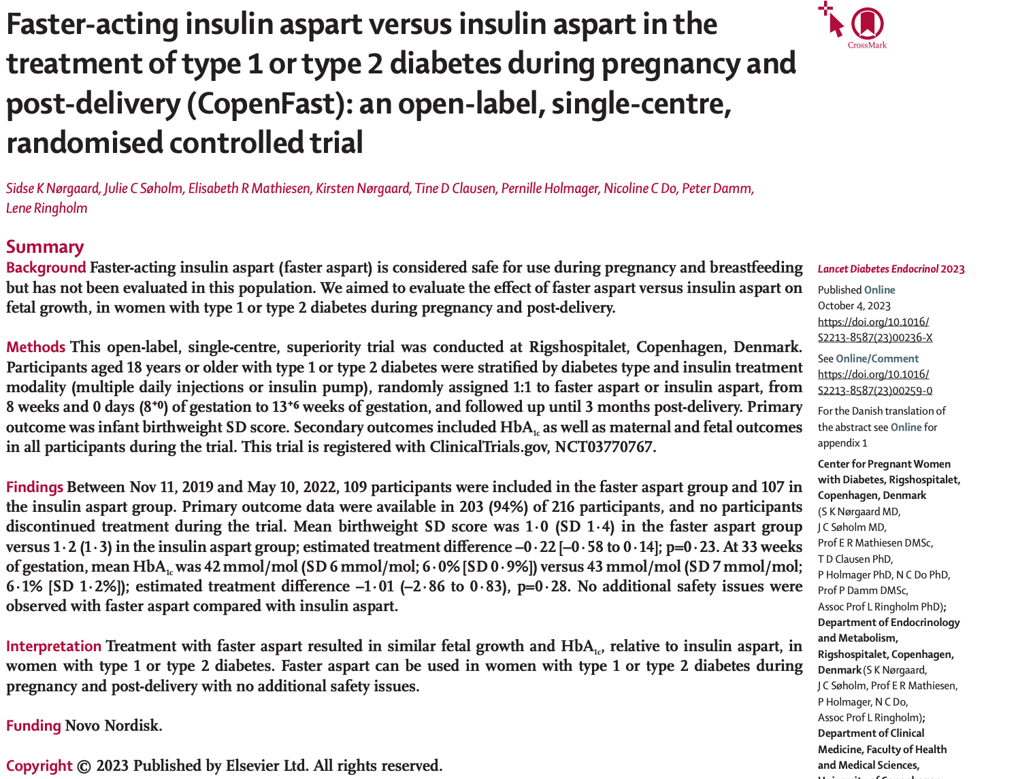

Slide 19
Overview of the study + aims
Journal
Year of publication
Study design
Type of study
Blinding
Number of centers/countries
Clear a priori aims?
If not specifically stated → ?data dredging

Slide 20
Published in the Lancet, in 2023
Open-label, single-centre, randomised controlled trial to determine superiority
Investigating the effect of faster aspart vs insulin aspart in the treatment of T1 or T2DM during pregnancy & post-delivery
1ry outcomes:
Infant birthweight SD score
2ry outcomes:
HbA1c
Maternal and fetal outcomes

Slide 21
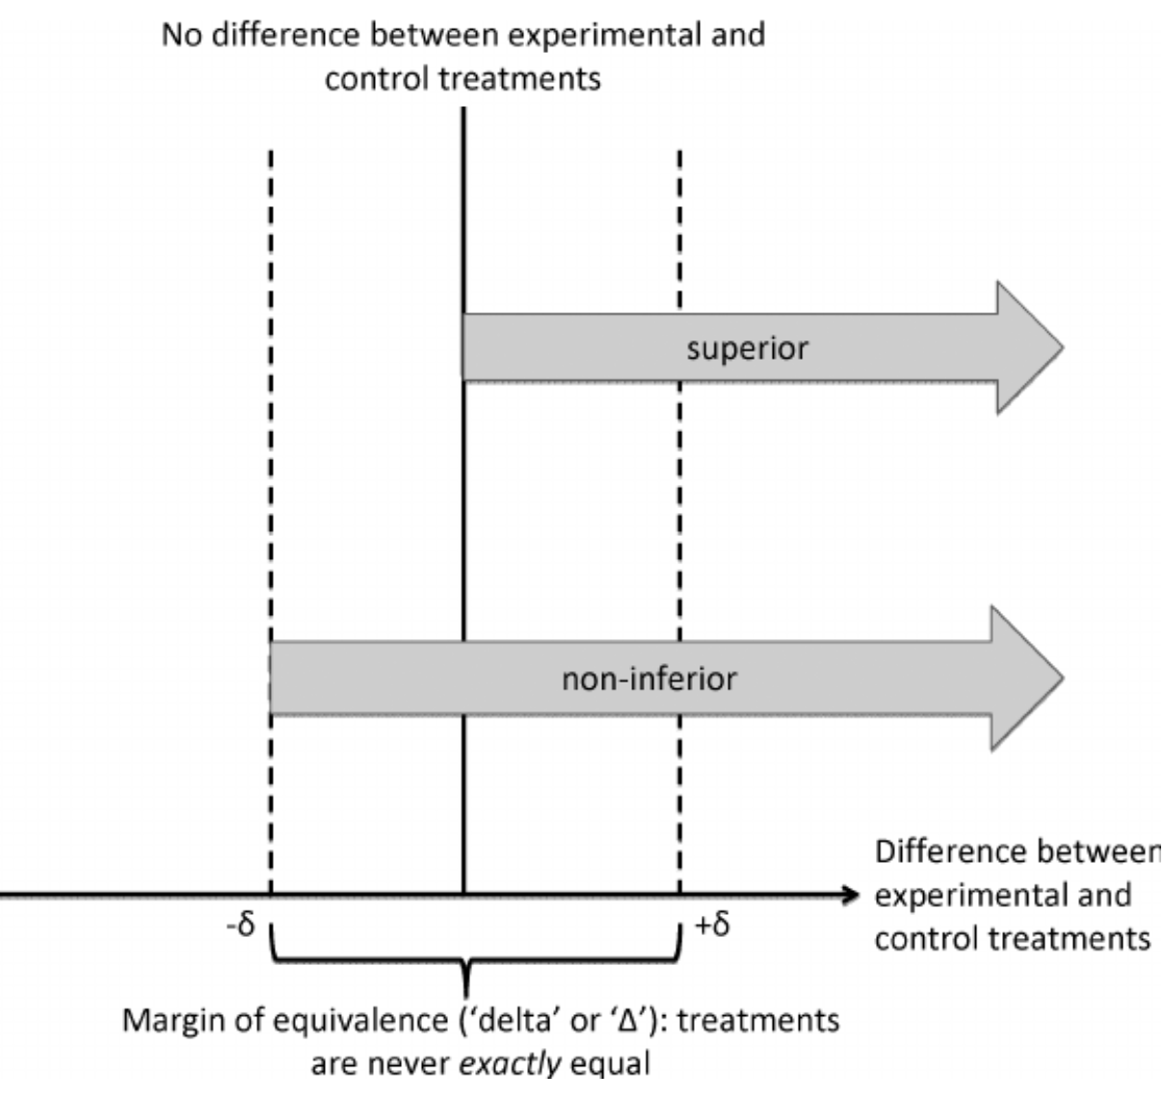

Slide 22
Population (Mnemonic: CSFABB)
Criteria:
Selection bias?
Is this a meaningful representation of the population?
Sample size:
Too small → does the study have enough power? Type 2 error (false negative)?
Follow-up:
Too short/too long → issues with outcome detection
Allocation:
Simple vs stratified vs block randomisation
Allocation bias?
Blinding:
Affects performance and detection bias
Baseline-characteristics
Are there any differences?
Stratification → spreads confounders

Slide 24
Criteria: 18+ yo with T1 or T2DM, between Nov 2019 and May 2022
Sample size: 109 in intervention and 107 in insulin aspart group
?power calculations
Follow-up: until 3 months post-delivery. Is it long enough to identify relevant fetal outcomes?
Allocation: randomly assigned 1:1
Blinding: open-label, ?detection bias, ?performance bias
Baseline-characteristics: not mentioned in the abstract, ?age groups, ?smoking, ?other treatments, ?pre-gestational Hba1c, etc.

Slide 25
Intervention (Mnemonic: NEC)
Novelty
Ethical considerations (CESF):
Consent: as per Nuremberg code in the Declaration of Helsinki, needs to be informed (?capacity)
Equipoise: is there a true clinical equipoise (i.e. do we really need to conduct this trial)?
Safety outcomes: ?attrition rate
Funding/registration: ?conflicts of interest
Clinical considerations:
How clinically useful/possible is this intervention?

Slide 26
Novelty: faster aspart has beneficial effects outside of pregnancy, but safety and efficacy have not been evaluated in pregnancy yet
Ethical:
Consent: women should be aware of risks
Equipoise: faster aspart could potentially help in achieving higher early exposure and greater early glucose lowering effect postprandially
Safety outcomes: no participants discontinued treatment + no safety issues were identified
Funding: Novo Nordisk (?conflicts of interest)
Clinical: cost-effectiveness? will this work in the NHS?

Slide 27
Control (Mnemonic: TEC)
Type:
Positive (gold standard) or negative (placebo)
Ethical considerations (CESF)
Clinical considerations:
Is this a control that is being used in practice at the moment?

Slide 28
Type: positive control (?gold-standard)
Clinical: what about diet and exercise? + ?metformin in T2DM

Slide 29
Outcomes (Mnemonic: M-SKIEY)
Measures
Statistical tests
Key findings
Internal validity
External validity
Y?

Slide 30
Outcomes (Mnemonic: M-SKIEY)
Measures:
Need to be appropriate, validated, clinically relevant
Clinical outcomes vs surrogate outcomes vs composite outcomes

Slide 31
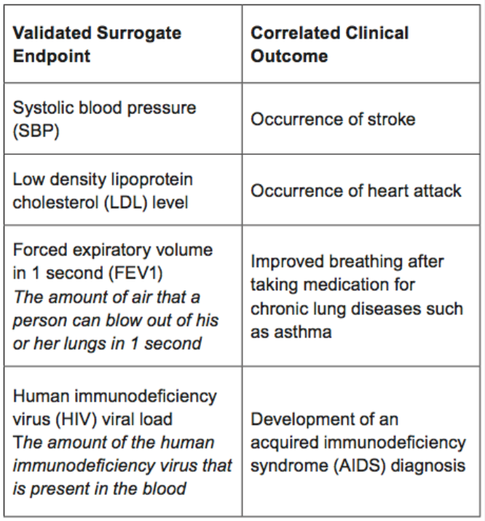

Slide 32
Outcomes (Mnemonic: M-SKIEY)
Measures:
Need to be appropriate, validated, clinically relevant
Clinical outcomes vs surrogate outcomes vs composite outcomes
Statistical tests:
Intention to treat (ITT): all participants are analysed according to the group they were randomised in, regardless of intervention their received
Per-protocol (PP): only participants who followed the protocol are analysed
Power calculations
?Multiple hypothesis testing → data dredging

Slide 33
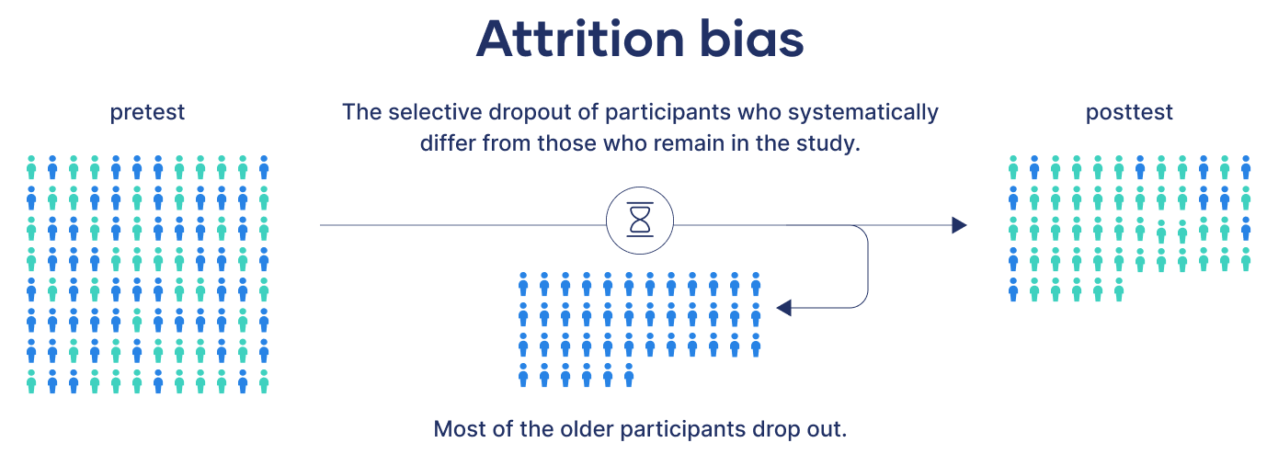

Slide 34
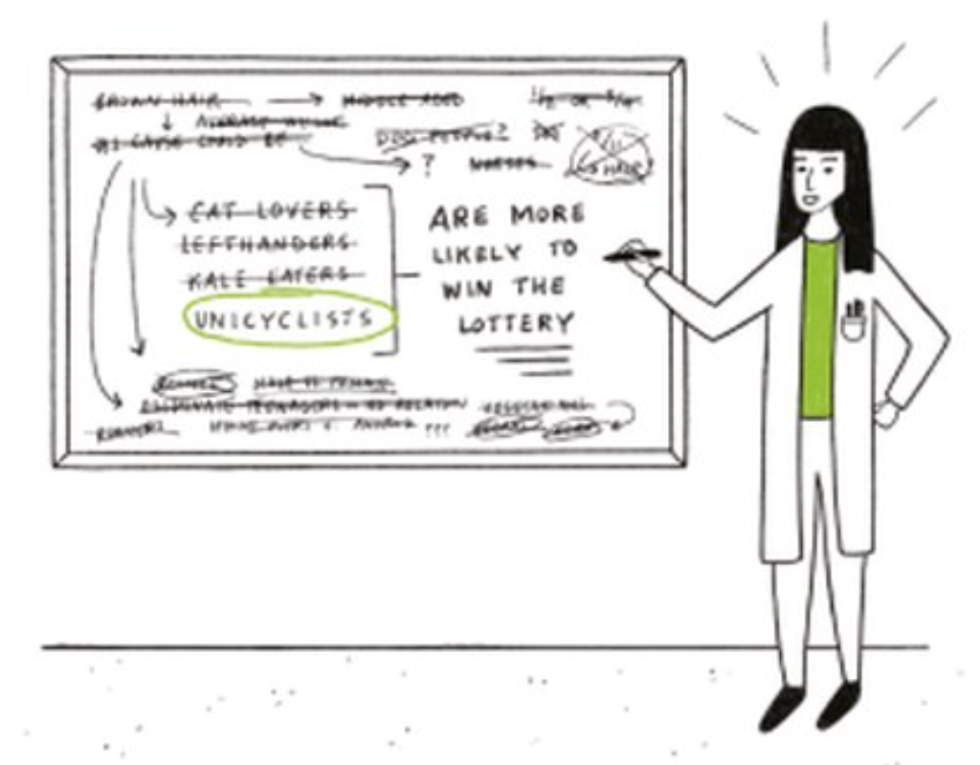
Data Dredging
The more tests you do, the higher the likelihood that one of the tests will be statistically significant by chance (type 1 error). To prevent this:
Avoid multiple hypothesis testing
Use the Bonferroni correction: this decreases the alpha level, making it harder to reach significance

Slide 35
Outcomes (Mnemonic: M-SKIEY)
Measures:
Need to be appropriate, validated, clinically relevant
Clinical outcomes vs surrogate outcomes vs composite outcomes
Statistical tests:
Intention to treat (ITT): all participants are analysed according to the group they were randomised in, regardless of intervention their received
Per-protocol (PP): only participants who followed the protocol are analysed
Power calculations
?Multiple hypothesis testing → data dredging
Key findings:
What outcomes have been reported?
Confidence intervals + p values
Type 1/Type 2 errors
Attrition rate and side effects
Clinical significance

Slide 36
Type 1 error (false positive)
Type 2 error (false negative)
Research conclusion: there IS a difference
Reality: there is NO difference
Causes
Confounders
Biases:
Performance bias
Detection bias
Attrition bias
Multiple hypothesis testing
When to think about this?
When results ARE statistically significant
Research conclusion: there is NO difference
Reality: there IS a difference
Causes
Sample is too small
Excessive use of exclusion criteria → diagnostic purity bias
Variance is too large
When to think about this?
When results ARE NOT statistically significant

Slide 37
Measures:
Birthweight & HbA1c: surrogate endpoints
Maternal and fetal outcomes: clinical outcomes
Statistical tests
Multiple linear regression, adjusted for stratification
?intention to treat
Key findings
Confidence intervals are broad, p values are non significant
No drop-outs, but primary outcome not available in 6%
Differences between groups are not clinically significant
What kind of error are we suspecting?

Slide 38
?TYPE 2 ERROR
Sample size is small
Could the exclusion criteria be too tight?
Mean HbA1c levels are in good control range, what about women who have uncontrolled diabetes? → ?diagnostic purity bias
Variance is large

Slide 39
Outcomes (Mnemonic: M-SKIEY)
Internal validity
External validity
Can we trust the study results? How reliable are they?
The extent of confidence in the outcome of research you are conducting
Look at:
Sources of bias
Possible confounders
Blinding
Statistical tests
Power
Can we apply these results to the wider population?
Degree to which the results can be generalised to the larger population
Look at:
Sample in the study vs population
Study setting vs real life clinical environment
Compliance
Cost-effectiveness

Slide 40
Y?
Was the study worthwhile?
Will this study change clinical practice?
Is it an important question? Prevalent disease? Few treatments available?
Is the intervention cost-effective
Side effects? Benefits vs risks
Is it acceptable to patients? Attrition rate?
Is it feasible to implement on larger scale?
Single study won’t change practice - scope for systematic review/meta-analyses?

Slide 41
Internal validity
Potential type 2 error
Performance bias?: open-label, extra effects from diet and exercise
External validity
Single-center study in Denmark
?well-controlled diabetes
?compliance in multiple daily injections vs insulin pump
Broader implications
No significant side effects identified, but is there a real benefit?
?Cost-effectiveness: will the NHS fund this
No evidence of superiority, but could give more treatment options to choose from

Slide 42
Recap
Population
(CSFABB)
Intervention
(NEC)
Control
(TEC)
Outcomes
(MSKIEY)
Criteria
Sample size
Follow-up
Allocation
Blinding
Baseline characteristics
Novelty
Ethical considerations
Clinical considerations
Type
Ethical considerations
Clinical considerations
Measures
Statistical tests
Key findings
Internal validity
External validity
Y
Ethics
(CESF)
Consent
Equipoise
Safety/side effects
Funding

Slide 43
Ethics: The Four Quadrants
Beneficence
Autonomy
Doing what is in the best interests of your patient
Placebo: is it justified if known treatment is available?
Intervention: if beneficial, is it justifiable to give control/placebo to other group
Respecting patient’s choice
Right to choose to participate (informed consent)
Non-maleficence
Justice
Do no harm
Placebo? Side effects of intervention/control?
Safety outcomes?
Doing what’s best for society as a whole
Half of people get treatment, half do not
Are the overall results good for society?
Who will benefit from the research?

Slide 44
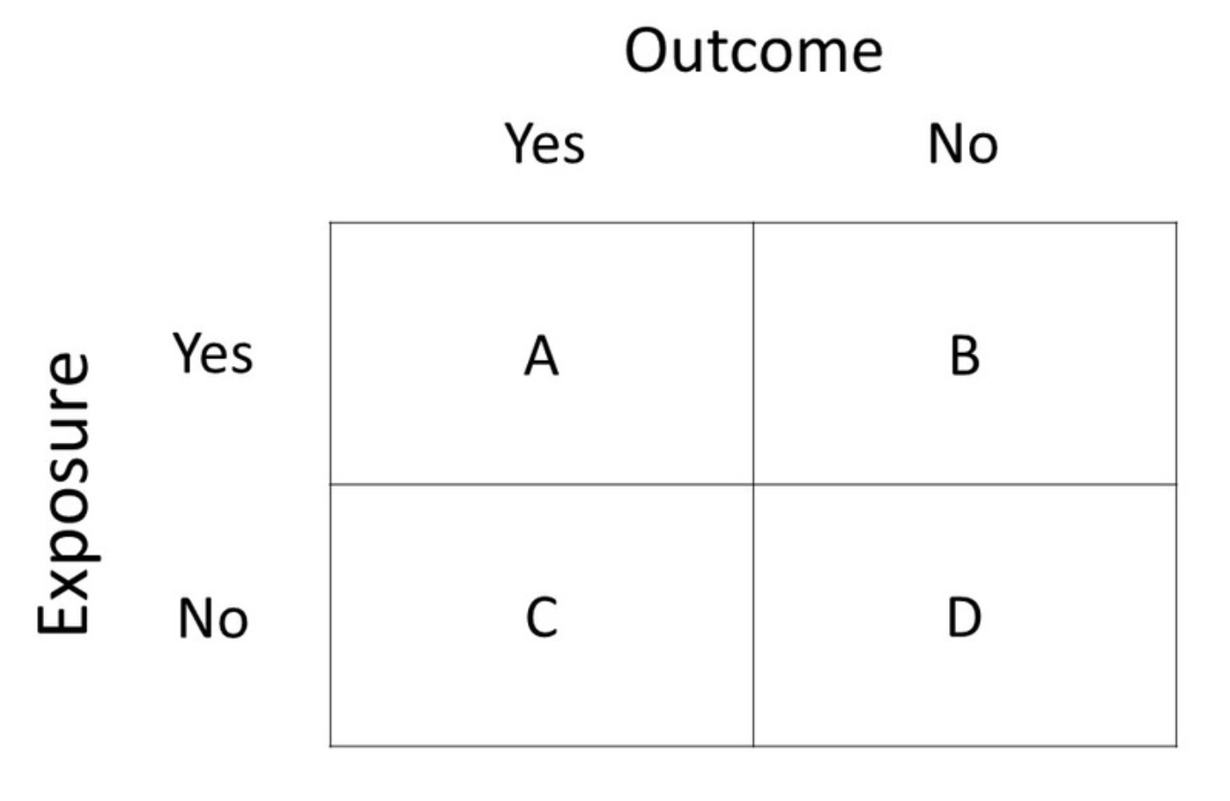
2x2 (Contingency) Tables

Slide 45
2x2 (Contingency) Tables
Example:
In our cohort study, 100 patients smoke cigarettes and 100 patients do not smoke. At the end of the study, 30 patients in the smoking group develop cancer. Only 10 patients in the non-smoking group develop cancer
Cancer
30 (A)
70 (B)
100
Smoking
10 (C)
90 (D)
100
40
160

Slide 46
Relative vs absolute risk
Absolute risk
AR in exposed cohort (y): smokers have a 30% (30/100) chance of developing cancer
AR in control (x): non-smokers have a 10% (10/100) chance of developing cancer
Absolute risk reduction (ARR): y-x = 20% → absolute amount by which smoking increases the risk of cancer
Relative risk
Relative risk of cancer in smokers compared to non-smokers: y/x = 0.3/0.1 = 3 (smokers are 3x more likely)
Relative risk reduction (RRR): difference in the risk between the two groups as a proportion of the risk in the control, (y-x)/x = 0.2/0.1 = 0.5 (50%)
Cancer
Cancer
30 (A)
30 (A)
70 (B)
70 (B)
100
100
Smoking
Smoking
10 (C)
10 (C)
90 (D)
90 (D)
100
100
40
40
160
160

Slide 47
Absolute risk
Smokers
AR: 30%
Non-smokers
AR: 10%
Absolute risk reduction
ARR: 20%

Slide 48
Relative risk
Smokers
AR: 30%
Non-smokers
AR: 10%
Relative risk
3 (300%)

Slide 49
Number needed to treat
How many people do we need to treat for 1 more person to benefit from treatment?
Calculation: 1/ARR
ARR = 0.3-0.1 = 0.2 (20%)
NNT = 1/0.2 = 5 people
The smaller the NNT the higher the benefit
Cancer
Survival
30 (A)
30 (A)
70 (B)
70 (B)
100
100
Smoking
Surgery
10 (C)
10 (C)
90 (D)
90 (D)
100
100
40
40
160
160

Slide 50
Odds ratio
Odds: ratio of number of times an event is likely to occur divided by number of times it is not likely to occur.
Odds of having cancer in smokers: 30/70 = 43%
Odds of having cancer in non-smokers: 10/90 = 11%
Odds ratio: AD/BC = 30*90/70*10 = 3.85
Cancer
Cancer
30 (A)
30 (A)
70 (B)
70 (B)
100
100
Smoking
Smoking
10 (C)
10 (C)
90 (D)
90 (D)
100
100
40
40
160
160

Slide 51
Diagnostic tests

Slide 52
Clinical trial phases
Phase 0
Phase 1
Phase 2
Phase 3
Phase 4
Human microdosing studies
Small number of people are given sub-therapeutic doses
Purpose:
Pharmacodynamics and pharmacokinetics
Human pharmacology and safety
Subjects: 20-100 healthy volunteers
Purpose: establish a dosage range, assess safety and identify any side effects
Therapeutic exploratory
Subjects: 100-150 patients
Purpose: study drug/treatment is given to patients to establish safety and effectiveness
Therapeutic confirmatory
Subjects: large number of patients in clinical settings
Purpose: further assessments of effectiveness, dose range, treatment duration & side-effects
Post marketing surveillance
Subjects: patients being treated by doctors
Purpose: study long-term side-effects and effects on special groups (children, pregnant women, elderly, etc.)
Marketing authorisation

Slide 53
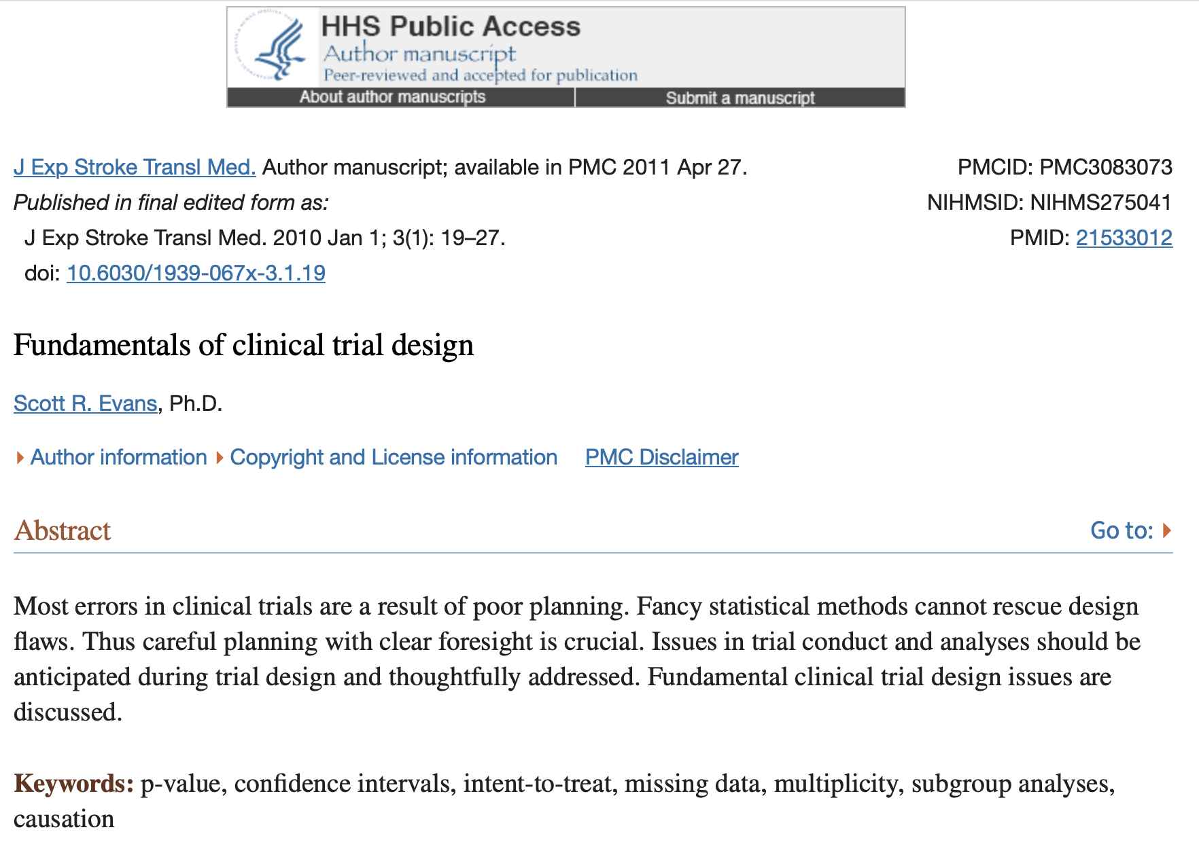
Clinical trials design: fundamentals

Slide 54
Clinical trials design: fundamentals
Research question
Planning and CTU
Funding
Trial lead up
Trial
Post-trial
Approach clinical trials unit (CTUs), get help with:
Literature search
Refine study design
Statistical input
Public involvement
Build team
Contact clinical research networks (CRNs), develop protocol and estimate resources required to help you write grant application
Sources of funding:
Industry
Research funding body (NIHR, MRC, charity)
Finalise protocol
IRAS application:
Clinical trial approval (CTA) by MHRA
Ethics approval by REC
R&D approval by HRA
Register trial: either public (WHO/ICMJE list), ISRCTN, clinicaltrials.gov
Ongoing management and monitoring
Safety reporting
Progress reporting
Financial management
Archive
Produce reports for:
Funders
Journal article
REC
MHRA

Slide 55
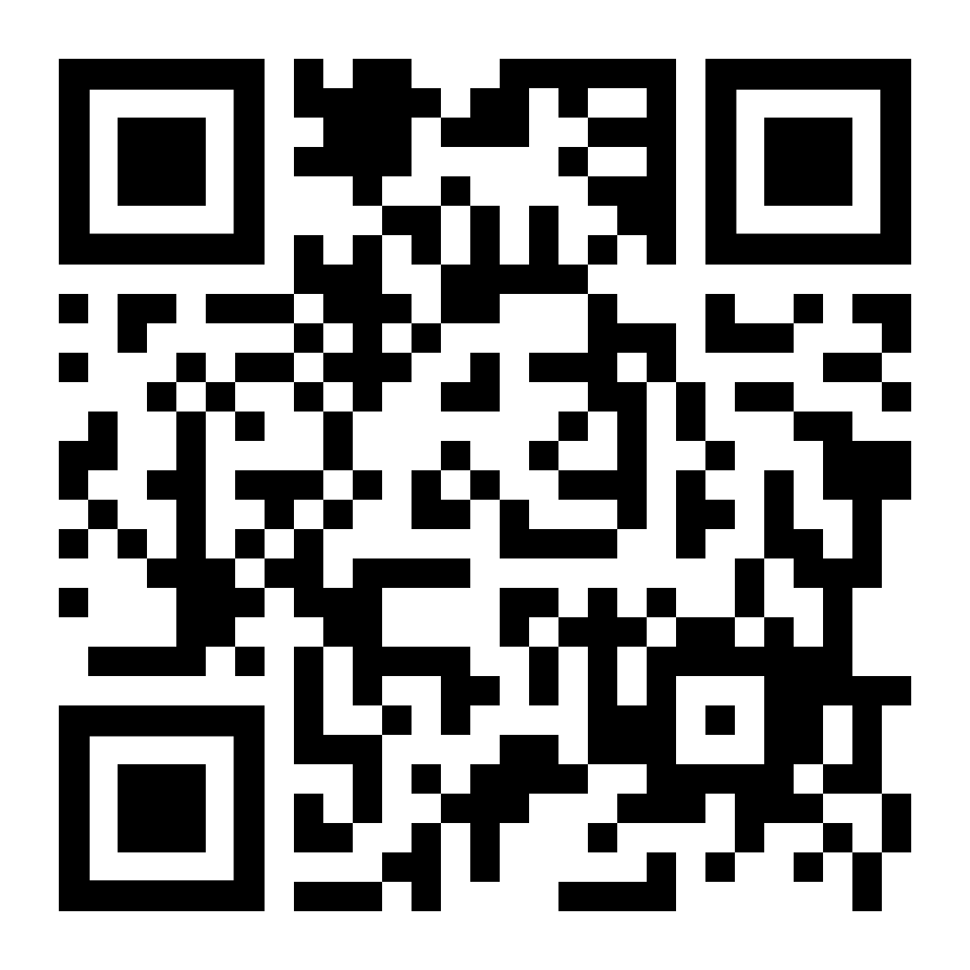
Thank you for listening!

