Slide 1

What I Wish I Knew for Year 3
Megan Cheadle & Naim Ghantous
Notes:
Ally

Slide 2
What We Will Be Covering
A Week in Third Year
Progress Test
Third Year Timeline
OSCEs
Stage 2 Year 3 Blocks
Intercalation
Mental Health
Wellbeing
Scholarly Project
MSA Stuff
Doctor as Teacher
Notes:
Ally

Slide 3
MON
Hospital Placement
Mental health (alternates w Balint) or Scholarly project or DaT
TUES
A Week in Third Year
WED
Teaching
THUR
Hospital Placement
Mental health (alternates w Balint) or Scholarly project or DaT
FRI
Notes:
Yathavi

Slide 4
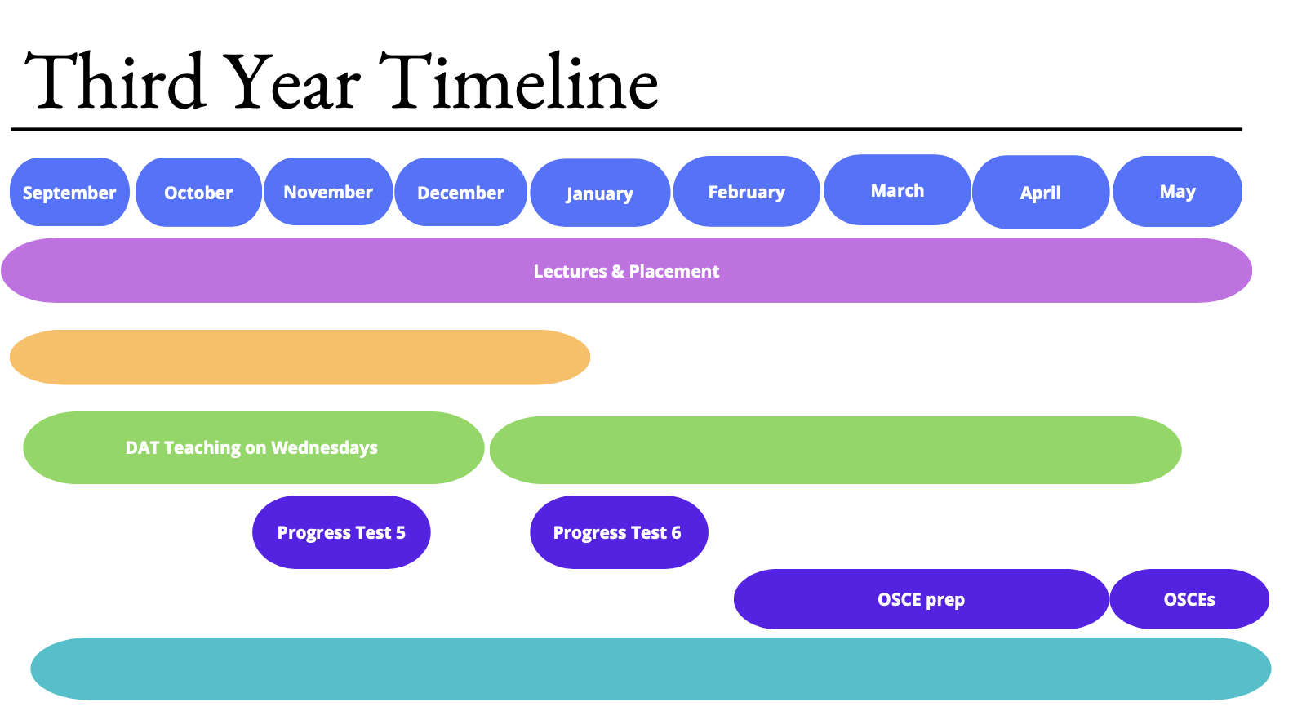
SPM Submission: early January
Scholarly Project
DaT Portfolio Submission:
Early May
DAT Teaching
Progress Test 4 (Formative)
Progress Test 5 (Summative)
May OSCE (Summative)
Extracurricular activities
Notes:
Yathavi

Slide 5

Stage 2 Year 3 Blocks
Notes:
Ally

Slide 6
Trauma and Accidents
General Advice
CONTENT:
Acute and Emergency
Orthopaedics
bit of radiology
(the ratio of which really depends on where you are placed)
This is the best block if you enjoy doing things - clinical skills (best block for sign offs!!) in ED, assisting in theatres, assessing patients
Absolutely key skills to develop are A-E assessment of unwell patients and radiograph interpretation (CXRs, AXRs, PXRs, CTs) alongside ECGs + ABGs
All examinations are relevant in this block!
Knowledge overlap with all other blocks (cardio/vascular emergencies, neurological/ENT emergencies, even acute onc)
Notes:
Maria
Lots more bedside teaching for most blocks in 3rd year
4th years can teach you stuff, help out with clinical skills
-T&A placement is good opportunity to practise reading CXRs, ABGs, ECGs and examinations (abdo, cardio, resp)
-Logging into kaizen on your phone beforehand saves time as doctors and nurses are often busy
-EPR login - good to look up more about patient’s history, review imaging
get to see a surgery! KCH Have two guaranteed surgical hours. great opportunity to get your scrubbing in sign up (major purpose for this session) so get it done then!
some surgeries especially trauma will have a lot of components, e.g.orthopaedic srugeons and vascular surgeons etc… so it might be hard to see.

Slide 7
Some T&A Topics + more specific advice
Emergency Presentations (as convincing as it is to learn these condition by condition, try and learn by presentation - i.e. what do I know that causes chest pain and what is the pathophys underlying it? This will help when you assess patients and in A-E OSCEs!)
  Cardio/resp - chest pain, SOB, syncope, palpitations
  Neuro/ENT/ophthal - headache, neurological deficit, back pain, sudden visual loss
  GI/uro - abdominal pain
  Trauma, sepsis, airway obstruction, shock
Upper and Lower limb injury - fractures (hip), dislocations (shoulder),
Learn the pathophys of the different types of shock and how they are treated
Toxicology and substance misuse (paracetamol, aspirin, alcohol, TCAs, benzos, cocaine) + acute mental health presentations
Notes:
Maria
Lots more bedside teaching for most blocks in 3rd year
4th years can teach you stuff, help out with clinical skills
-T&A placement is good opportunity to practise reading CXRs, ABGs, ECGs and examinations (abdo, cardio, resp)
-Logging into kaizen on your phone beforehand saves time as doctors and nurses are often busy
-EPR login - good to look up more about patient’s history, review imaging
get to see a surgery! KCH Have two guaranteed surgical hours. great opportunity to get your scrubbing in sign up (major purpose for this session) so get it done then!
some surgeries especially trauma will have a lot of components, e.g.orthopaedic srugeons and vascular surgeons etc… so it might be hard to see.

Slide 8
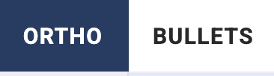



Useful Resources
Notes:
Maria
Lots more bedside teaching for most blocks in 3rd year
4th years can teach you stuff, help out with clinical skills
-T&A placement is good opportunity to practise reading CXRs, ABGs, ECGs and examinations (abdo, cardio, resp)
-Logging into kaizen on your phone beforehand saves time as doctors and nurses are often busy
-EPR login - good to look up more about patient’s history, review imaging
get to see a surgery! KCH Have two guaranteed surgical hours. great opportunity to get your scrubbing in sign up (major purpose for this session) so get it done then!
some surgeries especially trauma will have a lot of components, e.g.orthopaedic srugeons and vascular surgeons etc… so it might be hard to see.

Slide 9
Cognition, Movement, and Senses
General Advice
Learn neuroanatomy it is so important.
  The cranial nerves
  Arterial supply of the CNS
  Intracranial pressure
  Spinal cord + tracts
Bedside teaching + skills sessions are great to lock down your neuro exams + ophthalmoscopy, otoscopy
Practice examining patients and localising the lesion. Neurology is extremely systematic
CONTENT:
Neurology + Neurosurgery
Ophthalmology
ENT
Notes:
Maria
Lots more bedside teaching for most blocks in 3rd year
4th years can teach you stuff, help out with clinical skills
-T&A placement is good opportunity to practise reading CXRs, ABGs, ECGs and examinations (abdo, cardio, resp)
-Logging into kaizen on your phone beforehand saves time as doctors and nurses are often busy
-EPR login - good to look up more about patient’s history, review imaging
get to see a surgery! KCH Have two guaranteed surgical hours. great opportunity to get your scrubbing in sign up (major purpose for this session) so get it done then!
some surgeries especially trauma will have a lot of components, e.g.orthopaedic srugeons and vascular surgeons etc… so it might be hard to see.

Slide 10
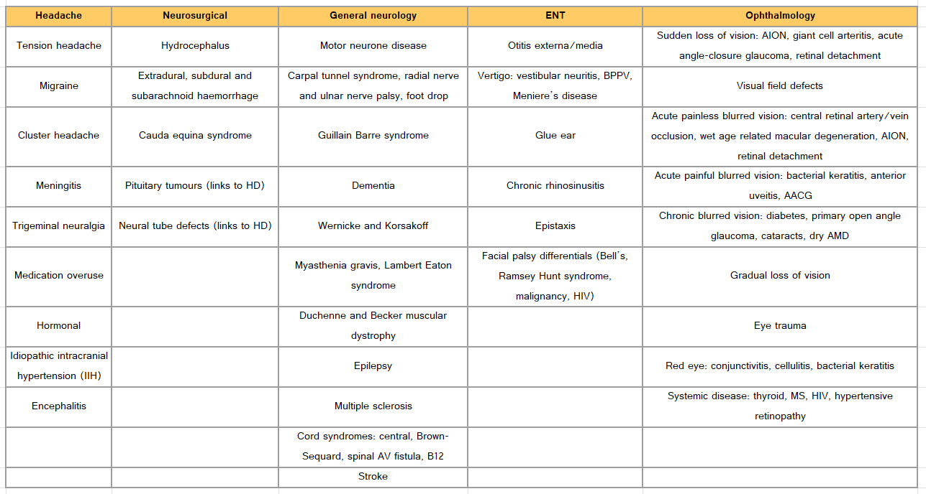
Some CMS Topics
Notes:
Maria
Lots more bedside teaching for most blocks in 3rd year
4th years can teach you stuff, help out with clinical skills
-T&A placement is good opportunity to practise reading CXRs, ABGs, ECGs and examinations (abdo, cardio, resp)
-Logging into kaizen on your phone beforehand saves time as doctors and nurses are often busy
-EPR login - good to look up more about patient’s history, review imaging
get to see a surgery! KCH Have two guaranteed surgical hours. great opportunity to get your scrubbing in sign up (major purpose for this session) so get it done then!
some surgeries especially trauma will have a lot of components, e.g.orthopaedic srugeons and vascular surgeons etc… so it might be hard to see.

Slide 11


Useful Resources
Notes:
Maria
Lots more bedside teaching for most blocks in 3rd year
4th years can teach you stuff, help out with clinical skills
-T&A placement is good opportunity to practise reading CXRs, ABGs, ECGs and examinations (abdo, cardio, resp)
-Logging into kaizen on your phone beforehand saves time as doctors and nurses are often busy
-EPR login - good to look up more about patient’s history, review imaging
get to see a surgery! KCH Have two guaranteed surgical hours. great opportunity to get your scrubbing in sign up (major purpose for this session) so get it done then!
some surgeries especially trauma will have a lot of components, e.g.orthopaedic srugeons and vascular surgeons etc… so it might be hard to see.

Slide 12
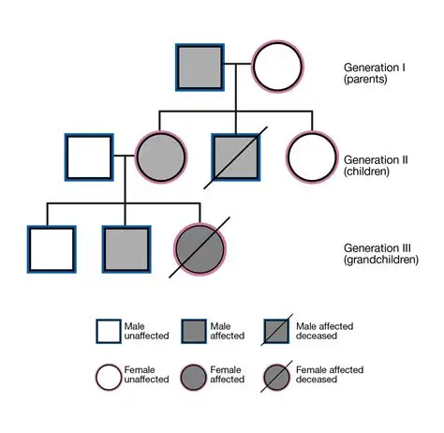
Cancer and Clinical Genetics
Learn the red flags: fever, weight loss, night sweats etc.
Cover a range of specialties
Understand referral pathways
Learn screening programmes -> breast, colon, cervical (+ no prostate!)
Drawing pedigree diagram
Breast clinic sign off -> breast examination
Understand triple assessment in breast clinic
Haem: LEARN THE CANCERS -> don’t worry about knowing the whole specialty
Content:
ONCOLOGY
HAEMATOLOGY
Notes:
Maria
Lots more bedside teaching for most blocks in 3rd year
4th years can teach you stuff, help out with clinical skills
-T&A placement is good opportunity to practise reading CXRs, ABGs, ECGs and examinations (abdo, cardio, resp)
-Logging into kaizen on your phone beforehand saves time as doctors and nurses are often busy
-EPR login - good to look up more about patient’s history, review imaging
get to see a surgery! KCH Have two guaranteed surgical hours. great opportunity to get your scrubbing in sign up (major purpose for this session) so get it done then!
some surgeries especially trauma will have a lot of components, e.g.orthopaedic srugeons and vascular surgeons etc… so it might be hard to see.

Slide 13
CCG Topics
Cancer screening (breast, cervical, bowel)
Breast cancer
Lung cancer
GI cancer (oesophageal, pancreatic, gastric, colorectal)
Haematological malignancies eg. lymphoma, leukaemia, myeloma
Urological cancers
Head and neck cancers
Palliative care; WHO pain ladder for analgesia
Tumour markers
Acute oncology - Metastatic Spinal Cord Compression (MSCC), Superior Vena Cava Obstruction (SVCO), hypercalcaemia, hyponatraemia, AKI, large bowel obstruction, biliary obstruction, ascites, pleural effusion
Notes:
Yathavi

Slide 14
Vascular
GSTT -> paired with Consultant (Thoracic Surgeon), weekly teaching sessions
Try to understand a patient comprehensively -> bloods, ABG, CXR, CT chest, echo, ECG
Learn how to read and interpret ECGs (calculate HR, normal values etc) & ABGs
Practice cardio, resp, peripheral vascular examinations -> listen to heart murmurs!
Start recognising vascular pathology eg varicose veins, varicose eczema, art/venous ulcers
Practice cannulas/venepuncture
Content:
CARDIOLOGY
VASCULAR
Notes:
Maria
Lots more bedside teaching for most blocks in 3rd year
4th years can teach you stuff, help out with clinical skills
-T&A placement is good opportunity to practise reading CXRs, ABGs, ECGs and examinations (abdo, cardio, resp)
-Logging into kaizen on your phone beforehand saves time as doctors and nurses are often busy
-EPR login - good to look up more about patient’s history, review imaging
get to see a surgery! KCH Have two guaranteed surgical hours. great opportunity to get your scrubbing in sign up (major purpose for this session) so get it done then!
some surgeries especially trauma will have a lot of components, e.g.orthopaedic srugeons and vascular surgeons etc… so it might be hard to see.

Slide 15
Vascular Topics
Pharmacology: Antiplatelets and anticoagulants, statins, diuretics, beta blockers, CCBs, ACEi, ARBs
Hypertension
Angina (stable and unstable), MI (NSTEMI and STEMI)
Heart failure
Valvular (aortic stenosis, mitral regurgitation, aortic regurgitation, mitral stenosis are main ones)
Bradyarrhythmias (heart blocks)
Tachyarrhythmias (atrial fibrillation, atrial flutter) -> LEARN TACHYCARDIA GUIDELINES
Abdominal aortic aneurysm
Aortic dissection
Infective endocarditis, pericarditis
Cardiac arrest
Peripheral Arterial Disease, Chronic Venous Insufficiency, Varicose Veins
Notes:
Ally

Slide 16
Mental Health (Psychiatry)
Once every fortnight, you have placement and the other week you have teaching
Placements - One term will be in community psychiatry and one in hospital psychiatry
  Community Psychiatry- more relaxed - consultations, phone calls, medication review etc
  Hospital psychiatry- more acute, so you will see patients who are more unwell
Teaching - you have small group teaching and Balint
  Small group teaching - teaching on psychiatry topics
  Balint (compulsory, reflection sessions to talk about cases that you found interesting)
Notes:
Ally and Maheen
me and my partner had a shared document were we wrote up mental state exams for each patient we saw and it helped a lot to understand how some patients present
Remember what to ask/observe for psychiatric history and MSE, both are different
don’t write off balint group as a waste of time - it can be very useful in improving the way you understand patients and communicate with them as hear different perspectives from your peers and supervisor

Slide 17
Mental Health - Safety Advice
On the ward
Carry your personal alarm
Know where the fixed alarms are
Familiarise yourself with the ward layout and exits
Know what to do if an emergency happens
When seeing patients
Don’t see patients on your own unless specifically advised it is safe to do so
Sit closest to the door so you have a clear exit
Be aware of your surroundings at all times
If you feel unsafe or there is an incident
Get help immediately
Tell your supervisor or the ward team
Report concerns to both KCL and the Trust
Notes:
Ally and Maheen
PsychED Up- course where they ran weekly 2 hour sessions for 7 weeks. Small groups, a psychiatrists, actors. Opportunity to practice how you interact with more complex/difficult patients, see other students doing as well and learning how to improve your techniques. Very helpful for placement & OSCEs. Was online last year

Slide 18
Mental Health - Advice
Brush up on common presentations and common exam questions - you will also get to reinforce a lot of this learning on placement
Risk assess always!!!
Difference between psychiatric history and MSE
Watch the clinicians do MSEs!!
  Learn how to ask the questions about delusions, hallucinations, thought disorder etc!!
  Remember: MSE is a snapshot of the patient’s mental state at that point in time - you are not trying to get background information
Notes:
Ally and Maheen
PsychED Up- course where they ran weekly 2 hour sessions for 7 weeks. Small groups, a psychiatrists, actors. Opportunity to practice how you interact with more complex/difficult patients, see other students doing as well and learning how to improve your techniques. Very helpful for placement & OSCEs. Was online last year

Slide 19
Scholarly Project
Notes:
Ally

Slide 20
Scholarly Project Module (SPM)
Every Tuesday/Friday in Term 1
Communication is key, the project will be kept on track if you keep in touch with your supervisor(s) and partners. If struggling to contact supervisor, find their nhs email and contact MBBS team!
Even if you don’t like the look of your project, you will learn a lot of valuable and transferable skills. Also by all means work hard and come out with a good project that you can present/publish but please don’t pressure yourself to do so
Give yourself deadlines! Whilst your supervisor will be there for help, SPM is super independent so stay disciplined. Try and get your draft done before Christmas
Notes:
Maria
Lots more bedside teaching for most blocks in 3rd year
4th years can teach you stuff, help out with clinical skills
-T&A placement is good opportunity to practise reading CXRs, ABGs, ECGs and examinations (abdo, cardio, resp)
-Logging into kaizen on your phone beforehand saves time as doctors and nurses are often busy
-EPR login - good to look up more about patient’s history, review imaging
get to see a surgery! KCH Have two guaranteed surgical hours. great opportunity to get your scrubbing in sign up (major purpose for this session) so get it done then!
some surgeries especially trauma will have a lot of components, e.g.orthopaedic srugeons and vascular surgeons etc… so it might be hard to see.

Slide 21


Scholarly Project Module (SPM)
Other bits of advice
  If your project involves patient data collection / ethical approval / logins PLEASE sort this out with your supervisor early
  Know how you will be assessed! All SPMs will culminate in a written manuscript but do you have to attend any departmental meetings to present your work etc?
  Get a reference manager (EndNote is free with KCL, Zotero is also good + free), this will save you hours at writeup, particularly if you are doing a review
Notes:
Maria
Lots more bedside teaching for most blocks in 3rd year
4th years can teach you stuff, help out with clinical skills
-T&A placement is good opportunity to practise reading CXRs, ABGs, ECGs and examinations (abdo, cardio, resp)
-Logging into kaizen on your phone beforehand saves time as doctors and nurses are often busy
-EPR login - good to look up more about patient’s history, review imaging
get to see a surgery! KCH Have two guaranteed surgical hours. great opportunity to get your scrubbing in sign up (major purpose for this session) so get it done then!
some surgeries especially trauma will have a lot of components, e.g.orthopaedic srugeons and vascular surgeons etc… so it might be hard to see.

Slide 22
Doctor as Teacher
Notes:
Ally

Slide 23
Doctor as Teacher
Weekly online teaching in term 2 - start with small group activity/discussion in the morning and then lecture to discuss the theory underpinning it in the afternoon
For coursework/assessment, you do a 10 minute microteach (teach any medical-related topic to a small group of 5-6 students online, applying the theory you have learnt throughout the module)
You then write an essay reflecting on this teaching and what you have learnt (you have to choose 3 of the 6 topics you will cover in the module to reflect on)
Advice
  It is a very relaxed module, so enjoy it!
  Try to keep up with the lectures weekly; they are not too intense
  Make sure you ask your peers from your microteach to write down the feedback and to send it to you via email (you will need this for the essay)
Notes:
Maheen
micro teach is all about experimenting with teaching style, topic isn’t as important, it’s only 10 minutes long - reflect on micro teach soon after, so you can reference it properly in your essay (word count was 2500 for us)

Slide 24
Progress Test
Notes:
Maria and Ally

Slide 25
Progress Test
Ground rules: 1). do not compare yourself with others, it does not matter, 2). in a similar vein, PT is not a good test of how good of a doctor someone will be, but 3). unfortunately it is very important
Strategies - there is no perfect strategy, try things that you know will/have work/ed for you
PassMedicine is your best friend you will be sick of it, spaced repetition (with Anki if that’s your thing)
Export the UKMLA condition list into an Excel spreadsheet and track what you study
NICE Guidelines for investigation and management
YouTube! (NinjaNerd, Medicosis, Rhesus Medicine), Oxford clinical cases
Remember, it is easy to get bogged down with the 3rd line antibiotic for whatever, but actually understanding how diseases work will do so much heavy lifting for you in PT and OSCEs!
Notes:
Maria
Lots more bedside teaching for most blocks in 3rd year
4th years can teach you stuff, help out with clinical skills
-T&A placement is good opportunity to practise reading CXRs, ABGs, ECGs and examinations (abdo, cardio, resp)
-Logging into kaizen on your phone beforehand saves time as doctors and nurses are often busy
-EPR login - good to look up more about patient’s history, review imaging
get to see a surgery! KCH Have two guaranteed surgical hours. great opportunity to get your scrubbing in sign up (major purpose for this session) so get it done then!
some surgeries especially trauma will have a lot of components, e.g.orthopaedic srugeons and vascular surgeons etc… so it might be hard to see.

Slide 26
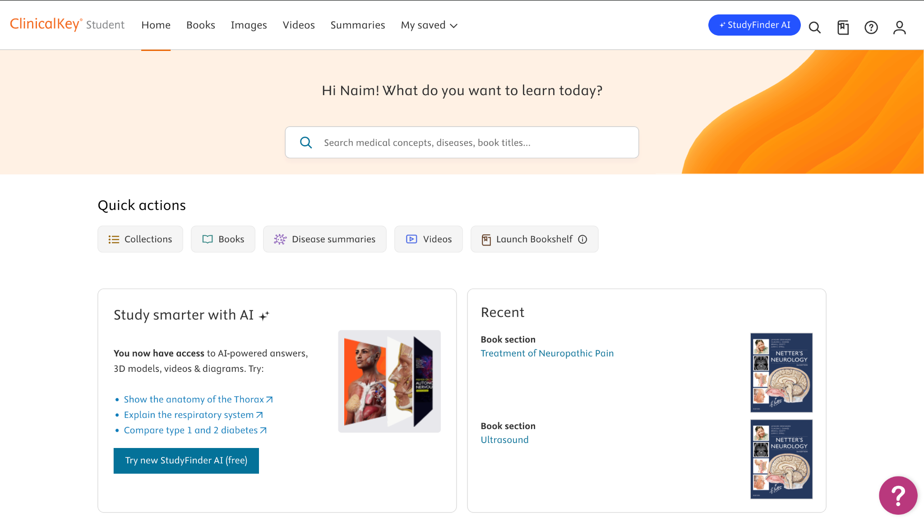
Progress Test
ClinicalKey Student is a great (free!!) resource, compilation of:
Textbooks, videos, disease summaries, AI assister (designed for healthcare), schematics etc.
KCL Online Library always has useful resources (Oxford Textbook of Medicine etc.)
Placement! Write up cases
Notes:
Maria
Lots more bedside teaching for most blocks in 3rd year
4th years can teach you stuff, help out with clinical skills
-T&A placement is good opportunity to practise reading CXRs, ABGs, ECGs and examinations (abdo, cardio, resp)
-Logging into kaizen on your phone beforehand saves time as doctors and nurses are often busy
-EPR login - good to look up more about patient’s history, review imaging
get to see a surgery! KCH Have two guaranteed surgical hours. great opportunity to get your scrubbing in sign up (major purpose for this session) so get it done then!
some surgeries especially trauma will have a lot of components, e.g.orthopaedic srugeons and vascular surgeons etc… so it might be hard to see.

Slide 27
OSCEs
Notes:
Maria and Ally

Slide 28
OSCEs
Start early - it’s way less scary once you know what to expect
Go to older years’ teaching whenever you can
Sign up for as many practice circuits as possible
Get yourself a good OSCE group early on
Big groups are fine just be happy to split up and mix it around
Make a plan together and keep each other on track
Don’t completely forget about PT content while you’re doing OSCE prep
Know the common stuff really well rather than stressing about niche conditions
Think beyond the diagnosis and know how you’d actually manage the patient
Don’t forget the drugs counselling
You don’t need to feel ready before you start practising
Practice A-Es!
Notes:
Maria
Lots more bedside teaching for most blocks in 3rd year
4th years can teach you stuff, help out with clinical skills
-T&A placement is good opportunity to practise reading CXRs, ABGs, ECGs and examinations (abdo, cardio, resp)
-Logging into kaizen on your phone beforehand saves time as doctors and nurses are often busy
-EPR login - good to look up more about patient’s history, review imaging
get to see a surgery! KCH Have two guaranteed surgical hours. great opportunity to get your scrubbing in sign up (major purpose for this session) so get it done then!
some surgeries especially trauma will have a lot of components, e.g.orthopaedic srugeons and vascular surgeons etc… so it might be hard to see.

Slide 29
Example OSCE Stations
A-E: Perform an A-E assessment on a patient presenting with sepsis, pneumonia, AAA etc
Interpretation: CXR, Abdo XR, Ortho XRs, CT head, blood tests (LFTs, TFTs, Lipids etc), ECG
Counselling: medications (Statins, Methotrexate, Steroids etc), breaking bad news, new diagnosis, confidentiality, screening programmes
Examination: cardio, resp, abdo, CN, peripheral neuro, ortho (shoulder, elbow, hand and wrist etc)
Clinical skills: venepuncture, cannulation, ECG, otoscopy, ophthalmoscopy, SPH
History taking
Mental health: MSE, psychiatric history, risk assessment, capacity assessment
Prescribing
Notes:
Maria
Lots more bedside teaching for most blocks in 3rd year
4th years can teach you stuff, help out with clinical skills
-T&A placement is good opportunity to practise reading CXRs, ABGs, ECGs and examinations (abdo, cardio, resp)
-Logging into kaizen on your phone beforehand saves time as doctors and nurses are often busy
-EPR login - good to look up more about patient’s history, review imaging
get to see a surgery! KCH Have two guaranteed surgical hours. great opportunity to get your scrubbing in sign up (major purpose for this session) so get it done then!
some surgeries especially trauma will have a lot of components, e.g.orthopaedic srugeons and vascular surgeons etc… so it might be hard to see.

Slide 30
OSCE Resources/Tips
Get a Geeky Medics subscription
  Some groups split the cost and share one subscription
  Really useful for practising structured histories examinations and communication stations
Create proper mock circuits with your group
  Make your own stations and mark schemes
  Run them under timed conditions
  Be serious about it and treat it like the real exam
  It helps simulate the pressure and makes you much more comfortable on the day
Go to the wards and learn from patients
  Spent the day before the OSCE in Tommies A&E -> cardio, resp, abdo, CN, peripheral neuro, history taking, CXR interpretation, bloods interpretation, MSE
Notes:
Maria
Lots more bedside teaching for most blocks in 3rd year
4th years can teach you stuff, help out with clinical skills
-T&A placement is good opportunity to practise reading CXRs, ABGs, ECGs and examinations (abdo, cardio, resp)
-Logging into kaizen on your phone beforehand saves time as doctors and nurses are often busy
-EPR login - good to look up more about patient’s history, review imaging
get to see a surgery! KCH Have two guaranteed surgical hours. great opportunity to get your scrubbing in sign up (major purpose for this session) so get it done then!
some surgeries especially trauma will have a lot of components, e.g.orthopaedic srugeons and vascular surgeons etc… so it might be hard to see.

Slide 31
Intercalation
Notes:
Maria and Ally

Slide 32
Intercalation
Pros
Cons
You will learn a lot about a subject area
Gives you time to build your portfolio
Developing new skills
Opportunity to explore new subject areas within medicine or even outside of medicine entirely
Growing as a person (and as an academic)
Learning about yourself and what you enjoy
If you intercalate outside of KCL, making new friends, networking, maybe even learning a new city
Money. Tuition + maintenance, especially for MSc
Joining a different year group when you return
Can be both more intense and independent than you anticipate (especially research years), and can therefore be quite mentally challenging
Overlap between Master’s and 4th Year
Your expectations of the course may not match what you actually get
Notes:
Maria
Lots more bedside teaching for most blocks in 3rd year
4th years can teach you stuff, help out with clinical skills
-T&A placement is good opportunity to practise reading CXRs, ABGs, ECGs and examinations (abdo, cardio, resp)
-Logging into kaizen on your phone beforehand saves time as doctors and nurses are often busy
-EPR login - good to look up more about patient’s history, review imaging
get to see a surgery! KCH Have two guaranteed surgical hours. great opportunity to get your scrubbing in sign up (major purpose for this session) so get it done then!
some surgeries especially trauma will have a lot of components, e.g.orthopaedic srugeons and vascular surgeons etc… so it might be hard to see.

Slide 33
Intercalation
There is a lot you can do!
But please do your research!
MSc Clinical Neurosciences - KCL
iBSc Anatomy - KCL
iBSc Management - Imperial
BSc History - UCL
MPhil Medical Sciences - Cambridge
iBSc Biomedical Engineering - Imperial
MSc Public Health - London School of Hygiene and Tropical Medicine
MSc Global Health Policy - LSE
MSc Women’s Health - UCL
MPhil Biological Science - Cambridge
Ask yourself (not others) what is important to me?
What do I want to learn, and do I want to be taught or do I want to conduct my own research? MSc or BSc?
Do I want to stay at King’s? Do I want to move somewhere else and meet new people?
Will this year benefit me, even if I did not end up pursuing its subject any further? (i.e. specialising)
Do I want to commit to a field now or is that something I want to think further on?
Talk to previous students at your course (2-3) and mentors (2-3), look at modules and the course’s history
Notes:
Maria
Lots more bedside teaching for most blocks in 3rd year
4th years can teach you stuff, help out with clinical skills
-T&A placement is good opportunity to practise reading CXRs, ABGs, ECGs and examinations (abdo, cardio, resp)
-Logging into kaizen on your phone beforehand saves time as doctors and nurses are often busy
-EPR login - good to look up more about patient’s history, review imaging
get to see a surgery! KCH Have two guaranteed surgical hours. great opportunity to get your scrubbing in sign up (major purpose for this session) so get it done then!
some surgeries especially trauma will have a lot of components, e.g.orthopaedic srugeons and vascular surgeons etc… so it might be hard to see.

Slide 34
Wellbeing
Notes:
Maria and Ally

Slide 35
Wellbeing
Please take care of yourself and make it a non-negotiable priority - lack of sleep + lack of proper eating + workload + stress = everything catches up very quickly and it is not nice
Reach out for help - so many people will be in the same boat; reach out to a friend, a senior, your personal tutor, faculty member, family, GP, MSA; whoever you are comfortable with; sometimes just talking to someone helps
Remember that at the end of the day you are becoming a doctor - patients remember how you made them feel, if you listened to them, if you took them seriously, if you helped <3 Absolutely put in all the effort to do the best you can (whatever that means for you), but throughout all of that, do not lose sight of the bigger picture
Notes:
Maheen
Please take care of yourself and make it a non-negotiable priority - lack of sleep + lack of proper eating + workload + stress = everything catches up very quickly and it is not nice
Remember that, at the end of the day, nothing exists if your health doesn’t (e.g. doesn’t matter the amount of hours if you are unwell on the day of your exam)
Reach out for help - so many people will be in the same boat; reach out to a friend, a senior, your personal tutor, faculty member, family, GP, MSA; whoever you are comfortable with; sometimes just talking to someone helps, other times they can offer valuable insight and advice and sometimes they can put things into perspective
Do NOT lose perspective - it is easy to fall into the trap of thinking you are not doing enough because it seems that everyone else somehow has a lot more hours in the day; take a moment to reflect how far YOU have come, not relative to anyone else
Remember that circumstances mean that comparison is never fair and balanced (e.g. it is a given that someone who works 3 jobs and has a full time caring role might not have the time, energy and/or capacity to be able to engage in as many societies as someone who does not have to do either) (This is a more extreme example to get the point across, but always remember that!)
Celebrate small wins - sometimes it is the little things that you have to actively found the joy in to keep sane. Decided on your SPM research question? Well done. Cooked for yourself after a long while? Proud of you. Caught up with friends even when you felt like isolating? Pat yourself on the back

Slide 36
MSA Stuff
Notes:
Maria and Ally

Slide 37
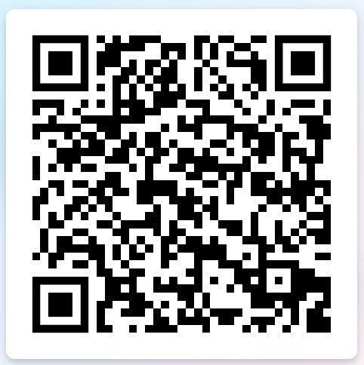
PALS Student Sign-Ups Now Open!
Want to be taught by Year 4 / Intercalating students to ace your PTs, SPM, DaT & OSCEs?
⬅️⬅️⬅️ SIGN UP NOW!!!
Notes:
Maria and Ally

Slide 38
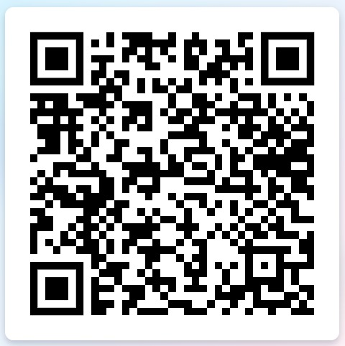
PALS Facilitator Sign-Ups Now Open!
Want to teach Year 2 students to help them ace their PTs, SSC and formative OSCE?
⬅️⬅️⬅️ SIGN UP NOW!!!
Notes:
Maria and Ally

Slide 39

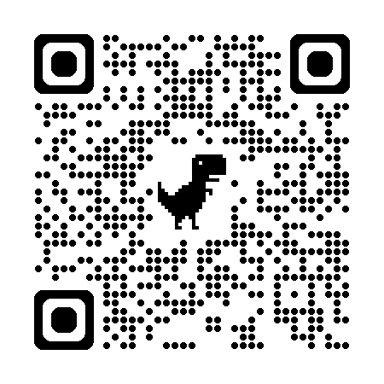
Any Questions? Feedback Form
Wishing you all the best in Year 3!
Useful contacts:
mbbsstage2@kcl.ac.uk
msa@kcl.ac.uk
jean.dimaculangan@kcl.ac.uk (MSA VP Education 26/27)
Follow GKT MSA on Instagram, Facebook & Twitter!
Feedback:
https://forms.gle/rcLoM2wBDwVsY8uJ8

