Slide 1

What I Wish I Knew in Second Year
By: Shaheer, Tarek and Arham
Monday 7th September 2026
Notes:
Ayesha/Shaheer will introduce (everyone briefly introduce themselves)

Slide 2
What We Will Be Covering
General Overview & Tips
General Practice (GP)
Assessments
OSCEs
E-Portfolio
Progress Test 3 Tips
Hospital Placement
Wellbeing
SSC
Resources and Opportunities
Block Overview
Notes:
Shaheer

Slide 3
MON
LECTURES
General:
A Week in the Life of a Second Year Med Student
TUES
GP/HOSPITAL PLACEMENT
WED
ANATOMY / CASE BASED DISCUSSIONS
THUR
INTRO TO RESEARCH (SEM1) /
SSC (SEM2)
FRI
GP/HOSPITAL PLACEMENT
Notes:
Shaheer

Slide 4
Stage 2 Year 2 Modules
From Science to Clinical Practice 1: Progress Tests 1,2,3 PT3 is summative
Human Development: OBGYN, Paeds, Endo
Supporting Life: Cardio, Resp
Inflammation: Rheum, Gastro, Nephro, Infectious Diseases, Diabetes, Pharmacology
Ageing: Bone Diseases, Dementia, Delirium, Frailty, Falls
Introduction to Clinical Research - 300 word summative
Student Selected Components - 2,000 word Dissertation / Creative Piece / Exam (languages only)
Longitudinal GP Placement - GP sign offs on Kaizen
NB: Your hospital placement blocks may NOT align with your teaching blocks
Notes:
Shaheer

Slide 5
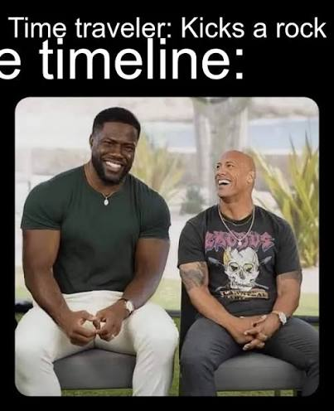
10th Nov
2nd Feb
30th Mar
1st Jun
Longitudinal GP placement
Block 1
Block 2
Block 3
Block 4
PT 1 - Nov
fOSCE - Mar
PT 3 - May
PT 2 - Jan
SSC
Key :
formative
eportfolio sign off deadline
summative
ICR essay and quiz
Notes:
4 blocks, 7 weeks each, of which one will be a campus week (+/ RCGP)
three PTs, the third is summative

Slide 6
General Advice for 2nd Year🫡
Be CONSISTENT from the very beginning! Cramming will not save you this time :(
A lot of FIRSTs this year - PTs, OSCEs, placements etc.
You will not be able to cover EVERYTHING for PTs and that’s okay
Focus on perfecting histories and examinations this year
Be on top of your sign offs
Bring a notepad and pen to take notes with during placements and ask questions
Have fun!!!
Notes:
All

Slide 7

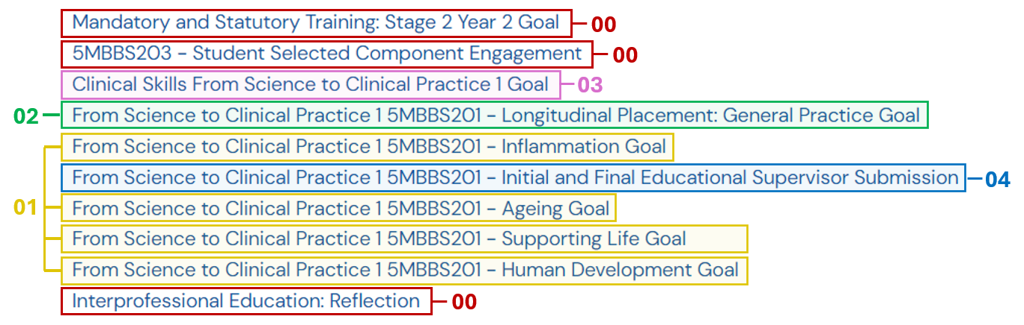
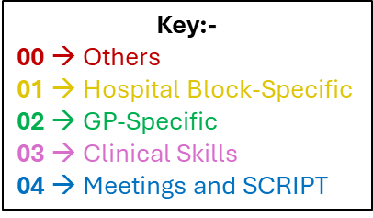
E-portfolio
The recommended timelines are noted in little red boxes on the following slides
Notes:
Tarek

Slide 8
E-portfolio: 00 → Others
Before placement starts
For all hospital blocks:
  Engagement log
-do it weekly!!
  Reflective notes: a case I saw and reflected on
  Educational supervisor: end of block report
MAST guidance document on KEATS + courses on eLFH
After SSC finishes
Just fill in the details of your SSC and supervisor at the end of the SSC, and your supervisor will fill it out for you
After the two IPE sessions finish
There will be two online sessions throughout the year
You need to write a few words to reflect what you learnt through those sessions
For Inflammation and Supporting Life:
  SLE: CBD
For Ageing and Human Development:
  SLE: Mini-Cex
Whenever possible
Whenever possible
Notes:
Tarek

Slide 9
E-portfolio: 01 → Hospital Block-specific goals
Lots of words…. what does any of this mean?
Engagement log - Write down what you learnt/did every day
CBD (Case based discussion) - Present a case (e.g. Hx, PMHx, FHx, SHx, Ivx, Tx etc) to someone (can be someone on the wards, or in some hospitals, there is dedicated time to present it to your teaching fellows)
Mini-Cex - Perform a practical skill on a real patient (e.g. take a history, perform an examination)
Reflective notes – A case I saw and reflected on - Reflect on a case you saw during your placements on that block (use the Gibbs’ reflective cycle)
Educational supervisor end of block report - Write a few words of reflection at the end of the block
Notes:
Tarek

Slide 10
E-portfolio: 02 → GP-specific goals
GP has its own goals on Kaizen
  SLE: Mini-Cex
  SLE: CBD
  Reflective notes: reflections on GP group assessment
  Reflective notes: reflections on going above and beyond
  Illness Scripts and Condition Write-Ups
  GP Reflection on Multi-Source Feedback
Whenever possible
Whenever possible
After working on your group project
As soon as possible
Try to get them done before Christmas break
Whenever possible
Notes:
Tarek

Slide 11
E-portfolio: 02 → GP-specific goals
  Reflective notes: reflections on going above and beyond → Reflect on a time you went above and beyond; this could be in a professional capacity (e.g. you went above and beyond your studies, and took part in an extracurricular, attended a conference, were part of a society committee), personal capacity (e.g. you went out of your comfort zone to achieve something) or something for others (e.g. you did something to help someone else)
  Illness Scripts and Condition Write-Ups → Write about the full history of a patient in GP (i.e. Hx, PMHx, FHx, SHx etc) and then write about a condition associated with the patient (i.e. its description, epidemiology, aetiology, pathology, symptoms, investigations, management etc))
  GP Reflection on Multi-Source Feedback → collect feedback from multiple sources (usually 5 is a good number) - some examples of sources can be your clinical partner, GP group, educational supervisor, other staff in the GP you sit in with (there will be a form you can send round; all you need to do is collate and reflect on the feedback you get)
Notes:
Tarek

Slide 12
E-portfolio: 03 Clinical Skills
Level 1 🡪 These need to performed by you under supervision, and the supervising person must sign it off. Preparatory skills are observe only, self certify
  Handwashing 🡪 Any placement
  Measuring observations 🡪 Any placement
  Peak flow testing 🡪 Any placement
  Instructing patients in the use of devices for inhaled medication 🡪 GP
  Advising patients on how to collect a mid-stream urine specimen 🡪 GP
  Urine multidipstick test 🡪 Labour or prenatal wards (HD), GP
  Prescribe and administer oxygen 🡪 Respiratory ward (SL)
  Prepare and administer injectable (subcutaneous) drugs 🡪 Diabetes ward (INF), C-Section ward (HD), Ageing wards (warfarin etc)
  Prepare and administer injectable (intramuscular) drugs 🡪 GP (One day reserved for flu jabs)
  Nutritional assessment 🡪 GP
  Measuring capillary blood glucose 🡪 Ageing wards or Diabetes wards (IN)
  Taking nose, throat, skin and wound swabs 🡪 GP, Early Pregnancy Unit (HD)
Whenever possible, ideally during the first half of your block
Notes:
Tarek

Slide 13
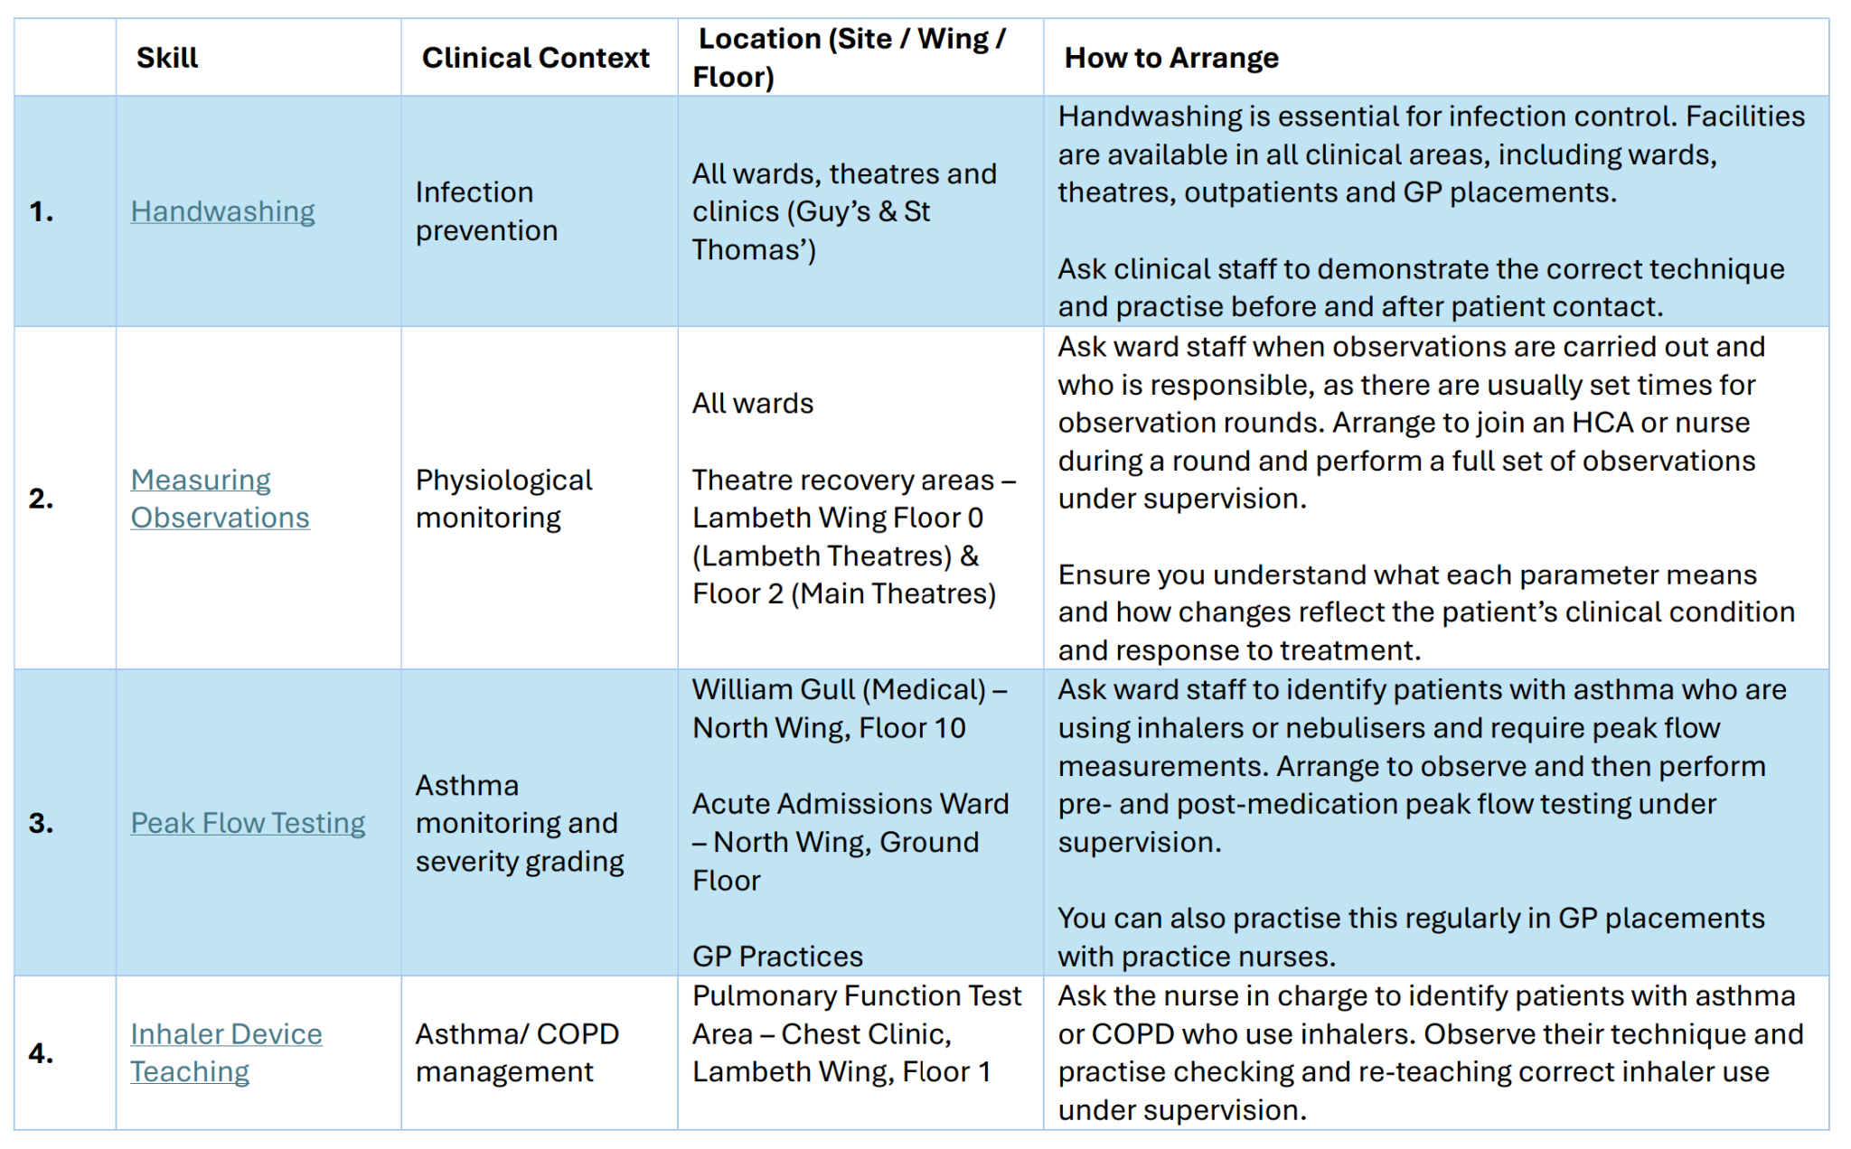

E-portfolio: 03 Clinical Skills
On Kaizen, there is an option to “complete on this device”, this can save a lot of time for your supervisor since they need to fill out fewer details.
Make sure their email is correct!!
Online prescribing modules, some are also really helpful in understanding certain topics (e.g. a few on conditions, on medications etc), and will help you
Notes:
Tarek

Slide 14
Making the most of hospital placement
Have clear goals for the day and share them with the Drs - they want to help
Introduce yourself to all members of the team and shadow other HCPs not just the Drs
Take every opportunity to practise Hx and Examinations (e.g.clinical tutor) - good revision for OSCES, ask which patients have good signs or would be good to examine
  Look at the patient’s notes (with permission) to see what you missed, have a go at interpreting scans etc. Try presenting cases- it’s a key skill and you will get useful feedback
Get your sign offs done early ideally first or second week so you have time for it to get signed off
Notes:
Shaheer

Slide 15
Making the most of hospital placement - cont.
Attend hospital teaching teaching sessions
On the wards, if you ever want to see anything, there’s no harm in asking - say you notice a patient going for a scan, ask if you can see it
If there’s nothing happening don’t feel you have to stay on the ward - try to make the most out of placement if there’s nothing happening - go to another ward, get a sign off etc.
Book the skills room with friends in chandler sail to practise skills/ OSCE throughout the year
Don’t stress about knowing everything, as long as you’re willing to learn and know the basics, you will end up learning a lot as you go
Be curious and read up on what you saw on placement - it will stay with you a long time
Notes:
Shaheer

Slide 16
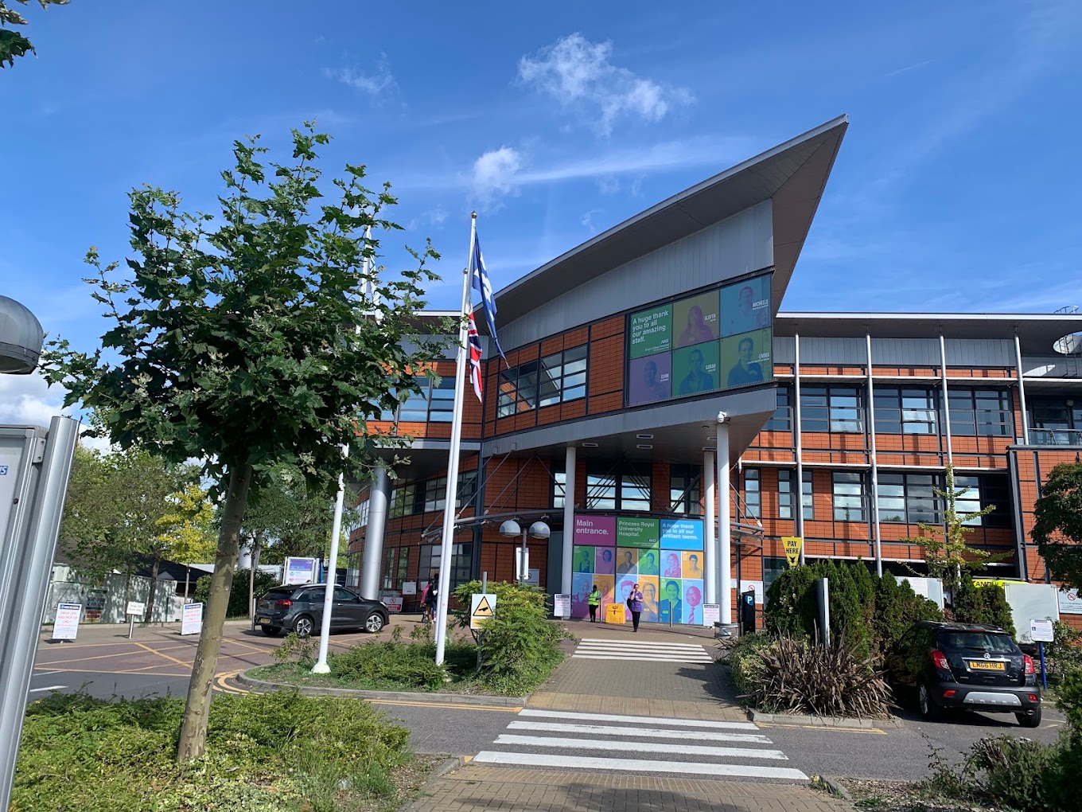
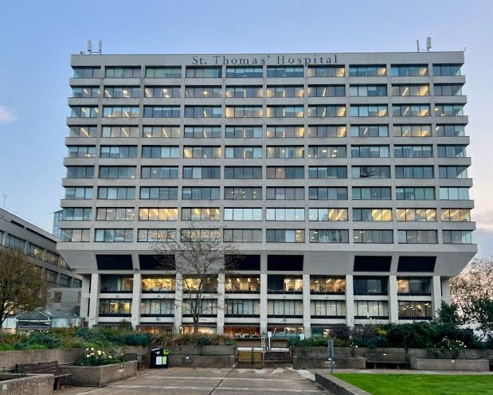
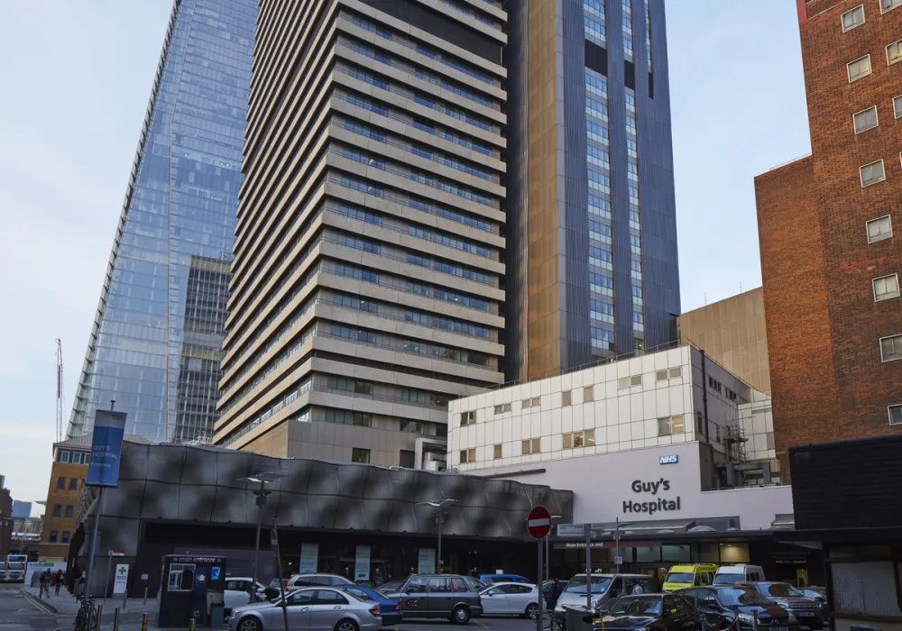

Notes:
All

Slide 17
Student Selected Component (SSC)
Choosing between Language Vs Research Project :
  Choose what you would enjoy!!
  When choosing a project, think about workload, time, how it’s assessed and what your overall aim is for the project (publication?) - would highly recommend submitting an abstract to GKT projects Conference
Research projects :
  Contact your supervisor early on if you haven’t heard back from them try and find their NHS email address
  Make sure you have a clear idea of what your project entails and how you will be assessed
    Usually 1. the essay and 2. engagement (on kaizen)
  Set some deadlines for yourself and stick to them!! (don’t leave it till the end!)
Enjoy it and have fun - bit of a break from the clinical work and lectures!
Languages -twice a week lessons on Strand campus, homework, exams etc.
  Language Exam - 1x Oral Exam, 1x Writing Exam
Only do a language SSC if you’re passionate about the language you choose
Notes:
All

Slide 18

STAGE 2 YEAR 2 BLOCKS

Slide 19
HUMAN DEVELOPMENT
GENERAL ADVICE
Speak to prospective mothers, and learn to take obstetric histories! (Geeky medics is good for this)
Have a good understanding of typical pregnancy timeline, childhood infections, medicine contraindications and immunisations.
Do read up on relevant conditions and guidelines the night before placement!!
Don’t feel discouraged if you don't see a birth, you will get a chance later on.
CONTENT:
WOMEN'S HEALTH
PREGNANCY
CHILD HEALTH
ENDOCRINOLOGY
Notes:
Arham

Slide 20
INFLAMMATION
GENERAL ADVICE
CONTENT:
RHEUMATOLOGY
GASTROENTEROLOGY
NEPHROLOGY
INFECTIOUS DISEASES
DIABETES
(wards/clinics vary by site)
Good block to get through sign-offs! especially blood glucose and SC insulin
Will see a lot of common presentations and memorable clinical signs.
Limited time per specialty vs other blocks maximise your time and ask questions!
For those at GSTT, this block is mostly based at Guy’s Hospital unlike the others
Notes:
Arham

Slide 21
AGEING
GENERAL ADVICE
CONTENT:
BONE DISEASES (OSTEOPOROSIS ETC.)
DEMENTIA
DELIRIUM
FRAILTY AND FALLS
PARKINSON’S DISEASE
Ask staff on the wards for good patients to take a history from - most elderly patients love to talk and you can learn a lot from them!
Be aware of how an ill elderly patient may present, polypharmacy, mobility and independence
Talk to and familiarise yourself with the different roles involved in their care (occupational therapy, dietician, physiotherapy etc.)
Notes:
Shaheer

Slide 22
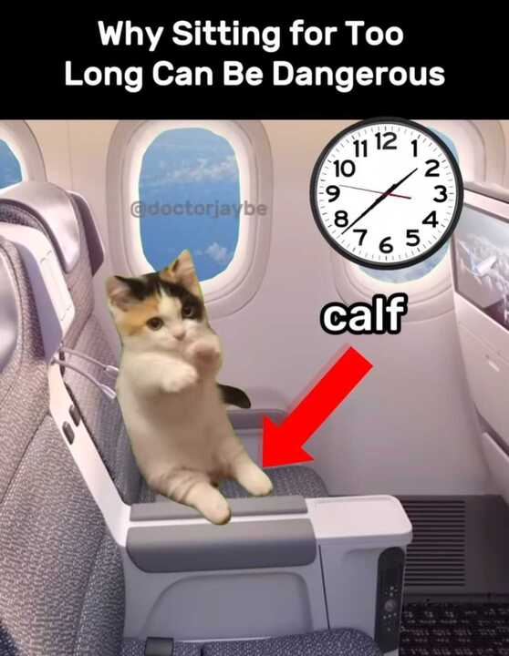

SUPPORTING LIFE
GENERAL ADVICE
By the end of the block, make sure you’ve understood :
  Key BP and cardio medications (calcium channel blockers, ACE inhibitors, thiazides etc)
  How to read basic ECGs, ABGs, and CXRs
  go over heart/mediastinum anatomy (arteries especially) beforehand if you’re in the cath labs/ cardiac surgery
Look for friendly MDT members - wards/theatres can be busy so attach yourself to someone who is willing to teach
Do as many cardio/resp exams as possible - especially as patients may have clinical signs!
Email block lead to ask to shadow a surgery (if not timetabled)
CONTENT:
CARDIOLOGY
RESPIRATORY
RENAL
NEUROLOGY
Life in the fast lane for ECGs
Geeky Medics - ABG interpretation
MedCalc - scoring systems
Notes:
Shaheer

Slide 23

GENERAL PRACTICE
GENERAL STRUCTURE
Sign-Offs (Kaizen):
Illness scripts (5x)
Mini Cex - history, skill
Case Based discussion
Multi source feedback reflection
Reflection on group project
Clinical skills (3 teaching sessions to ensure you get these done)
Tuesday/ Friday
8-10 people in each practise- usually everyone has a clinical partner
Day is divided into a group tutorial in the morning/afternoon - topic for that week will be on Keats
Other half of the day: student clinic, patient home visits, self directed learning, working on your group project
Group Projects - likely clinical humanities, you’ll work on it throughout the year
GP is where you can get lots of practice taking histories and improving communication skills, seek feedback from peers and your GP!
Notes:
Tarek

Slide 24
Making the most of GP
Your GP tutor will be your educational supervisor- meet regularly for sign offs remind them if needed. Remind them of key deadlines
Attend your teaching - it’s definitely useful. opportunities for personalised small group teaching - can ask for teaching on any topic
Observe how they take histories and ask questions, listen actively when they’re explaining things rather than jotting it down instantly
If you have student clinic, take notes or ask a friend to- esp useful for writing up illness scripts, case based discussions, eg
Write illness scripts as you go along - it’s useful revision
Get all sign offs done asap - GP is the best place for them
Keep on top of the group project - communicate with your group and set deadlines.
Simulated patients on campus week and RCGP sessions are amazing practise for OSCES
Notes:
Tarek

Slide 25
Assessments Summary
Progress Test 1: November - (Formative)
150 SBA Questions on content from all years.
You will not know everything nor will be expected to.
Remember you have only done one block so won’t know much and that’s fine you will improve each time! Use it to get an idea of how PTs are like
Progress Test 2: January (Formative)
Progress Test 3: May (Summative)
OSCE: March (Formative)
Intro to clinical research - 300 word summative essay & a quiz January
SSC essay/ creative piece / language exam - April
Kaizen e portfolio - May - don’t leave it to the last minute!!!
Notes:
Arham

Slide 26
What is a PT?
It tests you on the content you are expected to know by the time you qualify as a doctor
  Ensuring that you’re prepared for the AKT (Applied Knowledge Test) at the end of your final year (part of the MLA)
Each PT has 150 SBAs, and you will be examined on content from all years
  You won’t know (and are not expected) to know everything - all you have to do is pass; the pass mark is set according to your year
Can use the MLA content map to help with conditions list and map to blocks. You don’t learn everything on the content map, this is everything you need to cover by final year!
Remember you are not just studying to pass exams, but to become doctors and treat patients!
Notes:
Arham

Slide 27
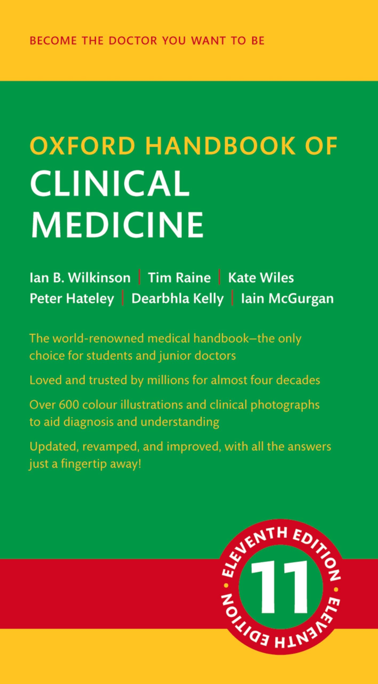

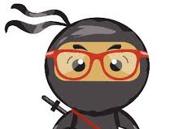





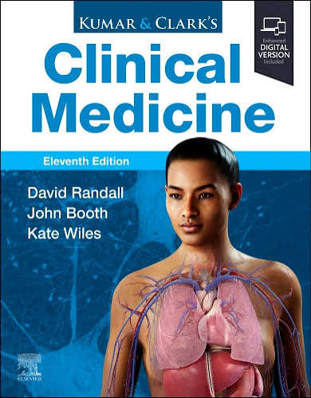


Progress Test 3 Tips
150 SBAs on content from all years similar to the AKT
PT1 - don’t stress it! Just learn the ropes, start with your block teaching and the big 4 specialties (Cardio, Resp, Gastro and Endo - you don’t have to know them all!)
Lots of different approaches
  could learn everything (year 1-5) in mild detail
    can pass on pattern recognition (not best for long term retention and understanding) PassMed
  or learn year 2 content in depth (helps a lot with OSCEs too)
  Question Bank: PassMedicine (Paid One), QuesMed
Resources: NICE CKS, Zero to FInals, BMJ Best Practice
  questions are very guideline based
Look out for society revision sessions
Notes:
Everyone share their own tips on how they study for the PTs!!
Find the balance between knowing the content and actually studying for your exams - focus shifts depending on the season!!

Slide 28
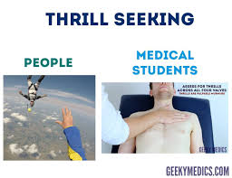
OSCEs
Objective Structured Clinical Examinations
OSCE FORMAT
ADVICE FOR NEARER OSCEs
Geeky medics is your best friend!
Practice with friends - do mock OSCE scenarios
  Run through each examination and ask for peer feedback
Read the OSCE guide on keats + clinical skills checklists!
Your clinical tutor (if you have one) is an invaluable resource - try to ask for bedside teaching!
Once you have the steps down, start incorporating time limits to prepare for OSCE
6 x 8 minute (including 2 min feedback) stations, 2 min break between (inc: clinical skills, history taking, communication, examinations, A to E)
For now:
Practice the steps and learning the signs (e.g. murmurs) rather than worrying about timing
Take histories of patients + present back
- ask for feedback from docs and work on it
During placement teaching/ small group teaching (think clinical communication workshops) try to volunteer where you can!
Notes:
All
Use the 2 minutes before the station to plan what things to ask/say/come up with differentials.

Slide 29
You don’t need to know everything, don’t compare yourself
1
Focus on becoming a good doctor, not a good medical student!
2
WELLBEING
Reach out to friends in older years for support and advice
3
Work together and help each other out
4
Find a routine and enjoy life outside the course!
5
Notes:
You don’t need to know everything- use placement to reinforce what is common and high yield

Slide 30
MSA Stuff
Notes:
Shaheer/Ayesha

Slide 31
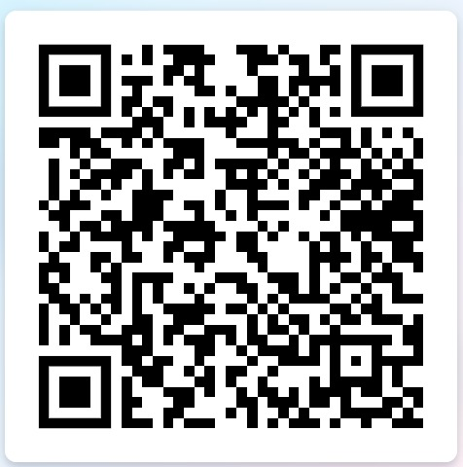
PALS Student Sign-Ups Now Open!
Want to be taught by Year 3 students to ace your PTs, SSC, & formative OSCEs?
⬅️⬅️⬅️ SIGN UP NOW!!!
Notes:
Shaheer/Ayesha

Slide 32
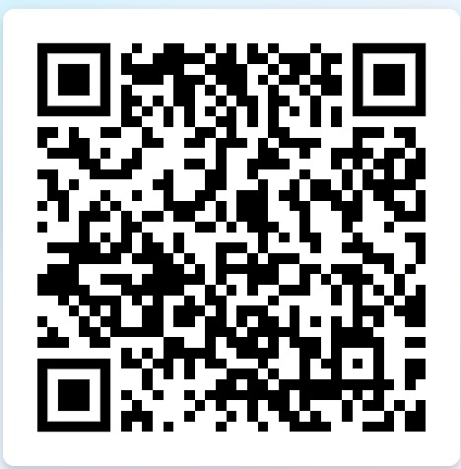
PALS Facilitator Sign-Ups Now Open!
Want to teach Year 1 students to help them ace their exams, and get teaching experience for your portfolio?
⬅️⬅️⬅️ SIGN UP NOW!!!
Notes:
Shaheer/Ayesha

Slide 33
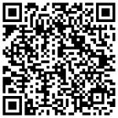
Parent Scheme Sign-Ups Now Open!
Wish you had someone to guide you in first year?
Help make the Year 1 experience easier by becoming a Parent!
Support a group of Year 1 students,
share your advice and experiences and
help them settle into medical school.
Be the person you wished you had in first year
⬅️⬅️⬅️ SIGN UP NOW!!!
Notes:
Shaheer/Ayesha

Slide 34

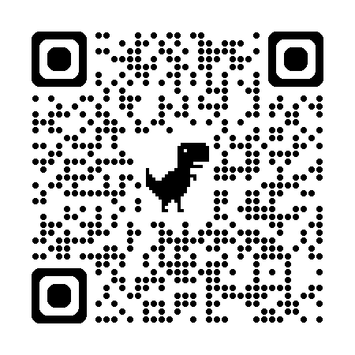
Any Questions? Feedback Form
Wishing you all the best in Year 2!
Useful contacts:
mbbsstage2@kcl.ac.uk
msa@kcl.ac.uk
jean.dimaculangan@kcl.ac.uk (MSA VP Education 26/27)
Follow GKT MSA on Instagram, Facebook & Twitter!
Feedback: https://forms.gle/DHMUfTRRyQLacrEW6

