Slide 1
SFP Made Simple
Introduction to the SFP
Dr Katherine Kuncewicz (FY1 UCL)
Dr Daria Andreeva (FY1 Imperial)
Dr Angela Lochmüller (FY1 UCL)

Slide 2
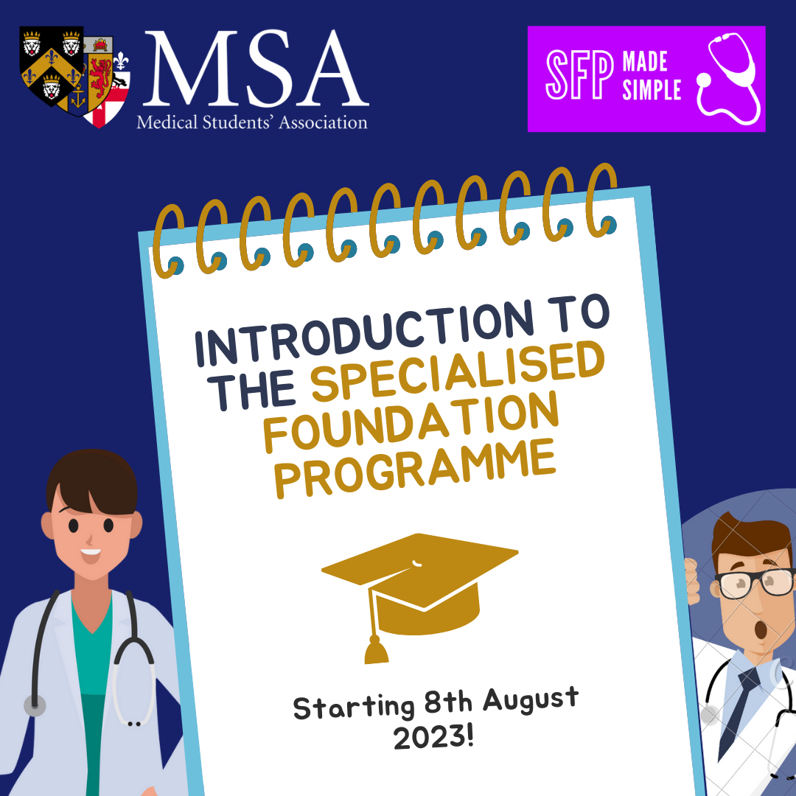
MSA Sponsor

Slide 3
Fundraising

Slide 4
Webinar schedule
1.
Introduction to the SFP with Q&A
2.
Maximising Portfolio Marks and Self-Scoring
3.
Writing White Space Questions
4.
Introduction to Interview and Clinical Scenarios
5.
Biomedical Statistics for the SFP
Tuesdays at 18:30
6.
Academic Station and Critical Appraisal
7.
Answer the Personal Questions with Confidence
8.
Interview Practice Workshops

Slide 5
The Specialised Foundation Programme
Two-year programme
5 blocks of clinical placements + 1 block of research/leadership/education, or
6 blocks of clinical placements + time release for research/leadership/education
Application process
Shortlisting stage - 2023 was based on
White space questions (**not London)
Additional degrees
Presentations (up to 10)
Distinctions, merits and/or scientific/medical prizes (up to 10)
Publications (up to 10)
*EPM decile will NOT count for SFP 2024
Interview stage
Personal questions and/or
Clinical station and/or
Academic station
*If you are not successful, you will still be considered for the standard FP

Slide 6
Where and what?
SFP locations:
Broken down into Specialised Units of Application (SUoA)
Can apply to a maximum of 2
Programmes by location (as of 2023)
All SUoA offer research programmes, others:
East of England: MedEd
East Midlands (LNR & Trent): MedEd + Leadership
KSS & Wessex: MedEd + Leadership
North West of England: MedEd + Leadership
Peninsula: MedEd + Leadership
Scotland: MedEd + Leadership
Wales: Leadership
Yorkshire & Humber: MedEd
Notes:
Medical education (as of 2023)
East of England
East Midlands (LNR & Trent)
KSS & Wessex
North West of England
Peninsula
Scotland
Yorkshire & Humber
Leadership & management (as of 2023)
East Midlands (LNR & Trent)
KSS & Wessex
North West of England
Peninsula
Scotland
Wales

Slide 7
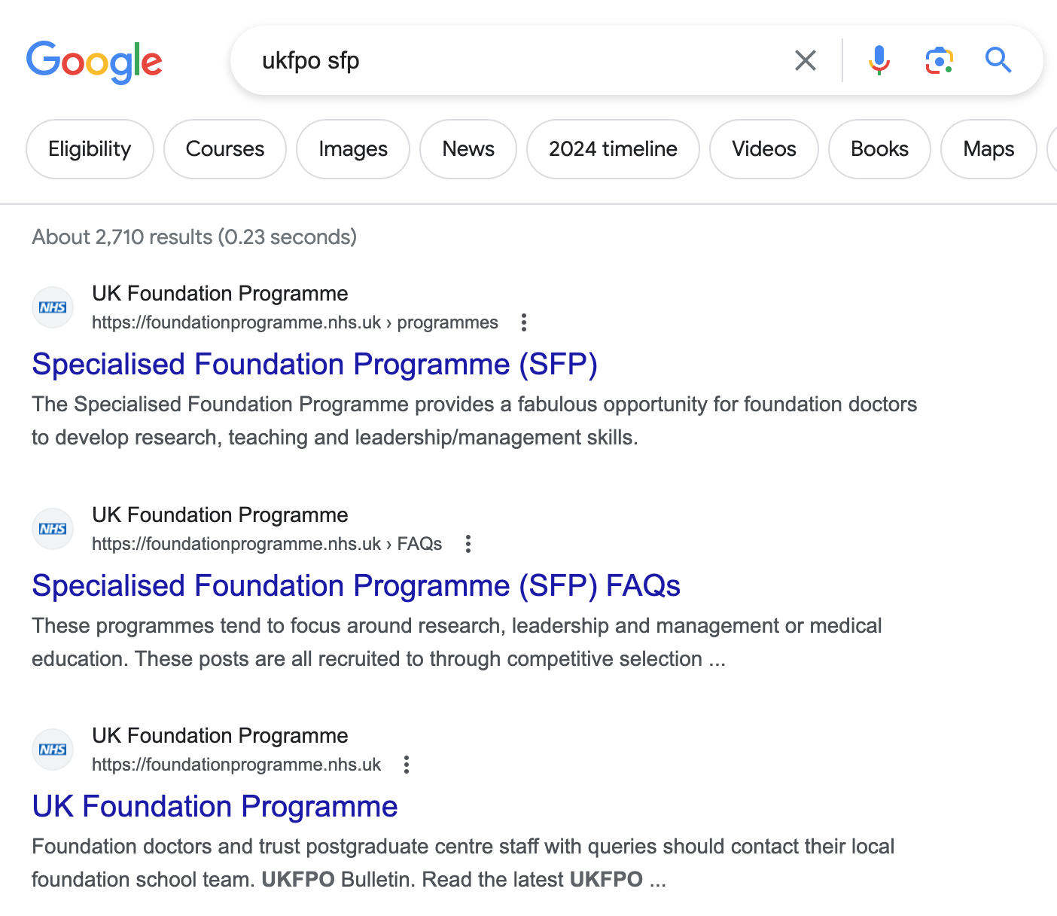

Slide 8
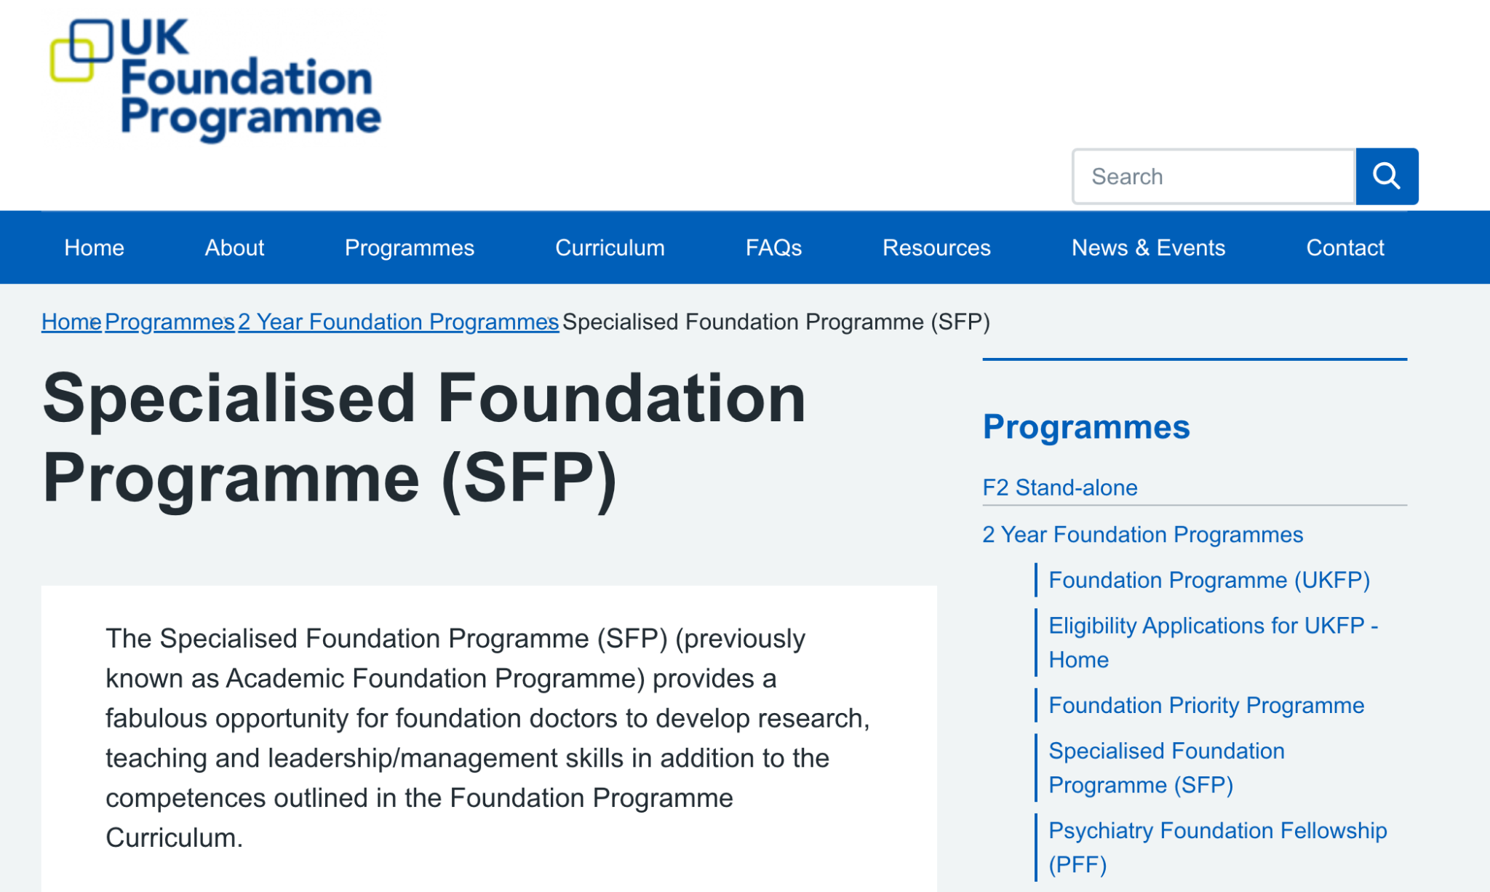
Notes:
Medical education (as of 2023)
East of England
East Midlands (LNR & Trent)
KSS & Wessex
North West of England
Peninsula
Scotland
Yorkshire & Humber
Leadership & management (as of 2023)
East Midlands (LNR & Trent)
KSS & Wessex
North West of England
Peninsula
Scotland
Wales

Slide 9
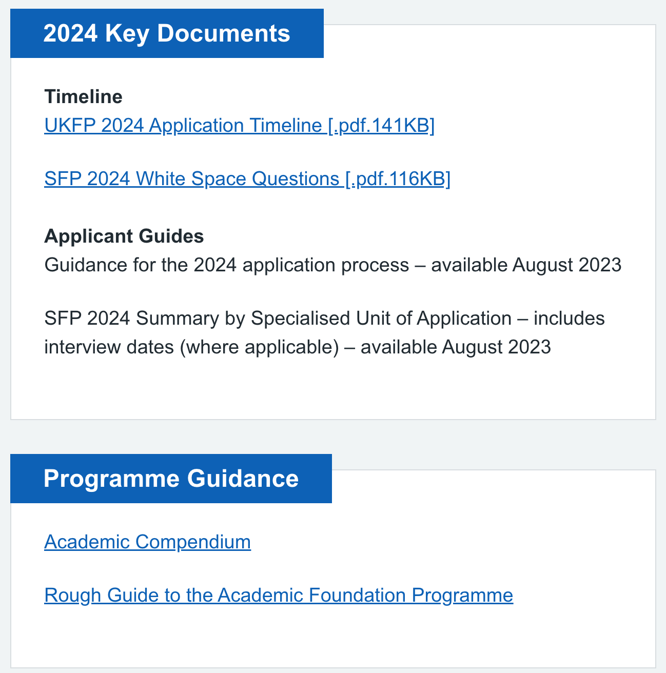
Notes:
Medical education (as of 2023)
East of England
East Midlands (LNR & Trent)
KSS & Wessex
North West of England
Peninsula
Scotland
Yorkshire & Humber
Leadership & management (as of 2023)
East Midlands (LNR & Trent)
KSS & Wessex
North West of England
Peninsula
Scotland
Wales

Slide 10
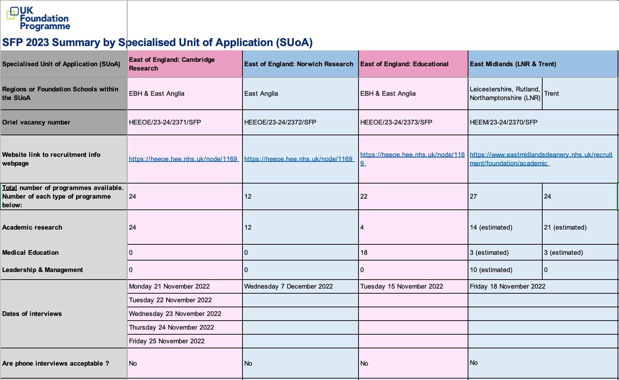
Notes:
Medical education (as of 2023)
East of England
East Midlands (LNR & Trent)
KSS & Wessex
North West of England
Peninsula
Scotland
Yorkshire & Humber
Leadership & management (as of 2023)
East Midlands (LNR & Trent)
KSS & Wessex
North West of England
Peninsula
Scotland
Wales

Slide 11
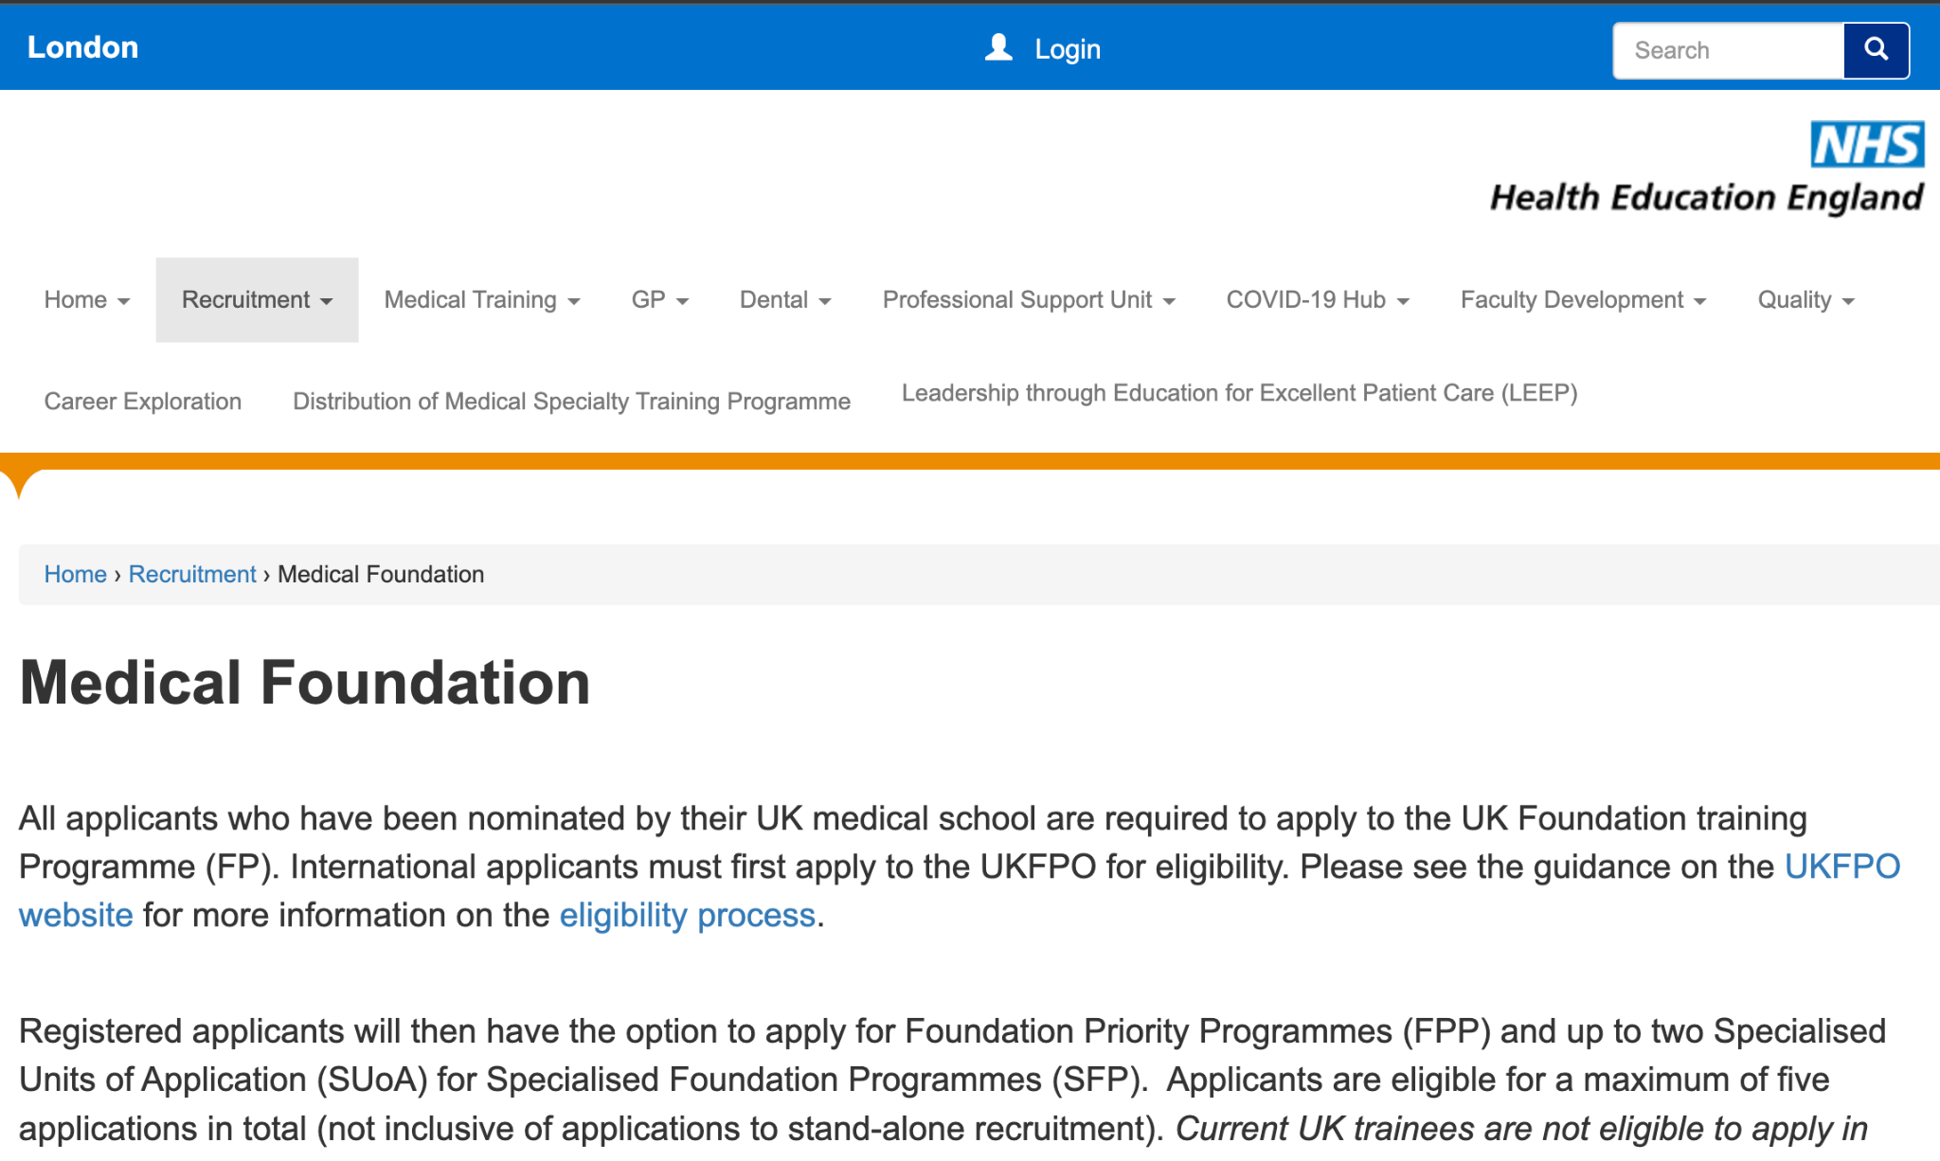
Notes:
Medical education (as of 2023)
East of England
East Midlands (LNR & Trent)
KSS & Wessex
North West of England
Peninsula
Scotland
Yorkshire & Humber
Leadership & management (as of 2023)
East Midlands (LNR & Trent)
KSS & Wessex
North West of England
Peninsula
Scotland
Wales

Slide 12
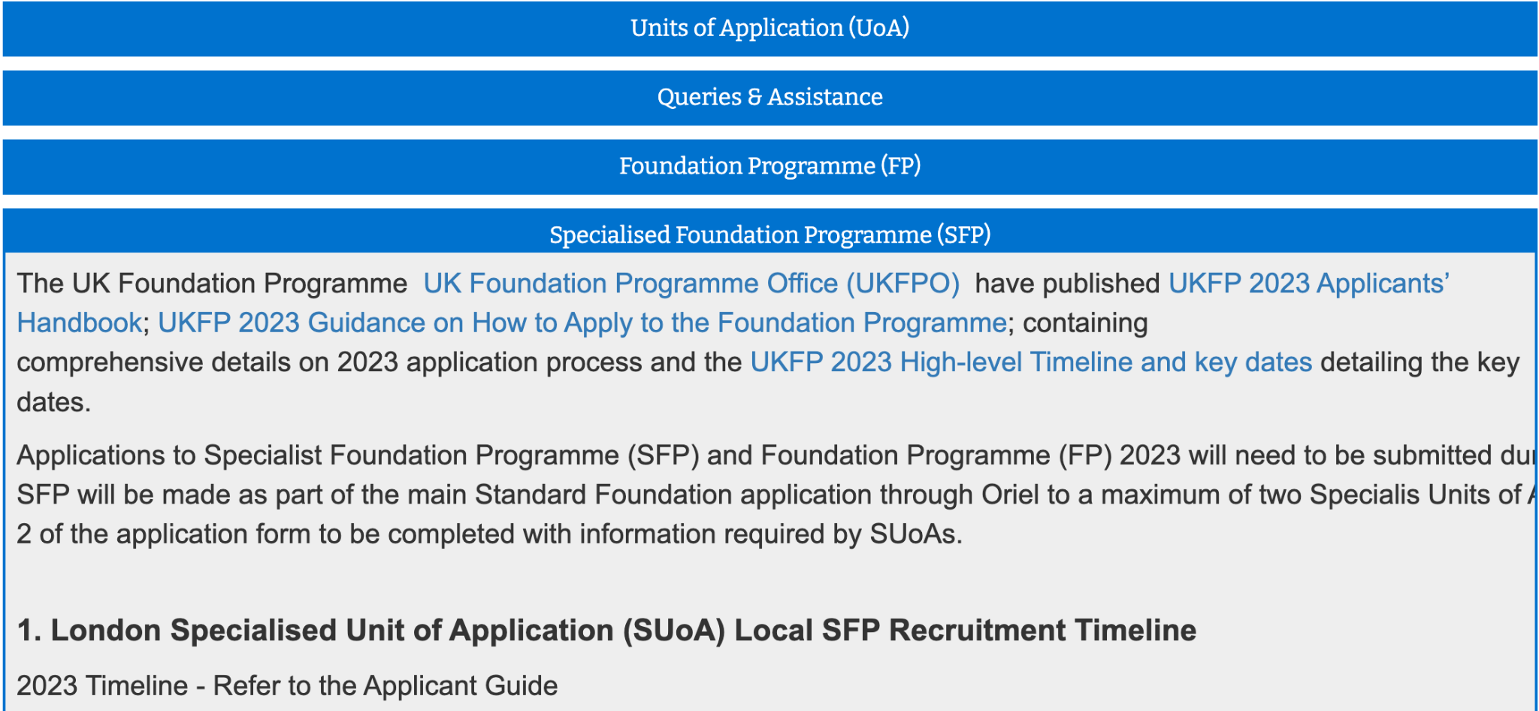
Notes:
Medical education (as of 2023)
East of England
East Midlands (LNR & Trent)
KSS & Wessex
North West of England
Peninsula
Scotland
Yorkshire & Humber
Leadership & management (as of 2023)
East Midlands (LNR & Trent)
KSS & Wessex
North West of England
Peninsula
Scotland
Wales

Slide 13
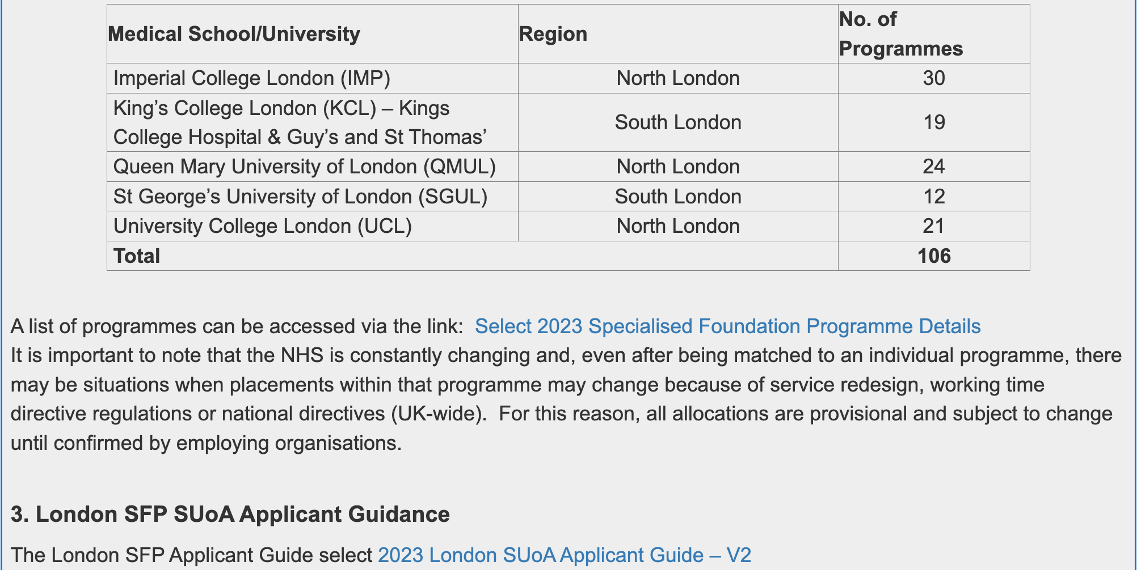
Notes:
Medical education (as of 2023)
East of England
East Midlands (LNR & Trent)
KSS & Wessex
North West of England
Peninsula
Scotland
Yorkshire & Humber
Leadership & management (as of 2023)
East Midlands (LNR & Trent)
KSS & Wessex
North West of England
Peninsula
Scotland
Wales

Slide 14
Placement lines examples (London)
FY1: Northwick Park Hospital
Paediatrics (4 mo)
Gastroenterology (4 mo)
General surgery (4 mo)
FY2: Charing Cross and Hammersmith Hospitals
Academic medicine (4 mo)
Acute internal medicine (4 mo)
Intensive care (4 mo)

Slide 15
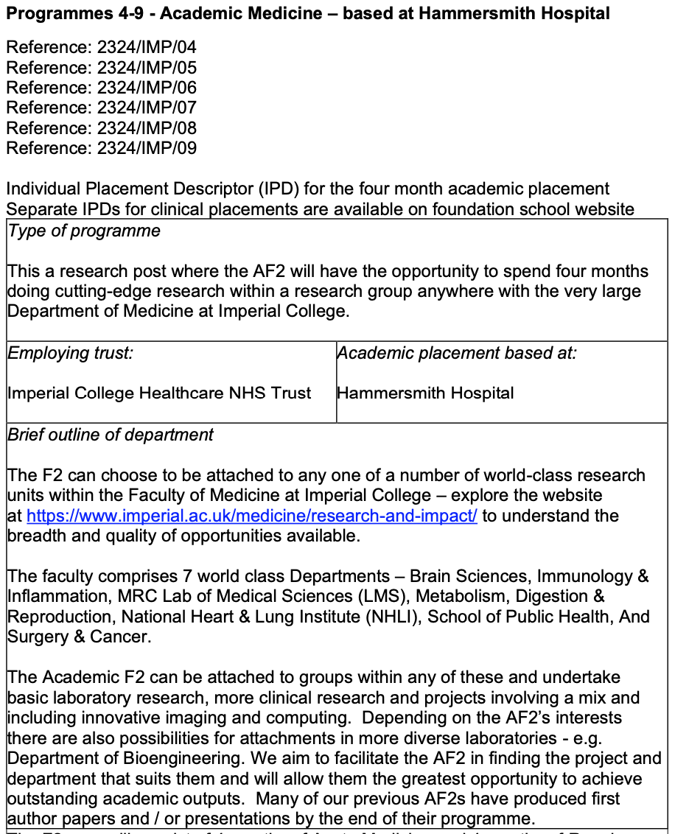
Notes:
Medical education (as of 2023)
East of England
East Midlands (LNR & Trent)
KSS & Wessex
North West of England
Peninsula
Scotland
Yorkshire & Humber
Leadership & management (as of 2023)
East Midlands (LNR & Trent)
KSS & Wessex
North West of England
Peninsula
Scotland
Wales

Slide 16
Placement lines examples (Oxford)
FY1: Royal Berkshire Hospital
Geriatric Medicine (4 mo)
Colorectal surgery (4 mo)
Psychiatry with academic day release (4 mo)
FY2: Oxford University Hospitals
Paediatrics (4 mo)
General medicine (4 mo)
Academic research (4 mo)

Slide 17
Why and why not?
Advantages
Disadvantages
Portfolio building and networking
Honorary member of staff at a university
Extra-curricular opportunities (sport societies, courses & modules)
Library services
Waived fees for publications
Bursaries
Allocated *PAID* time for research/leadership/education
Break from clinical rotas (*depends)
Great start if you want to continue down the academic pathway/apply for fellowships
Application process is less random
Reduced clinical exposure (less time to achieve same competencies)
Reduced pay (*Locuming is still possible)
Application process is time-intensive
More restricted FY1/FY2 lines
Notes:
Other pro that might change: knowing your allocation in advance

Slide 18
Timeline
Date | Event | Action
12th September 2023 | Registration opens on Oriel | Register on Oriel
20th September 2023 | Applications for FP, SFP, FPP open | Write up application
4th October 2023 (midday) | Applications for FP, SFP, FPP close
13th October 2023 (midday) | Deadline to change SFP ranking and preferences | Finish ranking preferences
13th October - 29th December 2023 | SFP selection process | Interviews
10th January 2024 | 1st offers released | Accept within 48hrs
17th, 24th, 31st January 2024 | Round 2, 3, 4 | Accept within 48hrs
5-9 February 2024 | Clearing round | Accept within 48hrs

Slide 19
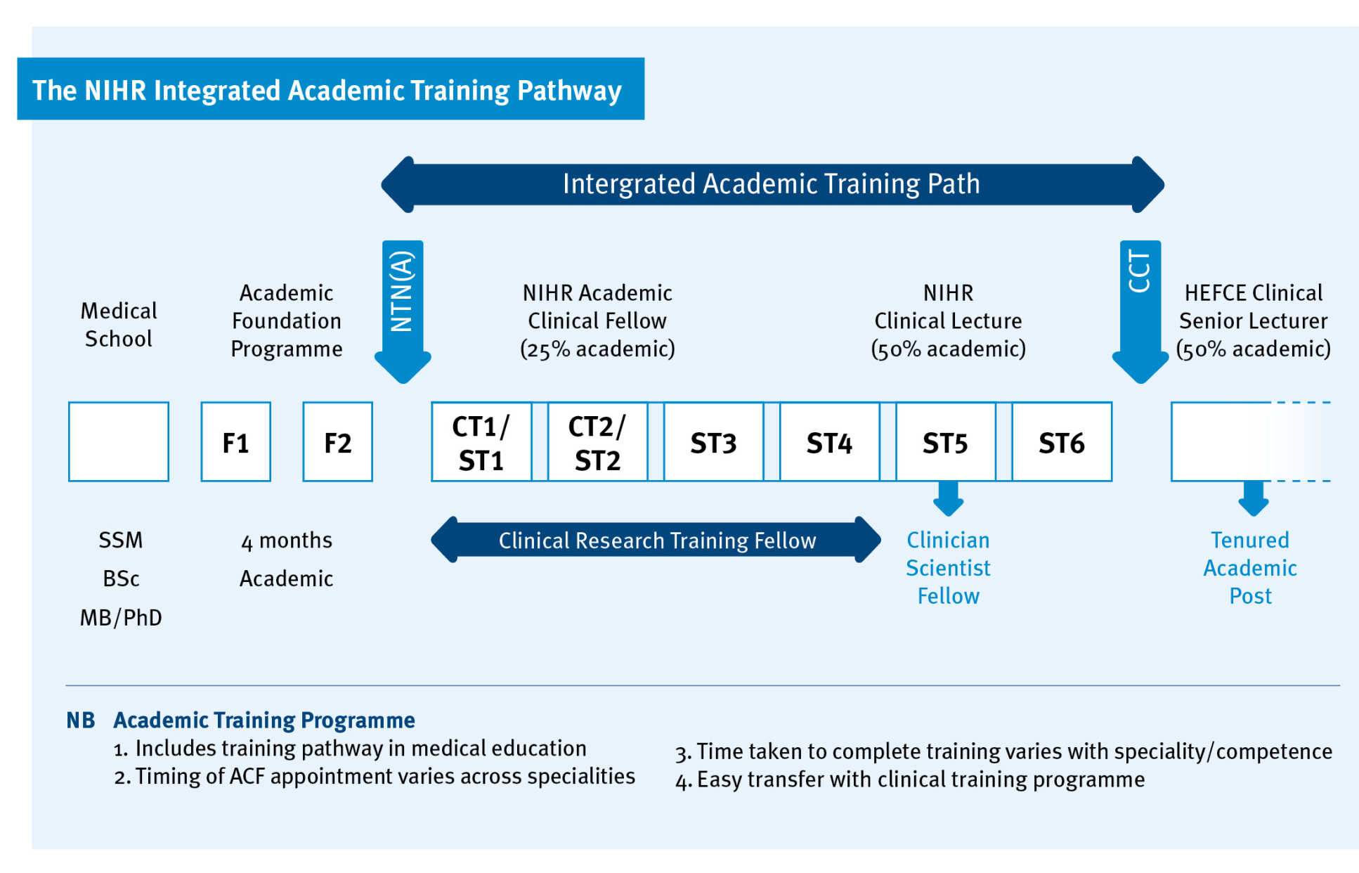
Academic Pathway

Slide 20
Preparation
Decide on SFP SUoAs & collect portfolio points
Rank SFP preferences & prepare for interview
- August
October
September
November
Write WSQs & submit Oriel application
Give interview & relax!

Slide 21
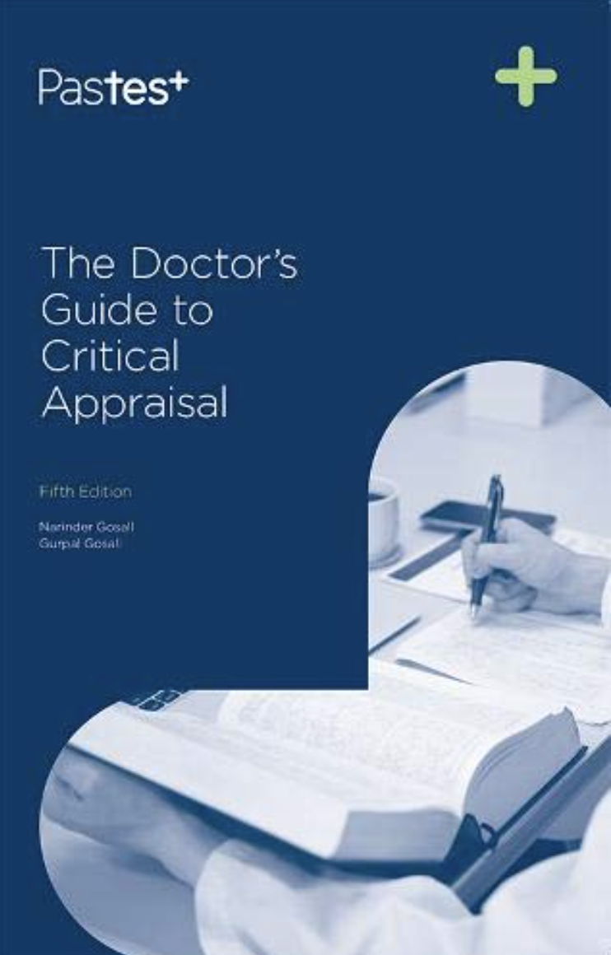
Resources
01
These webinars!
Med socs social media pages
Previous SFPs via personal contacts, LinkedIn, etc
Peers, near-peers & webinars
02
The ABCDE Approach (Zinchenko)
Oxford handbook, emergencies chapter
The Doctor’s Guide to Critical Appraisal (Pastest)
How to read a paper (Greenhalgh)
Books
03
SUoA specific interview guidance online
Geeky medics, Passmed EM Qs
iResus app
BiteMedicine’s AFP Cheat sheet pdf
ATSP Re: booklet pdf
OSCEStop ethics
Online material

Slide 22
SFP Experience:
Dimitrios Karponis, MRCP MBBS BSc
NIHR Academic Clinical Fellow in Dermatology

Slide 23
Next Steps
Collate portfolio points
Gather certificates
Get consultant sign-offs where required
Network
Linkedin
Email SFP leads at university
Get in contact with previous/current SFP trainees
Contact societies from desired deaneries
Find friends/colleagues who are also applying
Read available documents on SFP website

Slide 24
Q&A & Feedback form
Slides and recordings to be emailed on completion of the feedback form.

