Slide 1



Year 2 OSCE Crash Course
Prescribing
By: Maheen Siddiqui (Yr4), Shruti Turaga (Yr3) & Amy Zhang (Yr3)

Slide 2
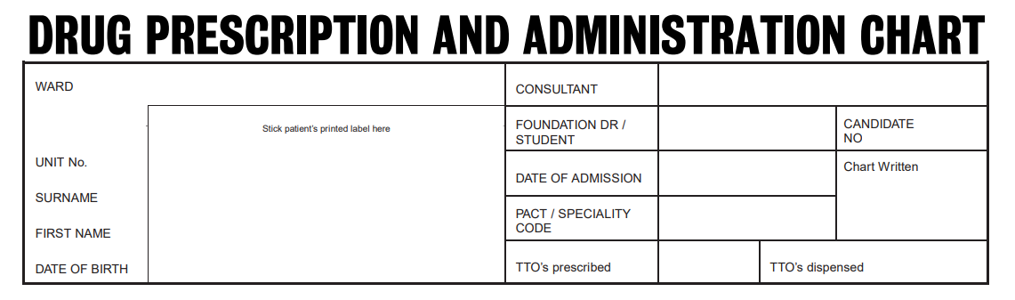

Slide 3
Not necessary, but as that extra addition, you can add your signature and bleep number (i.e. BL1234) here
Dr ABC
[Your name]
[Today’s Date]
1/1
There will usually be a sticker label in the OSCE that you have to stick in this section - do NOT forget to do that!
Leave the remaining slots empty

Slide 4
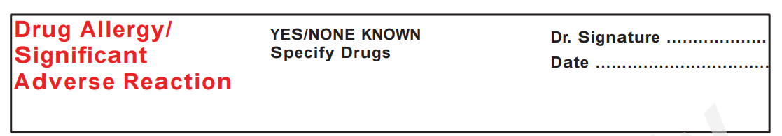

Slide 5
IF ALLERGIC
[Your sign]
[Today’s Date]
Paracetamol - rash over torso
Amoxicillin - anaphylaxis
Make SURE that you have written the drug AND the reaction
Not necessary, but as that extra addition, you can add your name and bleep number (i.e. BL1234) here
Usually, they will not mention non-drug allergy but if they have, you can add it on, especially if the reaction is very severe because e.g. some drugs might contain that as an ingredient

Slide 6
IF NO ALLERGIES
[Your sign]
[Today’s Date]
NKDA
Make SURE that you have written the words NKDA/No Known Drug Allergy if they have got none
Not necessary, but as that extra addition, you can add your name and bleep number (i.e. BL1234) here

Slide 7
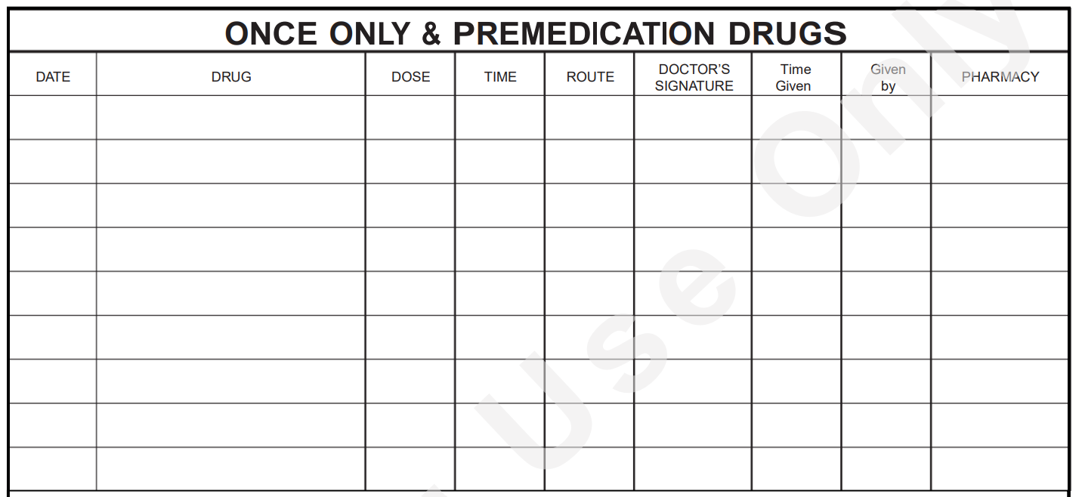
Write in BLOCK/CAPITAL letters!
Abbreviations to know
g, mg
NEVER write microgram as an abbreviation, it ALWAYS needs to be written in full
Abbreviations to know
PO, IM, IV, SC, NEB. INH
Always try to give the medication as PO, UNLESS the patient cannot tolerate oral intake (i.e. is vomiting), in which case use another route, usually IV
[Today’s Date]
PARACETAMOL
1g
08:00
PO
[Your sign]
Leave this section blank in the OSCE
(Nurses fill it out when they actually give the meds)
Most, if not all, medications in the OSCE will need to be prescribed here in the STAT section
This is the section where you prescribe the medications that the patient needs immediately when they have come to you (which is usually the first dose of most medications they will continue getting)
PRO TIP - always write 08:00, regardless of what time it is
It makes it a lot easier on the next page when you have to prescribe the rest of the doses

Slide 8
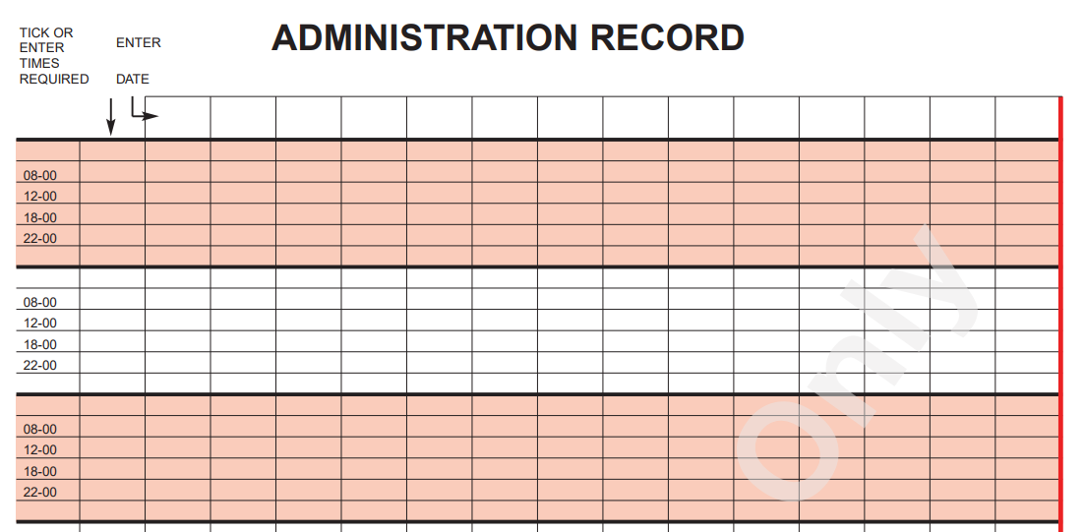
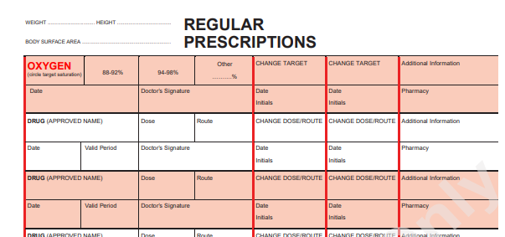
Circle the times you want the medication given
This is where choosing 08:00 in the previous section really helps. Because you already have set times starting at 8 in the sheet, you can just use these rather than having to calculate and write times
When you have given the first dose already in the previous STAT section, you HAVE to cross it out here
This helps the nurse know that this is already given and prevents duplication and overdose
[Date]
[Date]
[Date]
[Date]
[Date]
PARACETAMOL
1 g
PO
Pain
Max 4g per day
[Date]
Sign (and BL1234)
AMOXICILLIN
500 mg
PO
Community-acquired pneumonia
16:00
[Date]
5 days
Sign (and BL1234)
00:00
R/V
Always write indication (why you are giving it) in the additional information box
And then add any other relevant information in the BNF not already mentioned elsewhere on this chart
Valid period depends on medication given
For some meds, it mentions in BNF
If not mentioned:
PO antibiotics = 5 days
IV antibiotics = 2 days

Slide 9
If something has a valid/review period, put a box and write down R/V next to it for the last dose before review
And then for where there is a valid period, CROSS OUT all remaining dates to prevent any chances of error
[Date]
[Date]
[Date]
[Date]
[Date]
PARACETAMOL
1 g
PO
Pain
Max 4g per day
[Date]
Sign (and BL1234)
AMOXICILLIN
500 mg
PO
Community-acquired pneumonia
16:00
R/V
[Date]
5 days
Sign (and BL1234)
00:00
What to do if the drugs’ times don’t match the ones written
1. Calculate how far apart the doses need to be to be equally spaced, e.g. if you need to give 3 doses, then 24 hours/3 = 8 hours
2. Start at 08:00 for first dose - circle 08:00
3. Calculate what times the remaining two doses can be given (count 8 hours apart = 16:00 and 00:00)
4. Write the new times out in the space next to set times and circle them
5. Cross out any of the pre-written times that you are not using

Slide 10
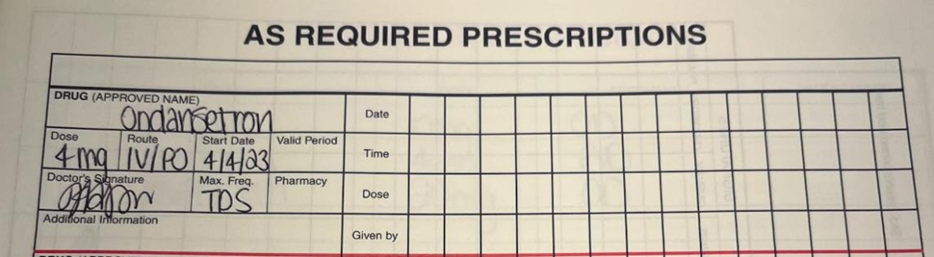
The “As Required” Section is for drugs that are not administered with a regular daily frequency.
They should only be administered if the patient experiences certain symptoms/signs or asks the nursing staff for them.
Max frequency is VERY IMPORTANT here - use the BNF
The indication that would prompt appropriate administration of such drugs should be stipulated on the drug chart under “Additional Information”

Slide 11
Other tips
Probably worth learning the details to fill in simple paracetamol to save you time
When using BNF, you can search using:
        Drugs
              Search drug name in the “Drugs” section of BNF
        Condition
              Search condition name in the “Treatment Summaries” section of the BNF
              For any infective condition e.g. pneumonia, if it does not turn up by searching condition name directly, you will have to search “Anti-infective” in the treatment summaries and navigate through there

Slide 12
Other tips
If they have not specified which section to put the medications in (STAT, regular, PRN), our advice for the safest bet in OSCE is:
      Put all drugs in STAT AND in regular
      As mentioned before, remember to cross out the first dose in the “Regular” section since you have already given that in STAT

Slide 13
Case 1

Slide 14
Patient details :
Name : Samuel Wright
DOB : 11/05/1947
Hospital : St Thomas’ Hospital
Ward : Albert ward
Consultant responsible : Dr Kapoor
Date of admission : 16/03/2026
You are a junior doctor on the ward.
Mr Wright is admitted to the ward with right lower lobe pneumonia.
He is febrile, in pain, and struggling to eat.
Prescribe prescribe him amoxicillin for treatment, paracetamol regular and cyclizine PRN.

Slide 15
Ondansetron
4mg
IV
Three times a day
PRN
Cyclizine
50mg
IV
Up to three times a day
PRN
Amoxicillin
500mg
Oral
Three times a day
5 days
Paracetamol
1g
Oral
Four times a day

Slide 16
Patient details :
Name : Samuel Wright
DOB : 11/05/1947
Hospital : St Thomas’ Hospital
Ward : Albert ward
Consultant responsible : Dr Kapoor
Date of admission : 16/03/2026
Case 2
Mr Wright presens to A&E with sudden onset SOB and pleuritic chest pain. CTPA confirms a pulmonary embolism.
He weighs 70kg, has a normal renal function and is allergic to enoxaparin (anaphylaxis).
Please prescribe him Apixaban for treatment, and PRN paracetemol PO for analgesia.
You may use the BNF

Slide 17
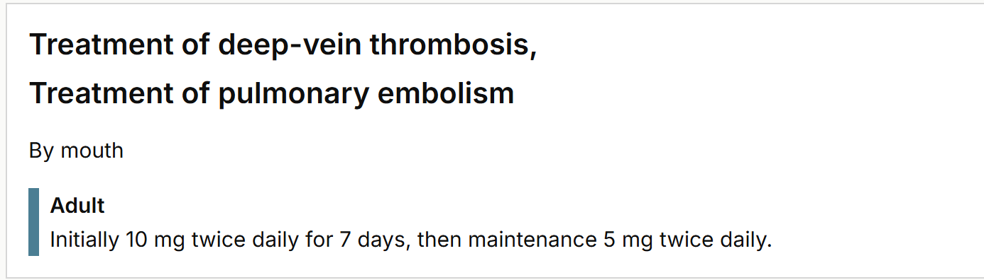
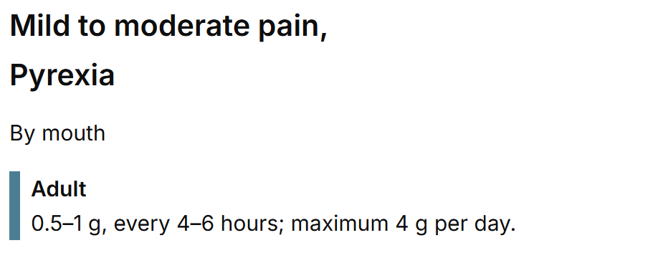
…...
3 separate prescriptions :
2x regular :
  one for loading dose (R/W after 7 days)
  one for maintenance
one PRN
  Paracetemol

Slide 18
Ful
Case 3
Mr Wright presented with lower urinary tract symptoms, and, following urine cultures was found to have a UTI. He is allergic to trimethoprim (rash)
Please prescribe him the appropriate medication
including paracetemol for his fever
You may use the BNF

Slide 19
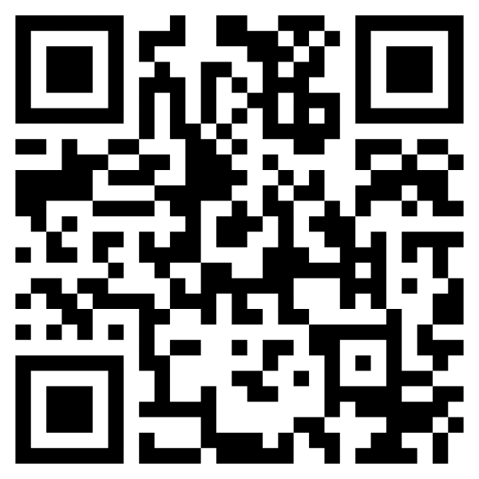
Feedback Form

