Slide 1

FAH
Ayesha Syeda

Slide 2

Topics included:
Histology (tissue organisation, cell junctions, soft connective tissue)
Skeletal muscle and nerve
Skeleton and joints

Slide 3
HISTOLOGY
the bane of everyone’s existence

Slide 4
Connective Tissue
Functions:
Filling space between tissues
Structural support
Attachment
Physical support
Defence against infection
Conduction for blood vessels, nerves, lymphatics
Regulating metabolism
Storage
Wound healing
Properties depend on the surrounding extracellular matrix
SOFT connective tissue
Organ capsule, Tendons, Ligaments, Areolar Tissue, Adipose Tissue, Phagocytic & immunocompetent cells
Physical barrier preventing transport of microorganisms that pass through the epithelia
Nutrient role
Cells are surrounded by extracellular matrix that they secrete It is made of ground substance (GAGS), glycoproteins, proteoglycans. Colourless, transparent mixture. Lubricant; Barrier to penetration; Regulating metabolism by allowing fluid movement
Permanent cells = fibroblasts, adipose
Transient cells = phagocytic + immunocompetent, mast cells, plasma, leukocytes, lymphocytes
HARD connective tissue
Bone
Cartilage

Slide 5
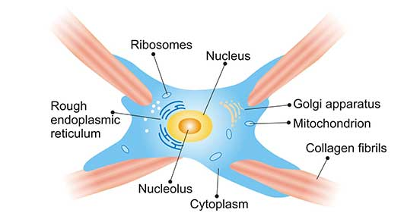
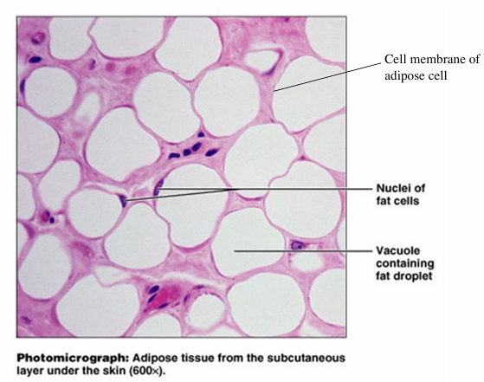
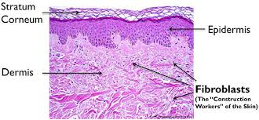
Fibroblasts
Adipose Cells
Permanent cells
Synthesise collagen + ground substance
In ALL soft connective tissue
Active fibroblasts:
  More cytoplasm
  RER
  Larger Golgi
Mature fibroblasts:
  Nuclei are condensed and elongated
  Sparse cytoplasm
Permanent cells
Mostly found in large adipose spreads
Isolated vs small groups
Largest store for energy
Continuous turnover
Sensitive to hormonal + nervous stimuli
Shaping body via subcutaneous layers
Fat pad deposits => shock absorbers
Keep tissues in place by filling spaces

Slide 6
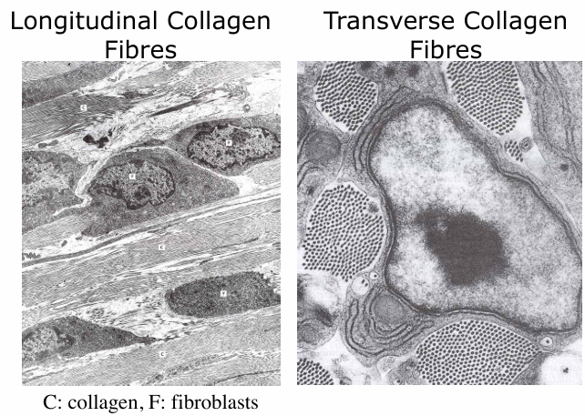
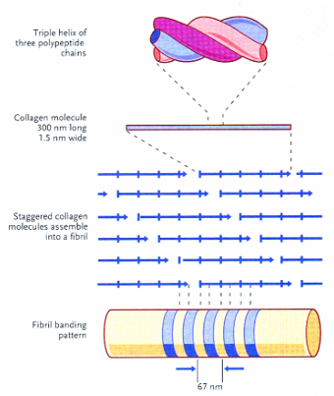
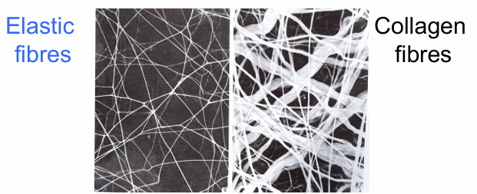
COLLAGEN
ELASTIC FIBRES
Most abundant fibres in connective tissue
Appears white
Inelastic & High tensile strength
  Flexible => can bend
  Strong => cannot stretch
Arranged in bundles of parallel arrays
Type 1: most abundant, widespread distribution, forms fibres
  Synthesised by fibroblasts
  3 polypeptide chains
  300nm long fibril
  Staggered assembly => banding appearance
Type 2: hyaline + elastic cartilage, forms thin fibres
Type 3: forms reticular fibres, can polymerise
Type 4: cohere as amorphous mat in basal lamina for attachment
Type 5: in basal lamina, foetal membranes + vessels
Stretchable & resilient fibres + sheets
Hydrophobic
Assembly via cross-linking
Tropoelastin monomers polymerise outside cell in extracellular tissue
Microdires of structural glycoprotein fibrillin _ elastin
Fine, straight, branched
Vary ratio of elastin:collagen AND arrangement of collagen => varying stretchiness

Slide 7
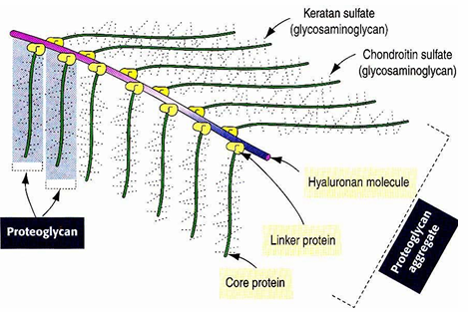
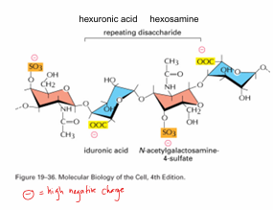
PROTEOGLYCANS
BASAL LAMINA
aka basement membrane
Interface between & attachment to underlying connective tissue -
Gives epithelia a strong, stable adhesion to underlying connective tissue
Epithelial cells attach to it on their basal surface via hemidesmosomes
Selective permeability barrier -> controlling entry+exit to/from cells
Control epithelial growth
Cell specialisation/differentiation
Barrier to downward growth of epithelium
Maintaining integrity of tissues
Core protein + Carbohydrate side chains
Glycosaminoglycans GAGS
  Linear polysaccharides of repeating disaccharide units
  Usually hexose/hexuronic acid + hexosamine
  10% protein weight BUT occupy most volume as porous hydrated gel
Carb chains don’t fold => occupy large volume
High negative charge of hydroxyl, carboxyl, sulphate group => hydrophilic => attracting Na+ => water enters ‘spongey’ matrix via osmosis
Swelling pressure turgor => ECM withstands compressive forces

Slide 8
Cell to Cell Junctions
Type of junction | name | Site of junction | Part of cytoskeleton involved | Proteins involved (transmembrane) | Proteins involved (extracellularly ie in adj cell/ in ECM) | Intracellular adaptor proteins (connect cytoskeleton to transmembrane protein)
adhering | Desmosomes | Between adj cells | IF | Cadherins -[ desmoglein and desmocolin] in cell membrane | [ desmoglein and desmocolin] in adj cell membrane, which attach to | [plakoglobin and desmoglobin] in/on intracellular attachment plaque(which connects to IF)
adhering | hemidesmosomes | Between cell and basal lamina | IF | Integrins (in cell membrane) | ECM proteins (e.g collagen and laminins ) | Plectin, erbin, BP230 in/on intracellular attachment plaque (connects to IF)
adhering | adherens | Between adj cells | Actin | Cadherins | Cadherins | actin-associated proteins eg catenins & p120
Non -adhering | Tight/occluding | Between adj cells | - | Claudins and occludins | Claudins and occludins
Non- adhering | gap | Between adj cells | - | 6 connexins/ one connexon in each membrane | 6 connexins in each membrane/ one connexon

Slide 9
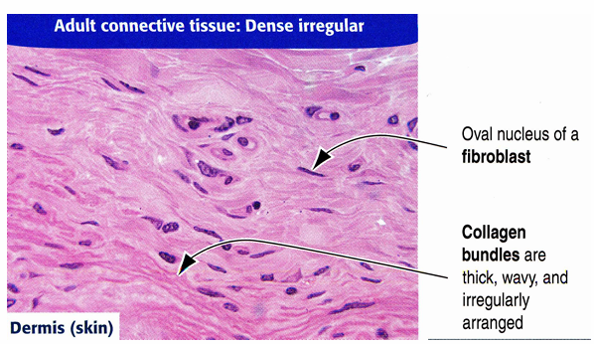
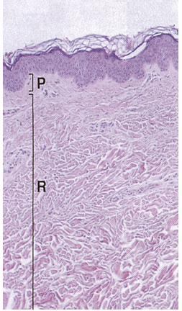
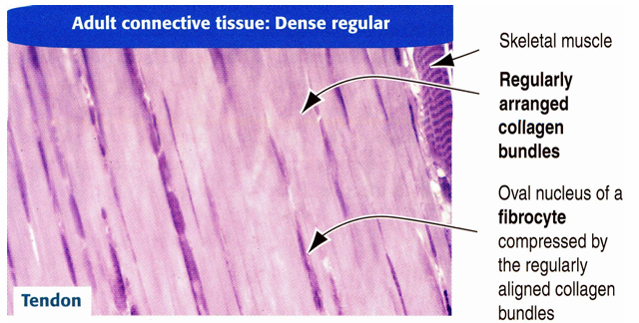
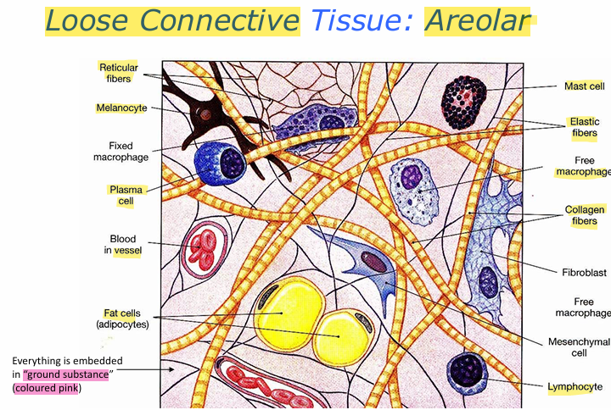
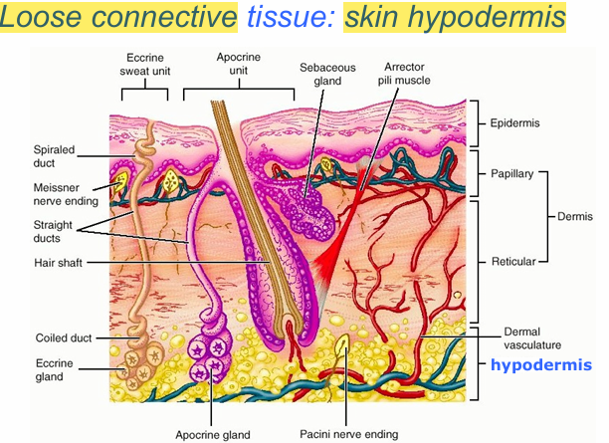
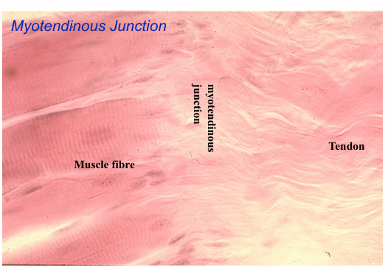
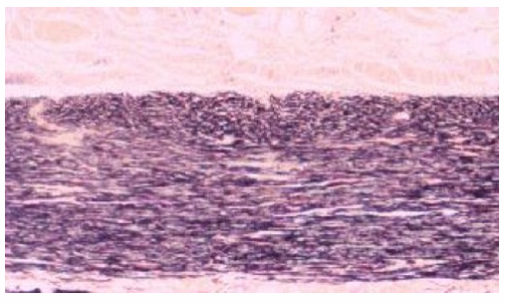
LOOSE connective tissue
DENSE connective tissue
Lamina propria of digestive + respiratory tracts & stroma of glands & skin hypodermis
Abundant elastic fibres (thin, straight, branching) + collagen bundles (thick, wavy) in ground substance
Fibroblasts (oval nuclear shape)
Immunocompetent/phagocytic cells
Skin hypodermis: abundant fat cells => mobility of skin; fibrous bands anchoring dermis to underlying deep fascia
Irregular
Skin dermis
Coarse, thick, intertwined bundles of collagen fibres in irregular arrangement
Papillary + reticular layers
Blood vessels, lymphatics, nerves
Regular
Tendons & Ligaments
Regularly oriented parallel bundles of collagen fibres separating linear rows of fibrocytes (thin dark lines)
In ligaments: elastic fibres => stretch and energy storage for movement; collagen => tensile strength and preventing overstretching!

Slide 10
HARD CONNECTIVE TISSUE!
CARTILAGE
BONE
Semi-flexible
75% water (high), 25% organic (volume)
Type 2 collagen => tensile strength
Proteoglycans => resistance to compression; electro-osmotic
Precursor for bones
Chondrocytes:
  Appositional growth = fibro/chondroblasts in perichondrium give rise to chondrocytes, produce matrix, add to existing cartilage; incorporate nearby collagen
  Interstitial growth = existing chondrocytes in matrix proliferate and hypertrophy; they receive nutrients through fluid matrix; cluster together
DIFFERENCES
Cartilage is deformable + permeable
=> enlarge by appositional + interstitial growth
=> no blood supply as diffusion is sufficient
Bone is rigid + impermeable
=> only enlarge by appositional growth
=> needs blood supply for nutrients
Mineralised
Inorganic (36%): hydroxyapatite - thin crystals, 8nm thick, variable length
Organic (28%): Type 1 collagen; other proteins
Low water content; dense matrix of minerals + salts
Support
Protection
Levers for body movement with muscle action
Bone marrow (yellow -> fat storage) (red -> haemopoietic)
Reservoir of Ca2+, PO43-, ions
To be continued …

Slide 11
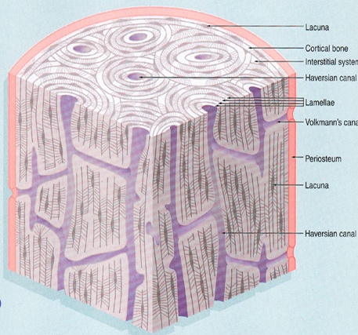
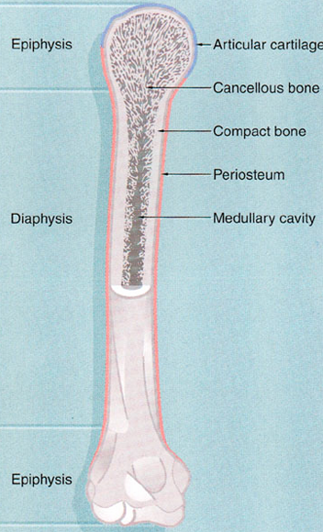
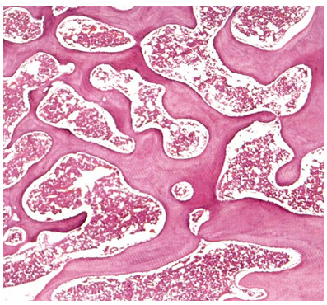
Bone Structure
Compact Bone
Outer layer of cortical (=compact) bone
Interior layer of trabecular (=cancellous, spongy) bone
Articular surfaces covered by articular cartilage (hyaline), which lacks a perichondrium
Non-articular surface covered by periosteum (connective tissues; new bone cells)
Internal surfaces lined by endosteum
Long bones: large central medullary cavity, filled with bone marrow, extends between bony trabeculae
Expanded ends (epiphyses (= secondary centre of ossification)) connected by shaft (diaphysis)
Prior to maturity, there is a growth plate between epiphysis and diaphysis
Metaphysis = transition zone between diaphysis and epiphysis
Usually also a nutrient artery entering shaft and periosteum
Middle of shaft = primary centre of ossification
Lamellar: collagen in sheets; 5µm thick; alternate orientations between sheets => greater strength.
0.25 - 0.35mm diameter
2 major patterns:
Circumferential: layers surround bony surface; at periosteal OR endosteal surfaces
Haversian systems: small concentric layers around central vascular canal
Cancellous/spongy Bone
Apposed lamellae => form trabeculae (50µm)
Trabeculae aligned along lines of stress => maximizes resistance to forces while adding minimally to the mass of the bone

Slide 12
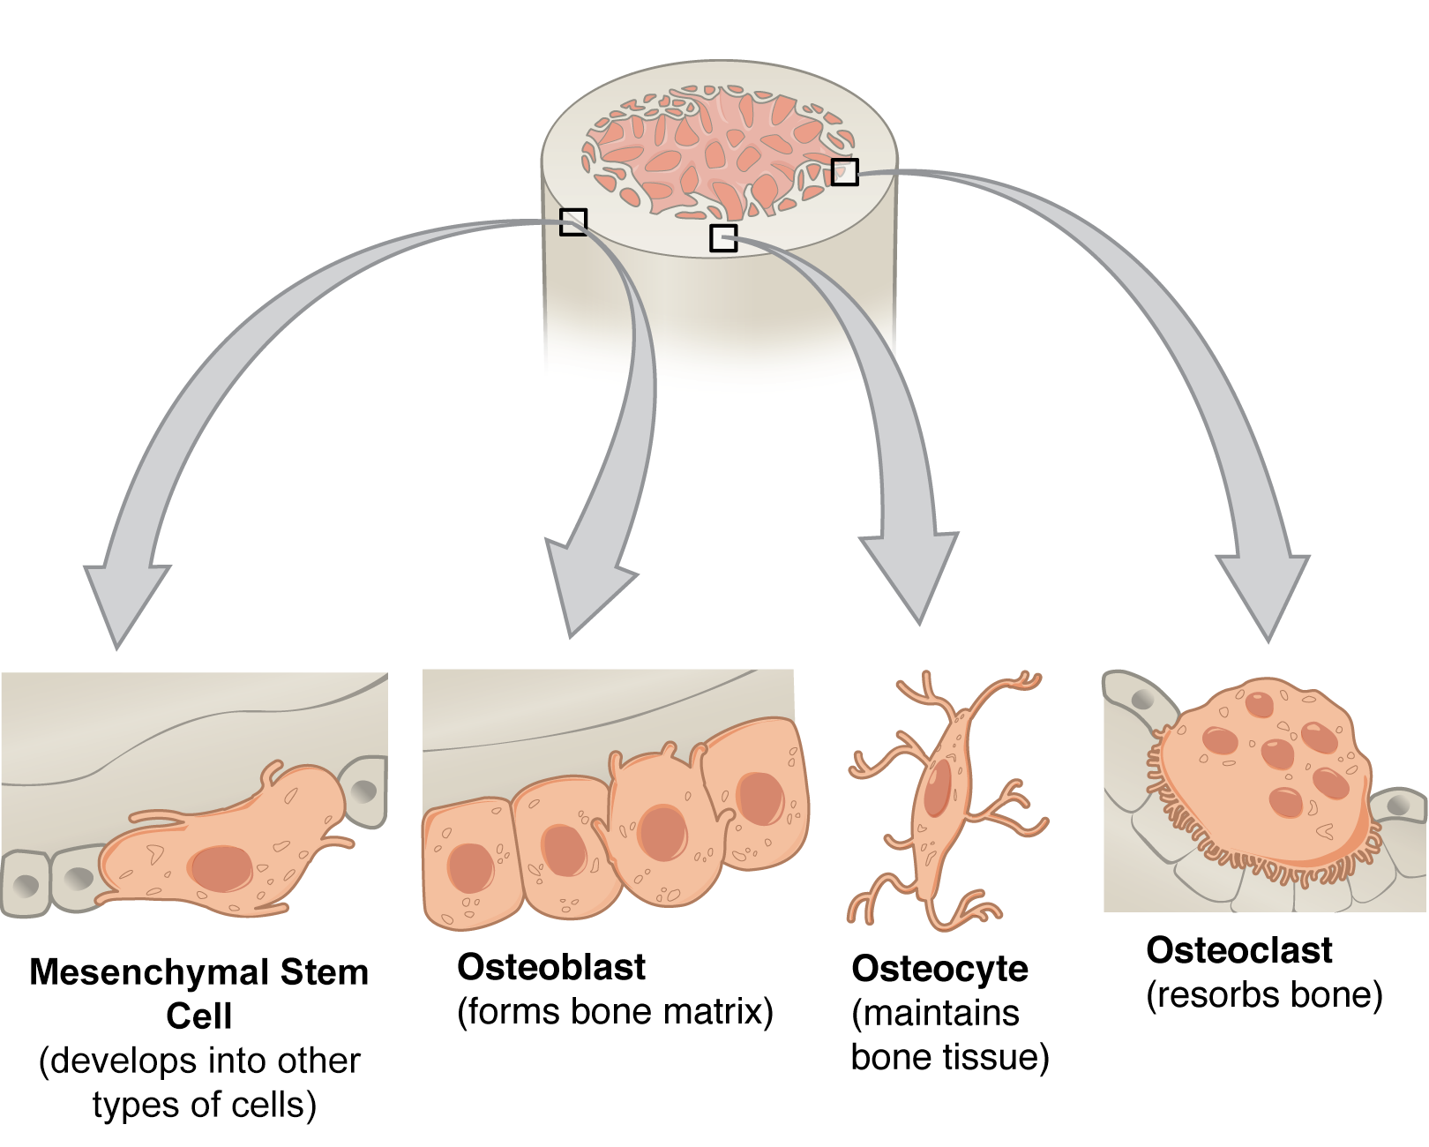
OSTEOPROGENITOR CELLS
mesenchymal, fibroblast-like
stem cell -> generation of osteoblasts
in cancellous (spongy) bone => near blood vessels
in compact bone => at periosteum + endosteum
OSTEOCYTES
Cell bodies in lacunae, mineralization around them (which traps them)
Numerous canals (canaliculI) radiate from lacunae; contain osteocyte cell processes;
=> diffusion of substances through bone
Nucleus + thin ring of cytoplasm + few organelles => little cellular activity
Gap junction joining processes of adjacent cells => communication, coordination
Calcium homeostasis
Responsive to mechanical forces
Strain receptors => mediating mechanically active bone remodelling
OSTEOBLASTS
on bone surface
deposition of osteoid (organic components of bone matrix)
secretory cells, i.e. extensive rough ER, Golgi, mitochondria, vesicles
cells in contact via desmosomes and gap junctions
Induce mineralisation through secretion of matrix vesicles
alkaline phosphatase => neutralise inhibitory effects of pyrophosphate on calcium deposition
OSTEOCLASTS
Resorption of bone => bone remodelling; Ca2+ homeostasis
In resorption cavities on bone surface - Highly motile
Variable size/shape (mononuclear to multinucleated)
Directly inhibited by calcitonin
Parathyroid hormone stimulates osteoblasts to release inducers of osteoclast differentiation
BONE-LINING CELLS
Undifferentiated flattened cells; At surface of quiescent bone; Inactive

Slide 13
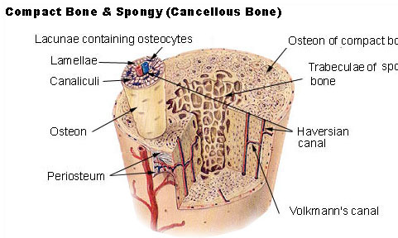
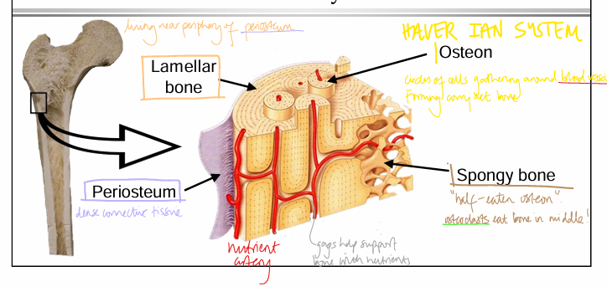
Haversian Systems
Around central vascular (Haversian) canal
4-20 concentric lamellae
Surrounded by cement line of mineralised matrix
Canals connected transversely via Volkmann’s canals
Interstitial lamellae between osteons
Formation
Osteoclasts tunnel through pre-existing bone
Tunnel invaded by blood vessels & osteoprogenitor cells
Osteoblasts lay down successful bone lamellae on tunnel walls
Interstitial systems = remnants of old osteons
The size of the osteon is limited by the distance the outer cell is from a blood vessel. If it is too far away, it will not receive enough nutrients to survive.

Slide 14
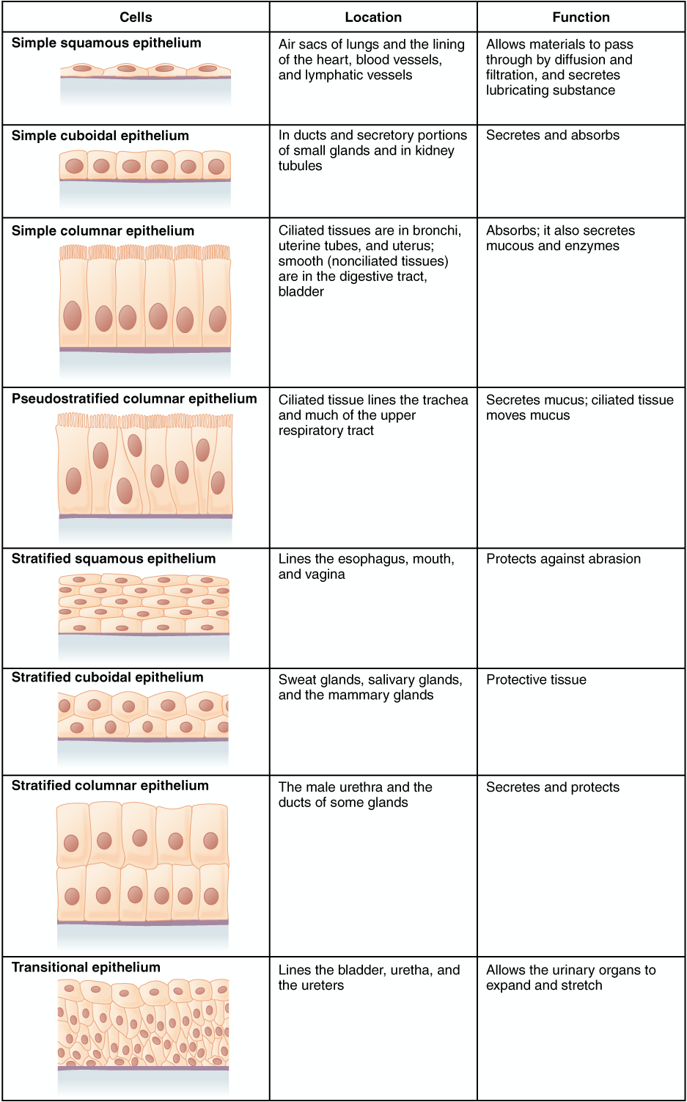
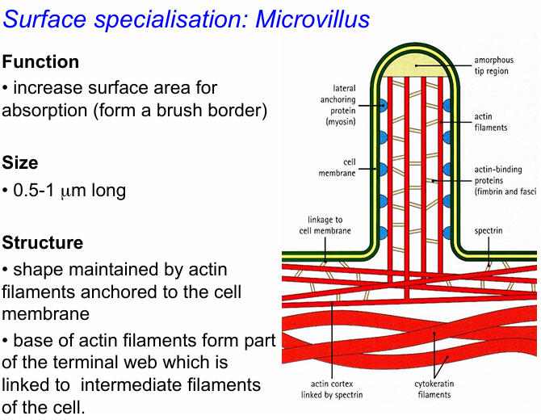
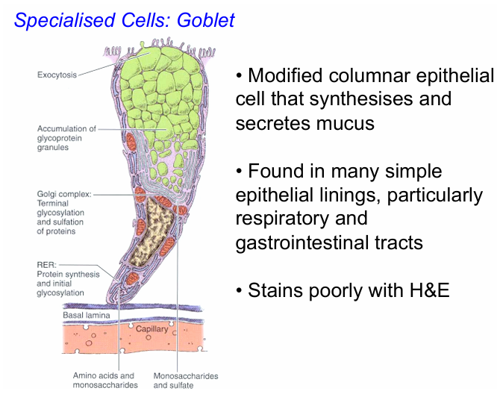
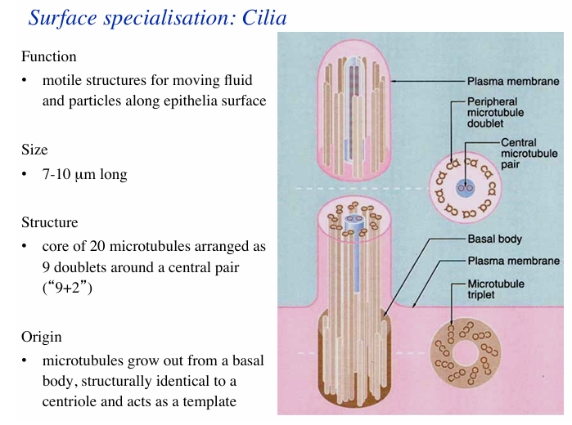
We recommend looking at the lecture slides for ‘Epithelia and Connective Tissue’ for good examples

Slide 15
SKELETON & JOINTS
i have faulty ones so may not be qualified to talk about this …

Slide 16
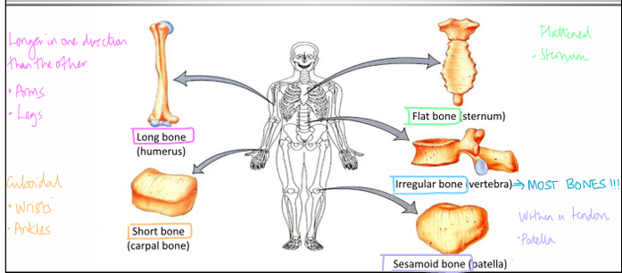
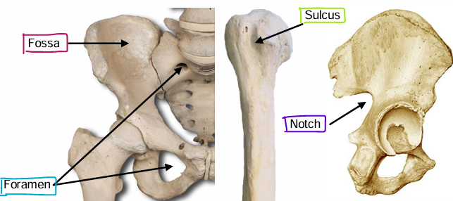
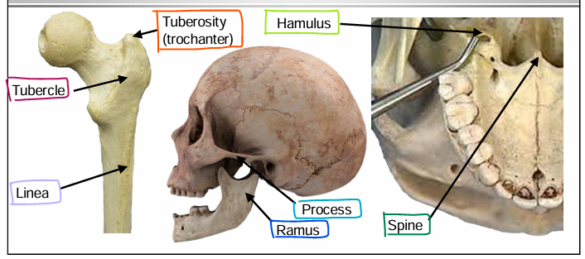
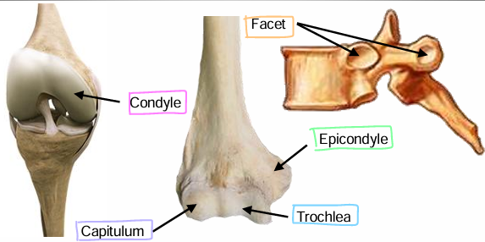
Functions of Skeleton:
Support
Movement (via muscle attachment
Protection (for internal organs)
Storage (calcium)
Haemopoiesis
Axial skeleton = trunk, skull, vertebral column, ribcage
Appendicular skeleton = limb bones
Girdles = bones connecting limb bones to trunk bones
OSSIFICATION = making bone
Intramembranous
Originating from soft connective tissue
Developing in mesenchyme
Flat parts of skull; some of clavicle
Articular cartilage is fibrocartilage
No hyaline cartilage - so not suitable for load-bearing or highly-moving joints
Endochondral
Develop from pre-existing cartilage model
Cartilage -> Bone
Lumps & Bumps
=> muscle/ligament attachment
Process = projecting outward from bone
Ramus = large process
Hamulus/conua = hooked process; for tendons
Spine = sharp lump
Tubercle = round lump
Tuberosity = large roughened area, large tubercle
Trochanter
Lines/linea/ridges/crests = extension to lumps
Articular Surfaces
Facet = small, round
Capitulum = “little head” of elbow
Trochlea = pulley
Condyle = knuckle, rounded
Epicondyle = outside condylar surface, for muscle/ligament attachment
Grooves & Holes
Sulci = grooves
Notches = not evident groove
Fossa = pit / depression
Foramen = hole

Slide 17
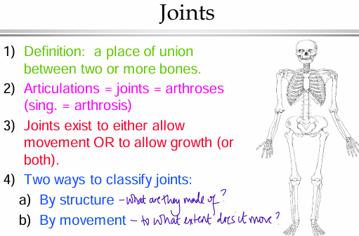
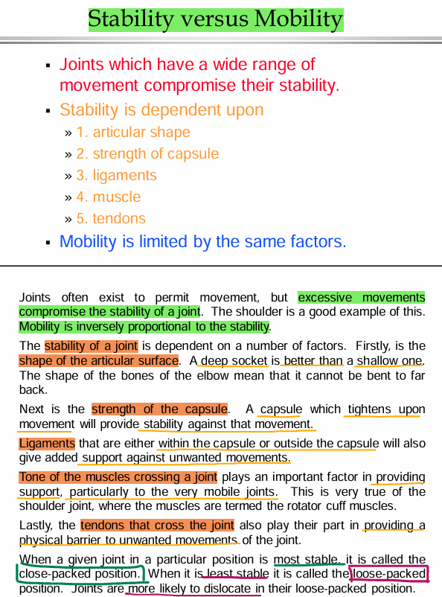
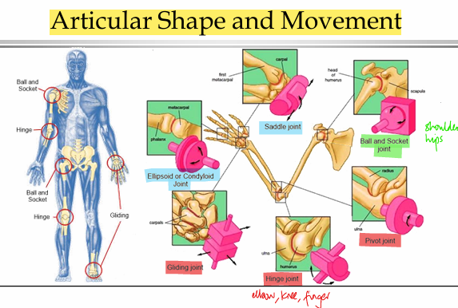
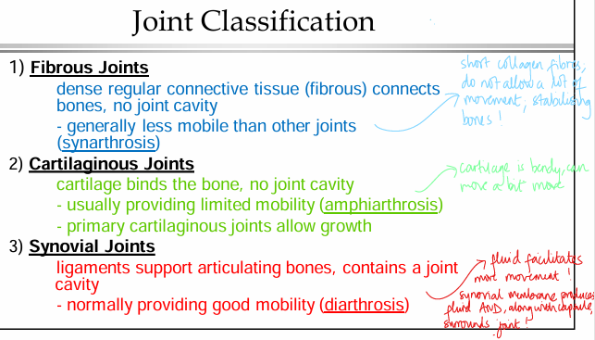
UNI-AXIAL
= moving in one plane
= gliding joints, hinge joints, pivot joints
BI-AXIAL
= moving in two planes
= ellipsoid joints, saddle joints
TRI/MULTI AXIAL
= moving in three planes
= ball socket joint

Slide 18
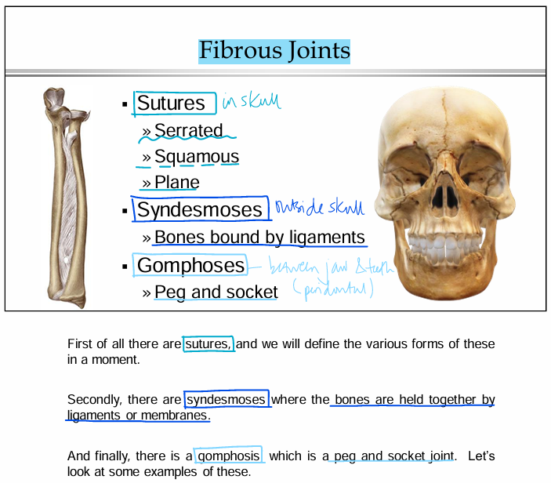
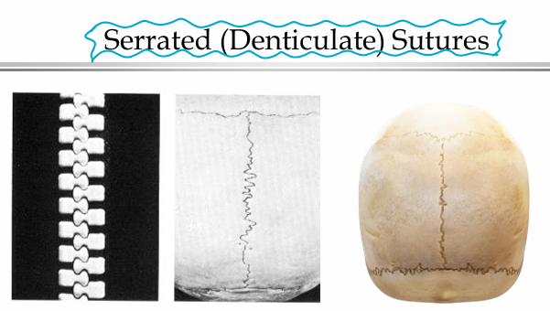
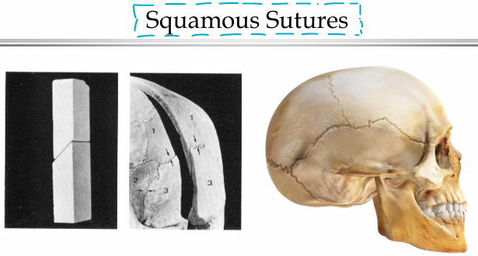
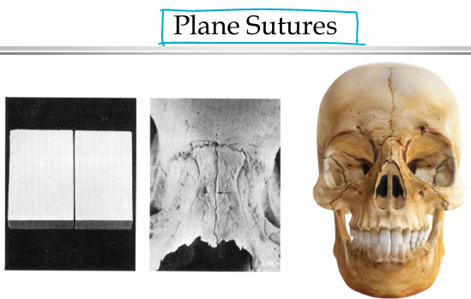
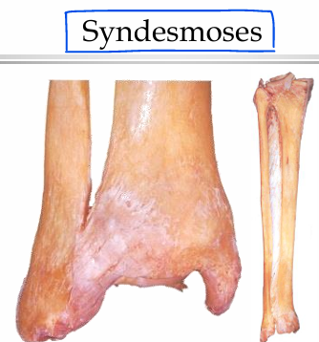
articulation between bones via fibrous tissue
=> little movement
SUTURES => permit growth; little movement
=> 3 types; found in skull
SERRATED: bones increase their stability by interlocking with each other
SQUAMOUS: bones are bevelled on each other
=> lateral stability at the side of the skull.
PLANE: bones meet edge to edge without additional support; stabilised via fibrous tissue
=> places at less stress
SYNDESMOSIS
=> bones held together by interosseous ligaments (fibrous tissue)
=> slight movement possible
<- interosseous membrane between tibia + fibula
<- inferior tibiofibular joint

Slide 19
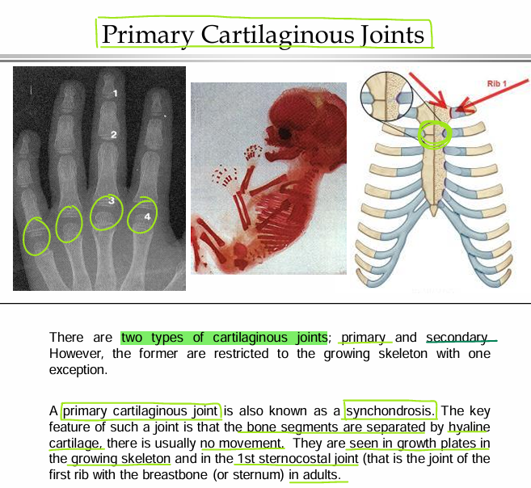
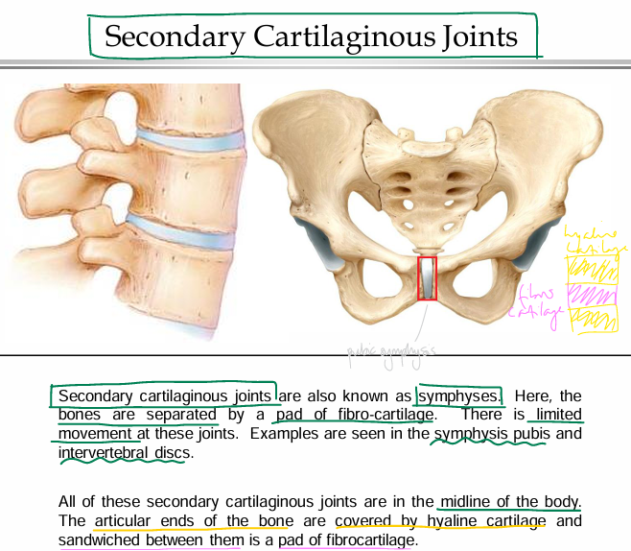
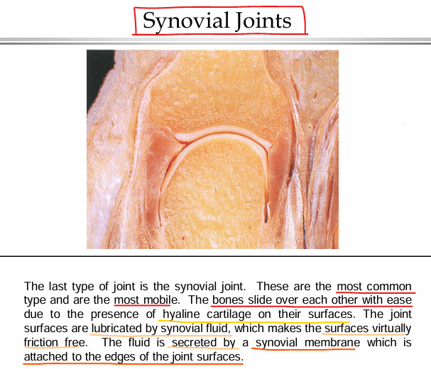

Slide 20
