Slide 1







GKTeach
Molecular Cell Biology
STAGE 1
Foundations of Biomedical Science

Slide 2
-Define different types of cells
-Recognise protein structures
-Understand pH and buffers role in the body
-Revise enzyme kinetics and define terms
-Describe lipid structures eg membranes
-Describe the significance of Hb in the body
-Revise intercellular signalling and transport
-Briefly cover DNA and genes
LEARNING OBJECTIVES

Slide 3

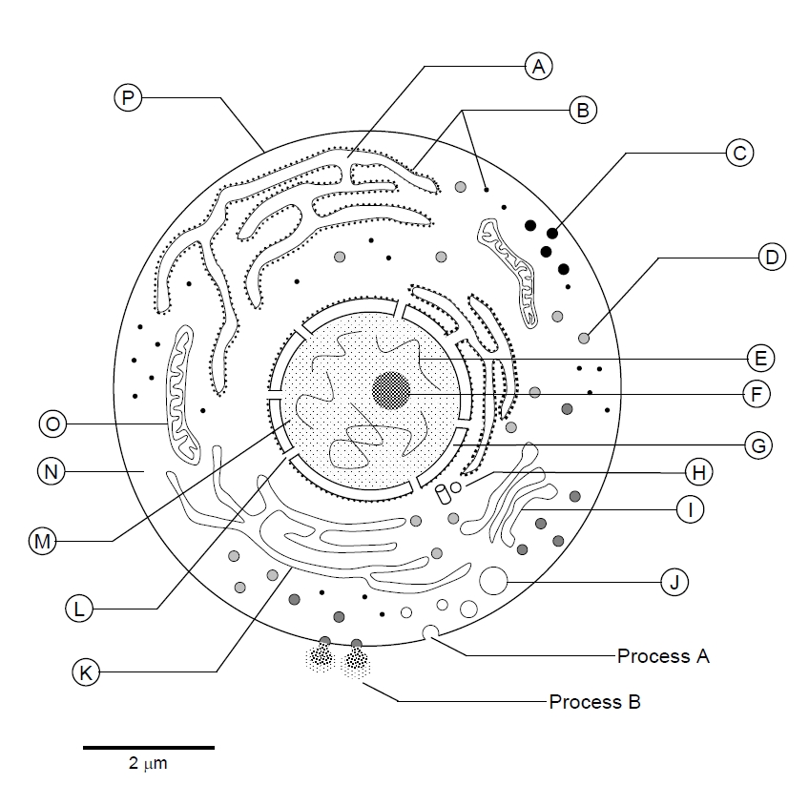
Cells and Organelles

Slide 4
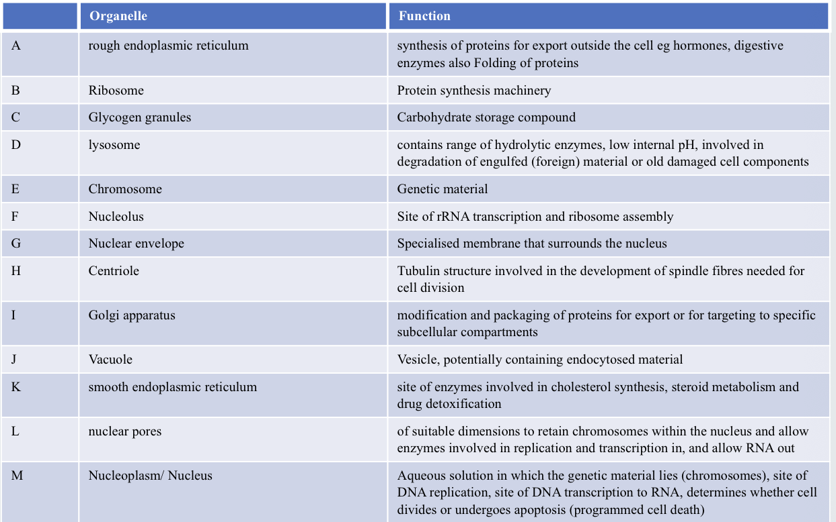

Slide 5
Protein Structure and Function
  Protein Structure: primary, secondary, tertiary and quaternary
  Alpha and beta helix
  Collagen triple helix
  Forces that stabilise protein structures: covalent and non covalent

Slide 6
SBA
Which of the following interactions is primarily responsible for maintaining the secondary structure of proteins such as α-helices and β-sheets?
A. Disulfide bonds between cysteine residues
B. Hydrogen bonds between backbone amide and carbonyl groups
C. Ionic interactions between charged side chains
D. Hydrophobic interactions between non-polar side chains
E. Van der Waals forces between adjacent residues

Slide 7
SBA
Which of the following interactions is primarily responsible for maintaining the secondary structure of proteins such as α-helices and β-sheets?
B. Hydrogen bonds between backbone amide and carbonyl groups
Secondary structure (α-helices and β-sheets) is stabilised mainly by hydrogen bonds formed between the backbone amide hydrogen and carbonyl oxygen atoms of peptide bonds.
Disulfide bonds (A) stabilise tertiary/quaternary structure.
Ionic interactions (C) and hydrophobic interactions (D) mainly contribute to tertiary structure.
Van der Waals forces (E) play a minor, general stabilising role but are not the primary determinant of secondary structure.

Slide 8
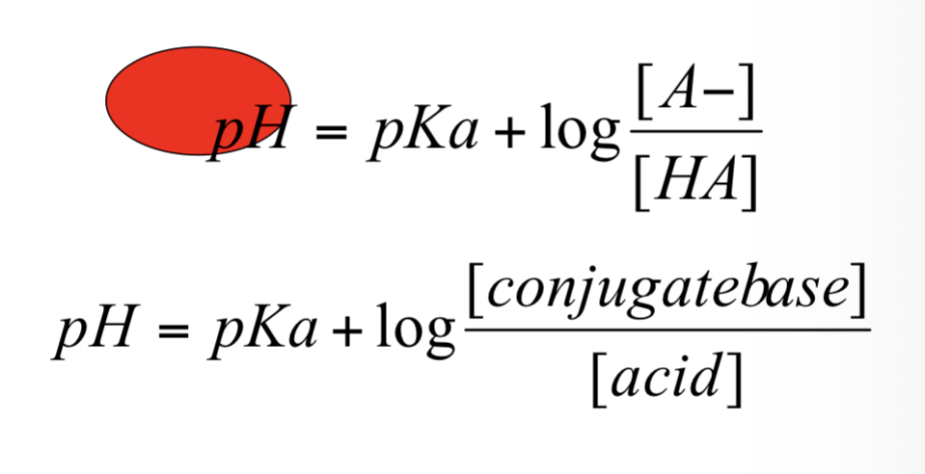
PH and Buffers
  PH only relates to free hydrogen ions
Acid base buffers are regulated by blood, lungs then kidneys
  pKa is pH at which acid is half dissociated

Slide 9
SBA
An enzyme has optimal activity at pH 7.4. When the pH is reduced to 5.5, its activity decreases. Which of the following is the most likely explanation?
A. Breakdown of the enzyme’s primary structure
B. Changes in the ionisation of amino acid side chains affecting the active site
C. Reduced substrate concentration at lower pH
D. Increased formation of disulfide bonds
E. Irreversible inhibition by excess hydrogen ions

Slide 10
SBA
An enzyme has optimal activity at pH 7.4. When the pH is reduced to 5.5, its activity decreases. Which of the following is the most likely explanation?
B. Changes in the ionisation of amino acid side chains affecting the active site
A change in pH alters the ionisation (charge) of amino acid side chains, especially those in the active site. This can affect substrate binding or catalysis, leading to reduced enzyme activity.

Slide 11
Enzymes
  Enzymes are proteins, fit together through induced fit theory
  Affecting enzymes- temperature, pH
  Enzyme kinetics- competitive, non competitive, irreversible

Slide 12
SBA
An enzyme-catalysed reaction is studied in the presence and absence of a drug. In the presence of the drug, the Vmax remains unchanged but the Km increases. What is the most likely mechanism of action of this drug?
A. Competitive inhibition
B. Non-competitive inhibition
C. Uncompetitive inhibition
D. Irreversible inhibition
E. Allosteric activation

Slide 13
SBA
An enzyme-catalysed reaction is studied in the presence and absence of a drug. In the presence of the drug, the Vmax remains unchanged but the Km increases. What is the most likely mechanism of action of this drug?
A. Competitive inhibition
In competitive inhibition, the inhibitor competes with the substrate for the active site. This means a higher substrate concentration is needed to reach the same reaction rate → Km increases
The maximum rate (Vmax) can still be reached if enough substrate is added → Vmax unchanged

Slide 14
Lipids and Membranes
  Phospholipid bilayer is amphipathic
  Asymmetrical, fluid, regulated, intrinsic, anchored and extrinsic proteins

Slide 15
SBA
Which of the following best describes the arrangement of phospholipids in a cell membrane?
A. Hydrophilic heads face inward, and hydrophobic tails face the aqueous environment
B. Hydrophilic heads and hydrophobic tails are randomly arranged
C. Hydrophobic tails face the extracellular fluid only
D. Hydrophilic heads form the core of the membrane
E. Hydrophobic tails face inward, and hydrophilic heads face the aqueous environment

Slide 16
SBA
Which of the following best describes the arrangement of phospholipids in a cell membrane?
E. Hydrophobic tails face inward, and hydrophilic heads face the aqueous environment
Phospholipids form a bilayer in which: the hydrophilic (polar) heads face the aqueous environments (both extracellular fluid and cytosol), the hydrophobic (nonpolar) tails face inward, away from water

Slide 17
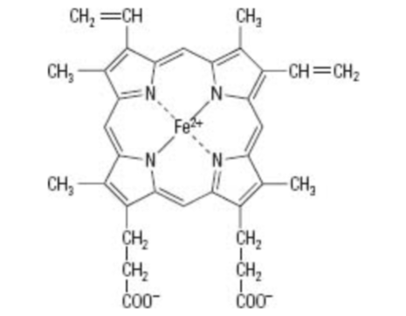
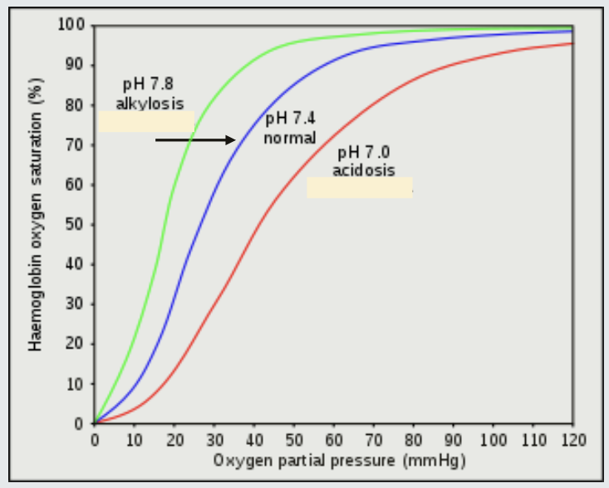
Haemoglobin
  Structure is essential to function- tetramer
  Tense and relaxed, Bohr effect, sickle cell

Slide 18
SBA
Which of the following best describes the Bohr effect in haemoglobin?
A. Increased pH reduces haemoglobin’s affinity for oxygen
B. Decreased carbon dioxide concentration reduces oxygen binding
C. Increased hydrogen ion concentration reduces haemoglobin’s affinity for oxygen
D. Oxygen binding increases the release of hydrogen ions
E. Haemoglobin binds oxygen more tightly in metabolically active tissues

Slide 19
SBA
Which of the following best describes the Bohr effect in haemoglobin?
C. Increased hydrogen ion concentration reduces haemoglobin’s affinity for oxygen
The Bohr effect describes how increased CO₂ and H⁺ (lower pH) reduce haemoglobin’s affinity for oxygen. This promotes oxygen release in metabolically active tissues where it is most needed.

Slide 20
Protein Targeting
  Preparing proteins for their function
  Targeting proteins to ER via signal peptide, targeting cytosolic protein to organelles via other peptide signals

Slide 21
SBA
Which of the following best describes how newly synthesised proteins are targeted to their correct location ?
A. All proteins are synthesised in the Golgi apparatus and then transported to their destination
B. Proteins destined for the endoplasmic reticulum contain a signal peptide that directs them to the rough ER
C. Mitochondrial proteins enter the nucleus first before being transported to mitochondria
D. Cytosolic proteins require a signal peptide to remain in the cytosol
E. Proteins are randomly distributed within the cell and localise based on function

Slide 22
SBA
Which of the following best describes how newly synthesised proteins are targeted to their correct location ?
B. Proteins destined for the endoplasmic reticulum contain a signal peptide that directs them to the rough ER
Proteins are targeted to specific cellular locations by signal sequences:
Proteins destined for the rough ER have an N-terminal signal peptide, which is recognised and directs the ribosome to the ER membrane for co-translational insertion.
Other organelles (e.g. mitochondria, nucleus) use different targeting sequences to direct proteins after translation.

Slide 23
Cytoskeleton
  Network of protein filaments within cell- maintain cell, transport, cytokineses, movement, chromosome separation
  Actin microfilaments, intermediate filaments, microtubules
Cilia

Slide 24
SBA
Which of the following correctly matches a cytoskeleton component with its primary function
A. Actin filaments – form the mitotic spindle during cell division
B. Microtubules – provide tensile strength and mechanical support
C. Intermediate filaments – maintain cell shape and resist mechanical stress
D. Cilia – composed mainly of actin filaments and anchor the nucleus
E. Microtubules – primarily involved in anchoring organelles to the plasma membrane

Slide 25
SBA
Which of the following correctly matches a cytoskeleton component with its primary function
C. Intermediate filaments – maintain cell shape and resist mechanical stress
Actin microfilaments: support cell shape, enable motility, and participate in endocytosis/exocytosis
Intermediate filaments: provide tensile strength and maintain the integrity of cells and tissues
Microtubules: form the mitotic spindle, guide intracellular transport, and make up cilia and flagella
Cilia: composed of microtubules (arranged in a 9+2 structure) and enable movement of fluids across cell surfaces

Slide 26
Intracellular signalling
  Change metabolic activities, secrete and release, changes in gene expression, sensory perception
  Secondary messenger- G protein coupled receptors
  cAMP dependent protein kinase A

Slide 27
SBA
A hormone binds to a G protein-coupled receptor (GPCR) on the surface of a liver cell. This activates adenylate cyclase, increasing intracellular cAMP levels and subsequently activating protein kinase A (PKA). Which of the following is a likely consequence of this signalling pathway?
A. Direct fusion of vesicles with the plasma membrane independent of phosphorylation
B. Altered metabolic activity through phosphorylation of target enzymes
C. Immediate change in gene transcription without secondary messengers
D. Inhibition of all G protein-coupled receptor activity
E. Direct movement of ions across the membrane without a channel

Slide 28
SBA
A hormone binds to a G protein-coupled receptor (GPCR) on the surface of a liver cell. This activates adenylate cyclase, increasing intracellular cAMP levels and subsequently activating protein kinase A (PKA). Which of the following is a likely consequence of this signalling pathway?
B. Altered metabolic activity through phosphorylation of target enzymes
Binding of a hormone to a GPCR can activate adenylate cyclase, increasing cAMP, which then activates PKA.PKA phosphorylates specific enzymes, altering their activity and changing cellular metabolism.

Slide 29


FEEDBACK
Thank you!!
Any questions?
teya.valkova@kcl.ac.uk

