Slide 1

Psychiatric Conditions and Emergencies
GKTeach
Leah Asante and Mahdiyyah Osman

Slide 2
Learning objectives
Recognise the signs and symptoms of psychiatric conditions
Understand the treatment and management of psychiatric conditions
Apply knowledge to confidently answer Psychiatry exam questions

Slide 3
Topics
Affective disorders
Psychosis and Schizophrenia
Personality disorders
Anxiety disorders
Other conditions
Psychiatric Emergencies
Legislation
Exam Questions

Slide 4
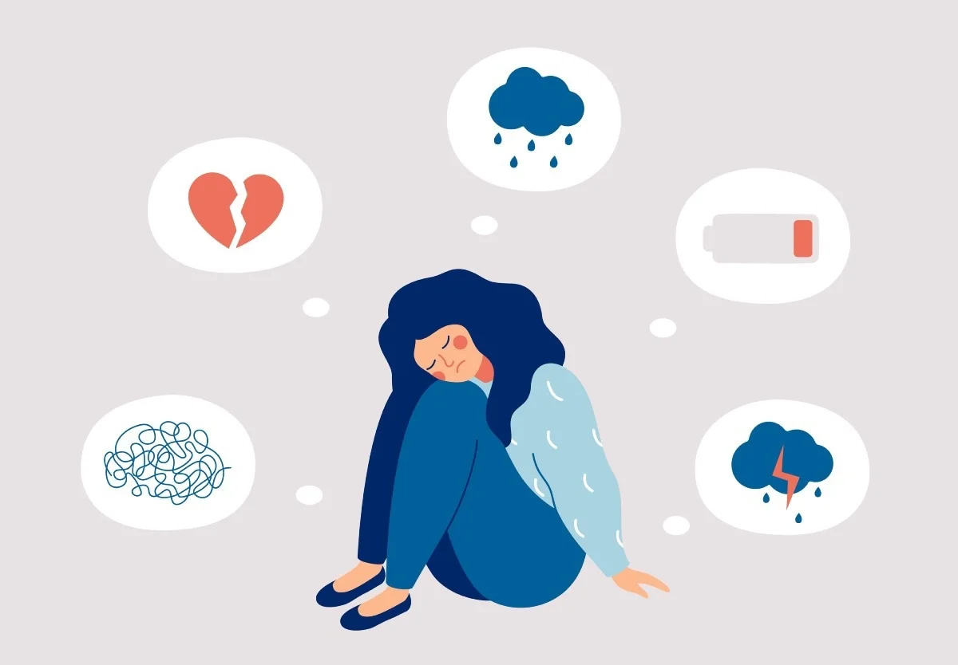
Affective disorders - major depressive disorder / clinical depression
Neurotransmitters involved
Serotonin (major player), norepinephrine and dopamine
Causes/risk factors
Unknown
Genetics - family history of depression
Biology
Environment
Psychology
Affect describes the external expression of emotions
Image Credit: Mary Long/Shutterstock
Notes:
Mahdiyyah

Slide 5
Major depressive disorder / clinical depression
Diagnosis - criteria from DSM-5, 5-9 symptoms of
Low mood
Diminished pleasure/interest (anhedonia)
Weight loss /gain
Insomnia / oversleeping
Psychomotor agitation (pacing, wringing hands) or impairment (e.g. slowing of thoughts or movement)
Fatigue
Feelings of worthlessness / guilt
Decreased concentration
Suicidal thoughts, ideation, attempts
For at least 2 weeks, most of the day, nearly every day
Must cause significant distress to patient’s daily life, not due to another medical condition or substance, not better explained by another mental disorder (e.g. schizoaffective disorder), and no manic or hypomanic episodes
Notes:
Leah

Slide 6

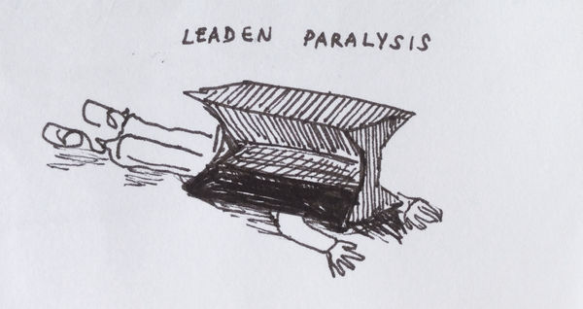

Others - Atypical depression
Mood reactivity - increased mood in relation to positive events / loved ones
Symptoms include:
Weight gain
Increased appetite
Oversleeping
Heavy limbs - leaden paralysis
Rejection sensitivity - feeling anxiety at the slightest evidence of rejection
https://www.deviantart.com/jessioddie/art/Leaden-Paralysis-510199497
Turn rejection into reflection. Credit: Getty Images / IStockphoto
Notes:
Mahdiyyah

Slide 7
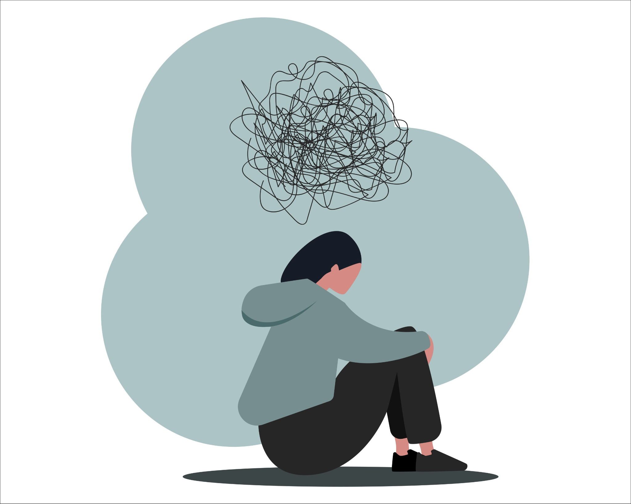
Others - dysthymia
Milder symptoms of depression that happen over longer periods of time
2 or more years
2 or more of the following symptoms
  Change in appetite
  Change in sleep
  Fatigue / low energy
  Reduced self-esteem
  Decreased concentration or difficulty making decisions
  Feelings of hopelessness or pessimism
Image from https://adaa.org/learn-from-us/from-the-experts/blog-posts/consumer/what-depression-how-can-we-overcome-it
Notes:
Leah

Slide 8



Depressive disorders - treatment
Non-pharmacological approaches
Physical activity - 20 mins x 3 / week, raised endorphins, neurotransmitters and endocannabinoids, increasing body temperature and relaxing tense muscles
Diet - more healthy foods, fruits and veggies
Psychotherapy - milder symptoms and younger patients
  CBT - cognitive behavioural therapy
  Interpersonal therapy
Photo by Bruno Nascimento on Unsplash
Photo by Jan Sedivy on Unsplash
Photo by Priscilla Du Preez on Unsplash
Notes:
Mahdiyyah
IPT is a talking treatment that helps people with depression identify and address problems in their relationships with family, partners and friends

Slide 9

Depressive disorders - treatment
Pharmacological approaches - severe depression or milder depression lasting over a long period of time
Antidepressants
  SSRIs - selective serotonin reuptake inhibitors
    Sertraline, fluoxetine, paroxetine
  SNRIs - serotonin and norepinephrine reuptake inhibitors
    Venlafaxine, desvenlafaxine, duloxetine
  Atypical antidepressants
    Buproprion and mirtazapine
  Tricyclic antidepressants e.g. amitriptyline
  Monoamine oxidase inhibitors (MAOIs)
ECT - electroconvulsive therapy - last line treatment for severe depression
Photo by Alexander Grey on Unsplash
Notes:
Mahdiyyah
Treatment begins with SSRIs
Efficacy, tolerability, low overdose potential
Most have comparable efficacy
Sertraline - first-line with postpartum depression and breastfeeding
Treatment starts with a low dose, and there should be a therapeutic effect after 1 week
If no improvement after 4-6 weeks, dose increase
If no benefit - different medication
To minimise discontinuation symptoms, individuals shouldn’t stop medications abruptly or when they travel
After discontinuation, should be monitored over several months, and treated if symptoms occur

Slide 10
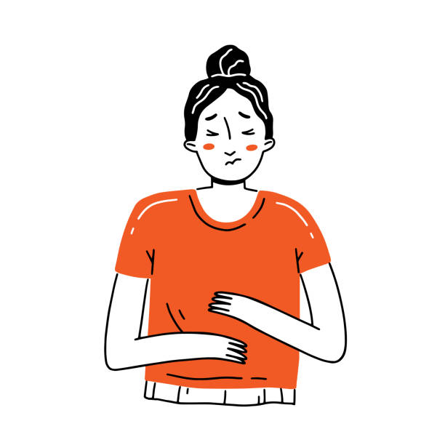



Depression Medication Side Effects
SSRIs
Common - GI - nausea, diarrhoea or constipation, loss of appetite, headaches, sexual dysfunction /loss of libido
Less common but good to know - hyponatraemia, gastrointestinal bleeding risk as increases stomach acid, serotonin syndrome
Interact with triptans - increased risk of serotonin syndrome
Initial increase in suicidal thoughts/self-harm - thought to be higher for those under 25
Creator: Ekaterina Chemakina | Credit: Getty Images/iStockphoto
Photo by Clem Onojeghuo on Unsplash
Tricyclic antidepressants e.g. amitriptyline - cardiac issues (arrhythmias, tachycardia, palpitations), anti-cholinergic side-effects (dry mouth, constipation, blurred vision)
MAOIs e.g. selegiline - hypertensive crisis if taken with foods that contain tyramine e.g. cheese, wine, fermented meats. Common SEs include dry mouth, nausea, diarrhoea or constipation, headache, drowsiness, insomnia, dizziness/lightheadedness
Atypical antidepressants e.g. mirtazapine - dry mouth, lightheadedness, dizziness
Image by Azat Valeev
Creator: Asiya Hotaman | Credit: Getty Images/iStockphoto
Notes:
Leah

Slide 11


Bipolar disorder
A chronic mental health disorder characterised by periods of mania/hypomania alongside episodes of depression.
Epidemiology
typically develops in the late teen years
lifetime prevalence: 2%
Two types of bipolar disorder are recognised:
type I disorder: mania and depression (most common)
type II disorder: hypomania and depression
Benjavisa Ruangvaree/Adobe Stock
Notes:
Leah

Slide 12
Mania vs Hypomania
A manic episode lasts for at least a week
At least 3 of the following 7 symptoms are present
  Inflated self-esteem or grandiosity
  More talkative than usual
  Urgency to keep talking
  Racing thoughts
  Easily distracted or excessive attention to irrelevant things
  Need to achieve certain things
  Reckless e.g. sexual indiscretions or bad financial investments
Hypomanic episodes are a milder version of at least 3 of the same symptoms
Lasts for at least 4 days
From an exam point of view the key differentiation is psychotic symptoms (e.g.delusions of grandeur or auditory hallucinations) which suggest mania, and hypomanic patients are able to function in terms of their daily living e.g. work and sleep, whereas manic patients are not
Notes:
Mahdiyyah

Slide 13
Management of Bipolar disorder
Lithium for mood stabilizing. An alternative is valproate.
Management of mania/hypomania
  consider stopping antidepressant if the patient takes one; antipsychotic therapy e.g. olanzapine or haloperidol
Management of depression
  talking therapies or antidepressants
Address co-morbidities
  increased risk of diabetes, cardiovascular disease and COPD
Primary care referral
if symptoms suggest hypomania then NICE recommend routine referral to the community mental health team (CMHT)
if there are features of mania or severe depression then an urgent referral to the CMHT should be made
Notes:
Leah

Slide 14
Any questions?

Slide 15
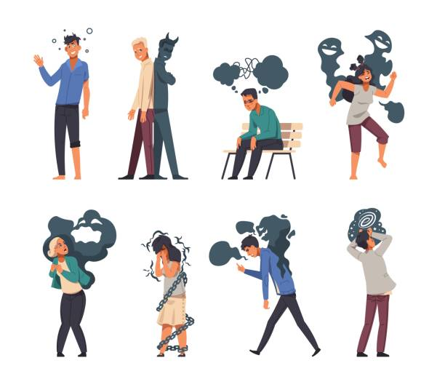
Psychosis
The term 'psychosis' encompasses a number of symptoms associated with significant alterations to a person's perception, thoughts, mood, and behaviour (NICE CKS). These perceptions are often fixed and unshakeable.
2. Delusions - individualistic, and cannot be convinced/reasoned otherwise
Experiences of influence, passivity, and control - thought withdrawal, insertion, broadcasting
Delusion of reference
Erotomanic
Grandiose
Jealous
Persecutory
Somatic
Nihilistic
Misidentification
Hallucinations:
Auditory
Visual
Tactile
Olfactory
Creator: SpicyTruffel | Credit: Getty Images/iStockphoto
Notes:
Leah

Slide 16
Schizophrenia
A disorder characterised by loss of contact with the environment
Deterioration in the level of functioning in everyday life
Disintegration of personality
Expressed as a disorder of feeling, thought, perception and behaviour
Positive symptoms
Psychotic symptoms
Hallucinations
Delusions
Disorganised speech e.g. word salad
Catatonic behaviour
Negative symptoms
Removal of normal processes, decreased emotions, loss of interests
Flat affect
Alogia - poverty of speech
Avolition - decreased motivation
Cognitive symptoms
Affects
Memory
Learning
Understanding
Subtle, difficult to notice
Notes:
Mahdiyyah
Word salad - random jumbling of words
Catatonia - immobility, mutism, withdrawal and refusal to eat, staring, negativism, posturing (rigidity), rigidity, waxy flexibility/catalepsy, stereotypy (purposeless, repetitive movements), echolalia or echopraxia, verbigeration (repeat meaningless phrases)

Slide 17
Schizophrenia
3 phases
Prodromal - withdrawn
Active - severe, psychotic symptoms
Residual - cognitive symptoms, and may become withdrawn again
Diagnosis (DSM-5)
2 of the following
Delusions
Hallucinations
Disorganised speech
Disorganised/catatonic behaviour
Negative symptoms
At least 1 has to be delusions, hallucinations or disorganised speech
Has to be ongoing for at least 6 months, and at least 1 month in active phase
Not attributable to another medical condition e.g. substance abuse
Notes:
Leah

Slide 18
Schizophrenia - treatment
Oral antipsychotics - OR depot injections (long-acting)
1st generation / typical e.g. haloperidol (fast-acting) chlorpromazine
  Older
  D2 antagonists
  Cause EPSEs - extra-pyramidal side effects
2nd generation / atypical e.g. clozapine (treatment resistant schizophrenia, many side-effects and monitoring), olanzapine, quetiapine
  D2 plus 5HTA and other serotonin antagonists, cause metabolic syndrome (+/- EPSEs)
Third generation e.g. aripirazole
  Partial D2 antagonists
  Milder EPSEs and no metabolic syndrome
Notes:
Leah

Slide 19
Any questions?

Slide 20
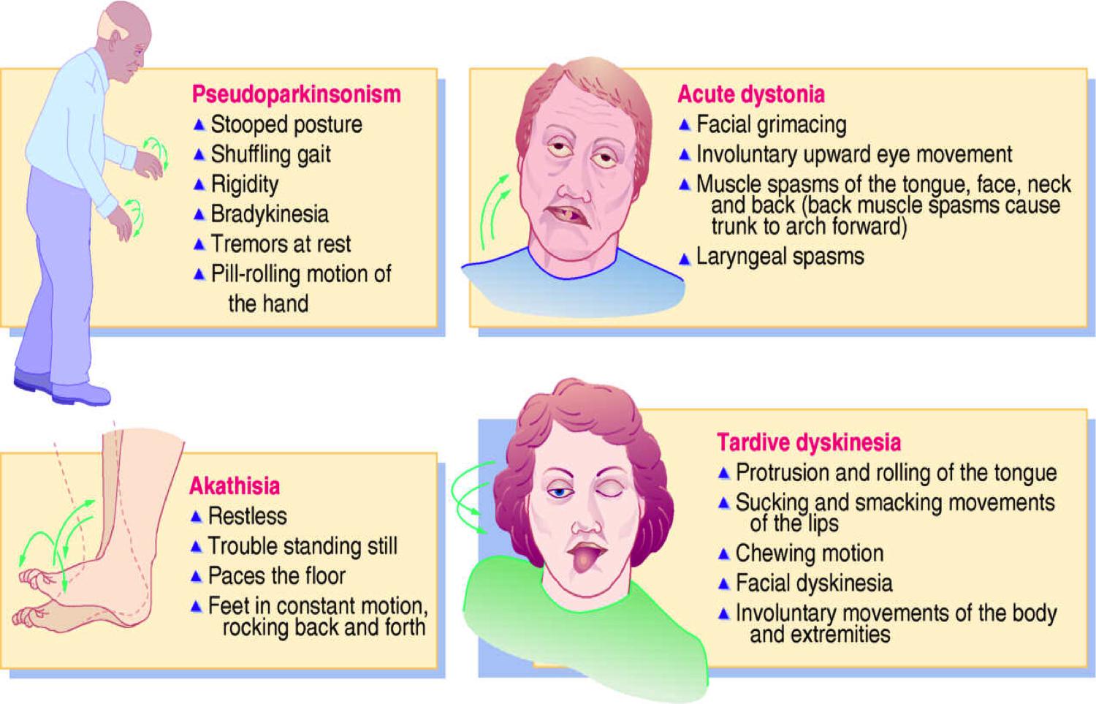
Extrapyramidal side effects
Akathisia - restless leg syndrome
Dystonia
Dyskinesia
Akinesia
Muscle stiffness
NMS
Parkinsonism
Tardive dyskinesia
Recognising EPSEs https://www.youtube.com/watch?v=2xfu-d_aYWs&ab_channel=evelynnO%27Dell
Meet Jeff, living with tardive dyskinesia https://www.youtube.com/watch?v=_UCaWSMddwA&ab_channel=Let%27sTalkAboutTardiveDyskinesia
https://psychonautwiki.org/wiki/Talk:Extrapyramidal_symptoms
Notes:
Mahdiyyah
Tardive dyskinesia causes involuntary movements most commonly in areas of the face, eyes, and mouth. Dystonia, on the other hand, leads to involuntary muscular contractions that can affect the head, face, and neck

Slide 21
Personality disorders
ICD-10 Criteria
Specific personality disorders
Disturbances in the personality and behavioural tendencies of the individual; not directly resulting from disease, damage, or other insult to the brain, or from another psychiatric disorder; usually involving several areas of the personality; nearly always associated with considerable personal distress and social disruption; and usually manifest since childhood or adolescence and continuing throughout adulthood
Notes:
Leah

Slide 22
Personality disorders
Emotionally unstable personality disorder
  characterized by a definite tendency to act impulsively and without consideration of the consequences; the mood is unpredictable and capricious
  there is a liability to outbursts of emotion and an incapacity to control the behavioural explosions
  there is a tendency for quarrelsome behaviour and conflicts with others, especially when impulsive acts are thwarted or censored
  Two types may be distinguished:
    impulsive type, characterized predominantly by emotional instability and lack of impulse control, and
    borderline type, characterized in addition by disturbances in self-image, aims, and internal preferences, by chronic feelings of emptiness, by intense and unstable interpersonal relationships, and by a tendency to self-destructive behaviour, including suicide gestures and attempts
Notes:
Leah

Slide 23
Personality disorders
Paranoid personality disorder
  Excessive sensitivity to setbacks, unforgiveness of insults
  Suspiciousness and a tendency to distort experience by misconstruing the neutral or friendly actions of others as hostile or contemptuous
  Recurrent suspicions, without justification, regarding the sexual fidelity of the spouse or sexual partner
  Combative and tenacious sense of personal rights
  There may be excessive self-importance, and there is often excessive self-reference
Notes:
Mahdiyyah

Slide 24
Personality disorders
Schizotypal personality disorder
Social and interpersonal deficits
Thinking that coincidences or events have personal meaning
Magical thinking or 'odd beliefs'
Bodily illusions or strange perceptual experiences
Being suspicious or paranoid
Not expressing emotions
Eccentric behaviour
Lack of close friends
Social anxiety
Schizoid personality disorder
Withdrawal from affectional, social and other contacts with preference for fantasy, solitary activities, and introspection
Limited capacity to express feelings and to experience pleasure
Others - anxious/avoidant, narcissistic, histrionic, anankastic, dependent
Notes:
Mahdiyyah

Slide 25
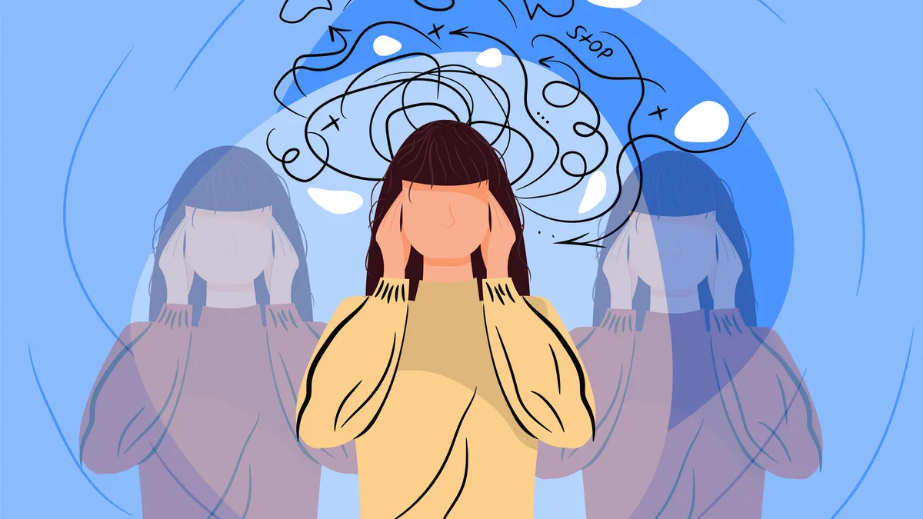
Personality disorders
Treatment
Patients should not usually be admitted / sectioned
Treatment should be aimed at helping them deal with their personality traits and behaviours, usually through psychotherapy
No medication to “fix” or cure
IrynaDanyliuk/Getty Images
Notes:
Leah

Slide 26
Anxiety disorders
Anxiety and fear-related disorders are characterised by excessive fear and anxiety, with symptoms severe enough to result in significant distress and impairment in functioning. Anxiety = fear in the absence of stimulus / imminent threat, future-orientated,referring to perceived anticipated threat.
Generalised Anxiety Disorder - GAD
Marked symptoms of anxiety manifested by
  General apprehensiveness not limited to a particular situation OR
  Excessive worry about negative events occurring in several different aspects of life
Additional symptoms of
  Muscle tension/restlessness
  Sympathetic autonomic overactivity - frequent GI symptoms e.g. nausea and abdominal distress, palpitations, sweating, shaking
  Nervousness, restlessness, being “on edge”
  Difficulty concentrating
  Irritability
  Sleep disturbances
Notes:
Leah

Slide 27
Anxiety disorders
Panic disorder
Recurrent panic attacks - discrete episodes of intense fear / apprehension
Rapid onset of
  Palpitations / increased HR
  Sweating / trembling
  SOB
  Choking feeling
  Chest pain
  Nausea / abdominal distress
  Dizziness / lightheadedness
  Chills / hot flushes
  Tingling / paraesthesias
  Depersonalisation / derealisation
  Fear of losing control, going mad, imminent death
Not restricted to particular stimuli / situations
Arise randomly
Worry about future attacks, avoidance of situations which might lead to attacks
Notes:
Mahdiyyah

Slide 28
Anxiety disorders
Social anxiety disorder
Marked and excessive fear or anxiety, occurring consistently in 1 or more social situations such as social interactions (having a conversation), doing something while feeling observed (eating/drinking in front of others, or performing in front of others
Individual worried that they will act in a way, or show anxiety symptoms, that will be negatively judged by others, be embarrassed, humiliating, lead to rejection or be offensive
Social situations are consistently avoided or dealt with intense anxiety
Long-lasting symptoms e.g. persist for months
Agoraphobia
Marked and excessive fear and anxiety occurring in, or in anticipation of, situations where escape may be difficult or help might not be available
E.g. when using public transport, being in crowds, being outside alone
Consistently fearful and anxious due to fear of specific negative outcomes e.g. panic attacks, embarrassing oneself
Active avoidance of situations
Others - PTSD, specific phobia, separation anxiety disorder
Notes:
Mahdiyyah

Slide 29
Anxiety disorders - treatment
Cognitive behavioural therapy - CBT very effective
SSRIs and SNRIs - e.g. sertraline, venlafaxine/duloxetine
Pregabalin (anticonvulsant)
In extreme cases, benzodiazepines and beta-blockers may be used for the physical symptoms of anxiety
Notes:
Leah

Slide 30
Any questions?
Notes:
Mahdiyyah

Slide 31
Psychiatric emergencies
Notes:
Mahdiyyah

Slide 32
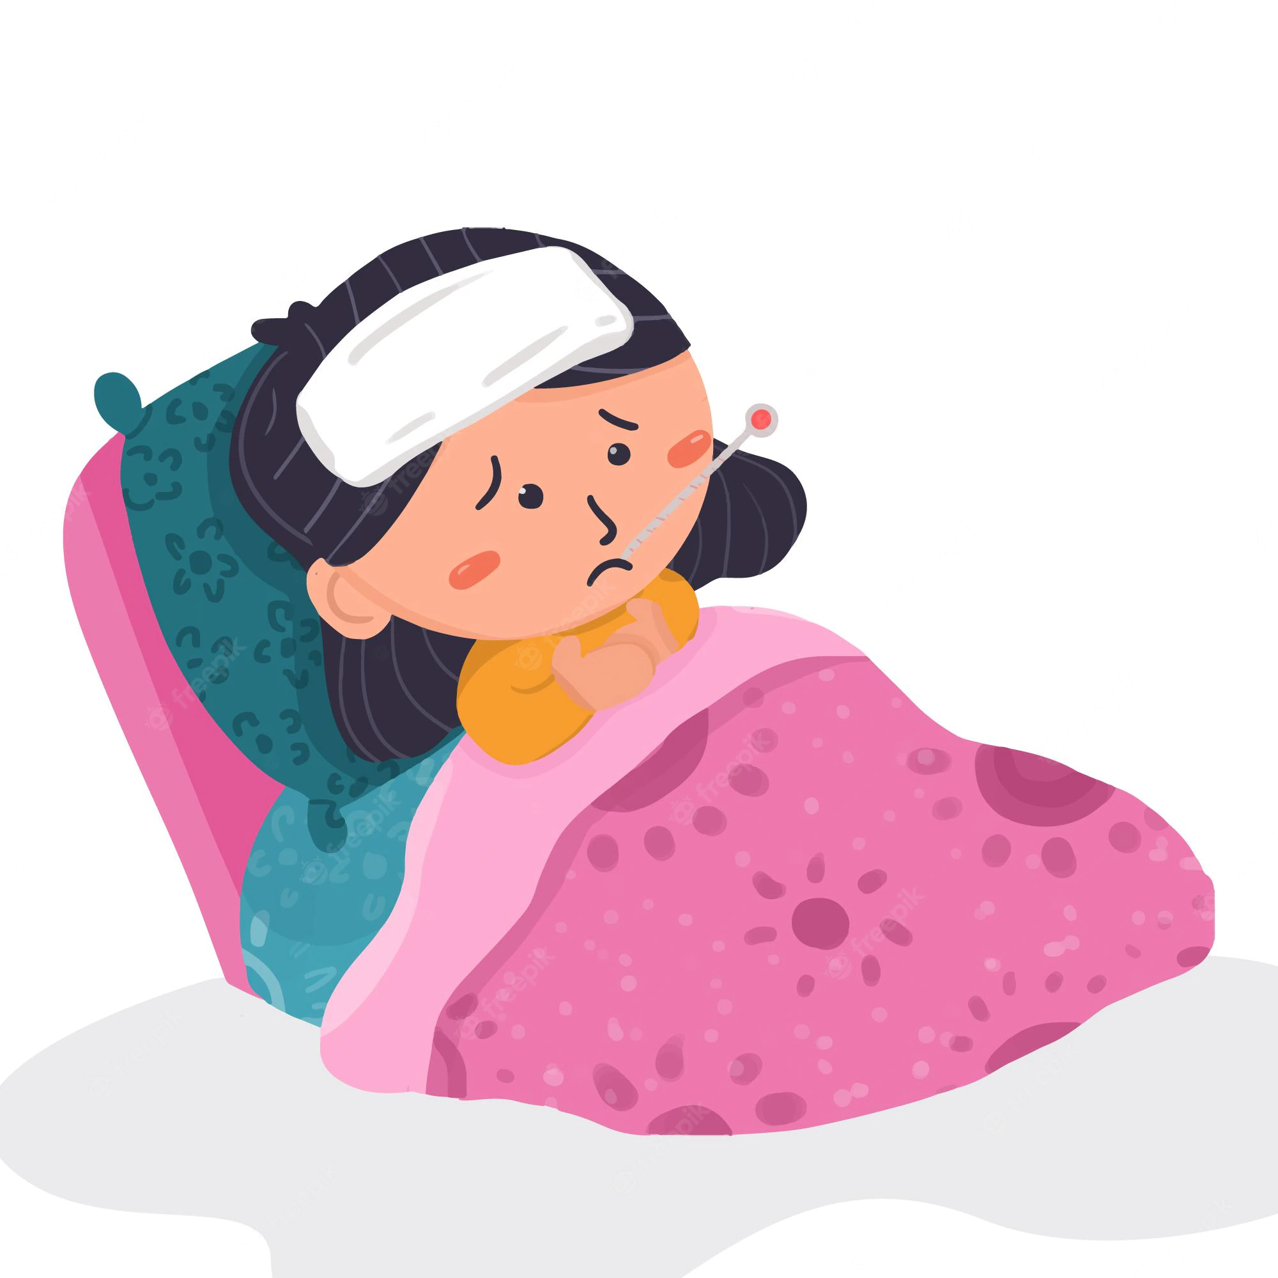


Neuroleptic malignant syndrome
Neuroleptic malignant syndrome is a rare but dangerous condition seen in patients taking antipsychotic medication. It carries a mortality of up to 10% and can also occur with atypical antipsychotics. It may also occur with dopaminergic drugs (such as levodopa) for Parkinson's disease, usually when the drug is suddenly stopped or the dose reduced.
Symptoms
Fever, sweating
Muscle rigidity
Confusion
Fluctuating consciousness
Fluctuating blood pressure, tachycardia
Elevated creatine kinase, leukocytosis, altered LFTs
Seizures
Normal pupils and hyporeflexia (whereas serotonin syndrome - hyperreflexia and dilated pupils, caused by antidepressants e.g. SSRIs)
Will progress to rhabdomyolysis if not treated
Treatment is to stop the offending antipsychotic and administer dantrolene - muscle relaxant, and bromocriptine, consider benzos
https://www.freepik.com/premium-vector/cute-cartoon-illustration-child-with-fever-bed_16618803.htm
https://www.vecteezy.com/vector-art/1877380-businessman-confused-cartoon-vector
Image by Azat Valeev
Notes:
Leah
The most widely accepted mechanism by which antipsychotics cause neuroleptic malignant syndrome is that of dopamine D2 receptor antagonism. In this model, central D2 receptor blockade in the hypothalamus, nigrostriatal pathways, and spinal cord leads to increased muscle rigidity and tremor via extrapyramidal pathways.
Treatment: Medications prescribed as treatment may include skeletal muscle relaxants, such as dantrolene; stimulators of dopamine production and activity, such as bromocriptine; and/or continuous perfusion of central nervous system depressants, such as diazepam.

Slide 33
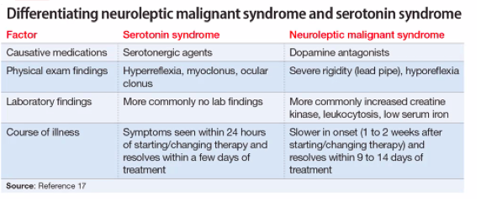
Serotonin syndrome
Serotonin syndrome is a serious drug reaction. It is caused by medications that build up high levels of serotonin in the body
Serotonin syndrome can occur when you increase the dose of certain medications or start taking a new drug
It's most often caused by combining medications that contain serotonin
Serotonergic agents
Antidepressants - SSRIs, SNRIs, MAOIs,
Triptans (for migraines)
Nausea medications e.g. ondansetron and metoclopramide
Anxiety meds e.g. buspirone
Notes:
Mahdiyyah
NMS = normal pupils and hyporeflexia
Serotonin syndrome = dilated pupils and hyperreflexia

Slide 34
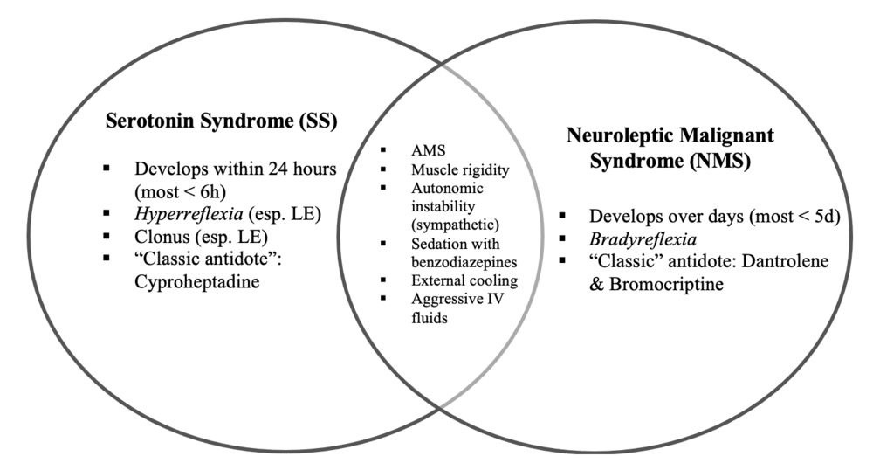
Image from https://www.emboardbombs.com/papers/neuroleptic-malignant-syndrome-lead-pipe-rigidity
Notes:
Mahdiyyah
AMS - altered mental status
LE - lower extremities

Slide 35
Serotonin/antidepressant discontinuation syndrome
About 20% of patient develop this after abruptly stopping or markedly reducing their antidepressant medication that was taken for at least 6 weeks.
Flu-like symptoms
Insomnia
Nausea
Imbalance
Sensory disturbances e.g. electric shock-like sensations, paraesthesias
Hyperarousal
These symptoms usually are mild, last one to two weeks, and are rapidly extinguished with reinstitution of antidepressant medication
Notes:
Mahdiyyah

Slide 36
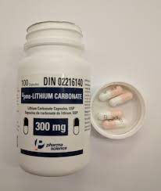
Lithium toxicity
Lithium is a mood stabilising drug used to treat bipolar disorder but also as an adjunct in refractory depression. It has a very narrow therapeutic range (0.4-1.0 mmol/L) and a long plasma half-life being excreted primarily by the kidneys. Lithium toxicity generally occurs following concentrations > 1.5 mmol/L.
Toxicity may be precipitated by:
dehydration
renal failure
drugs: diuretics (especially thiazides), ACE inhibitors/angiotensin II receptor blockers, NSAIDs and metronidazole.
Features of toxicity
coarse tremor (a fine tremor is seen in therapeutic levels)
hyperreflexia
acute confusion
polyuria
seizure
coma
Management
mild-moderate toxicity may respond to volume resuscitation with normal saline
haemodialysis may be needed in severe toxicity
sodium bicarbonate is sometimes used but limited evidence to support this. By increasing the alkalinity of the urine it promotes lithium excretion
Image from https://en.wikipedia.org/wiki/Lithium_toxicity
Notes:
Leah

Slide 37

Delirium
Also known as acute confusional state or acute organic brain syndrome. Patients become disorientated to time, place and people.
Predisposing factors include:
Age > 65 years
Background of dementia
Significant injury e.g. hip fracture
Frailty or multimorbidity
Polypharmacy
Image from https://www.ausmed.com/cpd/articles/postoperative-delirium
Notes:
Mahdiyyah

Slide 38
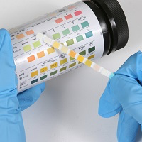
Delirium
Causes (CHIMPS PHONED)
Constipation
Hypoxia
Infections
Metabolic disturbances - acidosis, hyponatraemia, hypercalcaemia, hypoglycaemia
Pain
Sleeplessness
Prescriptions - opiates, sedatives, anticholinergics, BZs
Hypothermia/pyrexia
Organ dysfunction - hepatic/renal impairment, CNS pathology
Nutrition - B12/thiamine deficiency
Environmental changes
Drugs - intoxication/withdrawal - alcohol/G
Image from https://www.nice.org.uk/news/article/test-children-s-urine-before-prescribing-antibiotics-for-utis-says-nice
Notes:
Mahdiyyah

Slide 39
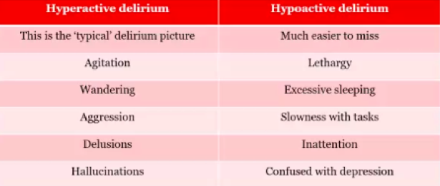
Hyper vs hypoactive delirium
Notes:
Mahdiyyah

Slide 40
Delirium - management
Treat the underlying cause e.g. antibiotics for an infection, stopping medication that can cause constipation
Use of antipsychotics for sedation if necessary e.g. Haloperidol or Olanzapine
Antipsychotics can often worsen Parkinsonian symptoms. Therefore, in patients’ with Parkinson’s, atypical antipsychotics such as quetiapine and clozapine are preferred
Notes:
Leah

Slide 41
Delirium Tremens
A severe, life threatening form of alcohol withdrawal
Medical emergency - 5-15% mortality
72 hours
Risk - history of DTs, seizures, severe alcohol dependency
Symptoms:
Global confusion / disorientation
Agitation / impending doom
Sweating
Paranoia
Severe tremors
Seizures
Perceptual disturbance e.g. hallucinations and delusions
Autonomic hyperactivity
Reduced GCS
Notes:
Leah

Slide 42
Delirium tremens - management
Medication
Thiamine - IM/IV pabrinex
Reduced regime - chlordiazepoxide / oxazepam
PR diazepam for seizures
Caution with antipsychotics as they reduce the seizure threshold
CIWA - Clinical Institute Withdrawal Assessment for Alcohol will tell you what to do based on symptoms
Monitor physical health
Nutrition / bloods
Admission to a medical unit / ICU
Notes:
Leah

Slide 43
Delirium tremens
Physical health complications - Thiamine Deficiency
Wernicke's encephalopathy
  Not just alcohol
  Confusion, ataxia and ophthalmoplegia - 10% of patients
  Other features - nystagmus/reduces GCS/hypothermia
  Medical emergency - mortality approx. 15 %
  Prevention/treatment - PO thiamine/IV pabrinex
Korsakoff's syndrome
  Wernicke's encephalopathy
  Confabulation - lack of insight
  Anterograde amnesia
  Retrograde amnesia
Community management
Dependence and consequences
Advise against abrupt withdrawal in community
Refer to alcohol liaison service or Community Drug and Alcohol Team (CDAT)
Ongoing vitamin supplementation - Thiamine 100mg TDS
Relapse prevention medication - acamprosate/natrexone/disulfiram
Harm reduction - don’t stop suddenly, reduce slowly
Cut down 10% over 3-4 days
Fibroscans - measure damage - fibrosis and scarring to liver
Notes:
Mahdiyyah
It may result from alcohol abuse, dietary deficiencies, prolonged vomiting, eating disorders, or the effects of chemotherapy.
provides additional vitamins B and C to correct deficiencies that may have occurred,
Wernicke's encephalopathy represents the "acute" phase of the disorder and Korsakoff's amnesic syndrome represents the disorder progressing to a "chronic" or long-lasting stage.
Thiamine = Vitamin B1
Confabulations refer to incorrect memories that the patient holds to be true, the production or creation of false or erroneous memories without the intent to deceive, sometimes called "honest lying". Alternatively, confabulation is a falsification of memory by a person who, believes he or she is genuinely communicating truthful memories

Slide 44
Legislation
The Mental Health Act (1983) - the main piece of legislation that covers the assessment, treatment and rights of people with a mental health disorder.
Section 2 - person has a mental disorder. Needs to be detained for assessment and for possible medical treatment. This is necessary for the safety of the patient and the protection of other people. Last for 28 days.
Section 3 - person has a mental disorder and needs to be detained for their own health or the safety/protection of other people. Treatment can’t be given unless the patient is detained. Doctors have agreed the appropriate treatment. Lasts for up to 6 months
*There are other sections but Section 2 and 3 often feature in progress tests.
The Mental Capacity Act (2005) - applies if a person has a mental health issue and they do not have the mental capacity to make certain decisions.
Deprivation of Liberty Safeguards - patients that can’t be sectioned but can be detained and stopped from leaving a place using this procedure under this Act or by a court order. This deprivation of liberty is within their best interests.
Notes:
Leah
Which professionals can undertake Mental Health Act assessment?
a person who is an approved mental health professional (AMHP), a registered medical practitioner (usually a doctor who knows you, such as your GP) and a section 12 approved doctor (usually a psychiatrist)

Slide 45
Other conditions and emergencies
Somatisation disorder
Multiple physical symptoms present for at least 2 years
Patient refuses to accept reassurance or negative test results
Conversion disorder
Neurological symptoms that cannot be explained by medical evaluation e.g. loss of motor or sensory function
The patient doesn't consciously feign the symptoms (factitious disorder) or seek material gain (malingering)
Cotard’s Delusion/Syndrome
A person believes they are dying, dead or parts of the body are missing
Eating disorders (Anorexia, Bulimia), PTSD & Acute Stress
*Clozapine-induced Neutropenia/ Agranulocytosis
Notes:
Leah

Slide 46
Any questions?
Notes:
Mahdiyyah

Slide 47
Exam Question Practice
https://vevox.app/#/m/155350535

Slide 48
Question 1
A 23-year-old man is brought to the physician by his family due to concerns about his behavior. The patient's parent tells the physician that for the past month, the patient has been telling them that he is receiving signals on the television from a secret organization to “save the world from the upcoming alien invasion.” His parent adds that they sometimes see the patient communicating with people who are not there. The patient dropped out of his college courses seven months ago after his grades deteriorated, although he was an excellent student before. At that time, the patient also stopped taking care of his hygiene, often not showering for multiple days, and he has withdrawn from his friends and family. Past medical history is noncontributory, and the patient does not drink alcohol or use recreational drugs. Which of the following is the most likely diagnosis?
Narcissistic personality disorder
Delusional disorder
Brief psychotic disorder
Schizophrenia
Schizophreniform disorder
Notes:
Mahdiyyah

Slide 49
Question 1
A 23-year-old man is brought to the physician by his family due to concerns about his behavior. The patient's parent tells the physician that for the past month, the patient has been telling them that he is receiving signals on the television from a secret organization to “save the world from the upcoming alien invasion.” His parent adds that they sometimes see the patient communicating with people who are not there. The patient dropped out of his college courses seven months ago after his grades deteriorated, although he was an excellent student before. At that time, the patient also stopped taking care of his hygiene, often not showering for multiple days, and he has withdrawn from his friends and family. Past medical history is noncontributory, and the patient does not drink alcohol or use recreational drugs. Which of the following is the most likely diagnosis?
Narcissistic personality disorder
Delusional disorder
Brief psychotic disorder
Schizophrenia
Schizophreniform disorder
Notes:
A - doesn’t fit
B -A disorder characterized by the development either of a single delusion or of a set of related delusions that are usually persistent and sometimes lifelong
C - Is not brief, has been ongoing for at least 7 months
D - Hallucinations, delusions, withdrawal and promodromal phase, not taking care of self
E - is a psychotic disorder that affects how you act, think, relate to others, express emotions and perceive reality. Unlike schizophrenia, it lasts one to six months instead of the rest of your life.

Slide 50
Question 2
A 28-year-old man comes to the office because of fear of leaving his home or walking on the street for the past five years. He avoids going outside, feels panic when he does, and asks for transportation from friends and family wherever he goes because he feels really anxious when using public transportation. Which of the following disorders is the most appropriate diagnosis?
Agoraphobia
Depression
Panic disorder
Separation anxiety disorder
Specific phobia
Notes:
Leah

Slide 51
Question 2
A 28-year-old man comes to the office because of fear of leaving his home or walking on the street for the past five years. He avoids going outside, feels panic when he does, and asks for transportation from friends and family wherever he goes because he feels really anxious when using public transportation. Which of the following disorders is the most appropriate diagnosis?
Agoraphobia
Depression
Panic disorder
Separation anxiety disorder
Specific phobia
Notes:
A - Fear of leaving home, walking outside, or using public transport, feels panic when thinking about it and anxious during
B - no signs of depression
C - Panic disorder does not have a single, predictable stimulus
D - No symptoms of this
E - phobia is not specific e.g. of escalators, or heights, more to do with being outside

Slide 52
Question 3
A 25-year-old woman comes to the emergency department because of cuts she made with a razor blade to her left forearm and right hip. She says her boyfriend broke up with her recently, and she has been feeling very lonely and empty. She reports frequent cutting with a razor blade on herself when feeling this way in the past. She lives with a roommate, but reports constant fighting with her. Which of the following is the most likely diagnosis?
Dysthymic disorder
Bipolar disorder type 2
Schizoid personality disorder
Major depressive disorder
Borderline personality disorder / EUPD
Notes:
Mahdiyyah

Slide 53
Question 3
A 25-year-old woman comes to the emergency department because of cuts she made with a razor blade to her left forearm and right hip. She says her boyfriend broke up with her recently, and she has been feeling very lonely and empty. She reports frequent cutting with a razor blade on herself when feeling this way in the past. She lives with a roommate, but reports constant fighting with her. Which of the following is the most likely diagnosis?
Dysthymic disorder
Bipolar disorder type 2
Schizoid personality disorder
Major depressive disorder
Borderline personality disorder / EUPD
Notes:
A - no evidence of persistent, mild-intensity depressive symptoms
B - no manic/hypomanic symptoms
C - Schizoid personality disorder - Withdrawal from affectional, social and other contacts with preference for fantasy, solitary activities, and introspection, limited capacity to express feelings and to experience pleasure
D - Symptoms do not point to MDD, other than feeling lonely/empty
E - EUPD, frequent cutting/self-harm in childhood/teenage years is pathopneumonic for EUPD

Slide 54
Question 4
A 28-year-old woman is brought to the emergency department by her sister because of erratic behavior. The sister claims that while driving the patient said "let's close our eyes” while crossing red-traffic lights, and then laughed frenetically. The patient works as a stockbroker and over the past 2 months she has joined multiple organizations as a consultant. She claims to sleep with different men after closing business deals because she feels empowered. When asked about her personal information, she talks very rapidly, claims to feel better than ever, while assuring that there is no need to keep her in the hospital. Her medical history is relevant for being diagnosed with major depressive disorder a year ago, and anorexia nervosa when she was 15-years-old. Physical examination is noncontributory. Her temperature is 36.1°C (96.9°F), pulse is 94/min, respirations are 29/min, and blood pressure is 125/60 mm Hg. Which of the following is the most likely diagnosis?
Bipolar disorder type 1
Bipolar disorder type 2
Borderline personality disorder
Brief psychotic disorder
Histrionic personality disorder
Notes:
Leah

Slide 55
Question 4
A 28-year-old woman is brought to the emergency department by her sister because of erratic behavior. The sister claims that while driving the patient said "let's close our eyes” while crossing red-traffic lights, and then laughed frenetically. The patient works as a stockbroker and over the past 2 months she has joined multiple organizations as a consultant. She claims to sleep with different men after closing business deals because she feels empowered. When asked about her personal information, she talks very rapidly, claims to feel better than ever, while assuring that there is no need to keep her in the hospital. Her medical history is relevant for being diagnosed with major depressive disorder a year ago, and anorexia nervosa when she was 15-years-old. Physical examination is noncontributory. Her temperature is 36.1°C (96.9°F), pulse is 94/min, respirations are 29/min, and blood pressure is 125/60 mm Hg. Which of the following is the most likely diagnosis?
Bipolar disorder type 1
Bipolar disorder type 2
Borderline personality disorder
Brief psychotic disorder
Histrionic personality disorder

Slide 56
Question 5
A 30-year-old woman in dirty clothing is brought by police to a psychiatric community crisis response center after being found shouting in the middle of a busy street about the end of the world. Bystanders noted that she was yelling and having a conversation with herself. On her arrival at the crisis center, her behavior quickly escalated. She became belligerent, shouting obscenities and trying to have a physical altercation with everyone around her. To calm her down and in an attempt to speak with her in a less agitated fashion, the psychiatric doctor on call ordered an intramuscular medication to be administered. Which of the following medications is most likely being used?
Clozapine
Haloperidol
Lithium
Olanzapine
Pherphanazine
Notes:
Mahdiyyah

Slide 57
Question 5
A 30-year-old woman in dirty clothing is brought by police to a psychiatric community crisis response center after being found shouting in the middle of a busy street about the end of the world. Bystanders noted that she was yelling and having a conversation with herself. On her arrival at the crisis center, her behavior quickly escalated. She became belligerent, shouting obscenities and trying to have a physical altercation with everyone around her. To calm her down and in an attempt to speak with her in a less agitated fashion, the psychiatric intern on call ordered an intramuscular medication to be administered. Which of the following medications is most likely being used?
Clozapine
Haloperidol
Lithium
Olanzapine
Pherphanazine
Notes:
A - Not used in acutely agitated patients
B - Fast onset of action and drug of choice as high potency too, usually given IM with lorazepam
C - Lithium - bipolar disorder treatment
D - Olanzapine - Delayed onset of action
E - Pherphanazine - medium-potent, typical antipsychotic. Several unwanted SEs

Slide 58
Question 6
A 35-year-old man comes to the office for an annual visit. He says he has been under a lot of stress lately at home and at work and is afraid that he will lose his job since his co-workers are trying to sabotage him. He does not get along with his co-workers and believes it is because he does a better job. At home, he suspects that his wife is cheating on him because he does not make enough money to support her. He denies any auditory and visual hallucinations, special powers, ideas of reference, or belief that others can hear his thoughts. His wife says he has always had a difficult time confiding in others and would hold grudges against friends and co-workers. Which of the following is the most likely explanation for this man's symptoms?
Narcissistic personality disorder
Paranoid personality disorder
Paranoid schizophrenia
Schizoid personality disorder
Schizotypal personality disorder
Notes:
Leah

Slide 59
Question 6
A 35-year-old man comes to the office for an annual visit. He says he has been under a lot of stress lately at home and at work and is afraid that he will lose his job since his co-workers are trying to sabotage him. He does not get along with his co-workers and believes it is because he does a better job. At home, he suspects that his wife is cheating on him because he does not make enough money to support her. He denies any auditory and visual hallucinations, special powers, ideas of reference, or belief that others can hear his thoughts. His wife says he has always had a difficult time confiding in others and would hold grudges against friends and co-workers. Which of the following is the most likely explanation for this man's symptoms?
Narcissistic personality disorder
Paranoid personality disorder
Paranoid schizophrenia
Schizoid personality disorder
Schizotypal personality disorder
Notes:
A - thinks he is better than co-workers but not arrogant towards wife, thinks he is letting her down
B - long-standing feelings of paranoia in life, reading into hidden meanings, paranoid thoughts are suspected and not believed with certainty
C - No evidence of fixed delusions or hallucinations, disorganised speech, behaviour, or catatonia, or negative symptoms
D - Schizoid - withdrawal from affectional and social contacts, limited capacity to express feelings or to experience pleasure
E - Social and interpersonal deficits, magical thinking or odd beliefs, bodily illusions or strange perceptual experiences

Slide 60
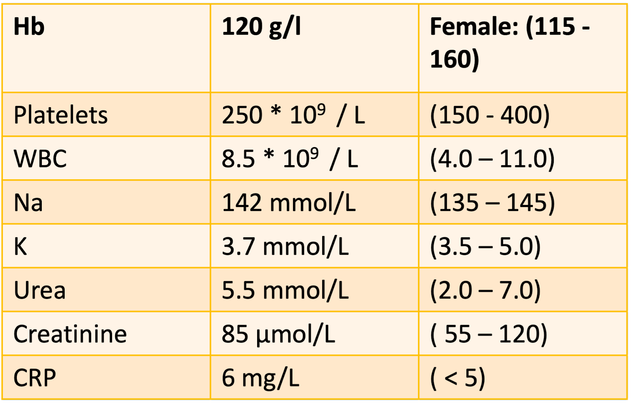
Question 7
You are called to review an 76-year-old woman who is distressed and shouting at 2am. The patient underwent a hemiarthroplasty for a fractured neck of femur 10 days ago.
The patient’s observations: heart rate 85/min, blood pressure 140/85mmHg, oxygen saturations 98% on air, respiratory rate 23/min, temperature 36.5ºC and blood glucose 6.4.
The patient has a past medical history of Alzheimer’s dementia, Gout and Type 2 diabetes. Her drug chart includes the following medications: codeine 30mg QDS (started on admission), paracetamol 1g QDS, donepezil, allopurinol, metformin, and ondansetron.
The fluid chart shows good oral intake and output.
Which of these is the most likely cause of the patient’s presentation?
a) Hypoglycaemia
b) Urinary tract infection
c) Progression of Alzheimer’s dementia
d) Constipation
Notes:
Leah
Note that patient is on Codeine and Ondansetron (an antiemetic) which are constipating medications

Slide 61
Question 7
You are called to review an 76-year-old woman who is distressed and shouting at 2am. The patient underwent a hemiarthroplasty for a fractured neck of femur 10 days ago.
The patient’s observations: heart rate 85/min, blood pressure 140/85mmHg, oxygen saturations 98% on air, respiratory rate 23/min, temperature 36.5ºC and blood glucose 6.4.
The patient has a past medical history of Alzheimer’s dementia, Gout and Type 2 diabetes. Her drug chart includes the following medications: codeine 30mg QDS (started on admission), paracetamol 1g QDS, donepezil, allopurinol, metformin, and ondansetron.
The fluid chart shows good oral intake and output.
Which of these is the most likely cause of the patient’s presentation?
a) Hypoglycaemia
b) Urinary tract infection
c) Progression of Alzheimer’s dementia
d) Constipation
Notes:
Leah
Note that patient is on Codeine and Ondansetron (an antiemetic) which are constipating medications

Slide 62
Question 8
A 42-year-old woman is brought to the psychiatry clinic by her daughter. Her daughter reports that the patient has been exhibiting unusual behaviour. This behaviour includes staying up all night, talking rapidly, excessive gambling, and saying she will soon become a millionaire.
The patient has a background of depression for which she takes sertraline.
On examination of her mental state, there is evidence of overly familiar behaviour, pressured speech, and flight of ideas.
What is the most appropriate pharmacological treatment?
a) Continue sertraline and add lithium
b) Stop sertraline and add citalopram
c) Stop sertraline and add olanzapine
d) Continue sertraline and add fluoxetine
Notes:
Mahdiyyah

Slide 63
Question 8
A 42-year-old woman is brought to the psychiatry clinic by her daughter. Her daughter reports that the patient has been exhibiting unusual behaviour. This behaviour includes staying up all night, talking rapidly, excessive gambling, and saying she will soon become a millionaire.
The patient has a background of depression for which she takes sertraline.
On examination of her mental state, there is evidence of overly familiar behaviour, pressured speech, and flight of ideas.
What is the most appropriate pharmacological treatment?
a) Continue sertraline and add lithium
b) Stop sertraline and add citalopram
c) Stop sertraline and add olanzapine
d) Continue sertraline and add fluoxetine
Notes:
Mahdiyyah
Acute episode of mania
starting treatment with an antipsychotic (olanzapine) is the correct treatment for an episode of mania. However, antidepressants (e.g. sertraline) should also be stopped rather than continued, as the continuation of the antidepressant may worsen the symptoms of mania
Lithium can be given as a mood stabiliser in the long-term management of bipolar disorder, but it should not be given to manage an acute episode of mania.

Slide 64
Question 9
A 70-year-old male is admitted to the in-patient psychiatric unit last night. On reviewing him this morning, he is a retired librarian, answering most questions minimally and stating he does not need to be here as he is deceased, and hospitals should be for living patients.
What is the most likely diagnosis?
a) Somatization disorder
b) Conversion disorder
c) Cotard’s syndrome
d) Schizophrenia
Notes:
Leah

Slide 65
Question 9
A 70-year-old male is admitted to the in-patient psychiatric unit last night. On reviewing him this morning, he is a retired librarian, answering most questions minimally and stating he does not need to be here as he is deceased, and hospitals should be for living patients.
What is the most likely diagnosis?
a) Somatization disorder
b) Conversion disorder
c) Cotard’s syndrome
d) Illness anxiety (hypochondriasis)
Notes:
This patient is presenting with Cotard's syndrome, a rare subtype of nihilistic delusions, in which they believe they or part of them is dead or does not exist. This is seen most commonly in severe depression, but is also associated with schizophrenia.
Illness anxiety disorder (hypochondriasis)
persistent belief in the presence of an underlying serious DISEASE, e.g. cancer
patient again refuses to accept reassurance or negative test results
Somatisation disorder
multiple physical SYMPTOMS present for at least 2 years
patient refuses to accept reassurance or negative test results
Conversion disorder
typically involves loss of motor or sensory function
the patient doesn't consciously feign the symptoms (factitious disorder) or seek material gain (malingering)

Slide 66
Question 10
A 38-year-old woman is brought by her son to A&E. The son believes the patient has taken an overdose of ‘some white tablets’ she keeps in her bedside drawer. The patient’s clinical notes show she has a history of bipolar affective disorder. The son recalls the patient not being able to form sentences when speaking and that her hands had been shaking the night before. She suddenly worsened in the early hours of the morning with confusion, drowsiness and convulsions.
Which medication is she most likely to have taken an overdose of?
Clozapine
Lamotrigine
Haloperidol
Lithium
Notes:
Mahdiyyah

Slide 67
Question 10
A 38-year-old woman is brought by her son to A&E. The son believes the patient has taken an overdose of ‘some white tablets’ she keeps in her bedside drawer. The patient’s clinical notes show she has a history of bipolar affective disorder. The son recalls the patient not being able to form sentences when speaking and that her hands had been shaking the night before. She suddenly worsened in the early hours of the morning with confusion, drowsiness and convulsions.
Which medication is she most likely to have taken an overdose of?
Clozapine
Lamotrigine
Haloperidol
Lithium
Notes:
A - clozapine for treatment-resistant schizophrenia
B - lamotrigine is an anti-epileptic drug, can be used to treat bipolar depression but NICE guidelines say not to use to treat mania
C - haloperidol overdose Difficulty with breathing (severe), dizziness (severe), drowsiness (severe), muscle trembling, jerking, stiffness, or uncontrolled movements (severe), unusual tiredness or weakness (severe)
D - lithium first line for BPD and symptoms classic of lithium toxicity - confusion, drowsiness, tremor, convulsions

Slide 68
Question 11
A 43 year-old man is started on haloperidol for schizophrenia. He presents to his general practitioner with a 1-day history of neck pain and difficulty moving the neck. On examination, she has normal observation except a mild tachycardia of 105 and neck stiffness with restricted range of motion. Her neck is involuntarily flexed to the right. She has normal facial movements.
What is the most likely diagnosis?
Neuroleptic malignant syndrome
Acute dystonia
Tardive dyskinesia
Akathisia
Notes:
Leah

Slide 69
Question 11
A 43 year-old man is started on haloperidol for schizophrenia. He presents to his general practitioner with a 1-day history of neck pain and difficulty moving the neck. On examination, he has normal observation except a mild tachycardia of 105 and neck stiffness with restricted range of motion. His neck is involuntarily flexed to the right. He has normal facial movements.
What is the most likely diagnosis?
Neuroleptic malignant syndrome
Acute dystonia - Torticollis
Tardive dyskinesia
Akathisia

Slide 70
Question 12
A 85-year-old man has been admitted to the hospital for malnutrition and dehydration. He has depression and anxiety. He is currently refusing antidepressant medication and nasogastric feeding. He denies any illness and tells you he is well enough to go home and wants to leave the hospital now.
Which of the following should be used to allow treatment for the patient’s depression?
Mental Capacity Act
No legal framework needed as the treatment is in the patient’s best interests
Deprivation of Liberty Safeguarding
Mental Health Act
Notes:
Mahdiyyah

Slide 71
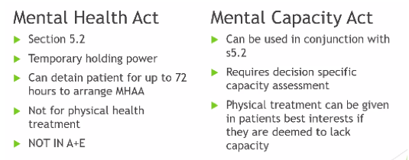
Question 12
A 85-year-old man has been admitted to the hospital for malnutrition and dehydration. He has severe depression and anxiety. He is currently refusing antidepressant medication and nasogastric feeding. He denies any illness and tells you that he is would like to go home.
Which of the following should be used to allow treatment for the patient’s depression?
Mental Capacity Act
No legal framework needed as the treatment is in the patient’s best interests
Deprivation of Liberty Safeguarding
Mental Health Act
Notes:
Mental capacity act - physical treatment can be given in patients best interests if they are deemed to lack capacity.
The Mental Capacity Act (2005) - applies if a person has a mental health issue and they do not have the mental capacity to make certain decisions e,g. refusing necessary treatment

Slide 72

Any questions? Feedback Form
Useful resources:
Passmedicine Psychiatry Question Bank
Mind charity www.mind.org,uk
GKTeach — updates in MSA newsletter, Facebook and Instagram
Osmosis med
Looking at the ICD/DSM and looking up symptoms and diagnosis criteria

