Slide 1







GKTeach
DNA & nucleic acids
DNA replication + mutagenesis, molecular basis of gene transcription, gene products and protein synthesis, protein targeting
STAGE 1
Saraswathi Karanam
saraswathi.karanam@kcl.ac.uk

Slide 2



DNA replication and mutagenesis

Slide 3
  To understand the chemistry and structure of RNA/DNA
  To define the mechanism of DNA replication
  Appreciate the implications of the chromosome end-problem
  To define the types of DNA mutagenesis
  Be aware of the clinical importance of DNA replication
LEARNING OBJECTIVES

Slide 4

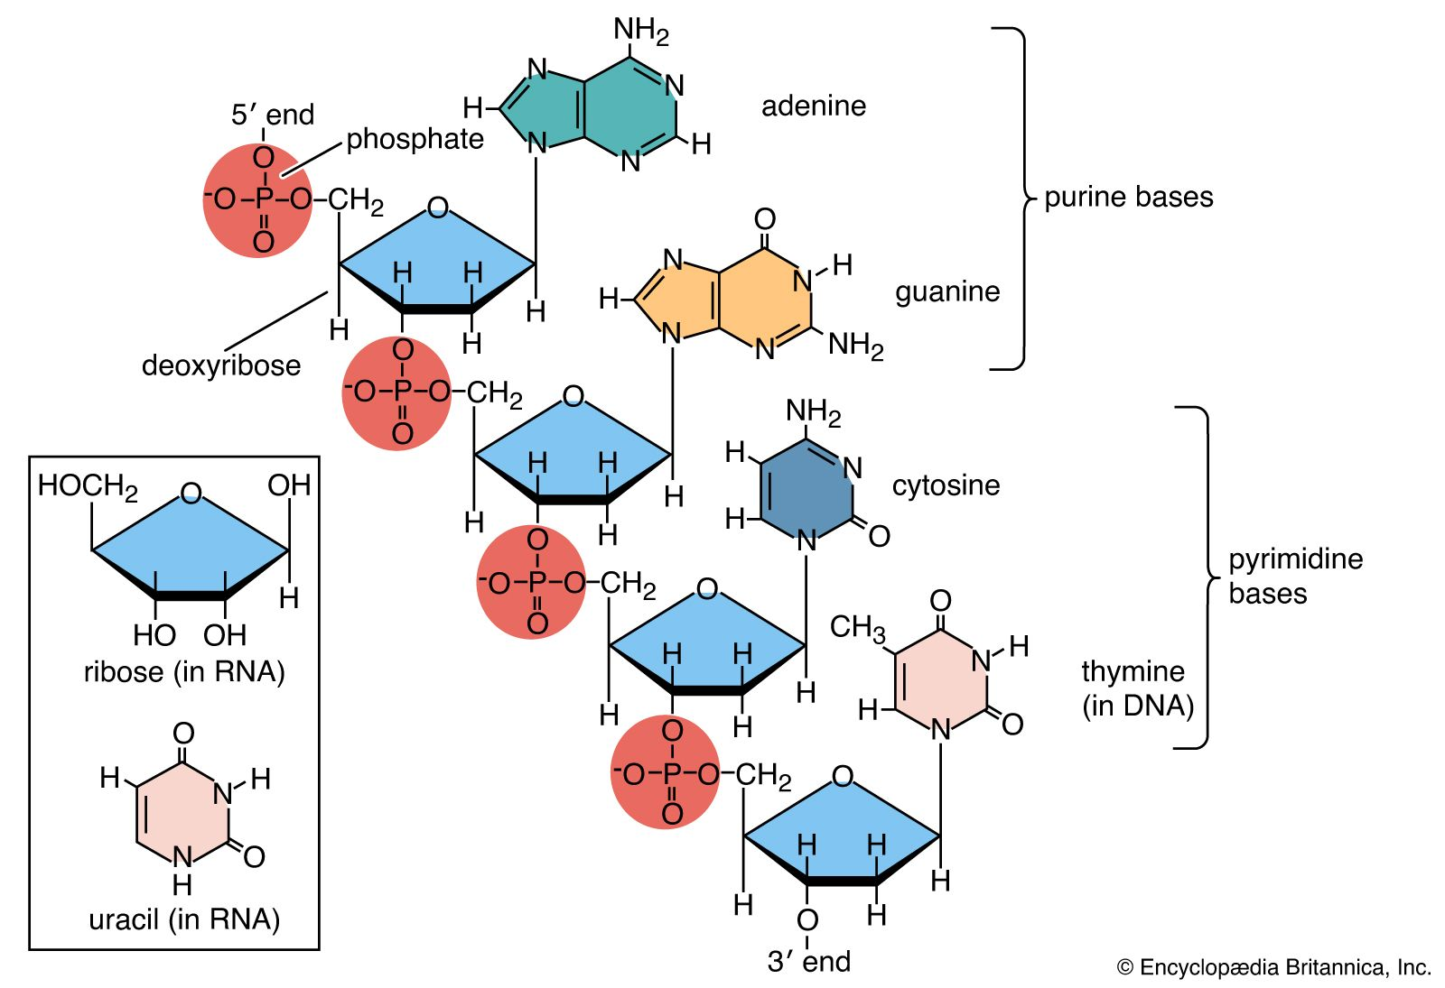
Chemistry and Structure of DNA
A DNA nucleotide consists of a nitrogen base attached to the 1' position and a phosphate group attached to the 5' position in deoxyribose sugar
A nucleoside is the combination of the nitrogen base and the sugar
There are 4 options for bases in DNA: guanine + adenine (purines) and cytosine + thymine (pyramidines)
In DNA the sugar is deoxyribose - lacks a OH at the 2' position compared to ribose
DNA strands have polarity/ directionality – 5' end has a free phosphate and 3' end has a free –OH group
The nucleotides are joined by phosphodiester bonds releasing PPi and the reaction is catalysed by DNA polymerase
Image reference: The Editors of Encyclopedia Britannica (2008). Nucleotide | biochemistry. In: Encyclopædia Britannica. [online] Available at: https://www.britannica.com/science/nucleotide.

Slide 5
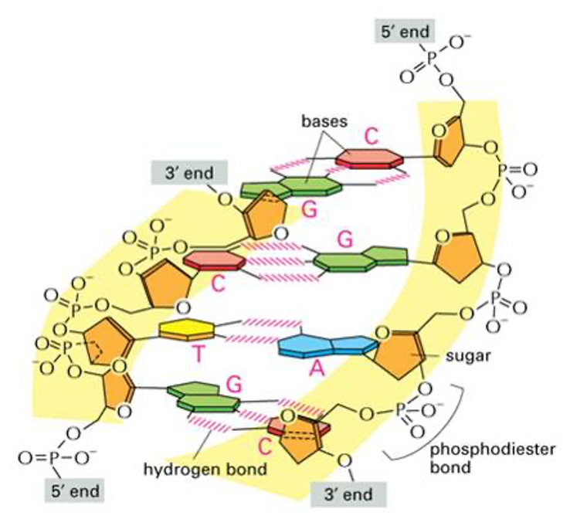
Chemistry and Structure of DNA (cont)
DNA consists of 2 strands that are stabilised by hydrogen bonds between bases:
  Adenine bonds to thymine with 2 hydrogen bonds
  Cytosine bond to guanine with 3 hydrogen bonds
DNA forms a right hand double helix with anti-parallel strands – 5' to 3' in one direction, 3' to 5' in the other
The bases are perpendicular to the helical axis
Image reference: Knight, S. (2024) DNA replication and mutagenesis background

Slide 6
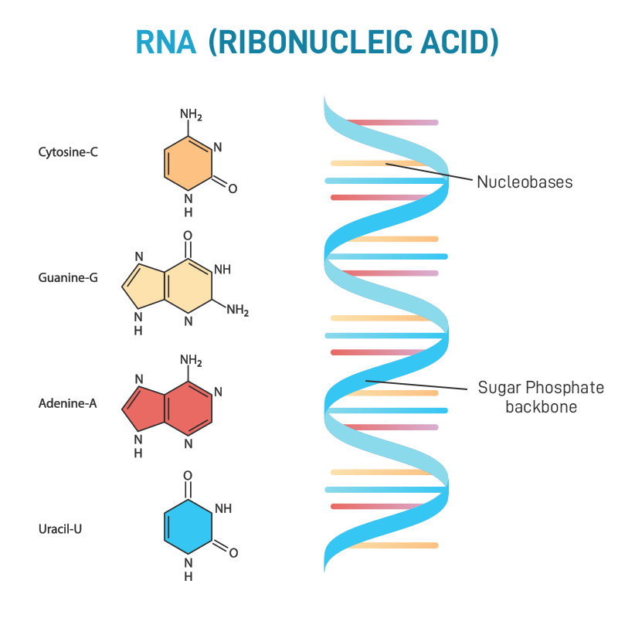
Chemistry and Structure of RNA
In RNA there are 4 bases: guanine + adenine (purines) and cytosine and uracil (pyramidines)
RNA is single stranded and the sugar is ribose
There are 2 classes of RNA: coding and non coding
Coding RNA
  mRNA
Non-coding
  rRNA – component of ribosome
  TRNA – involved in translation
  snRNA – small nuclear RNA involved in splicing
  miRNA – micro RNA involved in regulation of gene expression
  xist – involved in inactivating X chromosome
Image reference: GeeksforGeeks (2022). RNA Definition, Structure, Types and Functions. [online] GeeksforGeeks. Available at: https://www.geeksforgeeks.org/biology/rna-definition-structure-types-and-functions/.

Slide 7
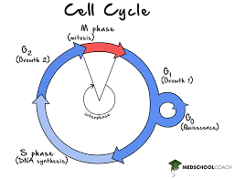
DNA replication overview
DNA replication is part of the cell cycle in eukaryotes: the signal causing the cell to replicate its DNA occurs in G1
If no signal occurs the cell enters a quiescent G0 phase
DNA replication is semi conservative – each new molecule
contains one parent strand and one daughter strand

Slide 8
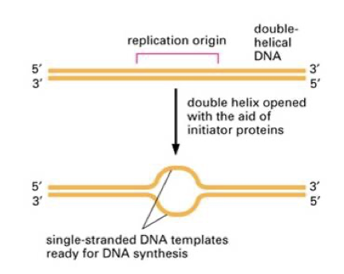
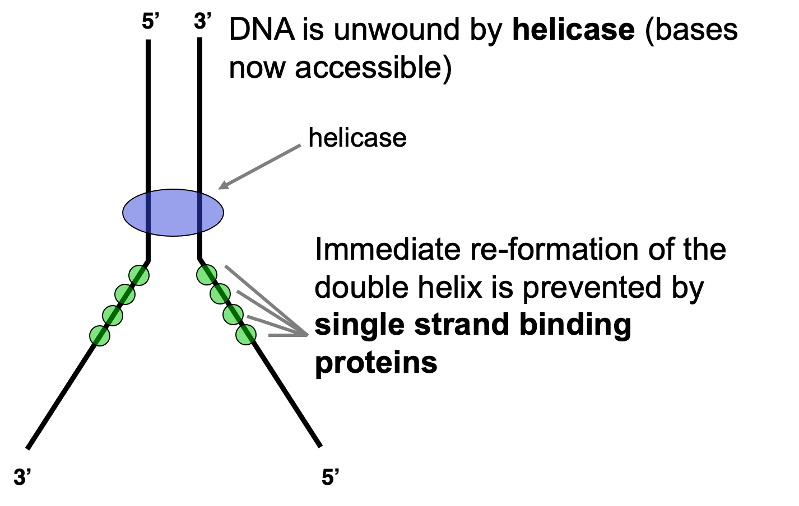
Initiation of DNA replication
Base pairs of the double helix are broken by initiator proteins at the replication origin
This allows the strand to unwind
Allows DNA polymerase access to the bases so new strands can be synthesised using the original ones as templates
This forms 2 'replication forks'
DNA helicase further unwinds the double helix
Single strand binding proteins prevent the immediate re-joining of the strands
Topoisomerase breaks a phosphodiester bond in one strand ahead of the replication fork allowing a degree of freedom for the helix to unwind without supercoiling
Image reference: Knight, S. (2024) DNA replication and mutagenesis

Slide 9
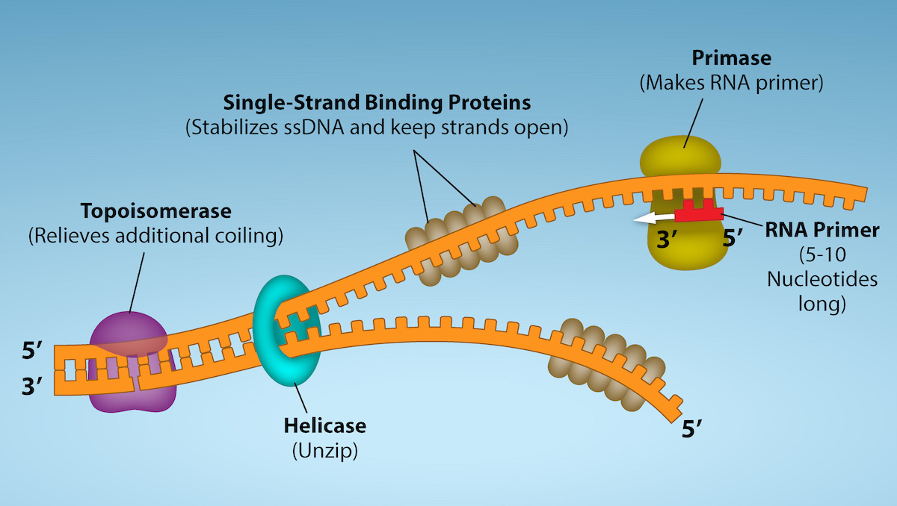
Initiation of DNA replication
3' OH is needed for DNA synthesis initiation
DNA polymerase cannot initiate DNA synthesis – can only add nucleotides to pre-existing chains
RNA polymerase can initiate DNA synthesis so DNA synthesis begins with the synthesis of a short RNA primer (8-10 nucleotides long) by primase (an RNA polymerase)
DNA polymerase requires the free 3' OH from the RNA primer to initiate synthesis
Image reference: https://bio.libretexts.org/Courses/Norco_College/OpenStax_Biology_2e_for_Norco_College/14%3A_DNA_Structure_and_Function/14.05%3A_DNA_Replication_in_Prokaryotes

Slide 10
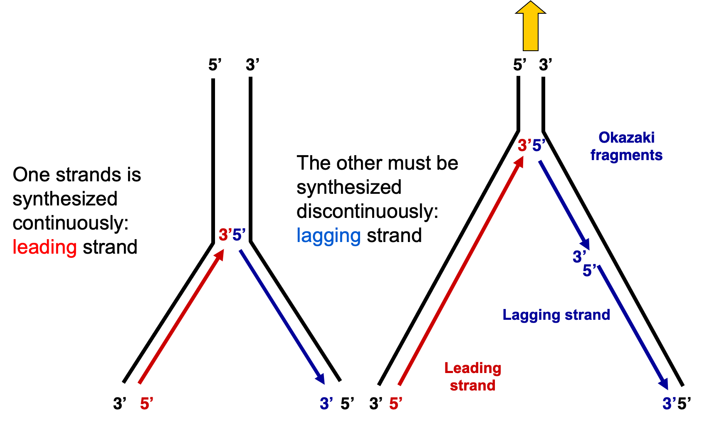
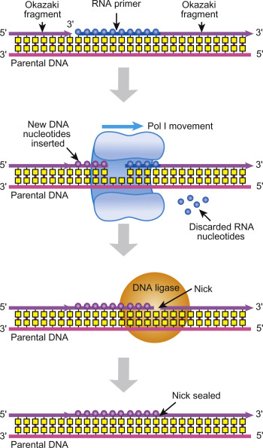
DNA replication
DNA polymerase synthesises new strands using the old ones as templates – semi conservative replication
Only works in 5' to 3' direction – results in different method for 2 parental strands
  Leading strand is synthesised continuously
  Lagging strand is synthesised discontinuously forming okazaki fragments
Helix unwinds further so replication can continue
Process of joining okazaki fragments
  DNA polymerase extends DNA until it reaches the next RNA primer
  The primer is degraded by an exonuclease leaving a gap
  DNA polymerase continues across the gap
  Missing phosphodiester bond in added by DNA ligase
Image references: Knight, S. (2024) DNA replication and mutagenesis
AbdelAziz, W. (2003). The DNA synthesome: its potential as a novel in vitro model system for studying S-phase specific anticancer agents. Critical Reviews in Oncology/Hematology, 48(1), pp.19–33. doi:https://doi.org/10.1016/s1040-8428(03)00096-9.

Slide 11
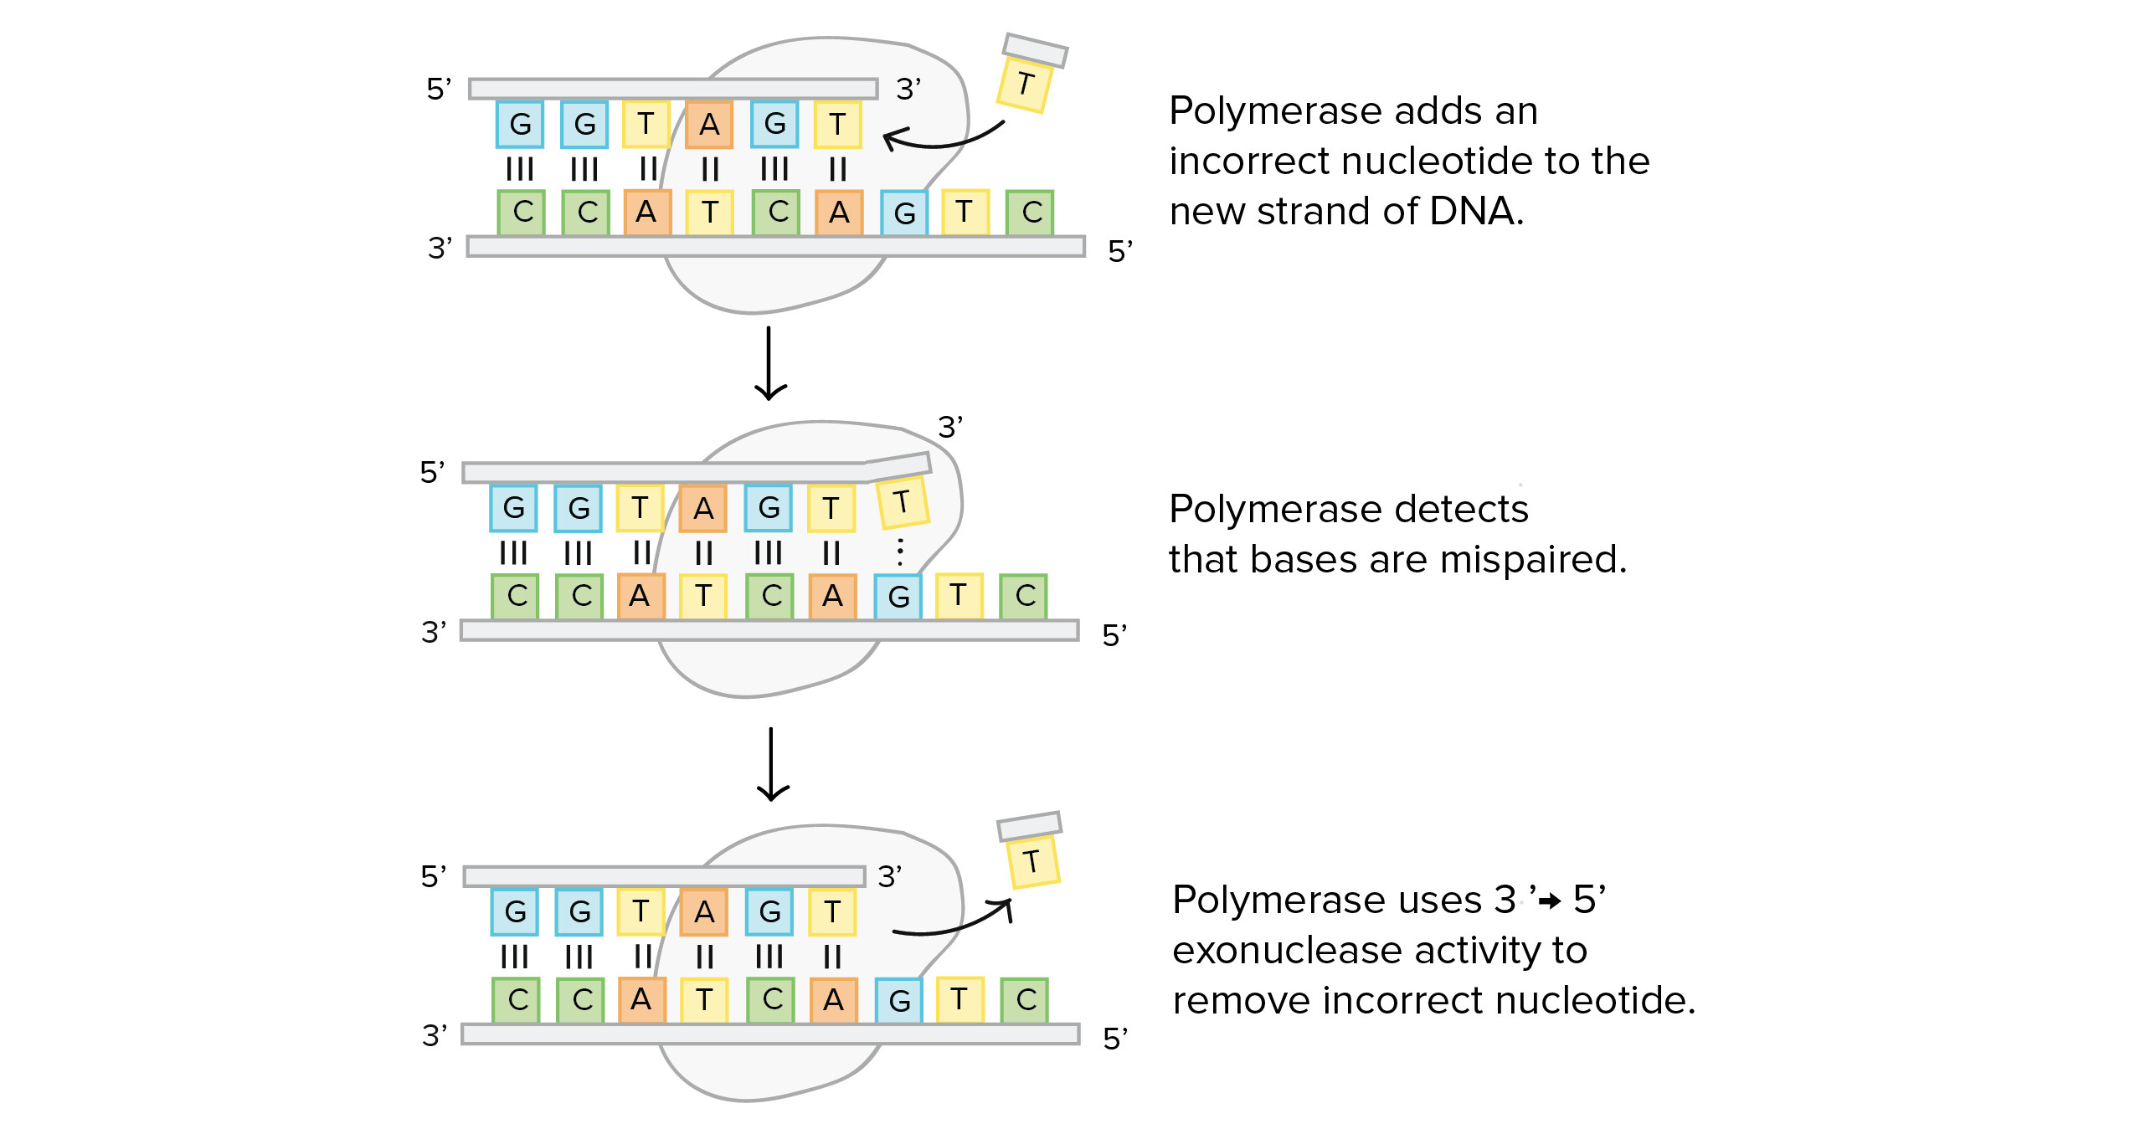
Proof reading
Image reference: https://www.khanacademy.org/science/biology/dna-as-the-genetic-material/dna-replication/a/dna-proofreading-and-repair#:~:text=DNA%20polymerases%20are%20the%20enzymes,This%20process%20is%20called%20proofreading.

Slide 12
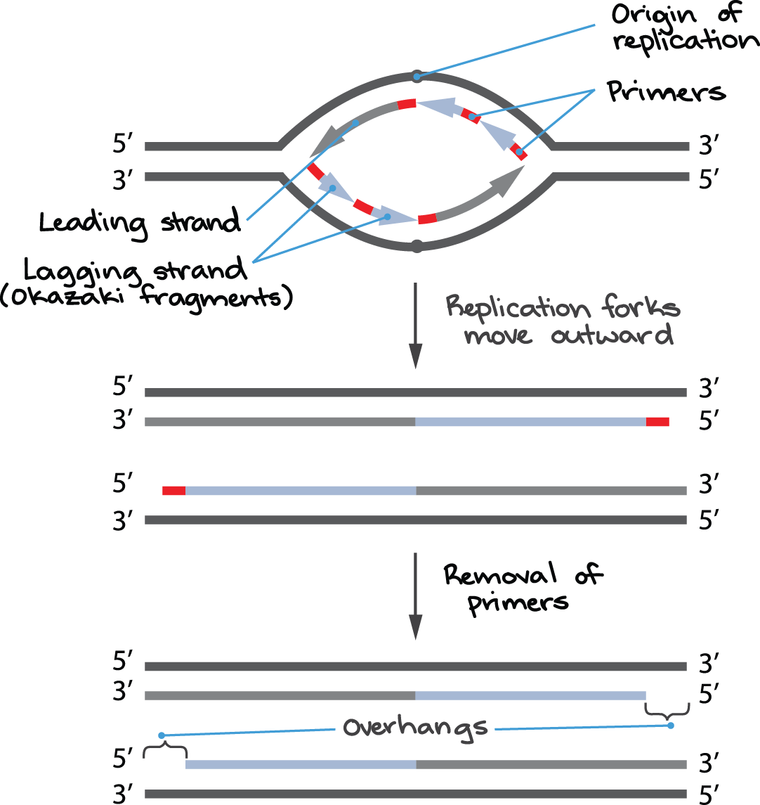
Chromosome end problem
Image reference: Khan Academy (2018b). Telomeres and telomerase. [online] Khan Academy. Available at: https://www.khanacademy.org/science/biology/dna-as-the-genetic-material/dna-replication/a/telomeres-telomerase.

Slide 13
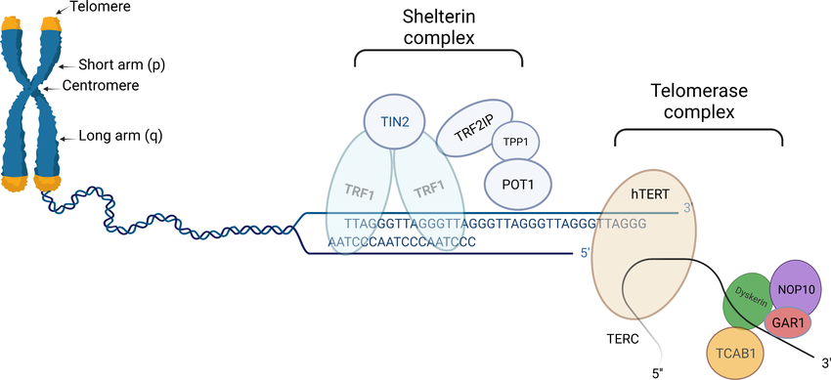
Chromosome end problem solution: telomeres
Specialised structure at end of chromosome: consists of hundreds of repeats of sequence 5'TTAGGG 3'
Telomeres get shorter after each replication – prevents loss of functional parts of the genome
  When they become too short cells stop dividing
Specific proteins bind to telomeres to form shelterin complex – prevents end to end chromosome fusions
In stem cells and gametes telomerase adds telomere repeats to the end of chromosomes – telomerase consists of reverse transcriptase and and an RNA telomere repeat template
Image reference: Telomere biology: from disorders to hematological diseases - Scientific Figure on ResearchGate. Available from: https://www.researchgate.net/figure/Schematic-presentation-of-telomere-left-part-shelterin-complex-middle-and_fig1_371286593 [accessed 10 Nov 2025]

Slide 14
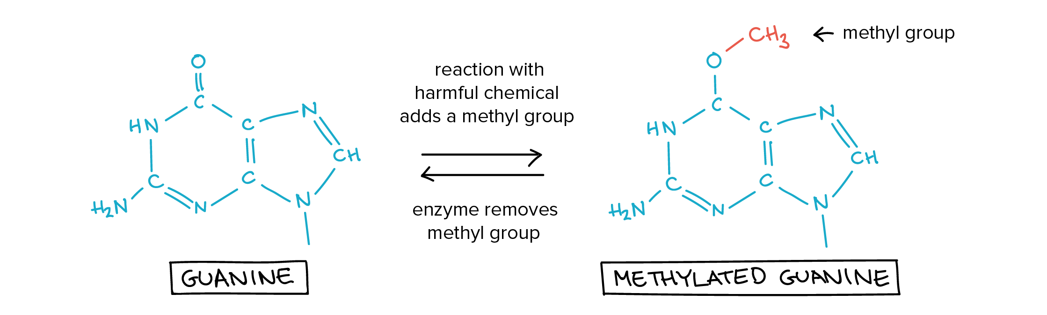
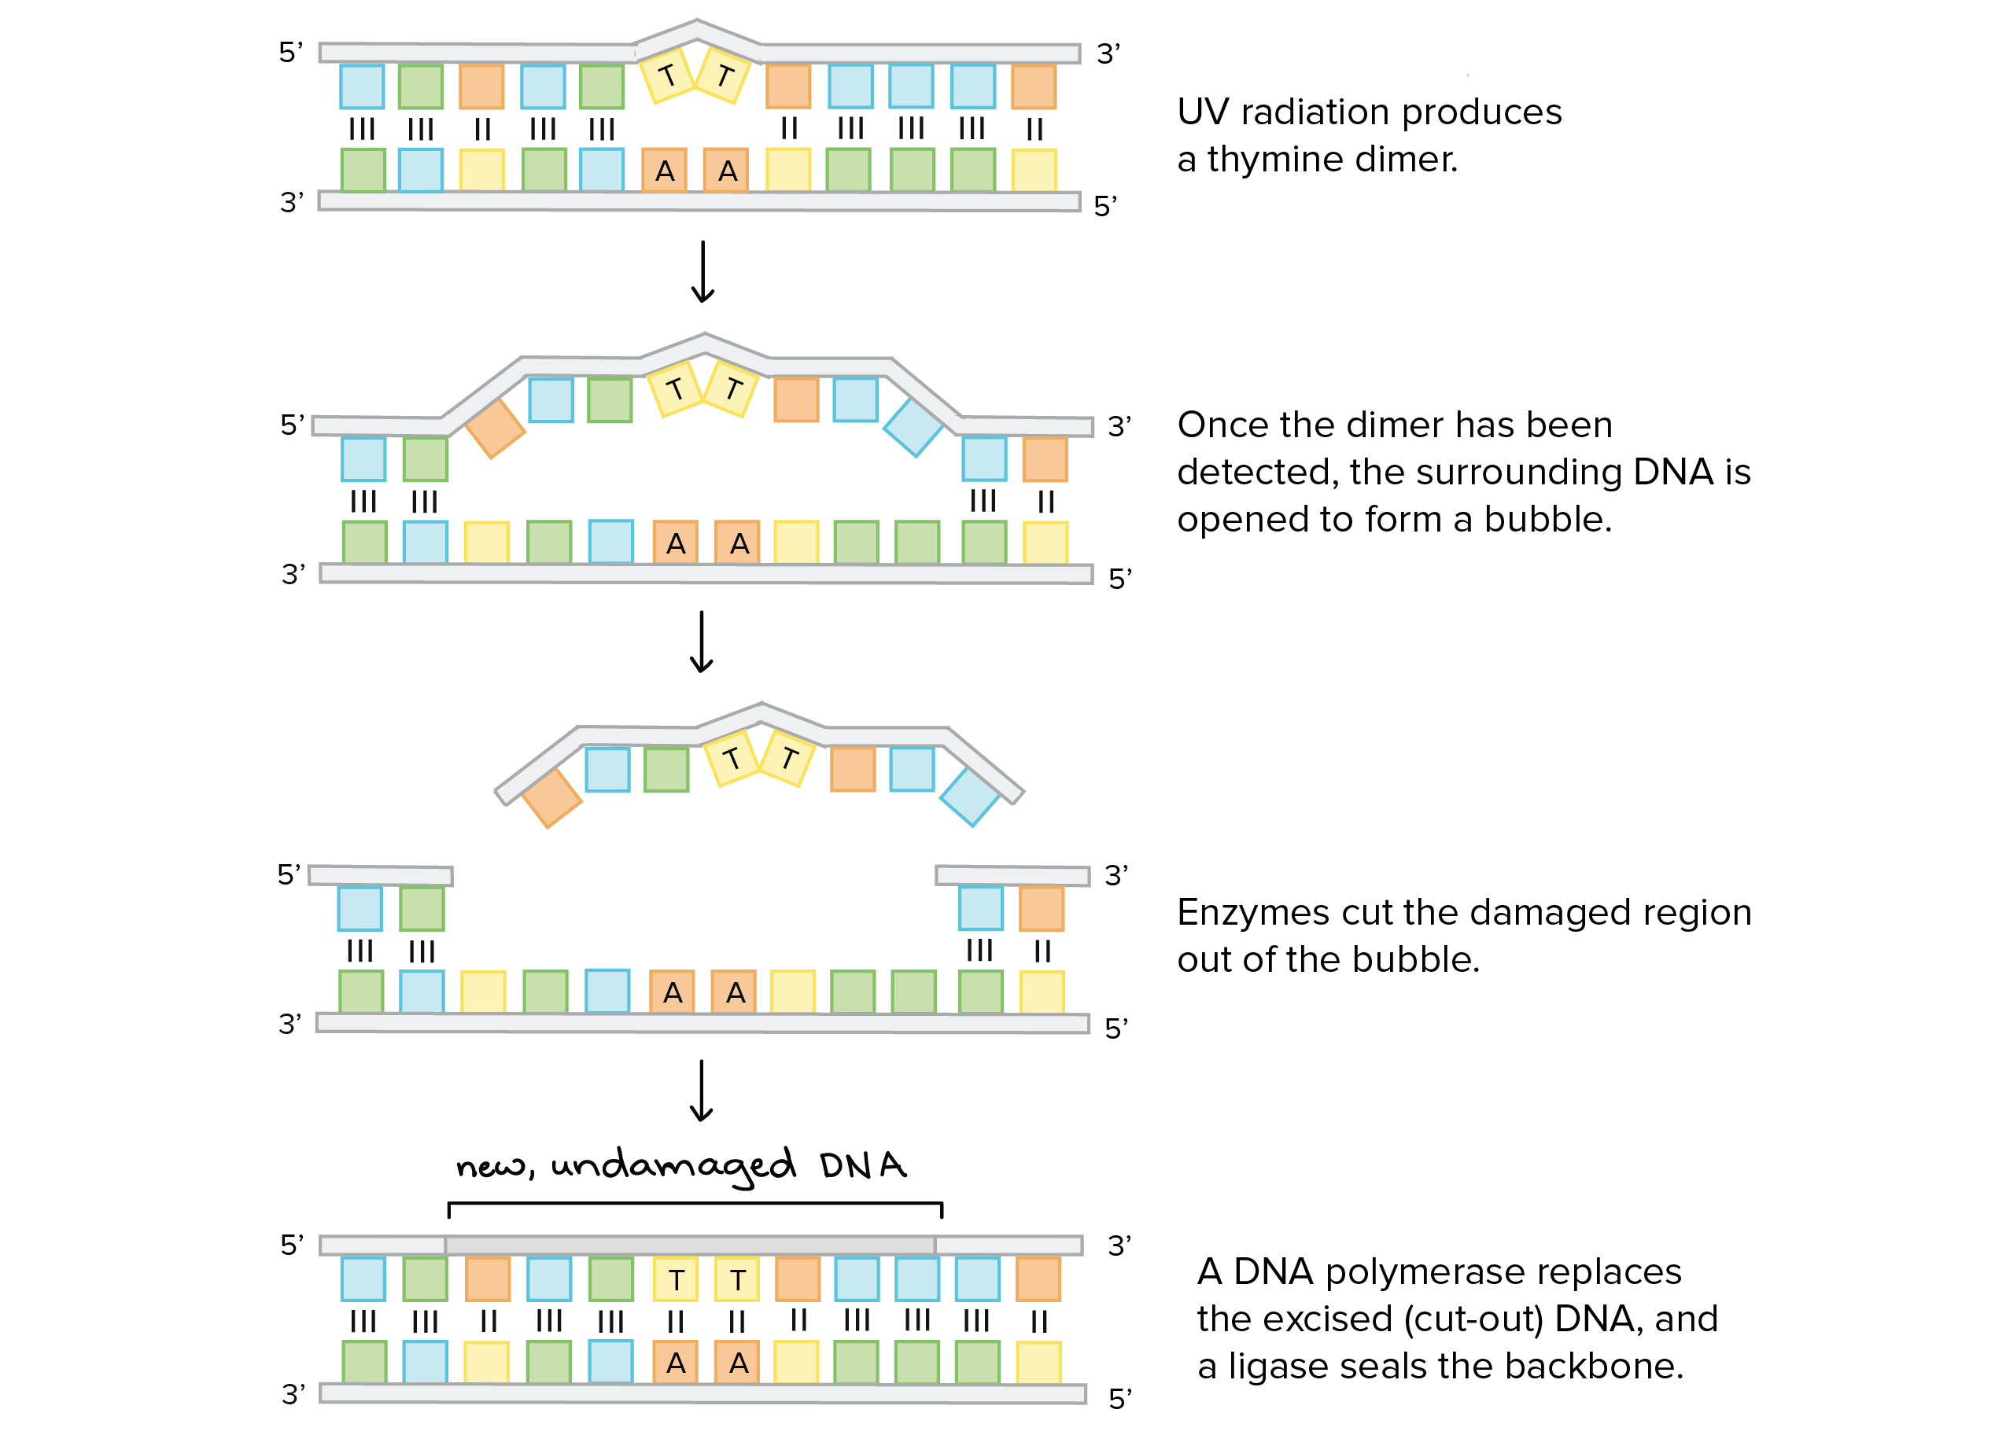
DNA damage repairs
METHODS OF REPAIR
Direct repair of alkylation caused by methyl-nitrosourea by specific enzyme that removes the methyl group
Nucleotide excision repair (NER) - removal of damaged region by nuclease and helicase action and re-synthesis
Repair of DSB – homologous recombination
  Exonuclease removes a few bases leaving protruding 3' ends
  Free strand invades homologous intact duplex promoted by protein Rad51
  Donor strand is used as a template for resynthesis
  Complex junction resolved to leave 2 duplexes
Image reference: https://www.khanacademy.org/science/biology/dna-as-the-genetic-material/dna-replication/a/dna-proofreading-and-repair

Slide 15
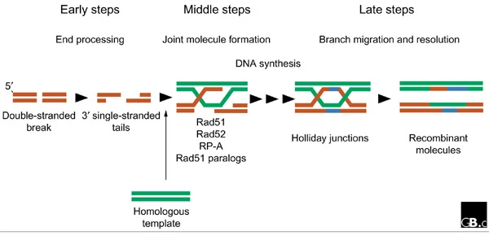
Homologous recombination
Image reference: Modesti, M. and Kanaar, R. (2001). Homologous recombination: from model organisms to human disease. Genome Biology, 2(5), p.reviews1014.1. doi:https://doi.org/10.1186/gb-2001-2-5-reviews1014.

Slide 16

SBA
What is the role of topoisomerases?
A) prevent rejoining of DNA strands
B) prevent double strand breaks
C) unwinding DNA strands
D) break base pairs to begin replication fork
E) initiate DNA synthesis

Slide 17
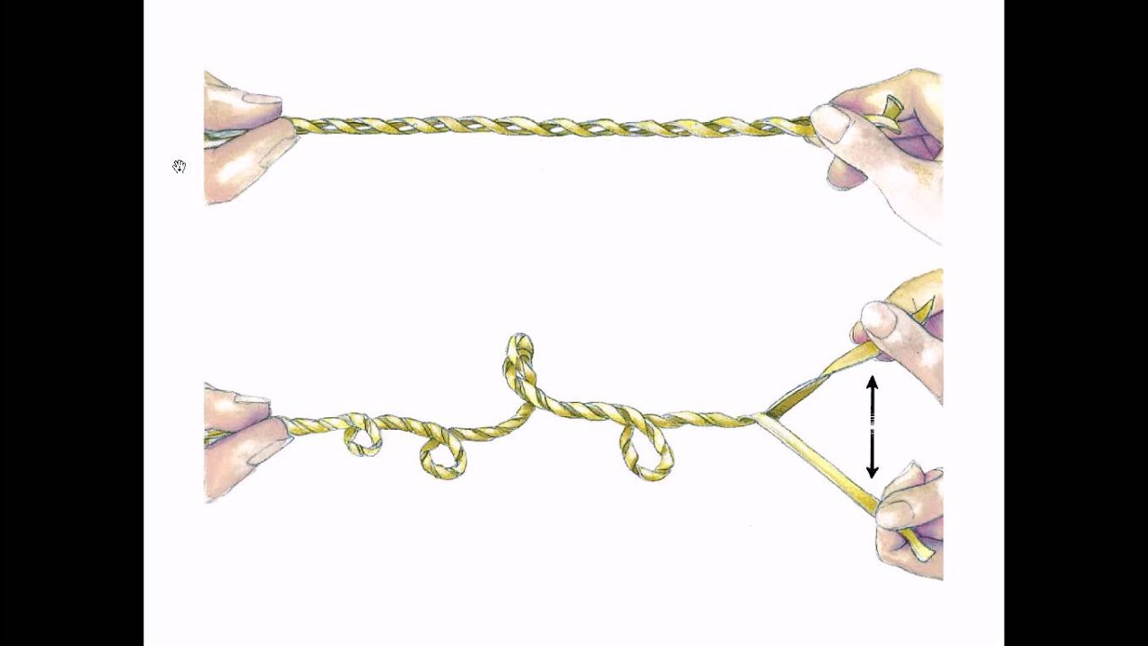
SBA answer
ANSWER: prevent double strand breaks
EXPLANATION: pulling strands apart increases their winding around each other – causing positive supercoiling
This would eventually cause double strand breaks as the helix would snap
Topoisomerase breaks a bond in one strand ahead of the replication fork to allow a degree of freedom for the helix to unwind
Image reference: Knight, S. (2024) DNA replication and mutagenesis

Slide 18
SBA
What type of mutation causes chromic myeloid leukaemia
A) replication slippage
B) deletion
C) inversion
D) translocation
E) duplication

Slide 19
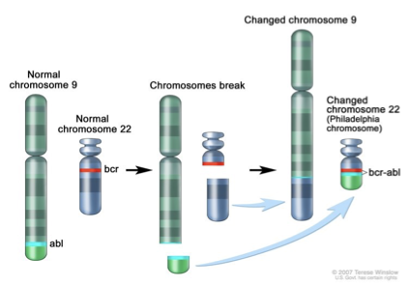
SBA answer
ANSWER: translocation
EXPLANATION: 90% of patients have philadelphia chromosome
Caused by translocation from chromosome 9 to chromosome 22
Causes formation of 2 hybrid genes
BCR/ABL mRNA encodes p210 'fusion' protein which is a constituently active tyrosine kinase resulting in permenant activation of cell growth Ras pathway
Image reference: Knight, S. (2024) DNA replication and mutagenesis

Slide 20
SBA
What is the function of shelterin?
A) degrade RNA primers
B) prevent degradation of DNA strands
C) repairs double strand breaks
D) prevents end to end fusion of chromosomes
E) initiates replication at origin

Slide 21
SBA
What is the function of shelterin?
A) degrade RNA primers
B) prevent degradation of DNA strands
C) repairs double strand breaks
D) prevents end to end fusion of chromosomes
E) initiates replication at origin

Slide 22
Molecular basis of gene transcription

Slide 23
  Outline the mechanism of RNA synthesis in prokaryotic cells
  Identify ways that eukaryotic transcription differs from prokaryotic transcription
  Describe the co-transcriptional/post-transcriptional modifications that occur in eukaryotic cells during conversion of the primary transcript (hnRNA to mRNA)
  Explain the terms 'exon' and intron
LEARNING OBJECTIVES

Slide 24
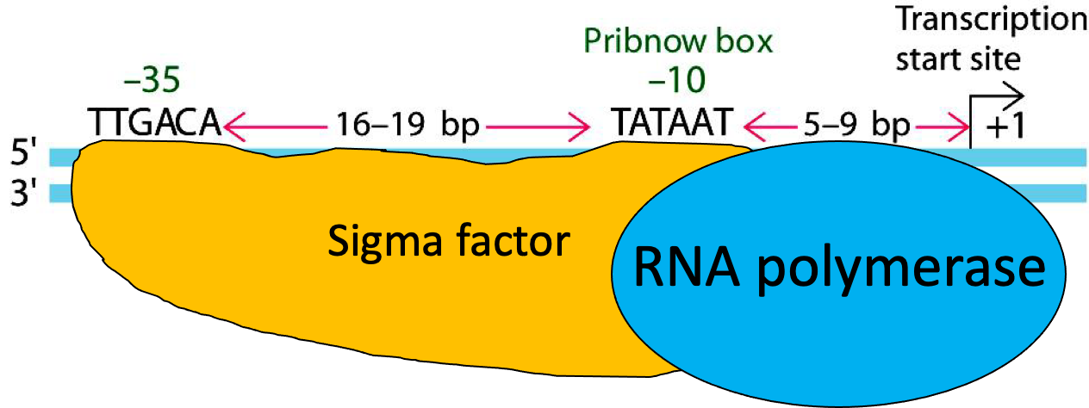
Transcription: initiation
Short recognition sequences (boxes) in the promotor region serve to align RNA polymerase at the transcription start site
RNA polymerase has affinity for DNA but this is not sequence specific
  A sigma factor binds to the –10 (Pribnow) and –35 boxes and recruits RNA polymerase to the transcription start site
Image reference: Hunt, R. (2024) 'molecular basis of gene transcription'

Slide 25
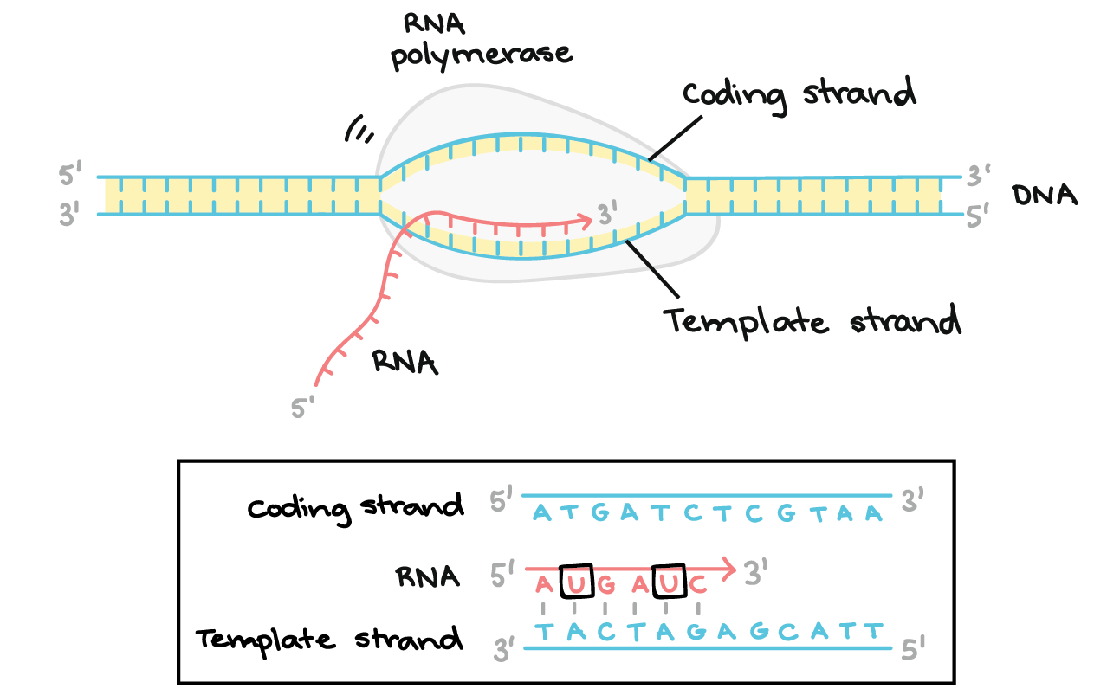
Transcription: elongation
RNA polymerase unwinds DNA as it moves
Does not require a primer
RNA polymerase reads DNA template and adds complimentary RNA nucleotides in 5' to 3' direction
Sigma factor dissociates after first few nucleotides are added
RNA nucleotides are joined by covalent phosphodiester bonds
Image reference: Khan Academy (2018). Stages of transcription. [online] Khan Academy. Available at: https://www.khanacademy.org/science/biology/gene-expression-central-dogma/transcription-of-dna-into-rna/a/stages-of-transcription.

Slide 26
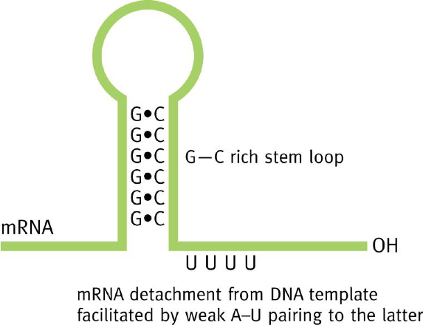
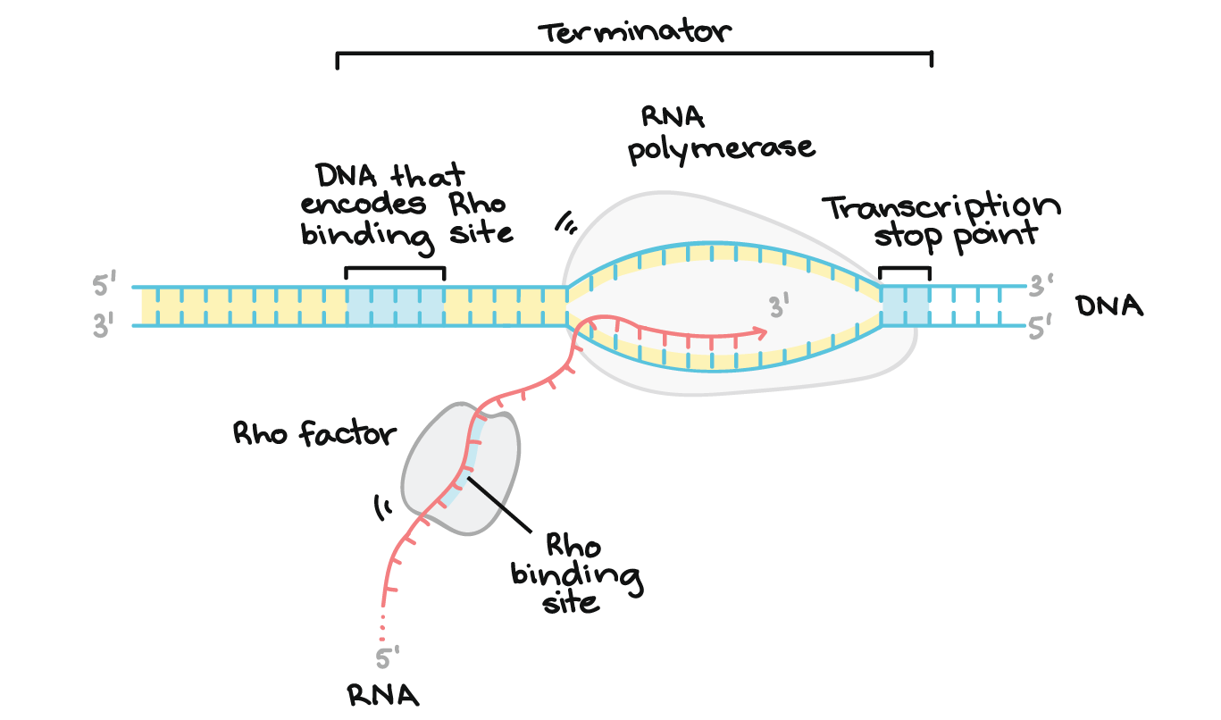
Transcription: termination
Rho independent termination
Termination controlled by GC-rich stop sequences in DNA
Causes a stem loop to form reducing the binding of mRNA to DNA template
A string of weak A-U pairings aid in detachment from DNA template
Rho dependent termination
RNA polymerase pauses at certain sequences (often GC rich as strands are harder to separate due to 3 hydrogen bonds)
Pauses allow rho to catch up with it releasing RNA
Rho has helicase activity and unwinds the DNA-RNA duplex separating newly generated RNA from DNA
Image reference: Hunt, R. (2024) 'molecular basis of gene transcription'
Image reference: Khan Academy (2018). Stages of transcription. [online] Khan Academy. Available at: https://www.khanacademy.org/science/biology/gene-expression-central-dogma/transcription-of-dna-into-rna/a/stages-of-transcription.

Slide 27
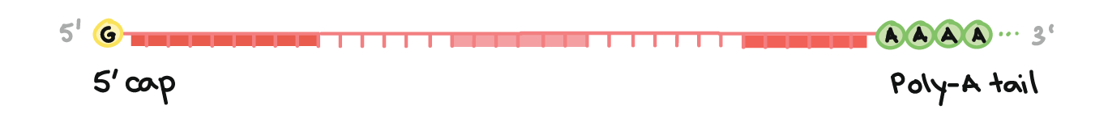
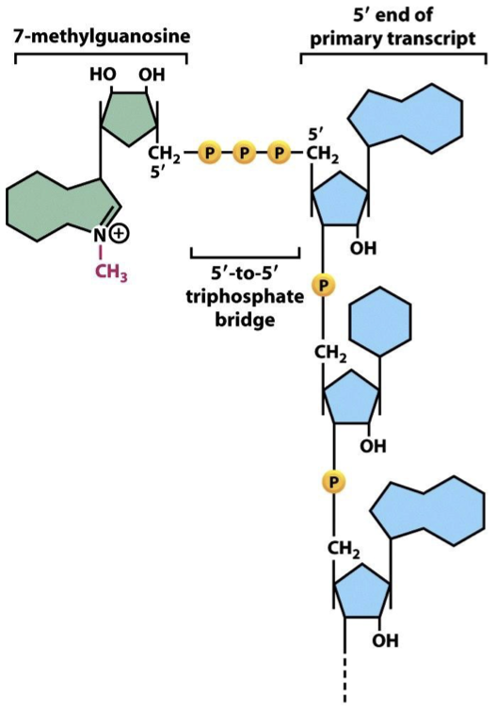
Eukaryotes: co-transcriptional/post -transcriptional processing
Capping
7-methylguanosine cap formed at 5' end
Guanosine base is added by reaction with GTP
This protects the transcript from degradation and has roles in the export from nucleus
Polyadenylation
Multiple (50-250) adenosine residues are added to 3' end of mRNA (not encoded by DNA template)
This also protects the transcript from degradation and has a role in export from nucleus
Image reference: https://www.khanacademy.org/science/ap-biology/gene-expression-and-regulation/transcription-and-rna-processing/a/eukaryotic-pre-mrna-processing
Image reference: Hunt, R. (2024) 'molecular basis of gene transcription'

Slide 28
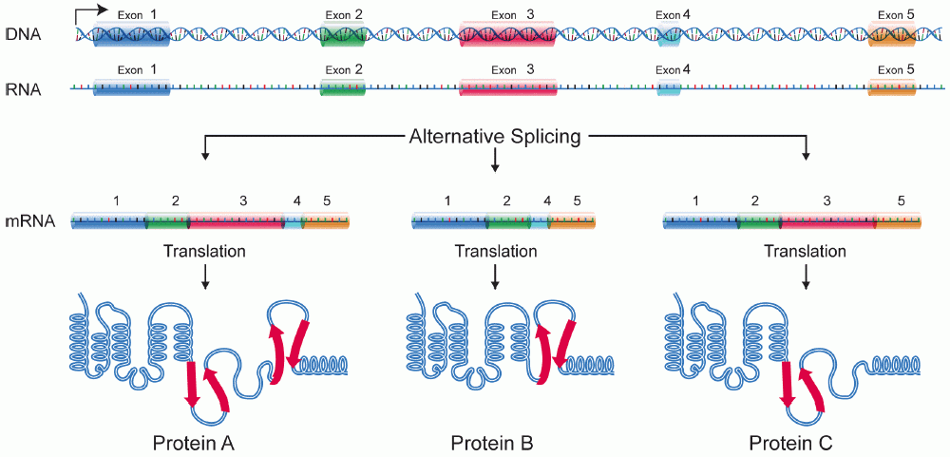
Eukaryotes: splicing
Complex of proteins (the spliceosome) removes introns
Alternative splicing – some hnRNA can be spliced in different ways resulting in different protein products from same genes
Often happens while transcription is occurring (co-transcriptional)
Image reference: https://www.khanacademy.org/science/ap-biology/gene-expression-and-regulation/transcription-and-rna-processing/a/eukaryotic-pre-mrna-processing

Slide 29
SBA
Which RNA polymerase is involved in transcription in eukaryotes?
A) RNA Pol I
B) RNA Pol II
C) RNA Pol III
D) RNA Pol IV
E) RNA Pol V

Slide 30
SBA
Which RNA polymerase is involved in transcription in eukaryotes?
A) RNA Pol I
B) RNA Pol II
C) RNA Pol III
D) RNA Pol IV
E) RNA Pol V

Slide 31
SBA
Where does the sigma factor bind?
A) the start codon
B) the shine dalgarno sequence
C) to the –10 and –35 boxes
D) the stop codon
E) the pribnow box

Slide 32
SBA
Where does the sigma factor bind?
A) the start codon
B) the shine dalgarno sequence
C) to the –10 and –35 boxes
D) the stop codon
E) the pribnow box

Slide 33
Gene products and protein synthesis

Slide 34
  Outline how the genetic code was deciphered
  Explain how amino acids are encoded by groups of 3 nucleotide bases
  Describe components required for translation
  Outline the process of activation of an amino acid to form an amino acyl tRNA
  Describe 3 stages of translation in prokaryotic cells
  Identify ways that eukaryotic translation differs from prokaryotic translation
LEARNING OBJECTIVES

Slide 35
How was the genetic code deciphered? KEY POINTS
Matthaei and Nirenberg
method to find out which bases encode which amino acid
EXPERIMENT KEY POINTS
Cell free system: an extract containing ribosomes, tRNA, enzymes etc but no intact cells
Added synthetic RNA of known composition: poly U RNA (UUUUUU)
Added radioactively labelled amino acids to see which were incorporated in new proteins
Only one amino acid radio-labelled per tube
After incubation (to allow protein synthesis) mixture was poured onto filter paper to remove unbound amino acids and mRNA
Scanned for radioactive signal – tube with radioactive phenylalanine had high signal: UUU codes phenylalanine
Har Gobind Khorana
Initially Nirenberg's lab were not able to control the order that nucleotides were polymerised
Khorana worked out how to synthesise RNA with a specific sequence making the process of finding out which codons code each amino acid easier

Slide 36
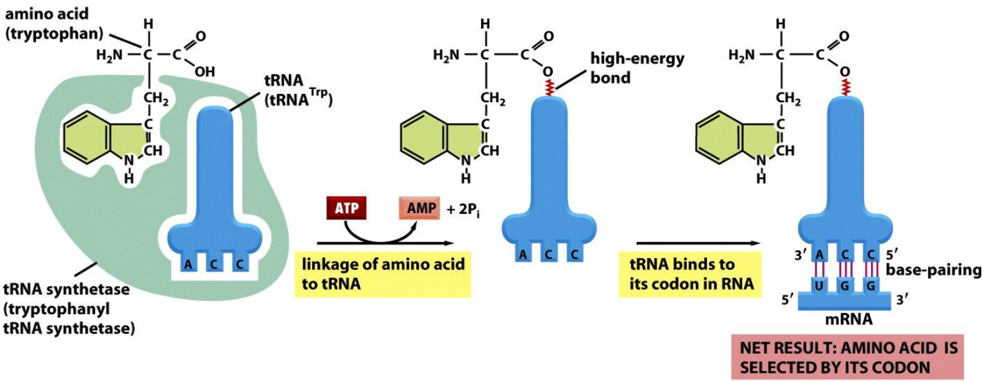
Charging tRNA
A charged tRNA has an amino acid attached to the 3' end via an ester linkage
Specific aminoacyl-tRNA-synthetases add amino acids to tRNA
Energy for charging tRNA comes from ATP hydrolysis:
Amino acid + tRNA + ATP -> aminoacyl-tRNA + PPi + AMP
Notation:
  tRNA classified by their amino acid e.g. tRNA^{phe}
  When they are charged they are sometimes referred to as activated and are named like this e.g. phe-tRNA^{phe}

Slide 37
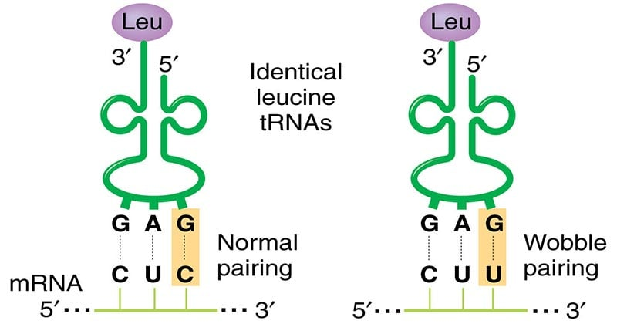
Wobble mechanism
Only tryptophan and methionine are encoded by a single codon
Often the first 2 letters in the codon are complementary – the 3rd base can vary
Allows a single tRNA species to recognise more than one codon
Image reference: Aryal, S. (2018). The Wobble Hypothesis | Molecular Biology / Genetics | Microbe Notes. [online] Microbe Notes. Available at: https://microbenotes.com/the-wobble-hypothesis/.

Slide 38
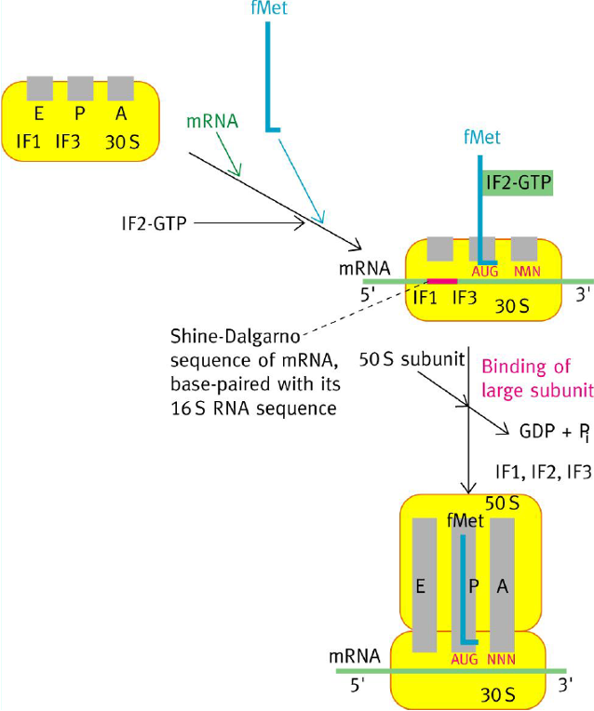
Translation: initiation
Initiation factors IF1 and IF3 bind the 30S subunit
This complex binds mRNA
FMet-tRNA^{fMet} (only prokaryotes) in complex with IF2-GTP enters the P site of the 30S subunit
The 16S rRNA binds to the Shine-Dalgarno sequence in the mRNA to line fMet-tRNA^{fMet} with the AUG start codon
  Shine-Dalgarno sequence is in the 5' UTR of mRNA
The large subunit binds which is accompanied by the hydrolysis of GTP releasing GDP, Pi and IFs (1,2,3)
Image reference: Hunt, R. (2024) 'gene products and protein synthesis'

Slide 39
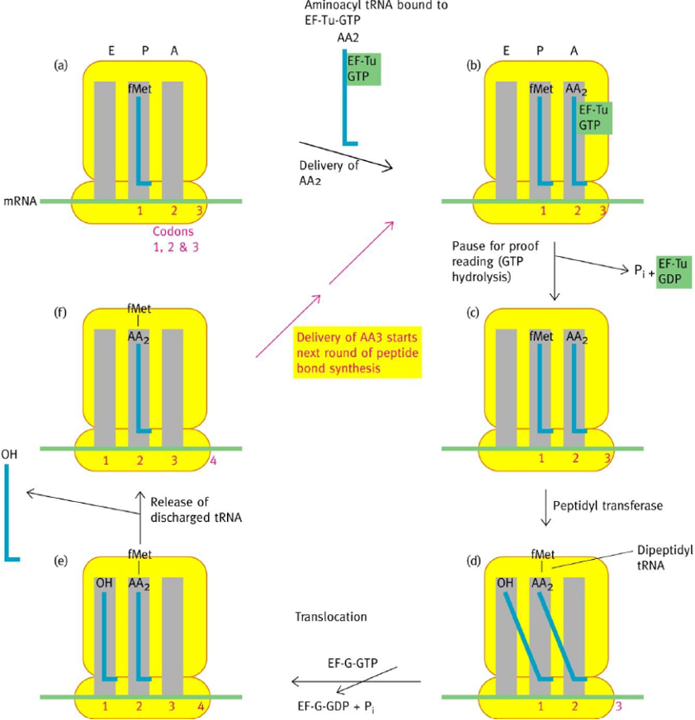
Translation: elongation
Aminoacyl tRNA binds to elongation factor EF-Tu GTP and enters the A site of the ribosome
If the anticodon of the tRNA is complementary to the codon of the mRNA then GTP hydrolysis takes place and EF-Tu GDP + Pi are released
Next the peptidyl transferase process occurs:
  The free NH2 of the incoming amino acid attacks the carbonyl carbon of the previous amino acid to form the peptide bond – the protein is synthesised by 'lifting' the incomplete polypeptide and placing the new amino acid underneath. The tRNA in the P site is left uncharged
  Translocation of the ribosome occurs with GTP hydrolysis of the GTP bound to EG-G – the A site is now free
  The discharged tRNA moves to the e site and is released from the ribosome
Image reference: Hunt, R. (2024) 'gene products and protein synthesis'

Slide 40
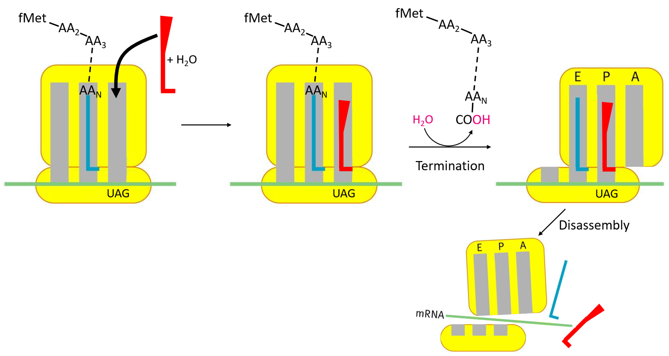
Translation: termination
The stop codon on the mRNA presents in the A site (UAA, UAG or UGA)
Release factor (RF1 or RF2) mimics the shape of the tRNA and enters the A site with a water molecule
The peptide is hydrolysed from the final tRNA using the water molecule
The ribosome disassembles – requires ribosomal recycling factor and IF3
Image reference: Hunt, R. (2024) 'gene products and protein synthesis'

Slide 41
SBA
What is the size of the rRNA in the ribosome small sub unit
A) 23S
B) 21S
C) 17S
D) 15S
E) 16S

Slide 42
SBA
What is the size of the rRNA in the ribosome small sub unit
A) 23S
B) 21S
C) 17S
D) 15S
E) 16S

Slide 43
SBA
Which of these statements about the differences in translation between eukaryotes and prokaryotes is true?
A) in eukaryotes transcription and translation occur simultaneously
B) in eukaryotes the mRNA encodes for multiple proteins
C) In prokaryotes, ribosomes recognize a Shine–Dalgarno sequence on the mRNA to begin translation
D) in both eukaryotes and prokaryotes the first tRNA is fmet-tRNAfmet
E) prokaryotic ribosomes are 80S

Slide 44
SBA
Which of these statements about the differences in translation between eukaryotes and prokaryotes is true?
A) in eukaryotes transcription and translation occur simultaneously
B) in eukaryotes the mRNA encodes for multiple proteins
C) In prokaryotes only, ribosomes recognize a Shine–Dalgarno sequence on the mRNA to begin translation
D) in both eukaryotes and prokaryotes the first tRNA is fmet-tRNAfmet
E) prokaryotic ribosomes are 80S

Slide 45
SBA
Which tRNA could be used in the translation of the codon 5' CUG 3'
A) 3' UTG 5'
B) 5' UAG 3'
C) 3' CAG 5'
D) 5' CAG 3'
E) 3' UAG 5'

Slide 46
SBA
Which tRNA could be used in the translation of the codon 5' CUG 3'
A) 3' UTG 5'
B) 5' UAG 3' - wobble pairing
C) 3' CAG 5'
D) 5' CAG 3' - exact
E) 3' UAG 5'

Slide 47
Protein targeting

Slide 48
  Describe the different ways in which proteins can be targeted to organelles or for secretion in eukaryotic cells
  Indicate the function of signal peptides and 'postcode' sequences in directing proteins to their appropriate locations
  Appreciate how defects in targeting can result in human disease
LEARNING OBJECTIVES

Slide 49
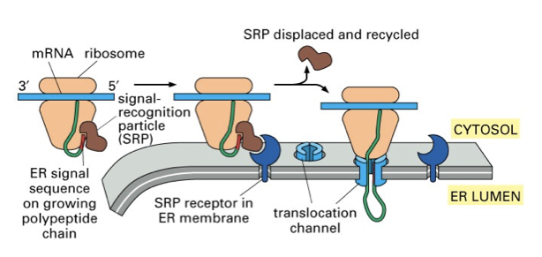
Protein synthesis at the ER and signal sequence SRP interaction
Secreted proteins, lysosomal proteins and membrane proteins are targeted to the endoplasmic reticulum by signal peptides
Protein synthesis begins via a cytosolic ribosome
The signal sequence at the N-terminus is the first part of the protein that is synthesised
The signal sequence is recognised by the signal recognition particle (SRP) protein complex and binds to it
The SRP binds the SRP receptor on the ER membrane
The ribosome is now bound to the ER membrane
The ribosome binds to the transcolon
The new protein is guided through the transcolon (translocation channel) in the ER membrane into the ER lumen
The signal sequence is cleaved via a signal peptidase and the SRP is recycled
Image reference: Knight, S. (2024) protein targeting

Slide 50
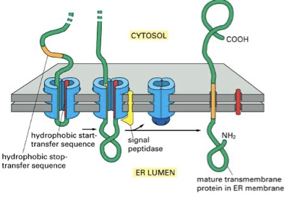
Proteins and the RER
Membrane proteins remain in the RER membrane
  Stop transfer sequences are 20-22 amino acids long
  They remain as transmembrane segments of proteins
  Other proteins enter the lumen of the ER – they do not have stop transfer
  sequences
Most proteins synthesised in the RER are glycosylated and become
Glycoproteins
  A commonly performed N-linked glycosylation is when a 14 sugar oligosaccharide is
  added to an asparagine residue
Then protein folding takes place
Improperly folded proteins are exported from the ER and are degraded by a proteosome in the cytosol
The proteins then reach their final destination through a series of intracellular transport steps where they are transported via membrane vesicles where they are further processed
Image reference: Knight, S. (2024) protein targeting

Slide 51
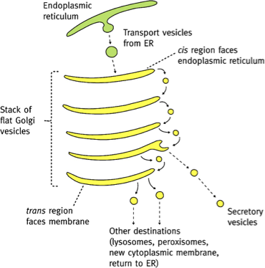
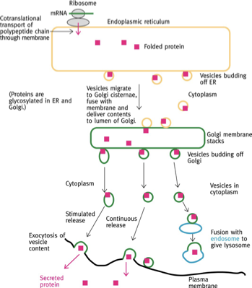
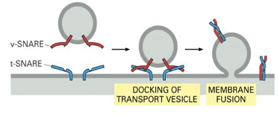
Golgi
Vesicles containing proteins bud of the ER and travel to and merge with the cis-golgi
The proteins mature and move between the cisterna via vesicles
In the trans-golgi the matured proteins are packaged into vesicles which are coated with specific v-SNARE proteins that target them towards specific compartments
The intended destination has a complimentary t-SNARE protein to ensure it arrives at the correct place
The vesicles are transported along pathways in the cytoskeleton
Image reference: Knight, S. (2024) protein targeting

Slide 52
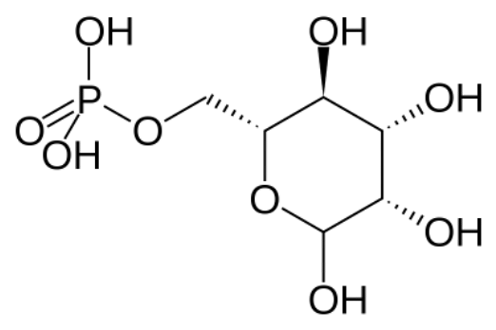
Targeting proteins to lysosome
Proteins are synthesised in ER and transported to trans-golgi
Lysosomal proteins are packaged into vesicles which are targeted to endosomes and phagosomes which converts them into lysosomes
Lysosomal proteins are tagged with mannose-6-phosphate in Golgi and the mannose-6-phosphate receptor in the golgi directs proteins into the correct transport vesicles
Image reference: Knight, S. (2024) protein targeting

Slide 53
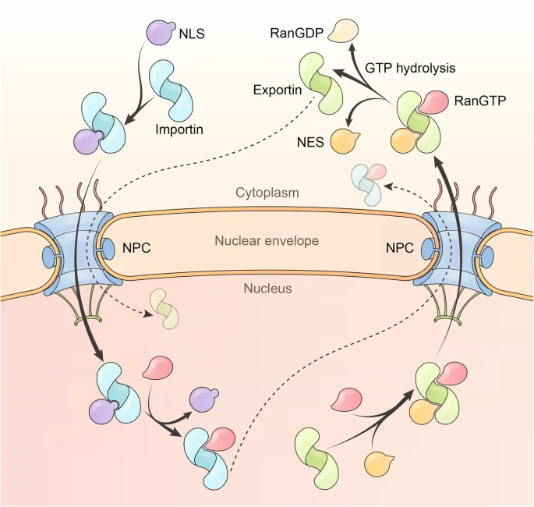
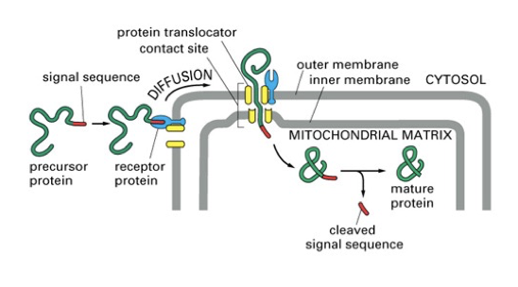
Targeting proteins translated in cytosol to specific locations within the cell
MITOCHONDRIA
Targeting occurs after translation but before folding
The protein is complexed with chaperone HSP70
The specific signal sequence is recognised by a receptor in the mitochondria outer membrane
NUCLEUS
Targeting occurs after translation and folding in cytoplasm
Nuclear proteins contain Nuclear localisation signal (NLS)
  Pro-Lys-Lys-Lys-Arg-Lys-Val (PKKKRKV) - basic
NLS binds to importin and is transported through the nuclear pore
Requires G-protein Ran and the hydrolysis of GTP
Exportin exports proteins from the nucleus
PEROXISOME
Peroxin proteins have a 3 amino acid sequence at the C terminus: Ser-Lys-Leu
This is recognised by PEX5 and this complex is imported into the peroxisome
Image reference: Yang, Y., Guo, L., Chen, L., Gong, B., Jia, D. and Sun, Q. (2023). Nuclear transport proteins: structure, function, and disease relevance. Signal Transduction and Targeted Therapy, [online] 8(1), pp.1–29. doi:https://doi.org/10.1038/s41392-023-01649-4.
Image reference: Knight, S. (2024) protein targeting

Slide 54
SBA
What are vesicles coated with for protein targeting?
A) t-SNARE
B) v-SNARE
C) HSP70
D) mannose-6-phospate
E) importin

Slide 55
SBA
What are vesicles coated with for protein targeting?
A) t-SNARE
B) v-SNARE
C) HSP70
D) mannose-6-phospate
E) importin

Slide 56
SBA
What is the 3 amino acid sequence recognised by PEX5?
A) Ser-Lys-Leu
B) Leu-Arg-Lys
C) Lys-Leu-His
D) Ser-Leu-Lys
E) Leu-Lys-His

Slide 57
SBA
What is the 3 amino acid sequence recognised by PEX5?
A) Ser-Lys-Leu
B) Leu-Arg-Lys
C) Lys-Leu-His
D) Ser-Leu-Lys
E) Leu-Lys-His

Slide 58
advice for revising this topic
This topic involves a lot of both memorisation and understanding for SBAs
When I revised this topic I started by watching youtube videos on the concepts I found confusing to help my understanding which made things easier to memorise
For memorising the details I like to use anki, quizlet and blurting
  I found blurting particularly helpful for learning translation
For anki I prefer to use other people's decks and make edits to them
The quizzes on keats give a good idea on what exam SBAs look like so make use of them
Make sure to revise clinical cases as they can ask questions on these

Slide 59
references
Knight, S (2024) DNA replication and mutagenesis [lecture]
Knight, S (2024) protein targeting [lecture]
Hunt, R (2024) molecular basis of gene transcription [lecture]
Hunt, R (2024) gene products and protein synthesis [lecture]

Slide 60

FEEDBACK

