Slide 1
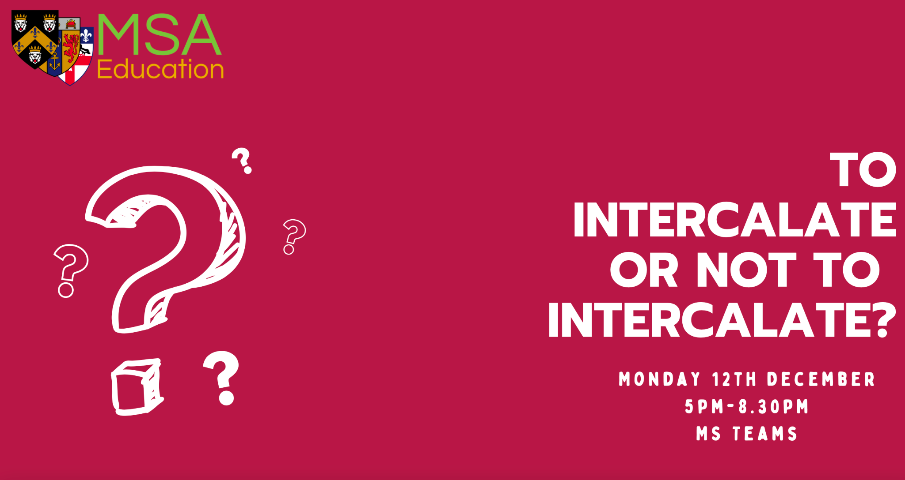

Slide 2
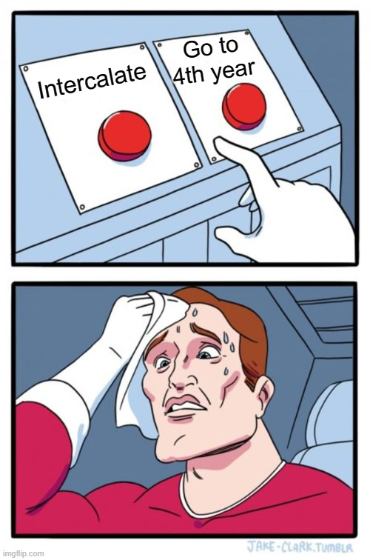

Decisions, Decisions…
https://pollev.com/gktmsaeducation848

Slide 3
Session outline
17.00-17.30 - Introduction to Intercalation
Speakers and Q&As
17.30-18.00 - Cardiovascular Science & Clinical Neuroscience
18.00-18.30 - Human Tissue Repair, Bioengineering & Management
18.30-18.45 - Non-Intercalating Experiences
19.00-19.30 - Women’s Health, Reproductive and Sexual Research & Public Health for Eye Care
19.30 - 20.00 - Neuroscience, Surgical Skills and Health & International Development
20.00 - 20.25 - Anatomy, Pharmacology & Immunology
20.25 - 20.30 - Closing Remarks and Feedback Form

Slide 4
Introduction to Intercalation
What is intercalation?
What can I intercalate in, and where?
Why should I intercalate (or not)?
BSc/MSc Applications & Funding
Top Tips

Slide 5
Intercalation
an additional year of study to explore a subject area as a degree in greater depth
Occurs between 3rd and 4th year
More than ‘just a year out of med’
Separate request if you want to apply for an external iBSc
Process for MScs is the same as iBScs now and do not require a ‘request to interrupt your studies’.

Slide 6
Types of intercalated degrees
BA (Bachelor of Arts) – tend to be a less specialised degree that focuses more on skills such as creative writing and critical thinking e.g. English Literature, Medical Ethics and Medical Humanities.
BSc (Bachelor of Science) – a more focused degree for mathematical and analytical subjects that fall under the Sciences, Mathematics and Business
Masters - a postgraduate level degree that can only be done after at least 3 years of medical school, they can be a MRes, Mphil, MA, MSc or Meng. Tend to be more intense.

Slide 7
iBSc and Intercalation
An opportunity to explore an aspect of medical studies in much greater detail.
Typically, intercalated subjects require you to examine current research and to conduct an experimental project of your own, deepening your knowledge and adding to your portfolio of skills.
Often joining 3rd year undergraduate students

Slide 8
MSc and Intercalation
A chance to study a specific (clinical) interest in great depth, particularly useful if in two minds about a specialty
Enhance your own personal development: independence, self-motivation, time management (transferable skills)
Opportunity to conduct independent, novel research
Networking opportunity (peers, lecturers, researchers)

Slide 9
Where Can I Intercalate?
The range of courses offered at other universities is vast, there is something for everyone
Similar to applying for med, you need to factors outside of the course alone (location, living expenses, etc)
https://www.intercalate.co.uk/ database of intercalations available for medical students

Slide 10
Intercalating - Pros
Learn how to do research and a possible publication
A welcome, relaxing break from medicine (not really)
Great opportunity for networking and exploring areas of interest
Adding to your skillset and working with other professionals
Another degree, for only a year’s work
Can get funding from SFE to do an additional degree, whereas if you decide to do a master's as a doctor, you will have to fund it yourself

Slide 11
Intercalating - Cons
Additional degrees no longer count towards FPAS and Speciality Training from 2023
Adds another year to an already long course
Extra year of expense - funding isn’t always available, debt incurs over the years
  Living in London > tuition fees
Need to return to a very intense clinical year of medicine
Adjusting to a iBSc is difficult, multiple courseworks + exams
Your peers may have a lot more knowledge (they’ve been doing this for 2 years already depending on the course you choose)
Notes:
Additional degrees will put you at an advantage if you’re applying for the academic foundation programme (AFP).
Specialty Training:
Removal of intercalated degrees from person specifications and scoring criteria – learning and skills obtained during the period of intercalation can still be scored e.g. research skills, publications etc.

Slide 12
Intercalating at King’s
Deadline for Internal iBScs applications: 23rd January 2023 date for internal students
Very easy to intercalate internally (only 300 word application)– but only 1 application can be made (via King’s Apply) - can write 2nd choice in one sentence at the end of the ps.
Some KCL courses are capped (so more competitive)
A good idea to have an iBSc at Kings for a backup – can still apply elsewhere
Benefits of staying at Kings vs desire to face new challenges
Also easier to change your iBSc choice within Kings, even after the deadline for accepting offers
Notes:
Leah
25 August 2023: Deadline to submit your transcript via King’s Apply. Applicants will need to confirm they have successfully completed their current year of study to the King's Admissions Team.

Slide 13
KCL iBScs
Cardiovascular Medicine
Anatomy, Developmental and Human Biology
Regenerative Medicine and Innovation Technology
Healthcare Genetics and Genomics
Pharmacology
Women’s Health
Physiology
Psychology
Primary Care
Global Health
Healthcare management
Infectious Disease, Autoimmunity and Immunotherapies
Notes:
Leah
Intercalated BSc | Study | King’s College London
University iBSc Fair:

Slide 14
Intercalating Externally - iBSc
New environment, new community
More choices of iBSc
Networking
More clinical or research based depending on interests
Personal Statement
Clinical experience
SSC/Scholarly Project/Other research projects
Prominent studies in the field
Different work hours depending on course
Look at assessment criteria
Notes:
Ebrahim

Slide 15
Intercalating - MSc
Research (course structure, modules, summer projects/dissertations, student opportunities)
Application Process (‘rolling deadline’)
  Cover letter/personal statement - different to UCAS personal statement
  CV
  References (academic/employer)
  Academic record (ROAR)
September to September (overlap w/ year 4 MBBS)
++Loaded schedule compared to iBSc counterparts BUT ENJOYABLE
Notes:
Ebrahim

Slide 16
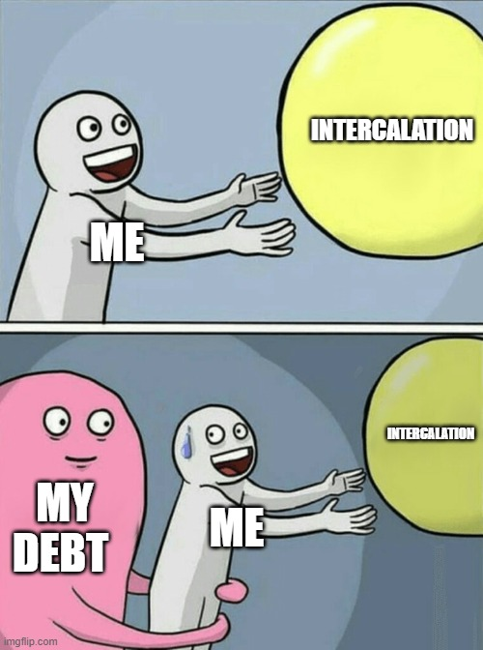
Funding
iBSc funding – similar to MBBS (via SFE)
iMSc – apply for the postgraduate loan (may no longer be available to EU) , up to £11.5K (includes tuition fees + living costs)
May not cover the full costs of the masters
Most MScs also have separate scholarships (make sure to check the deadlines for this in advance)
If eligible for the NHS bursary, they will only cover £9,250
https://www.gov.uk/postgraduate-scholarships-international-students - list of scholarships available for intl students
Notes:
Ebrahim

Slide 17
iBSc vs MSc
Degree subject/modules
Research/fieldwork opportunities
Course length & time commitment
Financial commitment

Slide 18
Application Tips
Personal statement is key – make it stand out - get it checked
Curriculum Vitae – get it checked
For references, inform your referees that you are hoping to apply and ask whether they would be happy to support your application.
  Personal Tutor
  Educational Supervisor (GP tutor from Year 2)
  Educational Supervisor (Year 3)
  SSC supervisor (Year 2)
  Scholarly Project Supervisor (Year 3)
Interviews – prepare early + have mock interviews
King's Career Services – check your CV and personal letter
Contact students who have intercalated in that subject or at that institution for inside information on the course (+ can offer application tips)

Slide 19
Panel and Q&As

Slide 20
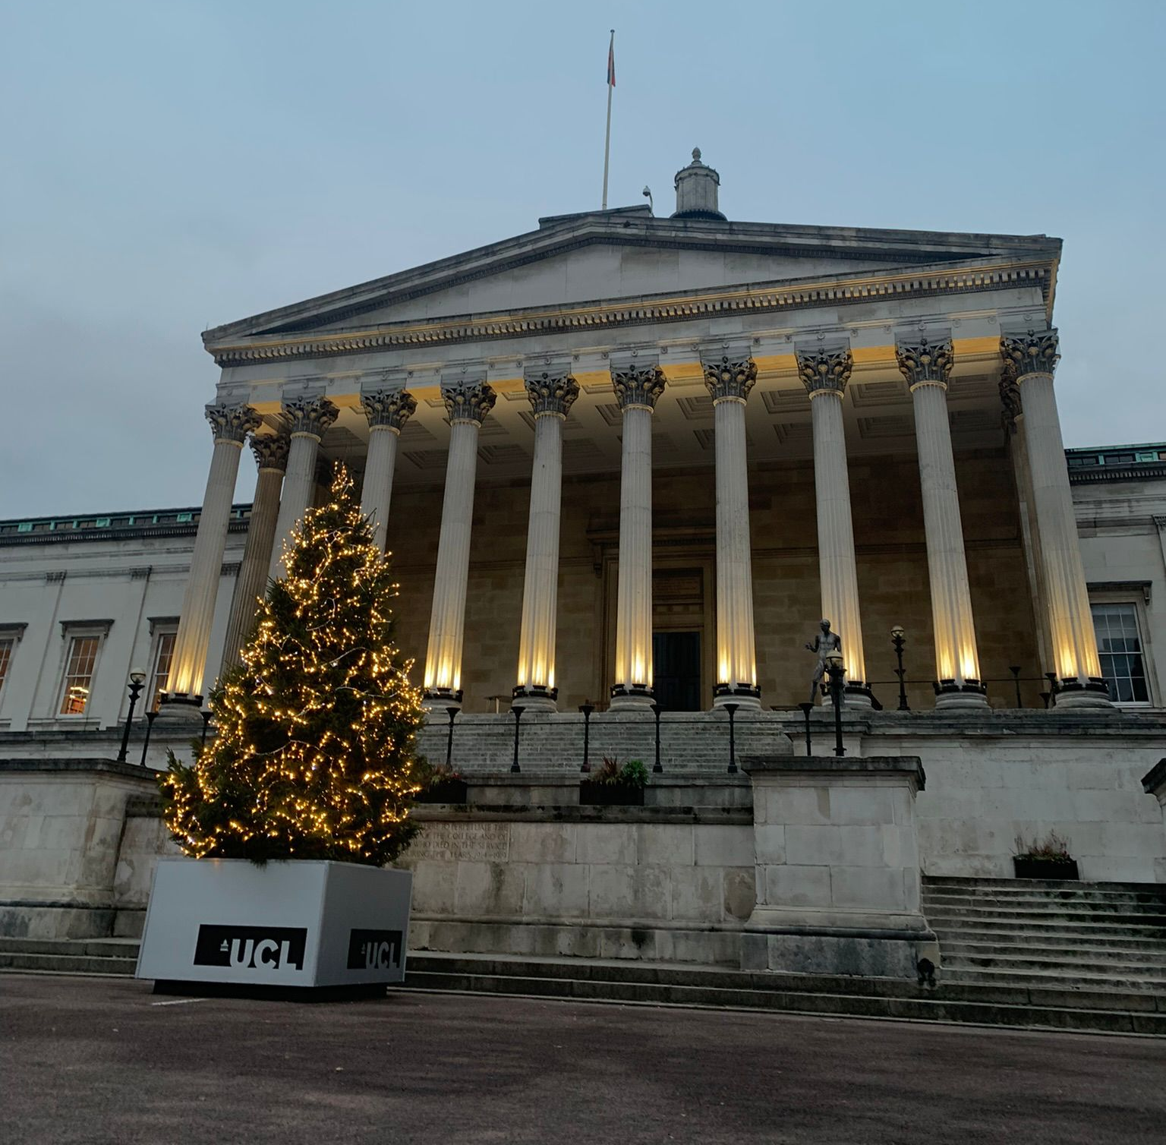
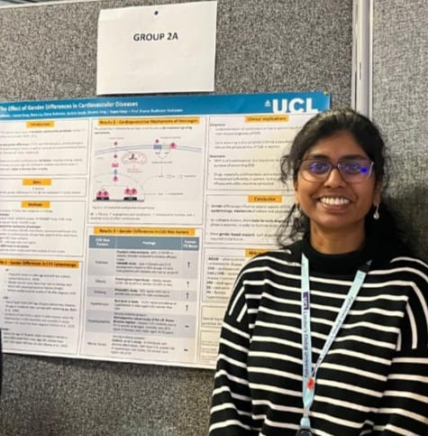
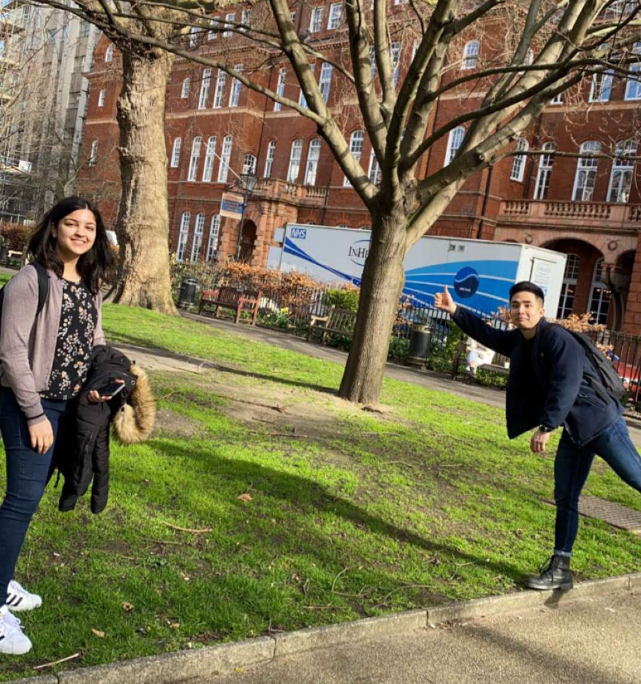
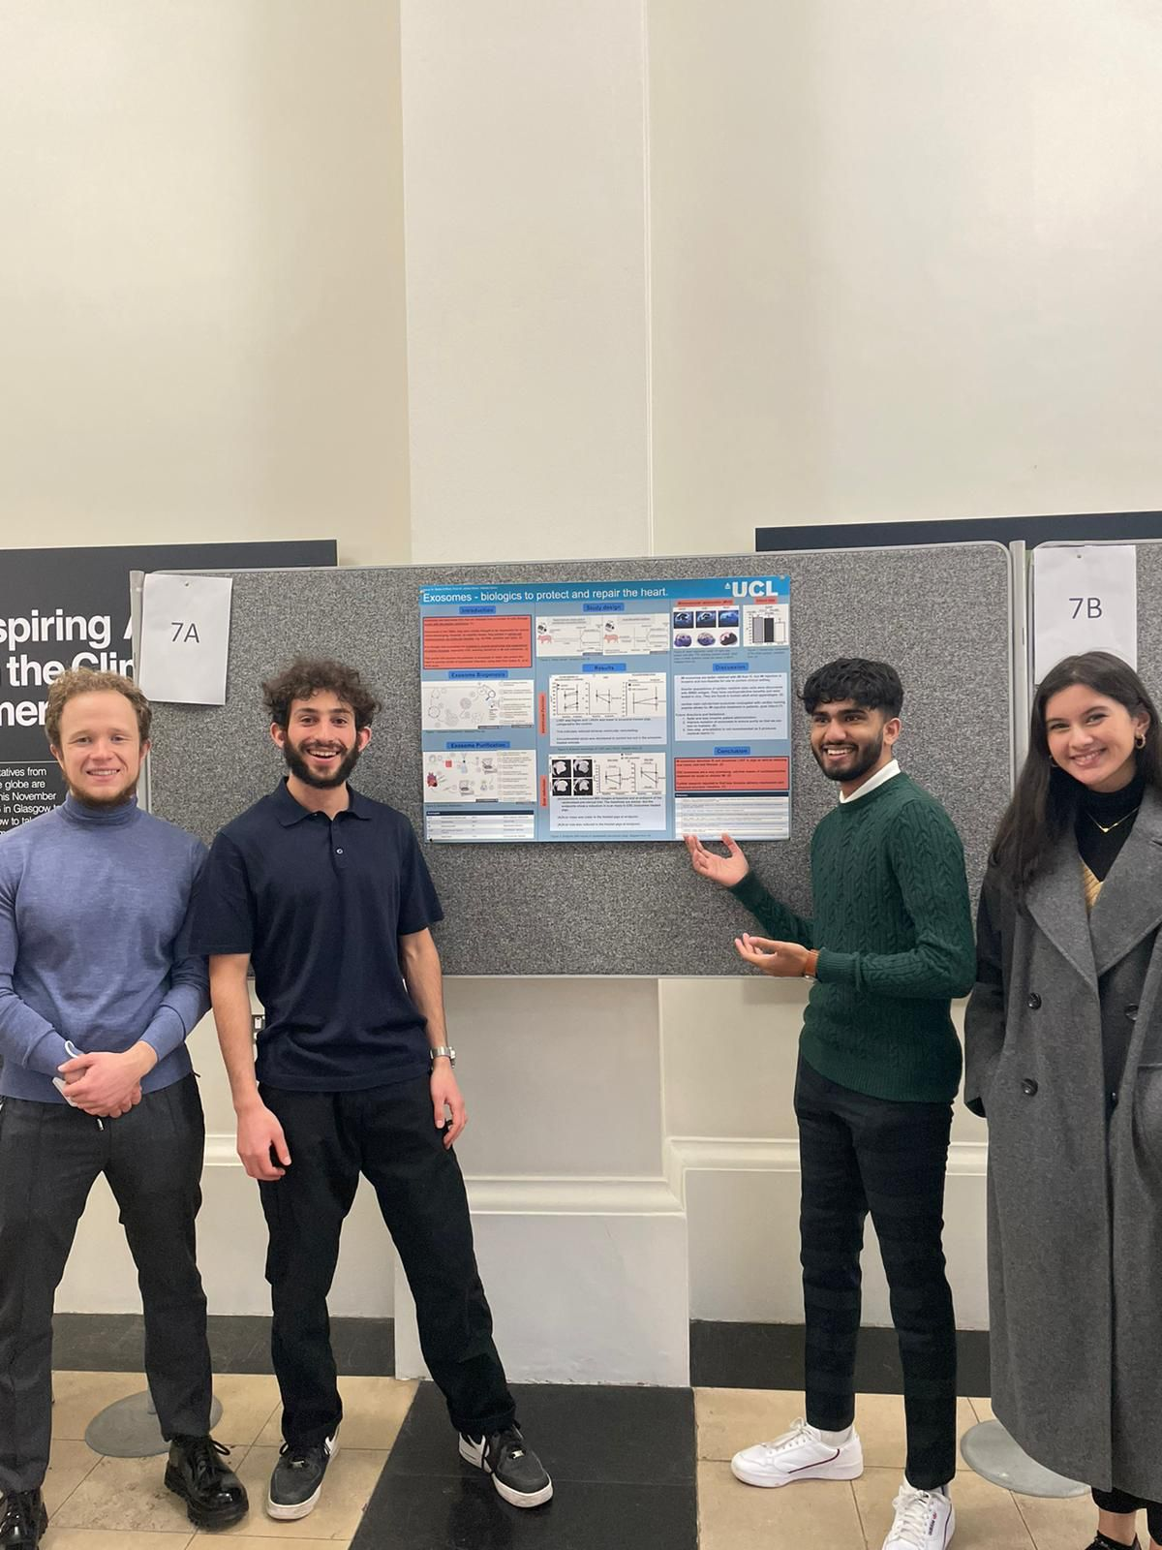
Clinical Neuroscience MSc and Cardiovascular Science iBSc/MSc
Malaika, Fizza and Jackcie

Slide 21
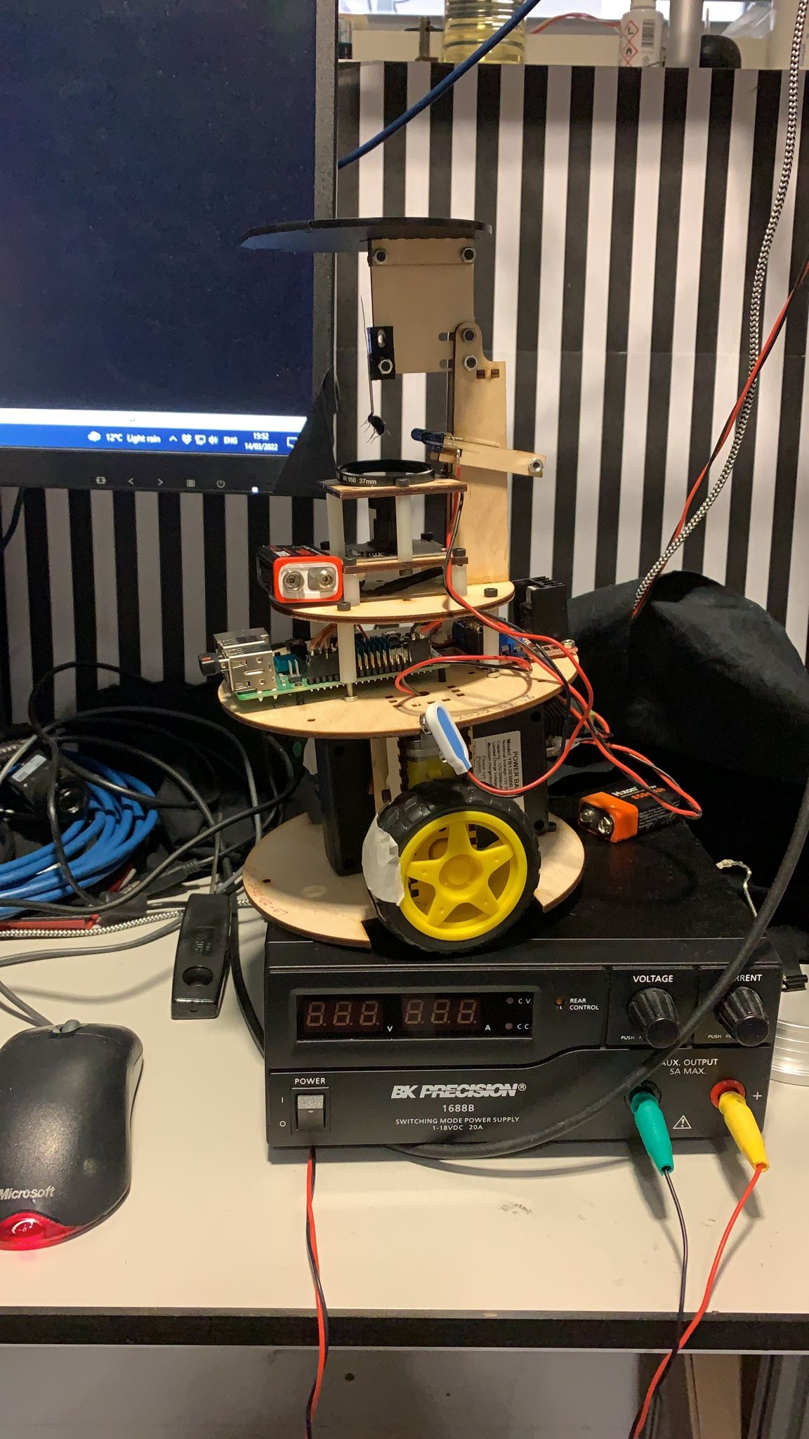
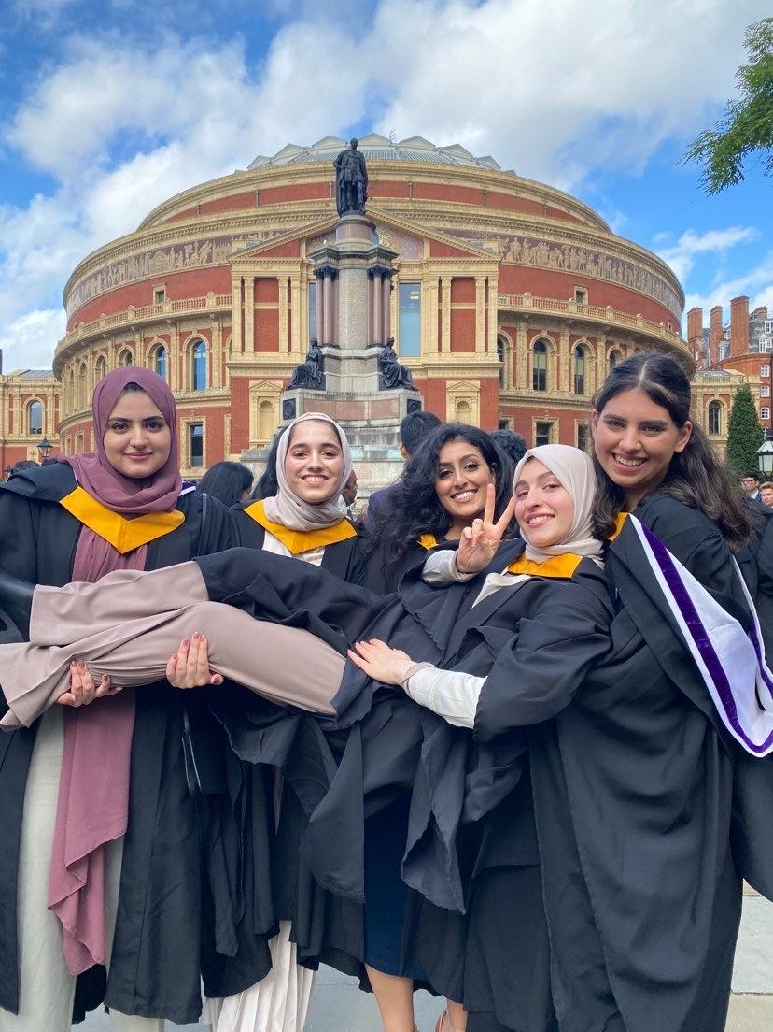
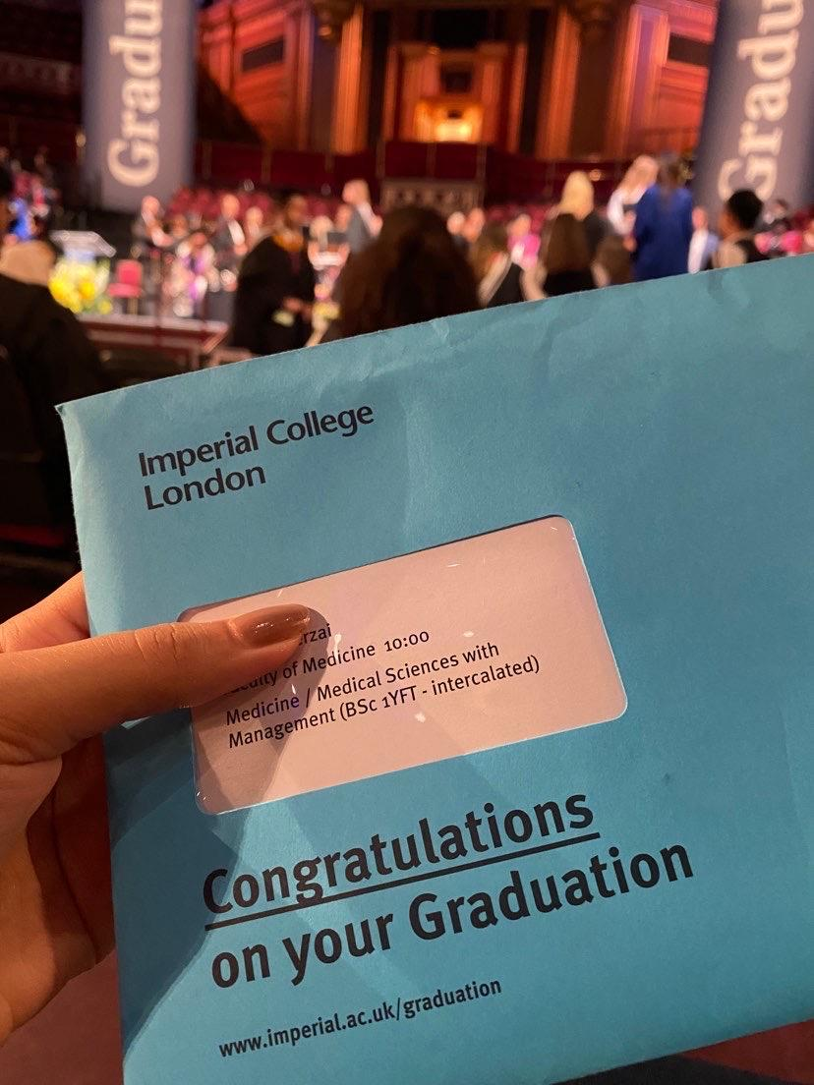
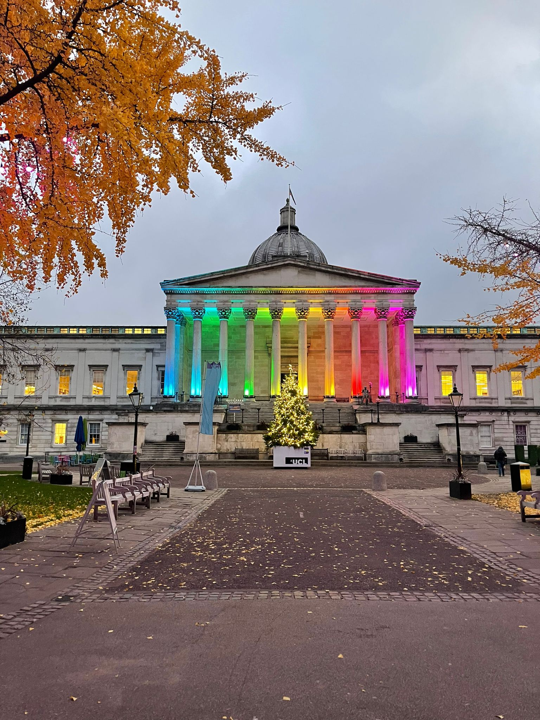
Human Tissue Repair MSc, Bioengineering iBSc and Management iBSc
Layla, Joseph and Hosna
Notes:
Layla, Joseph and Hosna

Slide 22
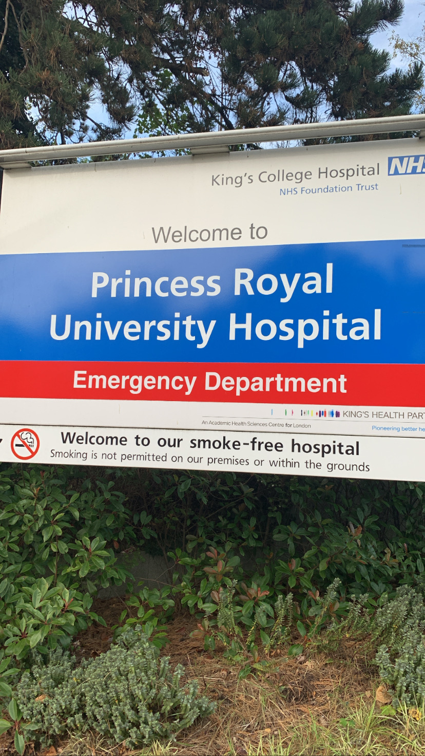
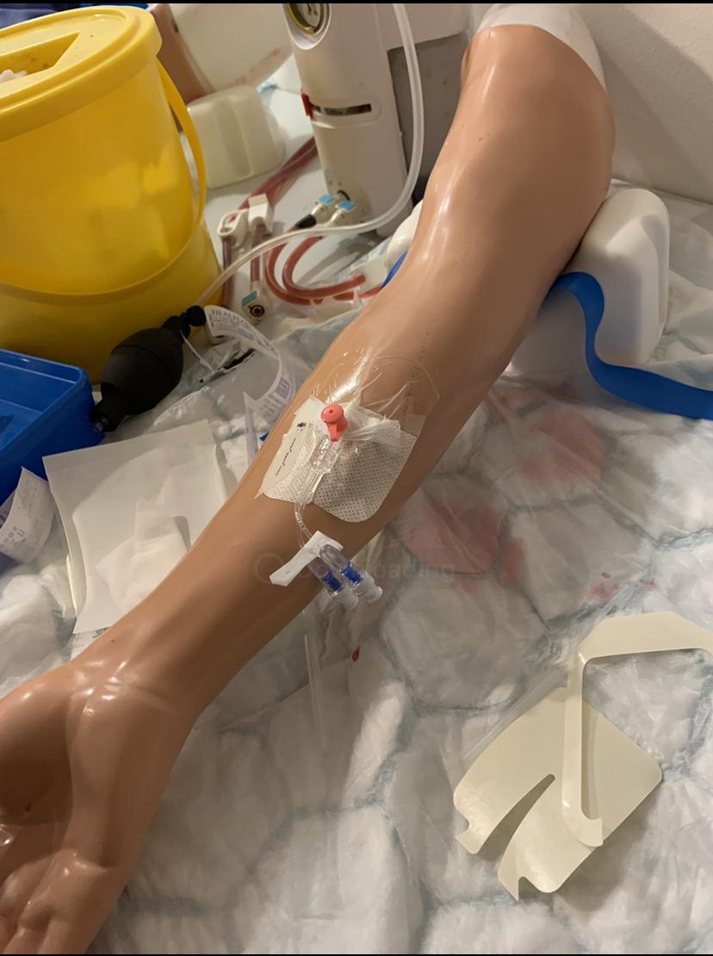
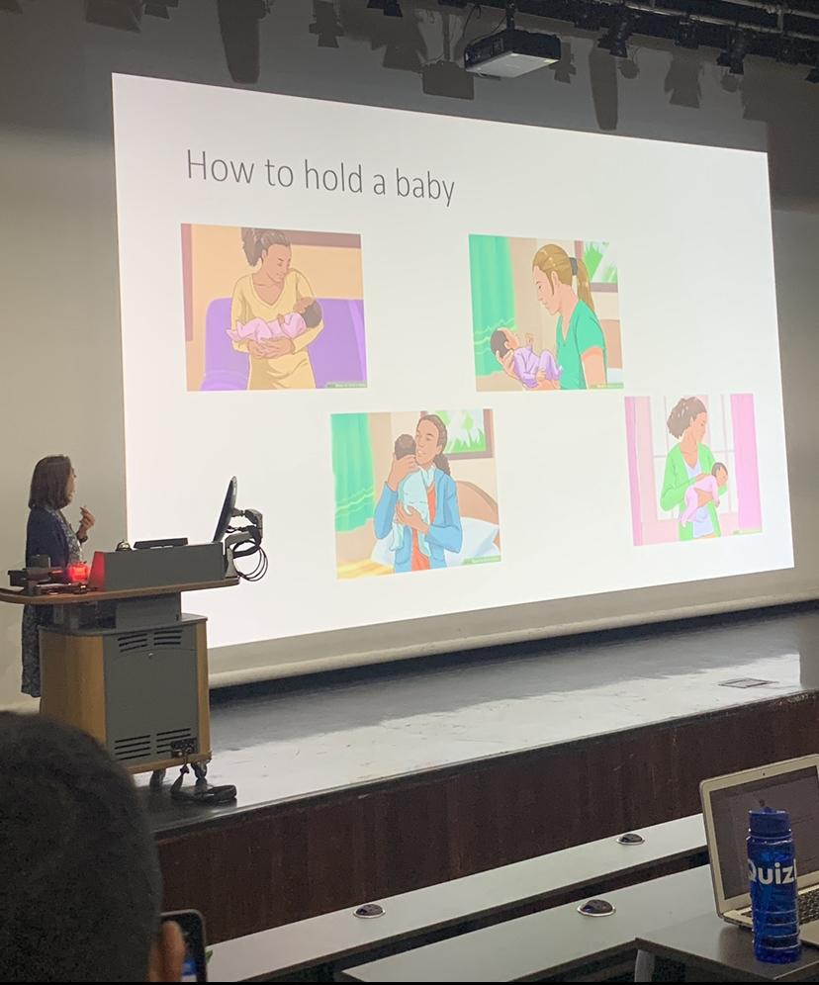
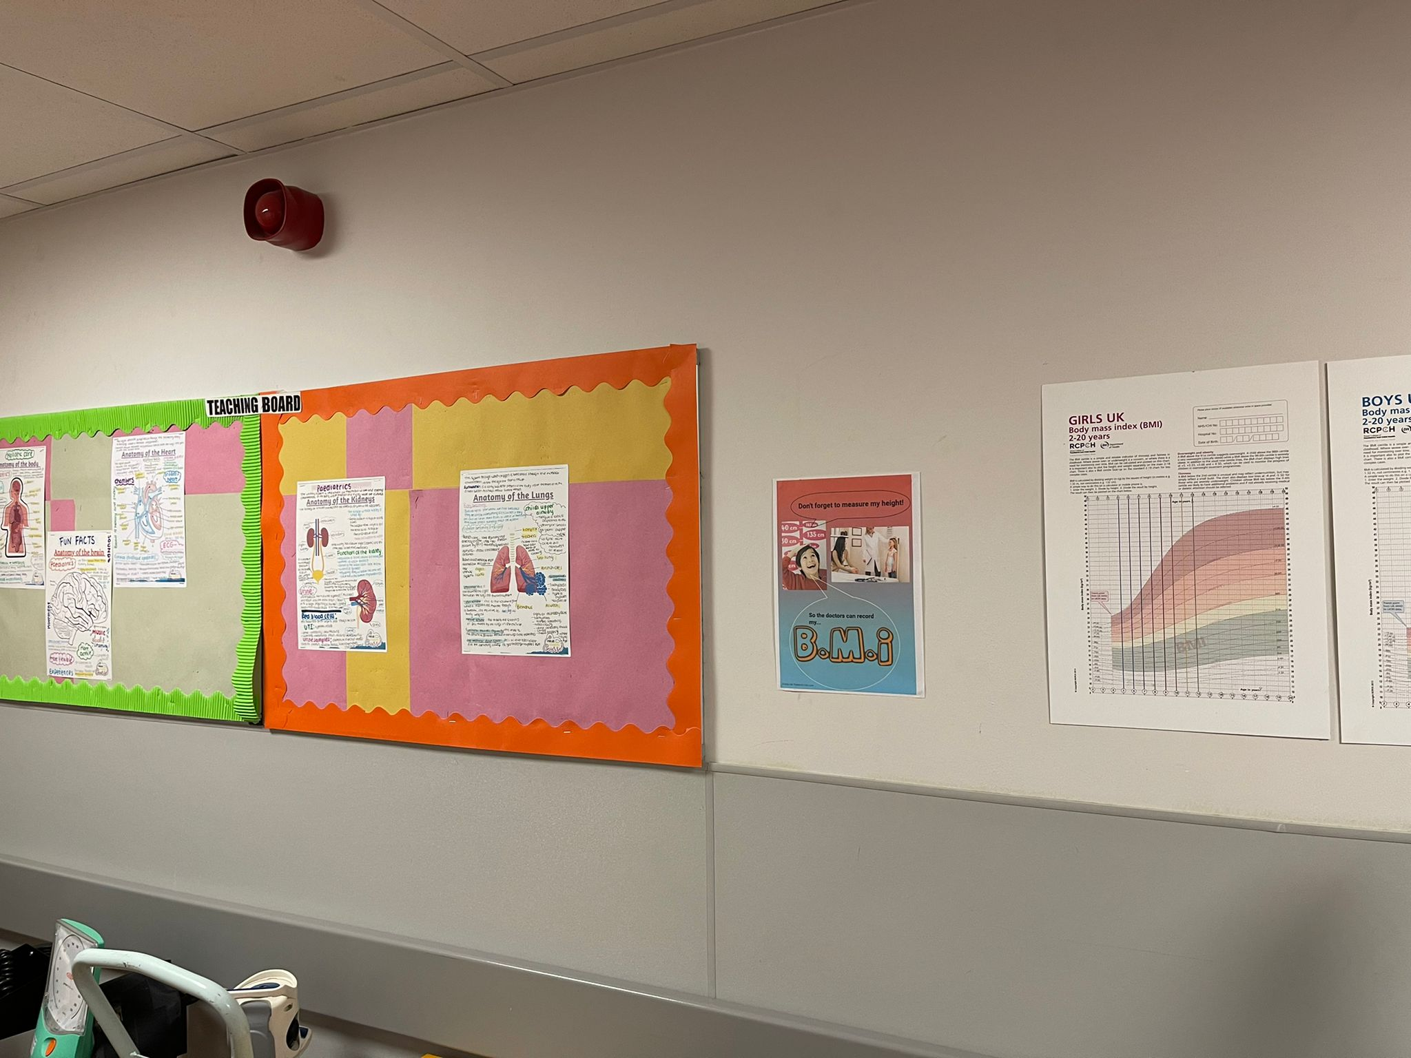
Non-Intercalating Experiences
Mini What I Wish I Knew
Stage 3 Year 4
Leah and Imade

Slide 23
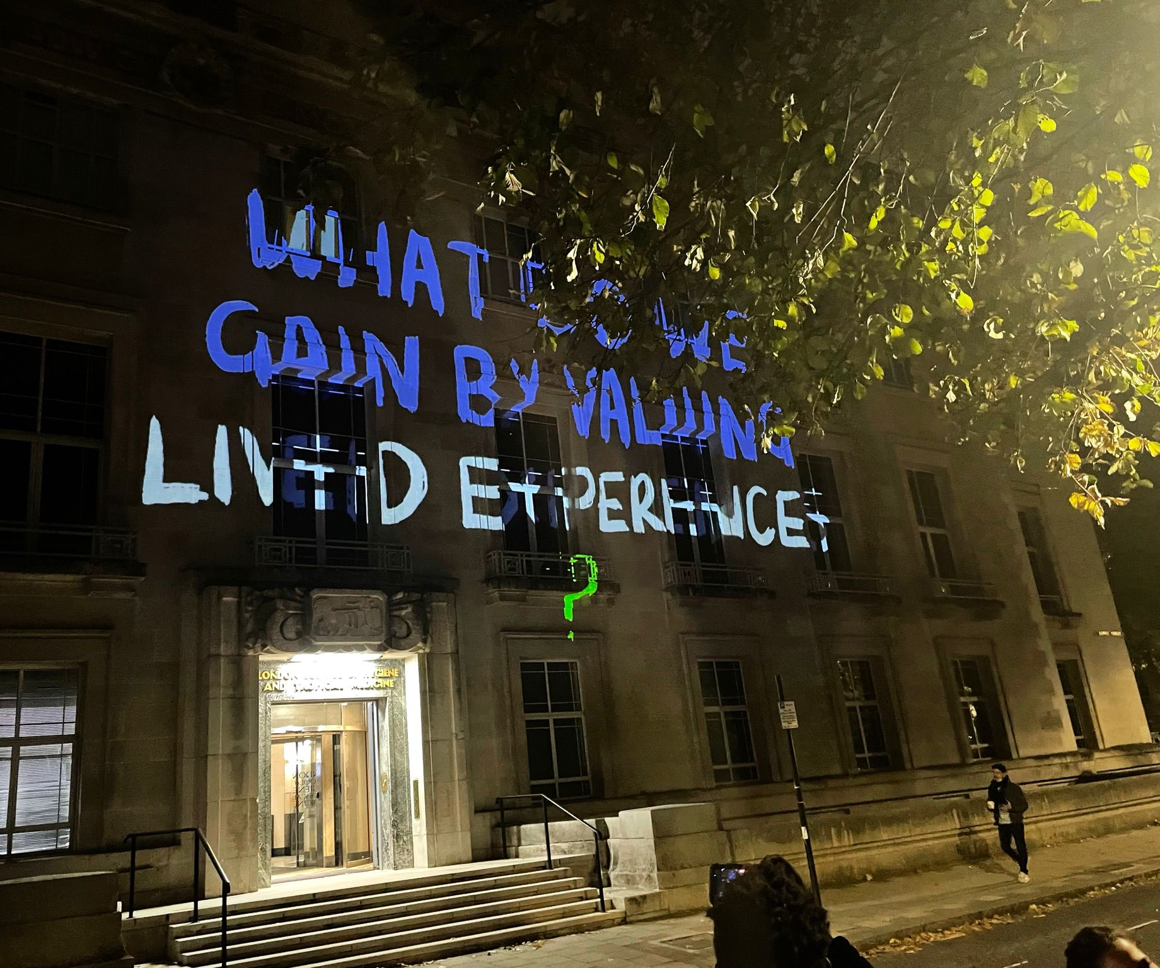
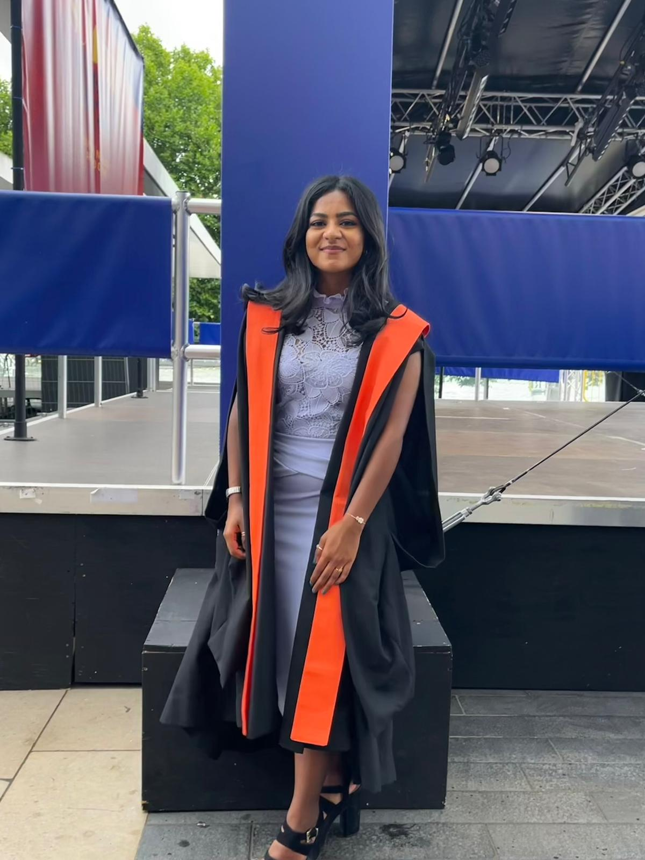
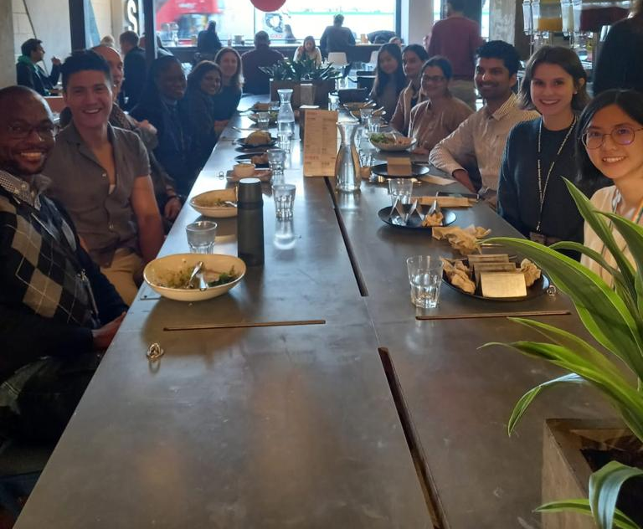

Reproductive and Sexual Research MSc, Public Health for Eye Care MSc & Women’s Health iBSc
Anu, Nav & Akalya
Notes:
Akalya, Anu and Nav

Slide 24
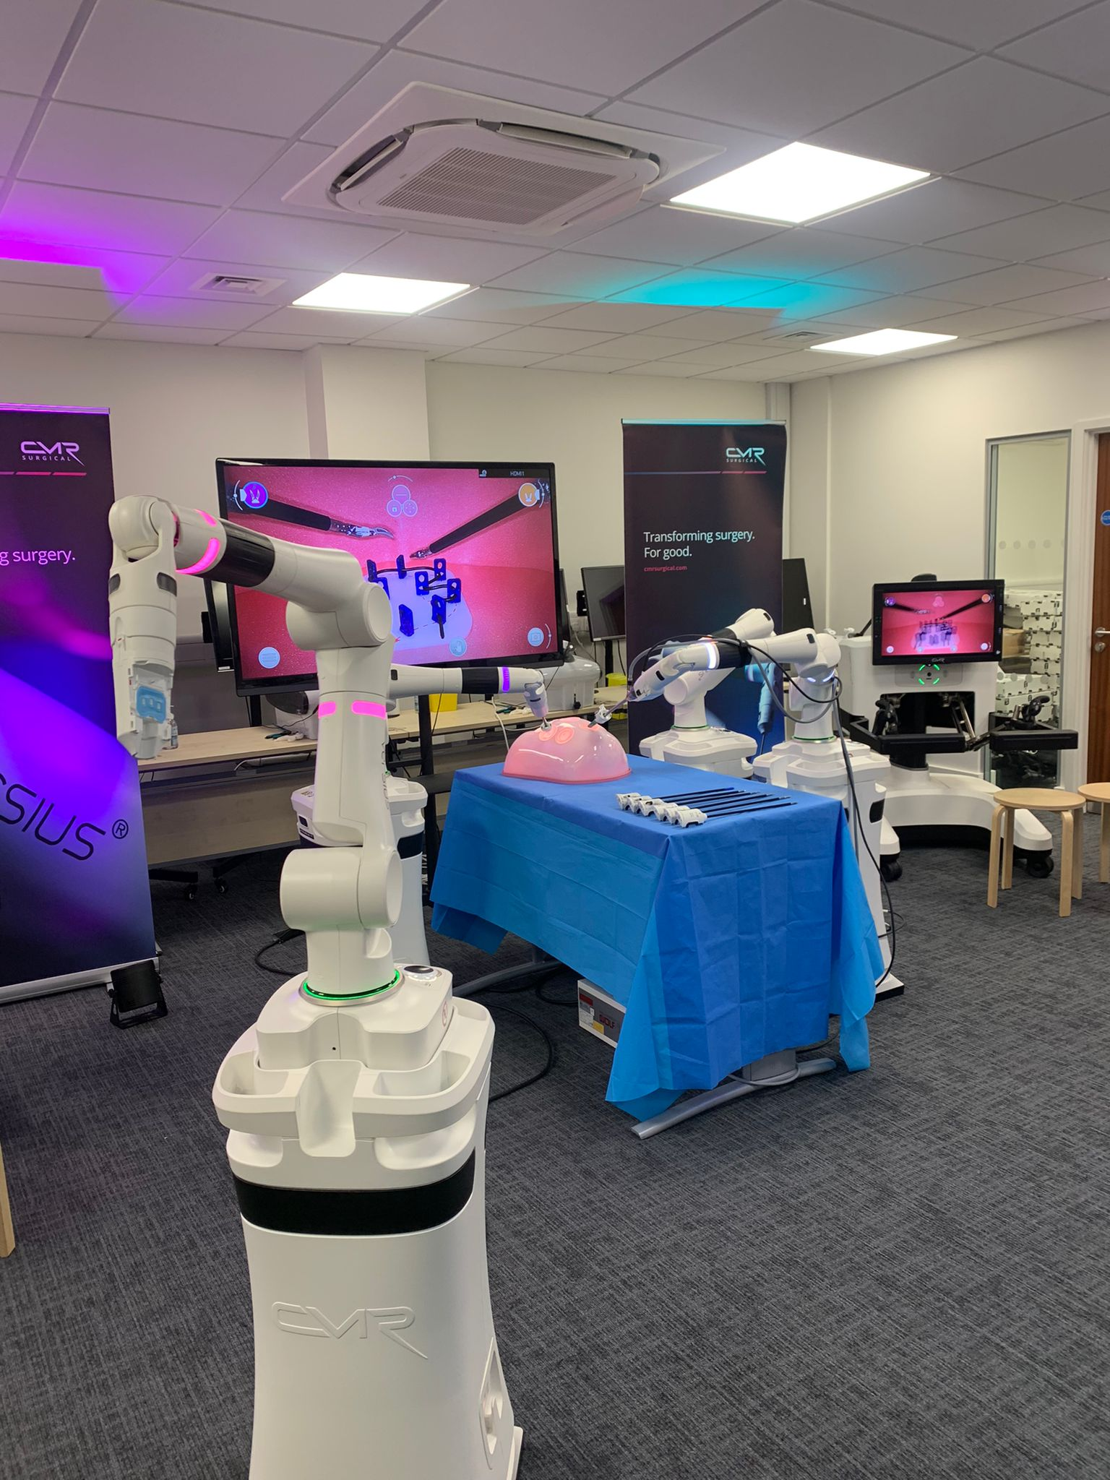
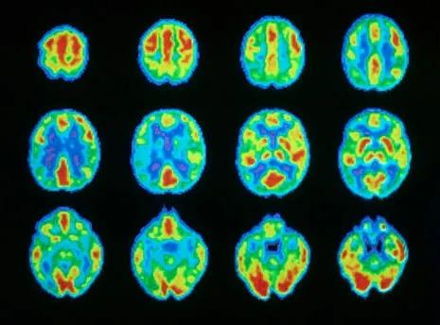
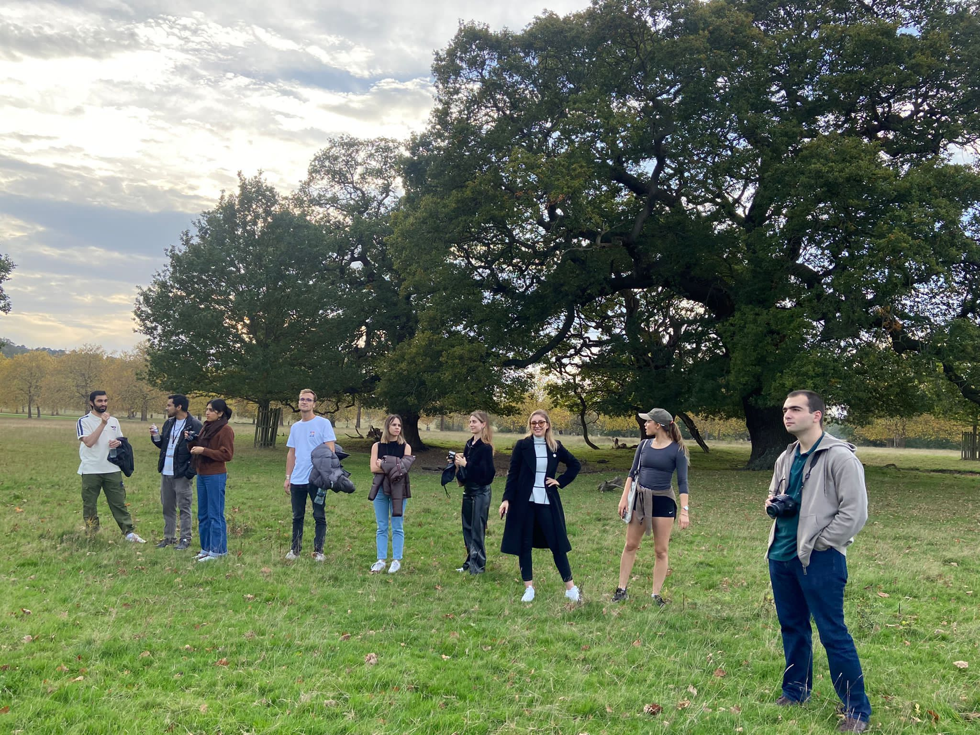
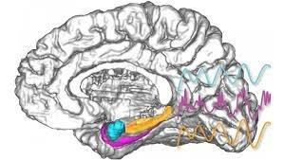
Neuroscience iBSc, Surgical Skills MSc and Health & International Development MSc
Maria, Mai and Sami

Slide 25
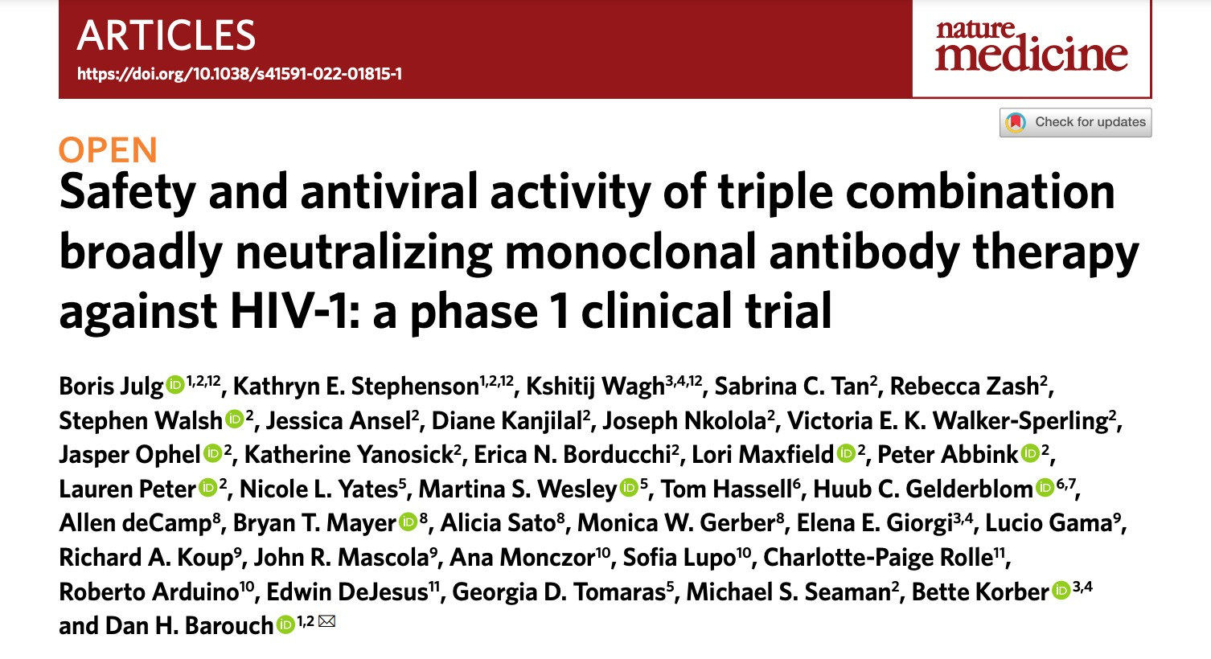
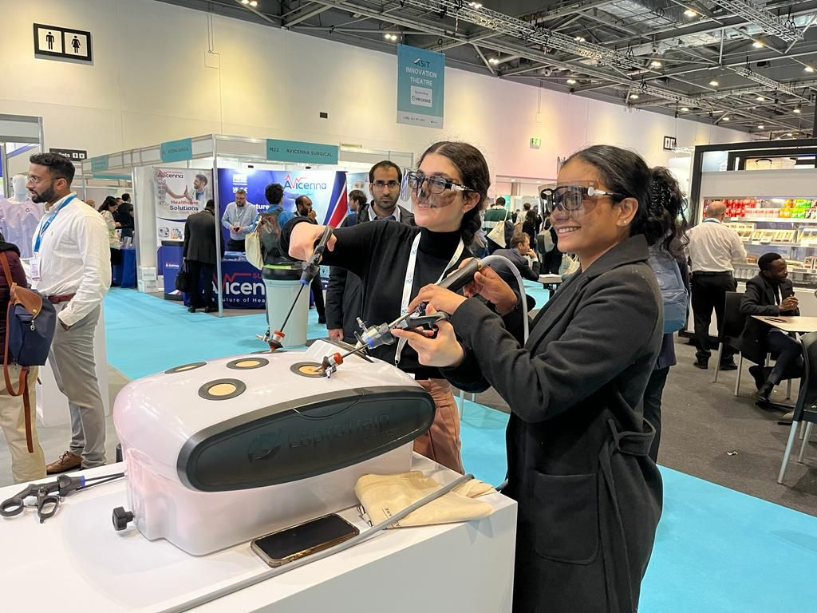
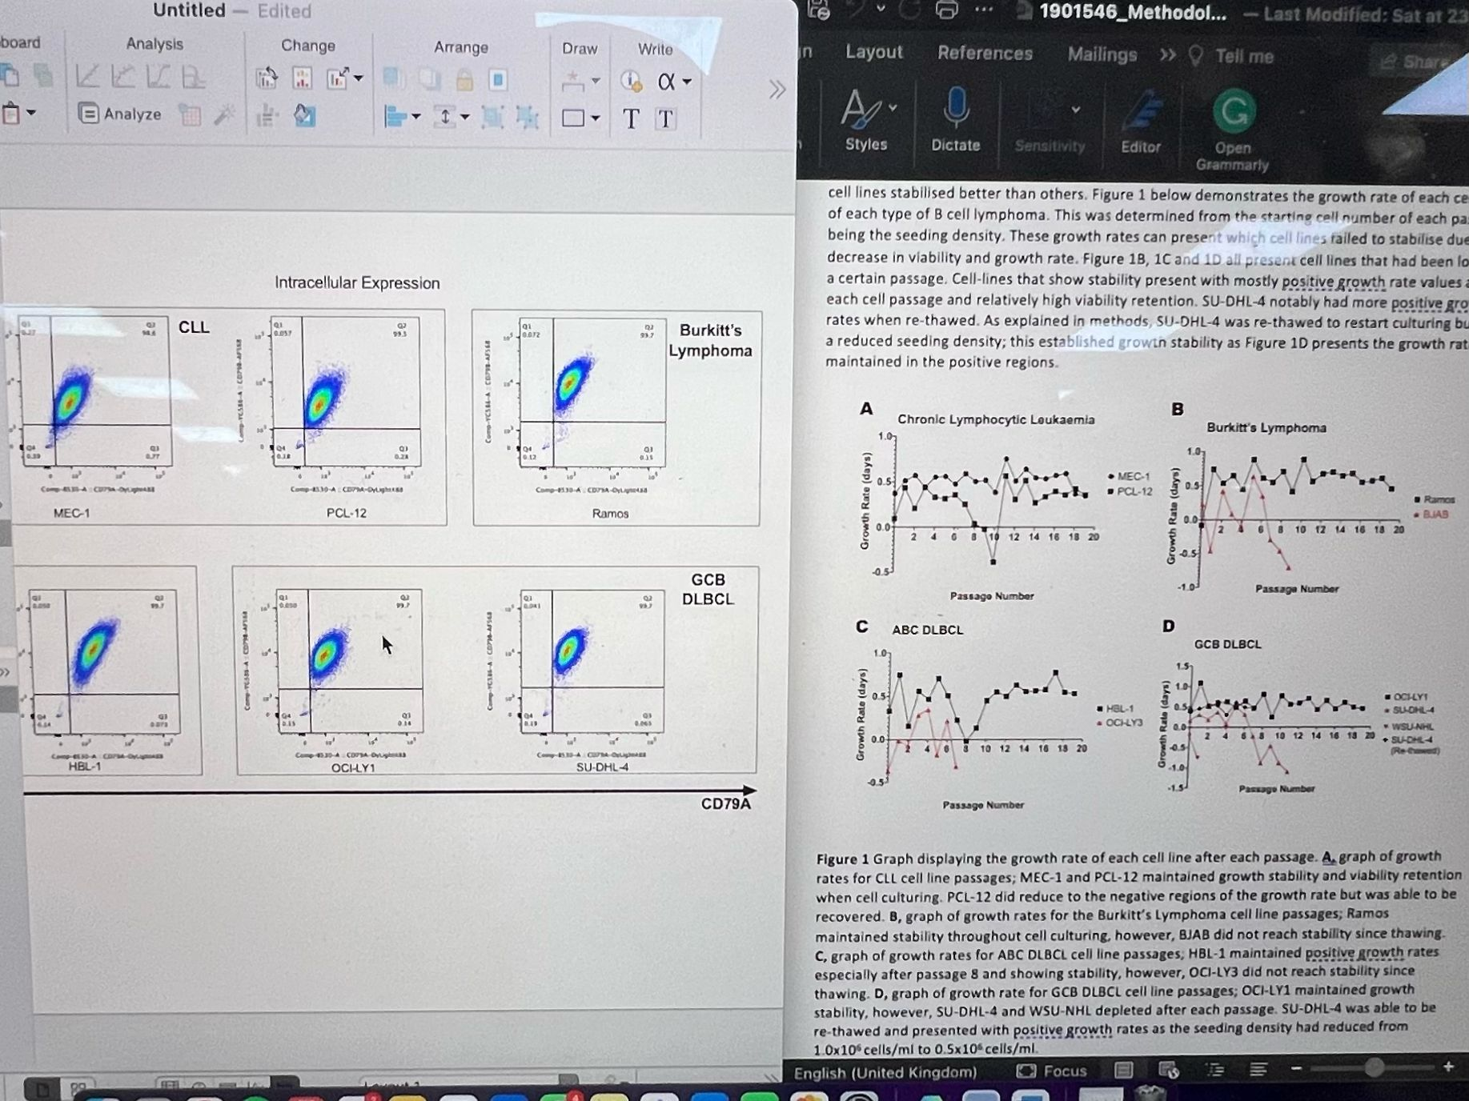
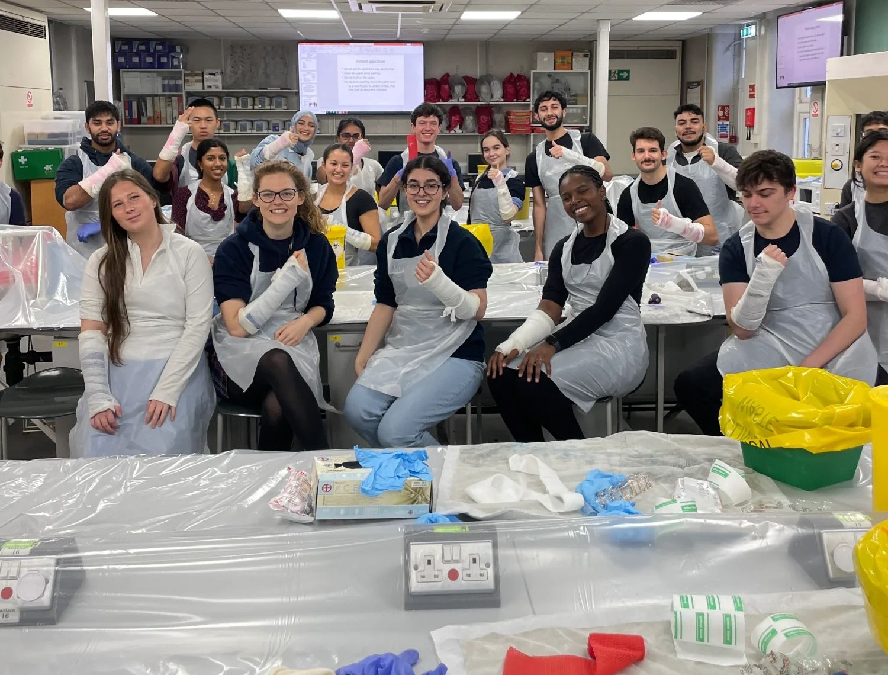
Anatomy, Pharmacology & Immunology iBSc
Nikki, Tanzim and Ebrahim

Slide 26
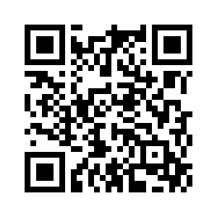
Feedback Form
Thank you for attending!
For more GKT MSA & MSA Education Updates, follow us on Instagram and Facebook
@gktmsa
Email us:
msa@kcl.ac.uk

