Slide 1







GKTeach
Immunity and Infection
Epidemiology and Biostatistics
STAGE 1
Keshani Ganendiran
23/03/2026

Slide 2
Innate immune response
Lymphocyte receptors, B cells and antibodies
T-cells, effector functions and MHC
Immune tolerance
Acute/Chronic inflammation
When the immune system goes wrong
Introduction to microbiology
Pathogenesis of microbial infections
Diagnosis and control of infection
Immunity and Infection

Slide 3

Innate immune response
  Non-specific immune response
  First part of the immune response
  0-96 hours
  Components: Physical barriers, Secreted compounds, Cellular components

Slide 4
How the innate immune system works
  Innate immune system recognizes PAMPs
  PRR recognizes PAMPs and tells the nucleus to upregulate immune response cells
  Types of PRR: Collectins, TLR and NOD like receptors
  Effector mechanism of innate immune response: Complement, Phagocytosis and killing, Cytokines and activation of adaptive immunity

Slide 5
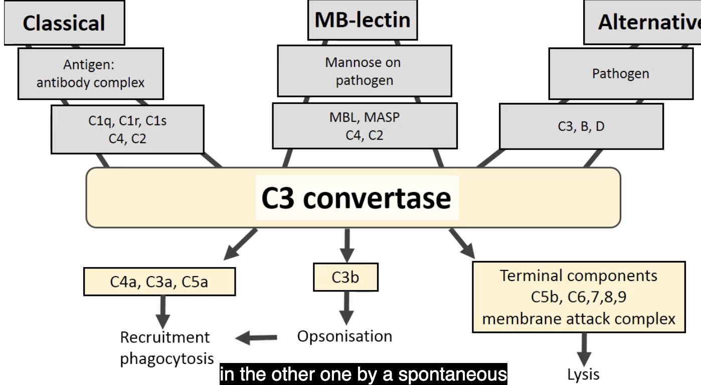
Effector mechanisms

Slide 6
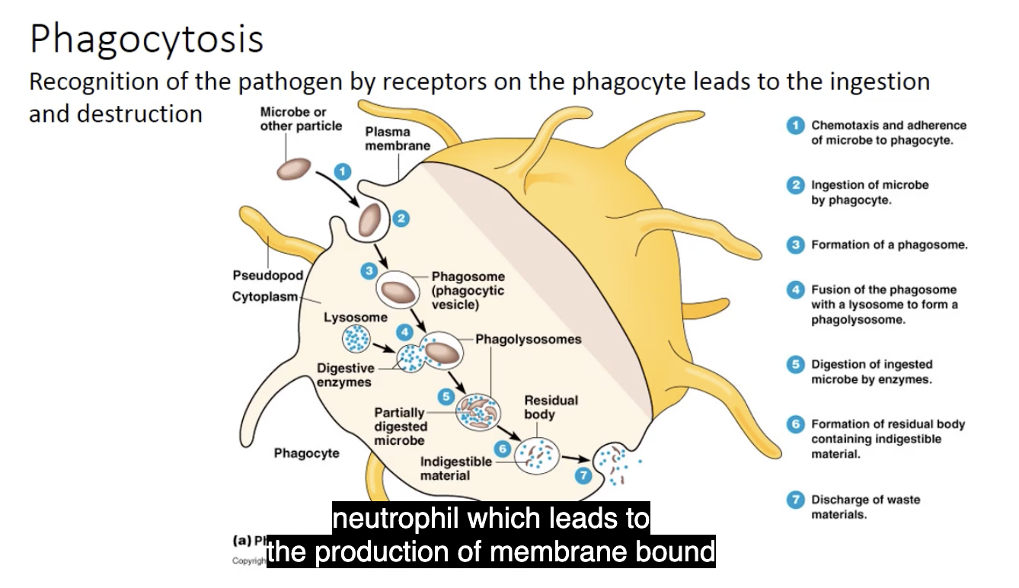
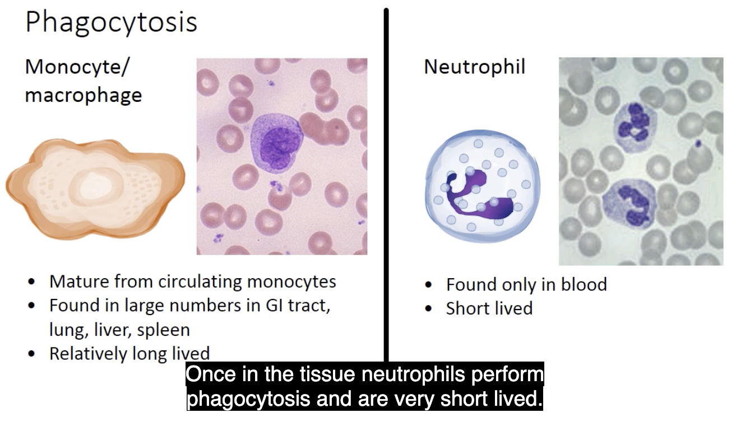
Effector mechanisms

Slide 7
Adaptive immune response
  More specific and has memory
  B lymphocytes and T lymphocytes
  B and T receptors both have variable and constant regions
  B cell – bone marrow
  T cell – thymus
  T cell receptor is not involved beyond the recognition of antigen, B cells differentiates into plasma cell that secretes antibodies

Slide 8
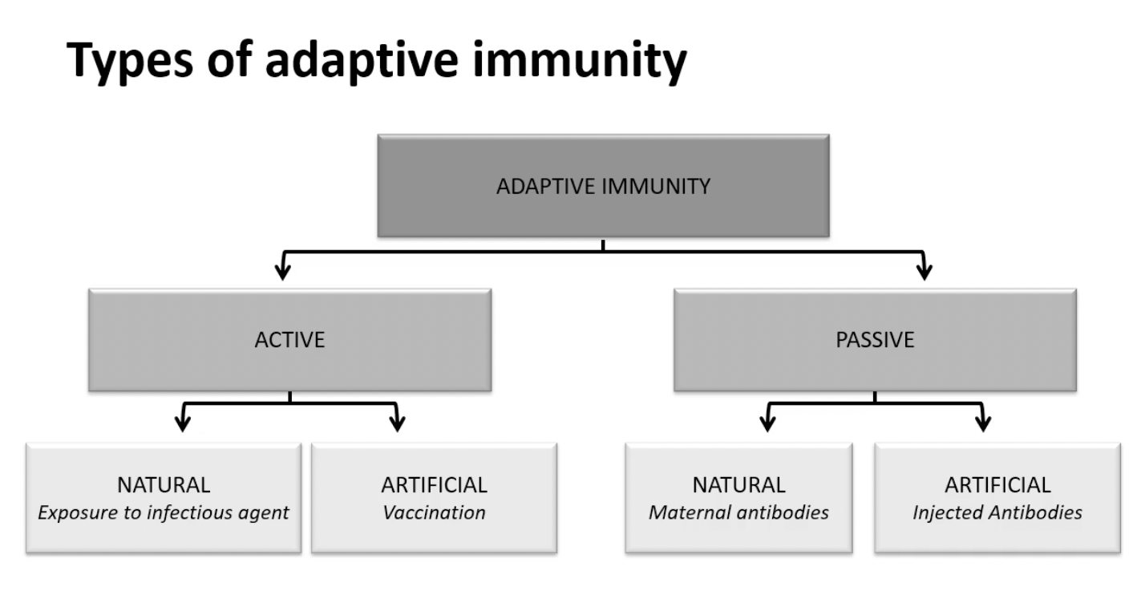
Adaptive immune response

Slide 9
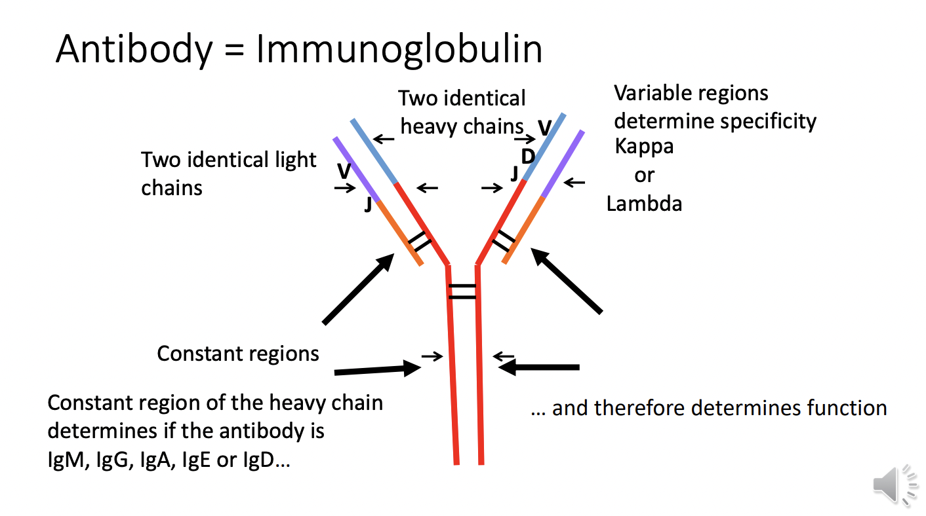
B cells

Slide 10
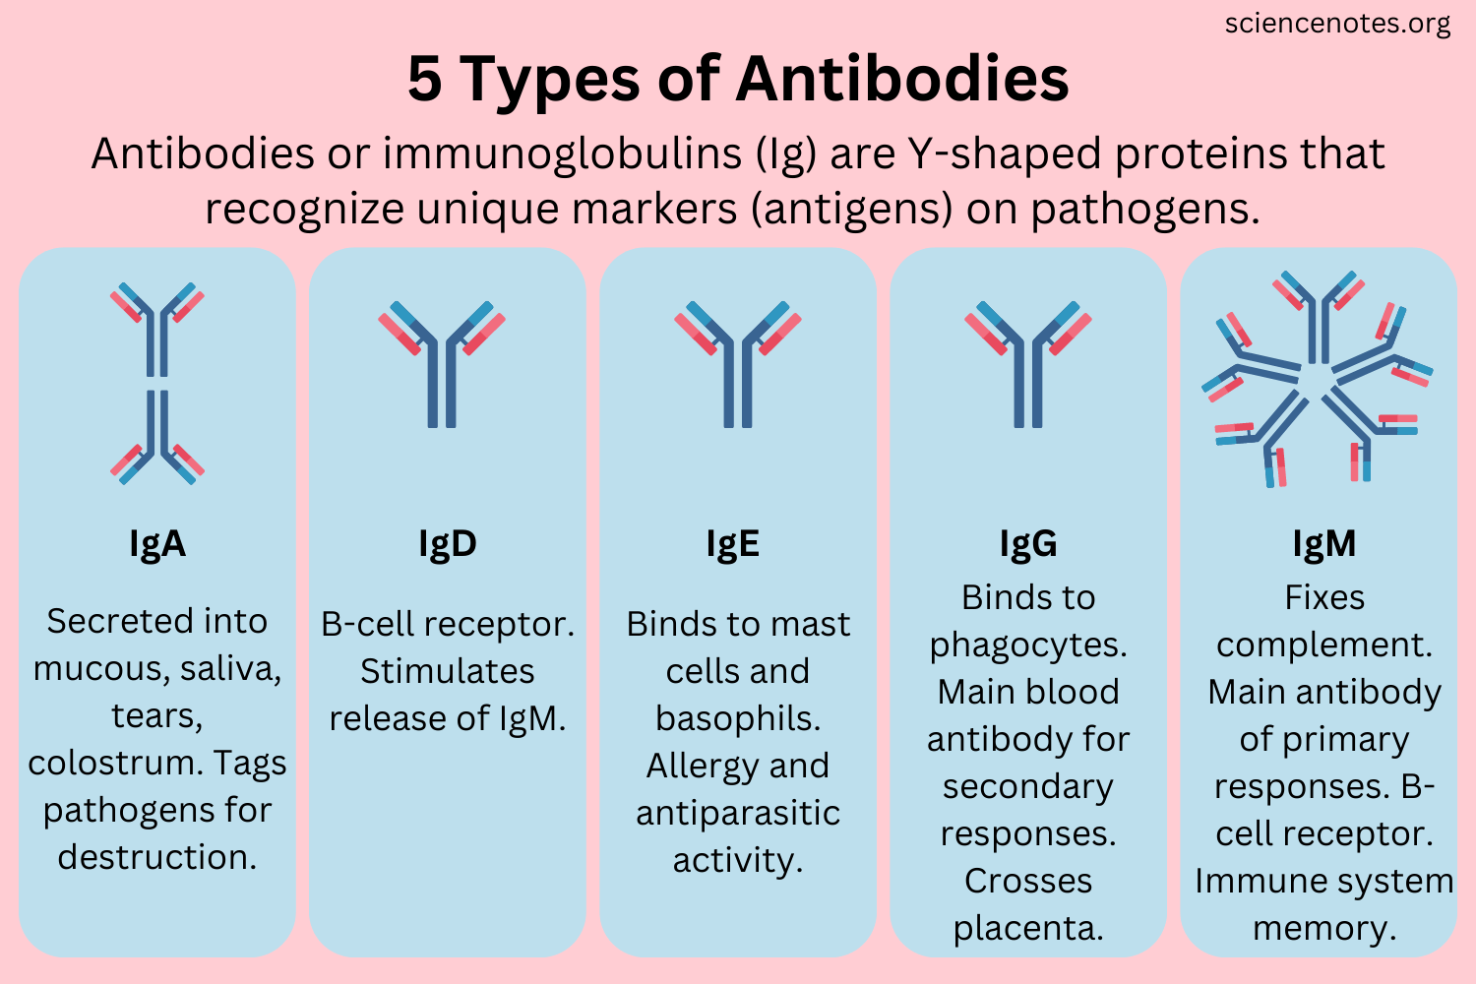
Antibodies

Slide 11
Germinal centre
  Germinal centre – contains highly proliferative B cells that have been activated
  As B cells divide, they start to mutate – somatic hypermutation
  Affinity maturation then happens – high affinity variants to the antigen are selected
  Germinal centre can generate memory cells or plasma cells

Slide 12
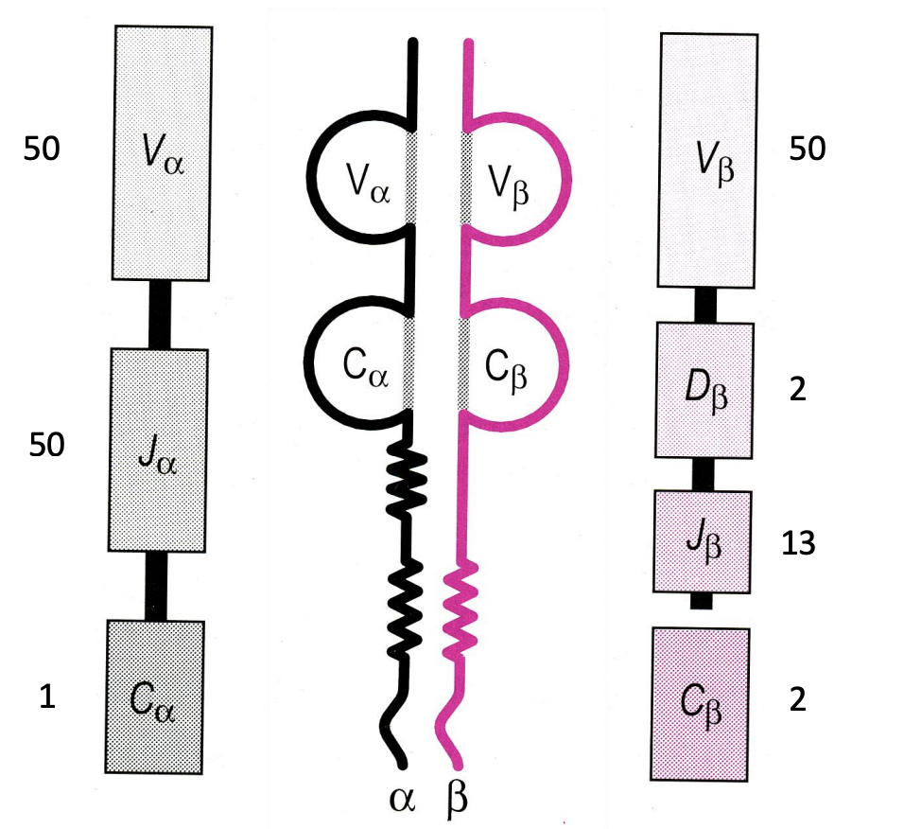
T cells
Membrane bound heterodimer
Two chains joined by disulphide bonds
Consist of variable and constant regions
TCR genes undergo rearrangements from germline before translation

Slide 13
T-cells, effector functions and MHC
  Peptides derived from foreign antigens are displayed to T cells in the context of MHC molecules
  MHC class 1: single chain molecule, expressed endogenously on all nucleated cells → eliminates virally infected cells
  MHC class 2: alpha beta heterodimer, expressed on specialized antigen presenting cells

Slide 14
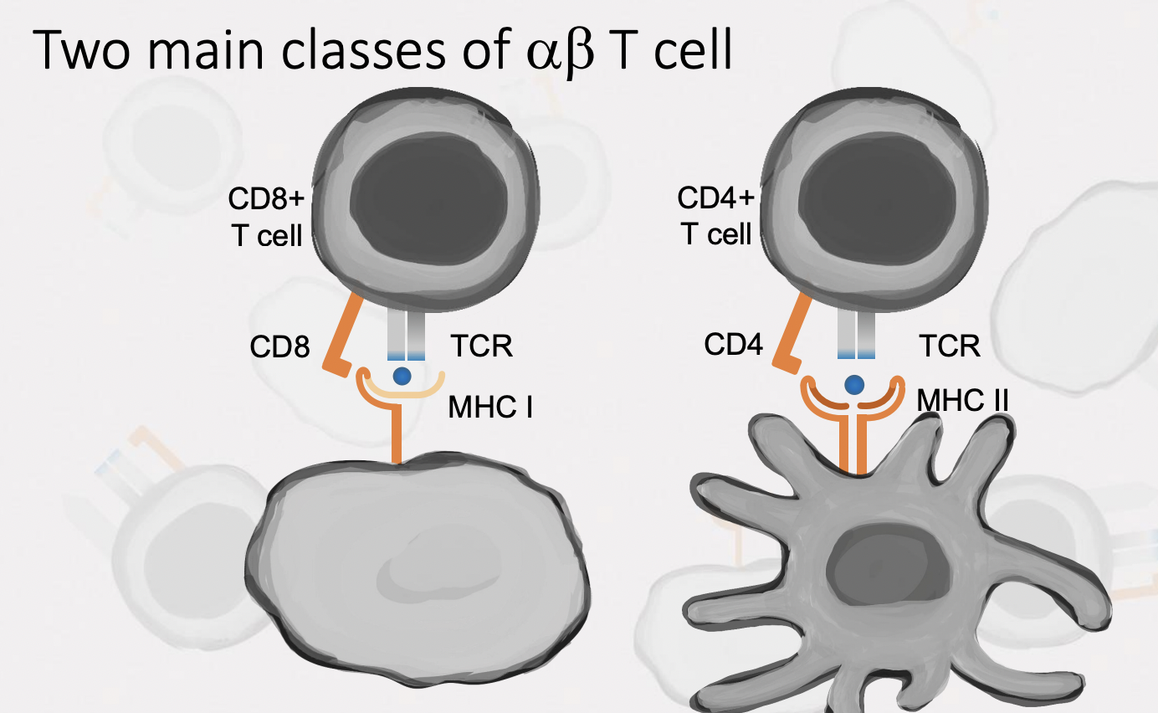
CD8 and CD4 T cells
  CD8 T cells – cytotoxic T cells → preferentially see peptides presented by MHC class 1 molecules
  CD4 T cells – helper T cells → preferentially see peptides presented by MHC class 2 molecules

Slide 15
How are CD8 and CD4 T cells activated?
  Signal 1: must encounter an APC bearing a peptide MHC complex that’s able to bind to the T cell receptors
  Signal 2: co-stimulation. CD80 and CD86 molecules released from APC and this needs to bind to CD28 on T cell

Slide 16
Helper T cells
  Can differentiate into different kinds of effector T cells with distinct functions
  Functions of the different T cells are associated with the cytokines they secrete
  Th1, Th2, Th17 and Treg
  Th1 – response against viruses + intercellular pathogens
  Th2 – response to extracellular parasites
  Th17 – response to extracellular bacteria

Slide 17
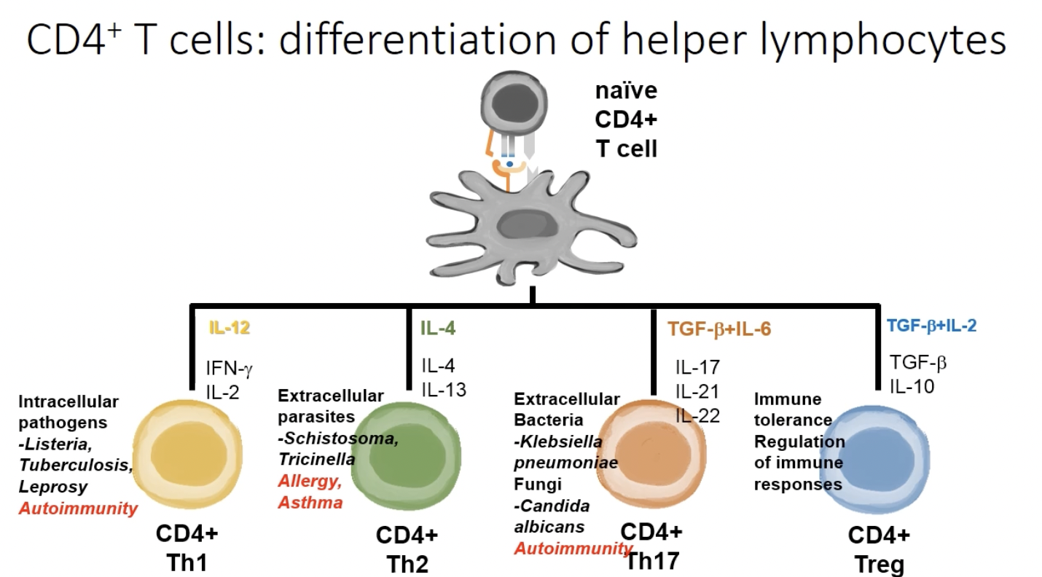
Helper T cells

Slide 18
Immune recognition and tolerance
  Expression of a functional TCR, containing both CD4 and CD8
  Positive selection – T cell receptor needs to be able to bind to MHC class 1 or class 2 with weak affinity. Happens in thymic cortex
  Negative selection – eliminates T cells with high affinity for self-peptides. Happens in thymic medulla and uses TMECs

Slide 19
Immune recognition and tolerance
  Peripheral mechanisms of immune tolerance:
  Anergy – when signal 1 is received without signal 2 in activation of T cells. This results in T cell remaining in circulation but unresponsive to future stimulation
  Regulatory T cells – dedicated to controlling or suppressing effector T cells
  2 types regulatory T cells: nTreg and aTreg

Slide 20
Inflammation
  Reaction of vascularized living tissue to local injury
  Tissues that are not vascularised such as the cornea, don’t undergo inflammation
  4 cardinal signs of inflammation: Redness, Swelling, Heat and Pain

Slide 21
Acute inflammation
  Mediated by innate immune response
  Vascular changes – transient vasoconstriction → prolonged vasodilatation and increased blood flow → increased permeability of microvasculature → oedema
  Acute serous inflammation – where accumulation of fluid is dominant feature
  Acute suppurative inflammation – accumulation of neutrophils
  Acute membranous inflammation – inflammatory membrane forms over the inflamed tissue

Slide 22
Chronic inflammation
  Associated with presence of lymphocytes and macrophages
  Proliferation of fibroblasts and small blood vessels
  Can lead to chronic granulomatous inflammation – persistent immune response characterized by the formation of granulomas
  Granulomas – clusters of immune cells that form to contain persistent infections or foreign substances

Slide 23
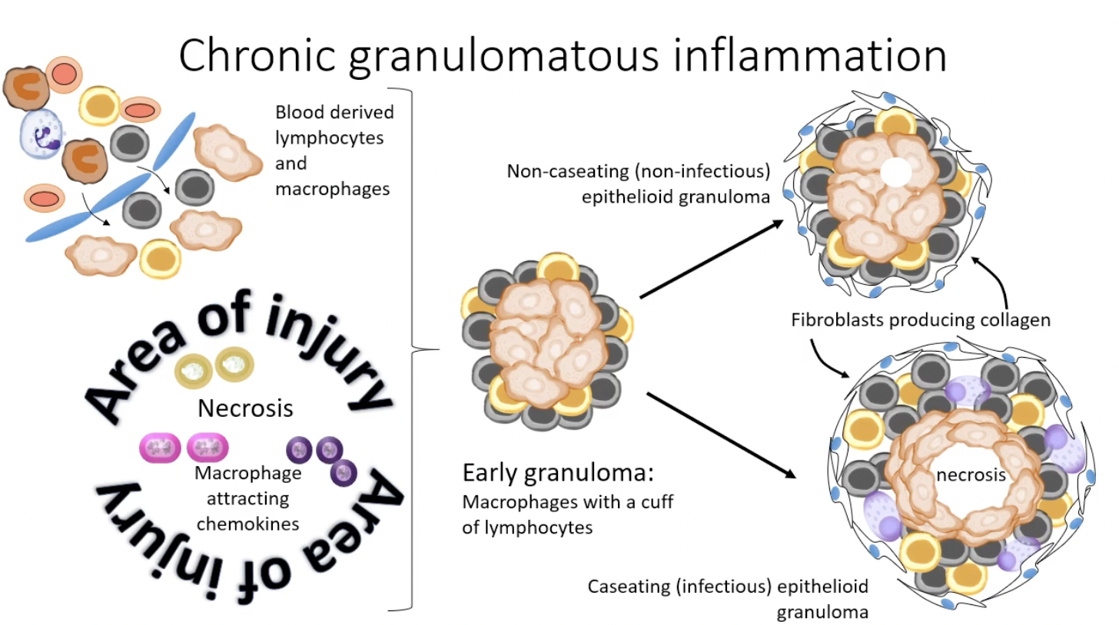
Chronic inflammation

Slide 24
When the immune system goes wrong
  Hypersensitivity
  Autoimmunity
  Immunodeficiency
  Cancer

Slide 25
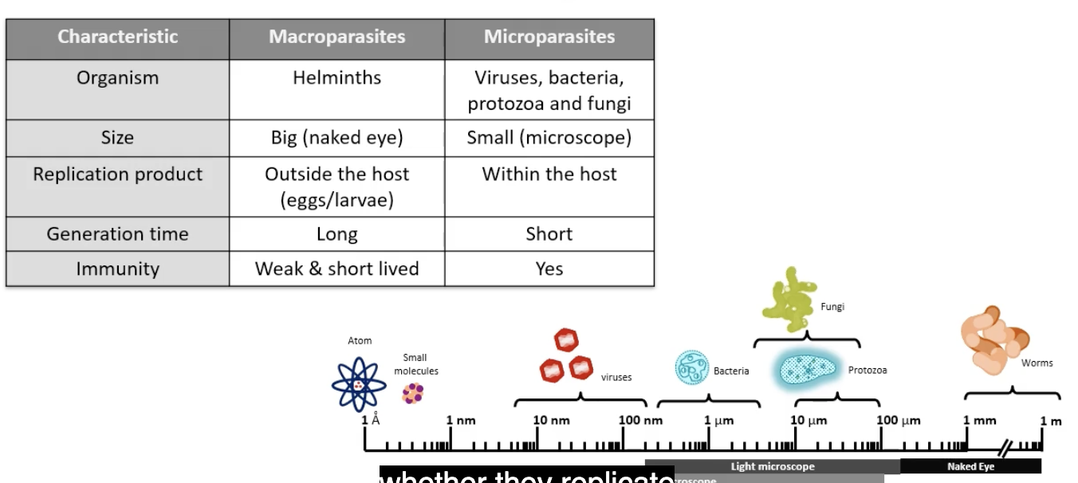
Microbiology

Slide 26
Gram staining bacteria
  Gram stain – can be used to identify bacteria as gram positive or negative
Crystal violet stain (blue)
Fixed with iodine
Decolourised with alcohol
Safranin stain (red)
Gram positive - violet
Gran negative - pink
  Peptidoglycan layer in gram +ve bacteria is thicker than in gram –ve bacteria
  Due to thin layer in gram –ve bacteria, it doesn’t retain the initial violet stain and becomes pink

Slide 27
Types of host-microbe associations
  Commensalism – one organism benefits and the other derives neither benefit nor harm
  Mutualism – beneficial to both organisms
  Parasitism – parasite benefits at the expense of the other

Slide 28
Pathogenesis of microbial infections
  Microbial pathogenesis: process by which infection leads to disease
  Epidemiological triad: when a pathogen meets the right host in an environment that favors the microorganism

Slide 29
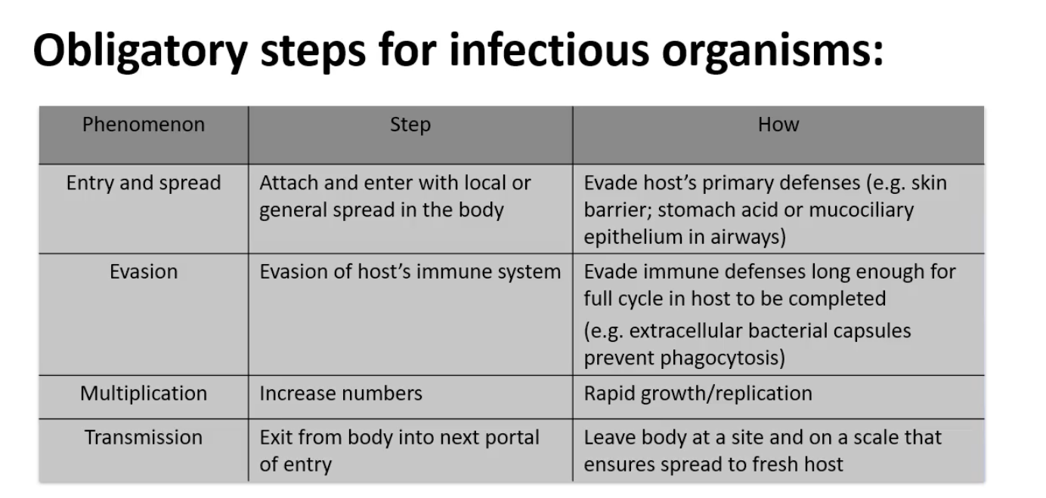
Mechanisms of pathogenesis

Slide 30
Stages of infectious disease progression
Incubation - time between exposure and onset of specific clinical sign
Prodrome - appearance of non-specific 'constitutional' symptoms occur (fever), not all infections have this stage
Illness - clinical features of infection manifest
Recovery - illness abates and return to healthy state

Slide 31
Infection classification
  Transmission: communicable and non-communicable
  Occurrence: sporadic, endemic, epidemic and pandemic
  Infection: superficial, systemic
  Outcome: acute, persistent

Slide 32
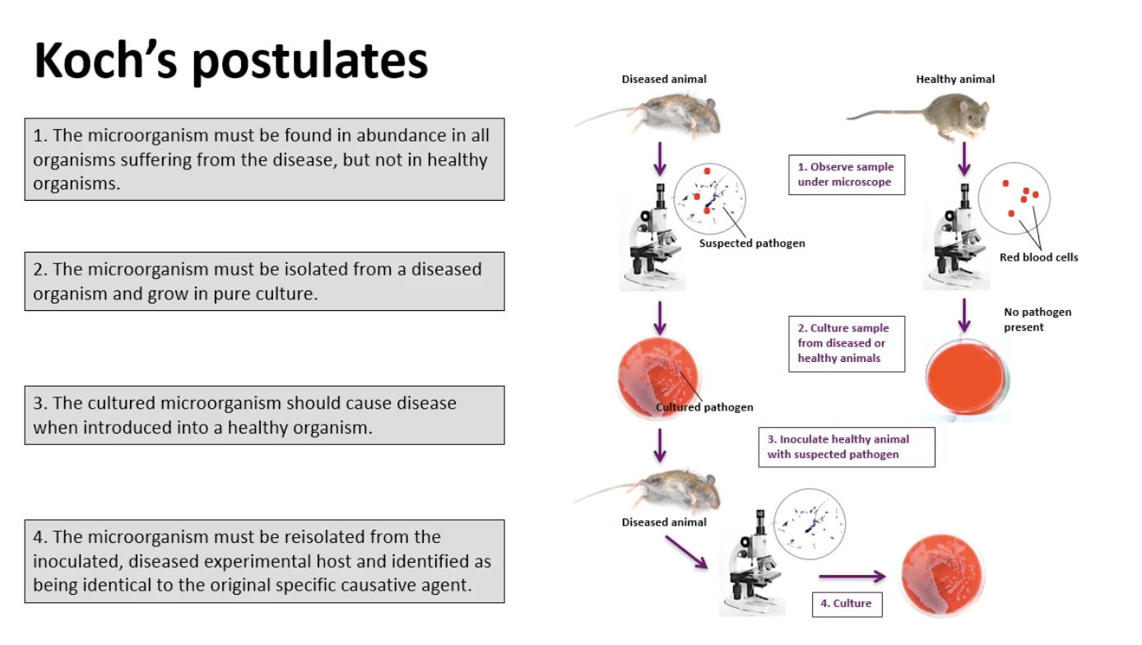
Detection and diagnosis of infection

Slide 33
Methods of detection
  Direct detection: clinical specimen examined for presence of microbe
  Indirect detection: blood and other bodily fluids examined for presence of antibodies against a pathogen

Slide 34
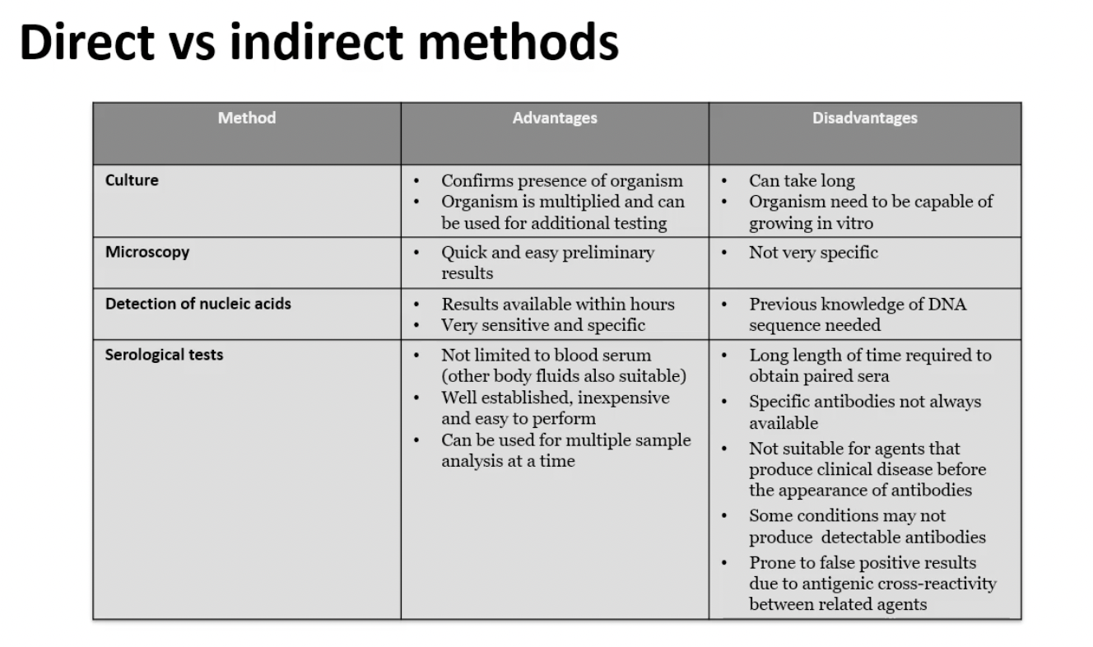
Methods of detection

Slide 35


SBA!!!

Slide 36
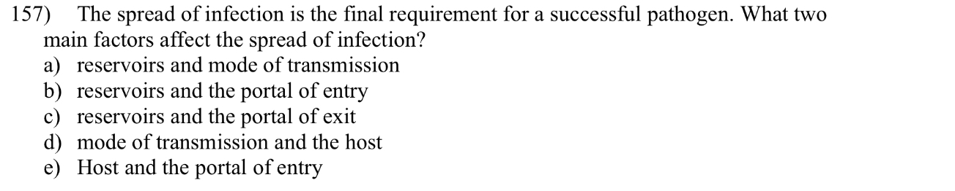

Slide 37
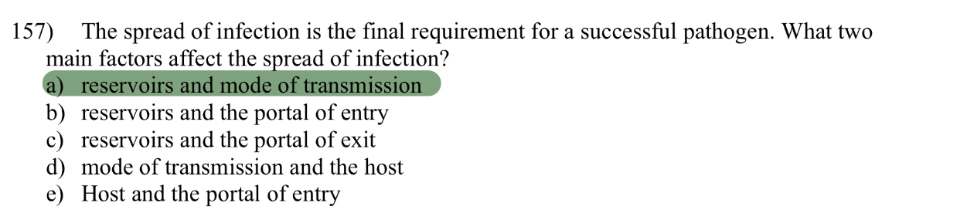

Slide 38
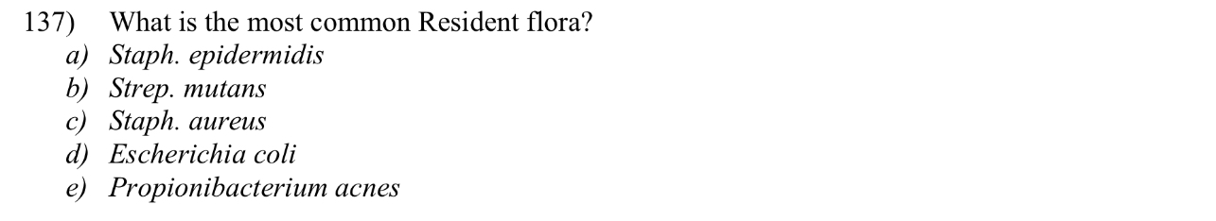

Slide 39
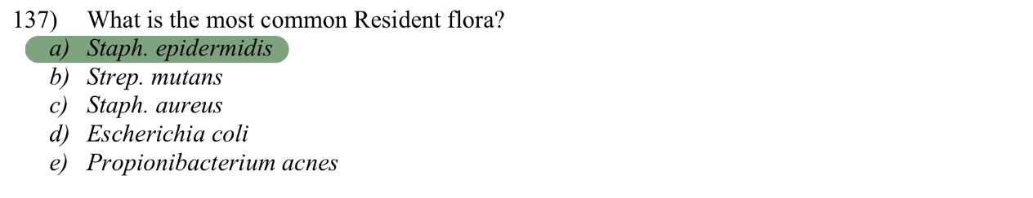

Slide 40
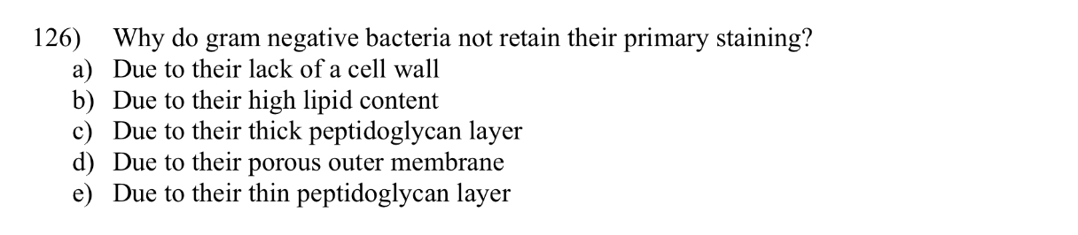

Slide 41
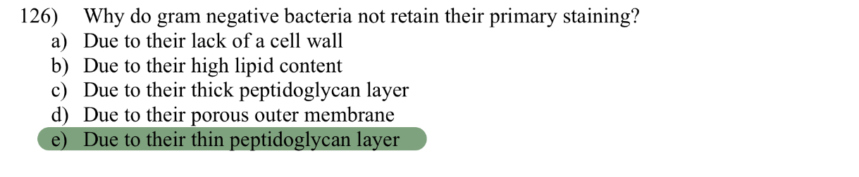

Slide 42
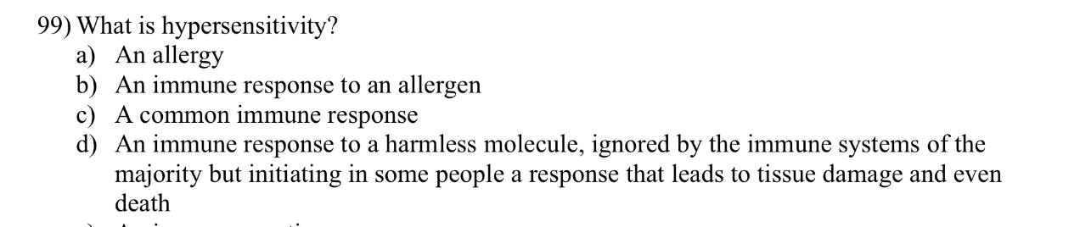

Slide 43
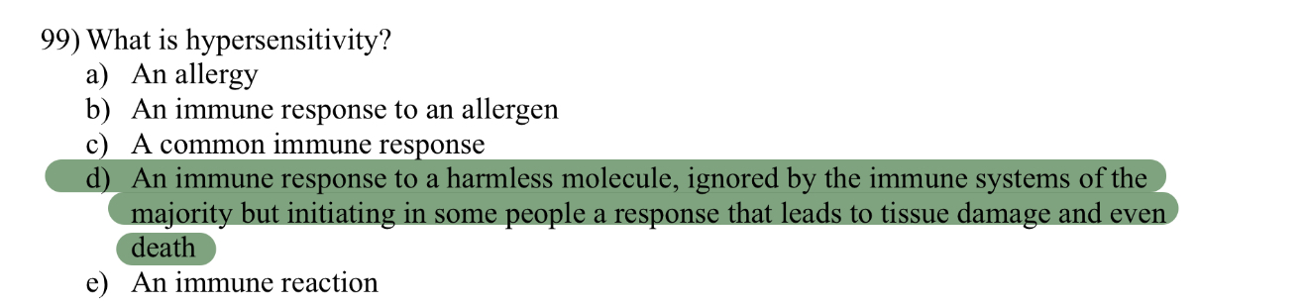

Slide 44
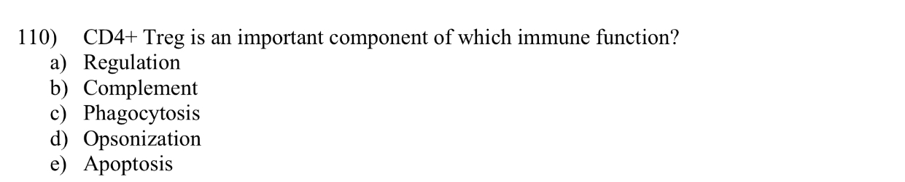

Slide 45
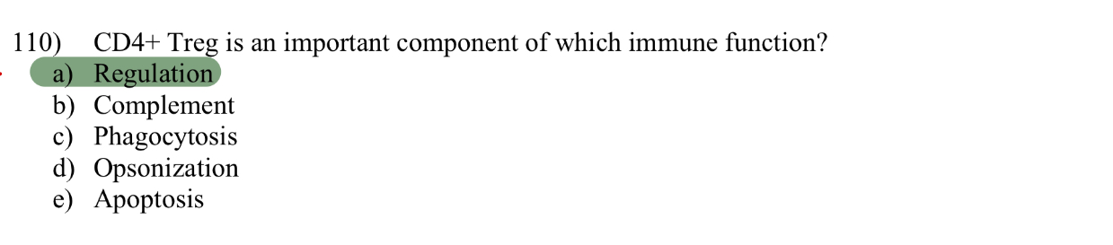

Slide 46
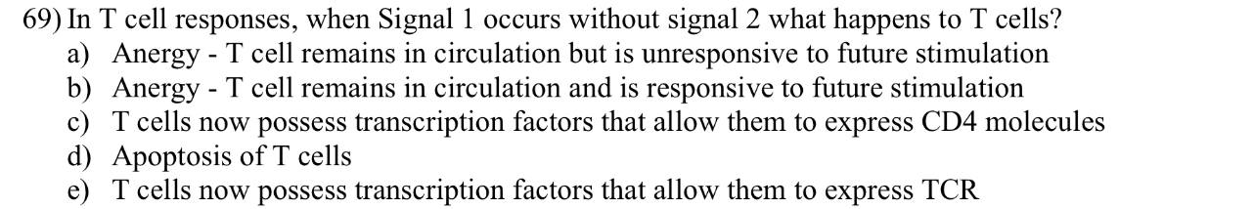

Slide 47
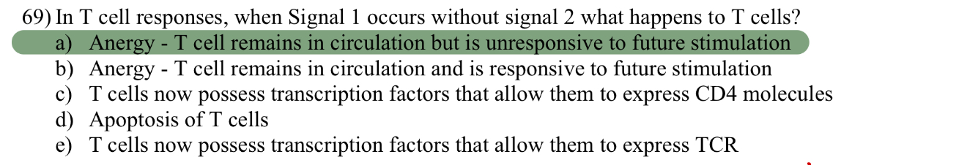

Slide 48
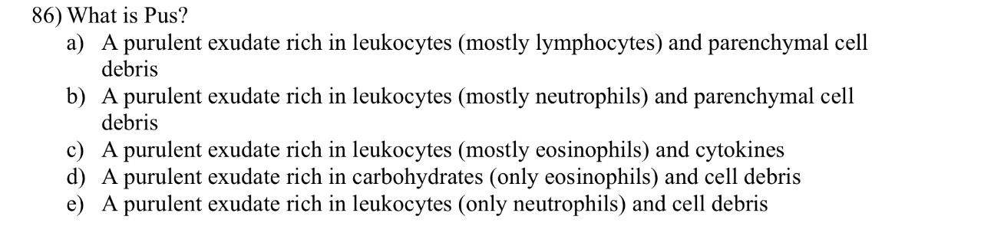

Slide 49
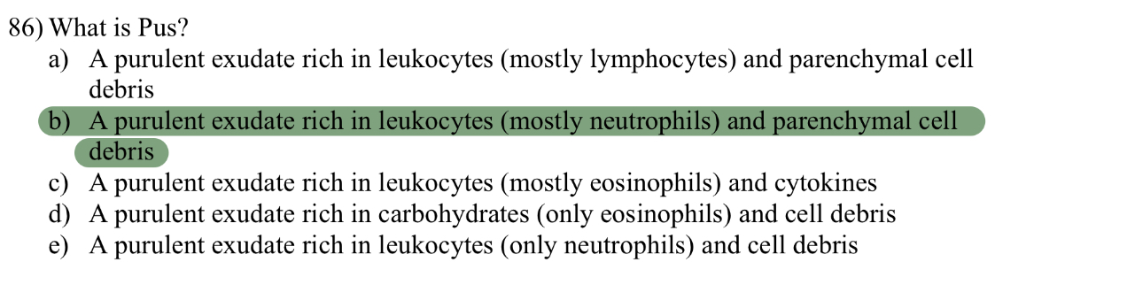

Slide 50
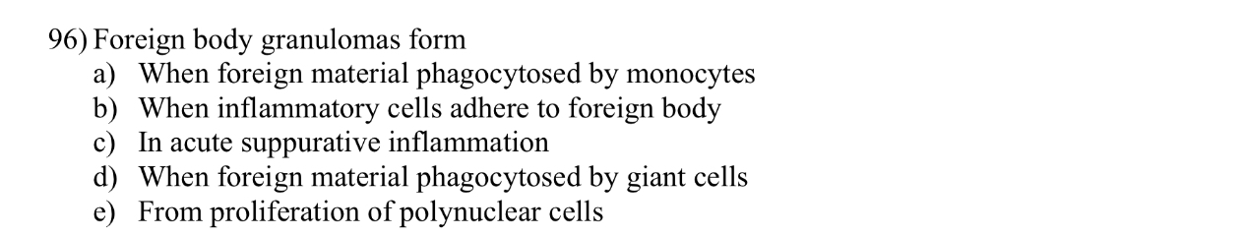

Slide 51
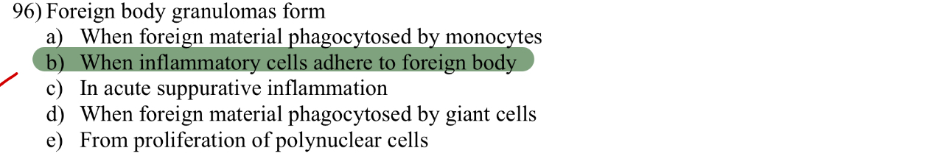

Slide 52
Diagnostic tests and screening
Cohort study and case control study
RCTs
T tests and Chi squared tests
Estimation and significance test and t values
Epidemiology and Biostatistics

Slide 53
Diagnostic tests and screening
  Reliability – consistency of results (repeatability/ reproducibility) → can be tested via repeat measurements and within-observer and between-observer repeatability
  Validity – truth of result, lack of bias
  A reliable test may not give valid results

Slide 54
Properties of a test
  Sensitivity – if someone has a disease, what is the probability that the test result will be positive?
  Specificity – if someone does not have the disease, what is the probability that the test result will be negative?
  Positive predictive value (PPV) – if someone has a positive test, what is the probability that they will have the disease?

Slide 55
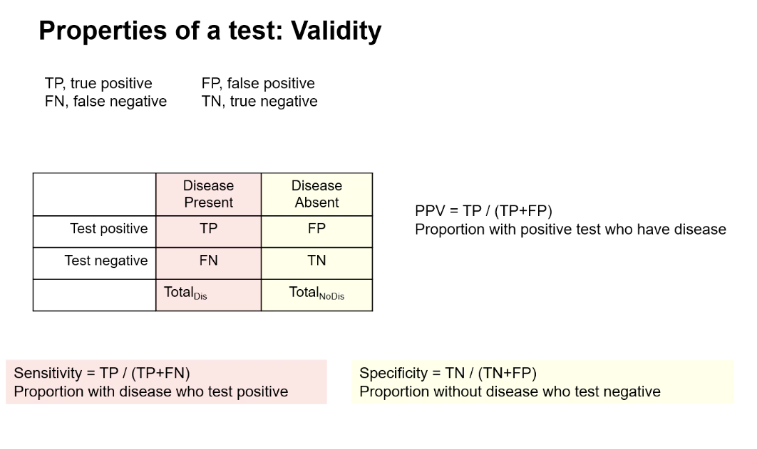
Properties of a test

Slide 56
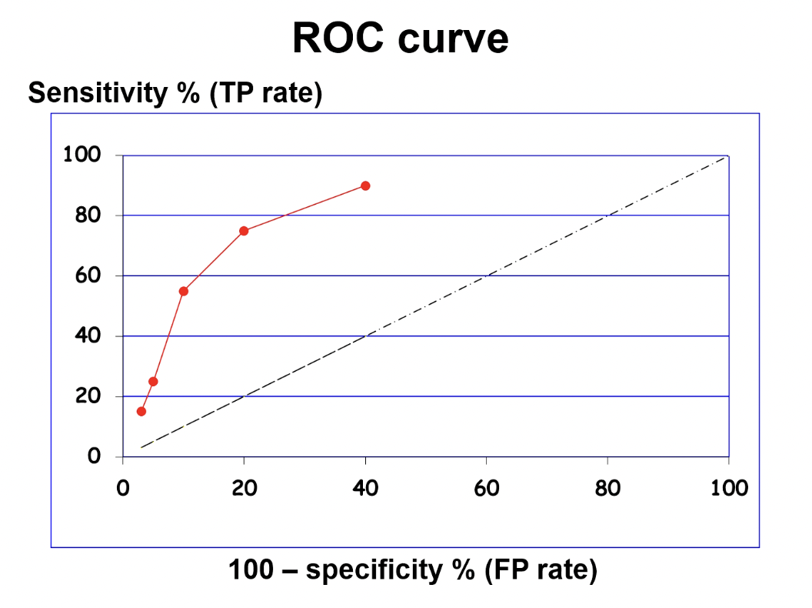
ROC curve
  An ROC curve shows the trade off between sensitivity and specifity

Slide 57
Screening
  Screening – secondary prevention intervention
  To bring forward the time of diagnosis so that early treatment can bring benefits
  Criteria for screening: Condition, Test, Treatment

Slide 58
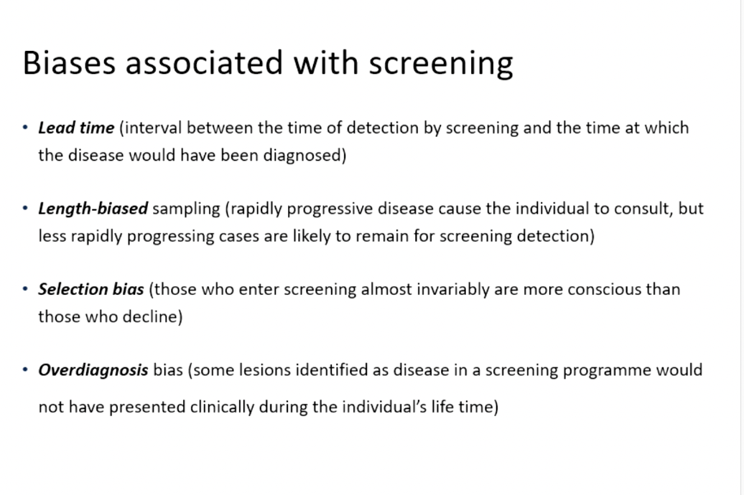
Screening

Slide 59
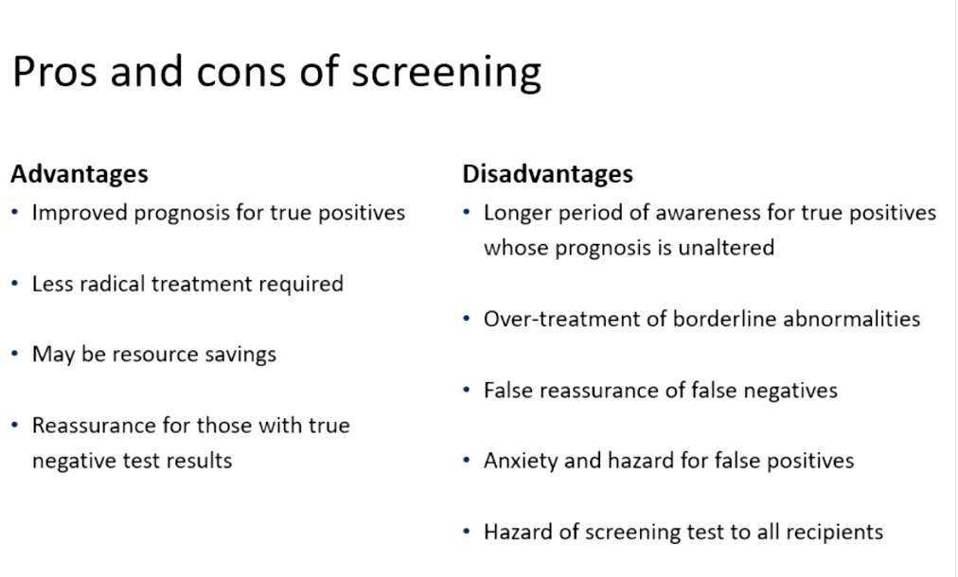
Screening

Slide 60
Cohort study design
  Subjects are usually free of disease at the start
  Groups defined according to risk factor exposure
  Followed up over time
  Compare incidence of disease in exposed and unexposed
  Need to consider confounding variables
  Relative risk is the ratio of risk in the unexposed and exposed → tells us how many times our risk is increased depending on exposure

Slide 61
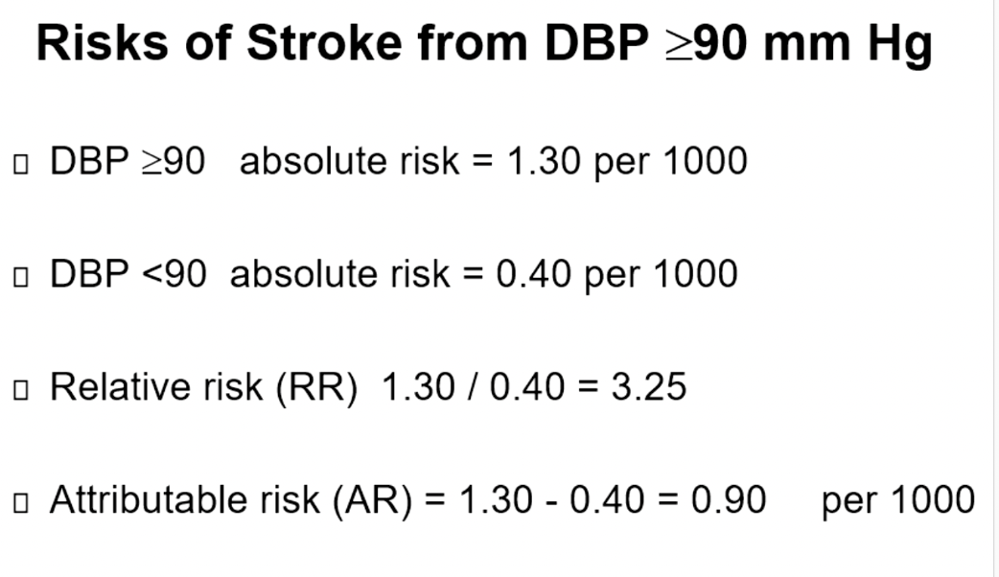
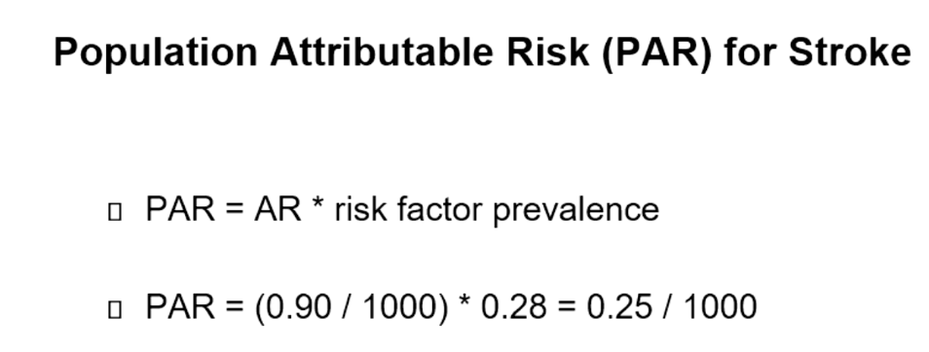

Slide 62
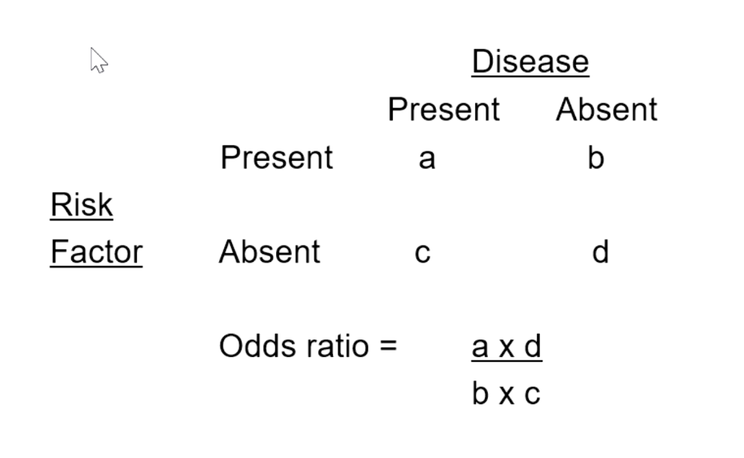
Case control study design
  All cases are cases of disease
  Controls include a sample of disease-free subjects
  Case-control study compares risk factor exposure in cases and controls
  Odds ratio is used to approximate relative risk

Slide 63
RCTs
  Planned experiment designed to assess efficacy of treatment/ intervention
  RCTs can be used to evaluate: drugs, methods of diagnosis, organising care, screening and disease prevention

Slide 64
Basic RCT design questions
  Population of interest?
  Intervention?
  Comparison?
  How is the outcome being assessed?

Slide 65
T-test
  Used to compare 2 means
  Paired samples – compares means from the same group at 2 different times
  Unpaired samples – compares means of 2 separate groups
  Null hypothesis – no difference between the 2 groups
  P value less than 0.05 means the null hypothesis can be rejected

Slide 66
Chi squared test
  Test for association between 2 categorical variables (2 distinct outcomes)
  Null hypothesis – no association between the 2 outcomes
  Always use frequencies, not percentages

Slide 67
Statistical significance
  Some results may be clinically important but not statistically significant → happens when sample sizes are small
  Some results may be statistically significant but not clinically important → happens when sample sizes are too big

Slide 68
SBA!!!

Slide 69
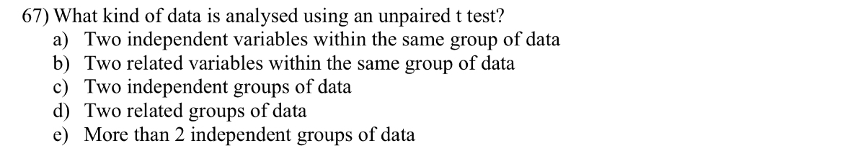

Slide 70
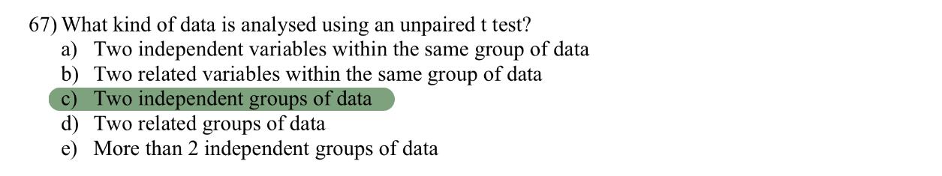

Slide 71
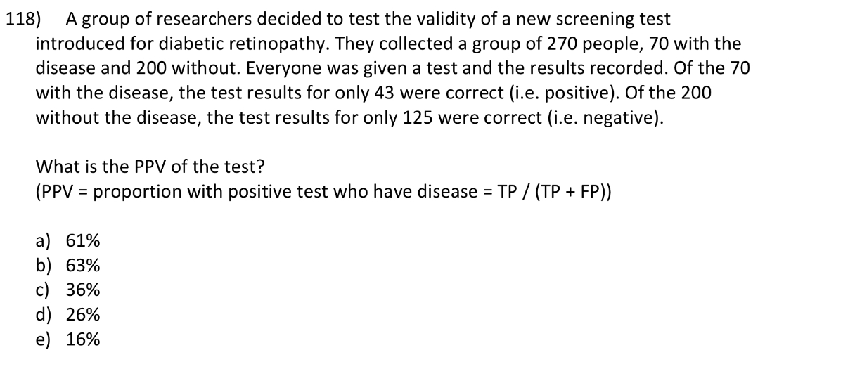

Slide 72
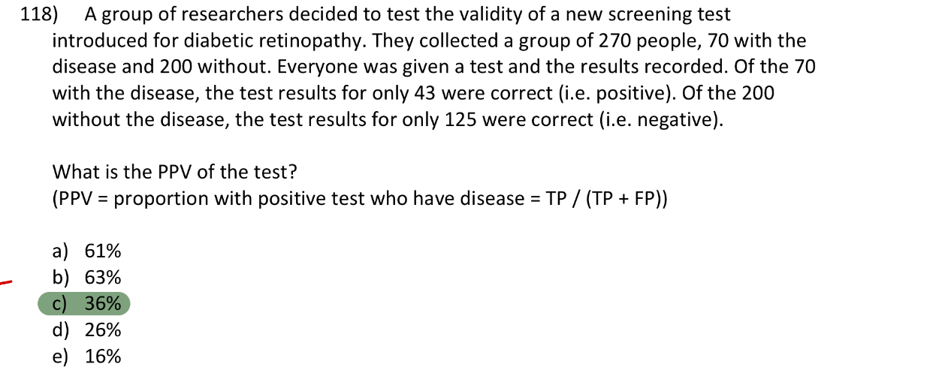

Slide 73
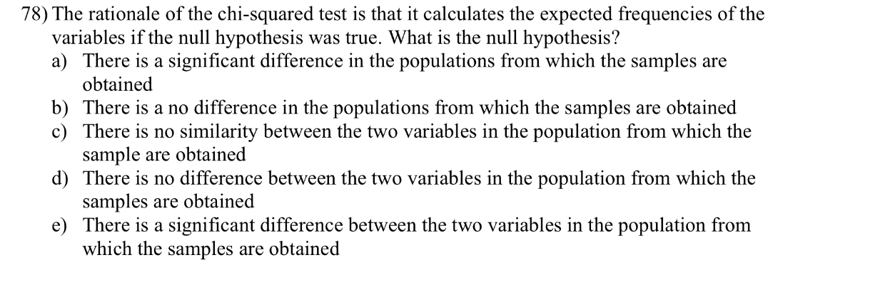

Slide 74
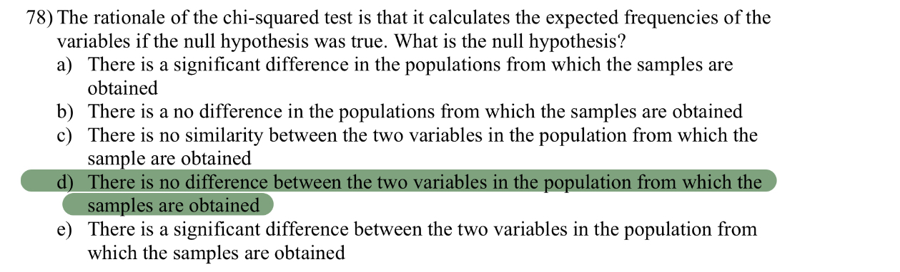

Slide 75
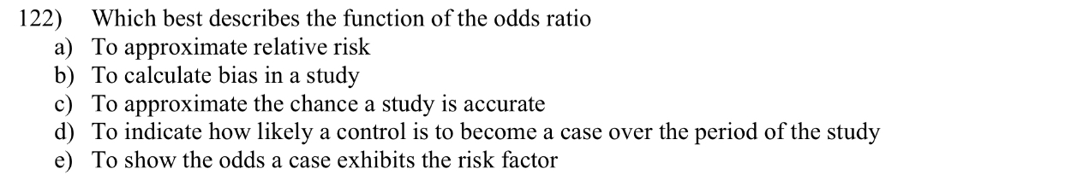

Slide 76
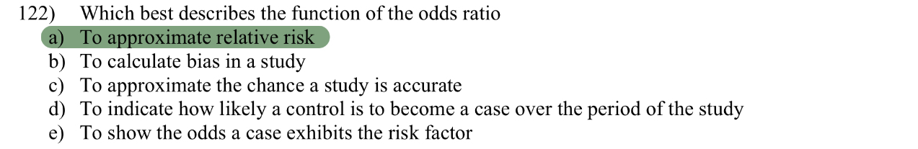

Slide 77
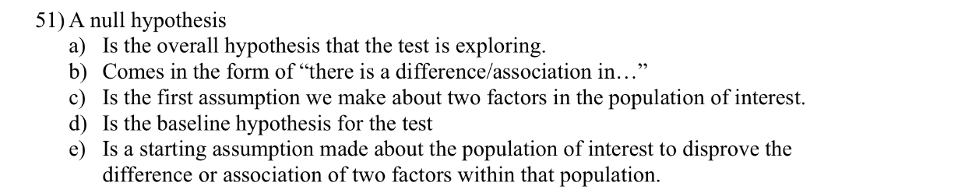

Slide 78
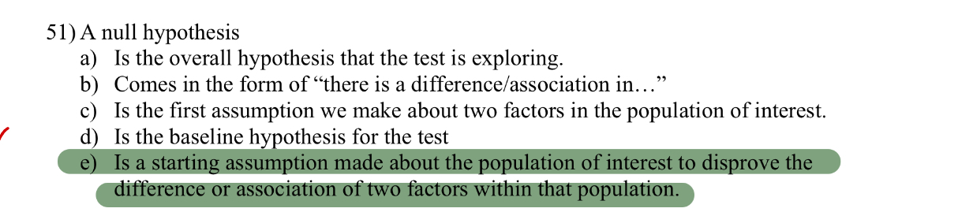

Slide 79

FEEDBACK
Thank you!!
Any questions?
keshani.ganendiran@kcl.ac.uk

