Slide 1
SFP Made Simple
4. Introduction to Interview and Clinical Scenarios
Dr Katherine Kuncewicz (FY1 UCL)

Slide 2
MSA Sponsor

Slide 3
Fundraising

Slide 4
Webinar schedule
1.
Introduction to the SFP with Q&A
Tuesdays at 18:30
2.
Maximising Portfolio Marks and Self-Scoring
3.
Writing White Space Questions
4.
Introduction to Interview and Clinical Scenarios
5.
Biomedical Statistics for the SFP
6.
Academic Station and Critical Appraisal
7.
Answer the Personal Questions with Confidence
8.
Interview Practice Workshops

Slide 5
Objectives
Overview of the Interview
Clinical Scenario and Examples
Q&A
1
2
3

Slide 6
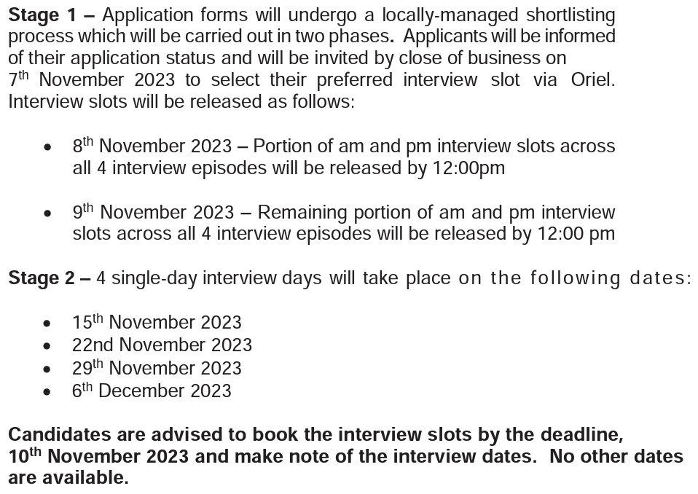

Slide 8
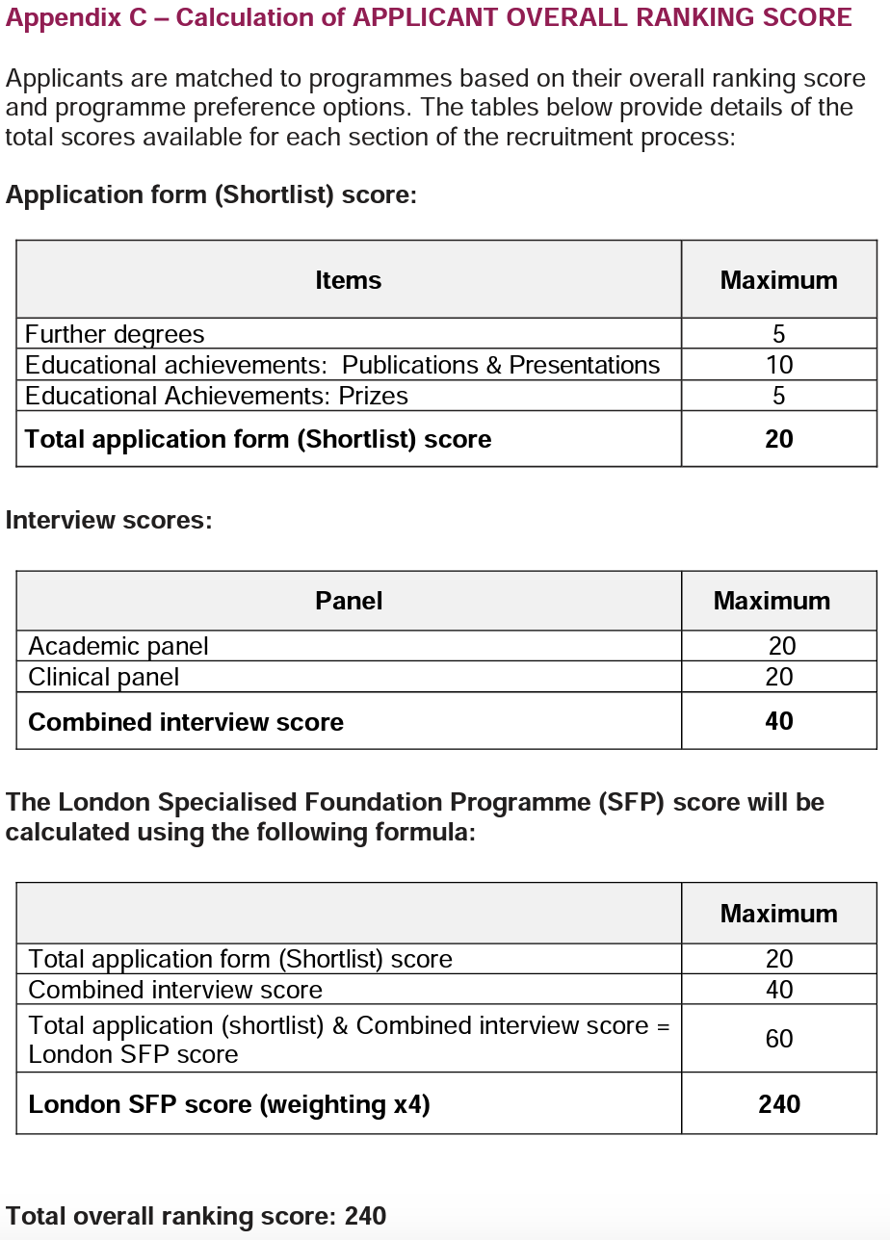
Interview Weighting
Interview - heaviest weighted component of application
Most time-consuming aspect of application

Slide 9
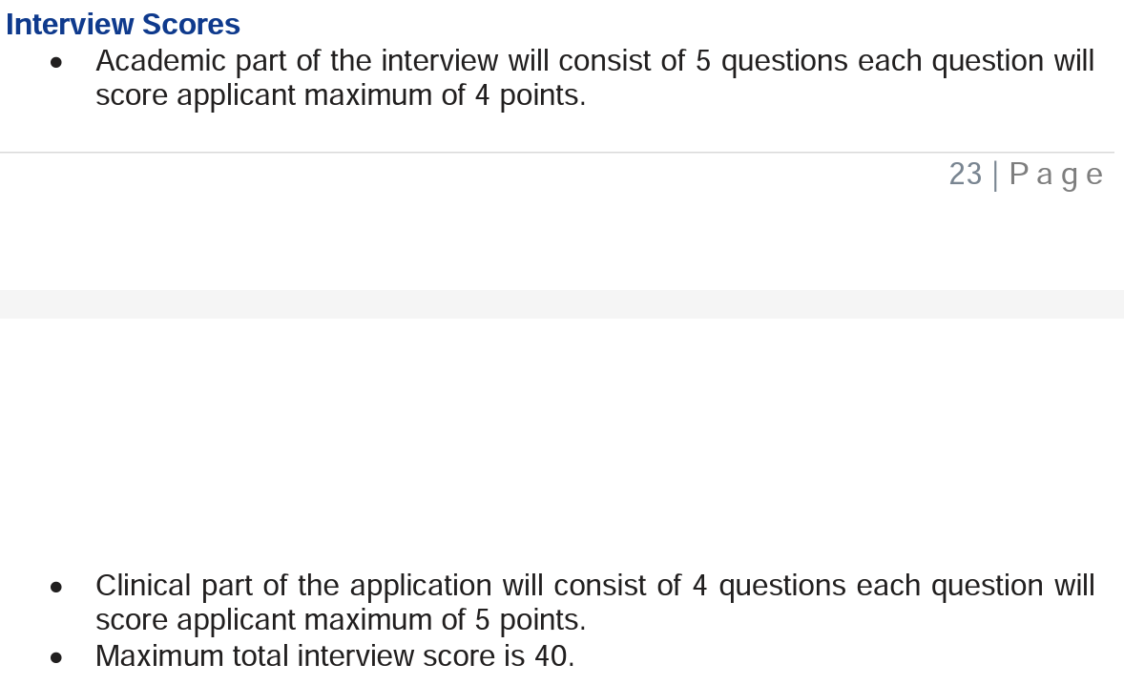

Slide 10
Sections of the Interview
Clinical
Academic
Personal
Different deaneries will include different sections and vary the content of the section.

Slide 11
Contents of the Clinical Station
Usually 3 unwell patients handed over.
Need to prioritise and discuss immediate management.
Often has an added ethical element.

Slide 12
Tips for the Clinical Station
Practice
Confidence
Familiarity with timings/content
Structure
Reasoning
Skills: ECG, CXR, ABG
Escalation routes
Recognition of limitations
React to changing situations
Ethical considerations

Slide 13
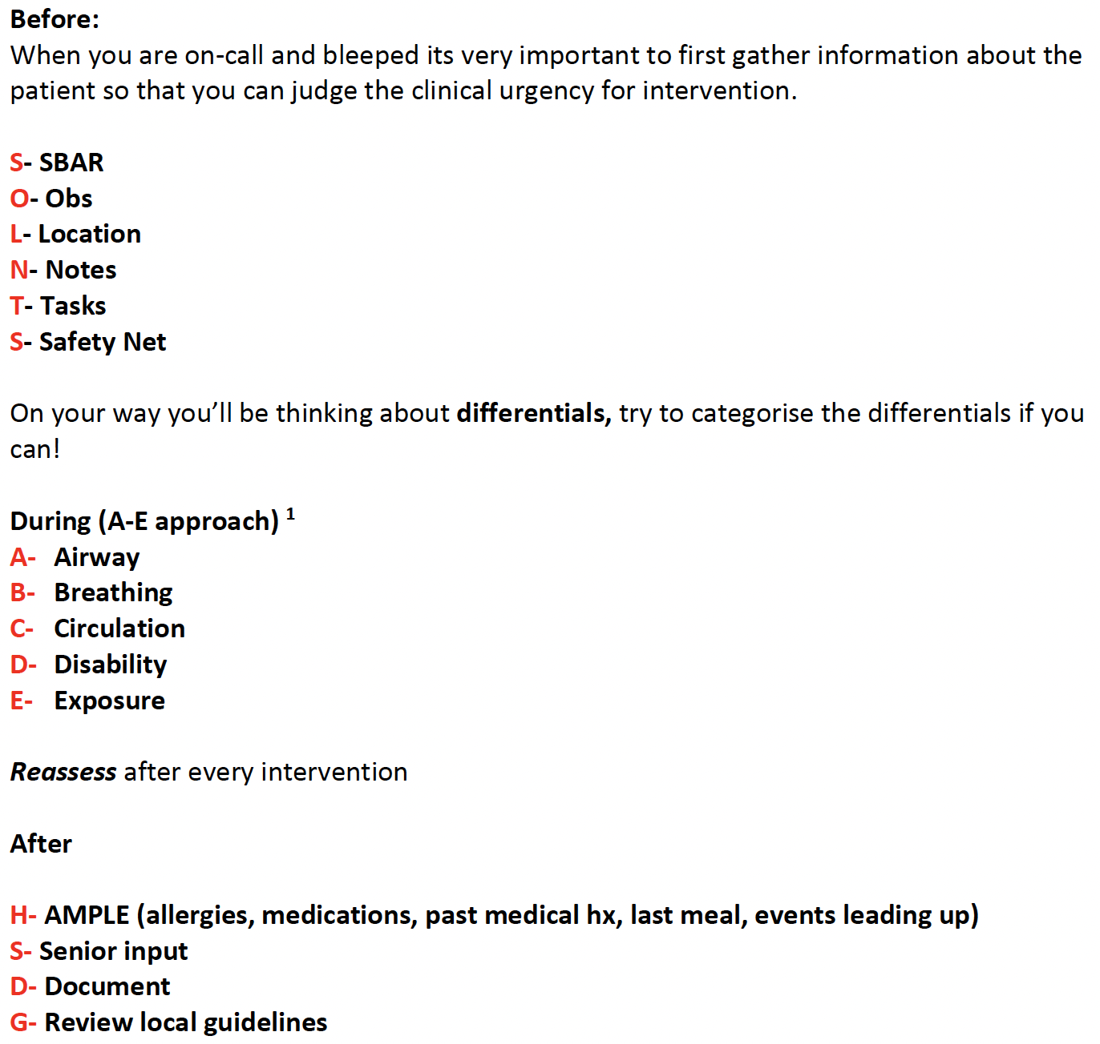
Useful Mnemonics

Slide 14
Resources
Nice guidelines
OSCE Stop
Oxford Handbook for Clinical Medicine

Slide 15
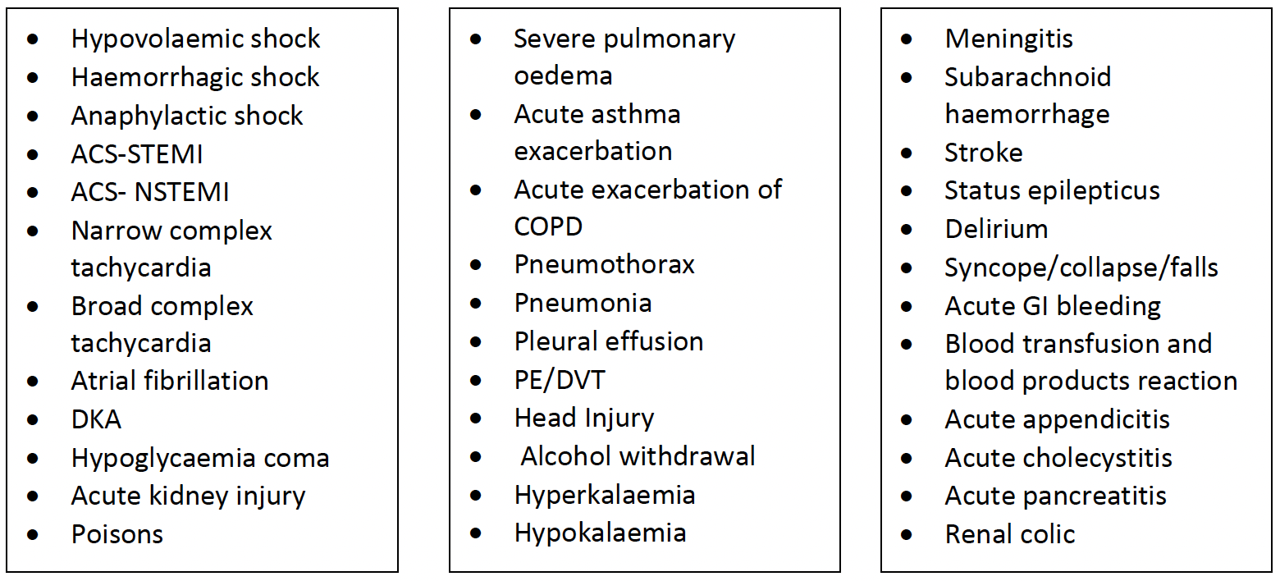
Common Conditions in Interview

Slide 16
Practice
Twice a week at least
Scenarios from A-E
Review book
Try to finish all scenarios

Slide 17
Feedback

