Slide 1



Year 2 OSCE Crash Course
Clinical Examinations
By: Maheen Siddiqui (Yr4), Jean Dimaculangan (Yr3), Shruti Turaga (Yr3)

Slide 2
General technique
Inspect (End-of-bed followed by general), palpate, percuss, auscultate
Introduction generally follows the same approach :
  W : wash hands
  I : introduce yourself
  P : permission, pain
  E : expose the patient adequately (+chaperone?)
  R : reposition patient (right side of bed)

Slide 3
The big question
Should you talk to the examiner?
    Our advice is NO
    Talk to the patient in patient-friendly language e.g. “I am going to take a look at your hands”, “Now, I will just be listening to your chest”, “I will be pressing down on your leg” etc. This way:
        The examiner knows that you are looking for things e.g. that you checked for signs on the hand
        You are still talking to the patient in patient-friendly language so they will give you high marks from their end
    The two minutes of presenting back is when you can use jargon to mention specific signs
        E.g. “there were no signs of splinter haemorrhages”
    That’s the best way to cover everything and get the best of all worlds

Slide 4
The high yield tips for the top mark
Be confident!!!
      This gets you more marks than you think - if you go in with confidence and it looks like you know what you are doing in the first minute, more likely than not, it will set you up well
Make everything obvious
      e.g. when palpating and looking for pain, very obviously turn your face to patient - it’s more discrete in real life, but examiners need to know that you have done it, so make it obvious in the OSCEs)
Talk to the patient!!!
      Describe what you are doing in patient-friendly language e.g. I will now be squeezing your finger
      This does two things: 1) you get patient points for explaining and keeping them in the loop and 2) even if the examiner stops looking/is writing feedback, they can hear that you have done a step)
Mention the patient’s name periodically
      Helps build rapport (but don’t overdo it)

Slide 5
The high yield tips for the top mark
Maintain dignity (and make it slightly obvious)
      e.g. say ……undress from the waist up. However, I will let you know when we get to that part, so you can remain as is for the time being
At the end, thank the patient and ask them if they have any questions (a lot of people forget that!)
Presenting back
      Structure of presentation
          Patient details and what exam
          All positive findings
          Important negative findings
          Offer investigations in this order:
                Bedside - e.g. obs (always can say this!), ECG, fluid balance, examinations (e.g. cardio, resp, abdo), pregnancy test (always in a woman of childbearing age!)
                Bloods - e.g. FBC and U&Es and LFTs (these three always, “as baseline”)
                Imaging - e.g. CXR, CT, MRI
                Special tests - e.g. endoscopy

Slide 6
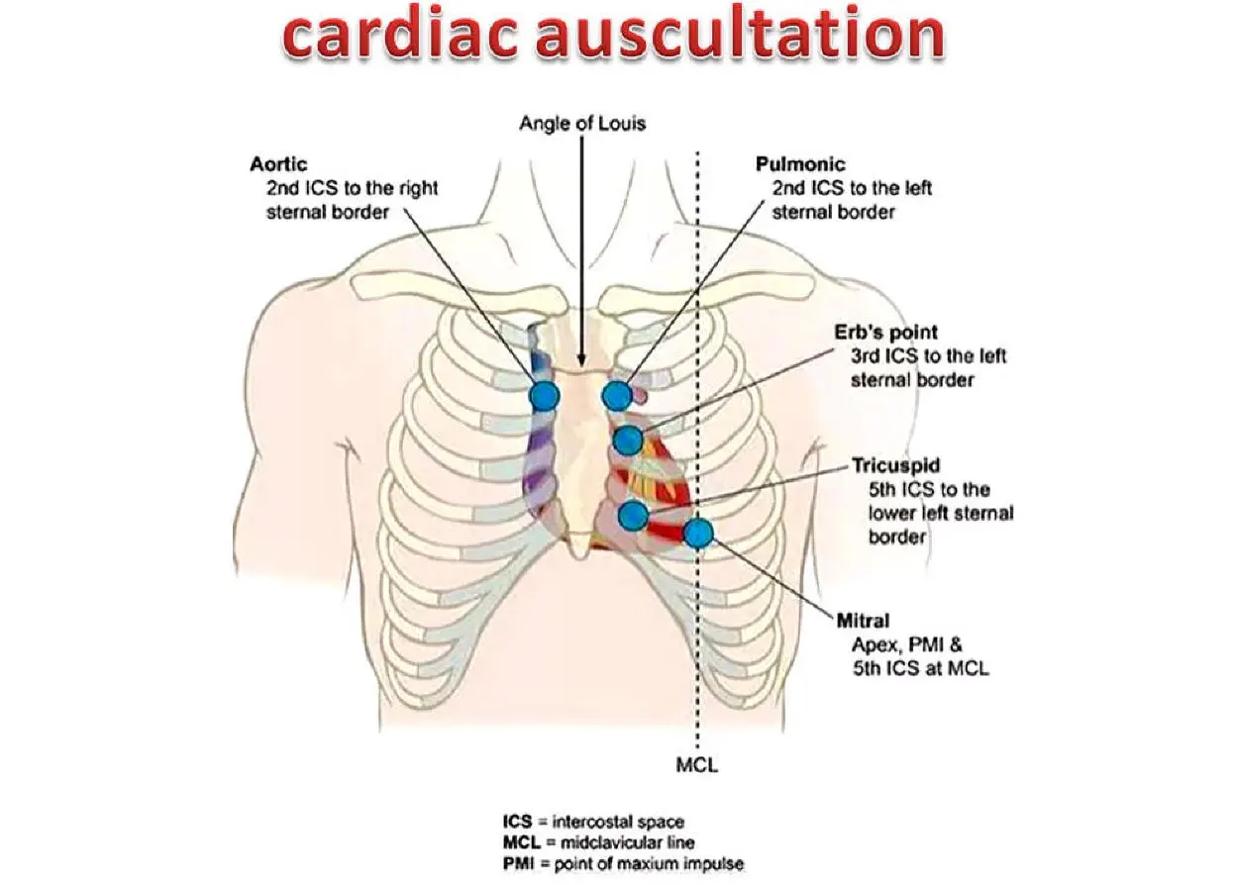
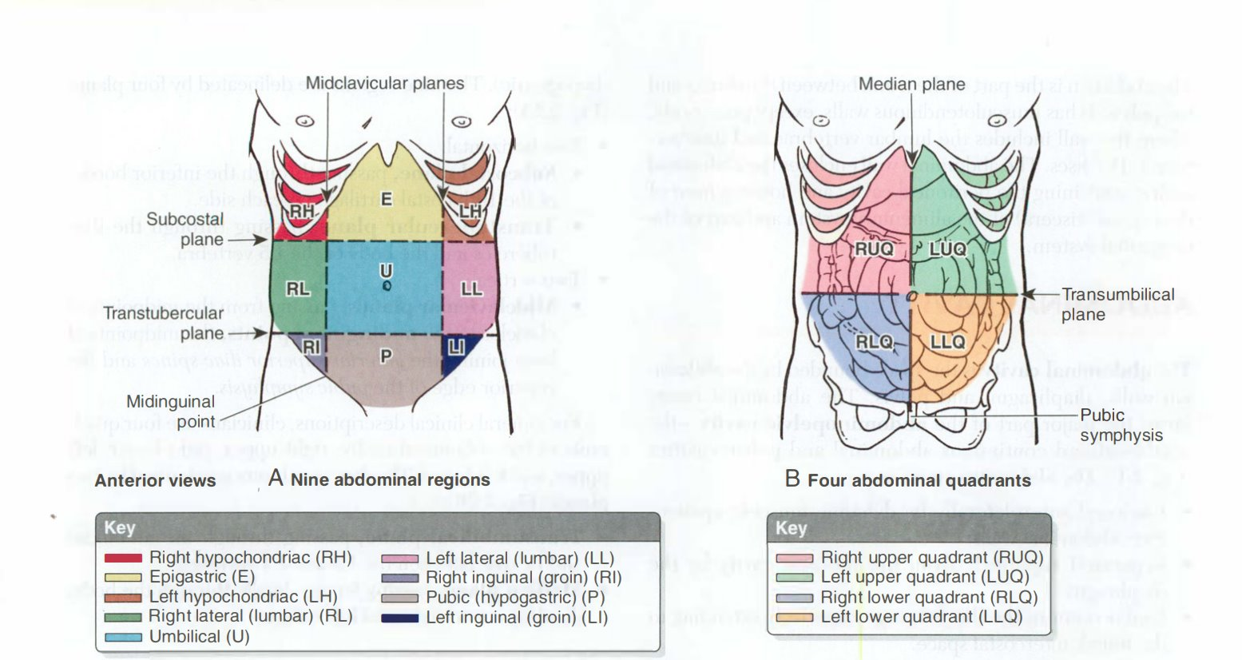

Slide 7
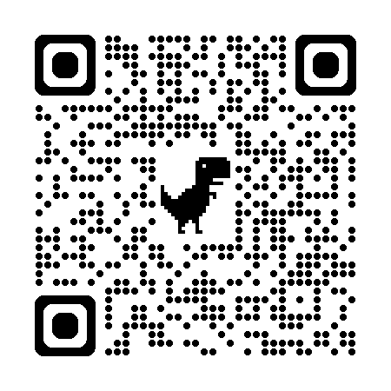
Cardiovascular

Slide 8
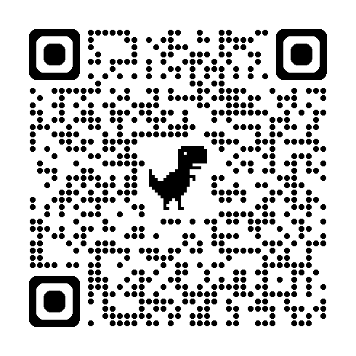
Respiratory

Slide 9
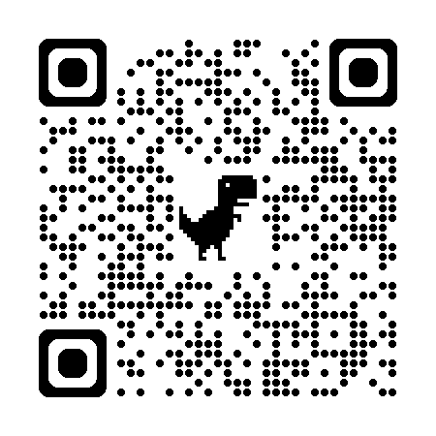
Abdominal

Slide 10
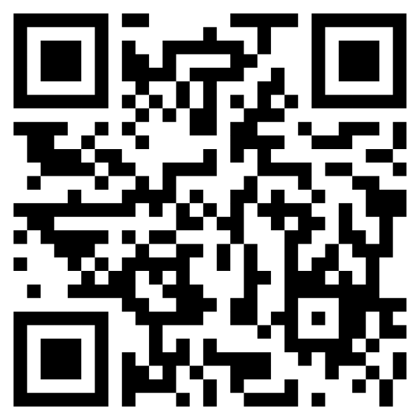
Feedback Form

