Slide 1







GKTeach
Nutrition & Metabolism (NAM)
STAGE 1
Ali Khan – Y2 MBBS
04/12/2025

Slide 2
  1. Understand the biochemical processes involved in NAM
  2. Use mnemonics/learning aids to memorise these
  3. Link these biochemical processes together, understand their role in the larger system
  4. Be apply to apply this knowledge in both recall & deductive MCQs
LEARNING OBJECTIVES
  Lectures Covered:
  Anaerobic Metabolism
  Aerobic Metabolism
  Fat as Fuel
  Amino Acid Metabolism
  Glycogen synthesis & regulation
  Liver & Gluconeogenesis

Slide 3


My Top Tips for NAM

Slide 4

NAM Top Tips
Make sure to understand, rather than just memorising
Use diagrams & mnemonics to help with memorisation
Draw out the diagrams to practise.
  - spamming this = easiest way to learn it, doesn’t actually take as long as you might think
Link your knowledge -> connect different processes to each other so you learn everything in context
      - if you see a particular molecule that appears in a different reaction, make that connection (e.g. Succinyl-CoA from TCA cycle is also involved in FA break down)
Notes:
Talk about context within overall syllabus -> how very specific points will often be tested, so it’s important to learn in close conjunction with slides
Volume is a lot less than PAS, therefore try to max this
Potentially thresholds for merit for this. Give pass mark for formatives anyway

Slide 5
Anaerobic Metabolism

Slide 6

Anaerobic Metabolism
Which of the following best describes the regulation of
glycolysis by phosphofructokinase (PFK)?
A) PFK is activated by ATP and inhibited by AMP
B) PFK is inhibited by high levels of citrate and ATP.
C) PFK is regulated only by substrate availability, not allosteric
effectors.
D) PFK activity is increased by high NADH levels and low citrate
levels.
E) PFK is activated by fructose-2,6-bisphosphate and AMP.

Slide 7
Anaerobic Metabolism
Which of the following best describes the regulation of
glycolysis by phosphofructokinase (PFK)?
A) PFK is activated by ATP and inhibited by AMP
B) PFK is inhibited by high levels of citrate and ATP.
C) PFK is regulated only by substrate availability, not allosteric
effectors.
D) PFK activity is increased by high NADH levels and low citrate
levels.
E) PFK is activated by fructose-2,6-bisphosphate and AMP.

Slide 8
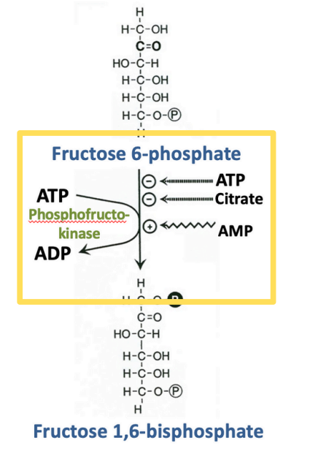
Anaerobic Metabolism
B) PFK is inhibited by high levels of citrate and ATP
Lots of enzymes involved in Glycolysis, TCA etc.
Only a few that you need to know more info about (related to inhibition/activation etc).
Think logically & break down into simpler ideas
PFK (& gluco/hexokinase) are the main enzymes that are actv./inhb. to regulate glycolysis
Notes:
Think logically & break down into simpler ideas:
What does PFK do? Step in glycolysis. What is glycolysis? Breaks down glucose into pyruvate to enter TCA cycle -> produces some ATP
If you have high energy/ATP levels, i.e. you’re well-fed, you will not need as much energy to be produced by glycolysis
Hence high citrate/ATP levels means glycolysis process doesn’t need to move forward
Hence inhibition

Slide 9
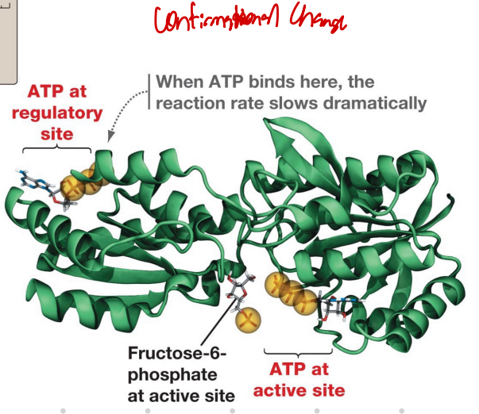
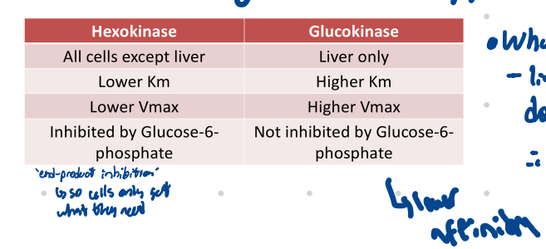
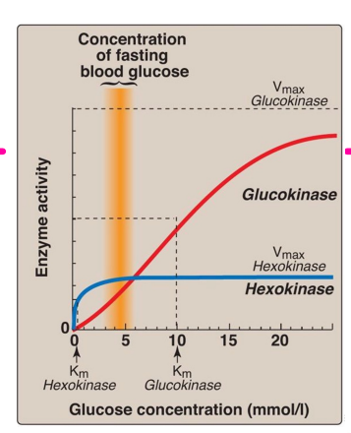
Anaerobic Metabolism
PFK is via allosteric control -> F-6-P enters active site, but 2 ATP binds to 1) active & 2) regulatory site
Notes:
Why are there different forms of this first enzyme?
- Different organs need & have different uses for glucose. Muscles obviously, brain, liver.
- Liver stores glucose as glycogen. Something which we’ll talk about in more detail later.
But liver also does glycolysis -> this breaks glucose down, for synthesis of other molecules e.g. fatty acid sysntehsis via Acetyl Co-A, maintain blood glucose conc.
So liver is doing all this, but in times where glucose levels in the body drop all that stuff in terms of fatty acid synthesis is less important – main thing is making sure other organs, more specifically the brain, has enough glucose to make ATP
Thus Glucokinase in the liver must have a higher Km -> need a higher concentration of glucose for it to be activated, in other words it’s only activated once you have an excess.
- Hexokinase is inhibited by product -> in other words, it stops once it’s broken down enough glucose into G6P.

Slide 10
Anaerobic Metabolism
Which of the following best describes the regulation of
glycolysis by phosphofructokinase (PFK)?
A) PFK is activated by ATP and inhibited by AMP
B) PFK is inhibited by high levels of citrate and ATP.
C) PFK is regulated only by substrate availability, not allosteric
effectors.
D) PFK activity is increased by high NADH levels and low citrate
levels.
E) PFK is activated by fructose-2,6-bisphosphate and AMP.
Notes:
incorrect- ATP inhibits PFK and AMP activates it-> the options arein reverse order
Correct
incorrect - PFK is regulated by allosteric effectors, rather than substrate availability alone
incorrect - NADH primarily affects oxidative phosphorylationrather than glycolysis
partially correct but incomplete - doesn't talk about the inhibitory effects of ATP and citrate

Slide 11
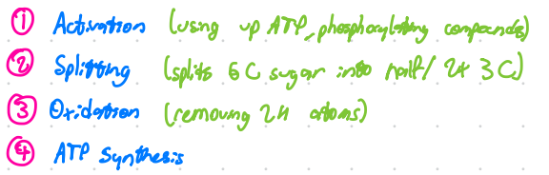
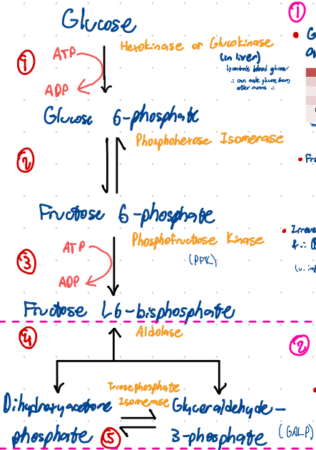
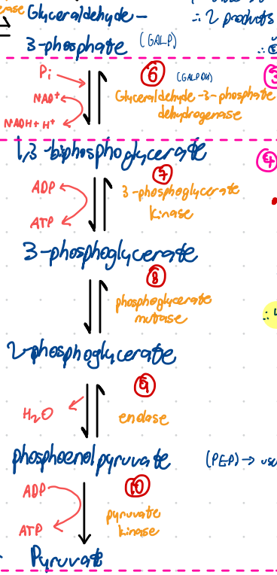
Anaerobic Metabolism
‘Isomerase’ -> changes from aldose (G6P) to ketose sugar (F6P)
‘Kinase’ -> adds phosphate to a molecule, using ATP
‘Dehydrogenase’
‘Mutase’ -> type of isomerase, moves functional group within the same molecule
Notes:
Note reversible vs irreversible steps

Slide 12



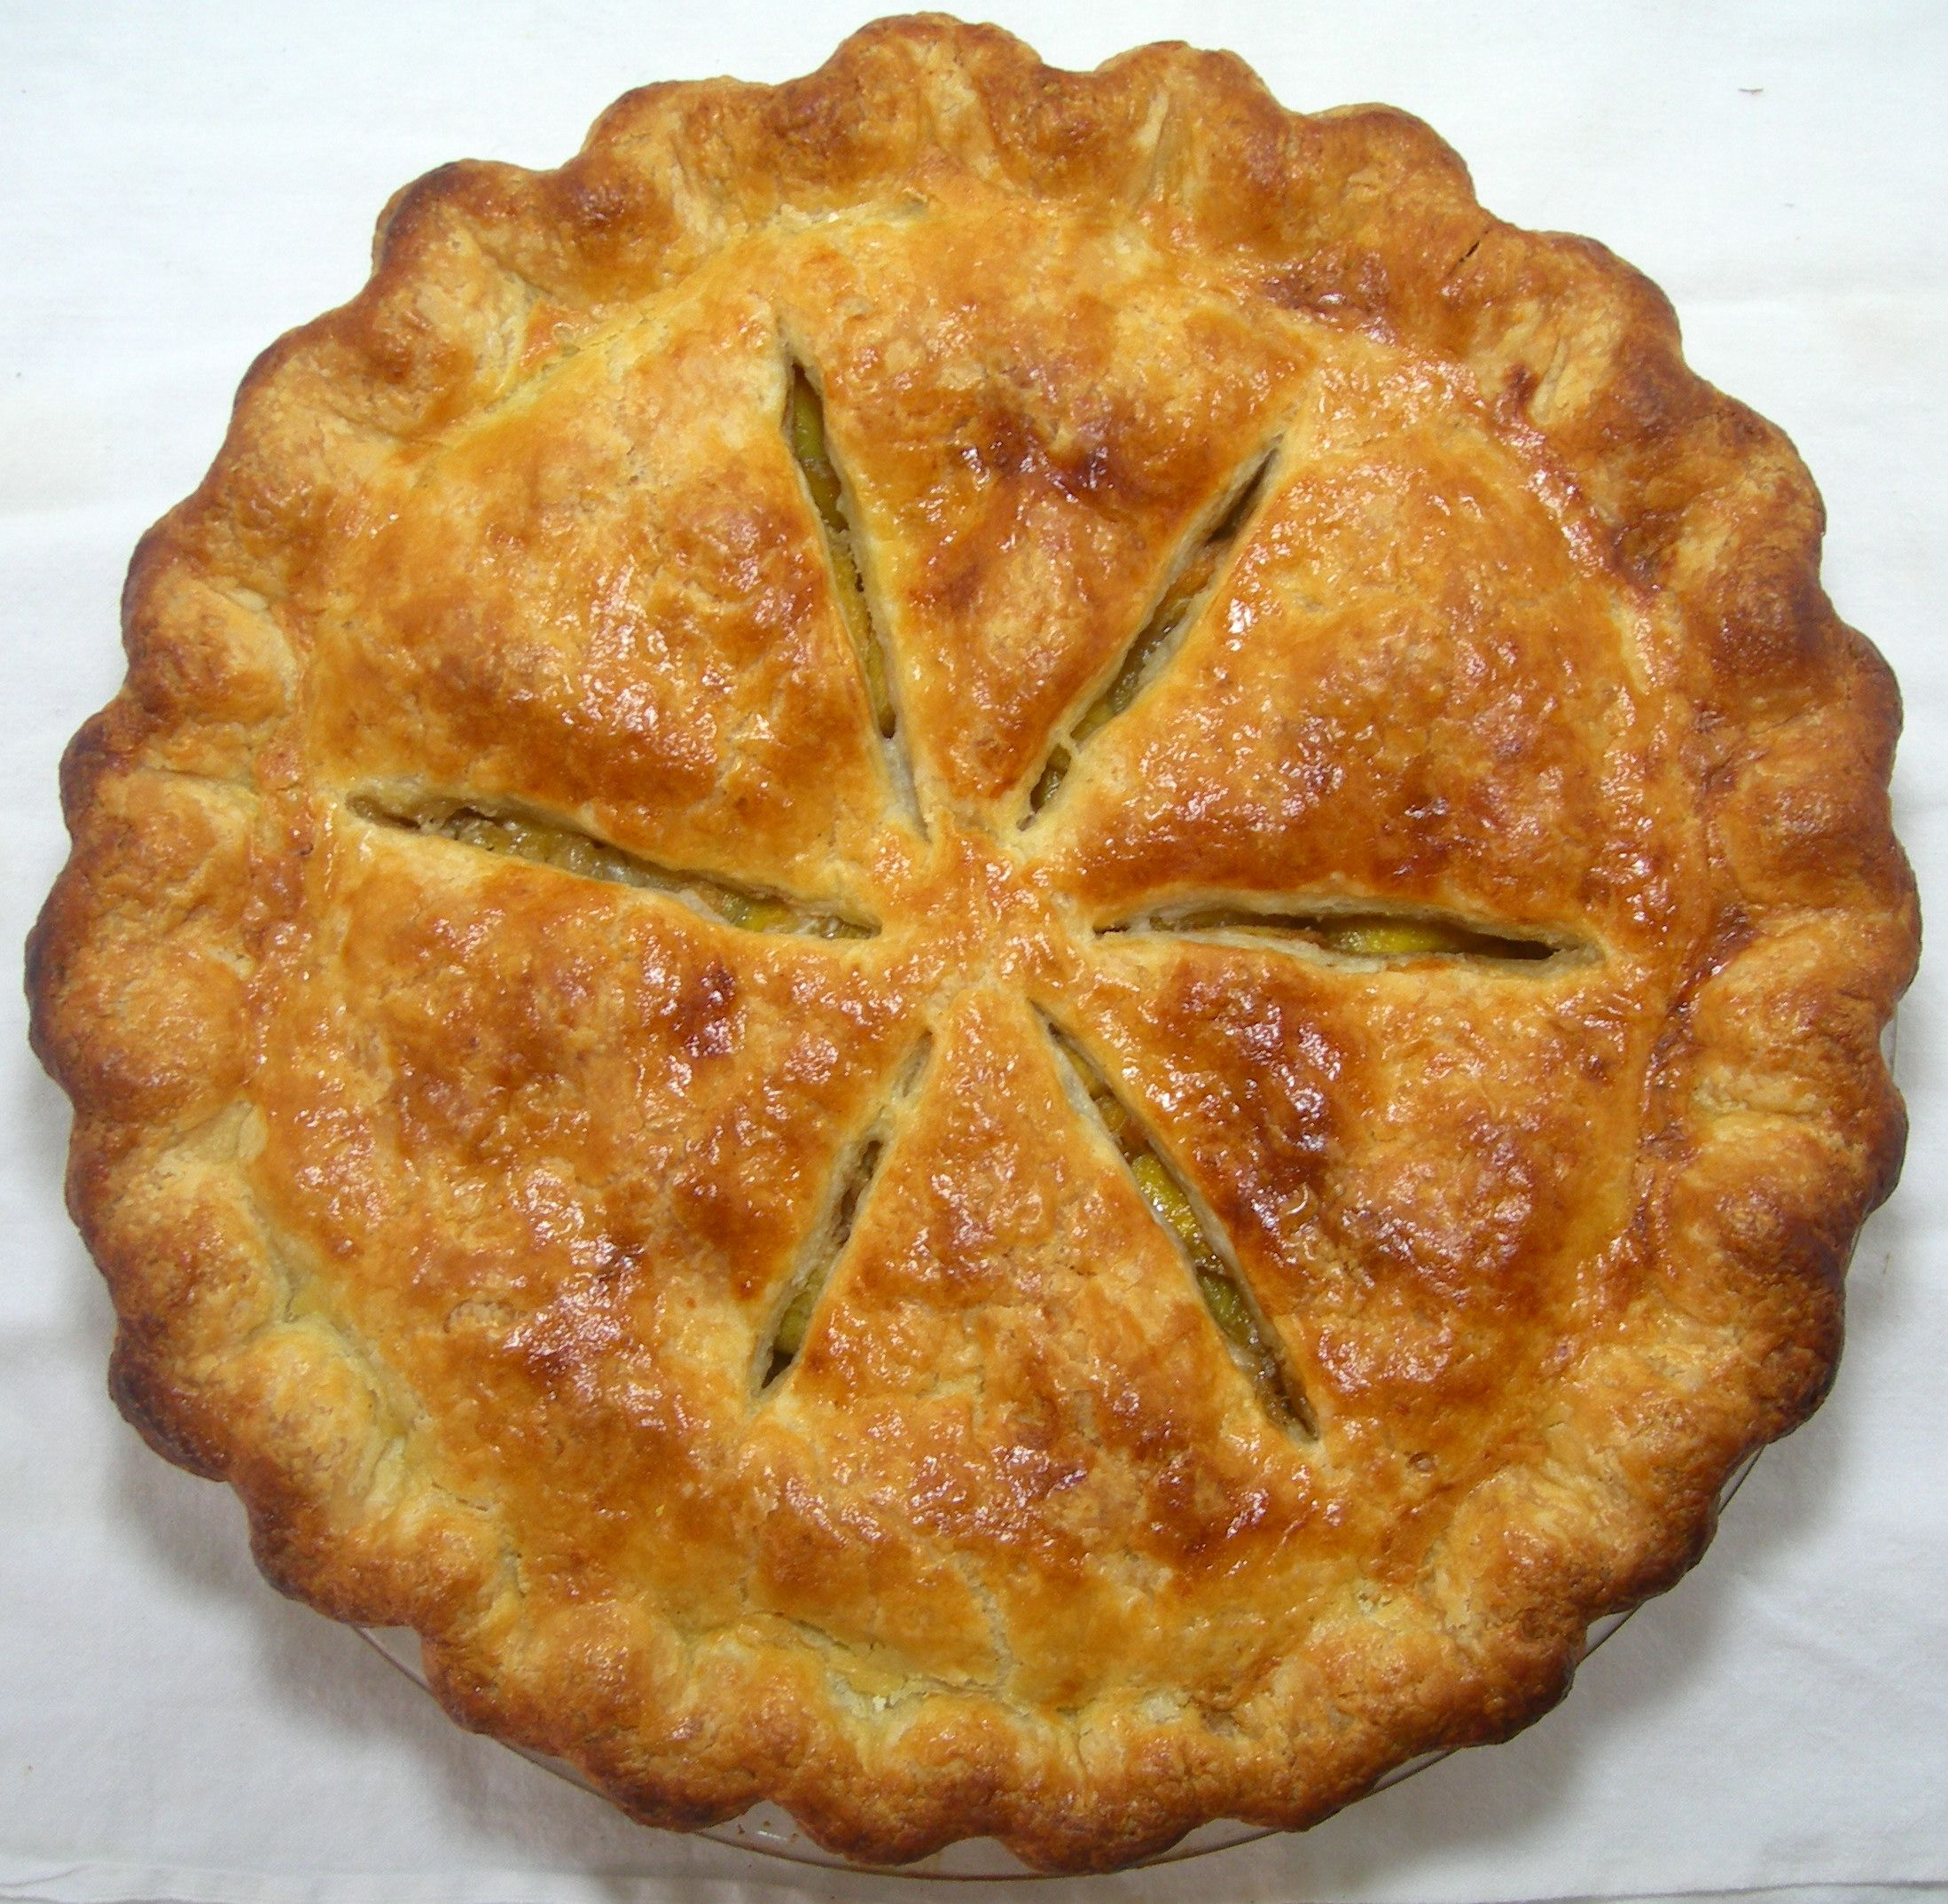
Anaerobic Metabolism

Slide 13
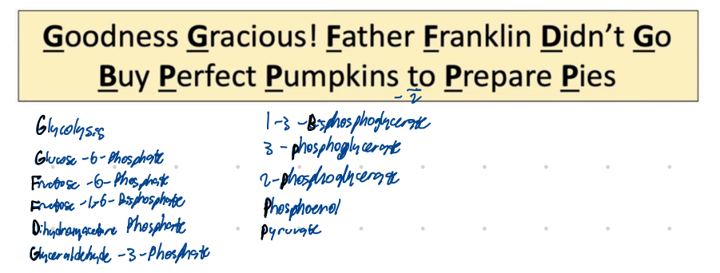
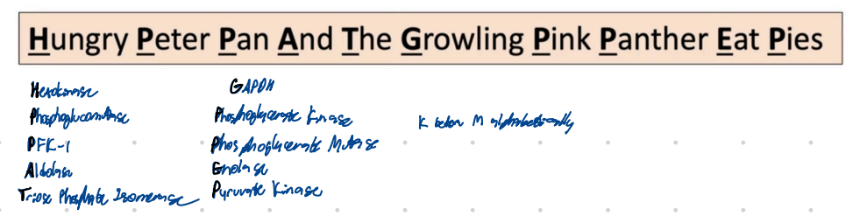
Anaerobic Metabolism

Slide 14
Aerobic Metabolism

Slide 15
Anaerobic Metabolism
Which of the following enzymes catalyzes a highly
exergonic and irreversible step in the citric acid cycle
A) Fumarase
B) Aconitase
C) Isocitrate Dehydrogenase
D) Succinyl-CoA Synthetase
E) Malate Dehydrogenase

Slide 16
Anaerobic Metabolism
Which of the following enzymes catalyzes a highly
exergonic and irreversible step in the citric acid cycle
A) Fumarase
B) Aconitase
C) Isocitrate Dehydrogenase
D) Succinyl-CoA Synthetase
E) Malate Dehydrogenase

Slide 17
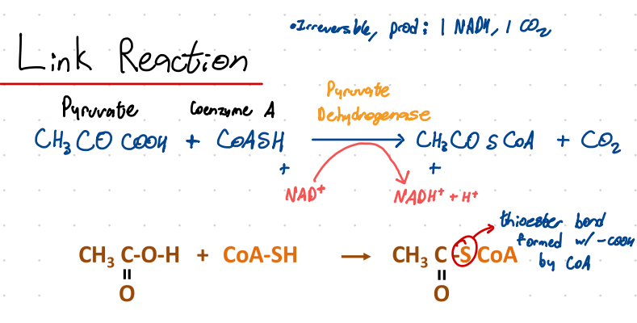
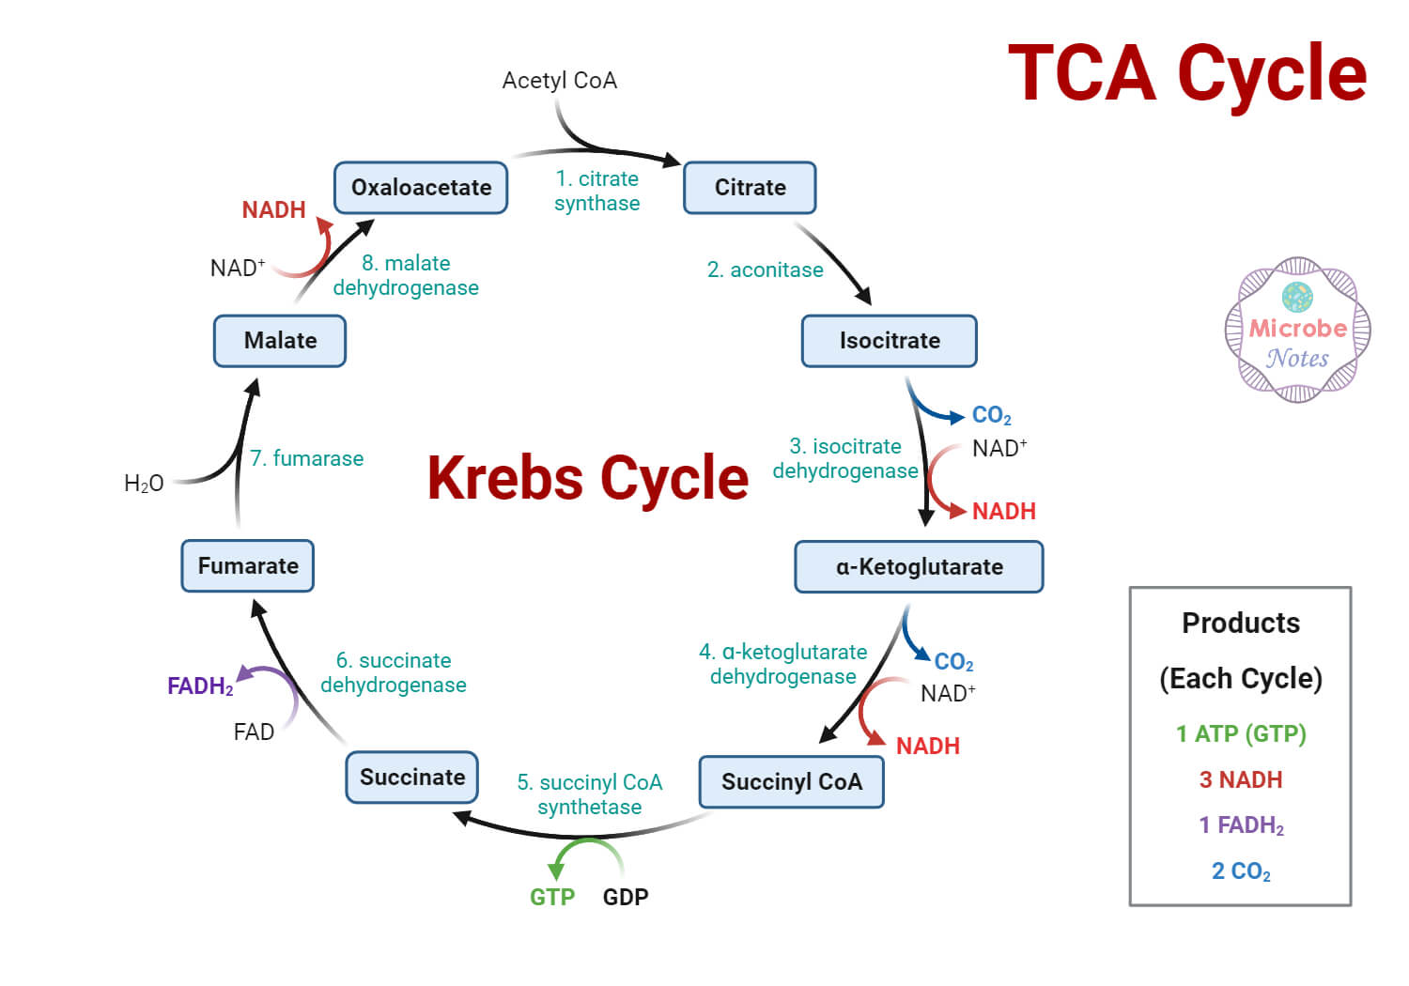

Anaerobic Metabolism
Which of the following enzymes catalyzes a highly
exergonic and irreversible step in the citric acid cycle
A) Fumarase
B) Aconitase
C) Isocitrate Dehydrogenase
D) Succinyl-CoA Synthetase
E) Malate Dehydrogenase
- Alpha KG step is rate-limiting step

Slide 18
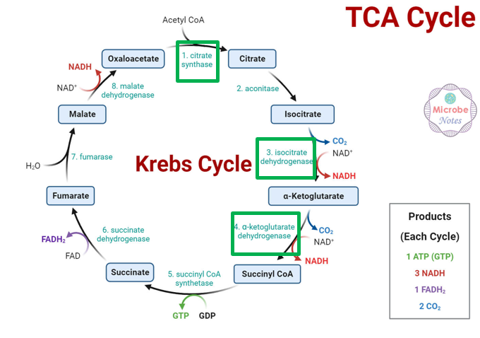

Anaerobic Metabolism
Can
I
Keep
Selling
Socks?
For
Money
Officer

Slide 19
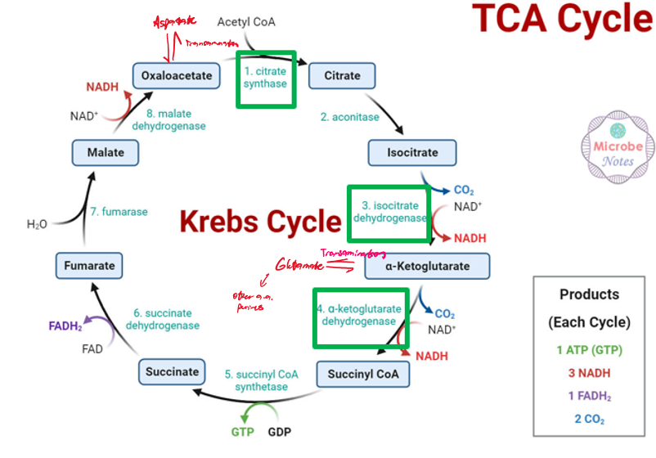
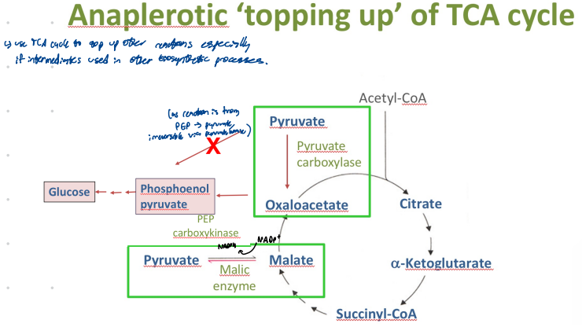
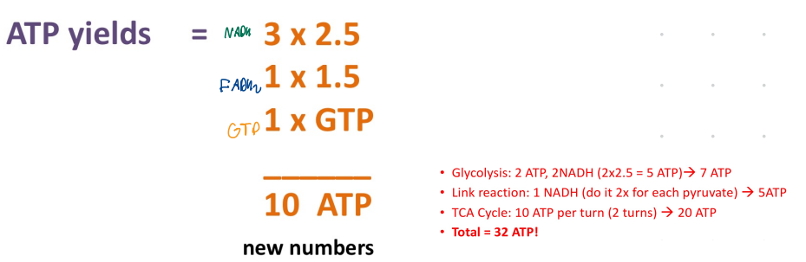
Anaerobic Metabolism

Slide 20
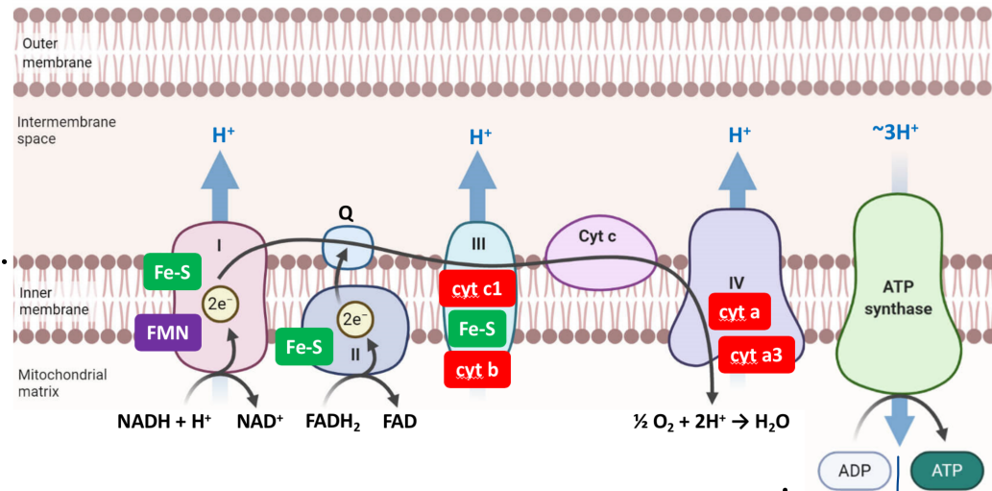
Anaerobic Metabolism

Slide 21
A 22-year-old man presents to A&E with hyperthermia (40.1°C), tachycardia, profuse sweating, and severe fatigue after taking an unregulated “weight-loss supplement” purchased online. Arterial blood gas shows a normal PaO₂ but elevated lactate.
Laboratory studies on a muscle biopsy sample show markedly increased oxygen consumption but very low ATP levels. The mitochondrial membrane potential is almost completely lost, although the electron transport chain complexes appear structurally intact.
Which of the following substances most likely explains this patient’s presentation?
A) Carbon Monoxide
B) Oligomycin
C) Rotenone
D) 2,4-Dinitrophenol
E) Cyanide

Slide 22
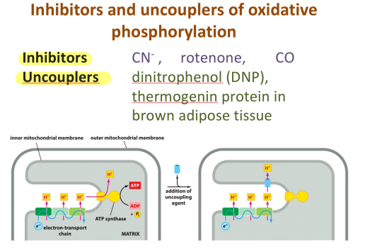
A 22-year-old man presents to A&E with hyperthermia (40.1°C), tachycardia, profuse sweating, and severe fatigue after taking an unregulated “weight-loss supplement” purchased online. Arterial blood gas shows a normal PaO₂ but elevated lactate.
Laboratory studies on a muscle biopsy sample show markedly increased oxygen consumption but very low ATP levels. The mitochondrial membrane potential is almost completely lost, although the electron transport chain complexes appear structurally intact.
Which of the following substances most likely explains this patient’s presentation?
A) Carbon Monoxide
B) Oligomycin
C) Rotenone
D) 2,4-Dinitrophenol
E) Cyanide
Notes:
DNP is an uncoupler of oxidative phosphorylation.
i.e. H+ ions can leak back across the membrane, proton gradient decreases. Thus ATP synthatse cannot produce ATP (it needs the gradient to drive movement of H+ across the membrane, which produces O2 in the process)
Punches hole I n the system
Therefore ETC senses a ‘low’ gradient, tries pumping more H+ out, so H2 consumption increases
It collapses the proton gradient, so the ETC speeds up (↑ O₂ use) but ATP cannot be produced.
The energy is released as heat, explaining the hyperthermia.
This mechanism is directly taught in your slides (uncouplers: DNP, thermogenin in brown fat).
Cyanide, rotenone, CO → inhibit the ETC → ↓ oxygen consumption, not ↑.
Oligomycin → blocks ATP synthase → ETC slows → no collapse of the proton gradient.

Slide 23
Anaerobic Metabolism
What is a major metabolic function of mitochondria?
A) Conversion of pyruvate to lactate
B) Generation of oxygen
C) Oxidation of glucose
D) Oxidation of NADH & FADH2
E) Synthesis of NADH
A) Conversion of pyruvate to lactate
B) Generation of oxygen
C) Oxidation of glucose
D) Oxidation of NADH & FADH2
E) Synthesis of NADH

Slide 24
Anaerobic Metabolism
What is a major metabolic function of mitochondria?
A) Conversion of pyruvate to lactate
B) Generation of oxygen
C) Oxidation of glucose
D) Oxidation of NADH & FADH2
E) Synthesis of NADH

Slide 25
Fat as Fuel

Slide 26
Fat as Fuel
Which of the following is NOT a primary function of lipids in the human body?
A) Energy storage in the form of triglycerides.
B) Providing structural components for cell membranes.
C) Serving as cofactors for enzymatic reactions.
D) Acting as the main source of immediate cellular energy.
E) Functioning as precursors for hormone synthesis.

Slide 27
Fat as Fuel
Which of the following is NOT a primary function of lipids in the human body?
A) Energy storage in the form of triglycerides.
B) Providing structural components for cell membranes.
C) Serving as cofactors for enzymatic reactions.
D) Acting as the main source of immediate cellular energy.
E) Functioning as precursors for hormone synthesis.

Slide 28
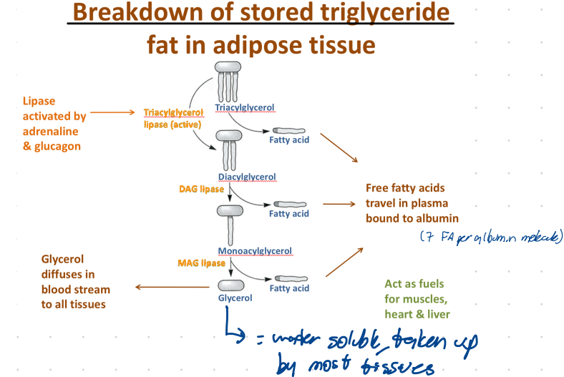
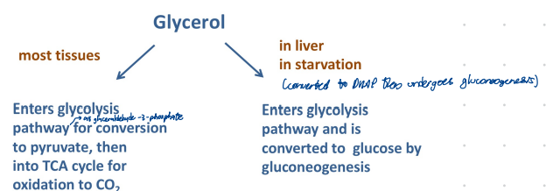
Fat as Fuel

Slide 29
A 4-year-old boy presents with recurrent episodes of hypoketotic hypoglycaemia during mild fasting. Blood tests show elevated long-chain fatty acids, and a muscle biopsy reveals markedly reduced levels of carnitine. Which of the following steps in fatty acid metabolism is most impaired?
A) Activation of fatty acids to fatty acyl-CoA
B) Transport of fatty acyl-carnitine across the inner mitochondrial membrane
C) Transport of the fatty acid across the outer mitochondrial membrane
D) β-oxidation in the mitochondrial matrix
E) Conversion of acetyl-CoA to ketone bodies

Slide 30
A 4-year-old boy presents with recurrent episodes of hypoketotic hypoglycaemia during mild fasting. Blood tests show elevated long-chain fatty acids, and a muscle biopsy reveals markedly reduced levels of carnitine. Which of the following steps in fatty acid metabolism is most impaired?
A) Activation of fatty acids to fatty acyl-CoA
B) Transport of fatty acyl-carnitine across the inner mitochondrial membrane
C) Transport of the fatty acid across the outer mitochondrial membrane
D) β-oxidation in the mitochondrial matrix
E) Conversion of acetyl-CoA to ketone bodies

Slide 31

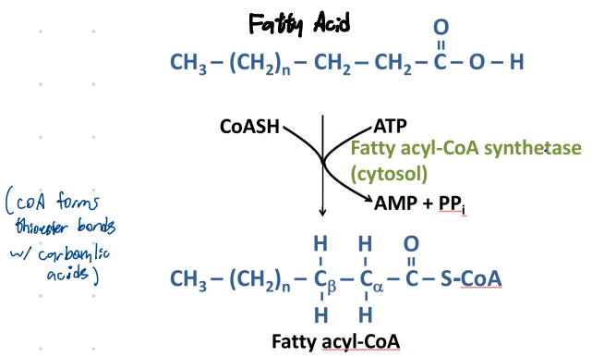
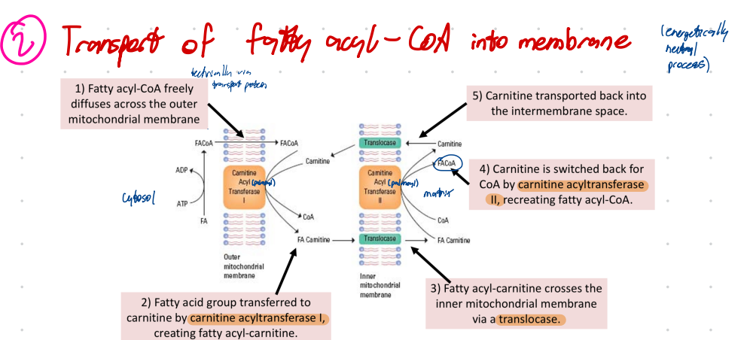
A 4-year-old boy presents with recurrent episodes of hypoketotic hypoglycaemia during mild fasting. Blood tests show elevated long-chain fatty acids, and a muscle biopsy reveals markedly reduced levels of carnitine. Which of the following steps in fatty acid metabolism is most impaired?
A) Activation of fatty acids to fatty acyl-CoA
B) Transport of fatty acyl-carnitine across the inner mitochondrial membrane
C) Transport of the fatty acid across the outer mitochondrial membrane
D) β-oxidation in the mitochondrial matrix
E) Conversion of acetyl-CoA to ketone bodies

Slide 32
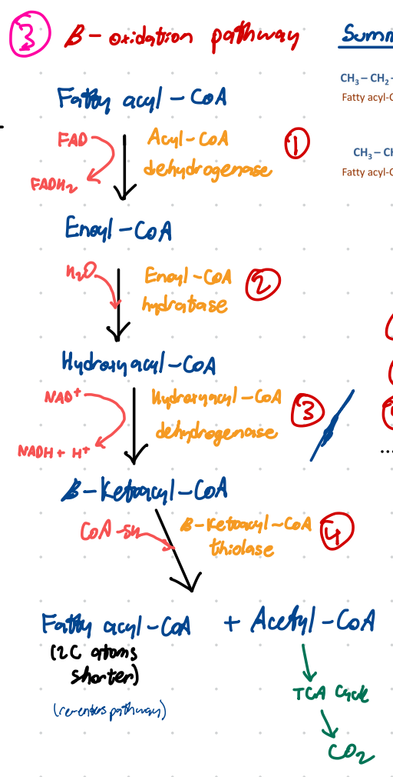

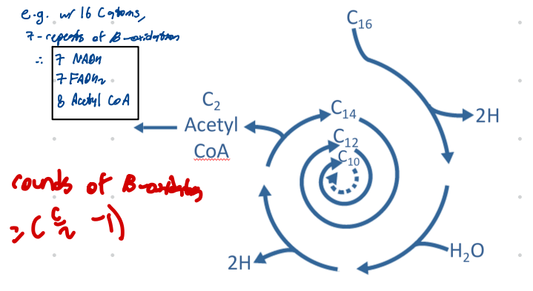
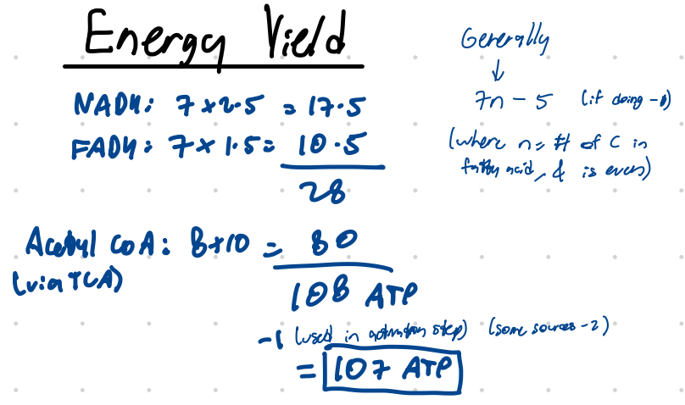
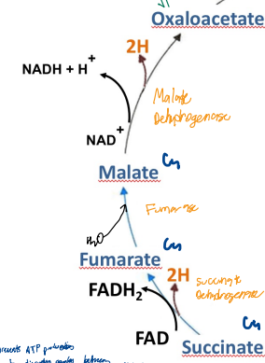
Same 3 steps as the end of TCA Cycle!!!
Notes:
No mnemonic – but this one is more intuitive
Enol -> to do with water
Thiolase – to do with sulfate.

Slide 33
Fat as Fuel
During the beta-oxidation of odd-numbered fatty acids, which of the following correctly describes the process or its outcomes?
A) The final cleavage step yields one molecule of acetyl-CoA and one molecule of succinyl-CoA.
B) Propionyl-CoA, a three-carbon molecule, is converted to methylmalonyl-CoA, which then enters the TCA cycle directly.
C) The beta-oxidation of odd-numbered fatty acids results exclusively in acetyl-CoA molecules.
D) Beta-oxidation of odd-numbered fatty acids does not contribute to gluconeogenesis.
E) Propionyl-CoA is converted to succinyl-CoA

Slide 34
Fat as Fuel
During the beta-oxidation of odd-numbered fatty acids, which of the following correctly describes the process or its outcomes?
A) The final cleavage step yields one molecule of acetyl-CoA and one molecule of succinyl-CoA.
B) Propionyl-CoA, a three-carbon molecule, is converted to methylmalonyl-CoA, which then enters the TCA cycle directly.
C) The beta-oxidation of odd-numbered fatty acids results exclusively in acetyl-CoA molecules.
D) Beta-oxidation of odd-numbered fatty acids does not contribute to gluconeogenesis.
E) Propionyl-CoA is converted to succinyl-CoA

Slide 35
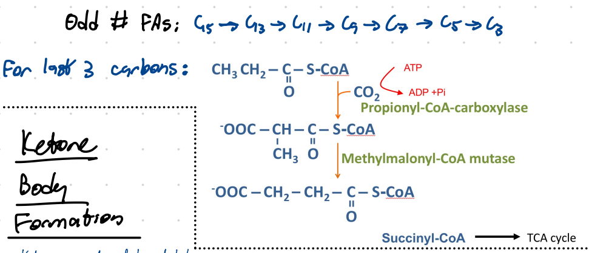

E) Propionyl-CoA is converted to succinyl-CoA

Slide 36
Fat as Fuel
A 19-year-old woman with untreated type 1 diabetes presents with Kussmaul breathing and fruity-smelling breath. Which of the following explains why acetoacetate is overproduced in this state?
A) Increased glycolysis in the liver
B) Excess acetyl-CoA from fatty acid oxidation exceeding TCA cycle capacity
C) Reduced β-oxidation of fatty acids
D) Liver using ketone bodies as fuel
E) Lack of oxaloacetate due to increased fatty acid synthesis

Slide 37
Fat as Fuel
A 19-year-old woman with untreated type 1 diabetes presents with Kussmaul breathing and fruity-smelling breath. Which of the following explains why acetoacetate is overproduced in this state?
A) Increased glycolysis in the liver
B) Excess acetyl-CoA from fatty acid oxidation exceeding TCA cycle capacity
C) Reduced β-oxidation of fatty acids
D) Liver using ketone bodies as fuel
E) Lack of oxaloacetate due to increased fatty acid synthesis

Slide 38
Fat as Fuel
A 19-year-old woman with untreated type 1 diabetes presents with Kussmaul breathing and fruity-smelling breath. Which of the following explains why acetoacetate is overproduced in this state?
Acetoacetate, β-hydroxybutyrate = KETONE BODIES
T1 diabetes, insulin is absent therefore ‘starvation’ mode
Liver behaves as if no glucose available, thus fat used as main fuel, thus beta oxidation
Produces lots of acetyl-CoA, cannot all be handled by TCA cycle (needs OAA to combine with acetyl-CoA, thus OAA is limiting factor)
    During ‘starvation’ periods gluconeogenesis converts OAA back to glucose, contributes to shortage
Excess acetyl-CoA is converted to ketone bodies by the liver
A) Increased glycolysis in the liver
B) Excess acetyl-CoA from fatty acid oxidation exceeding TCA cycle capacity
C) Reduced β-oxidation of fatty acids
D) Liver using ketone bodies as fuel
E) Lack of oxaloacetate due to increased fatty acid synthesis
NOTES
Liver cannot utilise ketone bodies
Brain cannot utilise fatty acids via beta oxidation
RBCs cannot utilise either
Notes:
Increased glycolysis in liver?? Wrong – gluconeogenesis is high, glycolysis suppressed
C) B oxidation is INCREASED
D) Livers cannot use ketone bodies as fuel
E) Lack of OAA is not due to fatty acid synthesis. Need insulin for that.

Slide 39
Amino Acid Metabolism

Slide 40
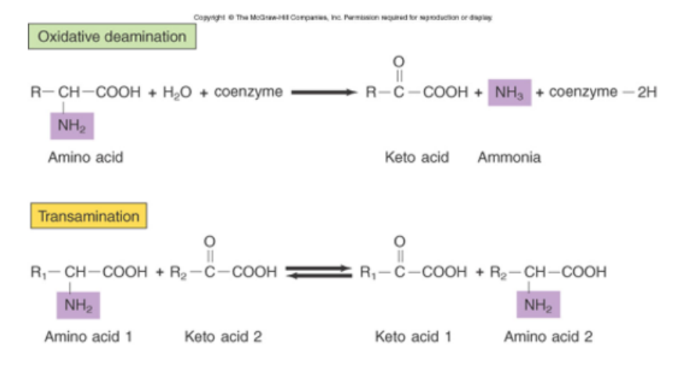


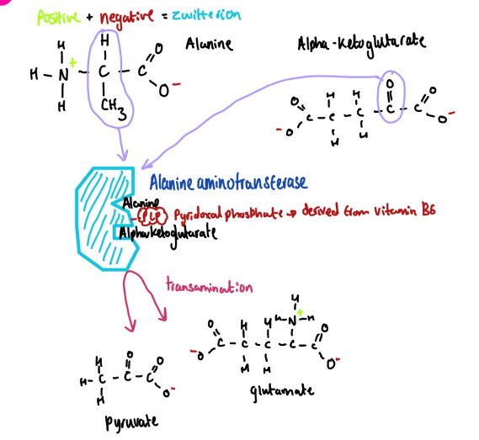
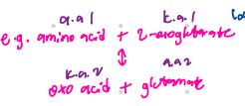

AA Metabolism
Oxidative Deamination = FOR GLUTAMATE
Ali Khan, MBBS Year 2
Notes:
Oxidative deamination (only works for glutamate)
Forms a.a. of original keyo acid
There transamination can be used to synthesise a.a. of the keto acid you have, more importantly can be used to synthesise glutamate
Essentially what it allows it to dois collect amine groups from other amino acids when those artte in excess. Then (via gluatamate) is able to bring that for deamination.
Mostly occurs in muscle
Importantly for oxidative deamination -> you’re losing those ammonia ions

Slide 41
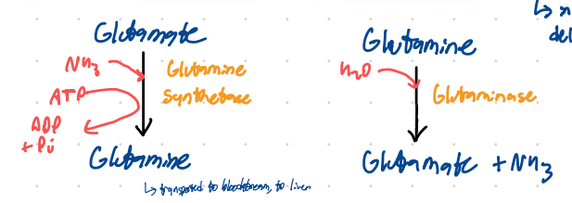
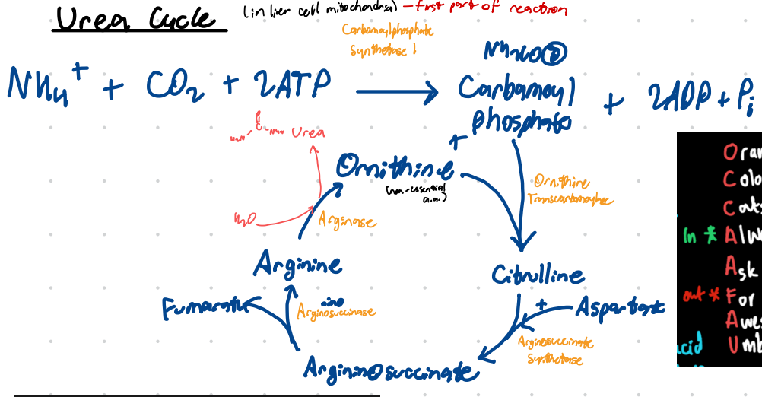

AA Metabolism
Amino groups/NH2 (taken from the amino acids via deamination) cannot just be carried in the bloodstream.
This must be done via glutamine, converted back to glutamate in liver

Slide 42
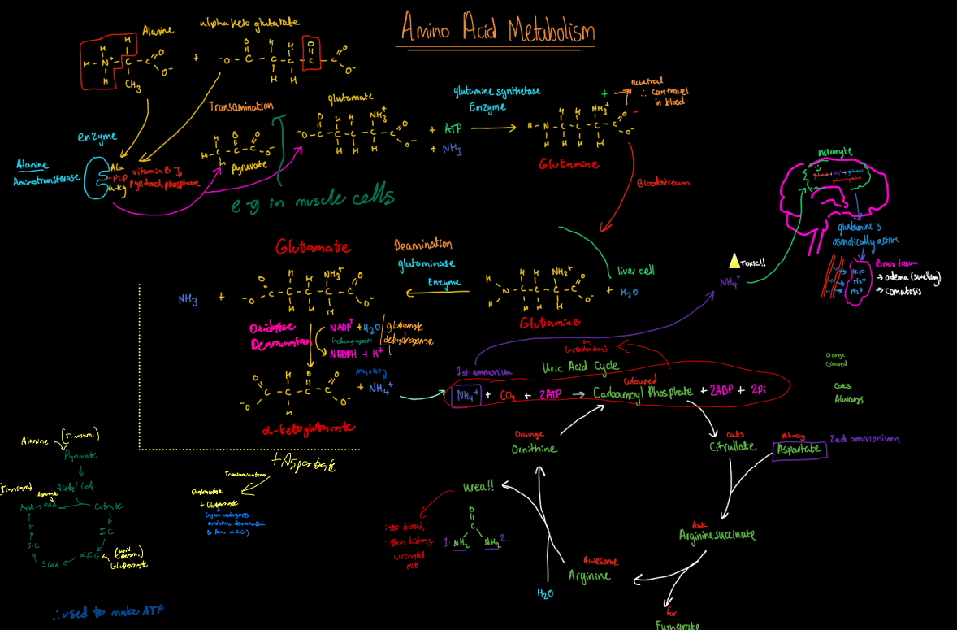
AA Metabolism
Amino groups/NH2 (taken from the amino acids via deamination) cannot just be carried in the bloodstream.
This must be done via glutamine, converted back to glutamate in liver

Slide 43
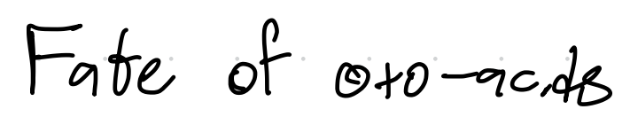
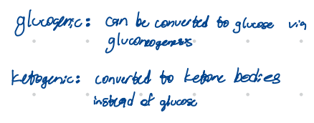
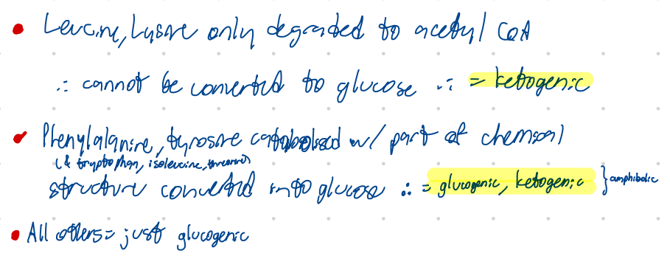
AA Metabolism

Slide 44
AA Metabolism
Alanine transfers its amino group to α-ketoglutarate. What is the product of this transamination?
A) Pyruvate
B) Ornithine
C) Citrulline
D) Glutamate
E) Succinyl-CoA

Slide 45
AA Metabolism
Alanine transfers its amino group to α-ketoglutarate. What is the product of this transamination?
A) Pyruvate
B) Ornithine
C) Citrulline
D) Glutamate
E) Succinyl-CoA

Slide 46
AA Metabolism
A 67-year-old male is admitted to the emergency department with severe confusion,
lethargy, and vomiting. Dr Ali takes a history of the patient, and his family reports
that he has a history of liver cirrhosis due to chronic alcoholism. Blood tests reveal
elevated levels of ammonia. The patient’s symptoms are most likely a result of:
a. Decreased degradation of protein in muscle
b. Lowered intake of essential amino acids in diet
c. Vitamin B6 deficiency
d. Late-onset carbamoyl phosphate synthetase 1 deficiency
e. Increased intake of aspartate in diet

Slide 47
AA Metabolism
A 67-year-old male is admitted to the emergency department with severe confusion,
lethargy, and vomiting. Dr Ali takes a history of the patient, and his family reports
that he has a history of liver cirrhosis due to chronic alcoholism. Blood tests reveal
elevated levels of ammonia. The patient’s symptoms are most likely a result of:
a. Decreased degradation of protein in muscle
b. Lowered intake of essential amino acids in diet
c. Vitamin B6 deficiency
d. Late-onset carbamoyl phosphate synthetase 1 deficiency
e. Increased intake of aspartate in diet

Slide 48
AA Metabolism
A 67-year-old male is admitted to the emergency department with severe confusion,
lethargy, and vomiting. Dr Ali takes a history of the patient, and his family reports
that he has a history of liver cirrhosis due to chronic alcoholism. Blood tests reveal
elevated levels of ammonia. The patient’s symptoms are most likely a result of:
a. Decreased degradation of protein in muscle
b. Lowered intake of essential amino acids in diet
c. Vitamin B6 deficiency
d. Late-onset carbamoyl phosphate synthetase 1 deficiency
e. Increased intake of aspartate in diet

Slide 49
AA Metabolism
A 31-year-old male is admitted to the emergency department with severe confusion,
lethargy, and vomiting. Dr Ali takes a history of the patient, and his family reports
that he has a history of liver cirrhosis due to chronic alcoholism. Blood tests reveal
elevated levels of ammonia. The patient’s symptoms are most likely a result of:
Decreased degradation of protein in muscle
  This would decrease ammonia production
b. Lowered intake of essential amino acids in diet
Less amino acids in diet = less deamination = decreased ammonia
c. Vitamin B6 deficiency
Needed for transamination. Deficiency = less transam, potentially less glutamate formed, thus less deam, = decreased ammonia
d. Late-onset carbamoyl phosphate synthetase 1 deficiency
e. Increased intake of aspartate in diet
Aspartate would drive urea cycle forward, thus in theory decreasing ammonia

Slide 50
AA Metabolism
A 31-year-old male is admitted to the emergency department with severe confusion,
lethargy, and vomiting. Dr Ali takes a history of the patient, and his family reports
that he has a history of liver cirrhosis due to chronic alcoholism. Blood tests reveal
elevated levels of ammonia. The patient’s symptoms are most likely a result of:

Slide 51
Glycogen Synthesis & Regulation

Slide 52
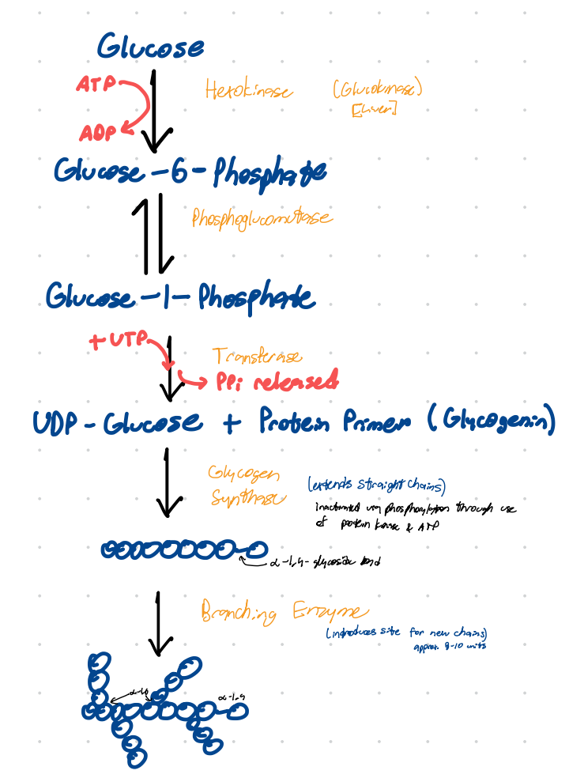
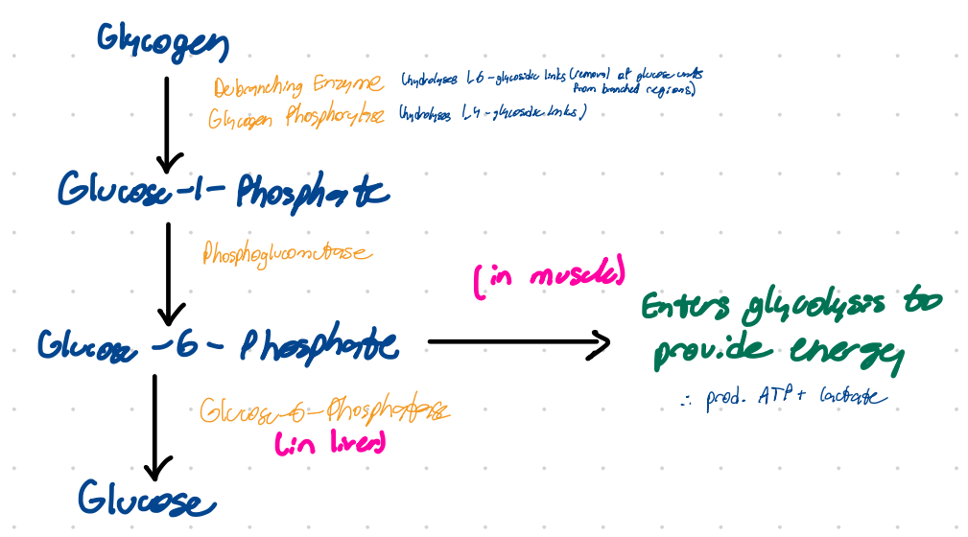
Glycogen Synthesis & Regulation

Slide 53
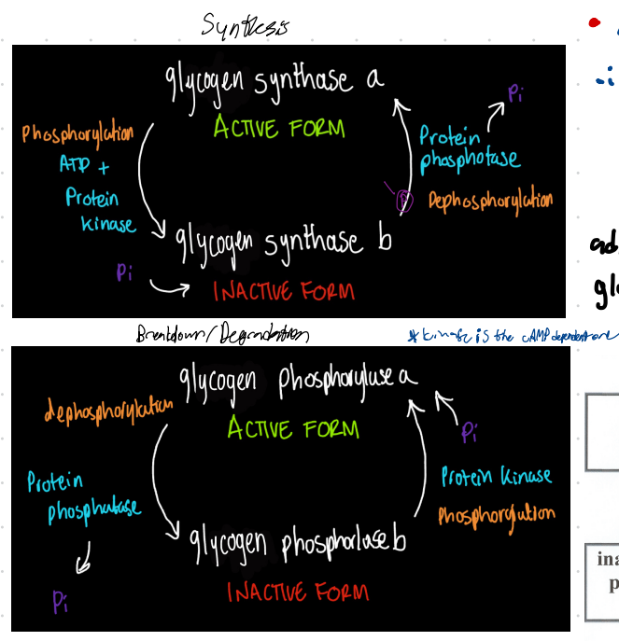


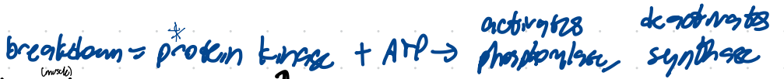
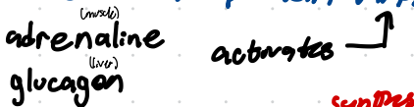
Glycogen Synthesis & Regulation
FED
FASTING
Notes:
KINASE PHOSPHORYLATES
Phosphatase does the opposite

Slide 54
Liver & Gluconeogenesis

Slide 55
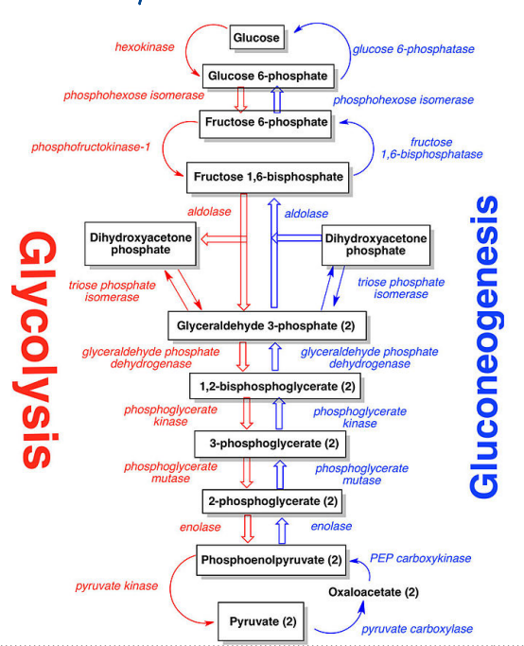
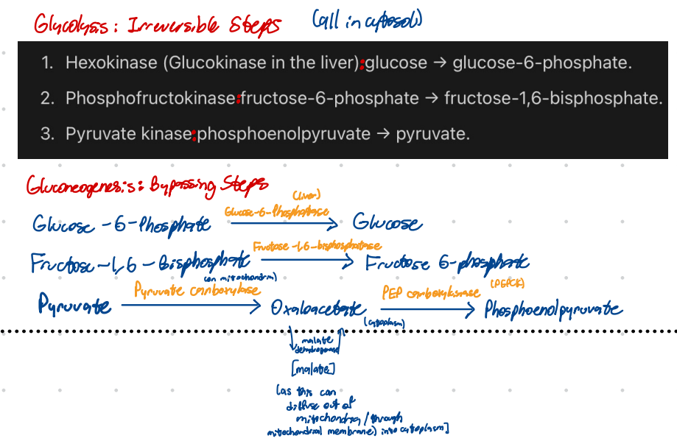
Liver & Gluconeogenesis

Slide 56
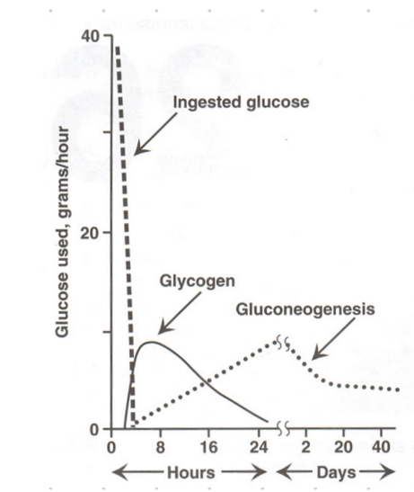
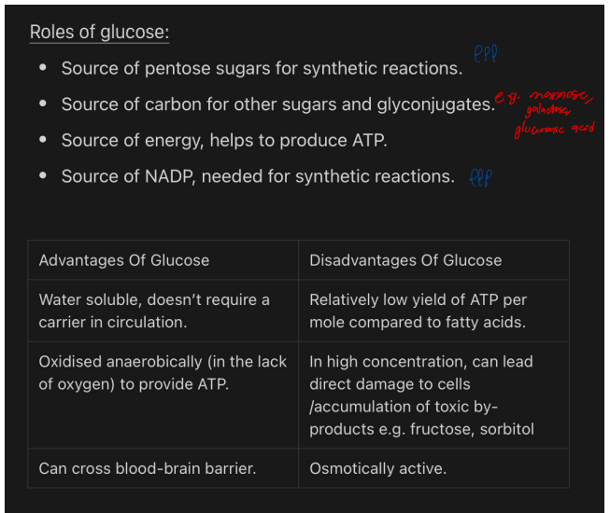
Liver & Gluconeogenesis

Slide 57
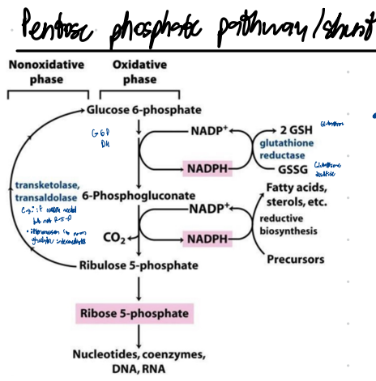
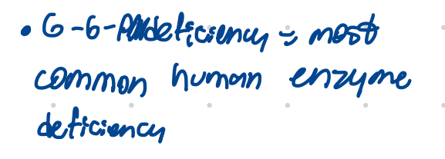
Liver & Gluconeogenesis

Slide 58
Liver & Gluconeogenesis

Slide 59
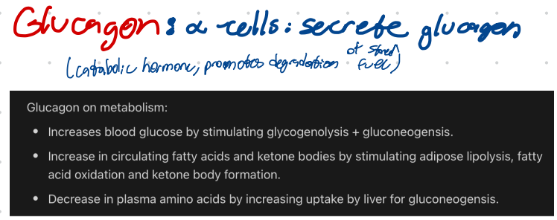
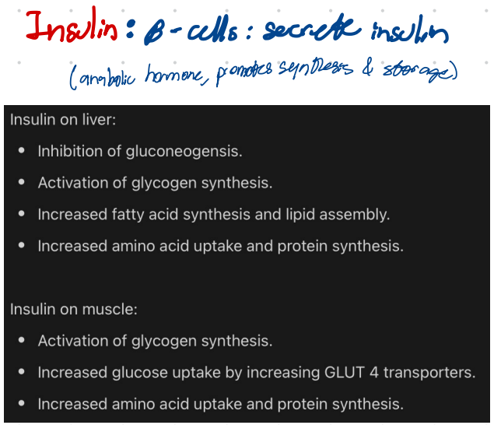
Liver & Gluconeogenesis

Slide 60
Liver & Gluconeogenesis
Which enzyme pair allows the liver to bypass the irreversible pyruvate kinase step during gluconeogenesis?
A. Hexokinase & phosphatase
B. Pyruvate dehydrogenase & citrate synthase
C. Pyruvate carboxylase & PEP carboxykinase
D. Glucose-6-phosphatase & fructose-1,6-bisphosphatase
E. Lactate dehydrogenase & malate dehydrogenase

Slide 61

Liver & Gluconeogenesis
Which enzyme pair allows the liver to bypass the irreversible pyruvate kinase step during gluconeogenesis?
A. Hexokinase & phosphatase
B. Pyruvate dehydrogenase & citrate synthase
C. Pyruvate carboxylase & PEP carboxykinase
D. Glucose-6-phosphatase & fructose-1,6-bisphosphatase
E. Lactate dehydrogenase & malate dehydrogenase

Slide 62
SBAs

Slide 63
Fat as Fuel
Which of the following hormones most strongly stimulates triglyceride breakdown in adipose tissue?
A) Insulin
B) Cortisol
C) Aldosterone
D) Adrenaline
E) Thyroxine

Slide 64
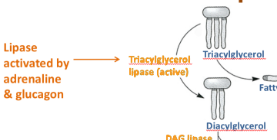
Fat as Fuel
Which of the following hormones most strongly stimulates triglyceride breakdown in adipose tissue?
A) Insulin
B) Cortisol
C) Aldosterone
D) Adrenaline
E) Thyroxine
Notes:
Why?
Think about basic ideas again
Adrenaline released during exercise, fight-or-flight, stress, acute danger, rapid metabolic demand.
Activates hormone sensitive lipases

Slide 65
Feedback
*INSERT QR CODE*
Thank you! 🔥🫡
Questions?
Contact:
ali.khan@kcl.ac.uk
- Feel free to reach out if you have any Qs/need advice!

