Slide 1







GKTeach
FPP
STAGE 1
PAS RECAP
YEAR 1 MBBS
14/04/2026
Amy Zhang (Yr3)
Notes:
-ANS: a pharmacological perspective
-Pharmacology of the sympathetic nervous system

Slide 2

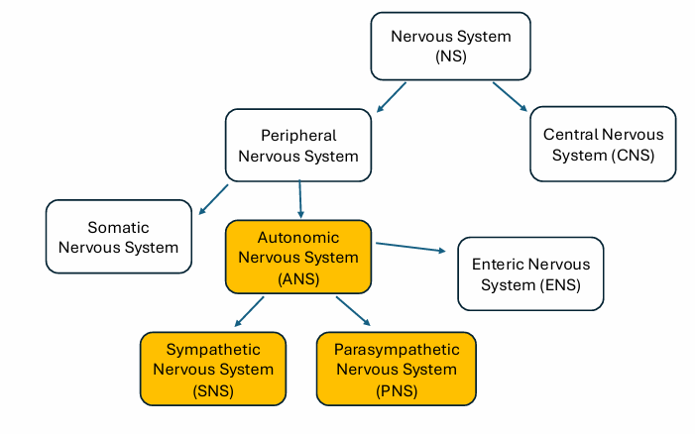
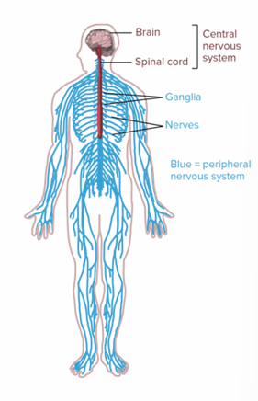
The Nervous System
Notes:
CNS= brain + spinal chord
Somatic- voluntary→ skeletal muscle
Autonomic- involuntary→ smooth muscle (visceral organs + blood vessels) + cardiac muscle (heart)
The autonomic NS: sympathetic vs parasympathetic, what is the enteric NS?
Autonomic: sympathetic, parasympathetic + enteric too
Sympathetic = fight / flight, Parasympathetic = rest + digest
Enteric (not today’s focus) = specifically innervates the GI tract, acts by itself but also influenced by sympathetic + parasympathetic

Slide 3
2 Major Subdivisions of the NS
Central Nervous System
  Brain and spinal cord
  Receives sensory info → integrates → generates motor activity
  Controls consciousness and perception
Peripheral Nervous System
  All nerves and ganglia (collection of nerve cell bodies) outside brain and spinal cord
  Carries sensory info to CNS from periphery via AFFERENT NERVES
  Carries motor info from CNS to periphery via EFFERENT NERVES
Notes:
Note: This is a superficial classification; motor neuron cell bodies may reside in the CNS but their axons are in the PNS.

Slide 4
The Peripheral Nervous System
Consists of the somatic and autonomic nervous system
Somatic
      Movement and control of muscles
  Connects with the skin
Autonomic
  Unconscious activities
  Conveys signals from the CNS to the rest of the body (except for somatic motor innervation of skeletal muscle)
Notes:
The peripheral nervous system can be further subdivided into the somatic and autonomic nervous system.
It is named the peripheral nervous system because the neuronal tissue (cell bodies and axons) are outside of the brain and spinal cord (i.e., the CNS). However, it is important to understand that the peripheral nervous system is not isolated from the CNS. It relays information to the CNS from the rest of the body and vice versa.
The somatic nervous system is also sometimes referred to the voluntary system. This is because is links the brain and the spinal cord to skeletal muscles throughout the body that are under conscious control, as well as to sensory receptors in the skin (somatosensory).

Slide 5
Autonomic Nervous System (overview)
Outside CNS but cannot function without it
Involuntary control, autonomic functions such as cardiac function (heartbeat), respiration, digestion, vascular regulation.
Maintains homeostasis (a stable cellular environment) by directly or indirectly (e.g. through controlling the blood supply) facilitating the response of virtually every organ system to changing external and internal demands

Slide 6
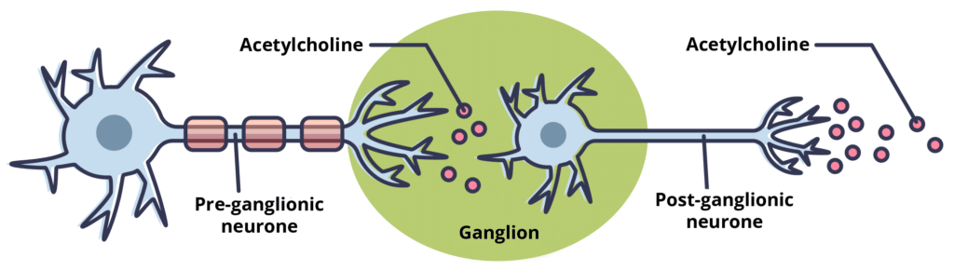
Parasympathetic Nervous System
"Rest and digest"
Primary neurotransmitter (NT) = Acetylcholine (ACh)
  -Pre- and post-ganglionic
Pathway: Long (nicotinic) -> short (muscarinic)
Key nerves:
  CN III, VII, IX, X
  Vagus
  Pelvic Splanchnic
Functions:
  Miosis
  Decrease HR
  Promote digestion
  Promote urination
Notes:
The parasympathetic nervous system is the branch of the autonomic nervous system that is responsible for "rest and digest". Essentially, what this means is that it is responsible for the body's internal functions when you are sitting resting and relaxing, and there is a absence of stress or danger.
Each parasympathetic pathway consists of 2 neurons: the pre-ganglionic and post-ganglionic neuron, both of which utilise the neurotransmitter acetylcholine. Hence, the parasympathetic nervous system can sometimes be referred to as the cholinergic system.
Pathway: the ganglionic body in the PNS is located close to the target tissue/organ, hence this pathway can be described as long followed by short. In the PNS, there are long pre-ganglionic fibres that synapse in the ganglion close to target organs. The post-ganglionic fibres are therefore short and synapse on the target tissue itself.
Myosis/miosis = pupil constriction

Slide 7
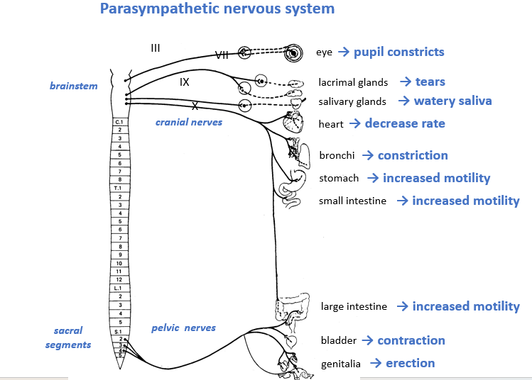
Notes:
Parasympathetic fibers are sent to various viscera to ensure different involuntary functions. In general, it is evident that the cranial outflow provides parasympathetic innervation to the head, and the sacral outflow provides the parasympathetic innervations of the pelvic viscera. However, an estimated 75% of all parasympathetic outflow in the whole body comes from the vagus nerve, that supplies the thoracic and abdominal viscera.
The parasympathetic innervation carried through the oculomotor nerve results in two events in the eye:
The contraction of the sphincter pupillae muscle, which leads to the constriction of the pupil (myosis).
The contraction of the ciliary muscle that results in loosening the zonular fibers of the lens, allowing the lens to shrink and increase its convexity. This process leads to increasing the refractive power of the lens in order to maintain a clear image and focus on a near object, and is a part of the accommodation of the eye.
Parasympathetic innervation carried through the facial and glossopharyngeal nerves stimulates the secretion of the submandibular, sublingual and parotid glands. The final result is increased salivation, which promotes digestion.
The parasympathetic outflow through the vagus nerve has a more direct effect on digestion, increasing the release of digestive juices and enzymes from the stomach, pancreas and gallbladder as well as increasing the peristalsis of the gastrointestinal tract.
The parasympathetic outflow through the vagus nerve plays an important role in heart rate. The vagus nerve acts on atrioventricular (AV) node, slowing its conduction and thus slowing the heart rate.
The sacral parasympathetic outflow acts on the pelvic viscera. It causes the relaxation of the internal sphincter of urinary bladder and simultaneous contraction of the detrusor muscle of the urinary bladder wall. This increases the intraluminal pressure within the bladder, thereby promoting urination.

Slide 8
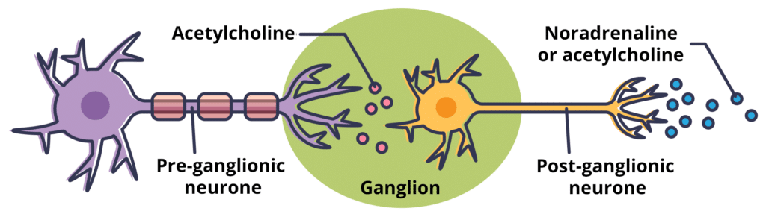
Sympathetic Nervous System
"Fight or flight“
Primary NT = Noradrenaline (NA)
  -Pre-ganglionic – ACh
  -Post-ganglionic – NA
Pathway: Short (ACh) -> Long (NA **)
Examples of sympathetic nerves:
  -Greater splanchnic
  -Thoracic and lumbar splanchnic
Functions
  -Mydriasis
  -Increase HR
  -Inhibits peristalsis
  -Decreases urine production
Notes:
The sympathetic and parasympathetic divisions of the nervous system work in very close association, with contrasting, yet tightly coordinated effects. The sympathetic system is involved in energy-expending (catabolism), enabling the body to use energy appropriately to respond to stressful situations and emergencies, as in the “fight or flight” response.
** - is because there is an exception to this 'rule' and that is for sweat glands, though it is the sympathetic nervous system stimulating it, both the pre- and postganglionic neurons use ACh as the NT.
Mydriasis = pupil dilation

Slide 9
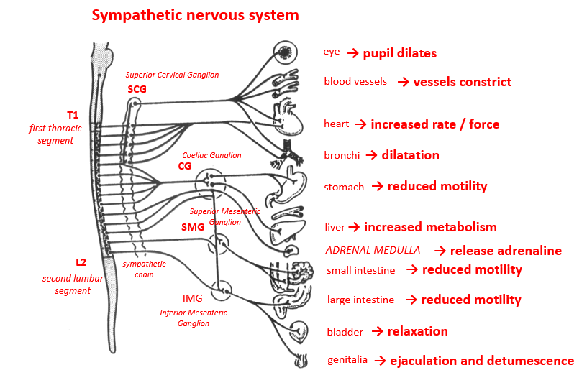
Notes:
Activation of the sympathetic system results in pupil dilation, piloerection, vasoconstriction of cutaneous blood vessels, sweating, release of adrenaline, bronchodilation, increased cardiac contraction and reduced digestion.
During normal conditions, blood vessels are tonically maintained in a resting state of moderate vasoconstriction. If sympathetic signals are increased, vasoconstriction increases and vice-versa. However, in coronary vessels, skeletal muscles and vessels of the external genitalia, sympathetic stimulation results in vasodilation.

Slide 10
‘Exceptions’- Exocrine gland secretion
Function | Sympathetic Effect | Parasympathetic Effect
General exocrine gland secretion | Decrease hormone production | Increase hormone production
Salivary glands | Modulates composition | Increases production of saliva
Sweat glands | Increase sweating | Decrease sweating
Notes:
Noradrenaline/adrenaline are neurotransmitters and hormones, let’s just think of them as neurotransmitters for the sake of this
Exocrine glands = secrete hormones into a duct, remember that hormones are long acting so waiting for their effects to kick in wouldn’t be ideal if you’re running from a bear!
HOWEVER, salivary glands and sweat glands are ‘exceptions’:
Salivary glands:
Parasympathetic increases = relax smooth muscle = more fluid flows through the salivary glands = ‘more saliva’ helps digestion
Sympathetic increases = constrict smooth muscle = less fluid flows through salivary glands, therefore more protein rich + viscous [modulates content of saliva]
Sweat glands:
When you have lots of adrenaline eg running away from a bear, you sweat. Therefore sympathetic stimulation increases activation of sweat glands = sweat more
When you’re resting you don’t sweat that much = parasympathetic decreases sweat gland stimulation = sweat less

Slide 11
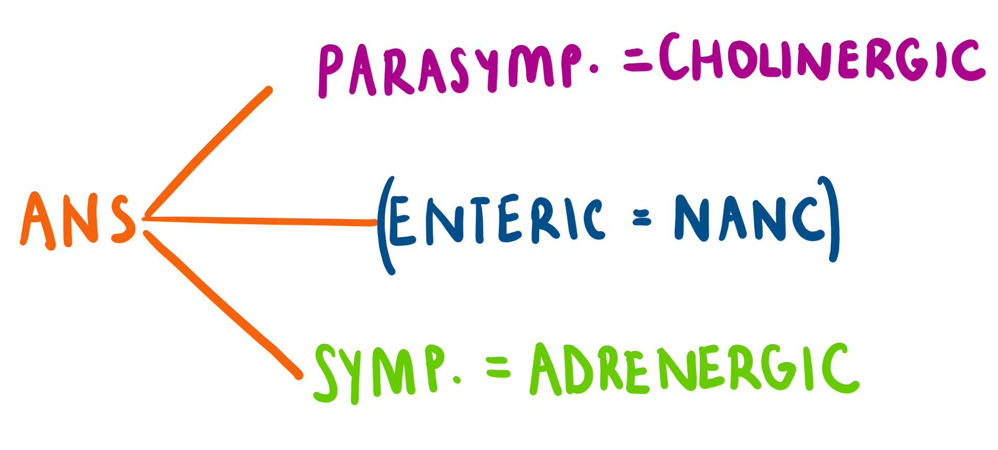
ANS receptor types
Notes:
What differentiates the cholinergic and adrenergic receptors? Their primary neurotransmitter!
Parasympathetic = cholinergic receptors = driven by acetylcholine neurotransmitter
Sympathetic = adrenergic receptors = driven by noradrenaline
Not as important:
Enteric + CNS (not the focus of today) = non-adrenergic-non-cholinergic receptors, don’t release acetylcholine or noradrenaline neurotransmitters ie none released
Be aware that co-stimulation exists = acetylcholine AND noradrenaline released ie both released

Slide 12
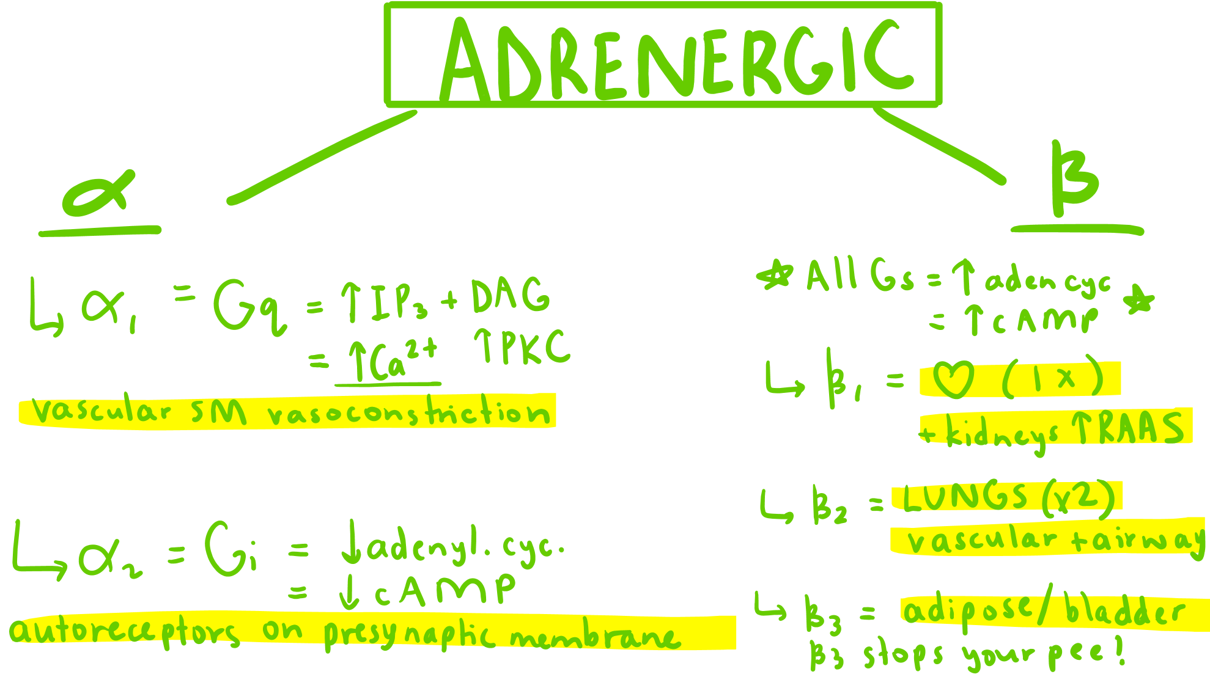
Adrenergic Receptors are GPCRs
Gq- stimulatory
    -Coupled to PLC
Gs- stimulatory
  -Coupled to Adenylyl Cyclase
Gi- inhibitory
  -Coupled to Adenylyl Cyclase
Alpha-1→ Gq
Alpha-2→ Gi
Beta-1, beta-2 and beta-3→ Gs
Notes:
I= inhibitory
S= stimulating
Q= quirky

Slide 13
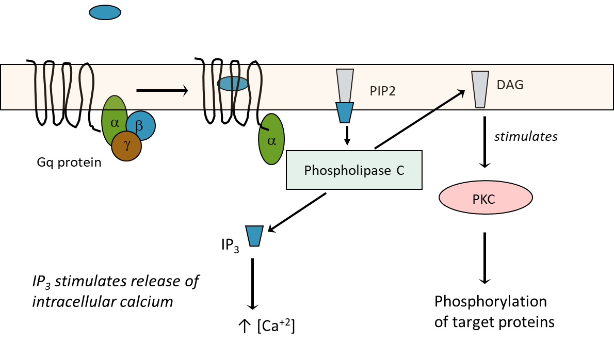
Adrenergic Receptors – Alpha 1
Alpha-1→ Gq
EXCITATORY
Activates PLC/IP3/DAG
Notes:
Sympathetic vascular smooth muscle: when running away, want increased blood pressure so more blood and oxygen delivered. Arteries will contract.
Binding of agonist to receptor causes conformational change
GDP exchanged for GTP bound to G Protein
Hydrolysis of GTP provides energy for dissociation of α- subunit, from β/ɣ subunits
α- subunit activates PLC which results in the formation of IP₃ and DAG
IP₃ mobilises Ca²⁺ from intracellular stores and DAG stimulates PKC
↑ intracellular Ca²⁺ activates Ca²⁺ dependent response
PKC phosphorylates downstream target proteins

Slide 14
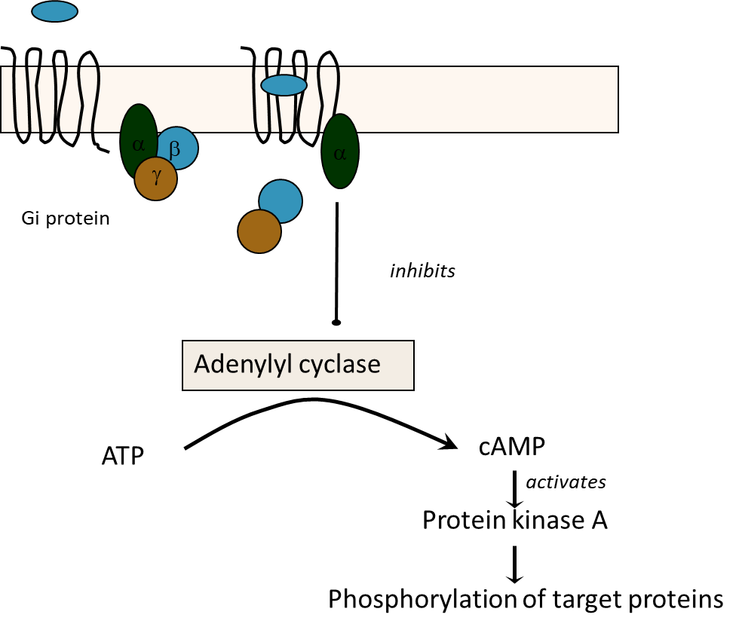
Adrenergic Receptors – Alpha 2
Alpha-2→ Gi
INHIBITORY
Inhibits adenyl cyclase
Notes:
Autoreceptors on presynaptic membrane: think of them as –ve feedback, when you have too much noradrenaline, the extra binds to autoreceptors on the presynaptic membrane which will stop further release of it.
Binding of agonist to receptor causes conformational change
GDP exchanged for GTP bound to G Protein
Hydrolysis of GTP provides energy for dissociation of α- subunit, from β/ɣ subunits
α- subunit inhibits Adenylyl Cyclase which prevents the formation of cAMP
Therefore no Protein Kinase A activation

Slide 15
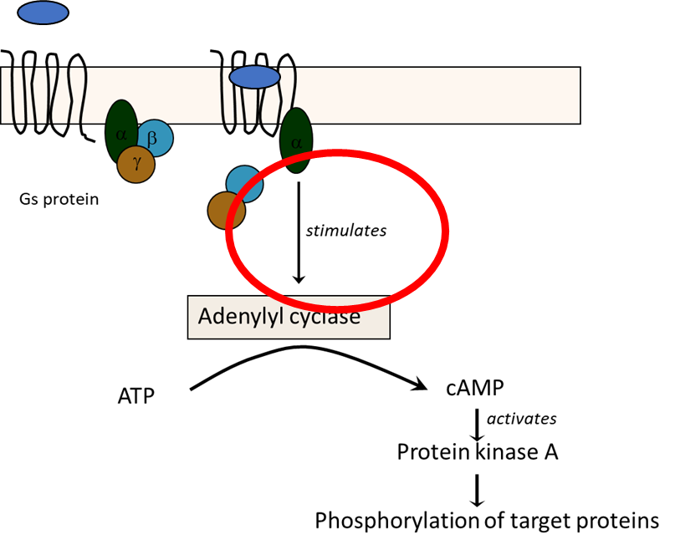
Adrenergic Receptors – Beta
Beta-1 and beta-2→ Gs
EXCITATORY
Activate adenyl cyclase
Beta-1 mainly in cardiac muscle→ increased force and rate of contraction
Beta-2 mainly in bronchial smooth muscle and skeletal muscle→ relaxation
Notes:
Binding of agonist to receptor causes conformational change
GDP exchanged for GTP bound to G Protein
Hydrolysis of GTP provides energy for dissociation of α- subunit, from β/ɣ subunits
α- subunit activates Adenylyl Cyclase which results in the formation of cAMP
cAMP activates Protein Kinase A which phosphorylates downstream target proteins
1 heart= beta 1 (+ kidneys for increased RAAS, Heart + kidneys are most imp for blood pressure control)
2 lungs= beta 2

Slide 16
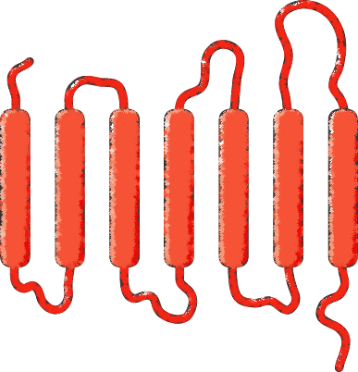
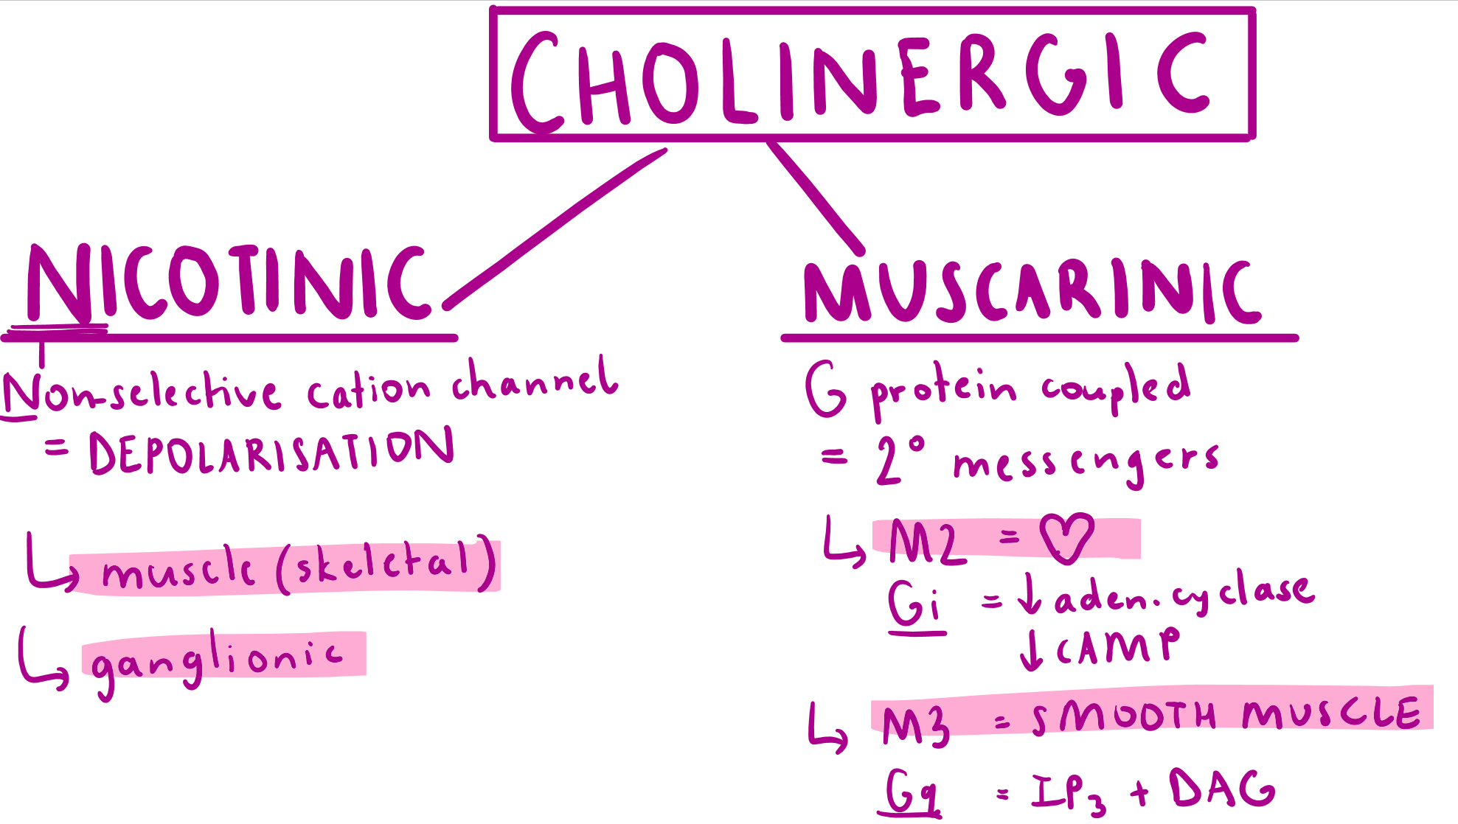
Cholinergic Receptors – Muscarinic (GPCRs)
7 transmembrane domain
M1, M3, M5 coupled with Gq→ activates IP3 and DAG→ increases intracellular calcium
  -Excitatory
M2, M4 coupled with Gi→ decreases cAMP→ decreases intracellular calcium
  -Inhibitory
Notes:
Odds are excitatory
Evens are inhibitory
Found at target tissues- heart, glands, smooth muscle
Parasympathetic smooth muscle: detrusor contracts so we can urinate, bronchioles contract as we have lower o2 demands, GI tract contracts so we can do peristalsis

Slide 17
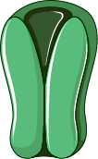
Cholinergic Receptors – Nicotinic (VGCs)
Pentameric ligand gated ion channel
5 subunits
Ganglionic nicotinic receptor= α2β3 subunits
NMJ nicotinic receptor = α2βδε
2 Ach molecules need to bind to 2 alpha subunits for activation
Found at autonomic ganglia, NMJ, CNS
Notes:
Non-selective cation channel→ depolarisation
Nicotinic: needed to make sure the entire peripheral nervous system functions well: ie rapid neural transmission
Somatic: When nicotinic receptor stimulated: cations (eg K+/Ca2+ etc) enter the muscle/ganglion causing depolarisation 🡪 skeletal muscle contraction
Autonomic sympathetic/parasympathetic: allows transmission of impulses down the ganglia

Slide 18
Effects of Acetylcholine
Heart
Activates M2 receptor
Gi protein→ downregulation of cAMP→ increased conductance of K+ channel→ hyperpolarization→ decreased HR
Smooth muscle cell
Activates M3 receptor
Gq protein→ increase in calcium via DAG-IP3 pathway→ increased myosin-actin interaction→ contraction
Notes:
Smooth muscle in gut, bladder and bronchioles

Slide 19
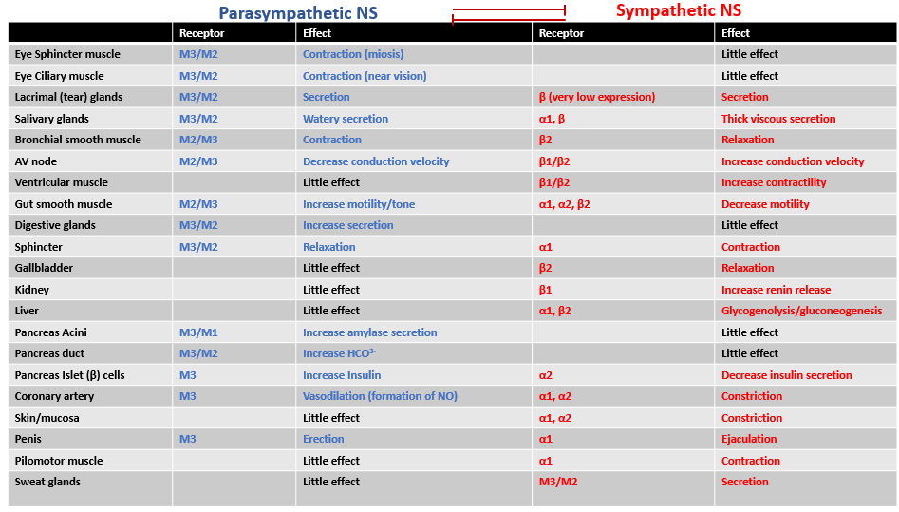

Slide 20
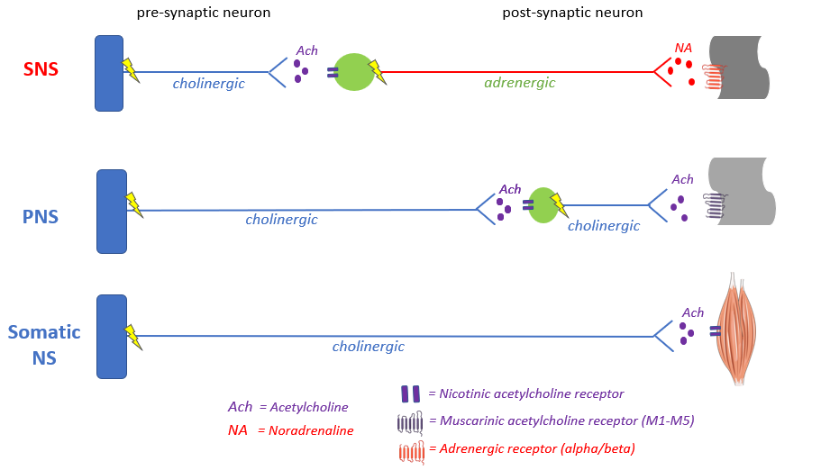
Notes:
Parasympathetic in lateral horn of grey matter/ brain stem
Sympathetic trunk ganglion in chain near spinal chord

Slide 21
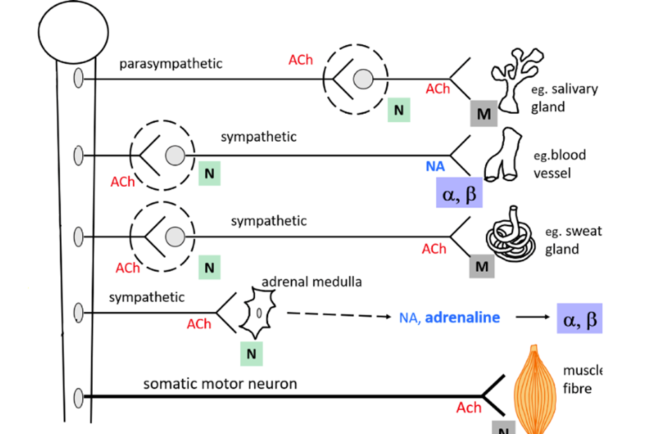
Notes:
NOTE: ALL preganglionic nerve fibres are cholinergic (Ach or nicotinic)
ALL parasympathetic post synaptic receptors are acetylcholine or nicotinic
Only the post-ganglionic fibres differ in NT used as is what differentiates PNS from SNS – it is why SNS is referred to as adrenergic system.
Adrenergic receptor: noradrenaline
Muscarinic receptor: acetylcholine
Synapses directly to adrenal gland→ no end neurone→ tends to be Ach but not always→ NA and adrenaline in positive feedback loop

Slide 22
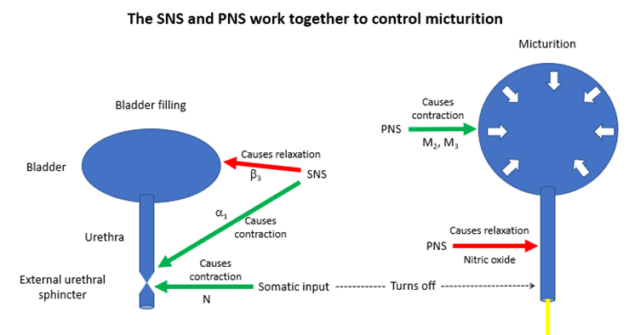
Micturition
Notes:
Bladder filling –
Want bladder to relax to fill, want urethra to contract to prevent urination
controlled by SNS via beta-3 receptors allows bladder smooth muscle to relax; via alpha-1 receptors, contracts urethra
Micturition
Switch to PNS voiding reflex
PNS causes contraction of bladder via M2, and M3 receptors
Nitric oxide inhibits the contraction of urethra
Turn off somatic input to also prevent contraction of urethra
During incontinence, get unwanted activation of the micturition pathway
3 rhymes with pee
B for beta = block – so bladder fills, stops you from peeing
M for muscarinic = make – so bladder contracts i.e., micturition
Although the sympathetic and parasympathetic nervous systems have opposing actions on the functioning of some organs they are not fighting with each other. Instead they cooperate with other, generally by being activated in a reciprocal fashion as effector arms of autonomic reflexes. An example of this is the baroreceptor reflex which stabilizes the blood pressure. The baroreceptors are pressure sensors located in the aortic arch and in the carotid sinuses, and they are activated by stretching of the aorta and the carotid arteries caused by an increase in blood pressure. When activated, they signal to the nucleus tractus solitarius in the medulla which will orchestrate a reflex which uses both branches of the ANS to bring the BP back down again. When blood pressure increases, parasympathetic drive to the heart increases, acting on the SA node, the heart’s pacemaker, to slow the heart rate. Sympathetic drive to the SA node will decrease, which reinforces this slowing. Sympathetic drive to the heart muscle, which increases it’s contractility, will also fall, so the heart will beat less forcefully. As a result of these cardiac effects, the cardiac output will fall. Sympathetic drive to the arteries, which causes vasoconstriction, will also decrease, leading to vasodilatation and a fall in peripheral resistance. The veins will also relax, and this reduces preload, which via the Starling effect will also decrease cardiac contraction. Since blood blood pressure equals cardiac output x total peripheral resistance, blood pressure will fall back to its set point. On the other hand, if the blood pressure fall from its set point ,the baroreceptor reflex will cause opposite effects on the ANS to occur, which brings the blood pressure back up again.

Slide 23
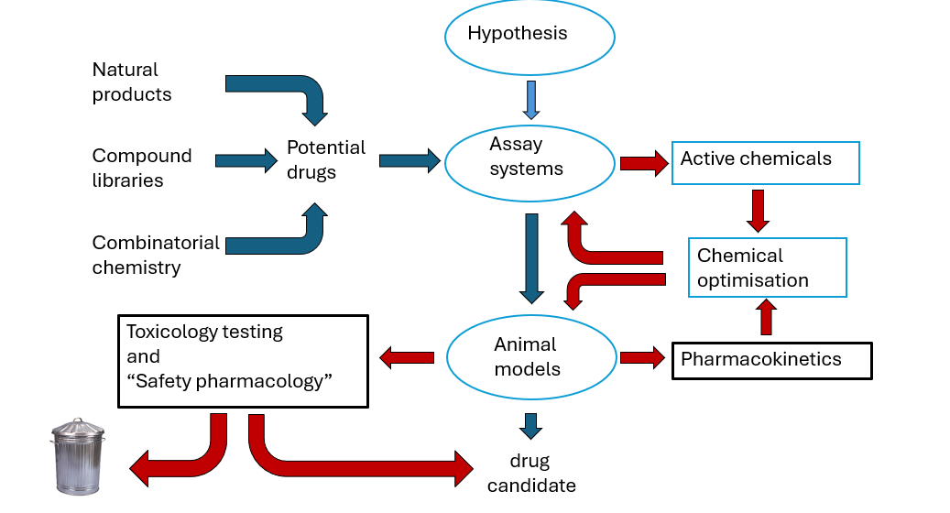
Pre-clinical drug discovery
Notes:
Toxicology testing: using higher doses over chronic periods to identify tissues/ organs at highest risk
Safety pharmacology: using therapeutic dose range to identify any acute effects on ‘core battery’- cardiovascular, CNS, resp

Slide 24
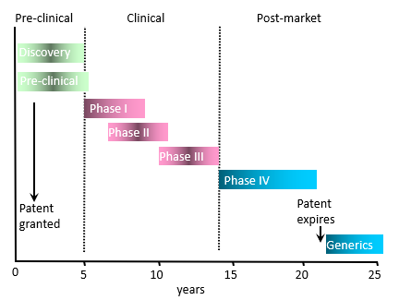
Clinical trials
Notes:
Phase I: explores safety (side effects) and tolerability (comfort)
-Small number of HEALTHY volunteers
Phase II: explores clinical efficacy and confirm safety and tolerability
- IIa: larger number of patients
-IIa: larger sample to confirm
Phase III: explores how effective and safe the treatment is compared to standard
-Drug tested in thousands of patients, often multi-centres
Phase IV: ongoing
-Drug licensed and on market, monitor consequences of increasing exposure in tens of thousands of patients

Slide 25
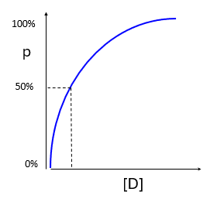
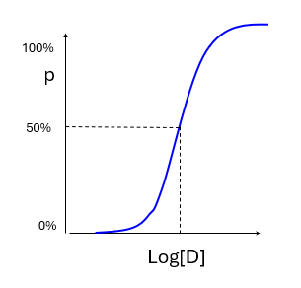
Pharmacology
D + R → ← DR
Notes:
Binding is reversible in most cases
P= proportion of receptors occupied
Log graph
AFFINITY of drug= “Molar concentration of drug required to occupy 50% of receptors at equilibrium”
Kd
Low Kd= HIGH affinity as need less drug to occupy receptors
High Kd= LOW affinity as need more drug

Slide 26
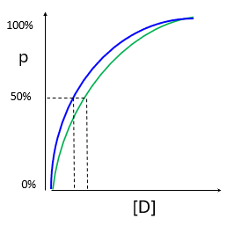
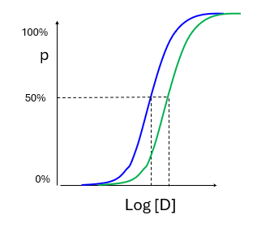

Affinity and Kd
Notes:
Binding is reversible in most cases
P= proportion of receptors occupied
Log graph
AFFINITY of drug= “Molar concentration of drug required to occupy 50% of receptors at equilibrium”
Kd→ dissociation constant
Low Kd= HIGH affinity as need less drug to occupy receptors, binds tightly, dissociates slowly
High Kd= LOW affinity as need more drug

Slide 27
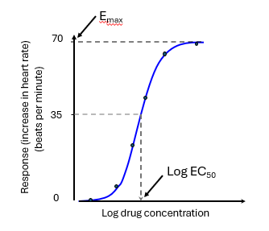
Concentration-response curve
Emax= maximum effect a drug can produce
EC50= concentration of drug that produces 50% of maximum response
-Used to quantify potency

Slide 28
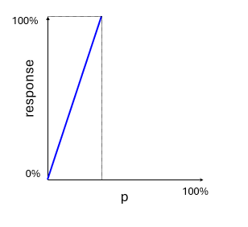
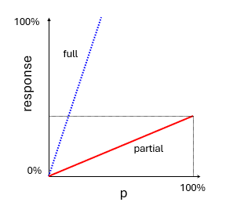
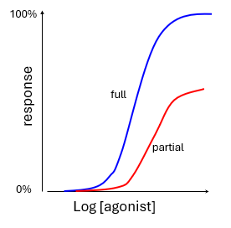
Agonists
Full agonist
Partial agonist
Notes:
Full agonists produce maximal response whilst only activating a fraction of the available receptors
Partial agonists fail to produce full response DESPITE occupying ALL available receptors

Slide 29
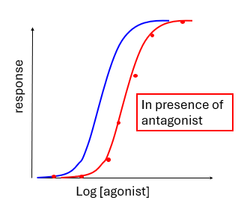
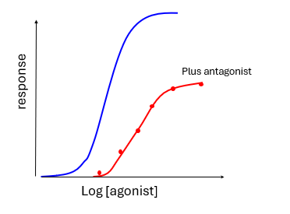
Antagonists
Reversible competitive antagonist
Irreversible non-competitive antagonist
Notes:
Competitive antagonists have affinity but not efficacy- will shift the log concentration response PARALLEL to the RIGHT
Non-competitive antagonists shift the log response to right but not parallel

Slide 30
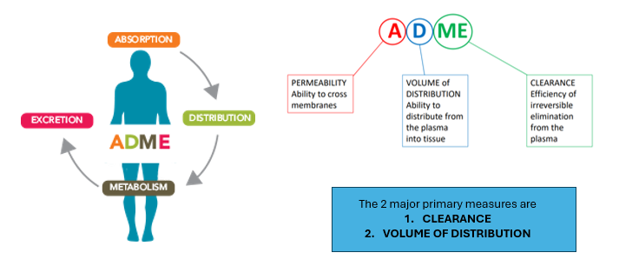
Pharmacokinetics
Notes:
Primary measures of a drug
Absorption: the process by which a drug moves from the site of administration to the site of action
-Solubility and pH dependent
Distribution: the process by which a drug moves from the bloodstream into the peripheral tissues
-Driven by relative affinity of binding for blood and tissue compartments
-Quantified by volume of distribution (amount of drug in body: amount in plasma)
Metabolism: irreversible chemical alteration of drug by a biological
-Phase 1: reactions
-Phase 2: conjugation reactions
Excretion: irreversible elimination of drug from the systemic circulation
-Defined by clearance→ important as only parameter that determines the maintenance dose rate required to achieve a target plasma concentration at steady state
-Renal excretion into urine
-Hepatic excretion into bile→ faeces

Slide 31


MCQs

Slide 32
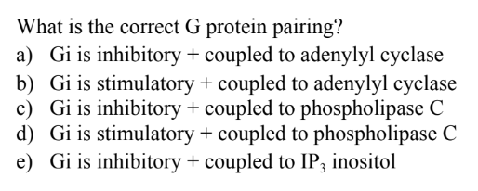
MCQs
Notes:
A

Slide 33
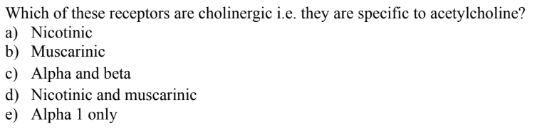
Notes:
D

Slide 34
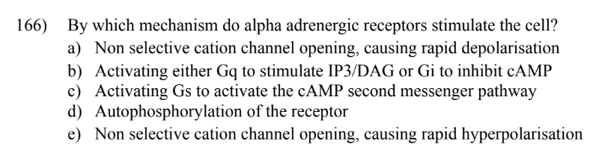
Notes:
B

Slide 35
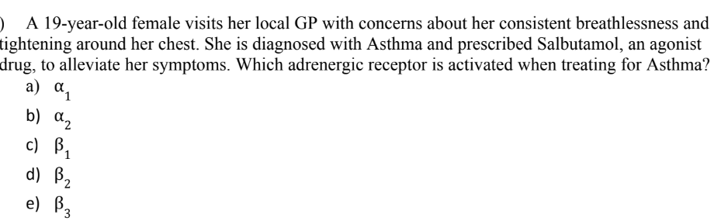
Notes:
D

Slide 36
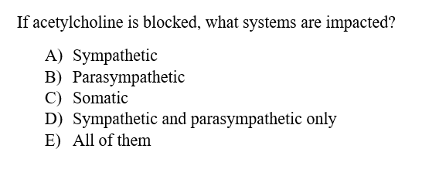
Notes:
E

Slide 37
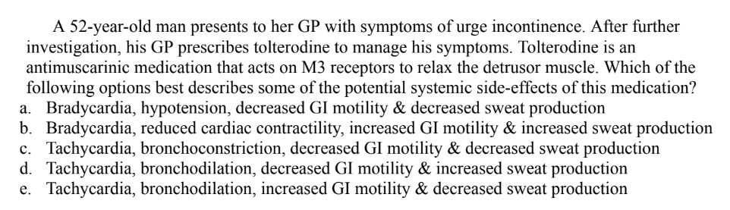
Notes:
D

Slide 38
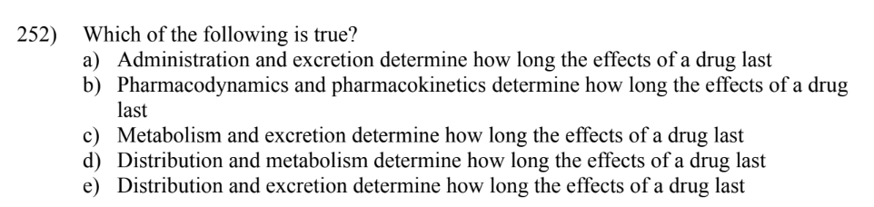
Notes:
C

Slide 39
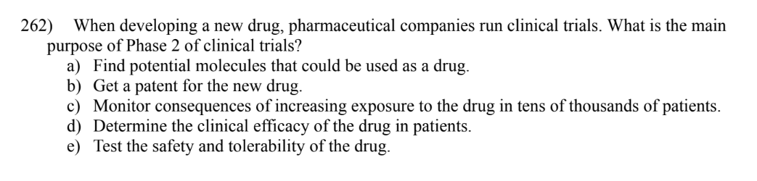
Notes:
D

Slide 40
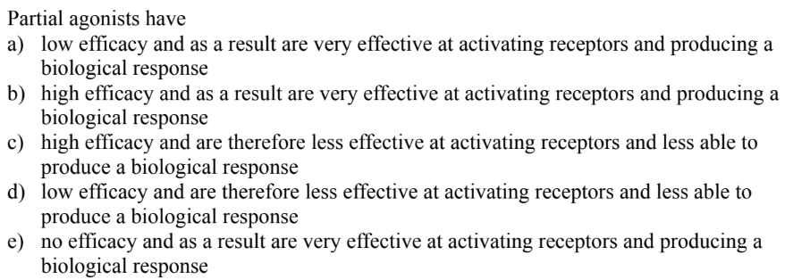
Notes:
D

Slide 41
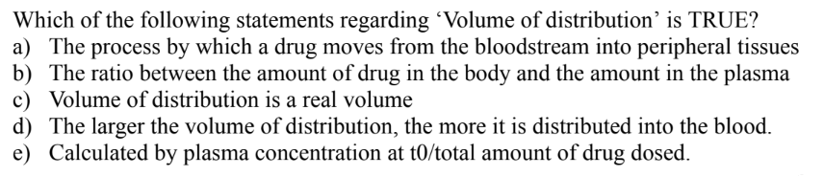
Notes:
B

Slide 42
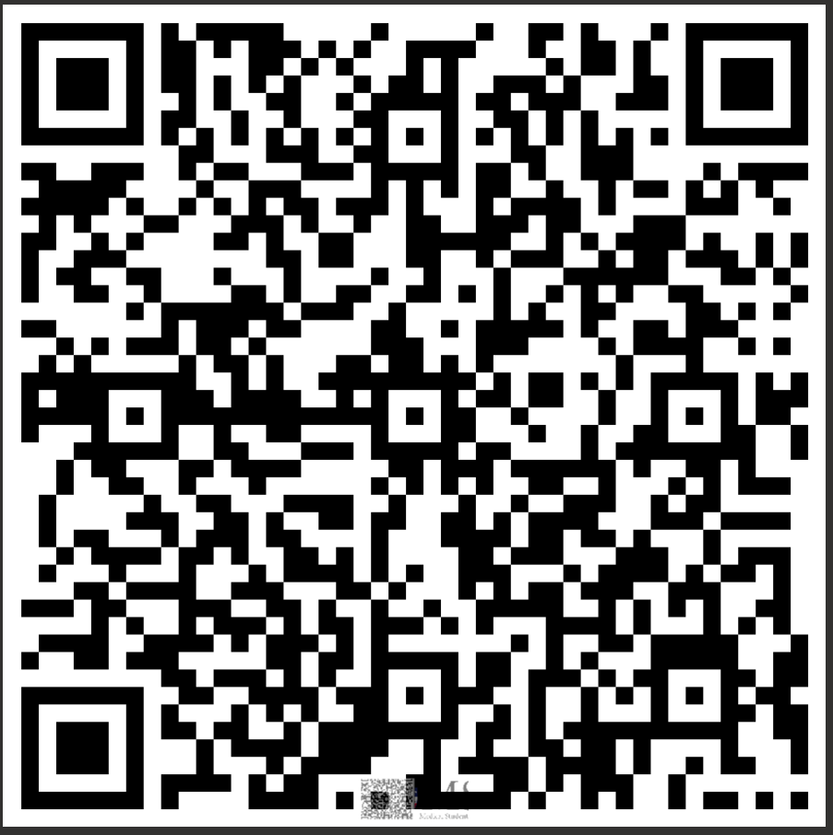
FEEDBACK
Thank you!!
Any questions?
amy.zhang@kcl.ac.uk

