Slide 1







GKTeach
Heart Anatomy
STAGE 1
FREDDIE COLES
YEAR 2 MBBS
frederic.coles@kcl.ac.uk ← if you have any questions, please email me (I have nothing better to do with my time)

Slide 2
  Understand the anatomical structure of the atria, ventricles, and associated vessels and valves
  Understand the conduction pathways within the heart, and the innervation of the heart itself
  Understand the auscultation sites, and the components of the cardiac cycle and the associated sounds
LEARNING OBJECTIVES

Slide 3
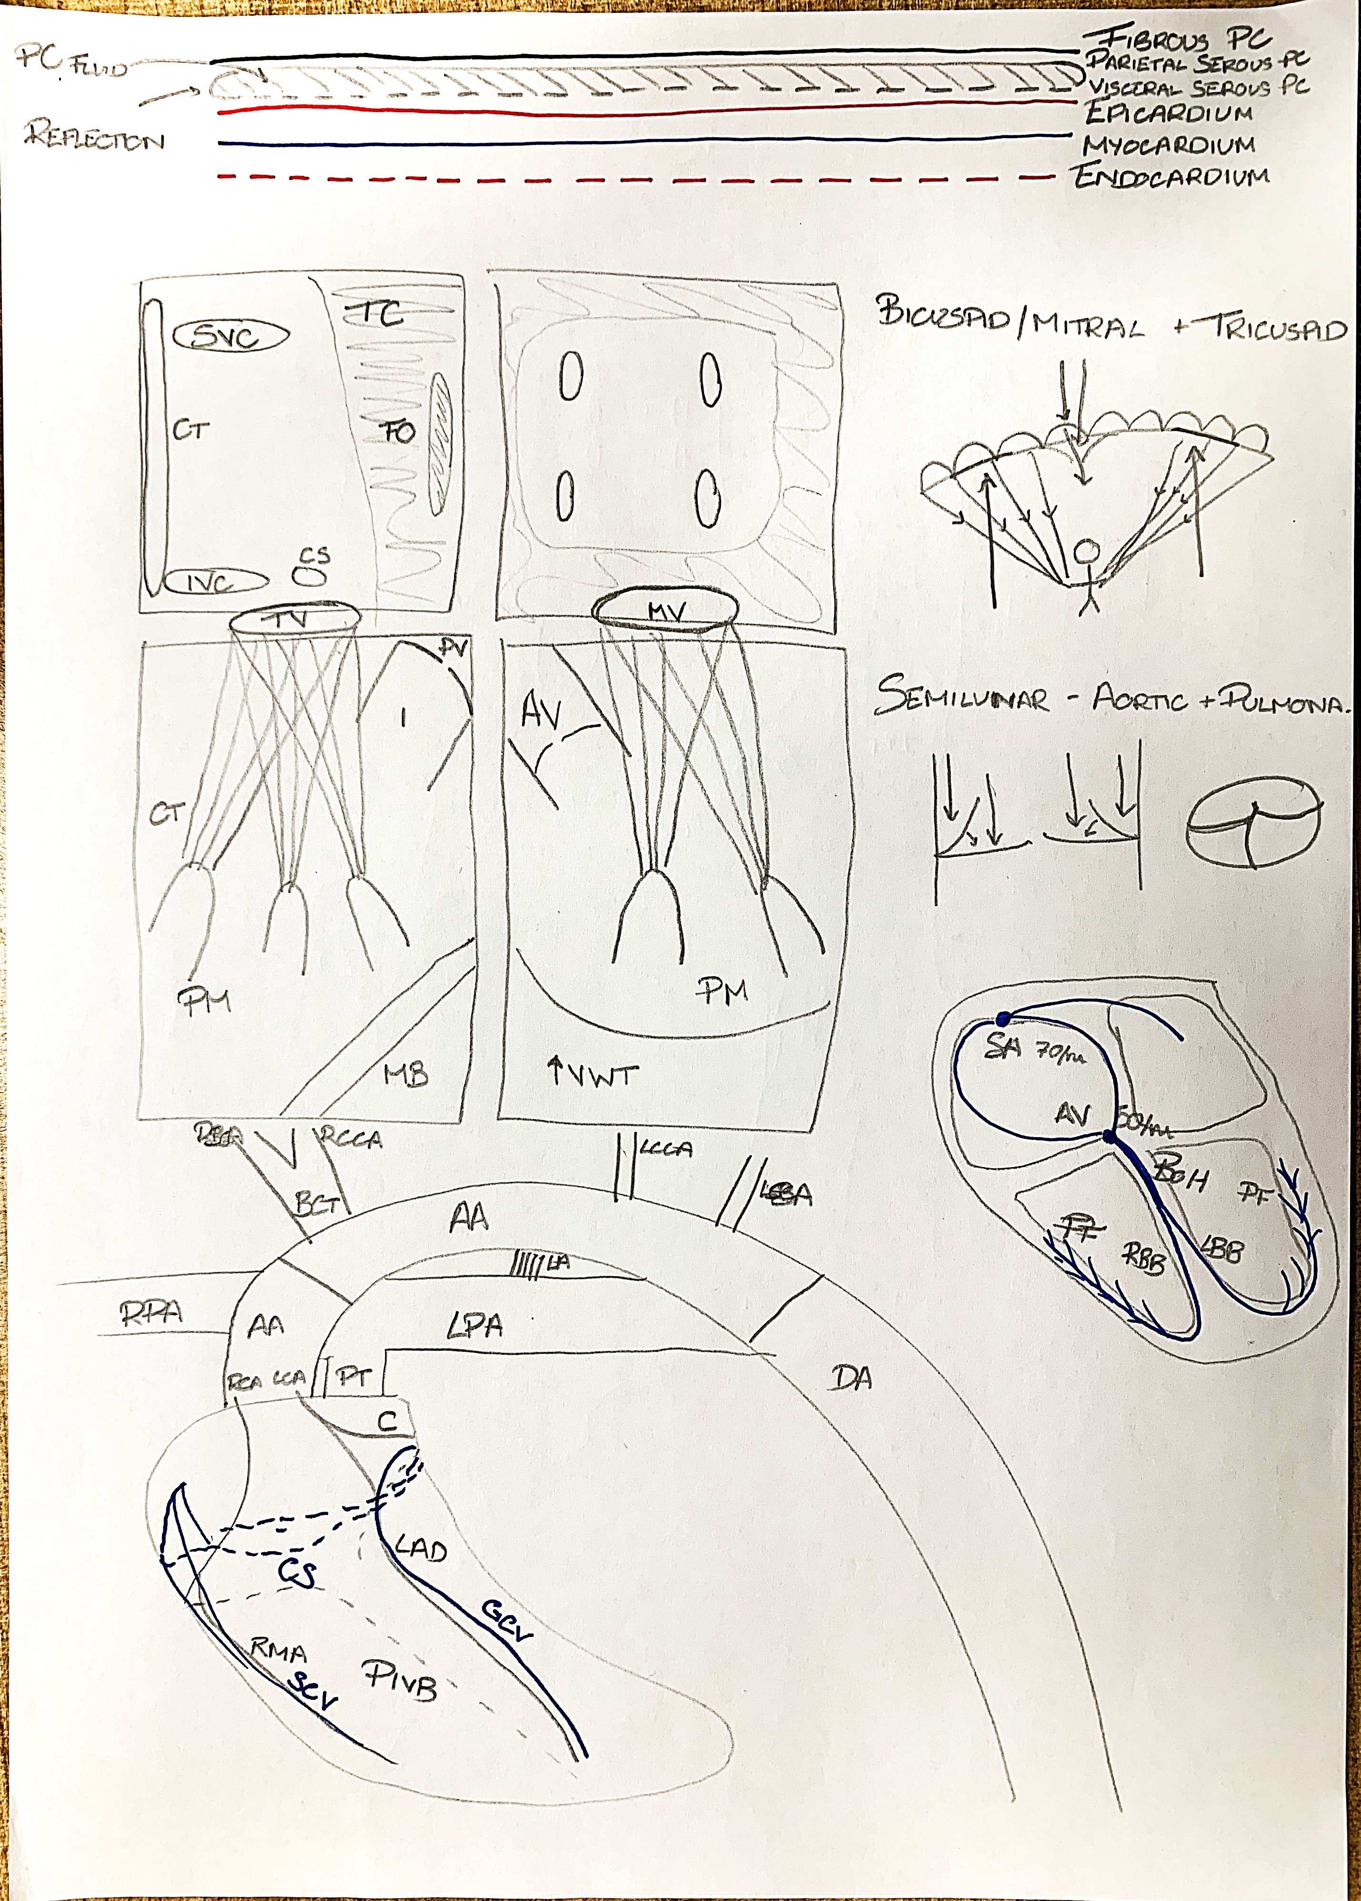

Slide 4


QUIZ!!

Slide 5

SBA - 1
Sampling blood from the right atrium, we unexpectedly find oxygenated and deoxygenated blood. How could this have happened?
A) Ventricular Septal Defect
B) Patent Foramen Ovale
C) Patent Ductus Arteriosus
D) Alveolar-Vena Cava Fistula (connection)
E) Misdirected Pulmonary Vein

Slide 6
SBA - 1 answer
Sampling blood from the right atrium, we unexpectedly find oxygenated and deoxygenated blood. How could this have happened?
B) Patent Foramen Ovale. As the pressure is much larger in the left side of the heart, blood will flow through the unclosed flap from the left atria in the right atria, giving us a mix of oxygenated and deoxygenated blood. In clinical practice however, it is not this shunting of blood we are worried about. We are worried about right-to-left shunting of blood and along with it any small blood clots that now enter the systemic circulation and can lead to strokes, embolisms and other devasting problems. This right-to-left shunting only occurs when the pressure in the right side of the heart exceeds that in the left, for example when coughing, sneezing or any straining

Slide 7
SBA - 2
When auscultating a patient, you find their heart sounds to be muffled but become less muffled in certain positions. What is the likely cause of their dulled heart sounds?
A) Myocardial Infarction
B) Pericardial Effusion
C) Pneumothorax
D) Pleural Effusion
E) Pulmonary Embolism

Slide 8
SBA - 2 answer
When auscultating a patient, you find their heart sounds to be muffled but become less muffled in certain positions. What is causing their dulled heart sounds?
B) Pericardial Effusion. This is what causes cardiac tamponade and is the collection of fluid in the pericardial space. The shifting dullness is caused by the settling of fluid depending on their position. If they where to lie on their left side, their apex heart sounds would be more muffled compared to if they were lying on their right side. Pericardial effusion only becomes cardiac tamponade when it begins to restrict the heart’s ability to function correctly.

Slide 9
SBA - 3
Where is the most likely location* of referred pain with angina?
A) Left arm and shoulder
B) Neck and Jaw
C) Left hip and leg
D) Back
E) Left ribs and chest
*typical for males

Slide 10
SBA - 3 answer
Where is the most likely location* of referred pain with angina?
A) Left arm and shoulder. Although all the other answers can be locations of cardiac referred pain, left arm and shoulder is the most common in men. Due to multiple factors, including systemic misogyny and pain dismissal, there is less research into presentations of acute coronary syndromes in women, not helped by the non-specificity of the symptoms experienced, such as acid reflux, shortness of breath and extreme fatigue. This is just something to be wary of in clinical practice, this is not examined in the MLA.

Slide 11
SBA - 4
Patient attends A&E with chest pain. The cardiologist diagnoses them with an anterior STEMI. Which coronary artery is most likely occluded?
A) Right Coronary Artery
B) Circumflex Artery
C) Right Marginal Artery
D)Left Anterior Descending Artery

Slide 12
SBA - 4 answer
Patient attends A&E with chest pain. The cardiologist diagnoses them with an anterior STEMI. Which coronary artery is most likely occluded?
D) Left Anterior Descending Artery. Clue is in the name, the diagnosis of an anterior STEMI comes from reading the ECG and determining which leads show to greatest ST elevation and which leads show potential ST depression. There is obviously other factors but the ECG is most useful initial tool in finding the location of the MI

Slide 13

FEEDBACK
Thank you!!
Any questions?
frederic.coles@kcl.ac.uk

