Slide 1







Anatomical terminology Skeleton and Joint
Basic tissues and body layers
GKTeach
STAGE 1
Physiology and Anatomy
YEAR 1MBBS
17/11/2025
Weaponising studying

Slide 2
  Learn ways to remember anatomical terminology
  Learn the differences between tissue types
  Learn about the development of skeletal muscle
  Learn the differences between joints
LEARNING OBJECTIVES

Slide 3


Anatomical terminology

Slide 4

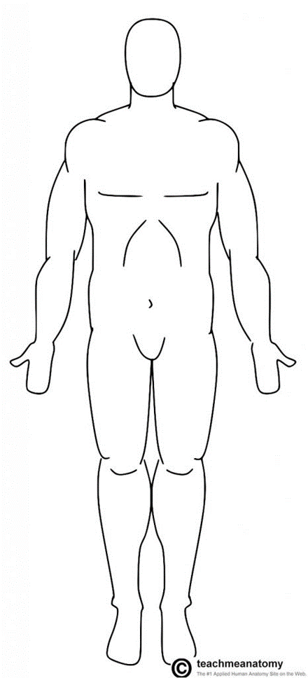
Anatomical terminology
Facing forward
Thumbs out
Feet parallel

Slide 5
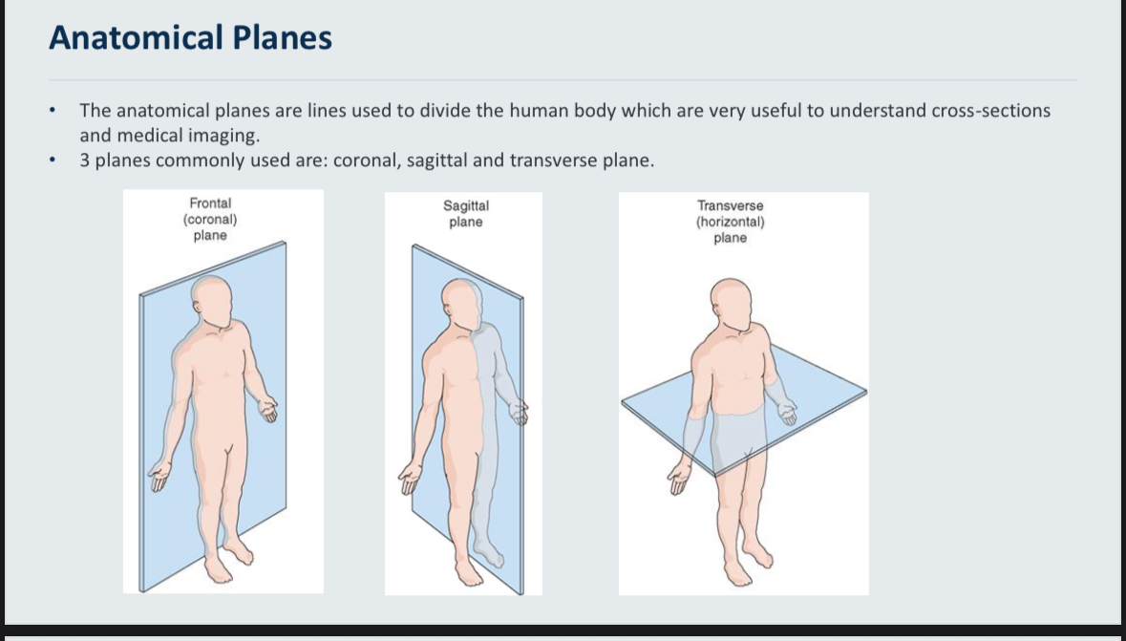
Anatomical terminology

Slide 6
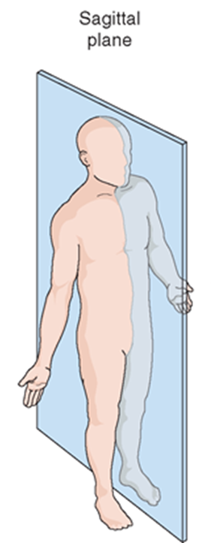

To remember the anatomical planes
SAGITTAL – Sages are very wise and if you cut through this plane both lobes of the brain remain intact

Slide 7
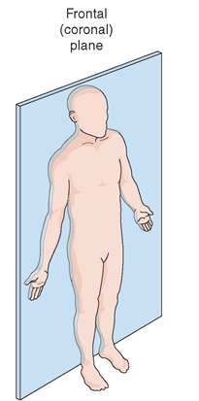
To remember the anatomical planes
FRONTAL (coronal) – cutting across this plane leaves the front part of your body completely intact

Slide 8
To remember the anatomical planes
Transverse means “across”
It’s the horizontal plane going across your body. From one side to the other

Slide 9
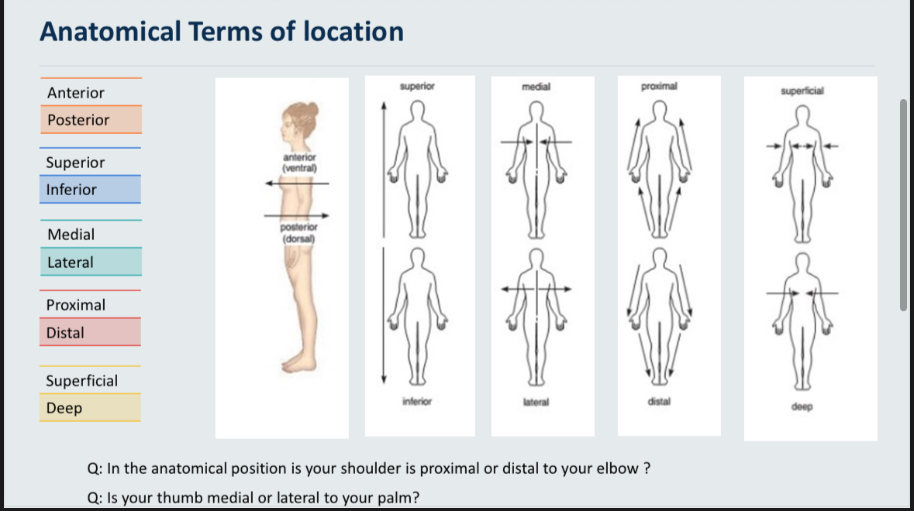
Anatomical terminology
Ventral means towards the belly (abdominal) so towards the front
Superior and inferior are also called cranial and caudal respectively
In the limbs, structures nearer the trunk(torso) are proximal.
Structures further away from the trunk are distal.

Slide 10
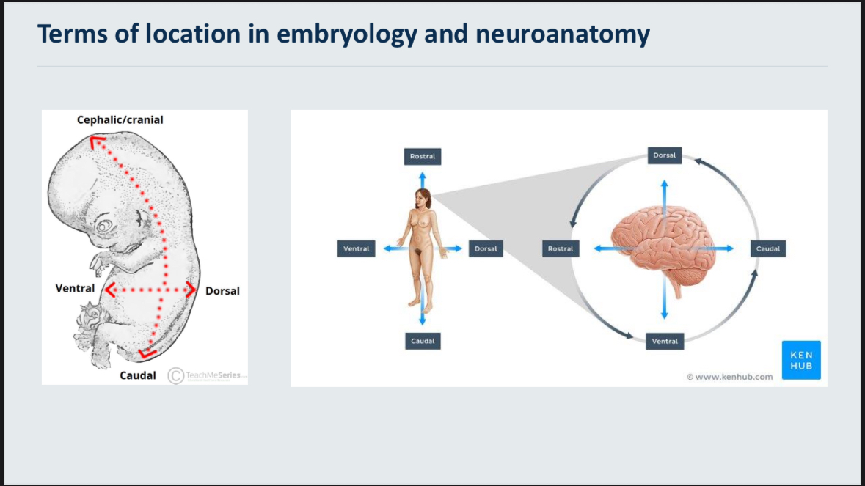
Anatomical terminology
Rostral means towards the nose or head
Latin word “rostrum” means “beak” or “nose”
Know that the dorsal side will be opposite the ventral
And rostral side will be opposite the caudal (tail) side
Dorsal aspect of brain starts at the back during embryology, then curves towards the top

Slide 11
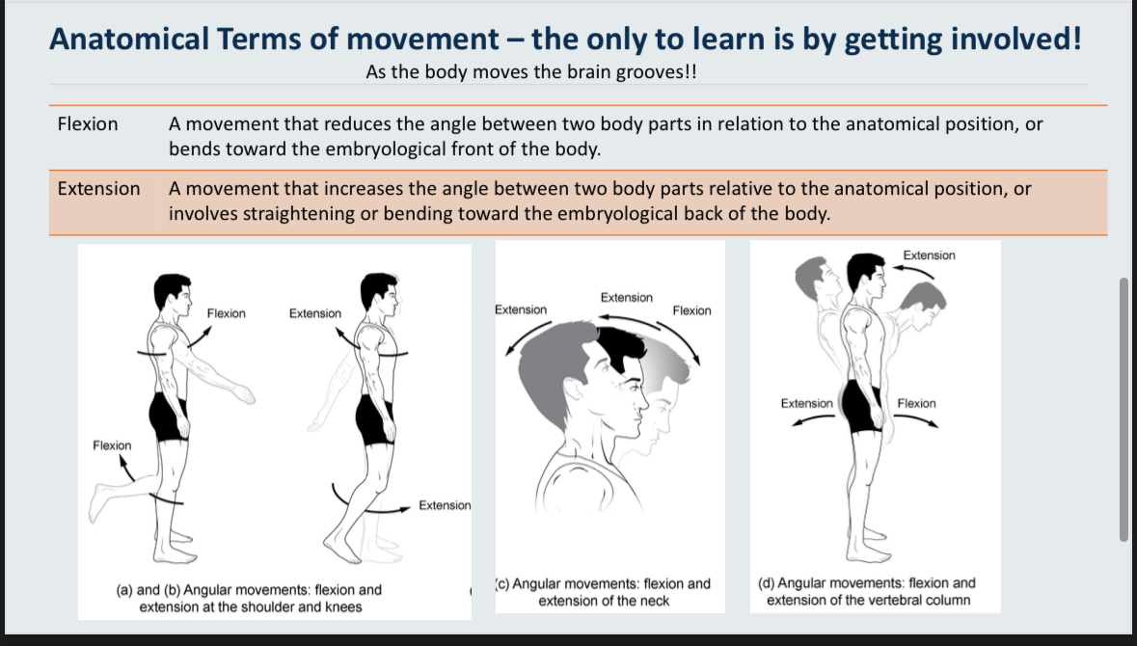
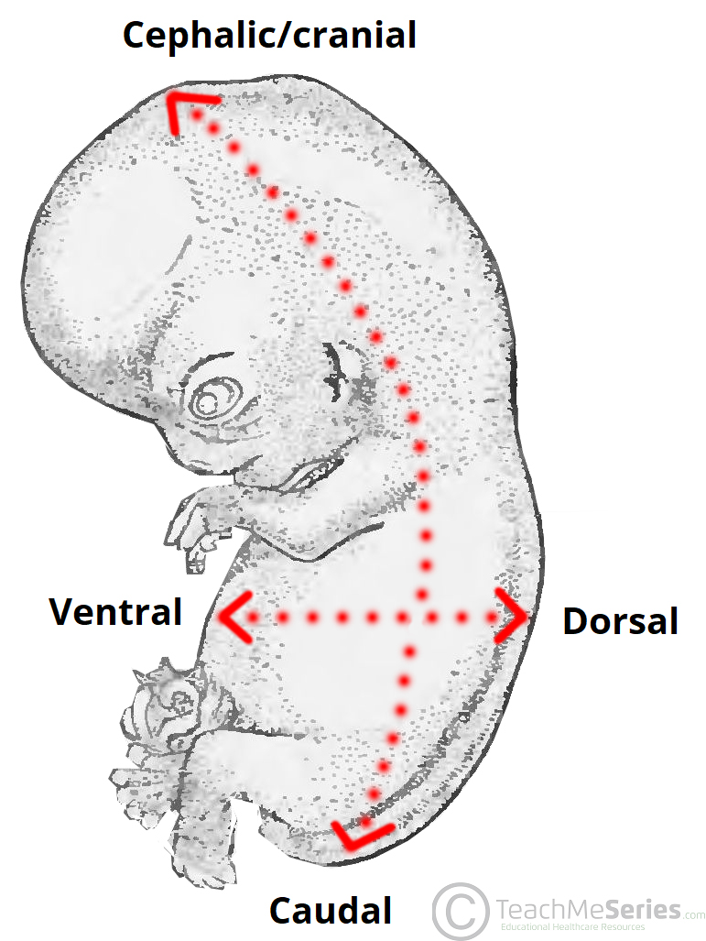
Anatomical terminology
We have 2 rules which we don’t use at the same time. The rules are applied situationally.
Rule 2 means above the transverse midline
Movements backwards are extension.
Movements forward are flexion. The opposite is true below the transverse midline
Rule 1
Rule 2

Slide 12
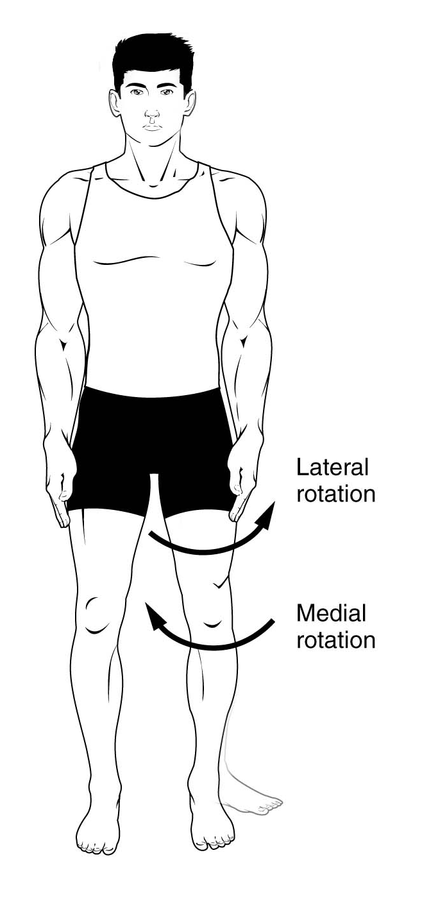

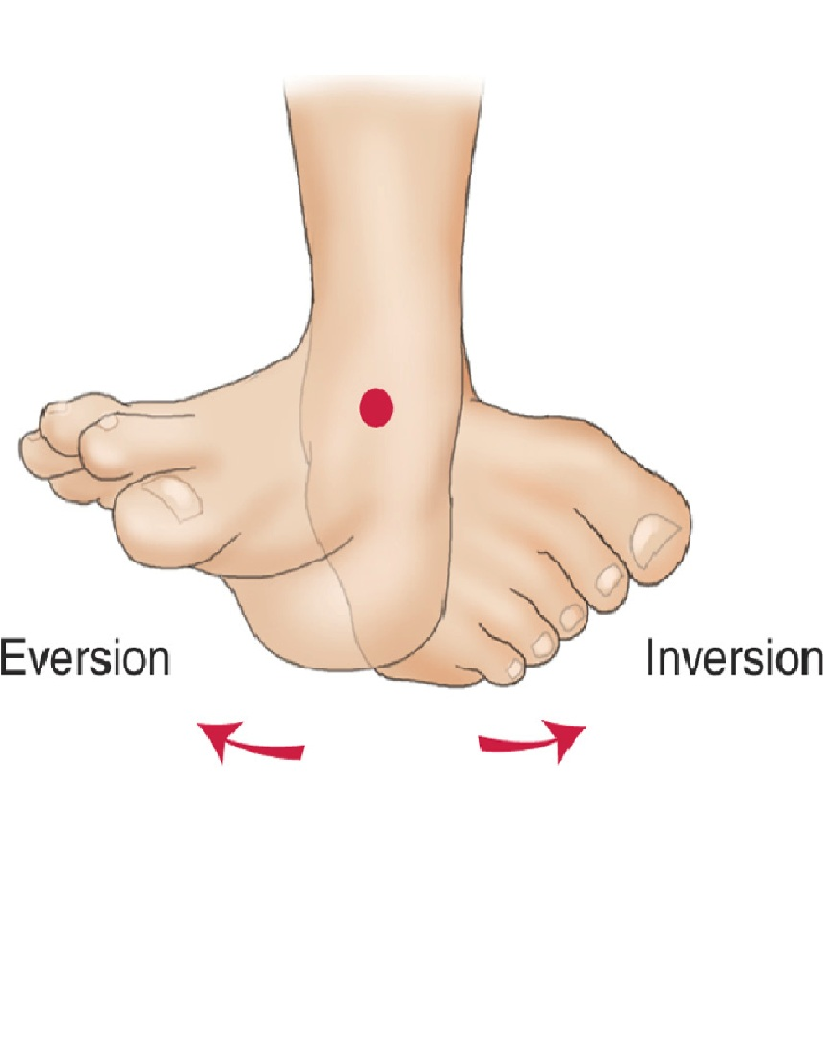
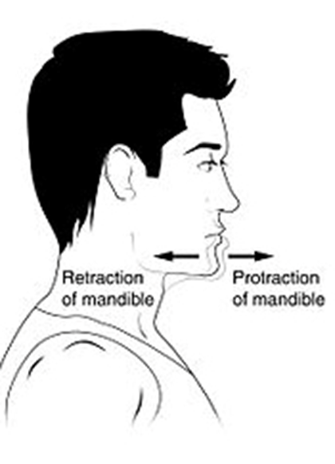

It’s more fun you try it yourselves
These 3 are relative to the sagittal midline
Abducting is taking away from the midline. Remember, if a person has been taken away, they’ve been abducted

Slide 13


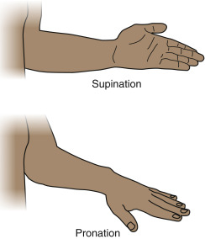
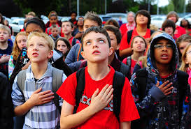
“Pronation” sounds very patriotic. If you had to pledge allegiance to your country, you would see the back of your hand
In Sup-ination your palm would face up like you’re holding a cup of soup
It’s more fun you try it yourselves
If you’re wondering why rotating the foot upwards and downwards about the ankle are both called flexion:
It’s because we’re using rule 2 to define plantarflexion
You are moving the foot towards the embryological back, rotating about the ankle joint
We’re using rule 1 in calling the upwards bending of the foot dorsiflexion rather than extension.
We’re reducing the angle between the foot and leg relative to anatomical position

Slide 14
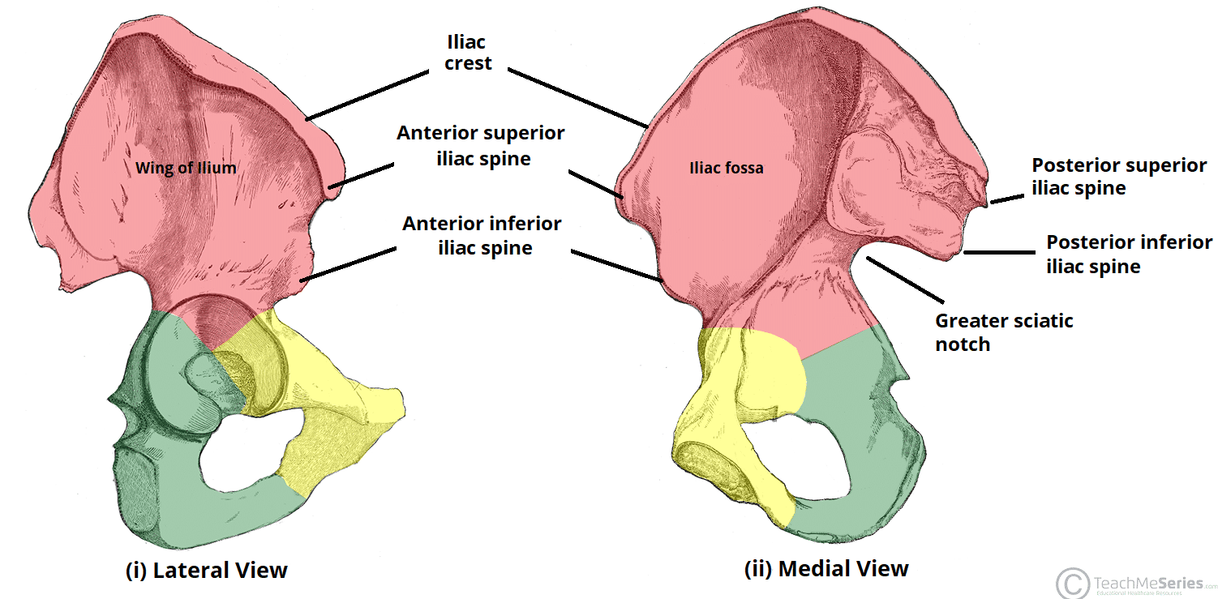
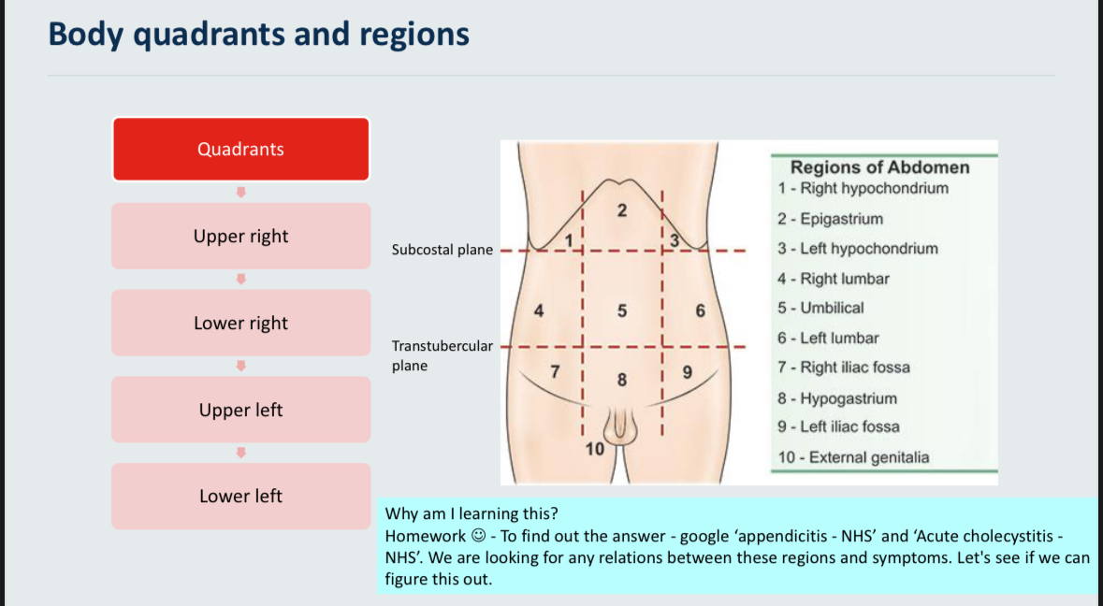
Anatomical terminology
“Hypo” means “below”, “chondral” means “cartilage” and they are regions below the cartilage of your ribs

Slide 15
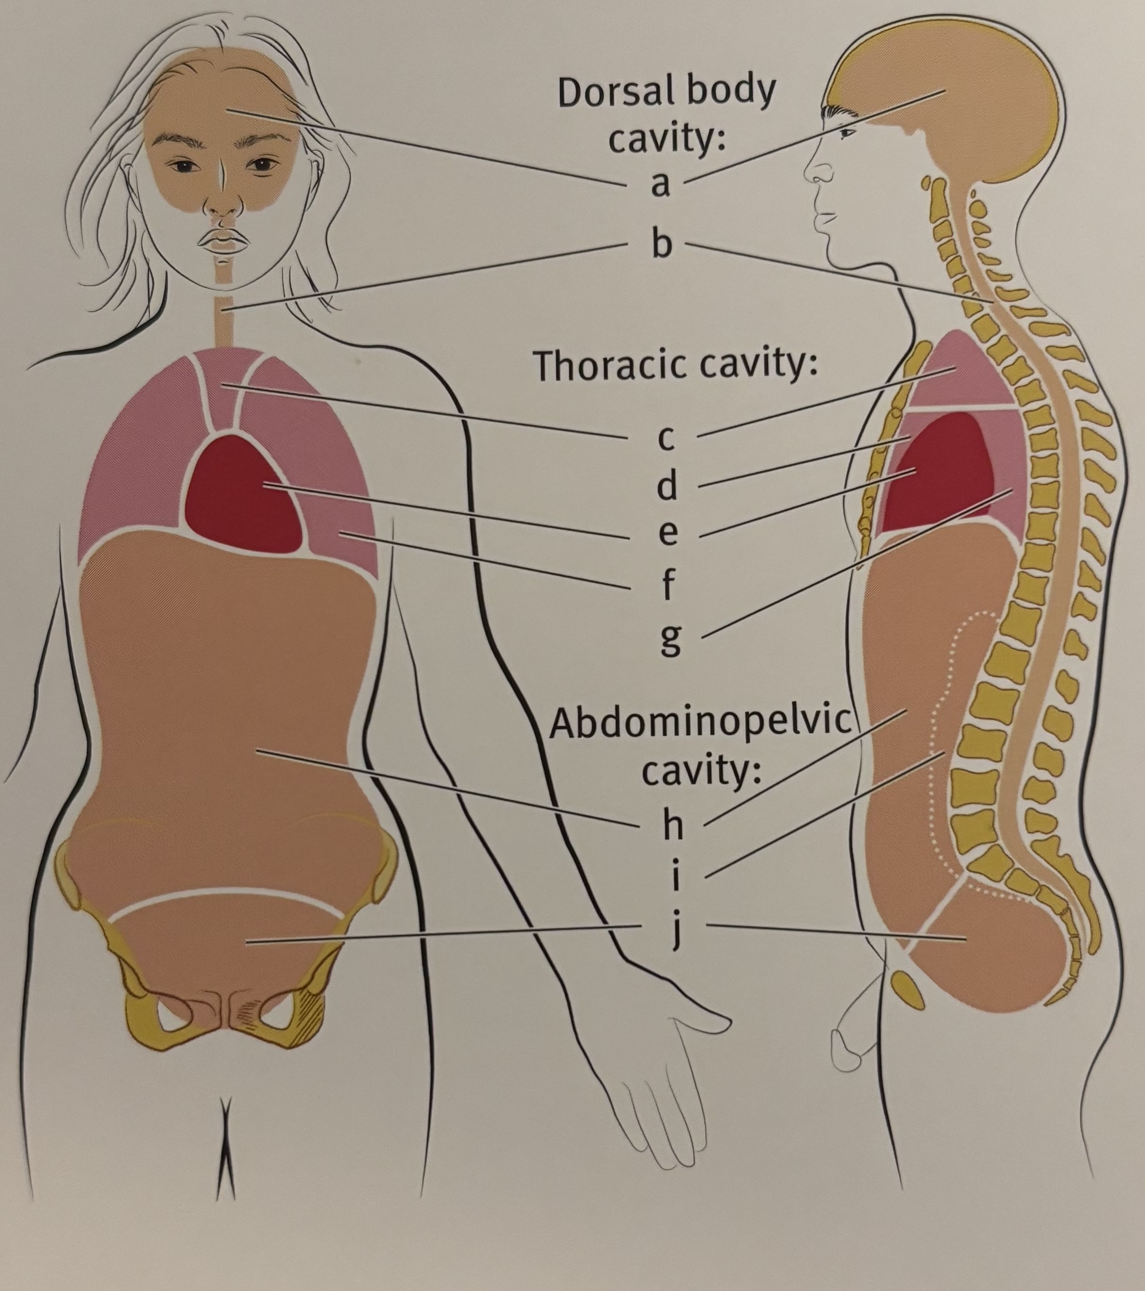
Body cavities
Mediastinum comes from the Latin word “mediastinus” meaning “in the middle”.
It refers to the middle cavities of the thorax. Not including the pleural cavities
Next slide for answers!!!

Slide 16
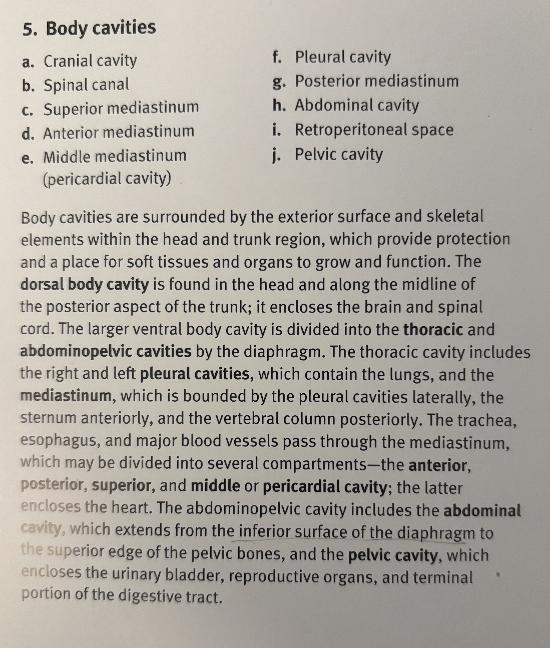
Body Cavities

Slide 17
S?BA
What is extension?
Movement away from the midline
Movement towards the midline
Straightening or Bending towards the embryological back of the body
Moving to increase the angle between 2 body parts relative to anatomical position
Straightening or Bending towards the embryological front of the body

Slide 18
SBA
Extension is…
C)Straightening or Bending towards the embryological back of the body D)Moving to increase the angle between 2 body parts relative to anatomical position

Slide 19
Skeleton and joints

Slide 20
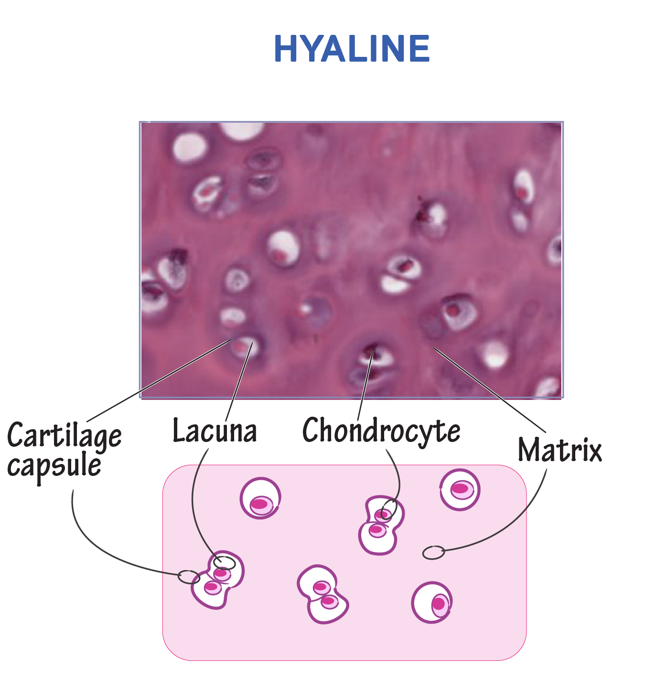
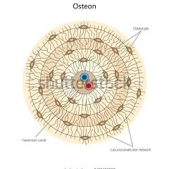
Bone and cartilage structure
Cartilage is made up of chondrocytes which produce + maintain cartilage’s extracellular matrix (ECM).
Chondrocytes produce mainly type 2 collagen, proteoglycans and glycosaminoglycans. The ECM is everything outside the chondrocyte giving cartilage it’s strength, flexibility and resistance to compression eg. Fibres (Collagen T1/T2/ elastic fibres), proteoglycans, glycosaminoglycans, water, etc.
Mature bone is made up if osteons. They’re concentric layers of lamellae which are a matrix of calcium salts and type 1 collagen fibres.

Slide 21
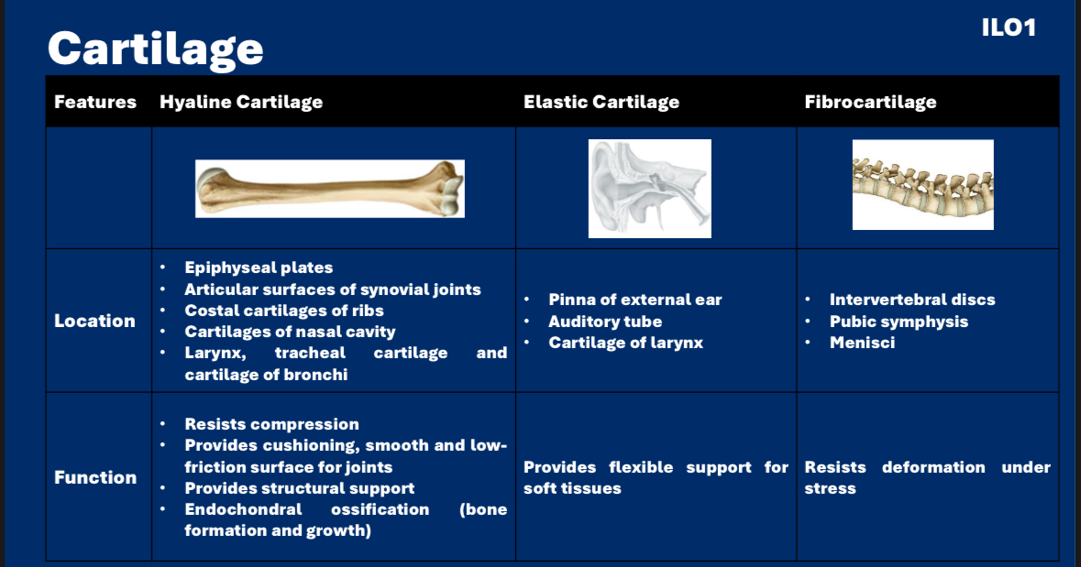
Cartilage is a type of connective tissue. It’s avascular so nutrients and oxygen diffuse through the extracellular matrix
Types of Cartilage
Elastic cartilage
  Most flexible, rich in elastic fibres.
  Found in ear (pinna), epiglottis.
Fibrocartilage
  Strongest, high collagen content.
  Found in intervertebral discs, pubic symphysis, menisci.
Hyaline cartilage
  Smooth, glassy, reduces friction.
  Found at synovial joints, ribs (costal cartilage), nose, trachea
  Chondroblasts are immature cartilage cells located in the inner perichondrium layer. The perichondrium is the outer connective tissue layer of cartilage consisting of an outer fibrous layer and inner chondrogenic layer. New cartilage is produced in the inner chondrogenic layer via appositional growth (width wise): chondroblasts deposit new ECM on the surface of the cartilage and then mature into chondrocytes which maintain the matrix
  New cartilage is also produced via interstitial growth (longitudinal): Chondrocytes undergo mitosis inside their lacunae. The 2 daughter cells produce ECM which pushes them apart. Tissue stretches from within, increasing the length of cartilage without adding to the surface
Cartilage types

Slide 22
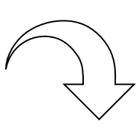
Bones
Functions include:
Protection and support
Movement
Storing calcium and phosphate
Blood cell production
Osteon

Slide 23
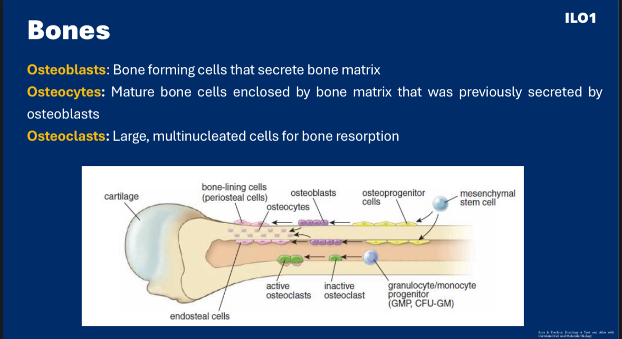
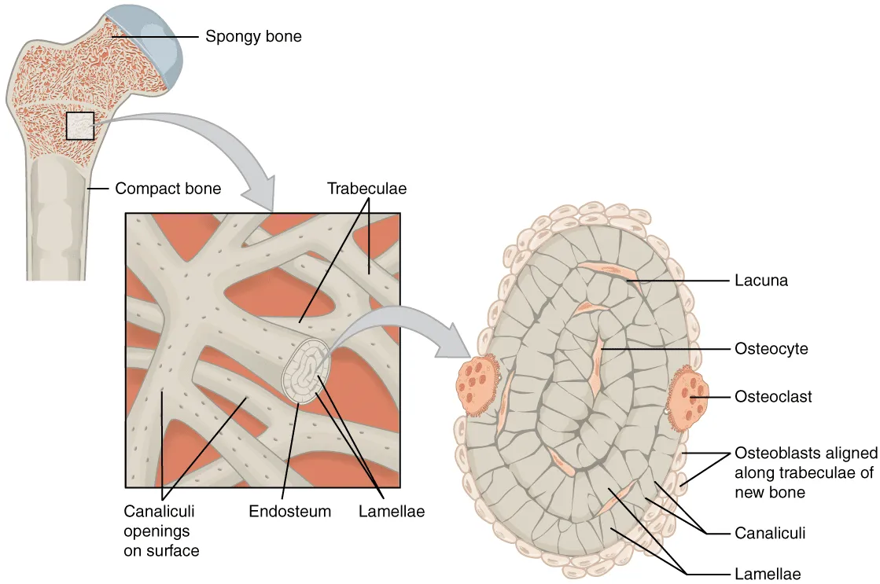
Appositional (width wide) growth strengthens bone by increasing the diameter. It happens as follows:
OSTEOBLASTS lay down OSTEOID which is the unmineralised organic matrix of bone. Osteoid forms the lamellae.
Calcium phosphate crystals aka hydroxyapatite turn the osteoid into hardened bone.
Osteoblasts are trapped in the matrix they’ve made and mature into osteocytes.
Osteocytes are in the lacunae (cavity) and maintain bone
Osteoclasts break down bone to form spongy bone.
Lamellar bone is strong and organised
It is near the periosteal surface
Some of the Osteos…

Slide 24
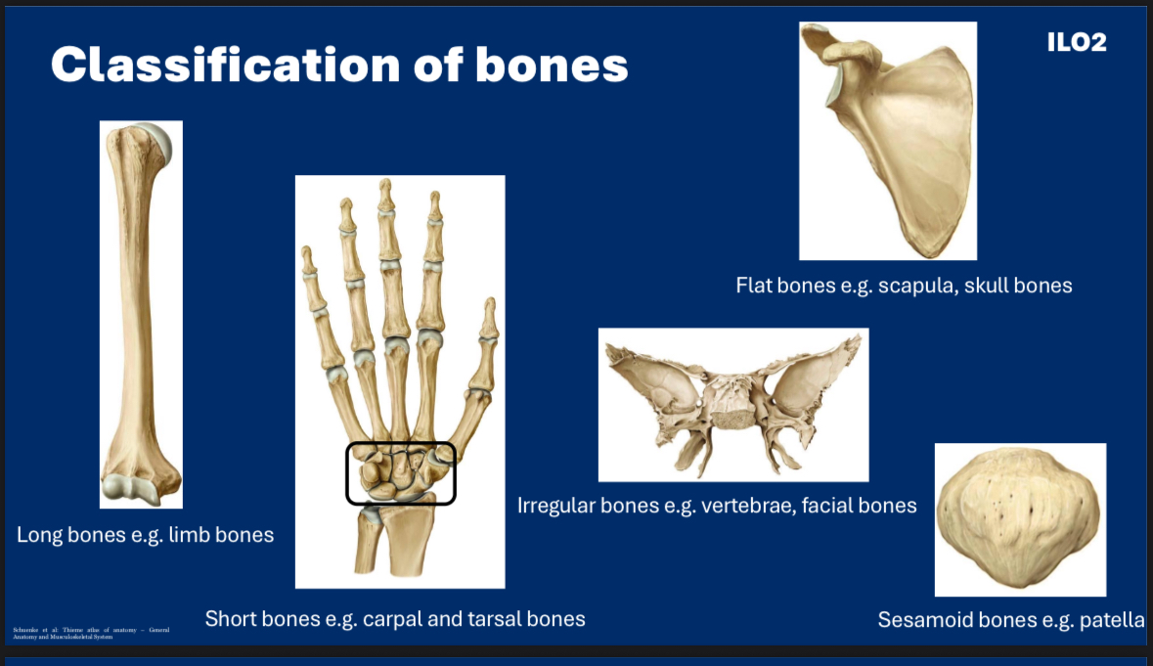
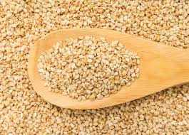
Bone class
Sesamoid bone shape due to its resemblance to a sesame seed

Slide 25
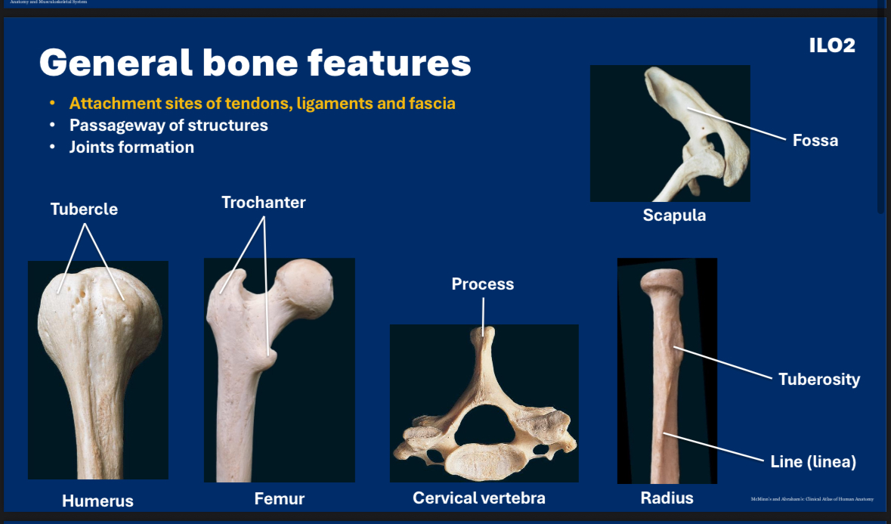
You will cover in anatomy
“Process” is from the Latin, “processus” which means going forward – like a projection pointing forward, even though it points dorsally
“Trochanter” comes from a Greek word meaning “to run quickly”. You’ll find it on your thigh bone and it attaches to muscles which help you run quickly
Namely:
Greater trochanter (7)
gluteus medius
Gluteus minimus
vastus lateralis
Obturator internus
Piriformis
Superior gemelli
Inferior gemelli
Lesser trochanter (2):
Iliacus
Psoas major

Slide 26
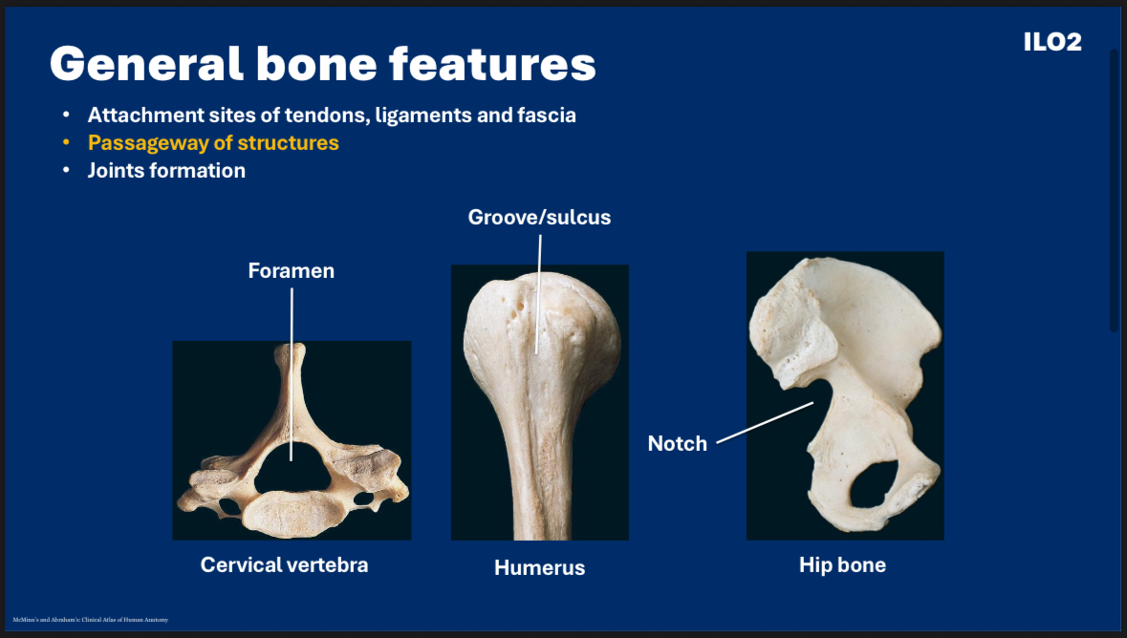
This too

Slide 27
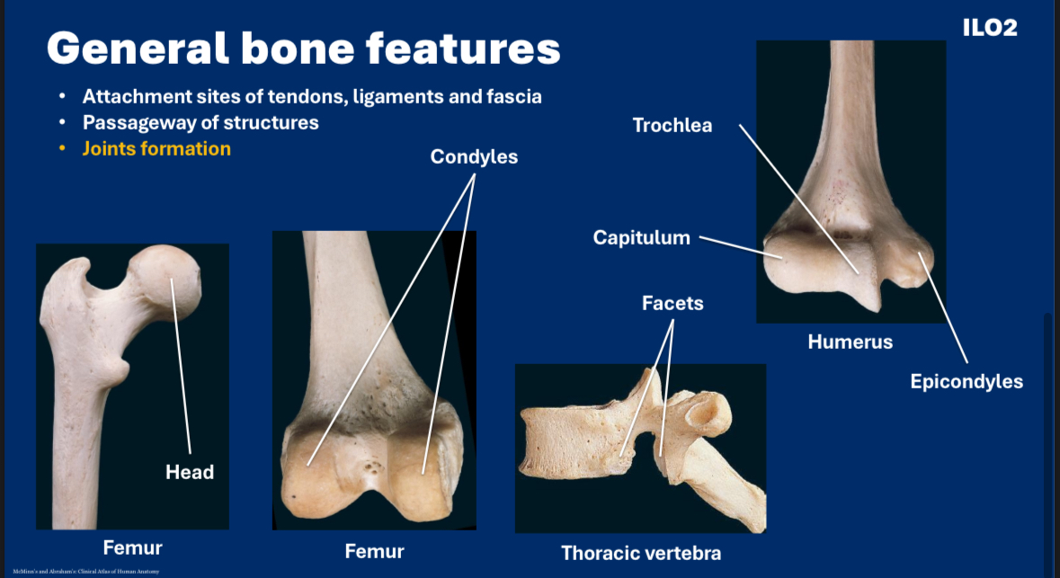
And this
“Condyle” means knuckle, joint or knob

Slide 28
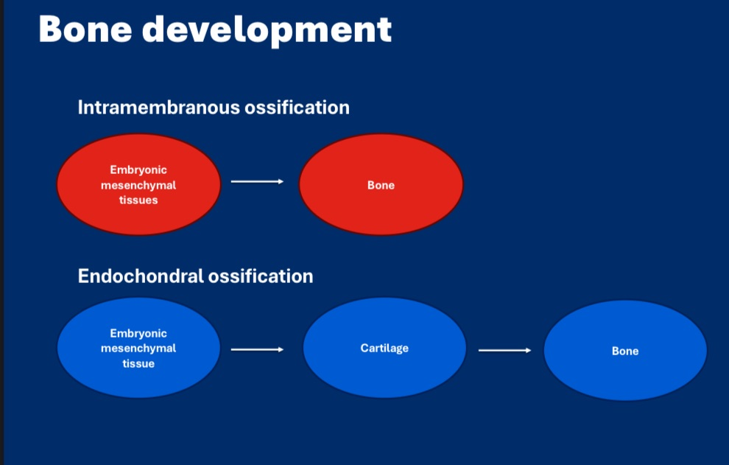
3 types of joints
No cartilage is involved with intramembranous growth ->
Mesenchymal cells cluster → become osteoblasts
Osteoblasts secrete osteoid
Osteoid calcifies
Growth is appositional (width wise)
Endochondral ossification:
Cartilage calcifies and deteriorates
Blood vessels bring osteoblasts
Primary ossification centre forms in diaphysis
Secondary ossification centres form in epiphyses
Epiphyseal growth plate controls lengthwise growth

Slide 29
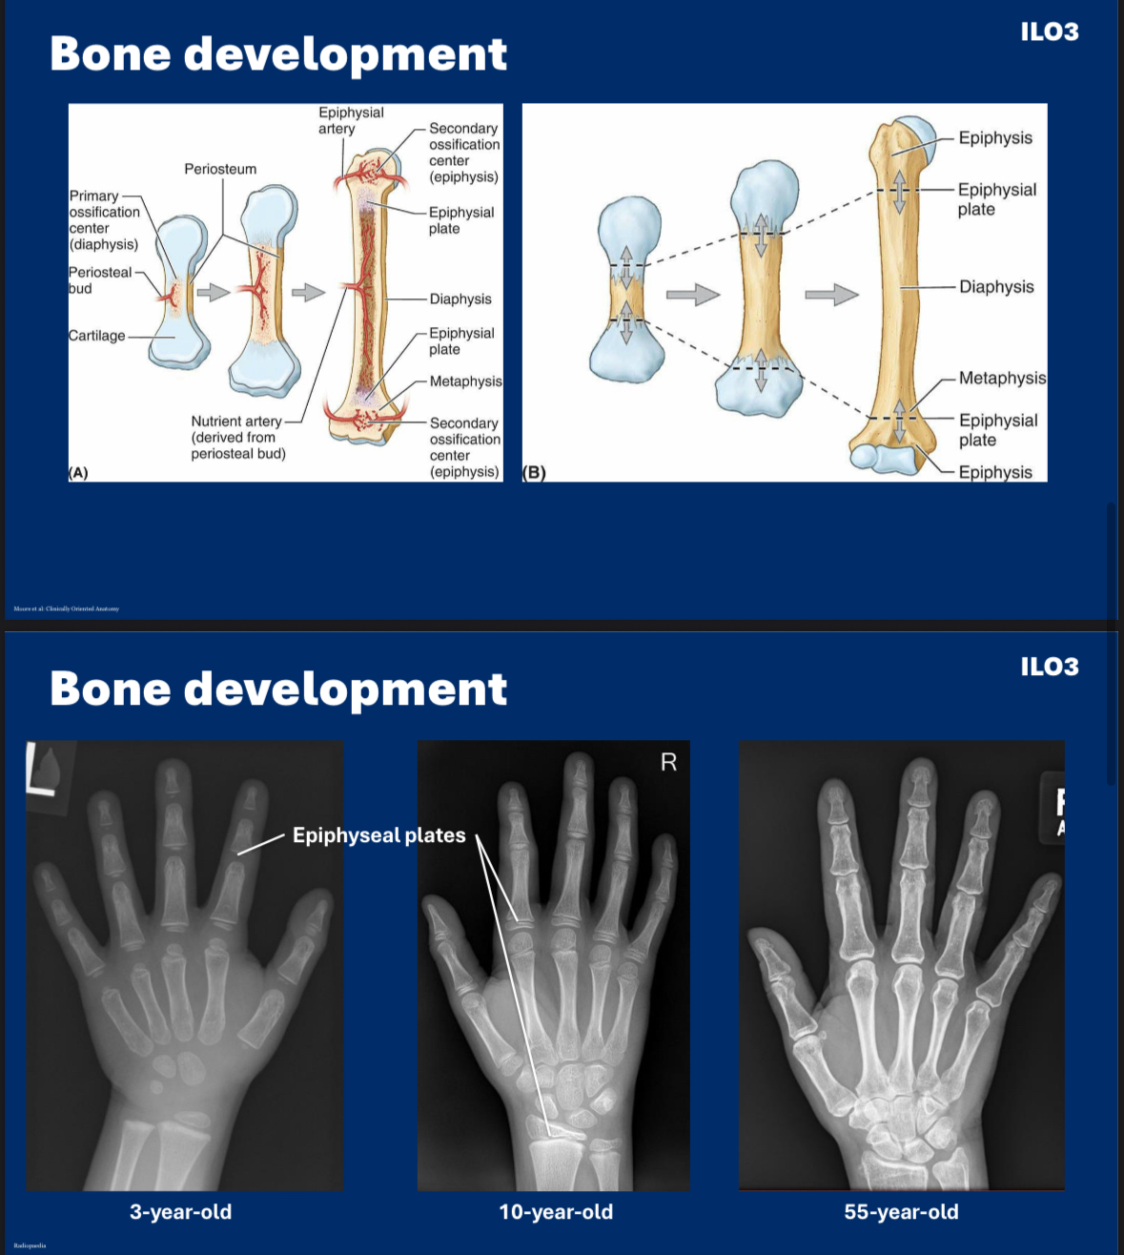
Cartilage and bone are both types of connective tissue
The diaphysis has the primary ossification centre. It is hyaline cartilage originally then replaced by bone. Ossification begins in the diaphysis
Lengthwise bone growth (longitudinal growth):
Chondroblasts hypertrophy (enlarge)
Secrete alkaline phosphatase, which calcifies the surrounding cartilage matrix.
Chondroblasts then undergo apoptosis (die)
The calcified matrix serves as a scaffold for osteoblasts to lay down bone.
The epiphysis contains the secondary ossification site which appears after birth
It is the rounded proximal and distal ends of long bones and is mainly spongy bone
The metaphysis is highly vascular and metabolically active. It has the epiphyseal growth plate during development, so new bone is added here towards the diaphyseal side in childhood and adolescence.
Growth plates (cartilage) close at around 18-25 years
Growth plates are made of cartilage which is radiolucent. This is why there appears to be gaps in the X ray.
The periosteum is dense connective tissue surrounding the bone, except at joints. Here vessels penetrate into compact and spongy bone. The periosteum contains fibroblasts, chondroblasts and blood vessels

Slide 30
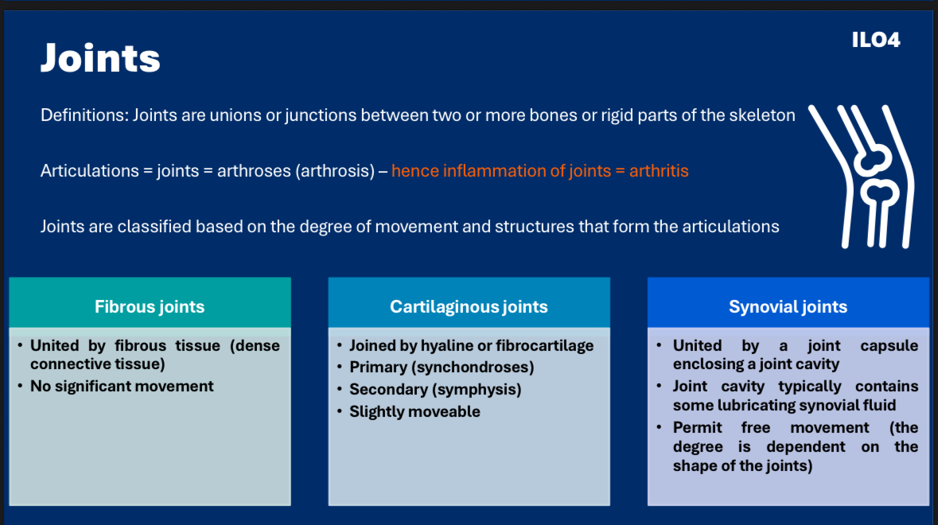
3 types of joints

Slide 31
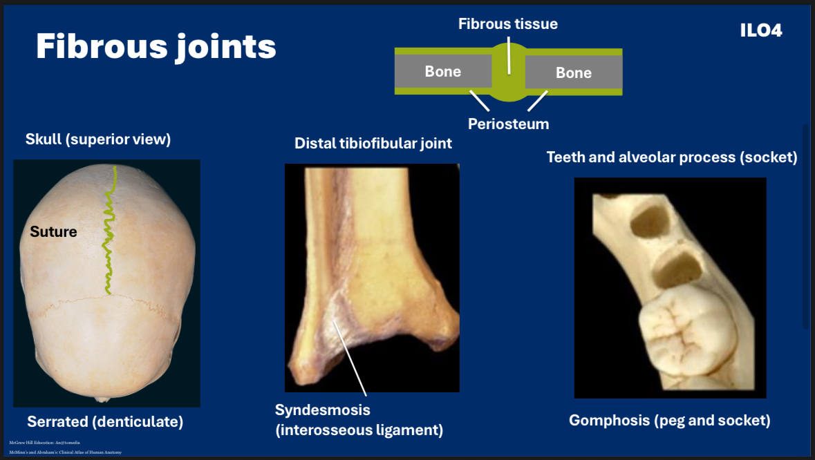
Fibrous joints
Fibrous Joints (synarthrosis – little/no movement)
No joint cavity; bones joined by fibrous tissue.
Sutures (skull)
  Types: serrated, squamous, plane.
Syndesmosis
  Bones linked by a ligament or interosseous membrane.
  Example: inferior tibiofibular joint.
Gomphosis
  Peg-in-socket.
  Teeth + alveolar sockets (connected by periodontal ligament).

Slide 32
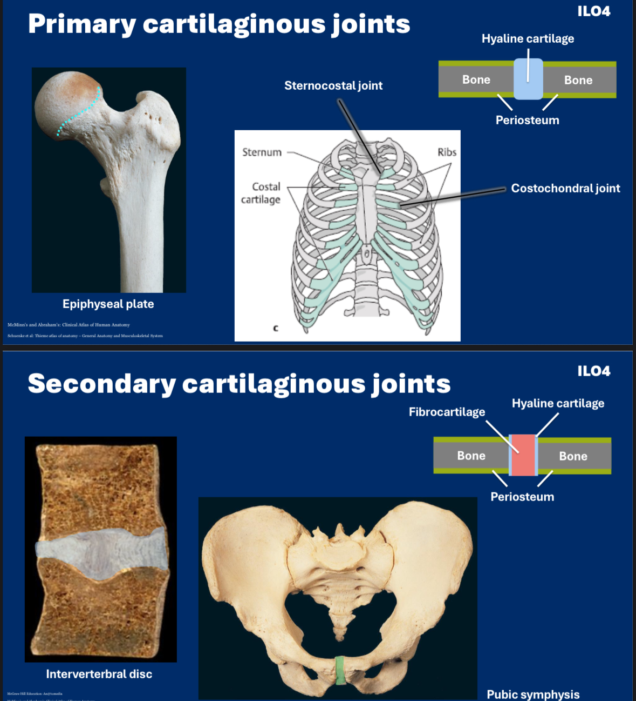
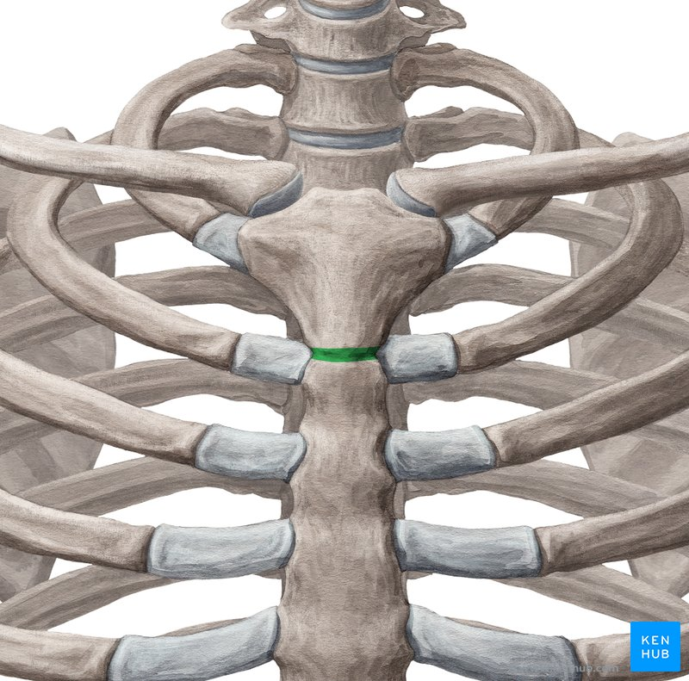
Cartilaginous Joints
Cartilaginous joints have limited movement – amphiarthrosis
Primary cartilaginous joints (synchondroses)
Hyaline cartilage.
Mostly growth-related.
Example: first sternocostal joint.
Secondary cartilaginous joints (symphyses)
Hyaline cartilage on surfaces + fibrocartilage between
Slight movement.
Examples: intervertebral discs, pubic symphysis, manubriosternal joint.

Slide 33
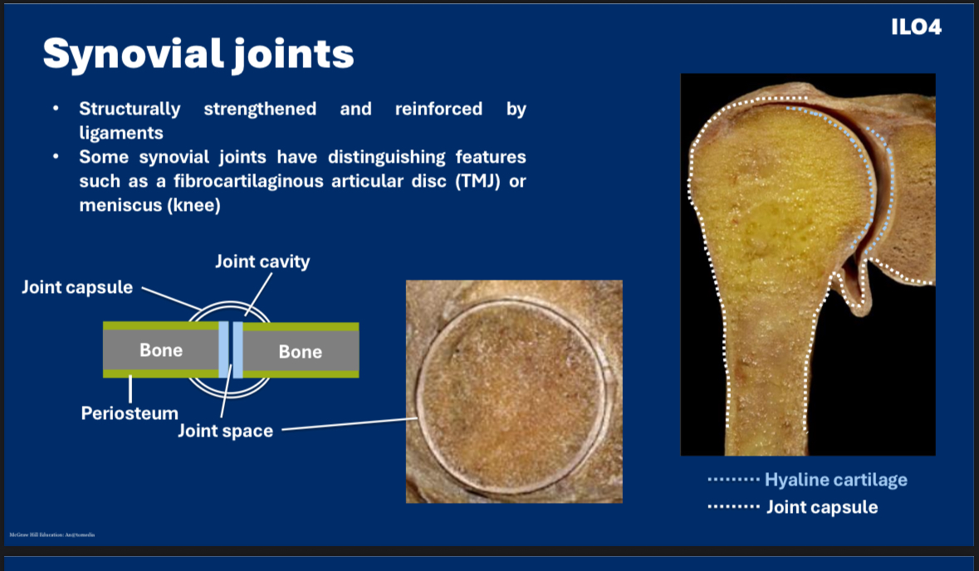
.
3 types of joints
Synovial Joints (diarthrosis – freely movable)
Features:
Joint cavity with synovial fluid
Synovial membrane lines cavity
Fibrous capsule around it
Ligaments stabilise the joint
Bursa
A synovial membrane pouch extending outside the capsule.
Provides cushioning between structures.
Synovial Sheath
Synovial membrane wrapped around a tendon to reduce friction

Slide 34
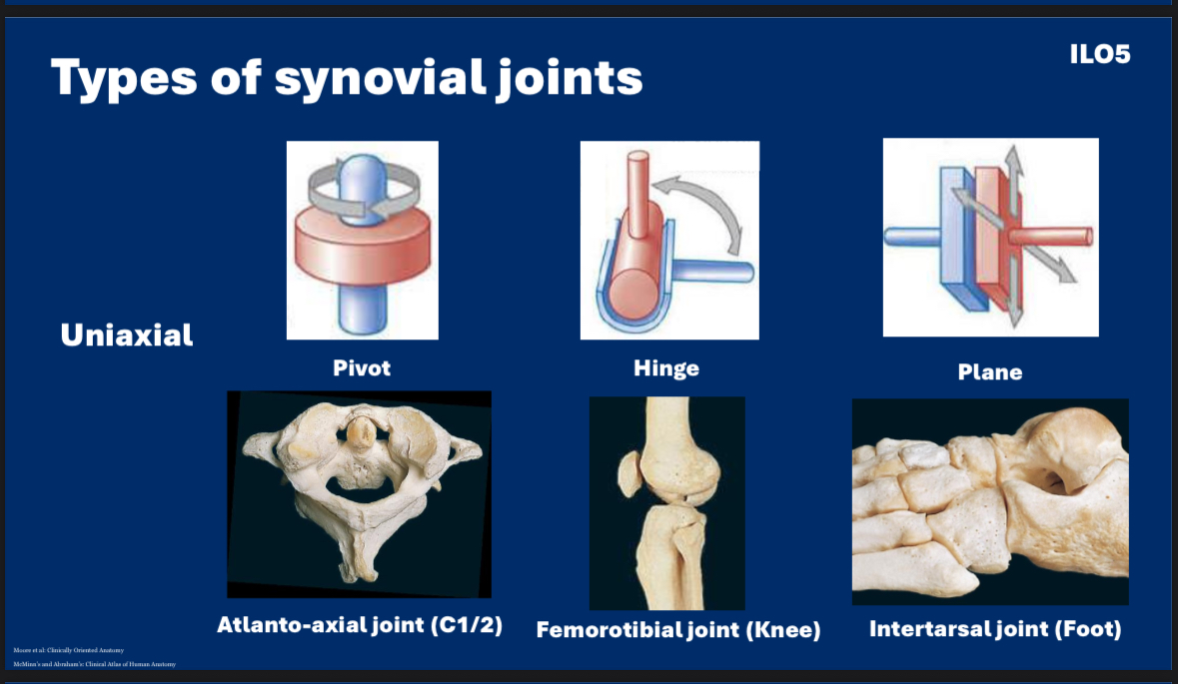
The name synovial comes from
The Greek “syn” meaning “with”
And the Latin “ovum” for “egg” as synovial fluid resembled egg white in colour, clarity and consistency
Uniaxial joints allow for movement only in one plane

Slide 35
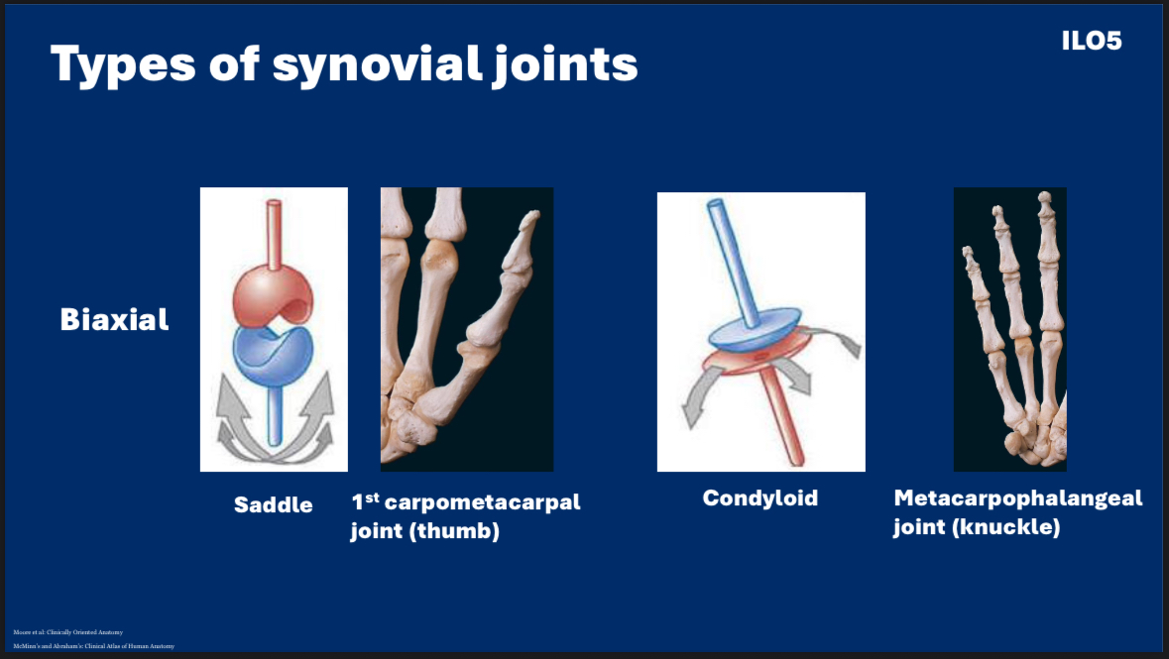
Biaxial joints allow for movement in 2 planes

Slide 36
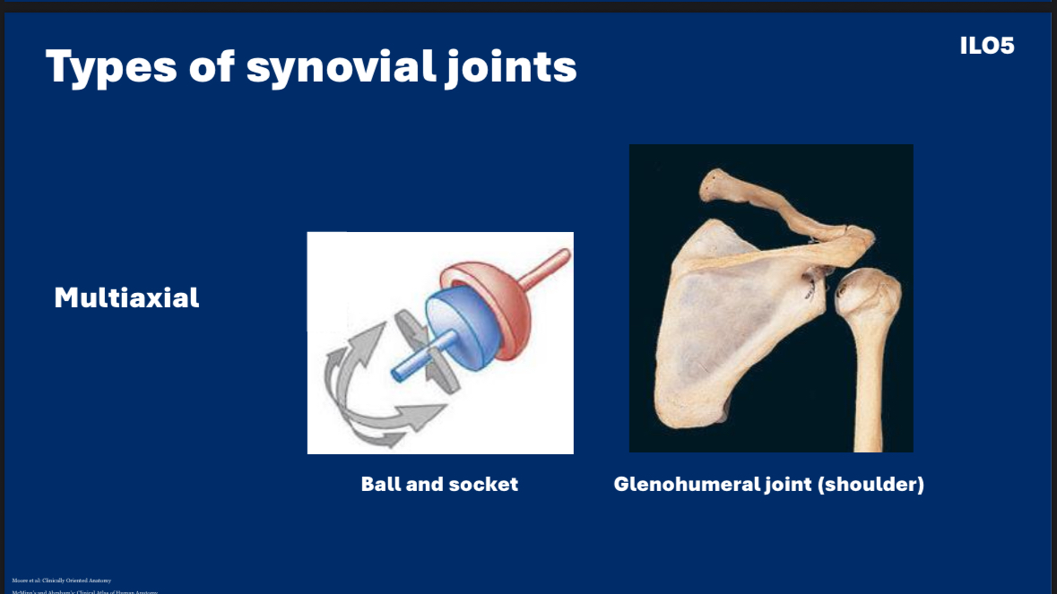
Multiaxial joints allow for movement in 3 planes
Anterior-posterior, medial-lateral, rotational

Slide 37
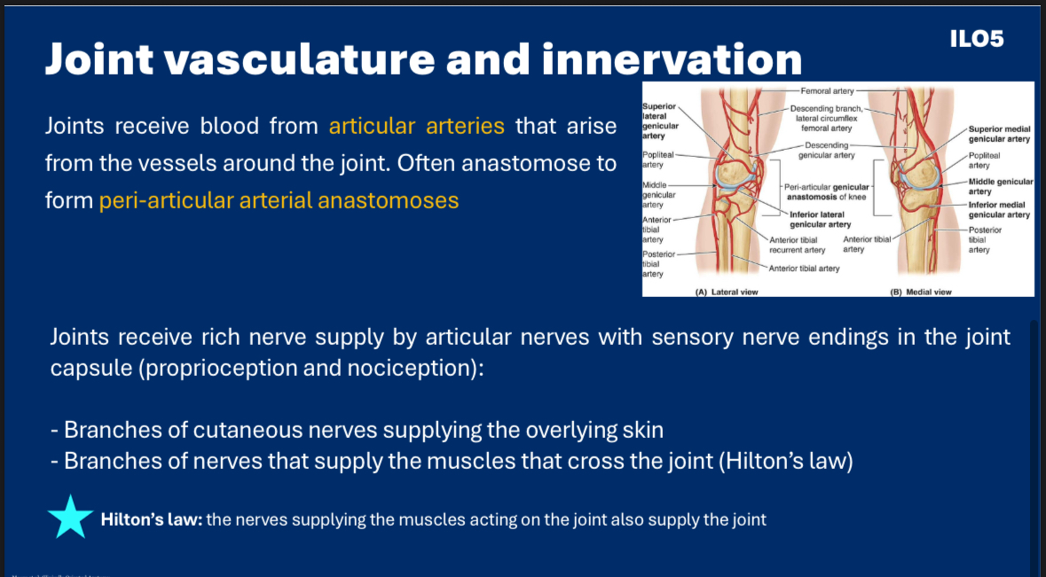

Slide 38
SBA
What type of joint is the first sternocostal joint?
A) Synonovial pivot joint
B) Synnovial condyloid joint
C) Fibrous
D) Primary cartilaginous
E) Secondary cartilaginous

Slide 39
SBA answer
What type of joint is the first sternocostal joint?
D) it’s the only primary cartilaginous joint remaining in the adult body

Slide 40
SBA
When chondroblasts in the perichondrium differentiate into chondrocytes and produce new cartilage matrix that add on to the surface of existing cartilage, it is known as:
A) Appositional growth
B) Interstitial growth
C)Extracortical growth
D)Osteochondral growth
E) Interosseus growth

Slide 41
SBA answer
When chondroblasts in the perichondrium differentiate into chondrocytes and produce new cartilage matrix that add on to the surface of existing cartilage, it is known as:
A)Appositional growth, width growth

Slide 42
SBA
Which is an example of a uniaxial joint?
A) Glenohumeral joint
B) Metocarpalphalangeal joint
C) Humeroulnar joint
D) Radiocarpal joint
E) Acetabulofemoral joint

Slide 43
SBA answer
Which is an example of a uniaxial joint?
C)The humeroulnar (elbow joint) is a hinge joint. These are uniaxial.

Slide 44
SBA
Which cells hypertrophy, calcify the surrounding matrix, and die during endochondral ossification?
A)Progenitor cells
B) Osteoblasts
C)Chondrocytes
D) Osteoclasts
E)Osteocytes

Slide 45
SBA answer
Which cells hypertrophy, calcify the surrounding matrix, and die during endochondral ossification?
C) Chondrocytes
Mesenchymal cells → differentiate into chondroblasts
Chondroblasts → become chondrocytes in the cartilage model
Chondrocytes in the center of the model:
Hypertrophy (enlarge)
Secrete alkaline phosphatase, which calcifies the surrounding cartilage matrix
Undergo apoptosis (die)
The calcified matrix then serves as a scaffold for osteoblasts to lay down bone

Slide 46
Basic tissue and body layers

Slide 47
4 types of tissues
Epithelium (epithelial tissue) – covers body surfaces, lines body cavities and forms glands
Muscle tissue – is made up of contractile cells and is responsible for movement
Nerve tissue – receives, transmits and integrates information from outside and inside the body to control the activities of the body
Connective tissue – underlines or supports the other three basic tissues, both structurally and functionally

Slide 48
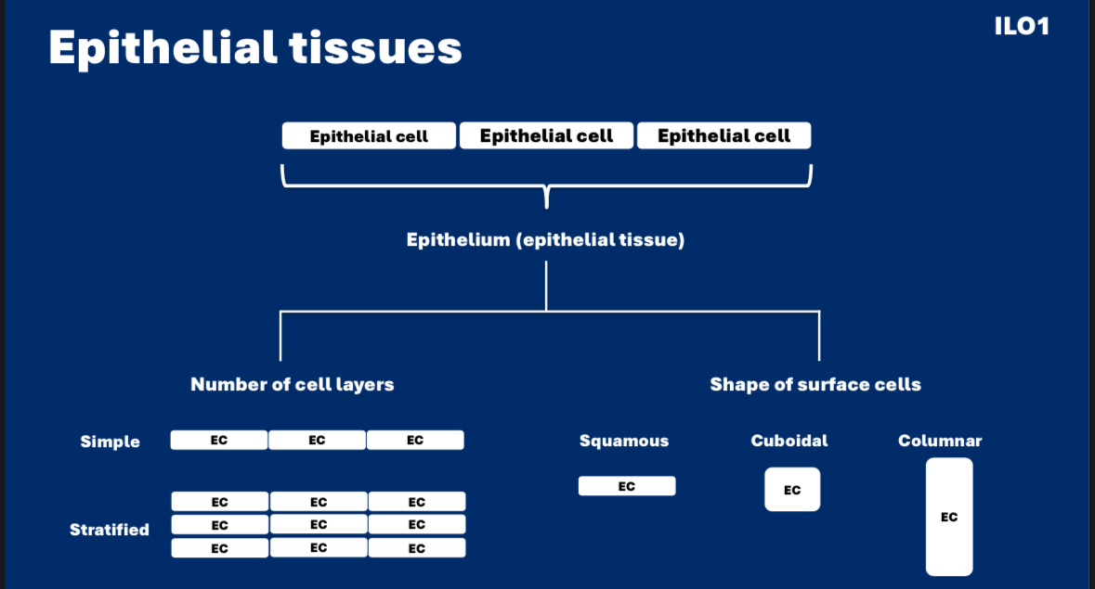
Epithelial tissues
They’re classified by the number of cell layers and the shape of surface cells

Slide 49
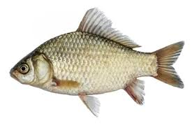
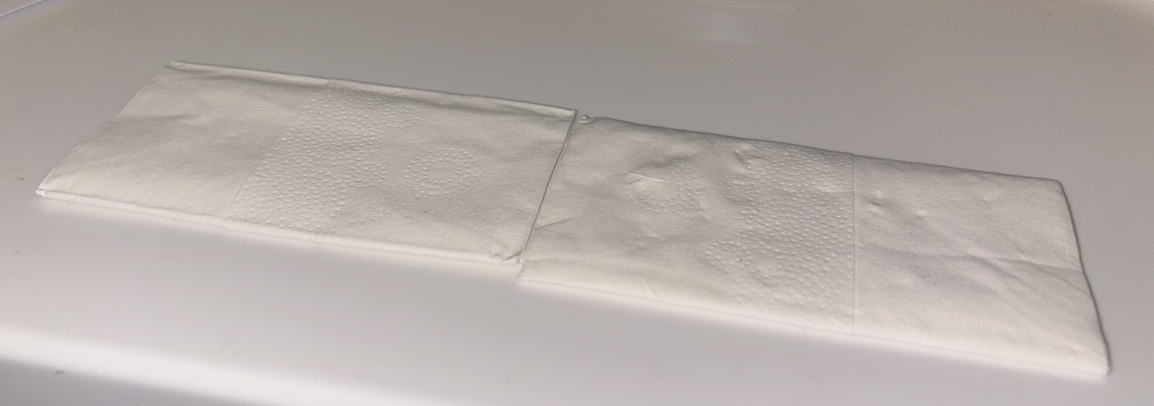
If the tissues were tissues….
SQUAMOUS
Name origin: squama
This means scale and refers to the scale of a fish which are flat and thin in appearance
Squamous epithelial cells are not square
Pocket tissues

Slide 50
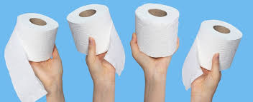
If the tissues were tissues….
CUBOIDAL
LOO ROLL

Slide 51
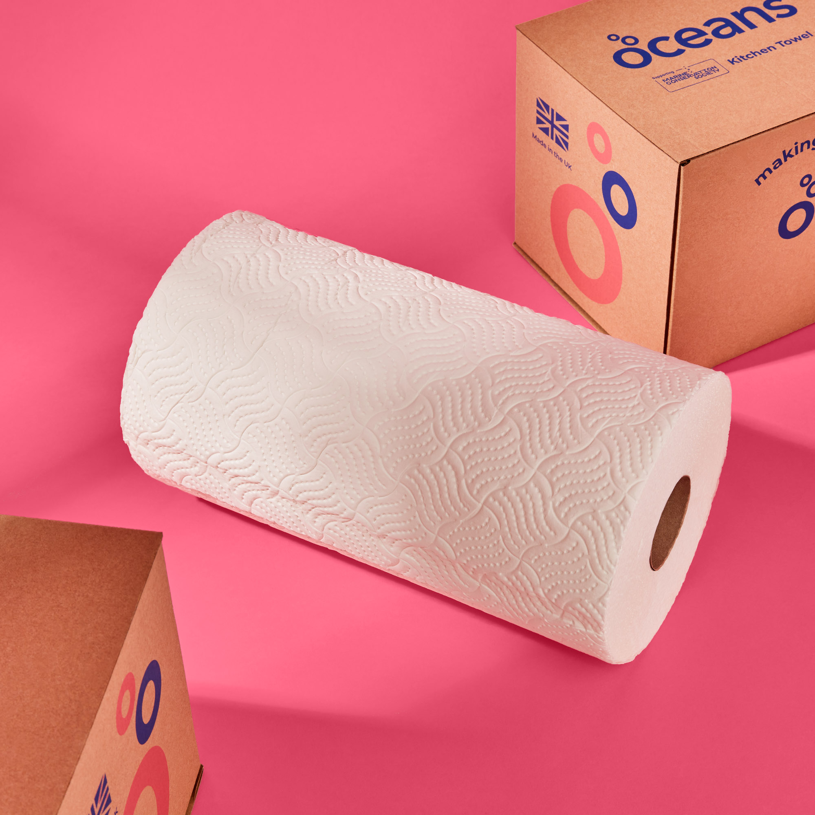
If the tissues were tissues….
COLUMNAR
Kitchen roll
A little more rectangular shaped

Slide 52
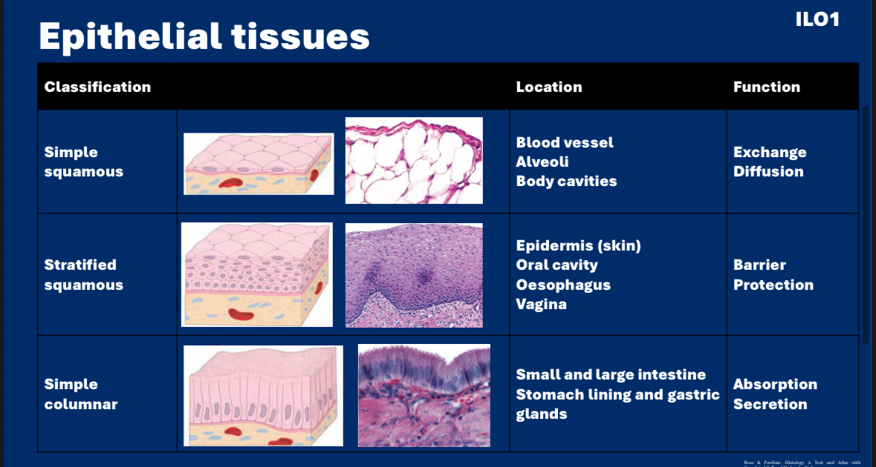
If the tissues were tissues….
COLUMNAR
Epithelial tissue is either:
simple with one layer
stratified with multiple layers

Slide 53
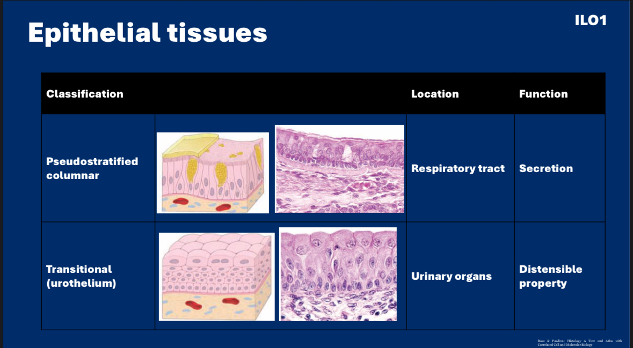
Discuss in pairs
why are these called pseudostratified and transitional cells

Slide 54
Discuss in pairs
“Pseudostratified” because it appears to have more than one layer of cells, but there’s only one layer. Every cell is attached to the basement membrane
“Transitional” as the cells stretch and expand in response to increased fluid volume, then retract without damage. It does this by using different shaped cells in several (3-6) layers
On top: umbrella cells - impermeable, tight junctions
In the middle: pyriform cells (Latin “pirum”) referencing the pear shape
On the bottom: columnar and cuboidal cells attached to cell basement membrane

Slide 55
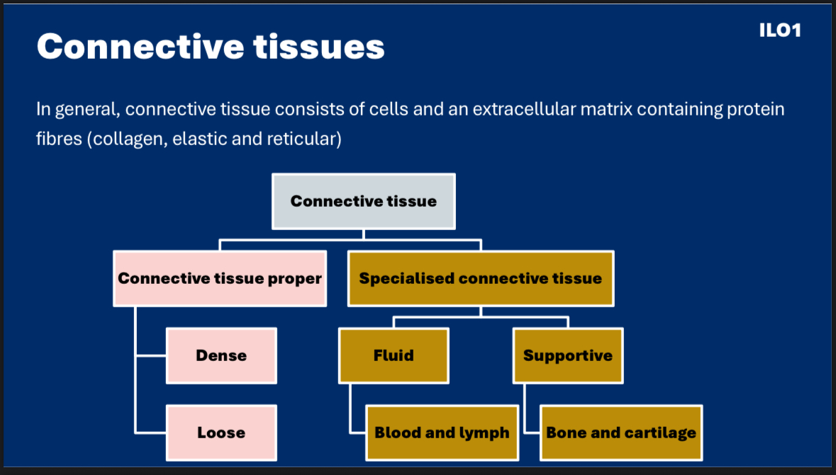
Protein fibres location
Collagen- Skin, bone, tendons, ligaments, organs, blood vessel walls
Mainly type 1 collagen which is densely packed large diameter fibres in parallel bundles
Elastic – aorta walls + large blood vessels, ligamentum flavum of vertebral column- yellow membrane connects laminae (next to spinous process) of C2-S1, elastic cartilage of ear and epiglottis
MADE of elastin which is 1000 times stretchier than collagen
Reticular – lymphoid organs, liver, endocrine glands, basement membranes, small blood vessels
Made of type III collagen mainly which is thin and forms mesh like scaffold
Ligaments - fibrous connective tissue that connect bones to bones
Tendons - fibrous connective tissue that connect muscles to bones

Slide 56
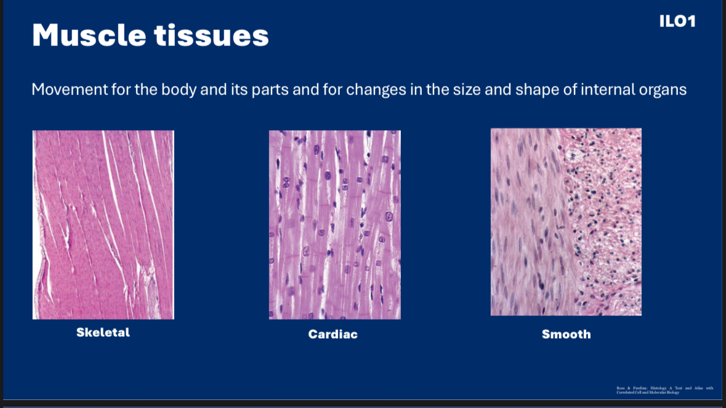

Slide 57
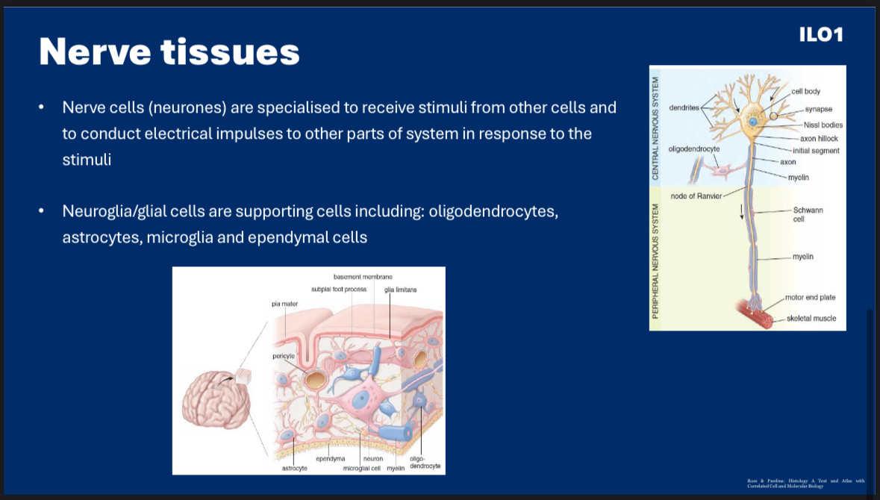
Nissl bodies are involved in protein synthesis
They are clusters of ribosomes and rough endoplasmic reticulums

Slide 58
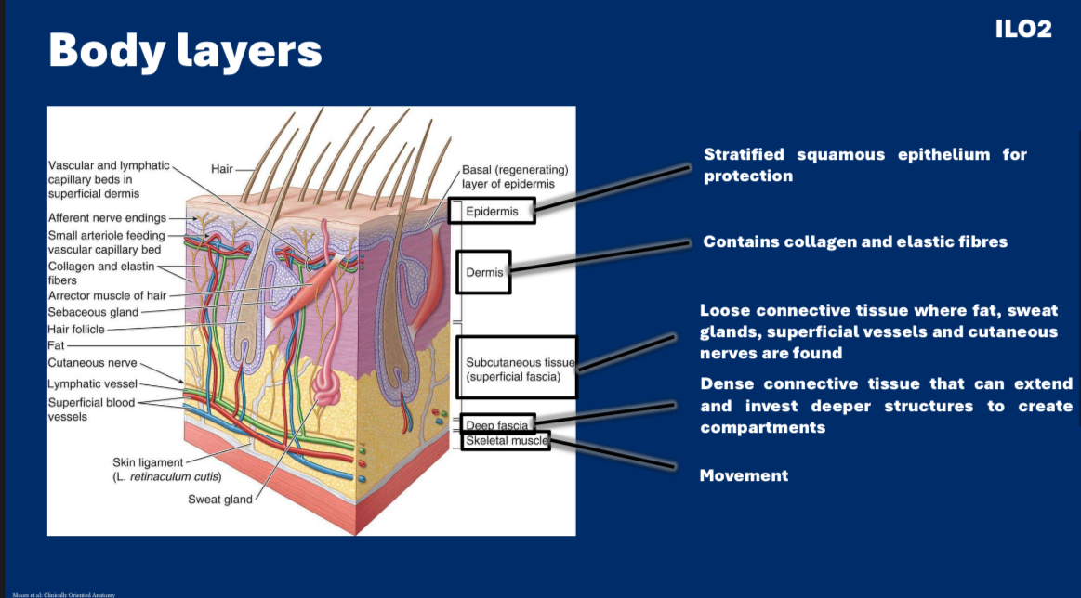

Slide 59


Slide 60


anastamoses
Anastomoses are communications (another vessel or surgical joining) between small arterial branches of major arteries providing detours for blood flow, offering a collateral route
We use the same word for surgical and natural joinings

Slide 61


Lymphatic circulatory system
Lymphatic (lymphoid)
Drainage of surplus tissue fluid and leaked plasma proteins and removal of debris from cellular decomposition and infection
Build-up of surplus material in extracellular space causes a reversal in osmotic pressure and retention of fluid resulting in OEDEMA
Lymphatic capillaries (plexuses) – simple squamous epithelium (endothelium)

Slide 62
SBA
What is the function of Nissl bodies in nerve cells?
A) They receive signals from other neurons and transmit them towards the cell body
B) They turn into repair cells after a peripheral nerve is damaged and clear debris from the damage site
C)They are a type of glial cell that produce the myelin sheath to insulate axons
D)Lipid synthesis – they consist of smooth endoplasmic reticulums
E) Protein synthesis – they consist of rough endoplasmic reticulums

Slide 63
SBA answer
What is the function of Nissl bodies in nerve cells?
E) They consist of rough endoplasmic reticulums for protein synthesis of secretory proteins, membrane proteins, and proteins for the cytoskeleton and cytosol.

Slide 64
SBA
What is the importance of anastomoses in arteries?
A) It prevents necrosis of a functional end artery
B)It prevents tissue necrosis by allowing blood to flow through a different arterial route
C) Prevents blockage of arteries in joints during movement
D) Forms the basis of collateral circulation
E)There is one between the right and the left coronary arteries which maintains blood flow and prevents cardiac ischaemia?

Slide 65
What is the importance of anastomoses in arteries?
B)It prevents tissue necrosis by allowing blood to flow through a different arterial route
D) Says more what they are part of and not what they do, perhaps not the single best answer

Slide 66
SBA
What does the deep fascia send through the superficial fascia in order to tether the skin?
A) Elastic fibres
B)Cartilage
C)Intermediate filaments
D)Collagen fibres
E)Serous membrane

Slide 67
What does the deep fascia send through the superficial fascia in order to tether (attach) the skin?
D) Collagen fibres, retinacula cutis

Slide 68
SBA
What type of epithelial tissue makes up the skin’s surface?
A) Keratinised squamous epithelium
B)Pseudostratified columnar epithelium
C)Keratinised stratified columnar epithelium
D)Stratified cuboidal epithelium
E)Keratinised cuboidal epithelium

Slide 69
What type of epithelial tissue makes up the skin’s surface?
A is correct – keratinised squamous epithelium
Keratinised to prevent water loss
Squamous - Flattened (fish scale) cells in the outmost layer
Stratified – multiple layer for protection
B)Pseudostratified columnar epithelium – found is respiratory tract
D)Stratified cuboidal epithelium – found in sweat glands not surface of skin

Slide 70

FEEDBACK
Thank you!!
Any questions?
K23005436@kcl.ac.uk

